Slide 1
Paxos
易星辰
2018.04.19

Slide 2
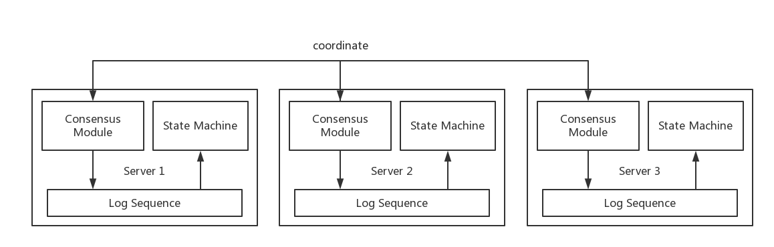
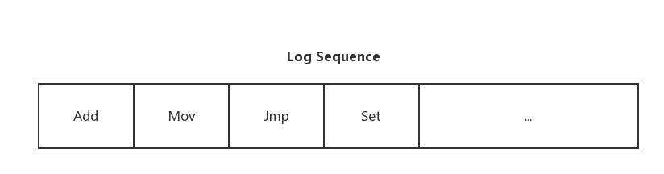
问题背景
分布式一致性算法
状态一致
确保所有副本中日志保持一致
Notes:
分布式系统中，一般存在多个多个数据副本，一般是通过日志来实现。

Slide 3
Paxos
问题
分布式系统就某个值达成一致
策略
对每个指令产生执行“一致性算法”
典型场景
初始状态一致
执行指令一致
最终状态一致

Slide 4
确定值
模拟选举投票
每次投票确定一个值
选择多数派(超过总成员半数)通过的决议
多轮投票
暴力
保证提议编号更大的提议者学习到前面已经被接受的提议
id | value | A1 | A2 | A3
1 | Add | acc |  | acc
2 | Mov |  | acc | acc

Slide 5
新的问题
Acceptor3 接受(2, Add)?
(2, Add)
(1, Mov)
(0, Add)
(3, Mov)
Proposer 1
Proposer 2
delay
delay
(2, Add)
(3, Mov)
(1, Mov)
(0, Add)
(1, Mov)
(3, Mov)
(0, Add)
Acceptor 1
Acceptor 2
Acceptor 3

Slide 6
问题分析
冲突
(3, Mov)提出时，(2, Add)并没有被接受。
再次暴力
Acceptor不再接受比其接受过最大的proposal id小的proposal。

Slide 7
算法正式描述
三个角色
Proposer、Acceptor、Learner
两个过程
Phase 1. (a) A proposer selects a proposal number n and sends a prepare request with number n to a majority of acceptors.
(b) If an acceptor receives a prepare request with number n greater than that of any prepare request to which it has already responded, then it responds to the request with a promise not to accept any more proposals numbered less than n and with the highest-numbered proposal (if any) that it has accepted.
Phase 2. (a) If the proposer receives a response to its prepare requests (numbered n) from a majority of acceptors, then it sends an accept request to each of those acceptors for a proposal numbered n with a value v, where v is the value of the highest-numbered proposal among the responses, or is any value if the responses reported no proposals.
(b) If an acceptor receives an accept request for a proposal numbered n, it accepts the proposal unless it has already responded to a prepare request having a number greater than n.

Slide 8
协议过程
Phase 1.a
Proposer选择一个提议编号n，向一个多数派中的所有Acceptor广播Prepare(n)请求。
A1
Prepare(n)
P1
A2
Prepare(n)
Prepare(n)
A3

Slide 9
协议过程
Phase 1.b
Acceptor接收到Prepare(n)请求，若提议编号n比之前接收的Prepare请求都要大，则承诺将不会接收提议编号比n小的提议，并且带上之前Accept的提议中编号小于n的最大的提议，否则不予理会。
Promised(n,
(mbal1, mval1))
A1
P1
Promised(n,
(mbal2, mval2))
A2
A3

Slide 10
协议过程
Phase 2.a
Proposer得到了一个多数派的承诺后，如果发现没有一个Acceptor Accept过一个值，那么向一个多数派中的所有Acceptor发起提议编号n和自己的值，否则，从所有接受过的值中选择对应的提议编号最大的，作为提议的值，提议编号仍然为n。
A1
Accept(n, v)
P1
A2
Accept(n, v)
Accept(n, v)
A3

Slide 11
协议过程
Phase 2.b
Acceptor接收到提议后，如果该提议编号不违反自己做过的承诺，则接受该提议。
A1
Accepted(n, v)
P1
A2
Accepted(n, v)
Accepted(n, v)
A3

Slide 12
学习过程
Learner
方案：
每当一个acceptor接受了新的提议，就广播给所有的learner，假设acceptor数量为m，learner数量为n，通信开销O(m * n)。
选择一个learner，负责接受acceptor的消息，通信开销O(m + n)。
选择一组learner，数量为c，通信开销c * O(m + n)。

Slide 13
Safety
Chosen:
Call a value chosen if it is accepted by a majority of acceptors.
Safety Properties:
No value is chosen unless it is first proposed.
No two distinct values are both chosen.

Slide 14
证明过程
逆推
P1. If a proposal with value v is chosen, then every higher-numbered proposal that is chosen has value v.
P2. If a proposal with value v is chosen, then every higher-numbered proposal accepted by any acceptor has value v.
P3. If a proposal with value v is chosen, then every higher-numbered proposal issued by any proposer has value v.
Paxos => P3 => P2 => P1

Slide 15
数学归纳法
P3: Assume proposal(m, v) is chosen, then show that any proposal issued with number n > m also has value v.
Step 1. n = k. 如果提议(m, v)被多数派接受，则提议m到k值均为v
Step 2. n = k + 1
a. 提议k + 1 不存在。
b. 提议(k + 1, v1), 由Phase 1.b得，k+1轮的prepare被多数派Q1承诺 并返回结果，v1是从返回的提议中选出来的，不妨设这个值选自
(t, v1), 则t的编号是返回结果中最大的。由于提议(m, v)被批准， 所 以存在一个多数派Q2接受(m, v)。Q1 和Q2存在交集，t >= m。
由Phase 1.a， t <= k, v1 = v。

Slide 16
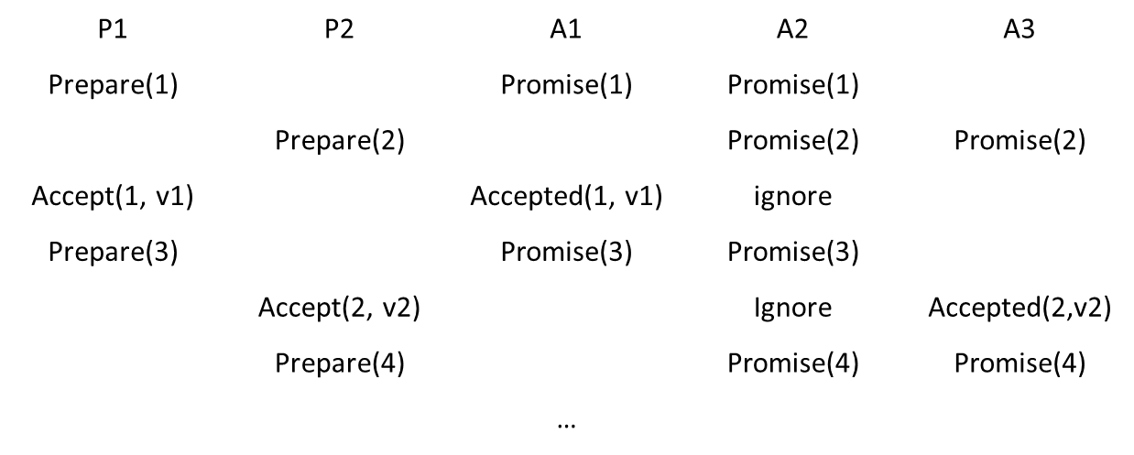
Liveness
Leader
特殊的proposer，提交和接收提议

Slide 17
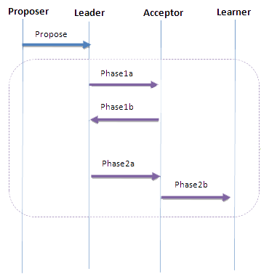
改进

Slide 18
Summary
与其预测未来，不如限制未来

Slide 19
Q&A

