Slide 1
PaxosStore
易星辰
2018.5.4

Slide 2
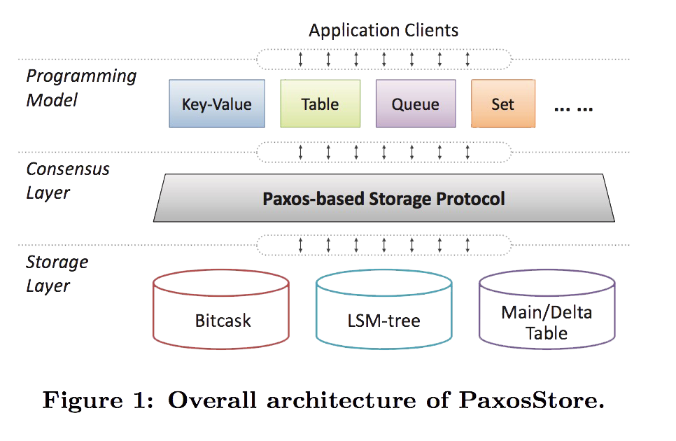
PaxosStore

Slide 3
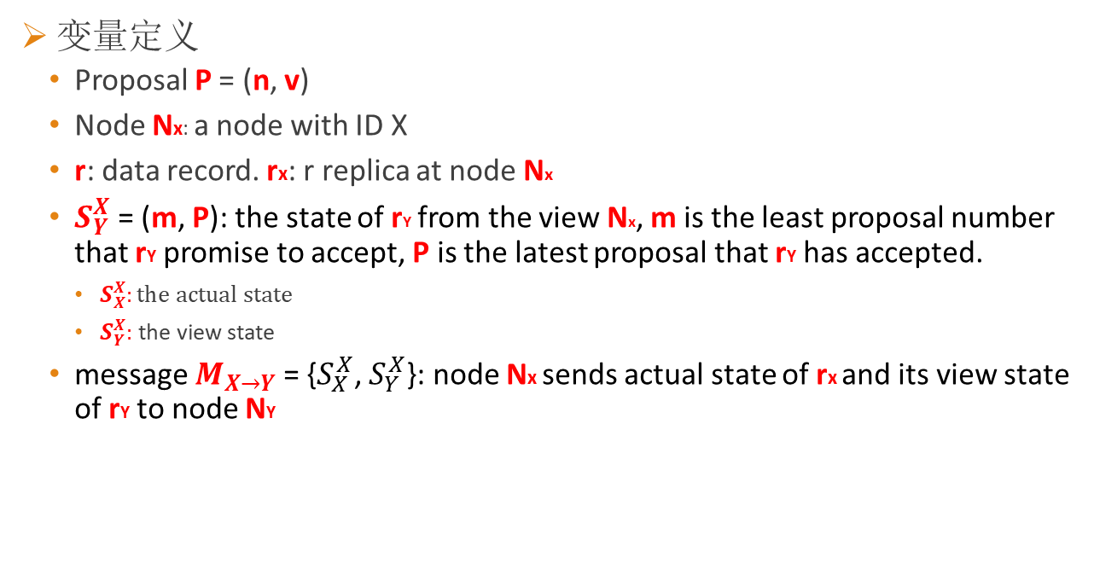
Paxos in PaxosStore
变量定义
Proposal P = (n, v)
Node Nx: a node with ID X
r: data record. rx: r replica at node Nx
$S_{Y}^{X}$ = (m, P): the state of rY from the view Nx, m is the least proposal number that rY promise to accept, P is the latest proposal that rY has accepted.
$S_{X}^{X}:the actual state$
$S_{Y}^{X}:$ the view state
message $M_{X→Y}$ = {$S_{X}^{X}$, $S_{Y}^{X}$}: node Nx sends actual state of rx and its view state of rY to node NY

Slide 4


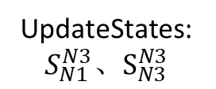
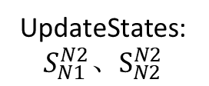
算法过程
Phase Issue($m_{i}$)
Issue($m_{i}$)
N1
N2
N3
UpdateStates: $S_{N1}^{N2}、S_{N2}^{N2}$
UpdateStates: $S_{N1}^{N3}、S_{N3}^{N3}$

Slide 5

算法过程
Phase Issue($P_{i}$) (invoked at $N_{A}$) :
$P_{i}$.n = $m_{i}$, 存在多数派C, 对于C中所有$节点X, S_{X}^{A}.m=P_{i}.n$
确定$P_{i}$.v

Slide 6
伪代码

Slide 7
PaxosStore in TLA+
Variables:
State: 二维数组
msgs: 消息集合
chosen: 被批准值集合
Action:
IssueM
IssueP
OnMessage

Slide 8
Q&A

