Slide 1
IMPLEMENTATION
The TLA+ Hyperbook
May 11th, 2018
Wang Zhifu

Slide 2
IMPLICATION
P => Q equals \not Q => \not P
IF P THEN Q
ELSE TRUE
P implies Q
correlation instead of causality

Slide 3
module-closed EXPRESSION & formula
A module-closed expression is a TLA+ expression that contains only:
built-in TLA+ operators and constructs,
numbers and strings,
declared constants and variables,
identifiers declared locally within it.
Forall and exists.
This function constructor.
And these set constructors.
A module-closed formula is a Boolean-valued module-closed expression.

Slide 4
Constant Expression & FORMULA
A constant expression is a (module-complete) expression that
Has no declared variables.
Has no non-constant operators.
’ and UNCHANGED
A constant formula is a Boolean-valued constant expression.
ASSUME …

Slide 5
State Expression
A state expression can contain anything a constant expression can as well as declared variables.
A state assigns values to variables.
A state expression has a value on a state.

Slide 6
Action Expression
An action expression can contain anything a state expression can as well as ’ and UNCHANGED.
A state expression has a value on a step (pair of states).

Slide 7
Module-closed expression
Action expression
A state expression is an action expression whose value on the step s -> t depends only on state s.
State expression
no non-constant operators
Constant expression
no declared variables
Action (formula)
Constant formula
Module-closed formula
A constant expression is a state expression that has the same value on all states.

Slide 8
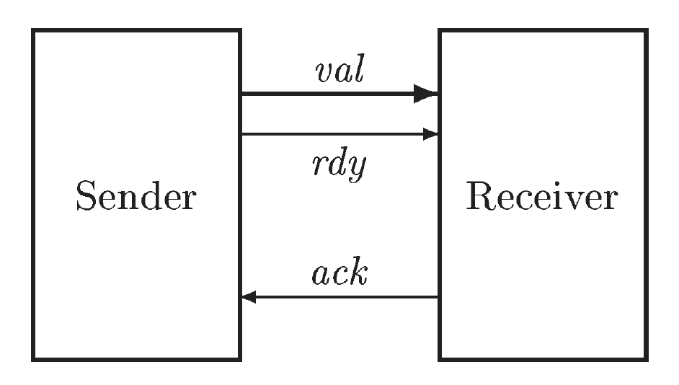
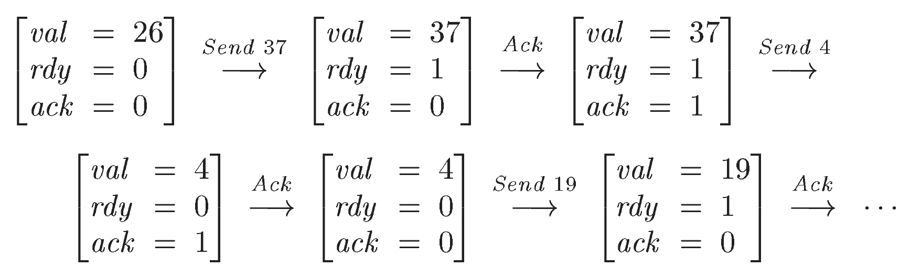
An Asynchronous Interface
Send is enabled if rdy equals ack.
Rcv step is enabled if rdy is different from ack.

Slide 9
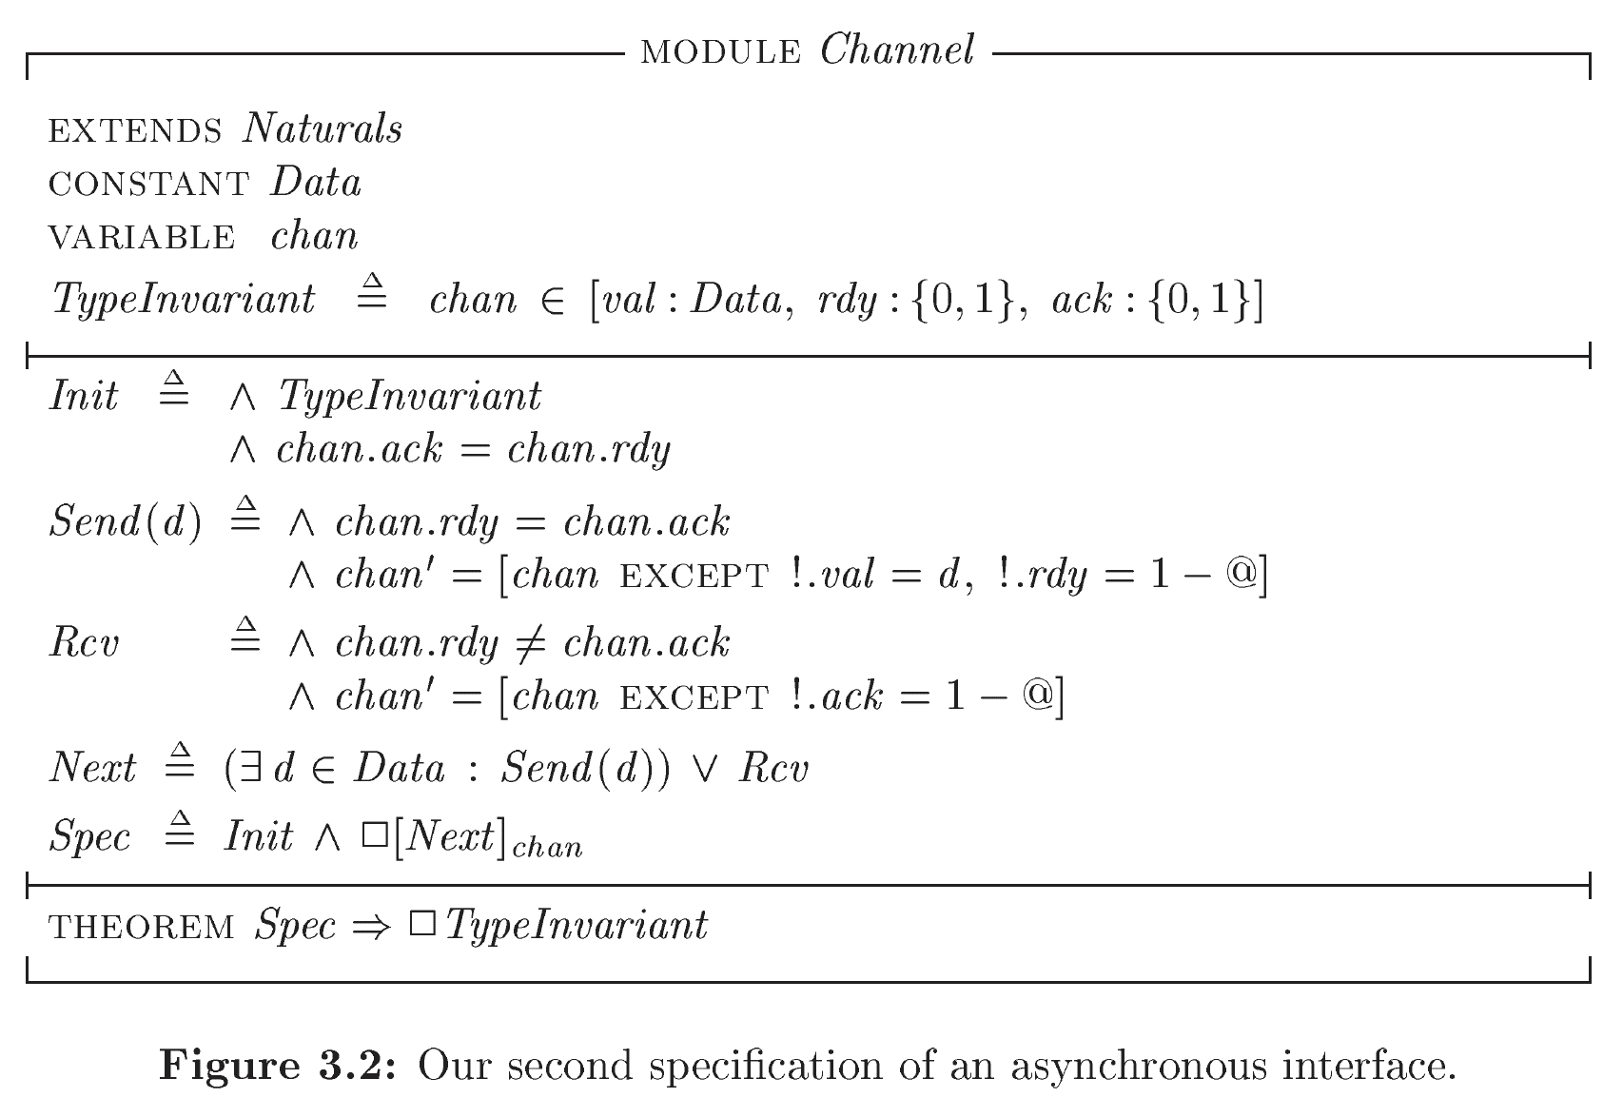
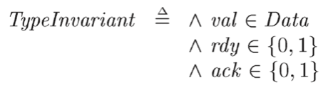
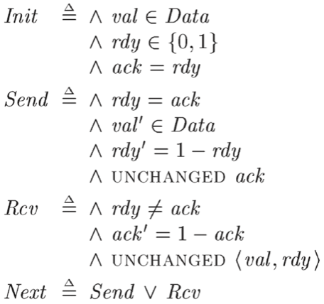
@ stands for chan.rdy

Slide 10

TEMPORAL FORMULA
A temporal formula has a Boolean value on a sequence s_1 -> s_2 -> s_3 … of states.
A temporal formula has a Boolean value on a behavior s_1 -> s_2 -> s_3 …
Spec should be true on s_1->s_2->s_3->s_4->… iff
Init is true on s_1->s_2->s_3->s_4->…
[]Next is true on s_1->s_2->s_3->s_4->…

Slide 11
For the action Next, always Next is true on a behavior iff Next is true on every step of the behavior.
For the action Next:
[]Next is true on s_1->s_2->s_3->s_4->… iff
Next is true on s_i->s_{i+1} for all i

Slide 12
THEOREMS
Asserts that for every behavior:
if the behavior satisfies Spec
then TypeInvariant is true on every state of the behavior
Asserts that TypeInvariant is an invariant of Spec.
For a temporal formula TF, THEOREM TF asserts that TF is true on every possible behavior.

Slide 13
closed-system SPEC
A formula like Spec, which describes the correct behavior of both the system and its environment, is called a closed-system or complete-system specification.

Slide 14
STUTTERING
Specifications are mathematical formulas.
A specification describes a universe in which the system and its environment are behaving correctly.
All TLA+ specs allow stuttering steps.
All behaviors are infinite sequences of states.

Slide 15
TERMINATION AND STOPPING
The universe keeps going even if the system terminates.
All the specs we have written so far allow the system being specified to stop at any time by taking infinitely many stuttering steps.
They specify what the system may do.
They don’t specify what it must do.

Slide 16
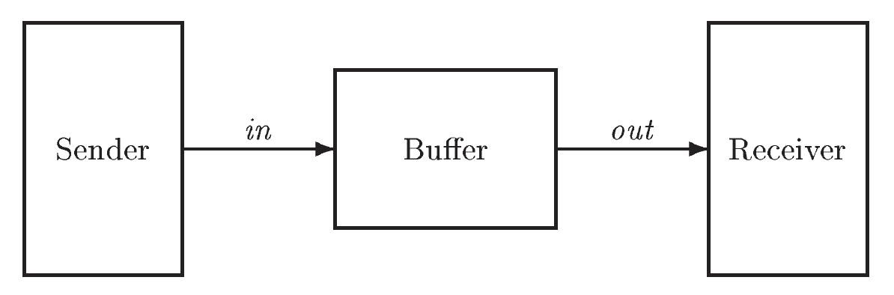
a FIFO buFFer

Slide 17
SYMBOL & SCOPE
I will use the term symbol to mean an identifier or an operator symbol.
Every symbol that is used in a specification must either be a built-in operator of TLA+ or it must be declared or defined.
Every symbol declaration or definition has a scope within which the symbol may be used.
The scope of a variable or constant declaration, and of a definition, is the part of the module that follows it.

Slide 18
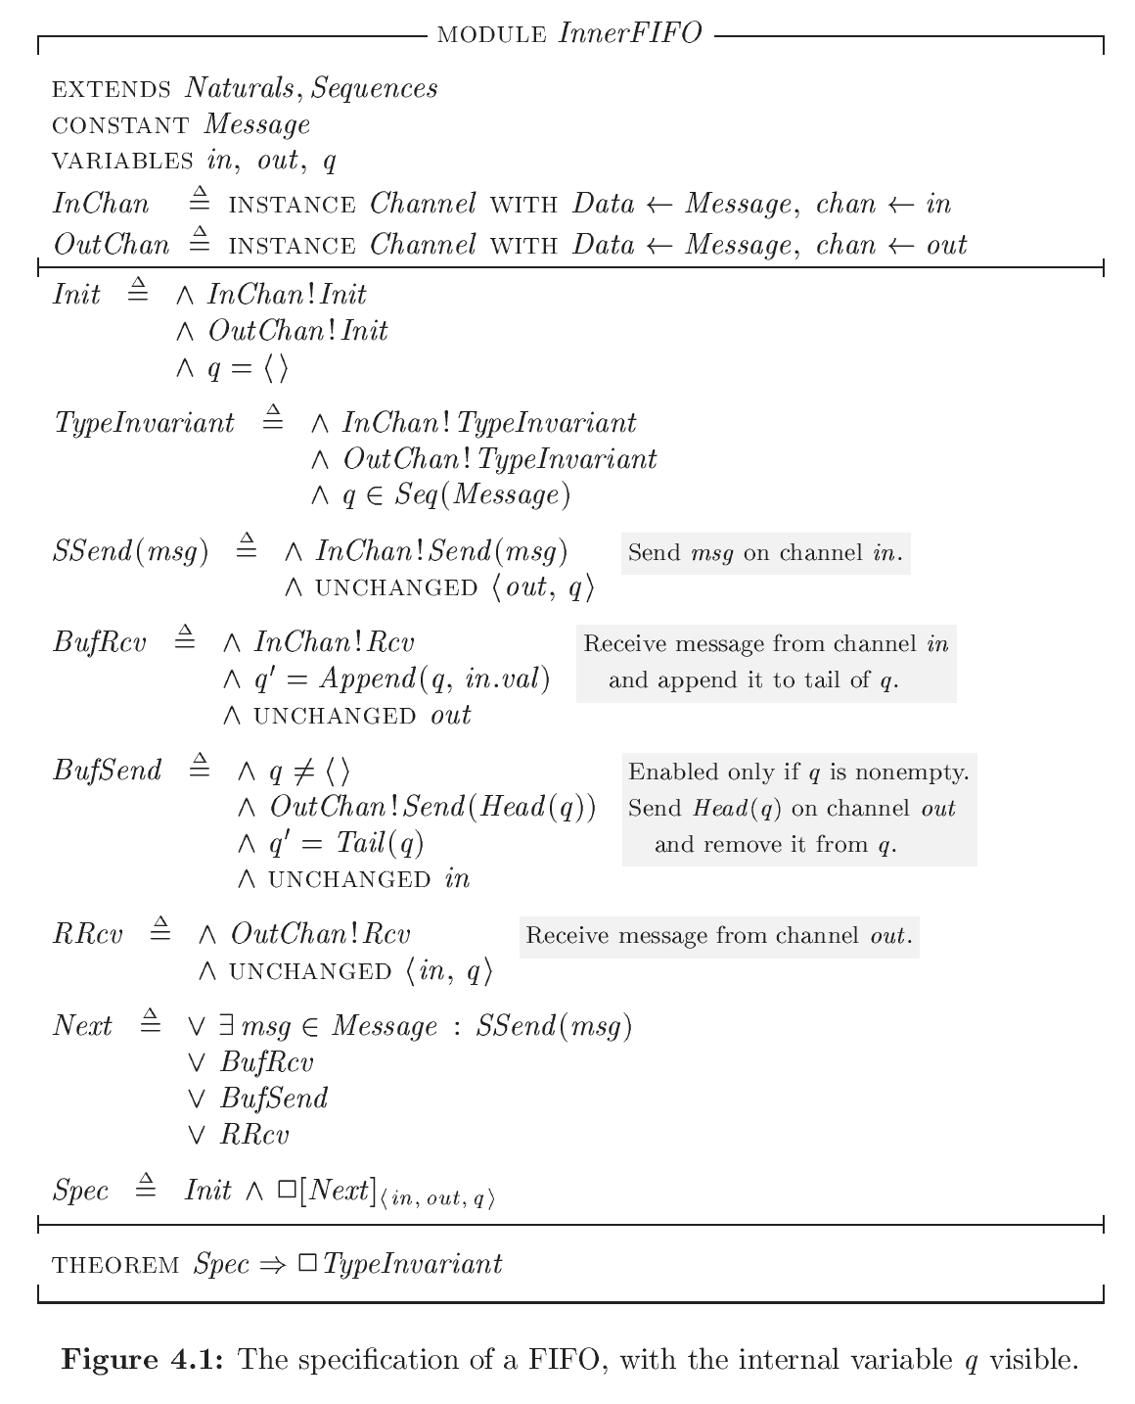

Slide 19
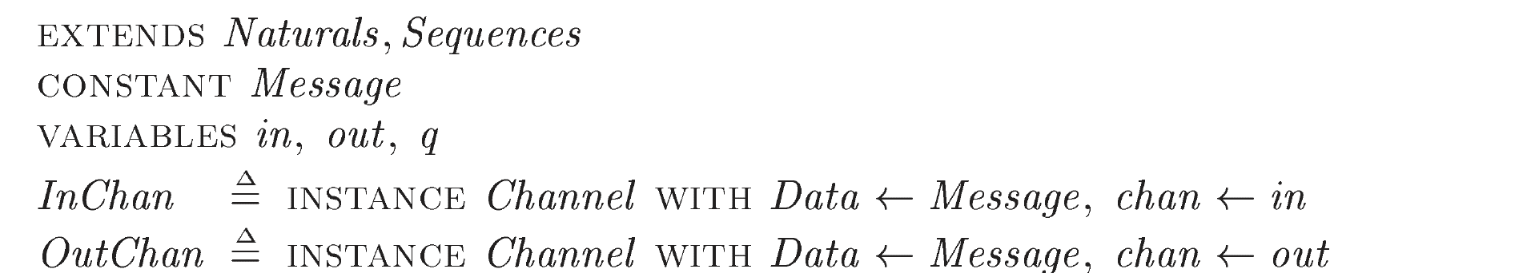
\
The Sequences module defines the following operators on sequences:
Seq(S) <3, 7> is an element of Seq(Nat).
Head(s) Head(<3, 7>) equals 3.
Tail(s) Tail (<3, 7>) equals <7>.
Append(s, e) The Append(<3, 7>, 3) equals <3, 7, 3>.
Len(s) Len(<3, 7>) equals 2.
…
Instantiation Is Substitution
Implicit Substitutions
Instantiation Without Renaming

Slide 20
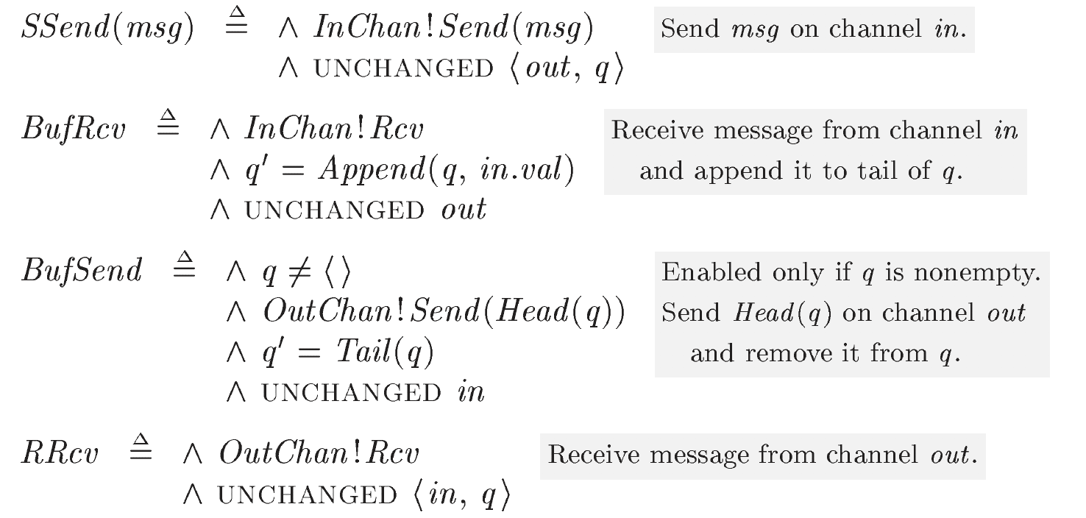

Slide 21
Priming a State Expression
For any state expression e, the value of the action expression e’ on s -> t is the value of e on state t.
UNCHANGED out equals out’=out
UNCHANGED <out, q> equals <out, q>’=<out, q>
equals <out’, q’>=<out, q>
equals (out’=out) /\ (q’=q)

Slide 22
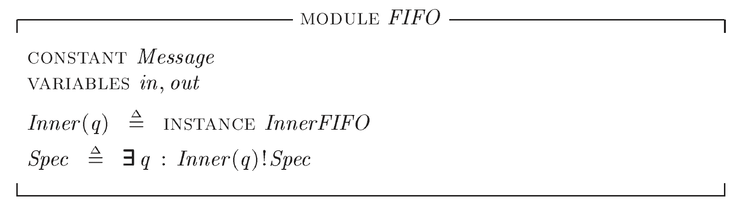
Hiding the Queue

Slide 23
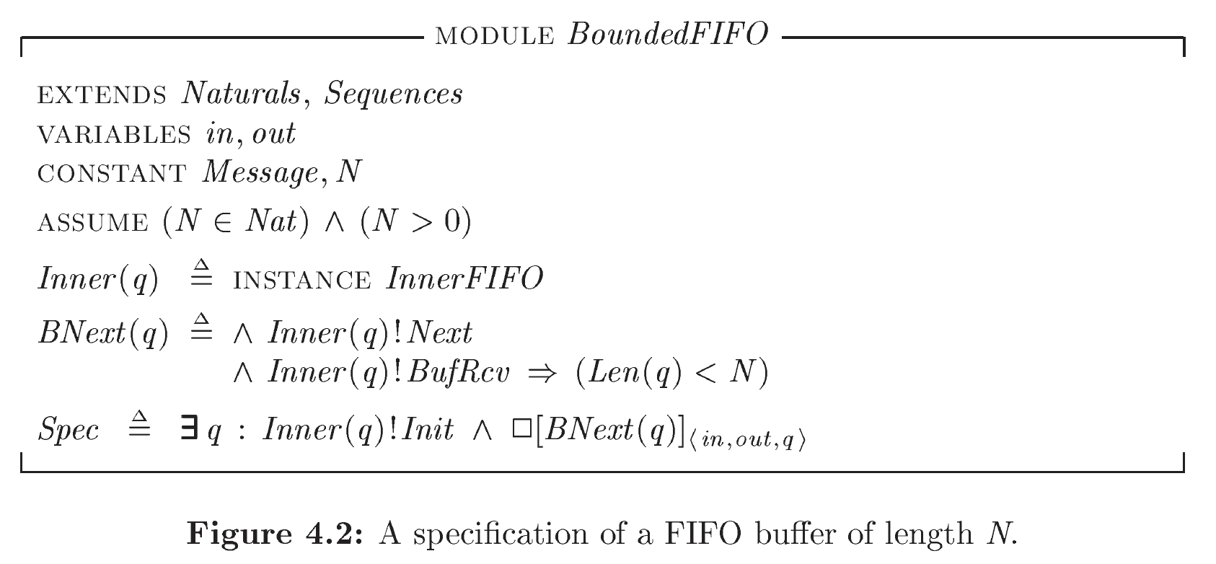
A Bounded FIFO

Slide 24
Q&A

