Slide 1

EfficientSAM
Leveraged Masked Image Pretraining for Efficient Segment Anything
Yunyang Xiong, Bala Varadarajan,* Lemeng Wu,*
Meta AI Research
demo（没上传源码）： https://github.com/yformer/EfficientSAM
Xiong, Yunyang, et al. "EfficientSAM: Leveraged Masked Image Pretraining for Efficient Segment Anything." arXiv preprint arXiv:2312.00863 (2023).

Slide 2
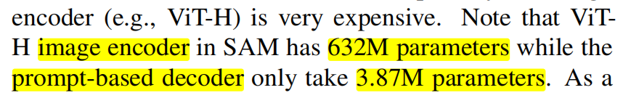
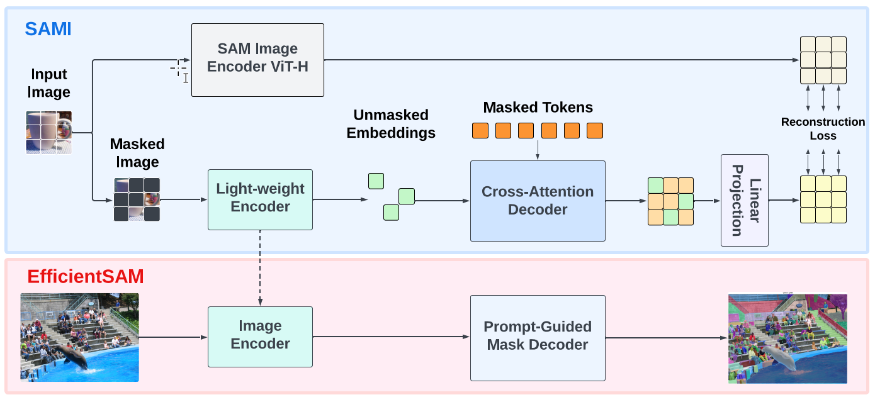
问题：SAM的image encoder会消耗大量的计算和显存资源，限制其在实时任务中的应用
leveraging
masked image pretraining, SAMI, which learns to reconstruct features from SAM image encoder
1）在 ImageNet 上对 SAMI 进行预训练
2）在 SA-1B 上微调 SAM
Notes:
利用对比学习，MAE从SAM imgencoder中学习重建特征，
提出了SAMI 一个利用sam ViT-H的掩蔽图像预训练框架
证明 SAMI-pretrained的主干网络的有效性
提出了EfficientSAM

Slide 3
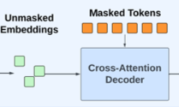
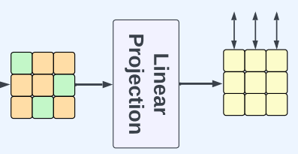
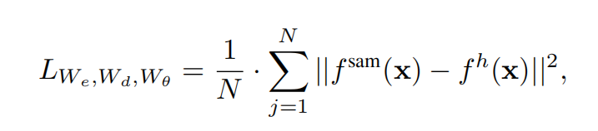
SAMI主要部件
Cross-Attention Decoder
Linear Projection Head
Reconstruction Loss

Slide 4
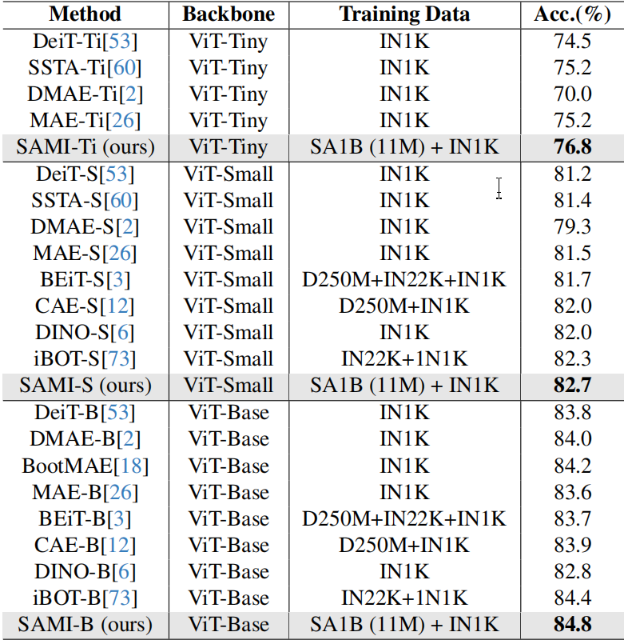
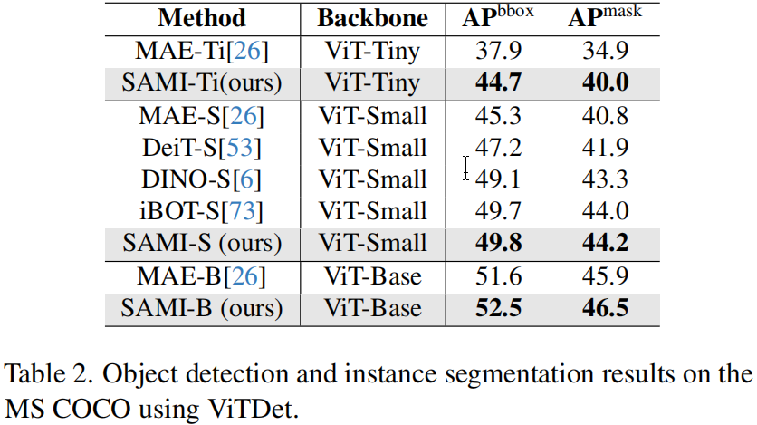
Results-SAMI预训练的主干网络
SAMI：image classification：MAE, DMAE, iBOT, CAE, and BEiT by 1.2%, 0.8%, 1.1%, 0.9%, and 0.4% respectively
SAMI：Object Detection and Instance Segmentation

Slide 5
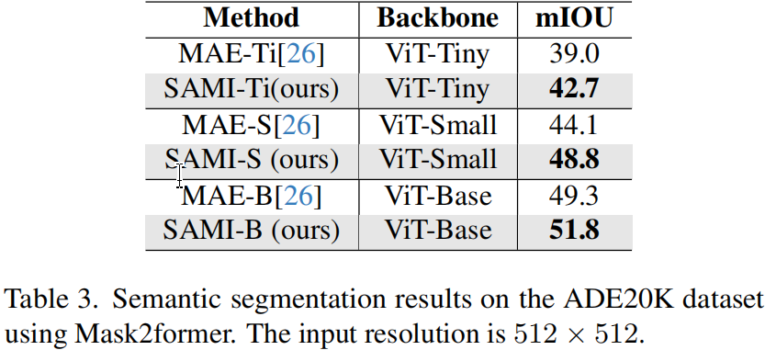
SAMI：Semantic Segmentation：Mask2former with SAMI-pretrained backbones achieve better mIoU, i.e., ↑2.5, ↑4.7, and ↑3.7

Slide 6
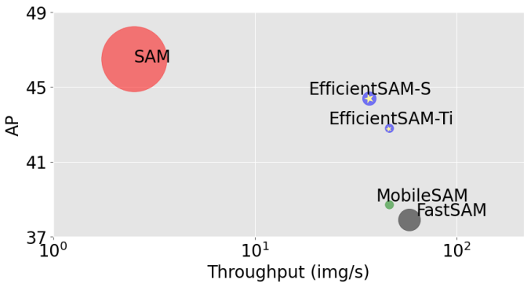
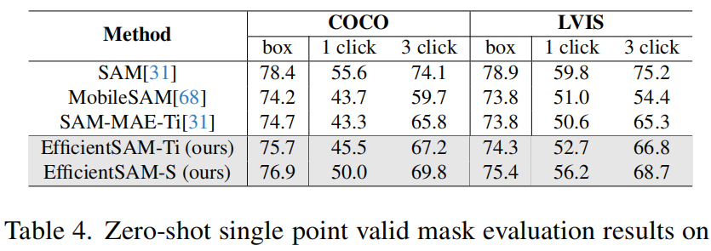
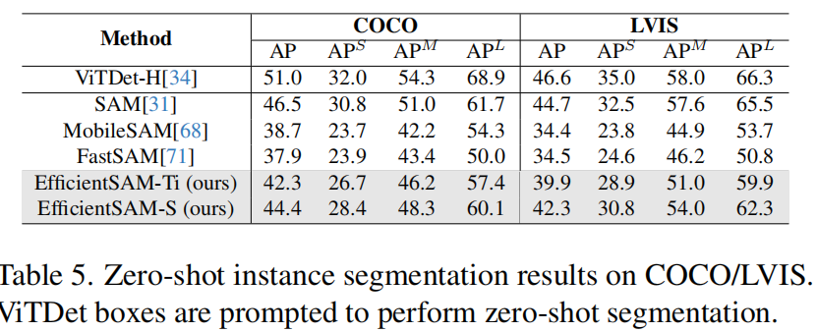
Results-EfficientSAM
Zero-Shot Single Point Valid Mask Evaluation
Throughput/Parameter/Performance comparison
of EfficientSAM, MobileSAM, FastSAM, and SAM for zero-shot Instance segmentation on COCO
Zero-Shot Instance Segmentation
EfficientSAMs are much light-weight than FastSAM, e.g, 9.8M parameters for efficientSAM-Ti vs 68M parameters for FastSAM. EfficientSAM-S also significantly reduces the gap between SAM with 0.6G parameters, only ∼2 AP reduction

Slide 7
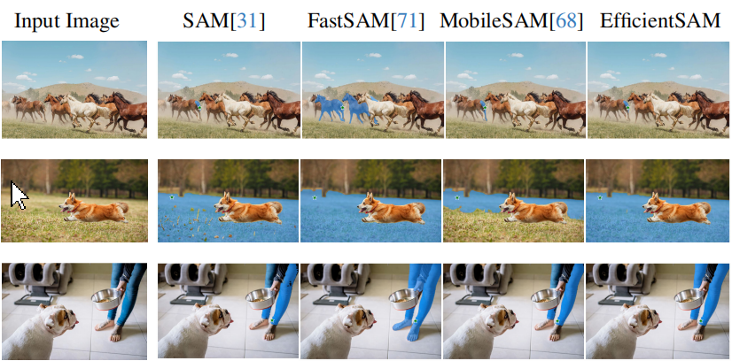
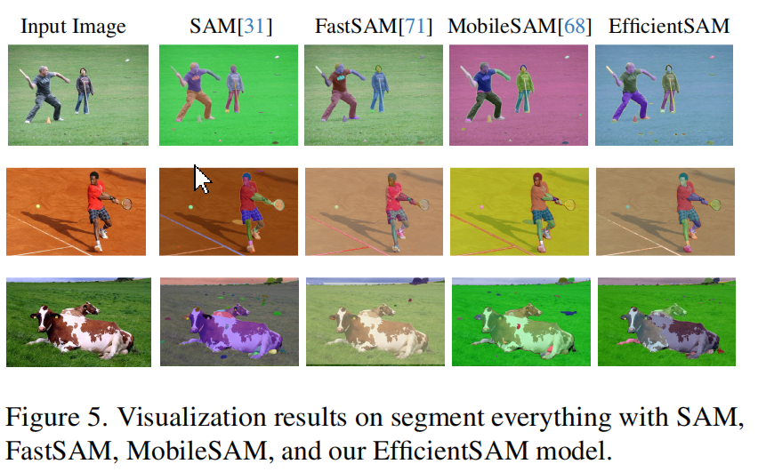
Salient Instance Segmentation

Slide 8
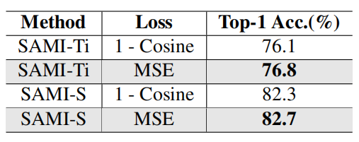
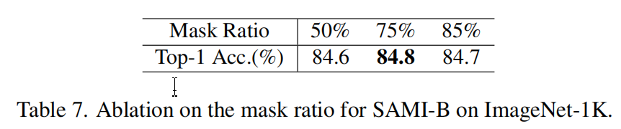
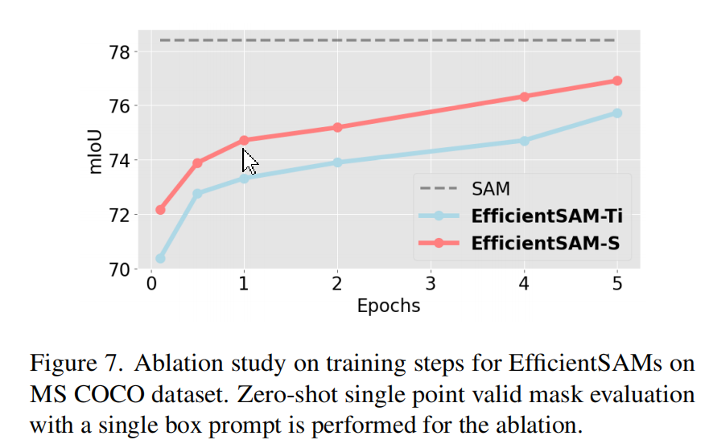
消融实验
Reconstruction Loss
MASK- ratio
Reconstruction Target.
We take a different encoder from CLIP
Effects of Finetuning Steps for EfficientSAMs

Slide 9
局限
比SAM弱

Slide 10
问题
ablation study中
Reconstruction Target.部分，没理解使用CLIP的作用是什么
Cross-Attention Decoder.没理解如何证明的
一些实现：
cross-Attention decoder如何实现，
reorder mask and unmask embeddings
Linear Projection Head如何aligning

