Slide 1
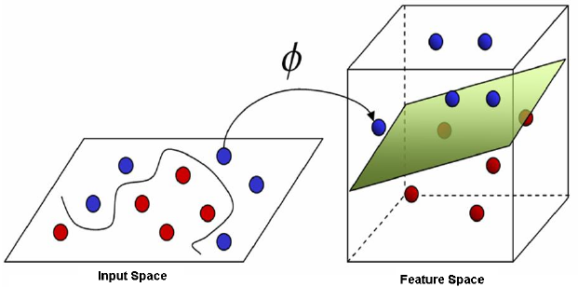
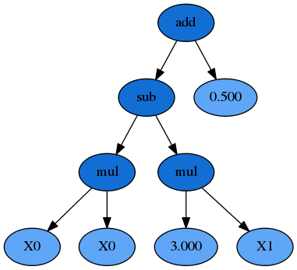
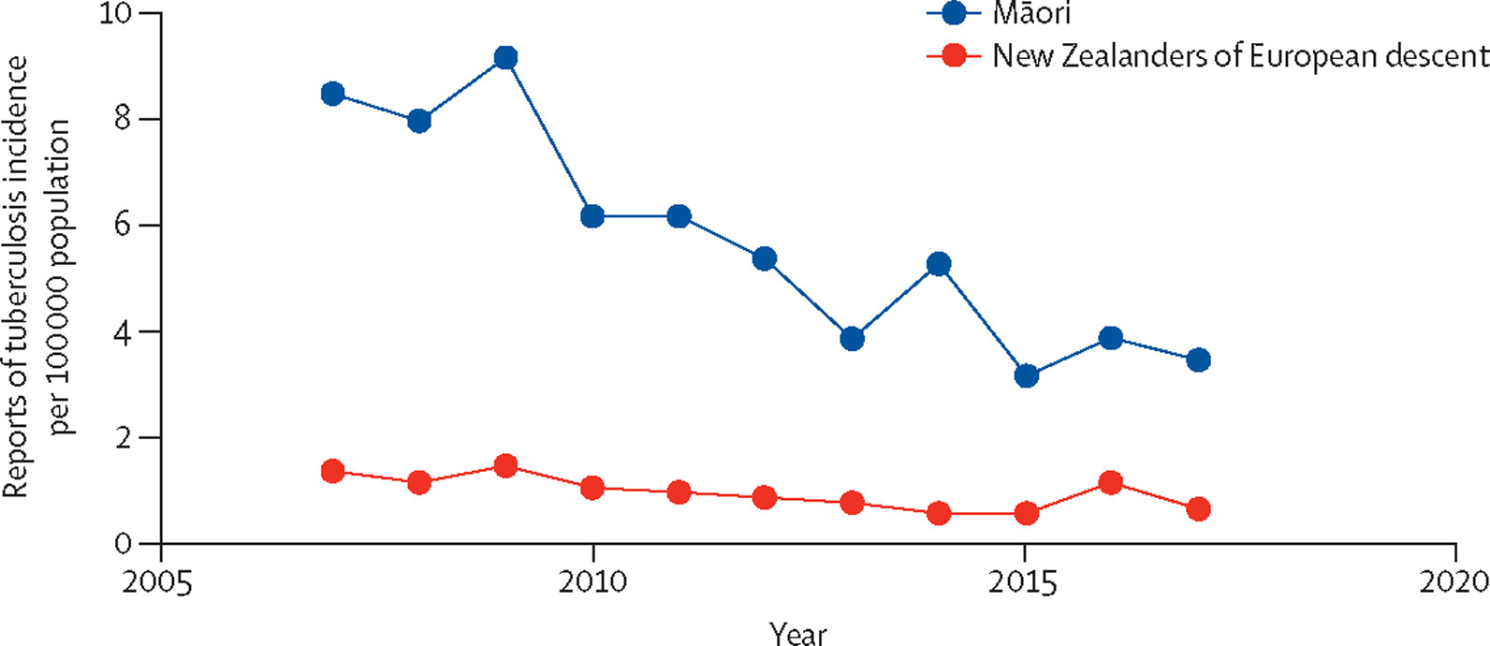
Genetic Programming for Automated Feature Construction
Hengzhe Zhang
Easy
Hard
Task：Feature Space Transformation
Technique：Genetic Programming
Māori
Goal: Democratizing Artificial Intelligence
Application：Predict and Prevent Diseases (For Māori 16.5%, Asian 15.3%, Pacific peoples 9.0%, and Other Minority Groups in NZ)
Pākehā

