Slide 1
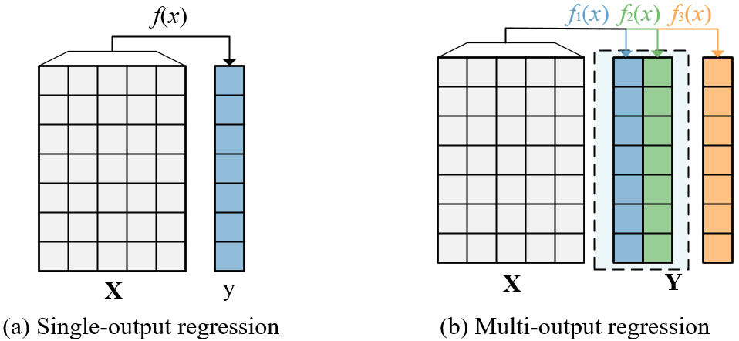
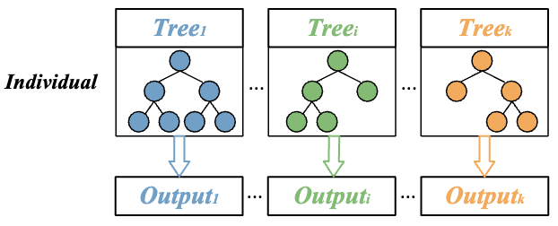
GP for Multi-output Regression---Chunyu
1. Multi-output regression
Inputs: X1, X2, ..., Xm
Outputs: The number of output variables is more than one Y1, Y2, ..., Yd.
2. Challenges
Complex interactions
The risk of overfitting on high-dimensional data
3. GP for Multi-output Regression
Multi-task GP: multi-output regression -> multi-task learning
Multi-tree GP: several GP trees in an individual
GP-based Feature Selection

