Slide 1



Multi-task Genetic Programming with Semantic based Crossover for Multi-output Regression
我们毕业啦
其实是答辩的标题地方
Presenter: Chunyu Wang
Email: chunyu.wang@vuw.ac.nz

Slide 2
Contents
1
Introduction
2
Algorithm
3
Experiments
4
Conclusions

Slide 3
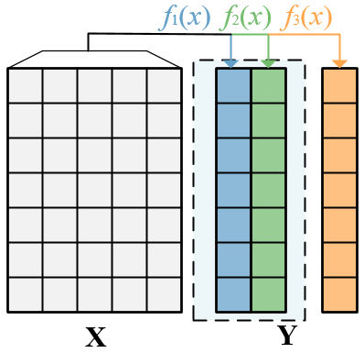
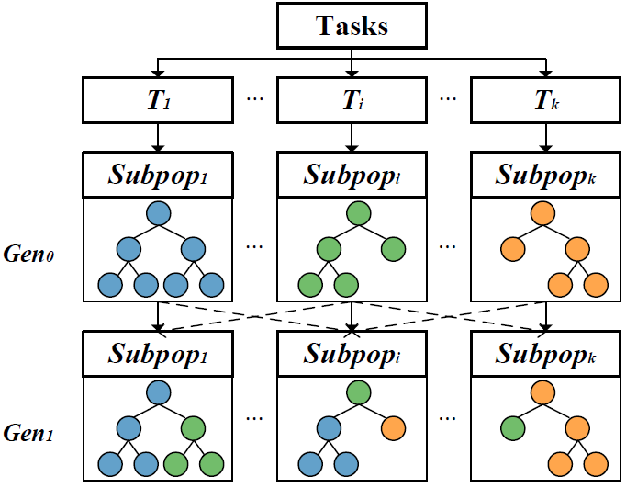
Introduction
Multi-output Regression
Inputs: X1, X2, ..., Xm
Outputs: The number of output variables is more than one Y1, Y2, ..., Yd.
Challenge: Complex interactions
Multi-task GP for Multi-output Regression
Problems: Multi-output regression -> Multi-task learning
Challenge: Effective knowledge transfer to capture complex interactions
1
Notes:
Multi-output regression is very different from single output regression. In multioutput regression, the number of output variables is more than one like the figure. The main challenge is the complex interactions between output variables. Like the figure, some output variables are related but not all. Based on some researches, the multi-output regression problems can be regarded as the special multitask problems where all tasks use the same inputs and each task predict each output variable. So we plan to use multitask GP to solve multioutput regression problems which aims to predict all tasks well simultaneously. The challenge there, is how to effective knowledge transfer to capture complex interactions between output variables for improving the overall performance. Because of the effectiveness of multitask multipopulation GP, this paper uses the framework.

Slide 4
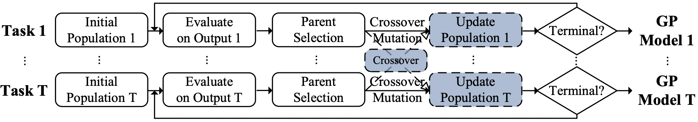
Algorithm
The workflow of the proposed GP method
Semantic based Crossover
Origin based Offspring Strategy
2
Notes:
In order to effective transfer knowledge, we propose a new semantic based crossover to identify the informative subtree from other similar tasks and generate high-quality solutions by crossover. The workflow of the proposed method like the figure. The blue box is the novel parts compared with standard multi-task multi-population GP method. When knowledge transfer is triggered, The semantic based crossover uses the cosine similarity between the semantics of parent from similar task and the semantics of current output variable to identify the informative subtree and then use the crossover operator to swap the informative subtree with current subtree. When knowledge transfer is not triggered, cosine similarity computes the semantics of parents from the same task. Then the offspring generated by the current task is reserved like the figure.

Slide 5
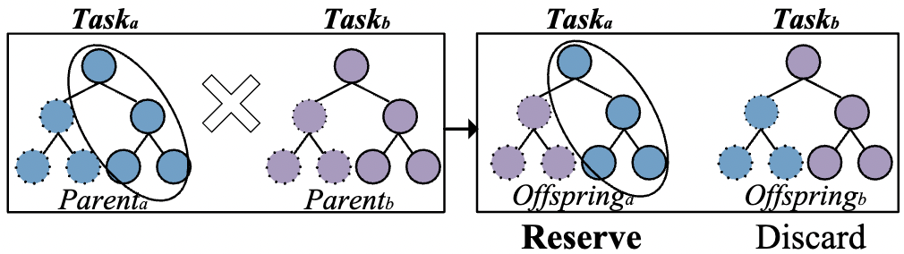
Algorithm
Current Task
Similar Task
Semantic based Crossover
Inter-task semantic based crossover:
cosine similarity [semantic(Parent_b), y_a]
Most similar subtree_b
Crossover [subtree_a, subtree_b]
Intra-task semantic based crossover:
cosine similarity [semantic(Parent_a), semantic(Parent_c)]
Most similar subtree_a, subtree_c->swap
Origin based Offspring Strategy
Maintain the main structure of offspring generated by the parent from the current task.
3
Notes:
In order to effective transfer knowledge, we propose a new semantic based crossover to identify the informative subtree from other similar tasks and generate high-quality solutions by crossover. The workflow of the proposed method like the figure. The blue box is the novel parts compared with standard multi-task multi-population GP method. When knowledge transfer is triggered, The semantic based crossover uses the cosine similarity between the semantics of parent from similar task and the semantics of current output variable to identify the informative subtree and then use the crossover operator to swap the informative subtree with current subtree. When knowledge transfer is not triggered, cosine similarity computes the semantics of parents from the same task. Then the offspring generated by the current task is reserved like the figure.

Slide 6
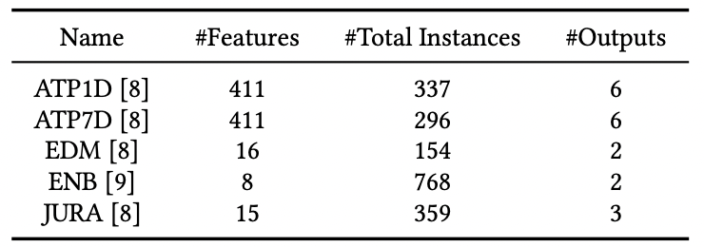
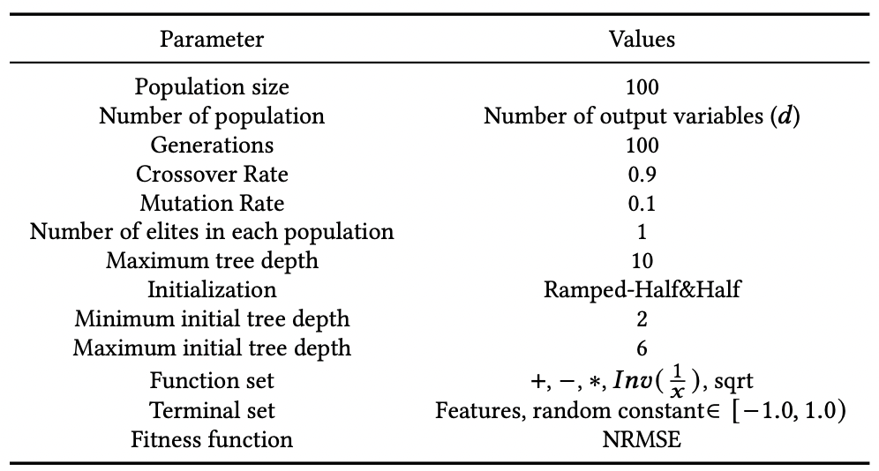
Datasets & Parameter settings
Table 1: Multi-output Regression Datasets
Data Split:
70% training
30% test
Table 2: Parameter Settings
Methods:
1. Standard GP
2. M GP (TCYB 2021)
3. M GP (TCYB 2021)
4. M GP
5. M GPWSC (Proposed)
2
2
f
2
semantic
2
4
Notes:
This paper uses the five multi-output regression datasets and 70% is regarded as training sets and 30% is test sets. Table 2 shows the parameter settings which is common setting in GP. Standard GP is used to predict output variable respectively. M square GP is multi-task multi-population GP. M square GP f combine M square GP with origin-based offspring strategy. M square GP semantic combines M square GP with semantic based crossover. M square GPWSC integrates semantic based crossover and origin-based offspring strategy which is proposed method.

Slide 7
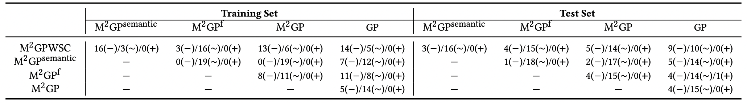
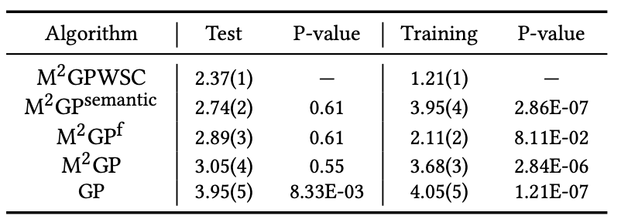
Results
Table 3:Statistical comparison of Training and Test NRMSE score for different GP methods on all output variables. ("−", "∼" and "+" indicate that method in the row is better than, similar to or worse than the method in the column.)
Table 4:Friedman’s rank of Training and Test NRMSE score for different GP methods on all output variables.
2
M GPWSC is superior to GP and standard multi-task multi-population GP in both learning and generalization performance
5
Notes:
From Significant statistical test shows that the proposed method is superior other methods in both learning and generalization performance.

Slide 8
Conclusions
Conclusions:
The proposed GP method can :
Effectively predict multiple output variables.
Improve the learning and generalization abilities of multi-task GP.
Future work:
This work will investigate other metrics to adaptively select tasks and the intensity of transfer knowledge.
6

Slide 9
Thanks for your attention

