Slide 1
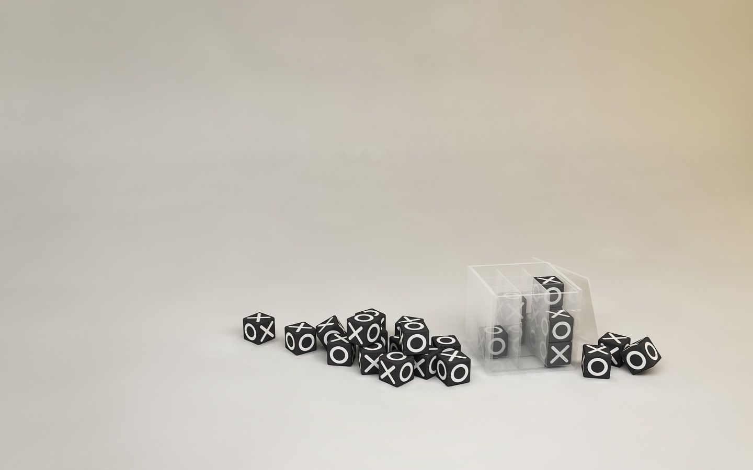
TIC TAC TOE
INTRODUCTION
DEMO
CONCLUSION
WHY THIS PROJECT
CHALLENGES
PRESENTED BY HENI LTAIEF
14/08/2021

Slide 2

???

Slide 3
WHY THIS PROJECT
1- It’s one of the coolest mind games
2- We can play it anywhere and at anytime

Slide 4


Slide 5
CHALLENGES
1- I lost a lot of time finding the easiest logic to implement
2- Problems in jQuery
3- Time management

Slide 6
Conclusion

Slide 7
Thank you

