Slide 1

GAINZ
Initial Project Proposal & Planning Overview

Slide 2
Project Foundation
Welcome to the GAINZ website development project. This presentation outlines our comprehensive approach to creating a cutting-edge e-commerce platform for gym supplements that will revolutionise how fitness enthusiasts access premium nutritional products.
Our structured methodology ensures we deliver a robust, user-friendly solution that meets both business objectives and customer needs whilst maintaining the highest technical standards.

Slide 3
Project Title Finalisation
Official Project Name
GAINZ E-Commerce Platform
A comprehensive digital solution for gym supplement retail
Project Scope
Full-stack web development including product catalogue, secure payment gateway, user accounts, and content management system
Target Launch
Q2 2026 with phased rollout of features and continuous optimisation based on user feedback

Slide 4
Problem Statement Definition
Market Gap Identification
Current gym supplement websites lack intuitive navigation, personalised recommendations, and reliable product information, leading to customer frustration and abandoned purchases.
Customer Pain Points
Difficulty finding suitable products for specific fitness goals
Lack of transparent ingredient information and certifications
Limited customer support and guidance
Business Challenge
Need for a competitive platform that drives conversions, builds trust, and establishes GAINZ as the go-to destination for quality supplements in a saturated market.

Slide 5
Existing System Analysis
Current Market Solutions
We've conducted thorough research into leading supplement retailers to understand industry standards and common approaches.
Generic template-based designs with limited customisation
Basic product categorisation without intelligent filtering
Minimal educational content or expert guidance
Slow page load times affecting user experience
Identified Limitations
Poor personalisation: No tailored product recommendations based on fitness goals
Weak trust signals: Insufficient product reviews and certification displays
Limited engagement: Lack of community features or expert content
Checkout friction: Complex payment processes leading to cart abandonment

Slide 6
GAINZ System Architecture
Application Logic
Smart recommendation engine, advanced search functionality, and personalised user dashboards
User Interface Layer
Responsive, accessible design optimised for all devices with intuitive navigation and engaging product displays
Data Management
Secure database infrastructure with product catalogue, customer profiles, and order processing
Security & Integration
Payment gateway integration, SSL encryption, and third-party API connections for shipping and analytics

Slide 7
Technology Stack & Requirements
Frontend
HTML
Tailwind CSS
JS
Backend
Python
My SQL(Database)

Slide 8
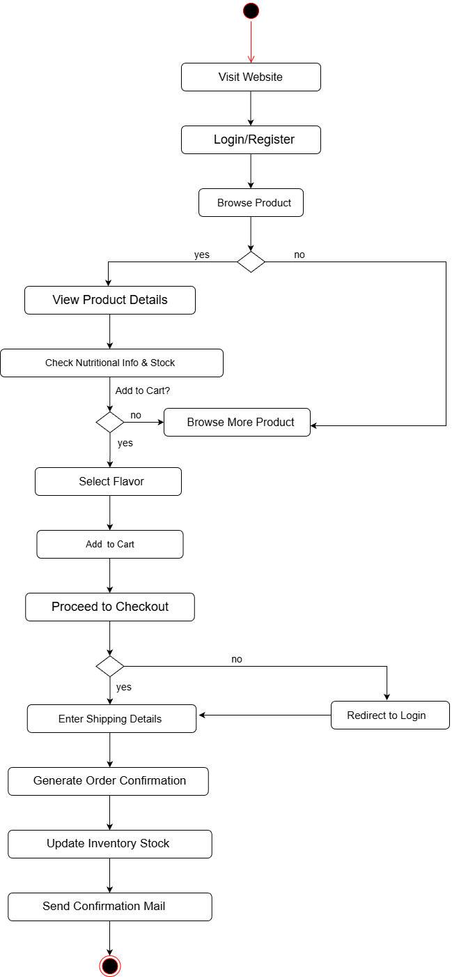
Activity Diagram

Slide 9
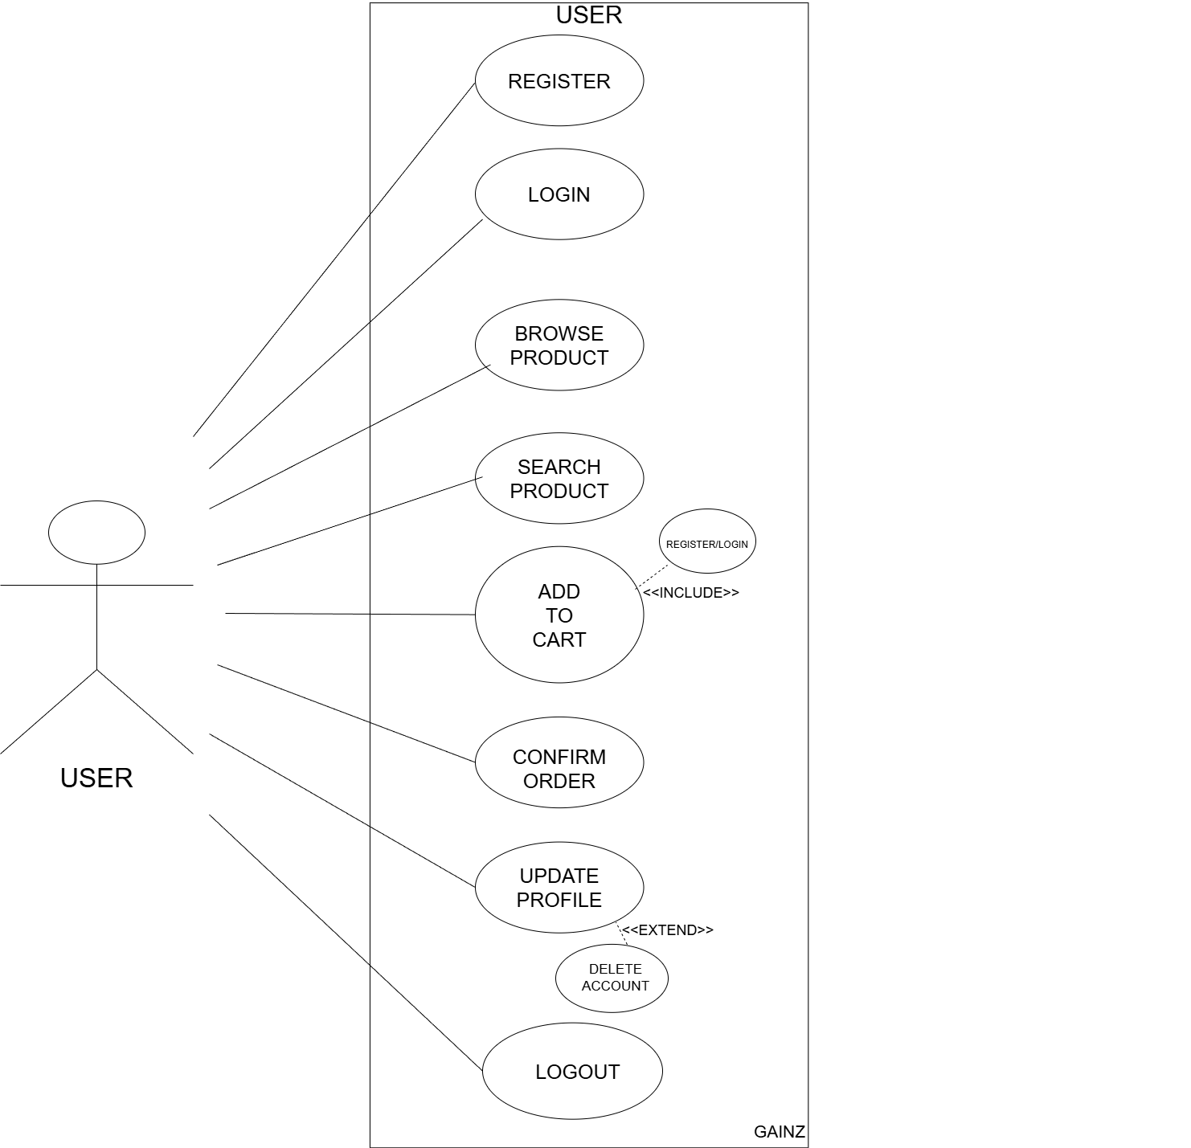
USE CASE Diagram

Slide 10
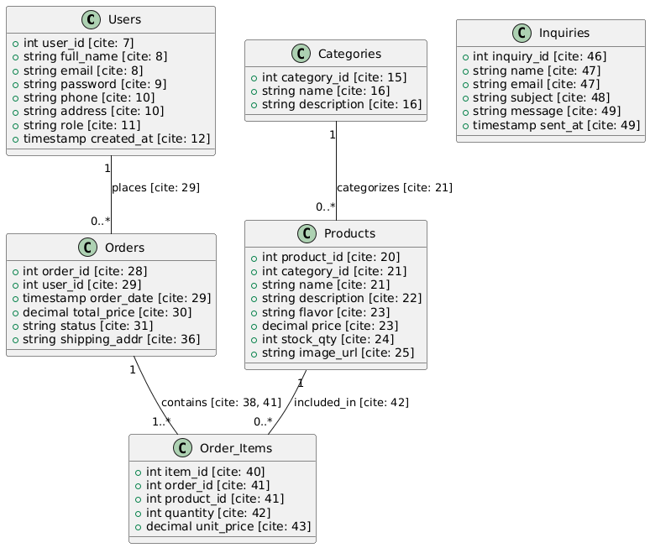
Class Diagram

Slide 11
Data Dictionary
User Table
Field Name | Data Type | Constraints | Description
user_id | UUID / INT | PK, AI | Unique identifier for each athlete.
full_name | VARCHAR(100) | NOT NULL | The user's legal name for shipping and billing.
email | VARCHAR(255) | UNIQUE, NN | Primary contact and login identifier.
password_hash | VARCHAR(255) | NOT NULL | Securely hashed password (never store plain text).
phone_number | VARCHAR(15) | NULL | For delivery notifications and 2FA.
fitness_goal | ENUM | NULL | Values: 'Muscle Gain', 'Fat Loss', 'Endurance'.
created_at | TIMESTAMP | DEFAULT NOW | Account creation timestamp.

Slide 12
Product Table
Field Name | Data Type | Constraints | Description
product_id | UUID / INT | PK, AI | Unique ID for each product SKU.
name | VARCHAR(100) | NOT NULL | Product name (e.g., "Elite Whey Isolate").
category | VARCHAR(50) | NOT NULL | Protein, Creatine, Pre-workout, Vitamins.
flavor | VARCHAR(50) | NULL | Flavor variants like 'Kesar Pista' or 'Mango'.
price | DECIMAL(10,2) | NOT NULL | Unit price in local currency.
stock_qty | INT | DEFAULT 0 | Real-time inventory count.
protein_per_serving | DECIMAL(5,2) | NULL | Nutritional value (grams).
is_active | BOOLEAN | DEFAULT TRUE | Toggle for out-of-stock or discontinued items.

Slide 13
Order Table
Field Name | Data Type | Constraints | Description
order_id | UUID / INT | PK, AI | Unique transaction ID.
user_id | UUID / INT | FK | References users(user_id).
total_amount | DECIMAL(10,2) | NOT NULL | Total cost after taxes and discounts.
order_status | ENUM | NN | 'Processing', 'Shipped', 'Delivered', 'Cancelled'.
shipping_address | TEXT | NOT NULL | Physical destination for the delivery.
payment_status | ENUM | NN | 'Pending', 'Paid', 'Failed', 'Refunded'.

Slide 14
Contact Table
Field Name | Data Type | Constraints | Description
inquiry_id | INT | PK, AI | Unique ID for the support ticket.
sender_name | VARCHAR(100) | NOT NULL | Name provided in the contact form.
sender_email | VARCHAR(255) | NOT NULL | Email provided for follow-up.
subject | VARCHAR(150) | NULL | Category selected (e.g., Order Support).
message_body | TEXT | NOT NULL | The actual message transmitted.
received_at | TIMESTAMP | DEFAULT NOW | When the message hit your system.

Slide 15
Thank You

