Slide 1
Hospital Management System
LIFELINE Hospital

Slide 2
Introduction
A web-based platform for managing hospital operations
Handles patients, staff, billing, appointments, and reports
Makes hospital work faster and more organized

Slide 3
Objectives
Digitize hospital records
Quick access to patient and staff data
Easy billing and appointment scheduling
Better communication and reporting

Slide 4
Existing System
Manual record-keeping (paper files/registers)
Time-consuming and error-prone
Difficult to track patient history and billing

Slide 5
Drawbacks of Existing System
Data loss risk (fire, misplacement)
Slow information retrieval
No real-time updates
Limited reporting and analytics

Slide 6
Proposed System
Web-based hospital management platform
Centralized, secure, and accessible data
Automated billing, appointments, and reporting

Slide 7
Features of Proposed System
Patient registration and management
Staff management
Appointment scheduling and approval
Billing and payment tracking
Reports and analytics dashboard
User roles and permissions

Slide 8
System Users
Admin: Manages users, settings, and reports
Doctor: Views appointments, patient records
Receptionist: Registers patients, schedules appointments
Accountant: Manages billing and payments

Slide 9
Role of Users
Admin: Full access, system configuration
Doctor: Patient care, update records
Receptionist: Data entry, appointment handling
Accountant: Billing, financial reports

Slide 10
Modules & Sub-Modules
Patient Management: Add, edit, search, delete patients
Appointment Management: Schedule, approve, view appointments
Billing: Generate, download, and track bills
Staff Management: Add, edit, assign roles
Reports: View analytics, download reports
Settings: Manage services, user roles

Slide 11
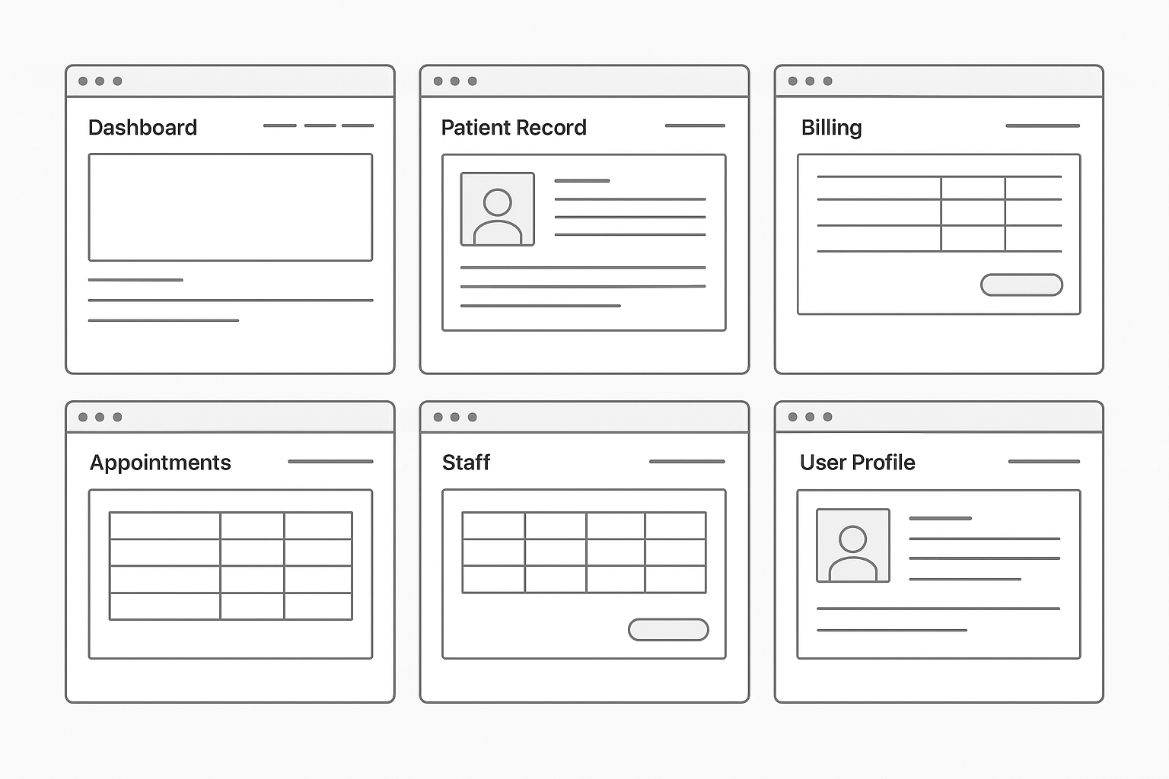
System Design (Wireframe)

Slide 12
Data Dictionary
Patient: Name, Age, Gender, Disease, Contact
Staff: Name, Role, Contact
Appointment: Patient, Doctor, Date, Status
Bill: Patient, Charges, Amount, Status
User: Username, Password, Role

Slide 13
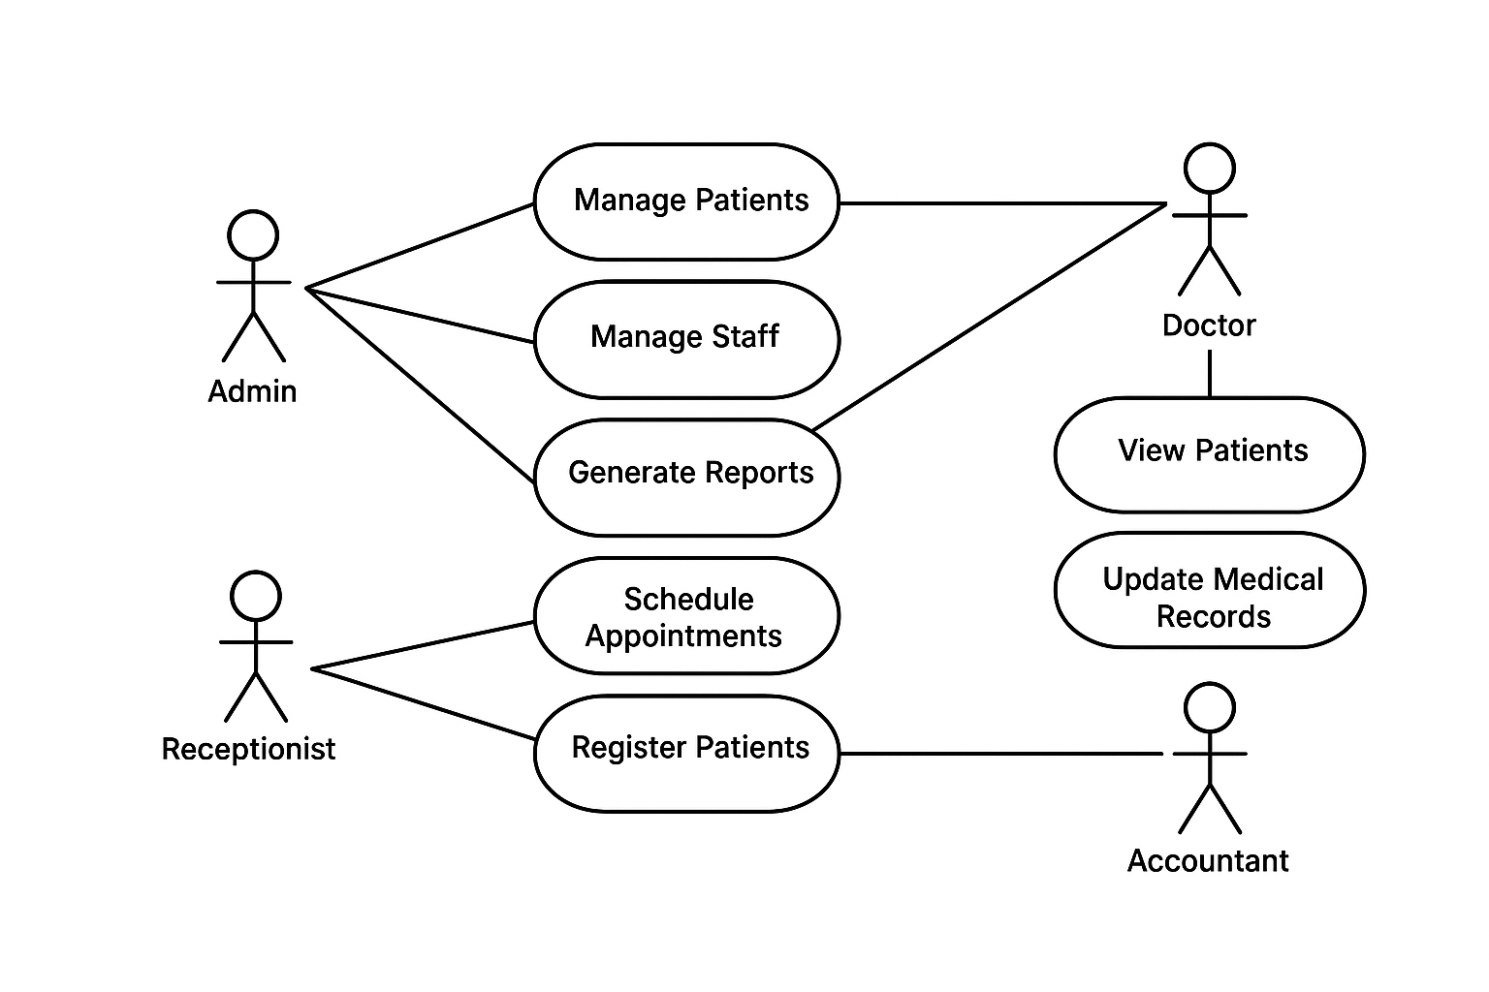
UML Diagram - Use Case

Slide 14
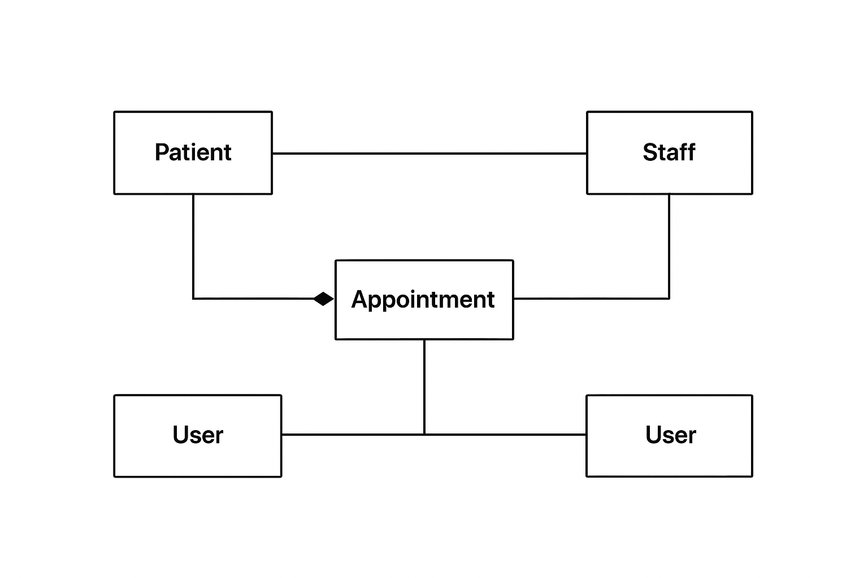
UML Diagram - Class Diagram

