Slide 1
Agentic RAG:
Tool Routing Under Prompt Ambiguity
Evaluating how LLM-based routing strategies choose between local knowledge retrieval and real-time web search as query ambiguity increases
Parin Shah · Henil Patel · Heta Shah
CS 6180 · Foundations of Generative AI · Team 8
1 / 6

Slide 2
Project Introduction & Objectives
Why routing is the critical decision layer in agentic RAG
The Problem
System Architecture
In agentic RAG, a router decides whether a query goes to a local vector database or live web search. Real-world queries are rarely clean — they are vague, context-dependent, and temporally ambiguous.
User Query
Who Benefits?
Router Agent
Financial analysts, compliance teams, and investors ask queries that blend static filing knowledge with live market data — one agent, two very different sources.
LLM-based classification
Research Gap
Local Vector DB
Web Search
Prior RAG evaluations focus on retrieval quality, not routing decisions. No principled benchmarks exist for routing quality across ambiguity levels.
ChromaDB · 22 10-Ks
Real-time via Tavily
⚠ Wrong Routing = Wrong Answer
Research Question
Routing 'stock price' to a 2025 10-K returns stale data. Routing 'business segments' to web misses deep filing knowledge.
How does routing accuracy degrade as prompt ambiguity increases?
2 / 6

Slide 3
Progress — What We Built
6 routing strategies × 4 LLM backends × 100 labeled queries across 22 company 10-Ks
Routing Strategies
Models Evaluated
Stack & Dataset
• Rule-Based — temporal keyword matching
• Llama-3-8B-Instruct
• LangChain + LangGraph
• Always-Local — naive baseline (52% ceiling)
• GPT-4o-mini
• ChromaDB (22 FY2025 10-Ks)
• Zero-Shot LLM — direct prompt → JSON
• Gemma-3-27B-IT
• Tavily real-time web search
• Few-Shot LLM — 3 labeled examples in context
• Claude Sonnet 4.6
• all-MiniLM-L6-v2 embeddings
• CoT LLM — chain-of-thought before classifying
• 100 queries · 3 ambiguity tiers
• LangGraph Agent — multi-node stateful workflow
• All via OpenRouter API
• 52 local · 48 web labels
3 / 6

Slide 4
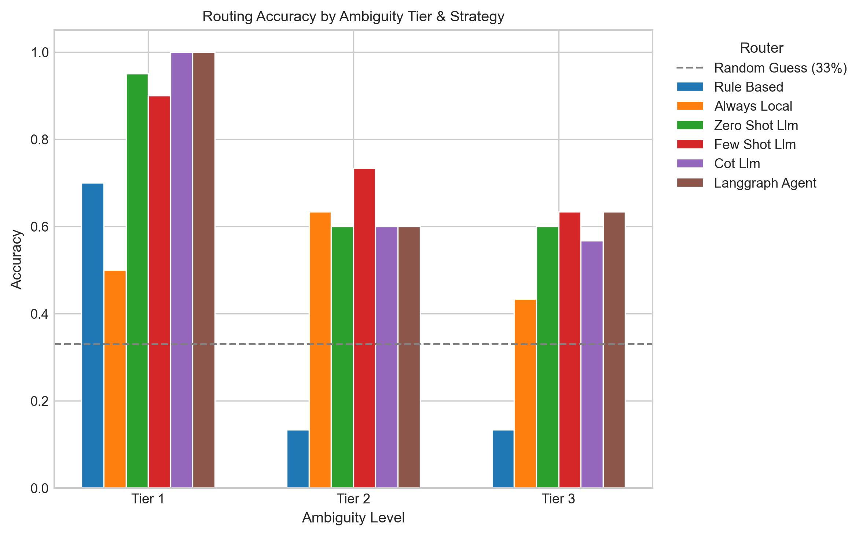
Results — Routing Accuracy by Ambiguity Tier
LLM-based routers decisively outperform baselines — but all degrade under ambiguity
LLM Routers Win
All LLM strategies reach 84% at 100% coverage. Rule-based collapses to 36% and abstains on 59% of queries.
Ambiguity is the Ceiling
LLM routers drop 27–37 accuracy points from Tier 1 → Tier 3. ANOVA p < 0.001 across all models.
Few-Shot Leads Tier 2
Few-Shot hits 83% on moderately ambiguous queries — 10 pts above Zero-Shot. Best practical production gain.
4 / 6

Slide 5
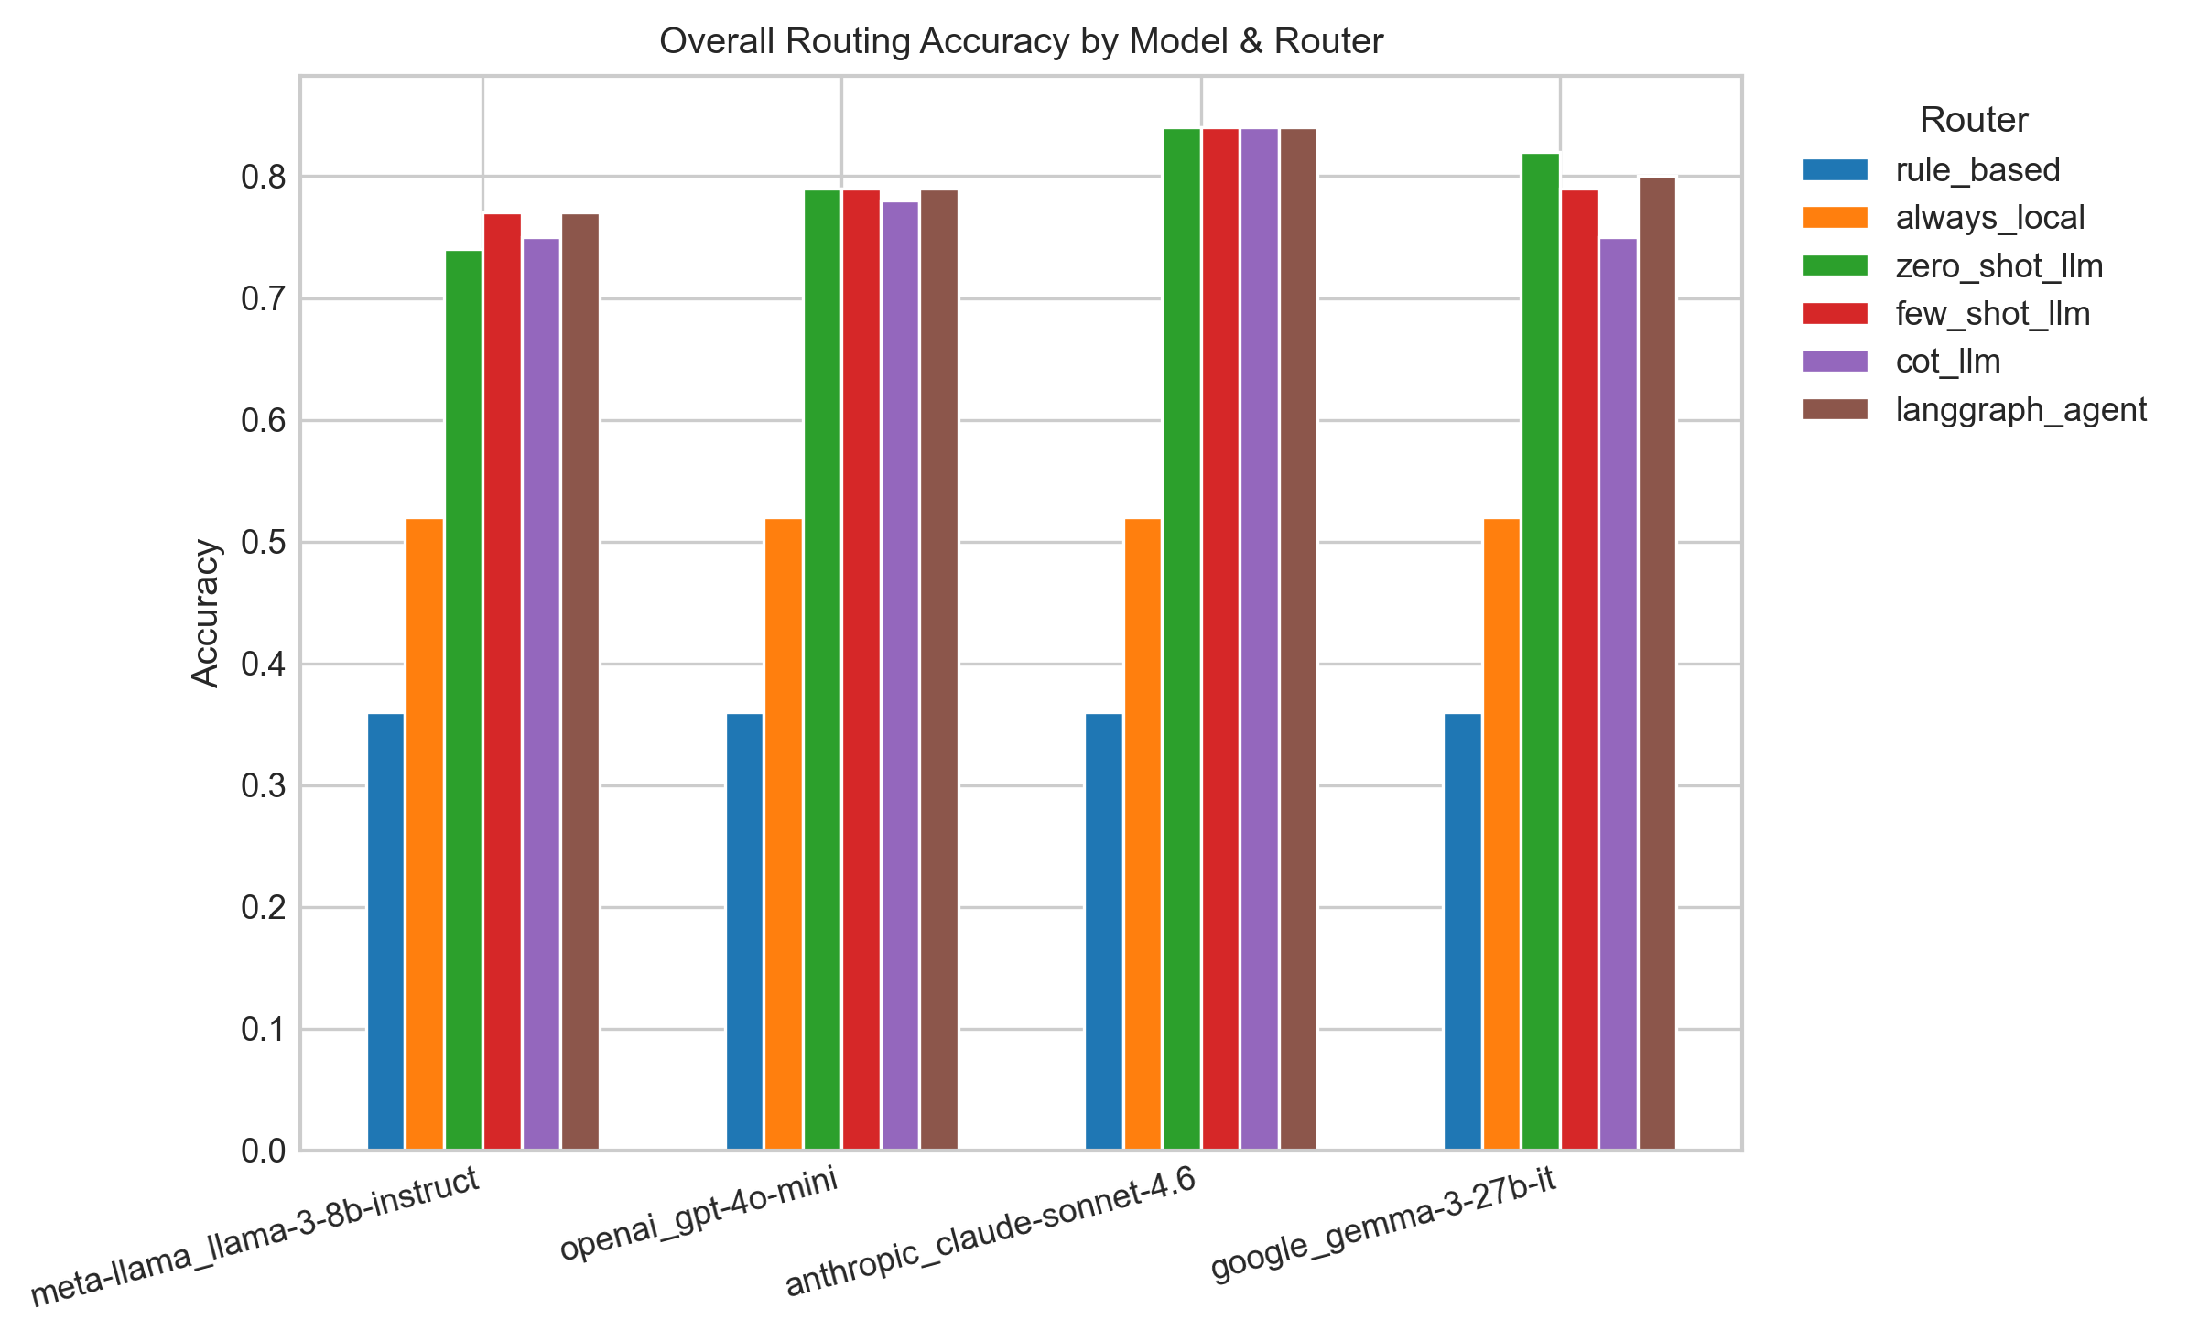
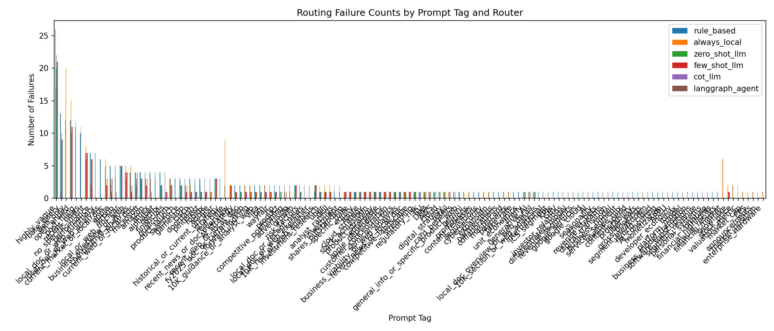
Model Comparison & Failure Patterns
Model quality drives Tier 1; ambiguity becomes the bottleneck at Tier 3
Model Summary
Model
Overall
Tier 1
Tier 3
Claude Sonnet
84%
100%
63–73%
Gemma-3-27B
75–82%
90–98%
57–67%
GPT-4o-mini
78–79%
98–100%
60–67%
Llama-3-8B
74–77%
90–100%
57–63%
Top Failure Modes
• Vague-Query Bias
Open-ended queries default to web even when the local 10-K has the answer
• Local → Web Misroutes
Risk factors, KPIs, strategy queries sent to web search
• Temporal Confusion
'Early 2026' — annual filing vs. live market data ambiguity
5 / 6

Slide 6
Next Steps
Two focused tasks to close the project
Linguistic Failure Analysis
Final Report
Examine which specific query features drive misroutes: • Missing temporal markers • Bare entity references (no verb, no scope) • Underspecified or open-ended queries Goal: characterize the residual 16–26% error rate at a linguistic level and produce interpretable findings about what makes a query hard to route.
Full write-up covering: • Related work & background • System design & methodology • Full experimental results • Limitations & future work The codebase is already reproducible. The report wraps the complete narrative around our findings.
Owner: Parin Shah
Owner: Heta Shah
6 / 6
Team 8 · Parin Shah · Henil Patel · Heta Shah · CS 6180 · Foundations of Generative AI

