Slide 1
Agentic RAG:
Tool Routing Accuracy Under Prompt Ambiguity
Henil Patel · Parin Shah · Heta Shah
Supervised By: Prof. Ryan Rad
CS 6180 · Foundations of Generative AI · Team 8

Slide 2
Project Introduction & Objectives
The Routing Decision: RAG enhances LLM reliability by grounding responses in retrieved documents, but modern agentic systems must dynamically choose between a local knowledge store and live web search at query time
Wrong routing = wrong answer: sending a time-sensitive query to a static document store returns stale data; sending a document-specific query to web search returns irrelevant results
Cost of Routing Errors: Routing errors cause responses that are outdated, off-topic, or confidently wrong, yet most benchmarks evaluate final answer quality, not the routing decision itself
The Research Gap: Despite rapid adoption of agentic RAG in enterprise systems, no principled benchmarks exist that measure how routing accuracy degrades as query ambiguity increases
Our Approach: This project isolates routing as the primary experimental variable, evaluating 6 strategies across 4 LLMs and 3 ambiguity tiers to identify where and why routers fail
Research Question
“ How does routing accuracy degrade as prompt ambiguity increases? ”

Slide 3
Methodology
Routing Strategies
Models Evaluated
Stack & Dataset
• Rule-Based: temporal keyword matching
• Always-Local: naive baseline (52% ceiling)
• Zero-Shot LLM: direct prompt → JSON
• Few-Shot LLM: 3 labeled examples in context
• CoT LLM: chain-of-thought before classifying
• LangGraph Agent: multi-node stateful workflow
• Llama-3-8B-Instruct
• GPT-4o-mini
• Gemma-3-27B-IT
• Claude Sonnet 4.6
• LangChain + LangGraph
• ChromaDB (22 FY2025 10-Ks)
• Tavily real-time web search
• all-MiniLM-L6-v2 embeddings
• 100 queries, 3 ambiguity tiers
• 52 local, 48 web labels

Slide 4
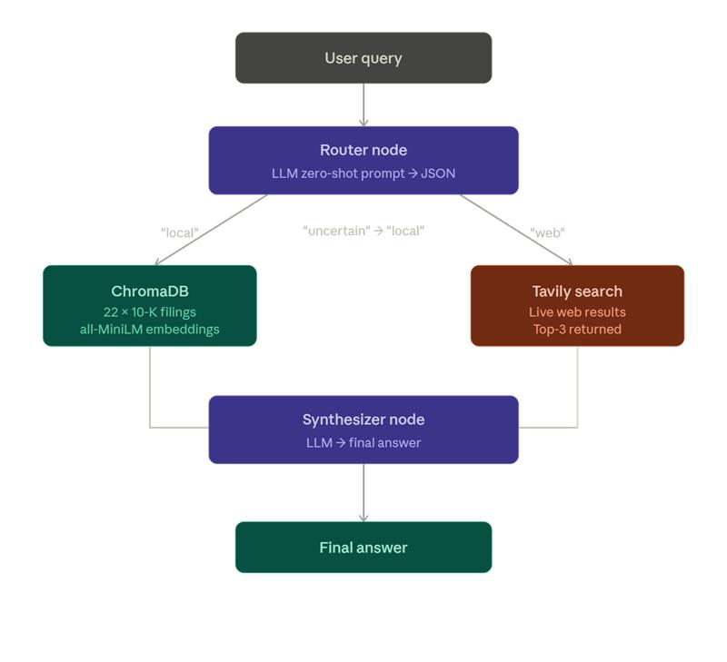
Methodology
Dataset & Ambiguity Tiers
100 labeled queries across 22 company 10-Ks
Tier 1 — Clear Intent (40 queries) Unambiguous, explicit source signal "How many employees did Amazon report as of Dec 31, 2025?" → local "What is Amazon's stock price right now?" → web
Tier 2 — Moderately Ambiguous (30 queries) Requires inference about recency or scope "What was Adobe's total revenue for FY2025?" → local or web "How is Alphabet integrating Gemini AI?" → web
Tier 3 — Highly Ambiguous (30 queries) Vague or open-ended, no clear source signal "What is Alphabet's moonshots strategy?" "How is Amazon's growth?"

Slide 5
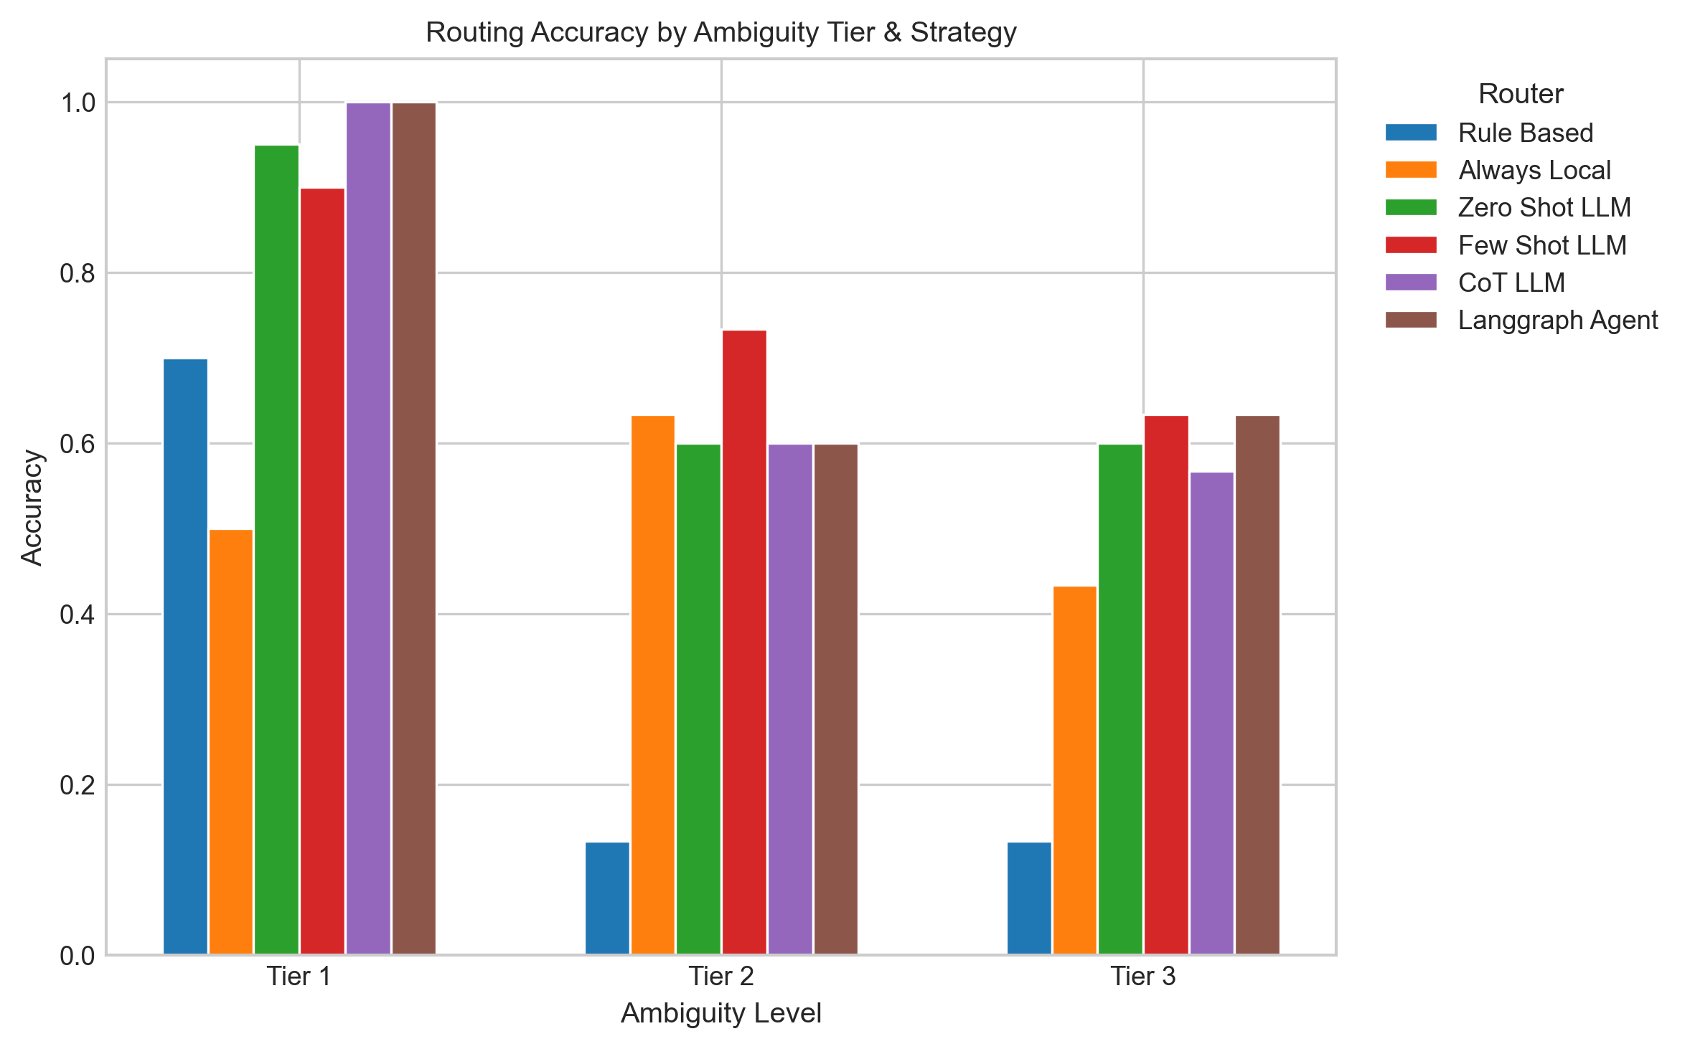
Results — Routing Accuracy by Ambiguity Tier
Sonnet 4.6 achieves the highest accuracy (84%) across all LLM-based strategies, followed by Gemma-3-27B (82%), GPT-4o-mini (79%), and LLaMA-3-8B (76%). Rule-based accuracy remains flat at 36% across all models.
All strategies degrade sharply from Tier 1 to Tier 2, with zero-shot dropping from 95% to 60% and few-shot from 90% to 73%. Rule-based collapses entirely at Tiers 2 and 3 (13%).
Model capability matters more than prompt strategy. Claude achieves 84% across all 3 prompt versions, adding few-shot or CoT changes nothing for strong models.

Slide 6
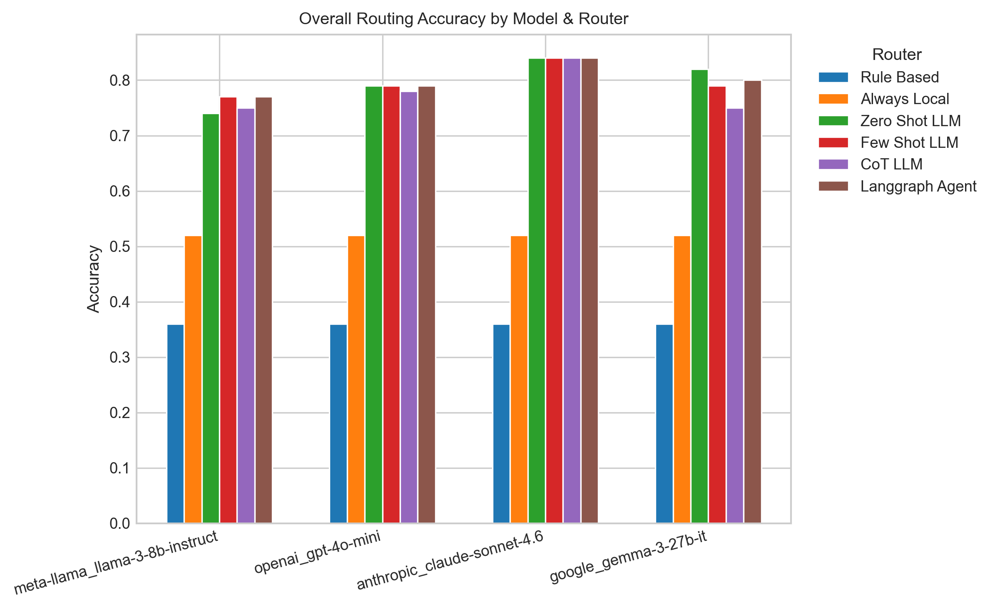
Model Comparison & Failure Patterns
Model Summary
Model
Overall
Tier 1
Tier 3
Claude Sonnet 4.6
84%
100%
63–73%
Gemma 3 27B
75–82%
90–98%
57–67%
GPT 4o mini
78–79%
98–100%
60–67%
Llama 3 8B
74–77%
90–100%
57–63%
Top Failure Modes
• Vague-Query Bias
Ambiguity is the Ceiling
Open-ended queries default to web even when the local 10-K has the answer
LLM-based routers achieve high accuracy on clear queries but routing accuracy degrades significantly as query ambiguity increases, dropping from 100% (Tier 1) to 73% (Tier 3) even for the strongest model (Sonnet 4.6). This demonstrates that query ambiguity, not model size or prompt strategy, is the primary bottleneck in agentic RAG routing.
• Local → Web Misroutes
Risk factors, KPIs, strategy queries sent to web search
• Temporal Confusion
'Early 2026' — annual filing vs. live market data ambiguity

Slide 7
Next Steps
Linguistic Failure Analysis
Final Report
Examine which specific query features drive mis-routes: • Missing temporal markers • Bare entity references (no verb, no scope) • Underspecified or open-ended queries Goal: Produce interpretable findings about what makes a query hard to route.
Full write-up covering: • Related work & background • System design & methodology • Full experimental results • Limitations & future work

Slide 8
Thank You

