Slide 1
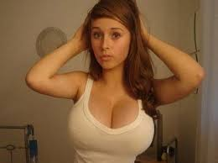
Clickbait Detection
10 Frames that will BLOW YOUR MIND
Thesis Meeting
19.05.2015
Sebastian Köpsel

Slide 2
Overview
General survey
Related work research
Started working with Twitter API
Started Machine Learning learning

Slide 3
General Survey
Clickbait
  Clickbait is a pejorative term describing web content that is aimed at generating online advertising revenue, especially at the expense of quality or accuracy, relying on sensationalist headlines to attract click-throughs and to encourage forwarding of the material over online social networks. Clickbait headlines typically aim to exploit the "curiosity gap", providing just enough information to make the reader curious, but not enough to satisfy their curiosity without clicking through to the linked content.
    src: http://en.wikipedia.org/wiki/Clickbait

Slide 4
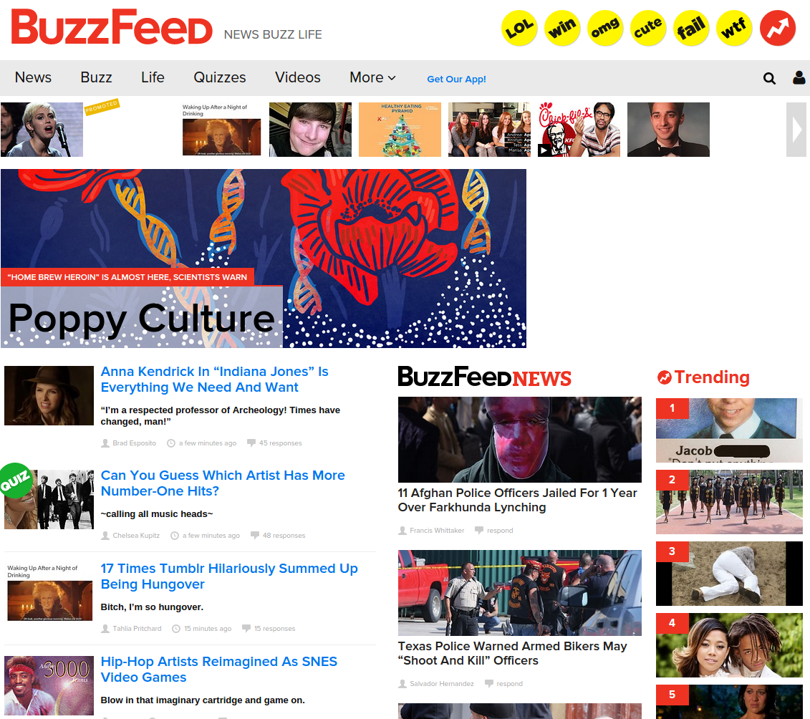
General Survey
List of notorious Clickbait pages
  upworthy.com
  BuzzFeed
  heftig.co (deutsch)
  viralnova
  likemag
List of partly clickbaity pages
  Fox news
  Huffington post
  New York Times
Non Clickbait Corpus
  Reuters

Slide 5
General Survey
List of relevant social media websites
  Facebook
  Twitter
  LinkedIn
  Reddit
  Pinterest
  Tumblr
  Google+

Slide 6
General Survey
Random Stuff I found
  Anti Clickbait Twitter Profiles
    @SavedYouAClick
    @EmbeddedVideo
    @HuffPoSpoilers
  Downworthy
  Clickbait Headline Generator

Slide 7
Related work research
I found nothing directly concerning Clickbait detection
I found a few related fields of research

Slide 8
Related work research
Text + Genre analysis/ classification
Buzzword detection
Spam detection
Plagiarism detection
(Advertisement)

Slide 9

Twitter API
Twitter API application
  With Java
  Using twitter4j
  Can read Stream, filters for URLs and expands t.co Links
Idea:
  We read Twitter global stream
  Search for shared links
  Store often shared ones to build training corpora

Slide 10
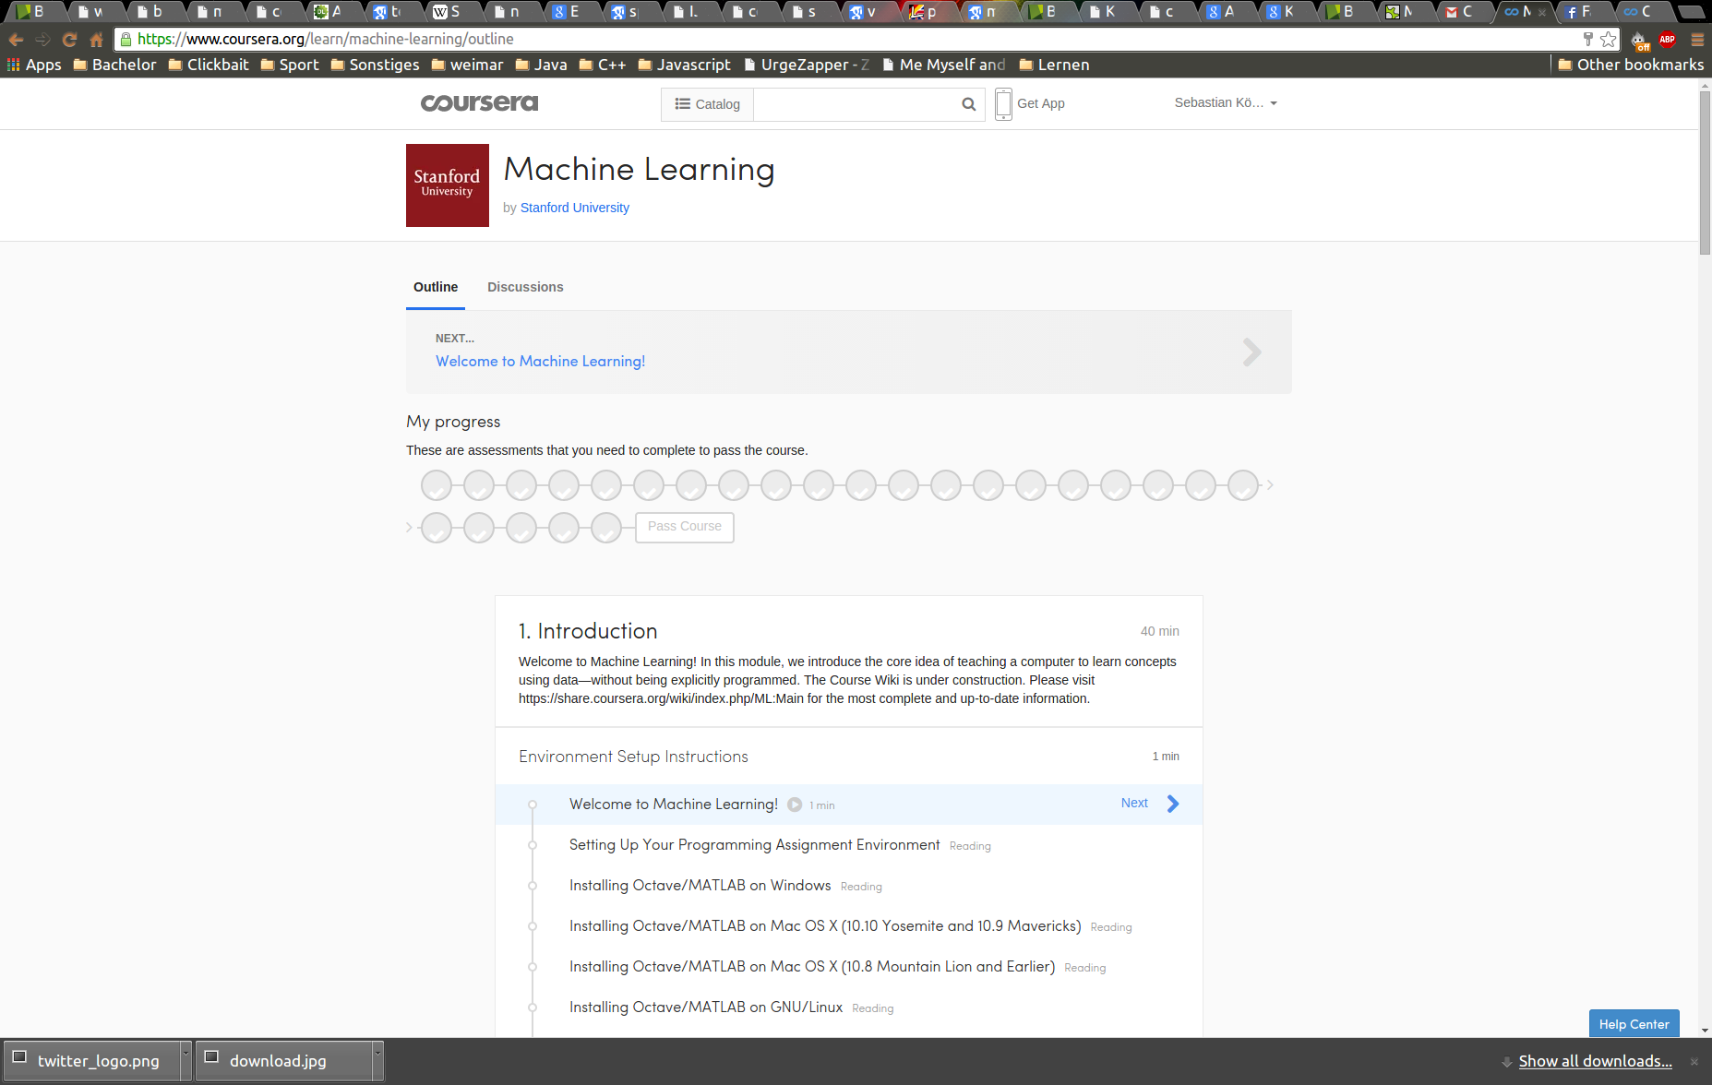
Machine Learning
Started reading introduction papers
Will do coursera course this week

Slide 11
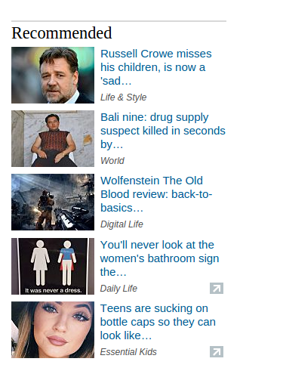
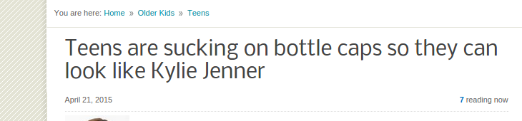
Conclusion
First ideas to detect Clickbait
  Common phrases
    Incomplete sentences with …
    Quizes-question marks
  Source pages
  Existence of social media button
  Use communities maybe from bloggers like Alison Gianotto(downworthy) to build corpus
  Plagiarism/ paraphrasing

