Slide 1
Thesis Meeting
03.07.2015
Sebastian Köpsel

Slide 2
Subcategories
Example subcategories:
  Listicle
  Gallery
  Video
  People
  News
  Opinion
  Expanation
  Health
  Music
  Fashion
  Explanation
  Animals
  Emotional Story
  Food
  Women
  IT
  Quiz
  Politics

Slide 3
Hierarchy
Classes
Aggressivness
Clickbait
“Clickbaity”
Serious
Type
Single
Reader Refering
Question
Opinions
People
…
Collection
Self Refering
Explanation
Topic
Politics
Animals
Emotional Stories
Food
Women
IT
Quizzes
.
.
.
Health
Music
Fashion

Slide 4
Expamples
Listicle Gallery | 10 most expensive wars in U.S. history
Question | Can lemon water really help you lose weight?
Explanation | An expert explains why it is so hard to hold Baltimore police accountable
Emotional Story | A Fatal Accident Is All The More Tragic -- Because It Could Have Been Avoided
Fashion | Channel your inner vintage swimsuit babe this Memorial Day Weekend

Slide 5
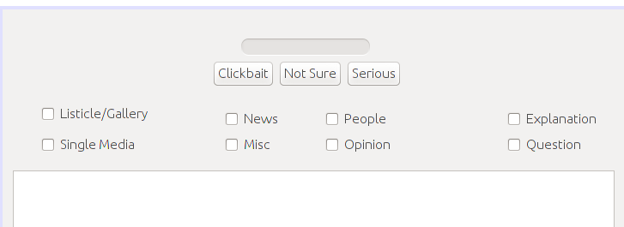
GUI Proposal I
Progress bar
Class annotation
Subcategories

Slide 6
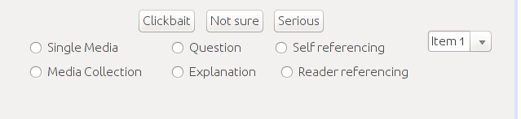
GUI Proposal II
Additional topic selection
Type
Possible addition: aggressiveness scale

Slide 7
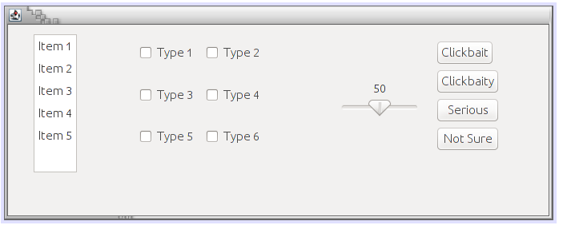
GUI Proposal 3
Final annotation
Topic
Type
Aggressivness scale

