Slide 1
Thesis Meeting
09.06.2015
Sebastian Köpsel

Slide 2
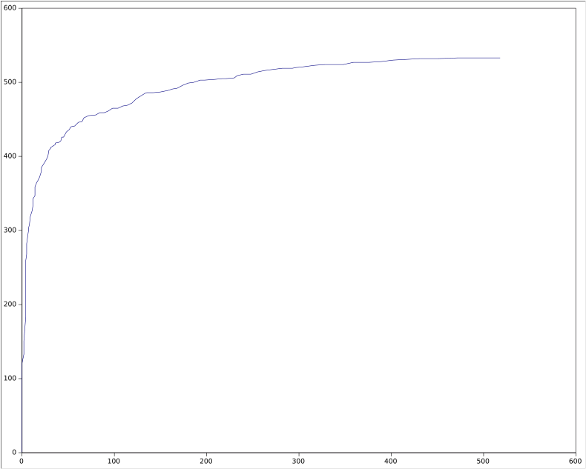
Overview
More Features
Data stuff yesterday

Slide 3
Amount-of-features
Dots
Words
NonstopWords
Stopwords
Syllables
Senteces

Slide 4
Has-Features
Questionmarks
Exclamationmarks
Numbers
Symbols
(Sensitve content)

Slide 5
Other Features
Ratio Stopworte zu allen Worten
User von dem der tweet ist
Testing vs Wordlists
  Self reference(I, mine, me etc.)
  Reader reference(you, your etc.)
  Affectwords
  Animals
  Abbreviations

Slide 6
Other Features
Maincontent length of associated Webpage
Type of media
Mentioned Users
Sentiment Feature - SentiWordNet 3 and StanfordCoreNlp
Readability
Max word length

Slide 7
Weka Results
Procedure
  All Features
  StringToWordVector with word 3-gramms
  Х² to reduce number of attributes to 100
  Balanced corpus

Slide 8
Results
 | J48 | Logistic Regression | Random Forrest | Naive Bayes
Accuracy in % | 83.6 | 86.7 | 85.9 | 85.1
ROC Area Weighted Avg. | 0.866 | 0.936 | 0.928 | 0.918

