Slide 1
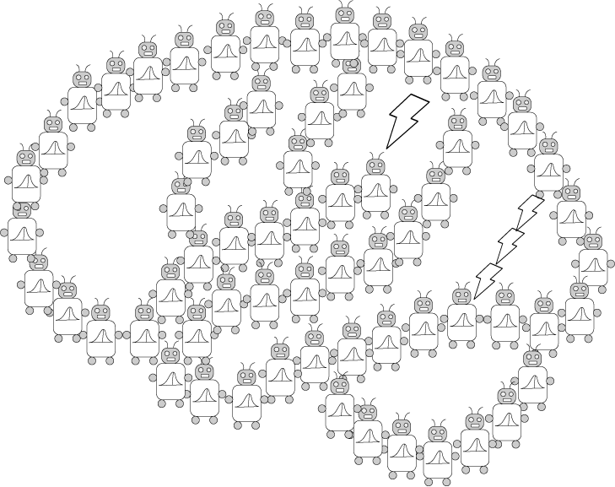
Basic Bayes and Judgment
PSYCH/COMP SCI/BMI 841: Computational Cognitive Science
Joseph Austerweil
January 23, 2025

Slide 2
Foundations in probability
Definitions: Set, outcome set/space, size, event, event set/space, random variables, and probability.
More on probability
Joint probability
Conditional probability as set restriction
Traditional definition of conditional probability
Marginalization and proving Bayes rule
Intuitive Bayes
Human judgment and heuristics and biases
Conclusions

Slide 3
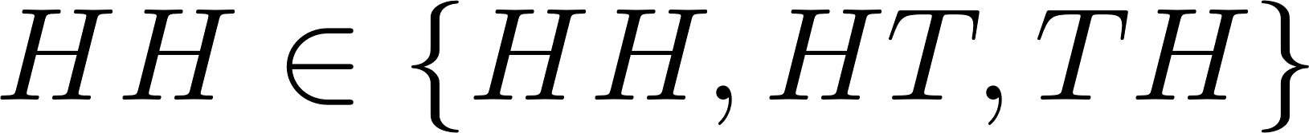





Foundations of Probability
A set is an unordered collection of items and its elements are unique.
So, {{HH, HT}, {HH, HT}, {TT}} = {{HH, HT}, {TT}}
Outcomes are either in or out of a set.
“in” operator
“not in” operator
Notes:
Event space a technicality needed for

Slide 4

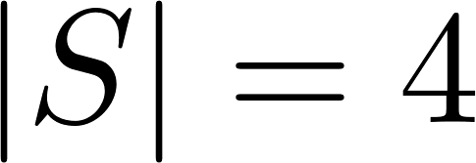





Foundations of Probability
Outcome set/space: Set/space of possible outcomes for all variables
E.g., For an outcome set of two coin flips:
S = {HH, HT, TH, TT}
is the cardinality or size of a set.
E.g., because there are 4 elements.
Event: a set of outcomes.
E.g., “at least one head” = {HH, HT, TH}
Event space: Set/space of events
E.g., E = { {HH, HT}, {HH, HT, TH}, {HH}, {} }
Start and end a set
Empty or null set
(set with no items)
Notes:
Event space a technicality needed for

Slide 5
Foundations of Probability
Event set/space: Set/space of events
E.g., E = { {HH, HT}, {HH, HT, TH}, {HH}, {} }
For finite outcome sets, all possible events is often the event space.
E = { {}, {HH}, {HT}, {TH}, {TT}, {HH, HT}, {HH, TH}, {HH, TT}, {HT, TH}, {HT, TT}, {TH, TT},
{HH, HT, TH}, {HH, HT, TT}, {HH, TH, TT},
{HT, TH, TT}, {HH, HT, TH, TT} }
For continuous outcomes, the word “space” is typically used instead of set. The math gets trickier.
We will discuss this more next week.
Notes:
Event space a technicality needed for

Slide 6



Foundations of Probability
A random variable is a function from the sample space to (an) event space.
E.g., Let Y be at least one of two coinflips is Heads.
It takes an outcome (e.g., HT) and puts it in its event space. What is the event space here?
{True, False} = {T, F}
Definition: A probability counts the number of outcomes that fall into one value as opposed to the number of possible outcomes.
What is the probability that Y = True, P(Y = True), or P(Y = T) or P(Y)?
HH HT
TH TT
Notes:
Event space a technicality needed for

Slide 7
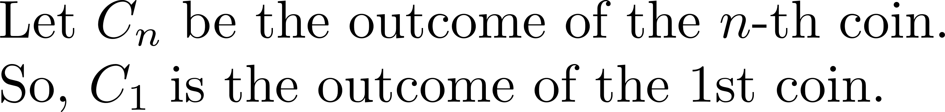

Foundations of Probability
First definition: A probability counts the number of outcomes that fall into one value as opposed to the number of possible outcomes.
What is the probability that the first coin is heads?
Notes:
Event space a technicality needed for

Slide 8



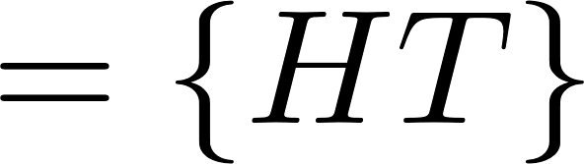



Foundations of Probability
Joint probability: What is the probability of two (or more) random variables have particular values (or satisfy some condition) for the same outcome?
E.g., what is the probability that the first coin is heads and the second coin is tails?
“Intersects” or “AND”
(what’s in both sets)
Notes:
Event space a technicality needed for

Slide 9










Foundations of Probability
Conditional probability: What is the probability of one or more variables having some values given one or more other variables have some other values?
It is the probability of the first random variable(s) when the universe of discourse is the set of outcomes that satisfy the second random variable(s).
E.g., what is the probability of the second coin being tails given the first coin was heads?
1/2
HH HT
TH TT
Notes:
Note the other one was ¼…..

Slide 10
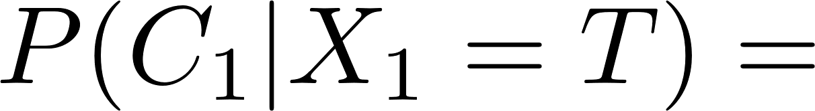

More on Conditional Probability
Outcome set/space: Set/space of possible outcomes for all variables (worlds)
E.g., Outcome set for two coin flips:
S = {HH, HT, TH, TT}
Remember our variables:
What is the probability that the first coin is heads given there was at least one heads?
HH HT
TH TT
2/3
Notes:
Event space a technicality needed for

Slide 11
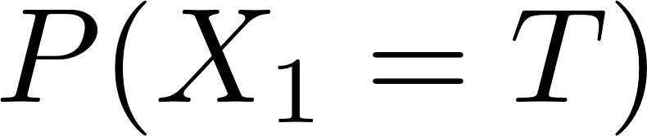



Conditional Probability Redux
What is the probability that the first coin is heads given there was at least one heads?
Boring definition of conditional probability*:
HH HT
TH TT
2/3
HH HT
TH TT
3/4
Notes:
Event space a technicality needed for

Slide 12







Marginalization
If you have two random variables, X₁ and C₁, and you are interested in the probability of just X₁ having a value (True), you can calculate it by adding over the joint probability of X₁ having that value and each value of C₁.
Sum
Values summed over
HH HT
TH TT
HH HT
TH TT
Notes:
Event space a technicality needed for

Slide 13
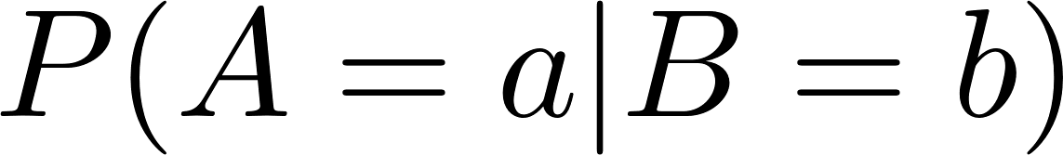
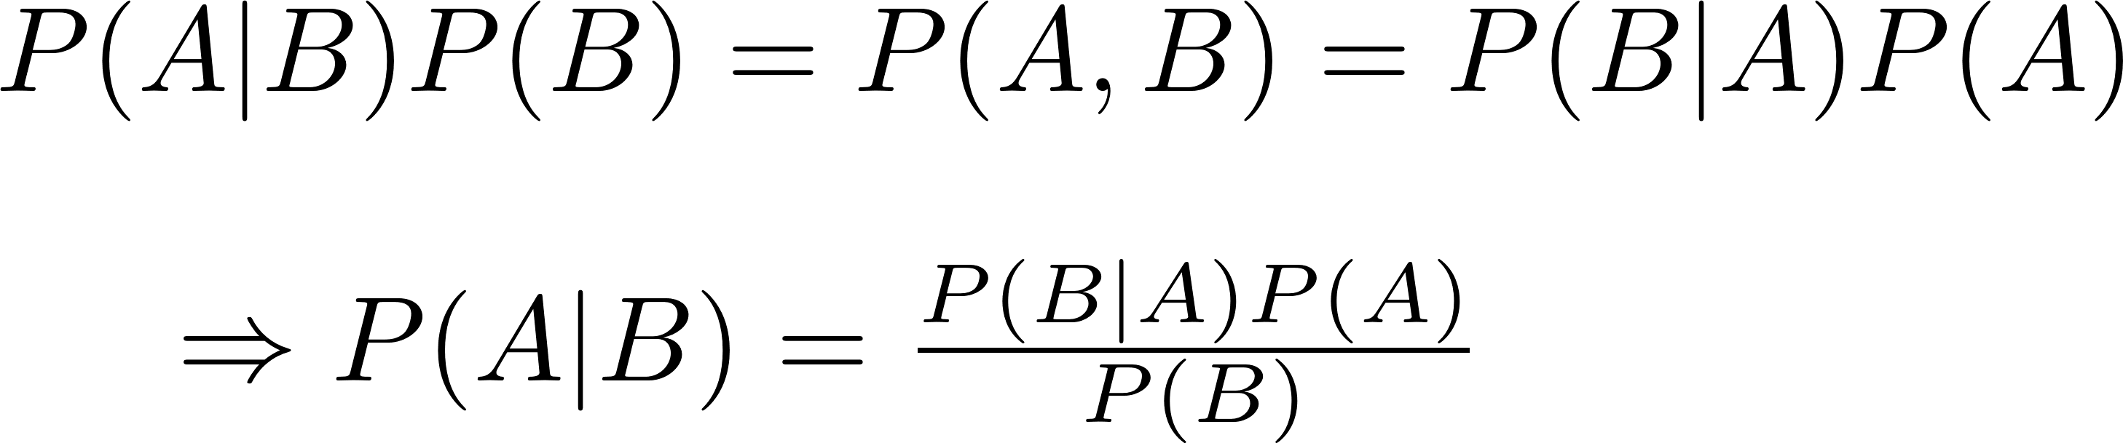






Proving Bayes’ Theorem
Recall one definition of conditional probability:
For two random variables A and B, the cond. prob. of A given B is
The cond. prob. of B given A is
Product rule
Thinking generatively…
Notes:
Event space a technicality needed for

Slide 14
Foundations in probability
Definitions: Set, outcome set/space, size, event, event set/space, random variables, and probability.
More on probability
Joint probability
Conditional probability as set restriction
Traditional definition of conditional probability
Marginalization and proving Bayes rule
Intuitive Bayes
Human judgment and heuristics and biases
Conclusions

Slide 15
In a dark and depressing world...
You have a 50 year-old friend who has been a chain smoker since they were 18.
There’s a nasty cold going around.
You go over to their house to bring them soup.
You hear them cough.
You know that they’re sick, but you don’t know what it is.
You’ve limited it to three possibilities:
A cold, a stomach virus, or lung cancer
How likely is each?
Notes:
Enter probability theory to save the day!

Slide 16
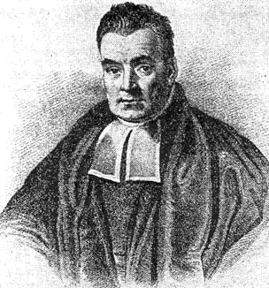
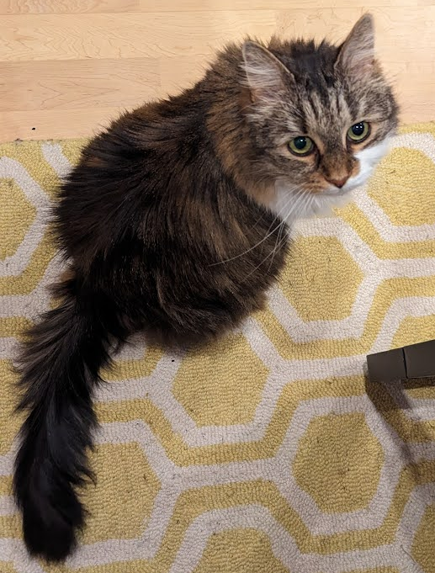
In a dark and depressing world...
I’ve got a rule to help!
I used it to try to prove G-d exists. It made me feel better.
Turns out that it’s really useful for other stuff too, but I didn’t figure that out!
For you to use it, you’ll need to learn to write probabilities carefully.
Math is so cool! Try this at parties.
You have a 50 year-old friend who has been a chain smoker since they were 18.
There’s a nasty cold going around.
You go over to their house to bring them soup.
You hear them cough.
You know that they’re sick, but you don’t know what it is.
You’ve limited it to three possibilities:
A cold, a stomach virus, or lung cancer
How likely is each?
Reverand Thomas Bayes
(1701-1761)
I’m unimpressed.
Please feed me treats.
Notes:
Enter probability theory to save the day!

Slide 17
Writing probabilities
d is a hidden property you don’t get to observe.
E.g., disease, emotions, goals...
Notes:
Enter probability theory to save the day!

Slide 18
Writing probabilities
d is a hidden property you don’t get to observe.
E.g., disease, emotions, goals...
o is what you observe in the world
E.g., coughing, punching, grabbing milk, ...
P(d = lung cancer) means the probability of lung cancer
“prior probability”
P(d = lung cancer | o = cough) means the probability of lung cancer given you know (things to right of “|”) that the person coughed.
“posterior probability”

Slide 19
Writing probabilities
d is a hidden property you don’t get to observe.
E.g., disease, emotions, goals...
o is what you observe in the world
E.g., coughing, punching, grabbing milk, ...
P(d = lung cancer | o = cough) means the probability of lung cancer given you know (things to right of “|”) that the person coughed.
“posterior probability”
P(o = cough | d = lung cancer) means the probability of coughing given you know (things to right of “|”) that the person has lung cancer.
“likelihood”

Slide 20
Bayes’ rule
Prior
probability
Likelihood
Posterior
probability
Total
probability
Sum over diseases
Given you hear your friend cough, what is the probability that she has…
for

Slide 21
Bayes’ rule via word math
likelihood
prior
posterior
high
medium
high
low
medium
low
high
very low
low/medium
To get actual probability, you divide each of these by their sum (normalization).
Notes:
Get people to fill in these pieces.

Slide 22
Bayes’ rule
likelihood
prior
posterior
0.9
0.45
0.1
0.45
0.9
0.1
To get actual probability, you divide each of these by their sum (normalization).

Slide 23
Bayes’ rule
likelihood
prior
posterior
0.9
0.45
0.405
0.1
0.45
0.045
0.9
0.1
0.090
To get actual posterior, you divide each of these by their sum (normalization).
0.405 + 0.045 + 0.090 = 0.54

Slide 24
Bayes’ rule
likelihood
prior
posterior
0.9
0.45
0.405/0.54 = 0.75
0.1
0.45
0.045
0.9
0.1
0.090
To get actual posterior, you divide each of these by their sum (normalization).
0.405 + 0.045 + 0.090 = 0.54

Slide 25
Bayes’ rule
likelihood
prior
posterior
0.9
0.45
0.405/0.54 = 0.75
0.1
0.45
0.045/0.54 = 0.083
0.9
0.1
0.090/0.54 = 0.167
To get actual posterior, you divide each of these by their sum (normalization).
0.405 + 0.045 + 0.090 = 0.54

Slide 26
Bayes’ rule
Posterior
likelihood
prior
h can be... the
Height of an object
Sound produced by a speaker
Time for an event to complete
Graduate student specialization
Engineer/Lawyer
GPA of student
Why is this controversial as a framework for studying the mind?
Notes:
To understand the psych literature, this is essential to understand...

Slide 27
Foundations in probability
Definitions: Set, outcome set/space, size, event, event set/space, random variables, and probability.
More on probability
Joint probability
Conditional probability as set restriction
Traditional definition of conditional probability
Marginalization and proving Bayes rule
Intuitive Bayes
Human judgment and heuristics and biases
Conclusions

Slide 28
What is reasoning and why do it?
What is reasoning?
Inferring from the known to the unknown. Called an inference
“Going beyond the information given”
What is the goal of reasoning?
To acquire information that supports adaptive behavior
Why is this hard?
Too much info.: problem of deciding which information is relevant.
E.g., There are small objects at the bottom and top of a hill.
What will happen? Does it matter what the objects are? Their states? The time of day? Whether there are other objects?...
Too little info.: inferences are often underdetermined (more than one solution)...
E.g., state of the world given retinal image (visual illusions)...
Notes:
Harder than physics!

Slide 29
Deduction and Induction
If the Prof. is great, then I am enjoying class.
The Prof. is great
I am enjoying class.
Deduction
Object 1 is a Swan and it is White
Object 2 is a Swan and it is White
Object 3 is a Swan and it is White
If X is a Swan, then it is White
Induction
Deduction = conclusions guaranteed to be true
Induction = conclusions likely to be true

Slide 30
Deduction vs. Induction
Deduction
Preserves truth
Depends on form, not on content
Logic
Induction
Confers probability
Depends on form and on content
Probability theory
“Normative theories”
Specify how one should make inferences
“Descriptive theories”
Describe how people in fact make inferences

Slide 31
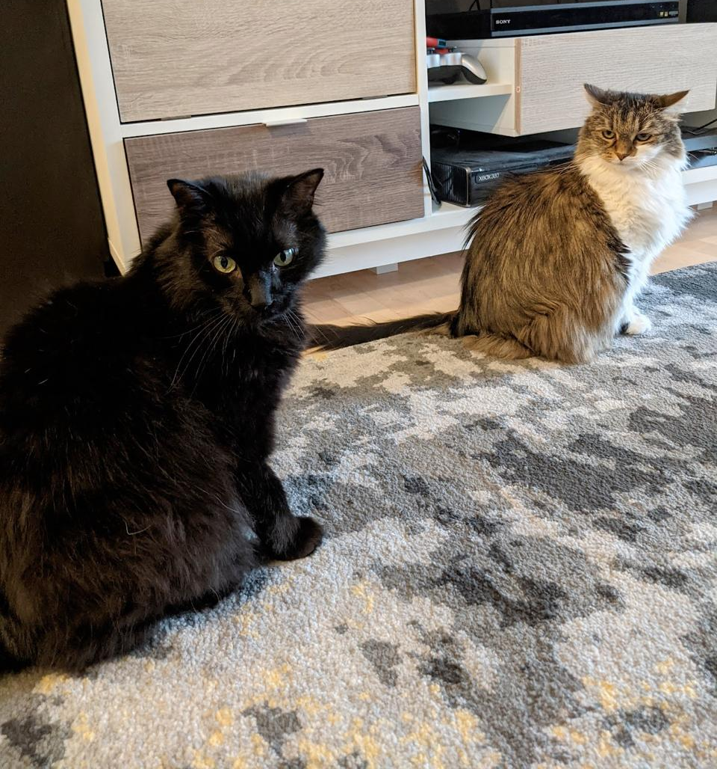
Judgment
Judgment is the subjective/intuitive evaluation of an event. Often its probability (this is inductive reasoning)
E.g. How likely is it that:
“the defendant did it”,
“I will win if I gamble”,
“I will get cancer if I smoke”,
“Aubrey Plaza will go out with me”
Why is this important?
We should make decisions based on likely events caused by the decision and the value of those events.
It’s Thursday at 6pm. Should you study for your exam tomorrow or go out with your friends?

Slide 32
Two cab companies operate in a given city, the Blue and the Green (according to the color of cab they run).
85% of the cabs in the city are Green,
and the remaining 15% are Blue.
A cab was involved in a hit-and-run at night.
There was a witness.
The witness is able to correctly identify the color of a cab at night 80% of the time.
A witness identifies the cab as a Blue cab.
What is the probability that the cab is Blue?
(Kahneman & Tversky, 1972; Bar-Hillel, 1980)
Notes:
Data is witness; hypothesis is cab being blue…

Slide 33
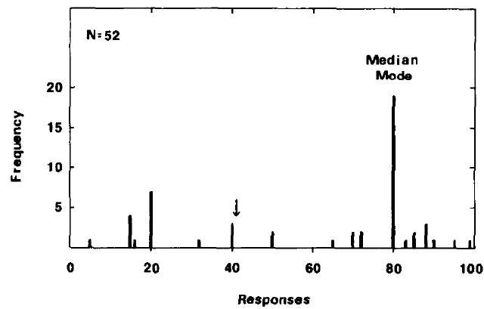
Base-rate neglect
Participants report the likelihood and neglect integrating the prior.
Remember that they should be multiplied together… (0.8 x 0.15 is numerator)
Correct Answer
Medical doctors/residents also fail at this, even in the context of medical diagnosis (Casscells, Schoenberger, & Grayboys, 1978).
(Kahneman & Tversky, 1972; Bar-Hillel, 1980)
Notes:
Arrow is correct answer.

Slide 34

Heuristics and biases
Daniel Kahneman
Amos Tversky
Won Nobel prize in economics despite never taking a single course!
101st greatest Israeli ever!
MacArthur Genius Fellowship and many other awards.
Would’ve won Nobel prize too if he hadn’t passed away in 1990s.
Notes:
Danny won nobel prize based on their work together on prospect theory. One of my late advisors spoke of Tversky as the most intelligent man he had ever met in his life.

Slide 35
Heuristics and Biases for Cognition
Our cognition (incl. maps) tend to be accurate
Errors usually reflect using reasonable strategies that are inappropriate in situations that are not ecologically valid.
Bias is knowledge that produces errors because it is used by the mind when it may or may not be appropriate or applicable.
A heuristic a rule of thumb or general problem-solving strategy that typically provides good solutions, but may contain biases.

Slide 36
Getting the correct answer: Depicting the situation (Witness said blue)
Answer is area of yellow relative to area of red.
Witness is right
Green cabs = 85%
Blue cabs = 15%
Witness correct = 80%
Witness incorrect = 20%
Witness is wrong

Slide 37
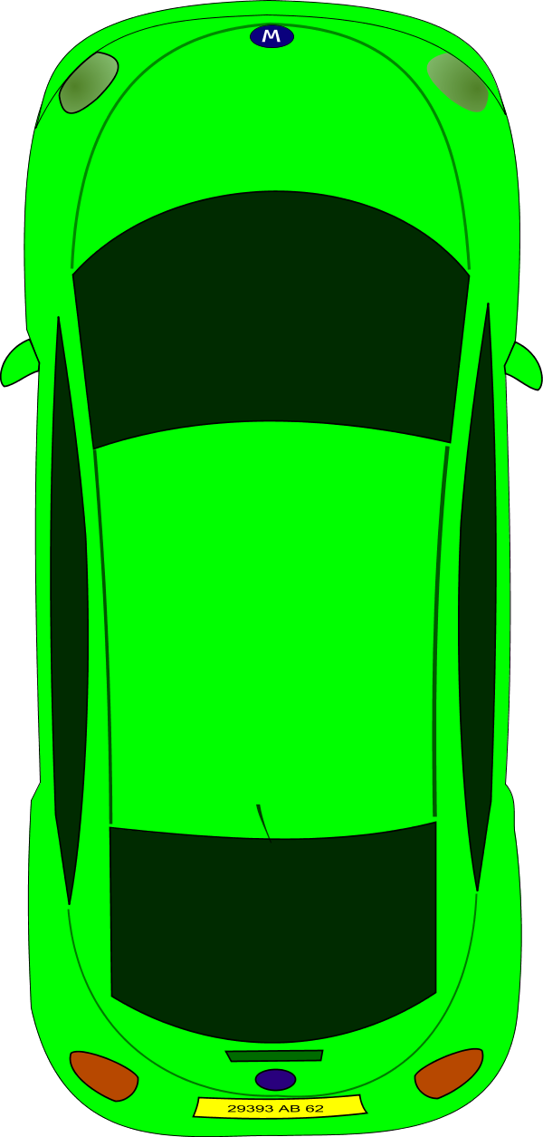
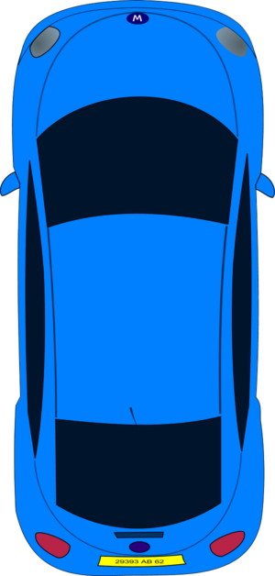
Getting the correct answer: Another depiction
85 of 100 Green
15 of 100 Blue
80% of 15 is 12
All the cabs in the city

Slide 38
Getting the correct answer: Another depiction
20% of 85 is 17
85 of 100 Green
15 of 100 Blue
80% of 15 is 12
All the cabs in the city

Slide 39
Getting the correct answer: Another depiction
20% of 85 is 17
85 of 100 Green
Probability of the cab being blue given the witness said it is blue is
12/(12+17) = 12/29 = 41%
15 of 100 Blue
80% of 15 is 12
All the cabs in the city

Slide 40
Bayes’ rule… again
Step-by-step:
Identify the “disease” and “observation” for the problem.
Use information given to define likelihoods (P(o|d) for each d) and priors (P(d) for each d).
Calculate numerators for each d.
Calculate the denominator for all diseases by summing the numerators (one disease must have produced the observation).
Divide the numerators by the denominator to be probabilities.

Slide 41
Bayes’ rule... again!
Observation: Witness reports blue (W = b) (correct 80%) “Diseases”:
B (the cab in the accident was blue) 15% Prior
G (the cab in the accident was green) 85% Prior
Slightly more likely to be Green despite witness saying blue!
Normalize: denominator = 0.12 + 0.17 = 0.29
(Kahneman & Tversky, 1972; Bar-Hillel, 1980)
Notes:
Data is witness; hypothesis is cab being blue…

Slide 42
Foundations in probability
Definitions: Set, outcome set/space, size, event, event set/space, random variables, and probability.
More on probability
Joint probability
Conditional probability as set restriction
Traditional definition of conditional probability
Marginalization and proving Bayes rule
Intuitive Bayes
Human judgment and heuristics and biases
Conclusions

Slide 43
Bayesianism
Bayesian inference is the mathematics of inductive problems.*
Steps to forming a Bayesian model:
1. Formalize the problem that people face.
2. Formalize the types of knowledge people have when solving the problem.
3. Apply Bayes’ rule and see what an ideal learner/observer would learn from the data.
4. How does the ideal learner behave?
5. What types of knowledge (*and/or constraints on learning) must be assumed for the model and people to behave similarly?
Notes:
Ask class how does this fit with hyp. space & prior?

