Slide 1

Introduction
PSYCH/COMPSCI/BMI 841: Computational Cognitive Science
Joseph Austerweil
January 23, 2025
Notes:
Start with an idea of what the class is about and then a short break and talk about some administrative things

Slide 2
Deductive and inductive
The problems that people excel relative to machines are inductive problems.
They feel easy to solve, but REALLY HARD!
Deductive
1 + 4 = ?
Inductive
? + ? = 5
Inductive problems involves going from observed data to underdetermined answers.
Requires knowledge of the rules of the system, but also expectations about possible answers

Slide 3
Visual illusions
http://web.mit.edu/persci/people/adelson/checkershadow_illusion.html
Notes:
A and B are same color

Slide 4
Perception and induction
? + ? = 5
square color + shadow = intensity
Your visual system solves this inductive problem, using rules about how retinal images are generated, and some expectations about color and shadow

Slide 5
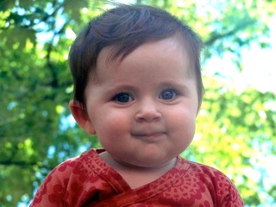
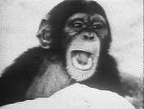
Learning language
data: utterances produced by people
hypotheses: all possible ways of combining sounds

Slide 6
The poverty of the stimulus
Utterances do not contain enough information to determine a language.
What are the rules of the system, and expectations about answers that humans have?
Noam Chomsky

Slide 7

Speech recognition
data:
hypotheses: speech sounds
accent of speaker
segmentation into words
How can human children go from raw sound to the structured representations required to understand and learn language?

Slide 8
Interpreting sentences
data: “The woman hit the man with the umbrella.”
hypotheses: what actually happened?
Notes:
Does everyone see the two interpretations?... (parsing)

Slide 9
Interpreting sentences
“The woman hit the man with the hammer.”
data: “The woman hit the man with the umbrella.”
“The woman hit the man with the mustache.”
hypotheses: what actually happened?
How do people integrate expectations about the world with syntactic rules to interpret sentences?

Slide 10
Inferring mental states
https://www.youtube.com/watch?v=VTNmLt7QX8E
(Heider & Simmel, 1958)

Slide 11
Inferring mental states
data: behavior of others
hypotheses: goals and beliefs
Are there rules that describe how we expect goals and beliefs to relate to behavior?
Expectations we have about the goals and beliefs of others?

Slide 12
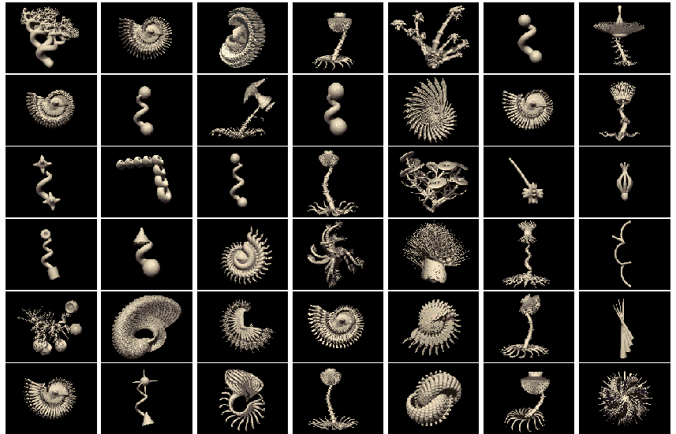
Learning new concepts
“tufa”
“tufa”
“tufa”

Slide 13
Learning new concepts
data: examples
hypotheses: possible sets of objects,
or ways of describing those sets
Are there rules that describe how we expect examples to relate to concepts?
What are the expectations we have about good concepts?

Slide 14
Learning words
“jumbuck”
Notes:
Driving in Australia outback with native…
Rabbit
Dinner
Rabbit before t, dinner after
Undetached rabbit parts
Momentary rabbit-stage
Mass of rabbithood
Temporal cross-section of a four-dimensional space-time extension of a rabbit

Slide 15
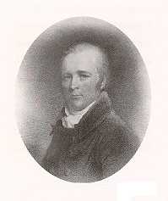
Scientific Discovery and Causal Learning
“The contagion spread rapidly and before its progress could be arrested, sixteen persons were affected of which two died. Of these sixteen, eight were under my care. On this occasion I used for the first time the affusion of cold water in the manner described by Dr. Wright. It was first tried in two cases ... The effects corresponded exactly with those mentioned by him to have occurred in his own case and thus encouraged the remedy was employed in five other cases. It was repeated daily, and of these seven patients, the whole recovered.”
Currie (1798)
Medical Reports on, the Effects of Water, Cold and
Warm, as a Remedy in Fevers and Febrile Diseases

Slide 16
Scientific Discovery and Causal Learning
Treated
Untreated
Recover
7
7
Die
0
2
“Does the treatment cause recovery?”

Slide 17
Inferring causal relations
data: interaction between objects
hypotheses: existence of causal relation
Are there rules that describe how we expect causes to relate to effects?
When do we think causal relations likely, and what properties do we expect?

Slide 18
The big questions
1. How does knowledge guide learning, inference, and decision-making from sparse, noisy or ambiguous data?
2. What are the form and contents of this knowledge?
3. How is this knowledge itself learned?
4. How do we balance constraint and flexibility, assimilating new data to our current model versus accommodating our model to the new data?
5. How can accurate inductive inferences be made efficiently, even with complex hypothesis spaces?

Slide 19
A strategy: Reverse engineering
Specify computational problems
Identify ideal solutions to these problems
Examine how well these solutions account for human behavior.
See how well they work for machine learning.

Slide 20
Outline for rest of class
Administrative Matters
Short Interlude
Basic Bayes

Slide 21
Now administrative matters...

Slide 22
Office hours
Joe: Tu 2-3pm zoom via Canvas
Also by appointment (in-person possible)
Life update
Email policy
I will do my best to respond to emails within 36 hours (48 hours if you send it late Friday or over the weekend).
Please do your best to keep them clear and concise.

Slide 23
Course topics
Cover parallel developments in human and machine learning
We will primarily focus on probabilistic models, but we will spend a few weeks on deep learning too.
(your project does not have to – more on that later).
Topics:
- Graphical models/Bayesian networks
- Hierarchical Bayesian models
- Markov chains/Foraging
- Reinforcement learning/Social reasoning/Communication
- Approximation: [Markov chain] Monte Carlo
- Bayesian nonparametrics
- Ethics/Prejudice in ML
- Deep learning and hybrid models

Slide 24
Course learning goals
Students who successfully complete the class will be able to
understand state-of-the-art machine learning techniques.
create a probabilistic model of a problem solved by the human mind (hopefully one relevant to your research interests).
analyze how model assumptions (explicit or implicit) enable learning.
think critically about the role of computational modeling in explaining human behavior.

Slide 25
Prerequisites
Prior experience with computational modeling and computer programming is required.
Most supported: Python
Supported: R
Legacy very supported: Matlab
Next support (in-progress): Julia
Other languages: I have coded many languages and likely will be able to help, but I can’t guarantee it.
Prior familiarity with linear algebra and probability theory is highly recommended.
Notes:
And also a project at the end if appropriate and there is time...

Slide 26
Typical Class Flow
This and the next two weeks will be atypical.
Today’s class is mostly Joe lecturing.
If time, we will do class introductions.
Weeks after that will be typical:
First half of class will be Joe lecturing.
Second half will be two student presentations and discussion.
Next week will be closer to typical. Joe will lecture for most of class, but will have more discussion.
Third week will be very atypical because Joe will be in Japan.
It will be completely async.
Notes:
And also a project at the end if appropriate and there is time...

Slide 27
Optional Sections?
To be discussed with class for interest
People have very different backgrounds in the class. To avoid as many bored stares, the purpose of this optional section is
reviewing math that went fast during class.
going through programming tutorials together.
etc
I answer questions that you have about math and programming.
They evolve into extra office hours often.
Some were recorded already and accessible to watch.
Rest of lecture today will have some of this.

Slide 28
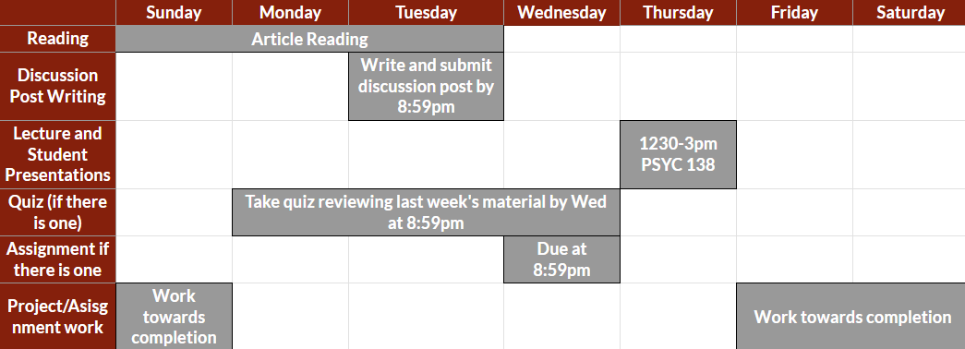
Typical Weekly Rhythm

Slide 29
Grading/Requirements
No required. Recs:
If you are concerned about catching up on probabilistic modeling, this book is a good one to look at:
Kruschke (2016). Doing Bayesian data analysis
If you want a book as reference, two good ones are:
Murphy (2012) Machine Learning: A Probabilistic Perspective
Goodfellow et al. (2016): Deep Learning
Requirement | Percentage of final grade
Discussion posts | 5% (5x1% each)
Assignments | 16% (1&2=4%, 3=6%, & 4 = 2%)
In-class discussion | 5%
In-class presentations | 10%
Project proposal | 10%
Final project presentation | 7.5%
Final project proposal | 30%
“Weekly quizzes” | 16.5%

Slide 30
Discussion Posts (5% total = 1% each)
You are expected to submit a (50-200 word) reaction to the reading for the week on the discussion board.
NOT A SUMMARY.
Should focus on one paper.
These are due by 8:59pm on Tuesday of each week.
The first one is due on 02/03 and last one is due on 04/21.
You are only required to do 5 of the 11 posts.
They are pass/fail and submitted through Canvas.

Slide 31
Assignments (16% total)
4 shortish mathematics/coding assignments
Submit through Canvas
Goal to solidify knowledge of computational topics from class.
As a course, I will mainly support Python and R:
Legacy Matlab support is available
I’m hoping to add Julia to the list.
Resources for them have been posted on Canvas.
You can use other programming languages, and I will still try to help. But, I might not be able to.
#3 is harder and longer than rest, so it’s worth 1.5x.
#4 is on RL, which has more helping code than the others.
Notes:
Poll class for Matlab tutorial...

Slide 32
Class presentations (2x 5% each)
Present the major results of one of the course readings.
Must be a non-optional reading.
Also, have 4-6 discussion questions at the end.
These should guide discussion.
Being controversial/provocative is encouraged!
Have to give two if you are taking the course for credit.
One if formally auditing.
Each presentation (including discussion) should be no longer than 25 minutes.
You are encouraged to meet with me beforehand.
Must submit to me on Canvas right before or after (8:59pm day of presentation deadline)!

Slide 33
Class presentations (2x 5% each)
Grade is determined by the following factors:
Understanding of the paper (2 pts)
Covering the key aspects of the paper (1 pt)
Presentation clarity (1 pt)
Appropriate discussion questions (0.5 pts)
Appropriate use of time (0.5 pts)
Not using Prezi (10⁹⁹⁹ deduction and have to clean up)
See guidelines and tips document posted online.

Slide 34
Class presentations (2x 5% each)
Focus on the following questions:
1. What is the question that this paper explores? If applicable, what aspect of human behavior are we trying to understand?
2. Any background/context for the paper? Previous work?
3. What is the underlying computational problem being solved? How does the paper formulate it?
4. What is the solution to the computational problem? (Go for intuitions more than rigor.)
5. How is the solution used to answer the question? How does it compare to other approaches/human behavior?
6. What conclusions can we draw from the results? What is your interpretation?
Notes:
JOE : GO THROUGH papers in syllabus after this.

Slide 35
Class project (47.5% total)
Opportunity for you to explore a question related to human and machine learning that YOU are interested in.
Different people have different backgrounds, and you should draw on your strengths and interests.
You do not not have to use a topic or technique from class.
(non-exclusive) Categories of topics:
Experiment: Conduct an experiment that tests a prediction of a model from class (or simple extension).
Modeling/ML: Take some human behavior (results from class or scraped data from the Internet) and model it using your own or an advanced ML method.
Math: Math analysis of learning problems/models.
Notes:
Example projects: modeling a simplified version of spit/bs. Statistical decision theory analysis of adversarial reasoning (with human experiments).
Example for math: ecological rationality proofs. Bayes-NN proofs.
Grad students expected to do a bit more (go for preliminary version of a conference paper)

Slide 36
Project proposal (due 03/12 at 8:59pm)
1 page (single-spaced) with four sections:
Background. Identify the topic of your project and briefly provide some context to the project. Summarize any previous research on the topic.
Question. State the question examined by your project.
This should be 1-2 sentences (possible points off for more)
Method. Briefly describe the method you are going to use. Give some of the concrete details behind your experiment procedure, modeling approach, data analysis, or math.
References. Have at least three references cited.
Only one reference can be a paper from class.
Worth 10 points; Pass/Fail
Notes:
Reasonable fonts/margins
Submit through Canvas

Slide 37
Project presentations (in-class 05/01)
Goal is to give everyone an opportunity to see the awesome things everyone has done for their projects!
Not expected to have finished your project, but have some preliminary results (beyond the proposal).
At most 10 minutes long.*
Aim to communicate four things:
Background. Previous work to understand your Q.
Question. The question you examine.
Method. The method you used (or are going to use)
Results. Preliminary results you have obtained.
Worth 7.5 points
Submit on Canvas by 8:59pm 05/01.
Notes:
Reasonable fonts/margins
Submit through Canvas

Slide 38
Final paper (due 05/06 at 8:59pm)
~6 pages single-spaced.
No strict guidelines, but recommendations on Canvas.
Most important factor is to motivate and present your results in a clear and succinct manner.
More details later on in class.
Submit through Canvas.
Worth 30 points.
Notes:
Reasonable fonts/margins
Submit through Canvas
Remember points/percentage interchangeable.

Slide 39
Lateness policies:
Discussion posts: No late posts. Post a different week.
Assignments: Three “free” days which you get to use throughout the semester. Can be distributed in any manner. Not prorated (12 hours late -> 1 day late; 25 hours -> 2 days).
Afterwards, 20% off assignment per day late (not prorated).
Proposal and paper: No lateness allowed (for proposal).
Again, 20% off assignment per day late (not prorated).
Notes:
No I want to go on vacation with my family, so can I have a day or two late
Or I need to turn in a cello. I don’t care how expensive your cello is...

Slide 40
Class recording policies:
Lectures by professor will be recorded.
I will upload them to Canvas shortly after class.
Paper presentations and discussions will not be recorded.

Slide 41
Plagiarism policies:
All submitted work will be analyzed for plagiarism.
Don’t do it.
Note that self-plagiarism (using your own writing from previous classes or trying to get “double” credit) is still plagiarism unless I give you explicit permission.
Plagiarism will not be tolerated and each case will be dealt with on an individual basis.
Notes:
No I want to go on vacation with my family, so can I have a day or two late
Or I need to turn in a cello. I don’t care how expensive your cello is...

Slide 42
Generative AI Policy
Overall, welcome to use tools as a resource for facilitating the course learning objectives.
For technical issues, they have become an indispensable tool and banning their use would be counterproductive from both pedagogical and research standpoints.
However, you are prohibited from asking quiz or assignment questions directly to them.
Your answers to quizzes and assignments can be informed by AI tools, but the majority of an answer should be written in your own words.
Use must be cited.
Rest of class, you are expected to use the following policy:
Your use of AI tools must be documented and cited to conform to this course’s expectations.
Please be aware you are responsible for how the information is used when you submit information based on an AI query

Slide 43
A short interlude…

Slide 44


