Slide 1

Human and Machine Learning
Week 1 — Introduction and Basic Bayes
Spring 2026 · Apr 17 · Prof. Joe Austerweil

Slide 2
Outline
Human and Machine Learning · Week 1
Welcome
Block 1 · 5 min
Why this course exists
Block 2 · 25 min
Basic Bayes
Block 3 · 25 min
Bayes in action
Block 4 · 35 min
GenJAX, admin, homework
Block 5 · 20 min
2

Slide 3

Human and Machine Learning · Week 1
Welcome
3

Slide 4
Human and Machine Learning · Week 1
Today
• Who you are, what you're hoping to get out of the course
• Why this course exists — inductive inference under uncertainty
• Basic probability and Bayes' rule
• Two worked examples: sick friend, Kahneman–Tversky cab problem
• What is GenJAX, and how will we use it?
• Logistics and homework
4

Slide 5
Human and Machine Learning · Week 1
Why This Course Exists
5

Slide 6
Human and Machine Learning · Week 1
Deduction vs. induction
Deduction
1 + 4 = ?
Preserves truth. One answer.
Induction
? + ? = 5
Underdetermined. Many plausible answers.
The problems people excel at — where we outperform machines — are inductive.
They feel easy. They are not.
6

Slide 7
Three inductive problems
(... that the mind solves constantly)
7

Slide 8
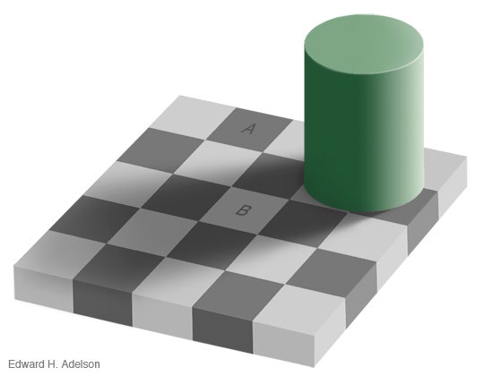
Human and Machine Learning · Week 1
1. Perception
Which square is darker — A or B?
The visual system solves
square color + shadow = intensity
for square color, using priors about how retinal images are generated.
You are literally looking at an inductive inference right now.
8

Slide 9
Human and Machine Learning · Week 1
2. Mental states
Data: other people's behavior (motion, speech, gaze).
Hypotheses: their goals and beliefs.
Heider & Simmel (1944) — animated geometric shapes.
Watch ~90 seconds, then describe what happened:
https://www.youtube.com/watch?v=VTNmLt7QX8E
9

Slide 10
Human and Machine Learning · Week 1
2. Mental states — debrief
Everyone spontaneously narrates the shapes as agents with intentions, grudges, fears.
Those intentions were never in the video. Shapes moved on a plane.
• Data: 2D motion trajectories.
• Hidden: goals, beliefs, relationships.
Your mind solved the inverse problem — behavior → mental states — without you noticing.
10

Slide 11
Human and Machine Learning · Week 1
3. Word learning
You're in the Australian outback. Someone points at a hopping animal and says "jumbuck."
What does jumbuck mean?
11

Slide 12
Human and Machine Learning · Week 1
3. Word learning
You're in the Australian outback. Someone points at a hopping animal and says "jumbuck."
What does jumbuck mean?
• the animal itself?
• undetached kangaroo-parts?
• kangaroo temporal-stages?
• any mammal?
• dinner?
All consistent with the data. Children pick one — fast.
They bring strong prior expectations about what words mean.
11

Slide 13
Human and Machine Learning · Week 1
Check-in
What's the common structure across these three problems?
• Hidden variable we care about: h
• Noisy / sparse data we observe: d
• Prior knowledge we bring to bear
P(h | d) ∝ P(d | h) · P(h)
(We'll unpack every symbol in the next hour.)
12

Slide 14
Human and Machine Learning · Week 1
Basic Bayes
13

Slide 15
Human and Machine Learning · Week 1
Outcomes, events, event space
Flip two coins.
• Outcome set: S = {HH, HT, TH, TT} |S| = 4
• Event: any subset of S
e.g., "at least one head" = {HH, HT, TH}
• Event space: the set of events (powerset, when S is finite).
For continuous S, the math gets trickier — we'll come back to it next week.
14

Slide 16
Human and Machine Learning · Week 1
Random variables
A random variable is a function from the outcome space to some value space.
Y : S → {T, F}, Y(s) = "does s have at least one H?"
Y(HH) = T, Y(HT) = T, Y(TH) = T, Y(TT) = F.
The word random is about the input, not the mapping. The function itself is deterministic.
15

Slide 17
Human and Machine Learning · Week 1
Probability
P(Y = T) = |{ s ∈ S : Y(s) = T }| / |S| = 3/4
Count the outcomes where Y takes the value you care about. Divide by total outcomes.
16

Slide 18
Human and Machine Learning · Week 1
Joint probability
P(first = H, second = T) = P({HT}) = 1/4
Joint = "both of these at once."
17

Slide 19
Human and Machine Learning · Week 1
Conditional probability — set restriction
Question: What is P(first = H | ≥1 H)?
Many people's first answer: 3/4. That's wrong.
Conditioning = restricting the universe to outcomes where the condition holds.
New universe: {HH, HT, TH} (3 outcomes). Of those, 2 have first = H.
P(first = H | ≥1 H) = 2/3
18

Slide 20
Human and Machine Learning · Week 1
The ratio definition
P(A | B) = P(A ∩ B) / P(B)
Same answer:
P(first=H | ≥1 H) = P({HH}) / P({HH, HT, TH}) = (2/4) / (3/4) = 2/3 ✓
19

Slide 21
Human and Machine Learning · Week 1
Marginalization
P(X) = Σ_c P(X, C = c)
Sum the joint over the values of whatever you want to get rid of.
20

Slide 22
Human and Machine Learning · Week 1
Bayes' rule — one line
From the product rule, both directions:
P(A | B) · P(B) = P(A, B) = P(B | A) · P(A)
Divide:
P(A | B) = P(B | A) · P(A) / P(B)
That's it. The rest of the course is understanding what this means.
21

Slide 23
Human and Machine Learning · Week 1
Check-in
For the problem I'm about to give you — the cab problem —
• What's d (the data, the observation)?
• What's h (the hidden variable)?
22

Slide 24
Human and Machine Learning · Week 1
Bayes in Action
23

Slide 25
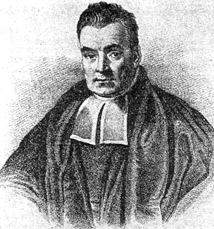
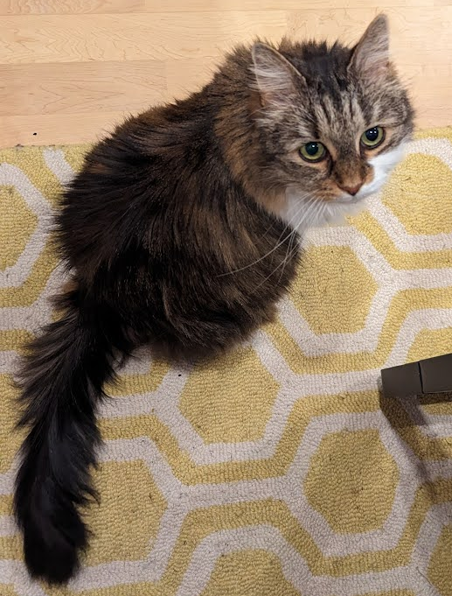
In a dark and depressing world...
I’ve got a rule to help!
I used it to try to prove G-d exists. It made me feel better.
Turns out that it’s really useful for other stuff too, but I didn’t figure that out!
For you to use it, you’ll need to learn to write probabilities carefully.
Math is so cool! Try this at parties.
You have a 50 year-old friend who has been a chain smoker since they were 18.
There’s a nasty cold going around.
You go over to their house to bring them soup.
You hear them cough.
You know that they’re sick, but you don’t know what it is.
You’ve limited it to three possibilities:
A cold, a stomach virus, or lung cancer
How likely is each?
Reverand Thomas Bayes
(1701-1761)
I’m unimpressed.
Please feed me treats.
Notes:
Enter probability theory to save the day!

Slide 26
Writing probabilities
d is a hidden property you don’t get to observe.
E.g., disease, emotions, goals...
Notes:
Enter probability theory to save the day!

Slide 27
Writing probabilities
d is a hidden property you don’t get to observe.
E.g., disease, emotions, goals...
o is what you observe in the world
E.g., coughing, punching, grabbing milk, ...
P(d = lung cancer) means the probability of lung cancer
“prior probability”
P(d = lung cancer | o = cough) means the probability of lung cancer given you know (things to right of “|”) that the person coughed.
“posterior probability”

Slide 28
Writing probabilities
d is a hidden property you don’t get to observe.
E.g., disease, emotions, goals...
o is what you observe in the world
E.g., coughing, punching, grabbing milk, ...
P(d = lung cancer | o = cough) means the probability of lung cancer given you know (things to right of “|”) that the person coughed.
“posterior probability”
P(o = cough | d = lung cancer) means the probability of coughing given you know (things to right of “|”) that the person has lung cancer.
“likelihood”

Slide 29
Bayes’ rule
Prior
probability
Likelihood
Posterior
probability
Total
probability
Sum over diseases
Given you hear your friend cough, what is the probability that she has…
for

Slide 30
Bayes’ rule via word math
likelihood
prior
posterior
high
medium
high
low
medium
low
high
very low
low/medium
To get actual probability, you divide each of these by their sum (normalization).
Notes:
Get people to fill in these pieces.

Slide 31
Bayes’ rule
likelihood
prior
posterior
0.9
0.45
0.1
0.45
0.9
0.1
To get actual probability, you divide each of these by their sum (normalization).

Slide 32
Bayes’ rule
likelihood
prior
posterior
0.9
0.45
0.405
0.1
0.45
0.045
0.9
0.1
0.090
To get actual posterior, you divide each of these by their sum (normalization).
0.405 + 0.045 + 0.090 = 0.54

Slide 33
Bayes’ rule
likelihood
prior
posterior
0.9
0.45
0.405/0.54 = 0.75
0.1
0.45
0.045
0.9
0.1
0.090
To get actual posterior, you divide each of these by their sum (normalization).
0.405 + 0.045 + 0.090 = 0.54

Slide 34
Bayes’ rule
likelihood
prior
posterior
0.9
0.45
0.405/0.54 = 0.75
0.1
0.45
0.045/0.54 = 0.083
0.9
0.1
0.090/0.54 = 0.167
To get actual posterior, you divide each of these by their sum (normalization).
0.405 + 0.045 + 0.090 = 0.54

Slide 35
Bayes’ rule
Posterior
likelihood
prior
h can be... the
Height of an object
Sound produced by a speaker
Time for an event to complete
Graduate student specialization
Engineer/Lawyer
GPA of student
Why is this controversial as a framework for studying the mind?
Notes:
To understand the psych literature, this is essential to understand...

Slide 36
Human and Machine Learning · Week 1
The Kahneman–Tversky cab problem
28

Slide 37
Two cab companies operate in a given city, the Blue and the Green (according to the color of cab they run).
85% of the cabs in the city are Green,
and the remaining 15% are Blue.
A cab was involved in a hit-and-run at night.
There was a witness.
The witness is able to correctly identify the color of a cab at night 80% of the time.
A witness identifies the cab as a Blue cab.
What is the probability that the cab is Blue?
(Kahneman & Tversky, 1972; Bar-Hillel, 1980)
Notes:
Data is witness; hypothesis is cab being blue…

Slide 38
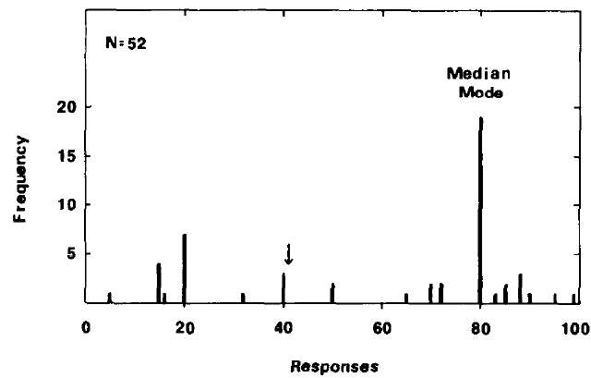
Base-rate neglect
Participants report the likelihood and neglect integrating the prior.
Remember that they should be multiplied together… (0.8 x 0.15 is numerator)
Correct Answer
Medical doctors/residents also fail at this, even in the context of medical diagnosis (Casscells, Schoenberger, & Grayboys, 1978).
(Kahneman & Tversky, 1972; Bar-Hillel, 1980)
Notes:
Arrow is correct answer.

Slide 39

Heuristics and biases
Daniel Kahneman
Amos Tversky
Won Nobel prize in economics despite never taking a single course!
101st greatest Israeli ever!
MacArthur Genius Fellowship and many other awards.
Would’ve won Nobel prize too if he hadn’t passed away in 1990s.
Notes:
Danny won nobel prize based on their work together on prospect theory. One of my late advisors spoke of Tversky as the most intelligent man he had ever met in his life.

Slide 40
Heuristics and Biases for Cognition
Our cognition (incl. maps) tend to be accurate
Errors usually reflect using reasonable strategies that are inappropriate in situations that are not ecologically valid.
Bias is knowledge that produces errors because it is used by the mind when it may or may not be appropriate or applicable.
A heuristic a rule of thumb or general problem-solving strategy that typically provides good solutions, but may contain biases.

Slide 41
Getting the correct answer: Depicting the situation (Witness said blue)
Answer is area of yellow relative to area of red.
Witness is right
Green cabs = 85%
Blue cabs = 15%
Witness correct = 80%
Witness incorrect = 20%
Witness is wrong

Slide 42
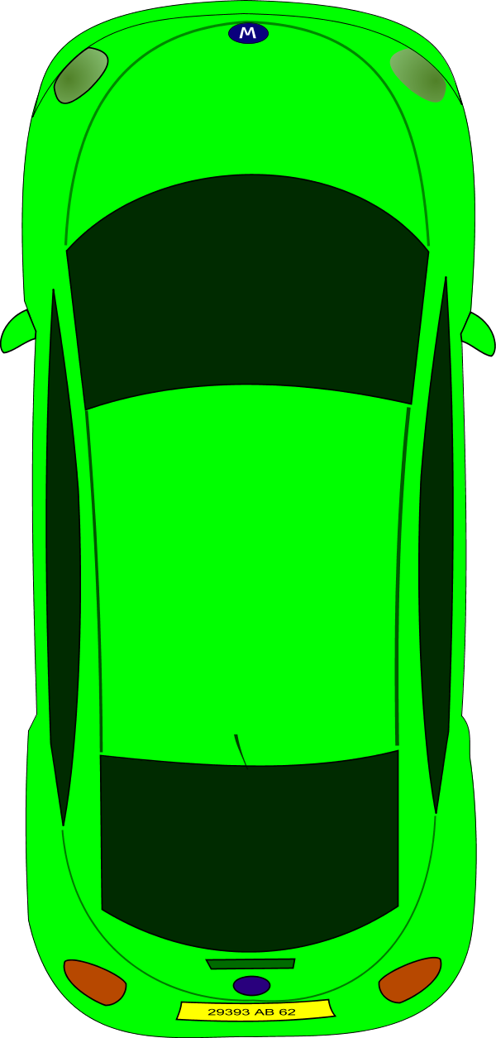
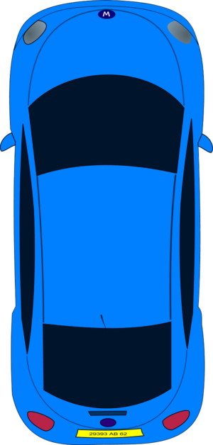
Getting the correct answer: Another depiction
85 of 100 Green
15 of 100 Blue
80% of 15 is 12
All the cabs in the city

Slide 43
Getting the correct answer: Another depiction
20% of 85 is 17
85 of 100 Green
15 of 100 Blue
80% of 15 is 12
All the cabs in the city

Slide 44
Getting the correct answer: Another depiction
20% of 85 is 17
85 of 100 Green
Probability of the cab being blue given the witness said it is blue is
12/(12+17) = 12/29 = 41%
15 of 100 Blue
80% of 15 is 12
All the cabs in the city

Slide 45
Bayes’ rule… again
Step-by-step:
Identify the “disease” and “observation” for the problem.
Use information given to define likelihoods (P(o|d) for each d) and priors (P(d) for each d).
Calculate numerators for each d.
Calculate the denominator for all diseases by summing the numerators (one disease must have produced the observation).
Divide the numerators by the denominator to be probabilities.

Slide 46
Bayes’ rule... again!
Observation: Witness reports blue (W = b) (correct 80%) “Diseases”:
B (the cab in the accident was blue) 15% Prior
G (the cab in the accident was green) 85% Prior
Slightly more likely to be Green despite witness saying blue!
Normalize: denominator = 0.12 + 0.17 = 0.29
(Kahneman & Tversky, 1972; Bar-Hillel, 1980)
Notes:
Data is witness; hypothesis is cab being blue…

Slide 47
Human and Machine Learning · Week 1
Synthesis — the 5-step recipe
This is the course's method.
1. Formalize the problem people face.
2. Formalize the knowledge they bring to it.
3. Apply Bayes' rule — compute what an ideal learner would infer.
4. Characterize the ideal learner's behavior.
5. Identify what knowledge and constraints must be assumed for model and human behavior to match.
Every week we pick a different cognitive domain and run this loop.
34

Slide 48
Human and Machine Learning · Week 1
GenJAX, Admin, Homework
35

Slide 49
Human and Machine Learning · Week 1
What is GenJAX?
Bayes' rule is easy to write. Enumerating hypothesis spaces by hand is not.
For continuous distributions you can't enumerate at all.
GenJAX is a probabilistic programming language.
You write the generative process as code. The machine does the enumeration and counting.
36

Slide 50
Human and Machine Learning · Week 1
GenJAX by example
import genjax
from genjax import gen, flip
@gen
def chibany_day():
lunch = flip(0.5) @ "lunch"
dinner = flip(0.5) @ "dinner"
return (lunch, dinner)
• @gen — this is a generative model, not a regular function.
• flip(0.5) — a Bernoulli random variable.
• @ "lunch" — name the random choice so we can condition on it later.
This function IS the outcome space Ω from Block 3. Every call samples a point.
37

Slide 51
Human and Machine Learning · Week 1
Preemptive callouts
• Use flip(p), not bernoulli(p). bernoulli takes a logit, not a probability.
• The @ operator here is not matrix multiplication. GenJAX overloads it.
• Output displays as Array(0, dtype=int32). Treat these as 0s and 1s.
• Everything runs in Google Colab. No local installation.
38

Slide 52
Human and Machine Learning · Week 1
Admin — grading
Final project
50%
proposal 5% · talk 7.5% · paper 37.5%
Programming assignments (4)
30%
Clusters 7.5% · Gen 7.5% · MC 10.5% · RL 4.5%
Weekly written reflections
15%
~200 words · 8 of 13 · pass / fail
Participation
5%
Quizzes
0%
self-check only
All four assignments are completed in GenJAX.
39

Slide 53
Human and Machine Learning · Week 1
Admin — the rest
• Textbook: A Narrative Introduction to Probability
https://josephausterweil.github.io/probintro/
• Tooling: Google Colab, GenJAX. No local setup.
• Office hours: TBD — I'll poll.
• Email: best-effort 36 h response (48 h on weekends).
• AI tools: welcome as a technical resource; must cite; not for quiz/assignment answers.
• Full syllabus on the course website (coming up).
40

Slide 54
Human and Machine Learning · Week 1
Semester readings — Weeks 3–7
Each week (starting 3) includes 1-2 papers alongside the textbook. These may change.
Wk 3 Conjugate Bayes & Topic Models
Griffiths & Tenenbaum 2001 (Randomness) · Steyvers & Griffiths 2000 (Topic Models)
Wk 4 Generalization & Hierarchical Bayes
Tenenbaum 1999 (Concept Learning) · Xu & Tenenbaum 2000
Wk 5 Hierarchical Bayes & Bayes Nets
DeZoete 2019
Wk 6 Causal Bayes Nets
Lagnado 2002 · Griffiths et al. 2004 (Hidden Causes) · Gerstenberg 2015
Wk 7 Markov Chains & Networks
Abbott et al. 2012 (Random Walks) · Mukherjee 2017
41

Slide 55
Human and Machine Learning · Week 1
Semester readings — Weeks 8–13
Wk 8 Monte Carlo Methods
Vul et al. 2009 (One and Done) · Griffiths & Sanborn 2007
Wk 9 SDT, MDPs & Reinforcement Learning
Schultz 1997 (Dopamine & Reward) · Daw et al. 2005 · Ho et al. 2015
Wk 10 Inverse Reinforcement Learning
Baker et al. 2007 (Theory of Mind) · Ho et al. 2016, 2017
Wk 11 Bayesian Nonparametrics
Austerweil et al. 2015 (BNP Book Chapter)
Wk 12 Deep Neural Networks
LeCun et al. 2015 (Deep Learning) · Lake et al. 2015 · Pereira et al. 2018
Wk 13 Ethics & Adversarial ML
Caliskan et al. 2017 (Bias) · Buolamwini 2018 · Zhou & Firestone 2019
42

Slide 56
Human and Machine Learning · Week 1
Homework for Week 2
1. Textbook T1 Ch 1-3 — reinforces everything from Block 3.
intro/01_goals.md · 02_hungry.md · 03_prob_count.md
2. Textbook T2 Ch 0-1 — gets GenJAX running in Colab.
genjax/00_getting_started.md · 01_python_basics.md
3. Start thinking about a final-project topic. We'll talk Week 2.
Week 2 has a short optional self-check quiz (Intro Probability Theory 1).
43

Slide 57
Questions?
Thanks — see you next Friday.
42

