Slide 1
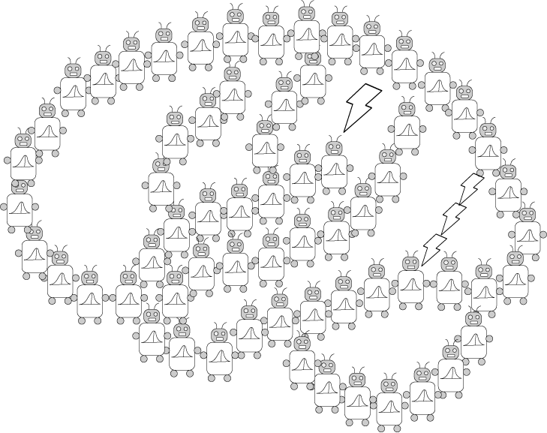
Levels of analysis and Bayes 2
PSYCH/COMP SCI/BMI 841: Computational Cognitive Science
Joseph Austerweil
January 30, 2025

Slide 2
Admin Matters
Bayes practice and thinking generatively
Levels of analysis
Short rest 1
Math to cover:
Expected value
Continuous probability
Gaussian
Mixture modeling
Beta-Binomial (discrete enters the continuum)
Short rest 2
Student intros + one paper presentation
Go over paper presentation advice here too.

Slide 3
Administrative Matters: Recordings
Class recordings getting woven into module pages in Canvas.
Would people prefer one page with all the links instead?
Doing two is challenging – alternatively could make a student writeable page for updating the lectures.

Slide 4
Administrative Matters: Discussion? + Quiz
Extra discussion section
As of now, won’t be doing it.
(Not feasible for this or next two weeks)
Will reassess Feb 17-21
Nice job on the quiz everyone
Q3: Apologies on the two equivalent answers
Q4: Frequentist/Bayesian debate not as important as people being not Bayesian at all.

Slide 5
Administrative Matters: Next Week
No in-person or virtual sync on Thursday 2/06.
No OH next week. (can schedule 1-1 if needed. May need to be outside normal WI work hours)
Please note that Japan will be 13 hours ahead
Email response may be more delayed than normal.
I’ll be in meetings all day Feb 5, 8, and 9 (Japan time)
I will be on plane all day Feb 2 and 11 (Central time)
I will release lecture recordings early next week
For class participation credit, please provide a comment/question to the associated discussion page for at least one recording.
Paper presentations
Any student presentations will be recorded and posted to Canvas.
For class participation credit, will want you to provide one comment on at least one of them.
First possible discussion post due 02/05 at 8:59pm
Quiz will be released Monday 02/03 at 8am
Quiz due back by 02/05 at 8:59pm

Slide 6
Admin Matters
Bayes practice and thinking generatively
Levels of analysis
Short rest 1
Math to cover:
Expected value
Continuous probability
Gaussian
Mixture modeling
Beta-Binomial (discrete enters the continuum)
Short rest 2
Student intros + one paper presentation
Go over paper presentation advice here too.

Slide 7
Bayes’ rule
Prior
probability
Likelihood
Posterior
probability
Total
probability
Sum over diseases

Slide 8
Thinking generatively…
How are the hypotheses generated?
defines the prior p(h)
How do the hypotheses generate the data?
defines the likelihood p(d|h)
With these quantities specified, Bayes’ rule inverts the generative process.

Slide 9
Bayes’ rule
Prior
probability
Likelihood
Posterior
probability
Total
probability
Sum over diseases
Given you hear your friend cough, what is the probability that she has…
for

Slide 10
One of your friends recently became sick. Concerned about them, you go with them to the doctor. The doctor notes that your friend may have contracted Yooper Syndrome, which is a terrible, rare illness. Left untreated, someone with Yooper Syndrome experiences extreme pain when they are outside of the Upper Peninsula of Michigan.
1 in 10,000 people are afflicted with Yooper Syndrome.
To determine whether your friend has Yooper Syndrome, the doctor has your friend eat a fried cheese curd.
9 in 10 people afflicted with Yooper Syndrome foam from the mouth for 20 minutes after eating a single fried cheese curd (the extra salivation due to the extreme desire for more fried cheese curds).
Only 7 in 10 people unafflicted with Yooper Syndrome foam from the mouth for 20 minutes after eating a single fried cheese curd.
You see your friend eat a single friend cheese curd at the doctor's office and foam from the mouth for 20 minutes.
Given this, what’s the probability that they have the Yooper?

Slide 11
Admin Matters
Bayes practice and thinking generatively
Levels of analysis
Short rest 1
Math to cover:
Expected value
Continuous probability
Gaussian
Mixture modeling
Beta-Binomial (discrete enters the continuum)
Short rest 2
Student intros + one paper presentation
Go over paper presentation advice here too.

Slide 12
David Marr
David Marr
1945-1980
1982
Notes:
40 years since vision. Died at 35 of leuikemia, but even still, one of the most important cognitive scientists. MIT lore about how much of Vision was actually Marr vs. his grad students/colleagues who completed the book.

Slide 13
Analyzing functional systems
What is being computed?
Why is it being computed?

Slide 14
Why is it being computed?
Justification of that formal system in terms of function
e.g. cash register: addition
buying nothing costs nothing
order of purchase is irrelevant
grouping does not affect total
Purchase + refund is zero
addition is the formal system that
satisfies these functional constraints

Slide 15
What is being computed?
Identification of the formal system in operation
e.g. cash register: addition
zero element 3+0 = 3
commutative 3+4 = 4+3
associative (3+4)+5 = 3+(4+5)
inverses 4+(-4) = 0

Slide 16
Marr (1982)’s three levels of analysis
Computation
“What is the goal of the computation, why is it appropriate, and what is the logic of the strategy by which it can be carried out?”
Representation and algorithm
“What is the representation for the input and output, and the algorithm for the transformation?”
Implementation
“How can the representation and algorithm be realized physically?”
constrains
constrains

Slide 17
What representation?
Many formal systems solve the same computational problems.
e.g. 2+2=4 and 010+010=100
What is the mapping between representations and the inputs and outputs to the system?
Different representations make certain operations easier or more difficult
e.g. finding powers of 10 or powers of 2
2+2 in binary = 4 in binary

Slide 18

Analyzing functional systems
What is the physical implementation of the system?
Notes:
Tophat question

Slide 19
Computational models can be defined at all three levels
Computational (Normative)
“What is the goal of the computation, why is it appropriate, and what is the logic of the strategy by which it can be carried out?”
Representation and algorithm (Descriptive)
“What is the representation for the input and output, and the algorithm for the transformation?”
Implementation (Descriptive)
“How can the representation and algorithm be realized physically?”
Models based on optimal solutions to abstract computational problems
Models based on cognitive processes
Models based on how neurons compute

Slide 20

The levels of a thermostat
Input
[heat setting]
Output
[heat?]
What is the computational level description?

Slide 21
Computational level description
Heat setting
Sends ON when input temperature is at heat setting.

Slide 22
Algorithmic level description
Read heat setting.
If temperature is less than the heat setting, then send ON to furnace.
Otherwise, do nothing.
How does this differ from computational level description?
Computational level has no structure in it.*
It is just a list of ON and OFF.
Algorithmic level describes how temperature and heat setting are compared and sends ON or OFF.
It describes a procedure.

Slide 23
Implementational level of thermostat
Input
[heat setting]
Output
[heat?]

Slide 24
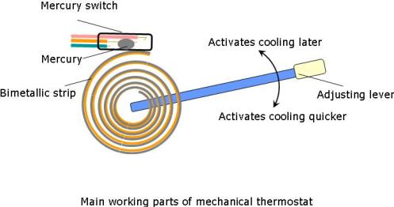
Implementational level of thermostat
Input
[heat setting]
Output
[heat?]

Slide 25
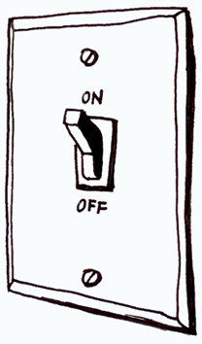

Implementational level of thermostat
Input
[heat setting]
Output
[heat?]

Slide 26
An example: Memory

Slide 27
An example: Memory
Computational
“How can the representation and algorithm be realized physically?”
Explaining human memory as an optimal solution to the statistical problem of identifying items likely to be needed again
(Anderson, 1989; Griffiths, Steyvers, & Firl, 2007)

Slide 28
An example: Memory
Representation and algorithm
“How can the representation and algorithm be realized physically?”
Explaining human memory based on the representation of items with binary features, and a rule for determining familiarity
Item 1: 00101011
Old probe: 00101011
Item 2: 01010010
New probe: 01111011
Item 3: 11011010
Activate items with matching features
…
Familiarity is sum of all activation
(e.g. Hintzman, 1988)

Slide 29
An example: Memory
Implementation
“How can the representation and algorithm be realized physically?”
Explaining human memory based on the circuits formed by hippocampal neurons
What computations are supported by different kinds of neurons?
What is the capacity of memory systems made from these neurons?
(Treves & Rolls, 1994)

Slide 30

Which of Marr’s levels is most important?
Implementation is the best. It’s the only one that captures my beauty precisely.

Slide 31

Which of Marr’s levels is most important?
Computational/Algorithmic is the best. It captures how different things play with me. I don’t care if they’re cats, plastic, human, or feather.

Slide 32
Is one level more important?
Marr: the computational level is most important, imposing the most constraints

Slide 33
Is one level more important?
Marr: the computational level is most important, imposing the most constraints
Only the computational level gives a teleological (vs. mechanistic) explanation
“...trying to understand perception by studying only neurons is like trying to understand bird flight by studying only feathers: It just cannot be done. In order to understand bird flight, we have to understand aerodynamics; only then do the structure of feathers and the different shapes of birds' wings make sense.”
Notes:
Mention Victor’s post. Promise it was already on my slides…

Slide 34
Is one level more important?
The computational level is also the one at which it doesn’t matter whether we’re studying humans or machines…
Provides the potential for insights to cross from one discipline to another
input
output
input
output
input
output

Slide 35
Different kinds of explanation
Mechanistic: how?
algorithm
implementation
Teleological: why?
function/problem
optimal solution
Notes:
Give extra example of a pen. (Why are there pens?)

Slide 36
Bad teleological explanations…
Some properties of the structure of organisms are explained by their history, not their function
e.g. male nipples
Reuse of existing structure (Exaptations)
- e.g., feathers of birds (temp. regulation)
- Are noses for wearing glasses?
Some aspects of human cognition are going to be explained by the structure of our brains and our cognitive capacities
looking for teleological explanations everywhere will cause trouble… it’s a strategy rather than a rule
There is a teleological explanation for any behavior.
Notes:
Intelligent design = teleological explanation for life.

Slide 37
Some Pros/Cons of Each Level
Computational
Pro: Designed systems, Goal-directed behavior , Emergent phenomena, Medium independent
Con: Physical history, exaptations, always some goal that can explain any phenomena
Algorithmic/Representational
Pro: Interpretable, Easy to manipulate, Medium independent,
Con: Hard to identify, Typically task-specific

Slide 38
Some Pros/Cons of Each Level
Algorithmic/Representational
Pro: Interpretable, Easy to manipulate, Medium independent, focuses on info. processing
Con: Hard to identify, Typically task-specific
Implementational
Pro: Closest to empirical reality, reductive
Con: Medium-specific, how reductive should it be?
Should we explain cognition with atoms?

Slide 39
Computational models can be defined at all three levels
Computation (Normative)
“What is the goal of the computation, why is it appropriate, and what is the logic of the strategy by which it can be carried out?”
Representation and algorithm (Descriptive)
“What is the representation for the input and output, and the algorithm for the transformation?”
Implementation (Descriptive)
“How can the representation and algorithm be realized physically?”
Models based on optimal solutions to abstract computational problems
Models based on cognitive processes
Models based on how neurons compute

Slide 40
Computational models can be defined at all three levels
Computation (Normative)
“What is the goal of the computation, why is it appropriate, and what is the logic of the strategy by which it can be carried out?”
Representation and algorithm (Descriptive)
“What is the representation for the input and output, and the algorithm for the transformation?”
Implementation (Descriptive)
“How can the representation and algorithm be realized physically?”
Models based on optimal solutions to abstract computational problems
Models based on cognitive processes
Models based on how neurons compute

Slide 41
Bayesianism/Rational analysis
Bayesian inference is the mathematics of inductive problems.
Steps to forming a Bayesian model:
1. Formalize the problem that people face.
2. Formalize the types of knowledge people have when solving the problem.
3. Apply Bayes’ rule and see what an ideal learner/observer would learn from the data.
4. How does the ideal learner behave?
5. What types of knowledge (*and/or constraints on learning) must be assumed for the model and people to behave similarly?
Notes:
Ask class how does this fit with hyp. space & prior?

Slide 42
Explanatory virtues (adapted from Godfrey-Smith, 2001)
In what ways can a theory be explanatory?
Empirical: The theory predicts the phenomena of interest and it is the causally relevant factor.
Reductionism: Should we only work on particle mechanics then?
But what about Newton’s laws of physics?
Explanatory: Regardless of its empirical validity, the theory helps us understand the phenomena of interest. It is the answer to the big Qs of the domain.
Methodological: The theory is a useful guiding principle (heuristic) for designing experiments.
Notes:
For methodological/instrumental – many neural mechanisms were theorized based on computational-level description. E.g., opponent processing theory of color. Fourier decomposition of sound waves (sine vs. square).

Slide 43
Bayesian Fundamentalism
Existence proof demonstrating the Bayesian model that exhibits the same behavior as people in some domain.
Explicitly eschews mechanisms for how Bayes is computed.
All that matters is input-output pattern corresponds to some Bayesian model.
Relation to:
Behaviorism?
Evolutionary Psychology
(Jones & Love, 2011)

Slide 44
Bayesian “Enlightenment”
Measure natural environment to constrain priors.
(ecological statistics)
Give “psychological status” to the hypothesis space/generative models/priors.
Deriving “process” models from techniques used to approximate Bayesian models. Also, analyzing biases/heuristics in terms of psychological assumptions.
Confirmation bias is “rational” assuming deterministic hypotheses (Austerweil & Griffiths, 2008; 2011).
Analyzing neural network processes as equivalent to Bayesian models with implicit biases.
Integrating Bayesian models with neural mechanisms (e.g., priors as % of neurons devoted to hypothesis).
(Jones & Love, 2011)

Slide 45

Short rest 1

Slide 46
Admin Matters
Bayes practice and thinking generatively
Levels of analysis
Short rest 1
Math to cover:
Expected value
Continuous probability
Gaussian
Mixture modeling
Beta-Binomial (discrete enters the continuum)
Short rest 2
Student intros + one paper presentation
Go over paper presentation advice here too.

Slide 47
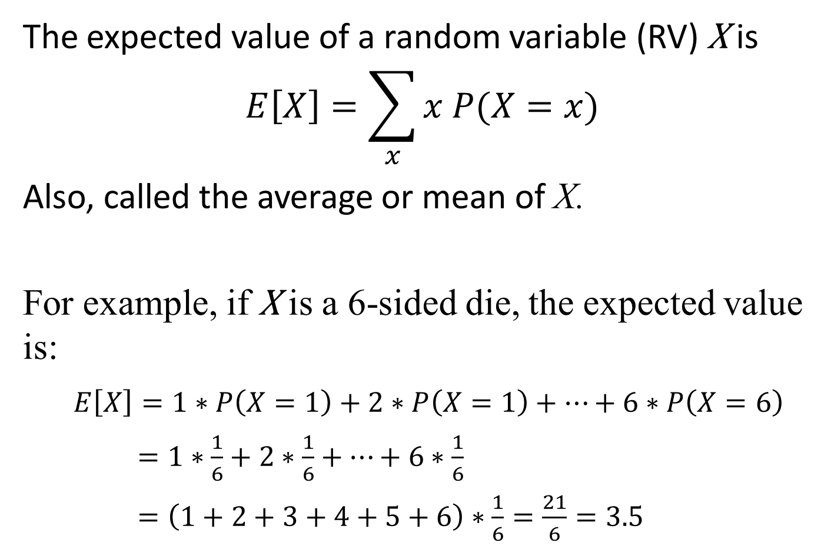
Expected value
The expected value of a random variable (RV) X is
$$E\left[X\right]=\sum_{x}{x P(X=x)}$$
Also, called the average or mean of X.
For example, if X is a 6-sided die, the expected value is:
$E\left[X\right]=1∗P\left(X=1\right)+2∗P\left(X=1\right)+⋯+6∗P\left(X=6\right)$
$=1∗\frac{1}{6}+2∗\frac{1}{6}+⋯+6∗\frac{1}{6}$
$=\left(1+2+3+4+5+6\right)∗\frac{1}{6}=\frac{21}{6}=3.5$

Slide 48
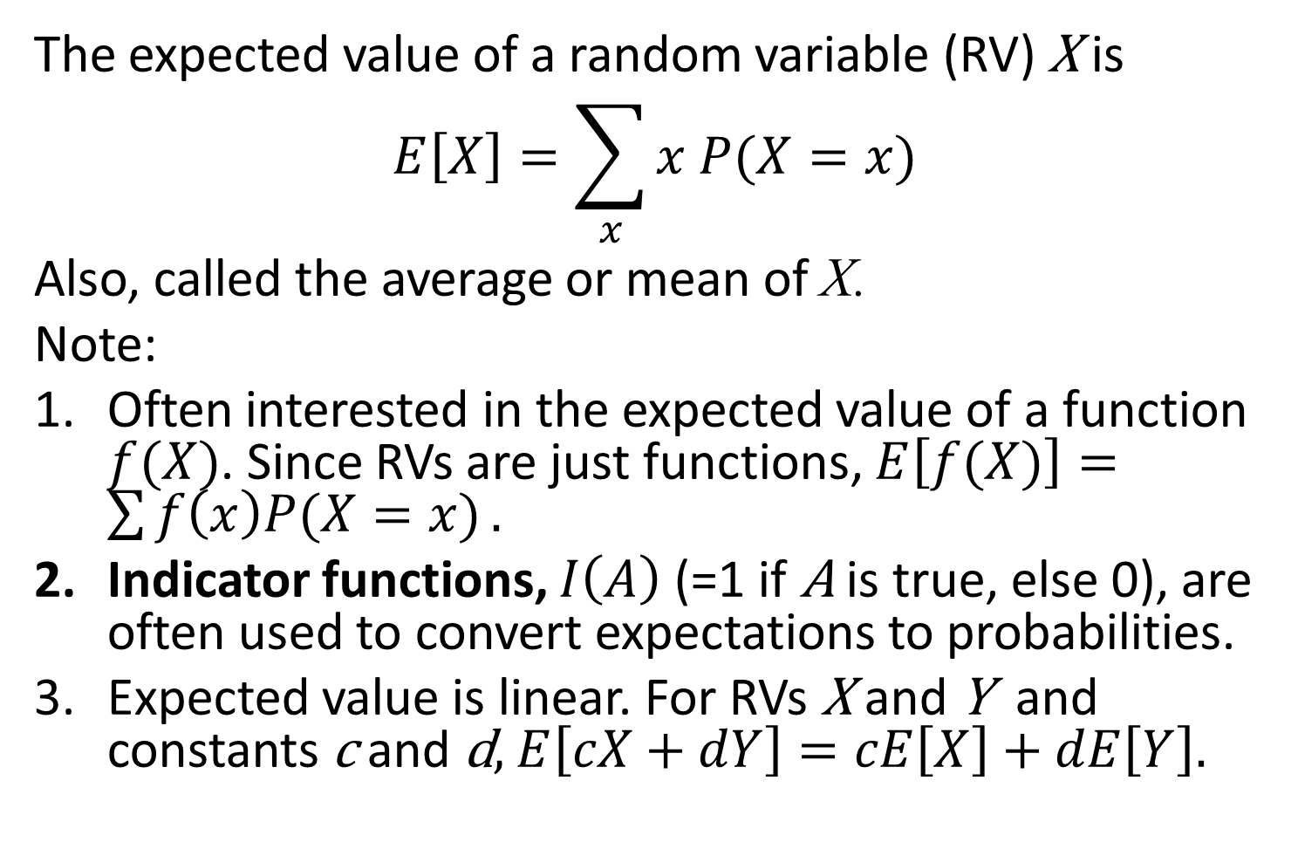
Expected value
The expected value of a random variable (RV) X is
$$E\left[X\right]=\sum_{x}{x P(X=x)}$$
Also, called the average or mean of X.
Note:
Often interested in the expected value of a function $f(X)$. Since RVs are just functions, $E\left[f(X)\right]=\sum{f\left(x\right)P(X=x)}.$
Indicator functions, $I\left(A\right)$ (=1 if A is true, else 0), are often used to convert expectations to probabilities.
Expected value is linear. For RVs X and Y and constants c and d, $E\left[cX+dY\right]=cE\left[X\right]+dE\left[Y\right].$

Slide 49
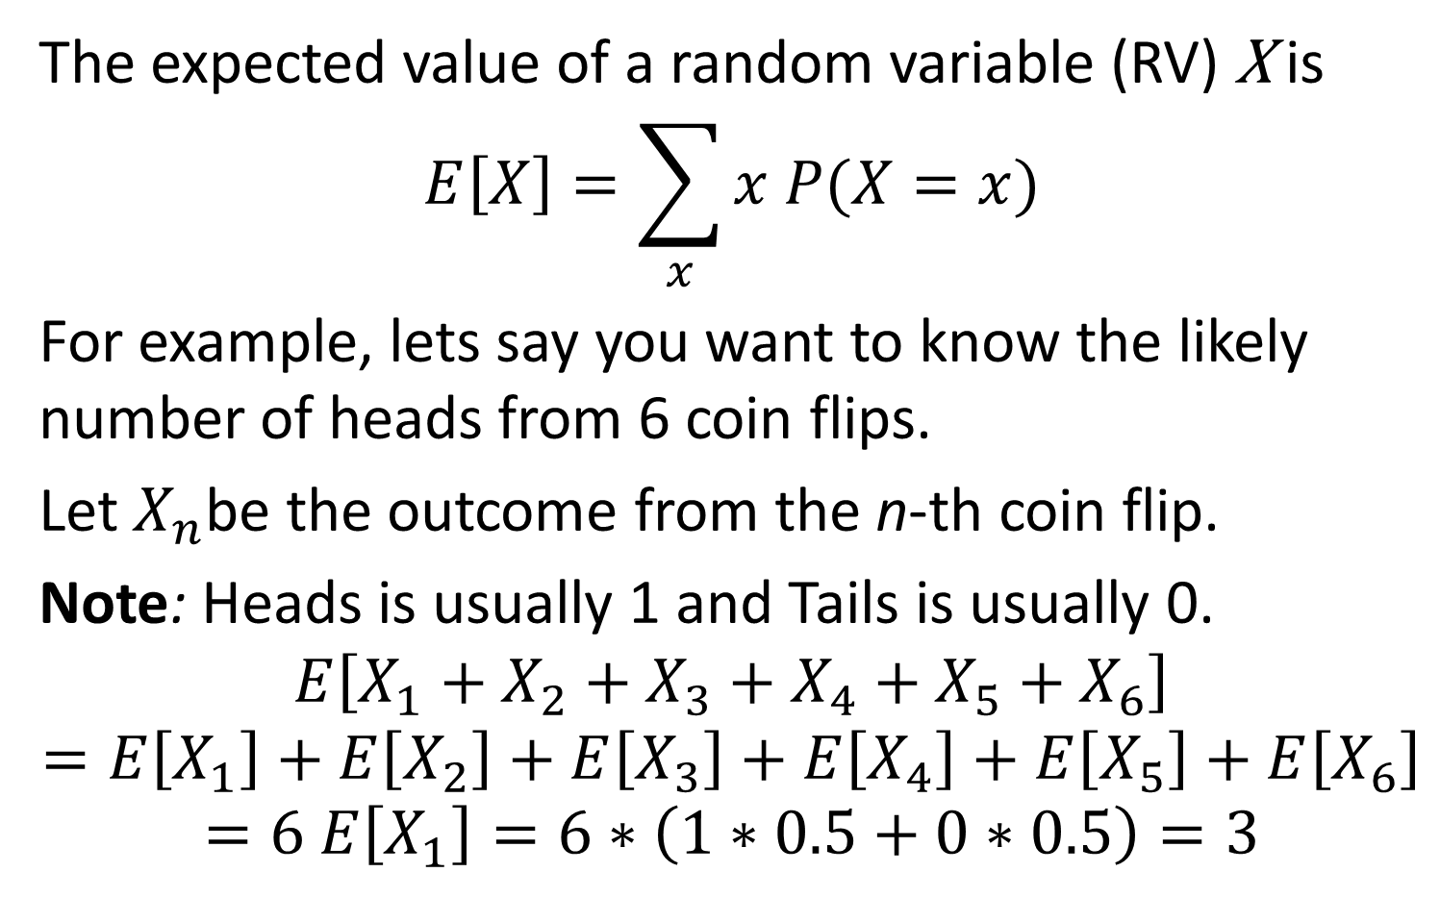
Expected value
The expected value of a random variable (RV) X is
$$E\left[X\right]=\sum_{x}{x P(X=x)}$$
For example, lets say you want to know the likely number of heads from 6 coin flips.
Let $X_{n}$be the outcome from the n-th coin flip.
Note: Heads is usually 1 and Tails is usually 0.
$$E\left[X_{1}+X_{2}+X_{3}+X_{4}+X_{5}+X_{6}\right]$$
$$=E\left[X_{1}\right]+E\left[X_{2}\right]+E\left[X_{3}\right]+E\left[X_{4}\right]+E\left[X_{5}\right]+E\left[X_{6}\right]$$
$$=6 E\left[X_{1}\right]=6∗\left(1∗0.5+0∗0.5\right)=3$$

Slide 50
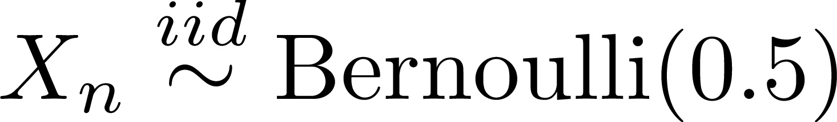


The Bernoulli Distribution
N fair coinflips X₁, X₂, …, X_{N} can be represented as
“independent and identically distributed as”
Parameter for distribution
“distributed as”
“type of distribution”
Notes:
Will revisit with examples over time.

Slide 51
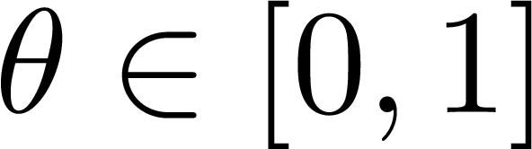
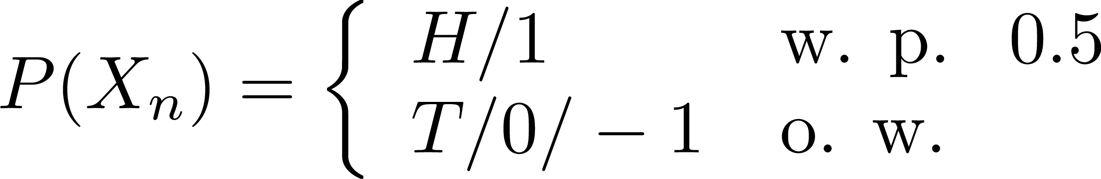
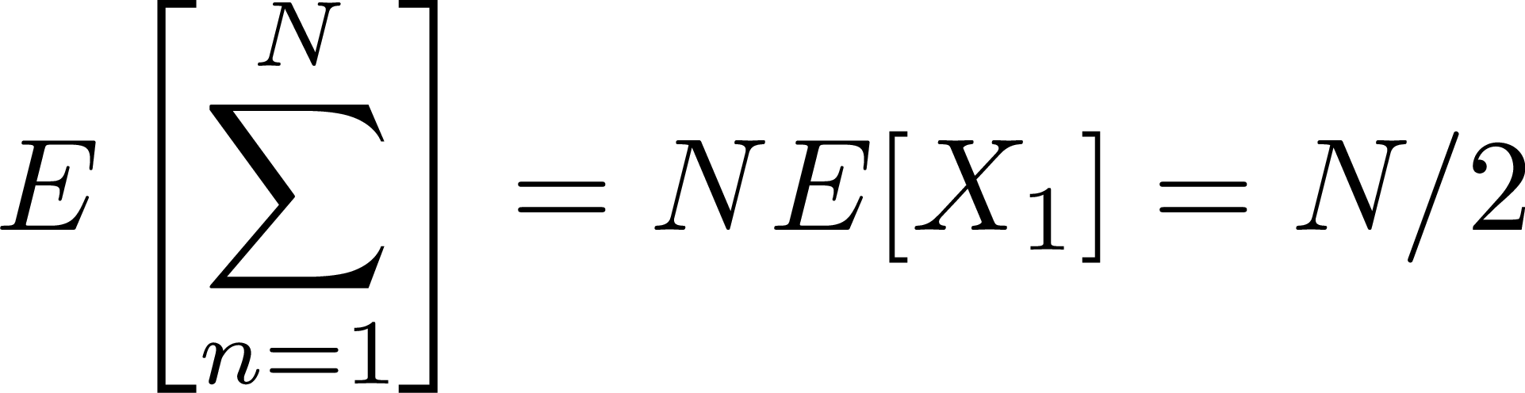










The Bernoulli Distribution
N fair coinflips X₁, X₂, …, X_{N} can be represented as
What is the expected value for the sum of two coinflips?
N coinflips?
Heads or 1
with probability 0.5
Continuum from 0 to 1 (inclusive)
otherwise
Tails or 0 or -1
Sum from 1 to N (with index n)
Notes:
Will revisit with examples over time.

Slide 52
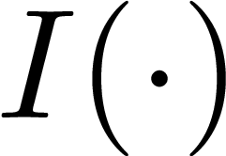
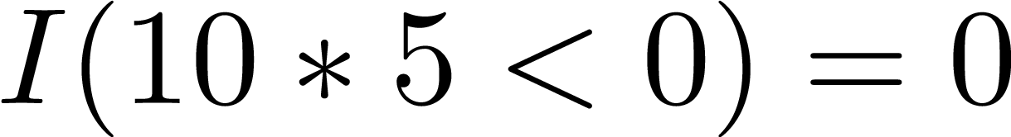
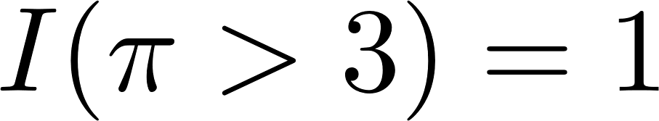
Probability, Bernoulli and the Expectation Indicator Function “Trick”
The indicator function returns 1 when its argument is true and 0 otherwise.
E.g., or
Convert between expectations and probabilities
Will be critical during the approximation unit
For an event A and random variable Y,

Slide 53
Admin Matters
Bayes practice and thinking generatively
Levels of analysis
Short rest 1
Math to cover:
Expected value
Continuous probability
Gaussian
Mixture modeling
Beta-Binomial (discrete enters the continuum)
Short rest 2
Student intros + one paper presentation
Go over paper presentation advice here too.

Slide 54

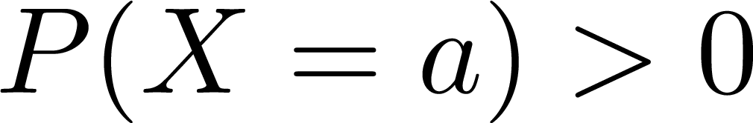
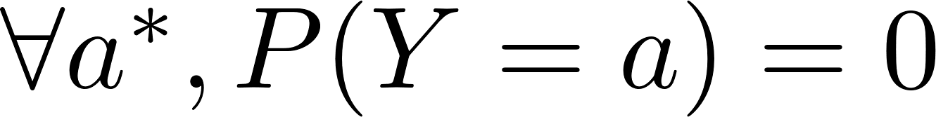
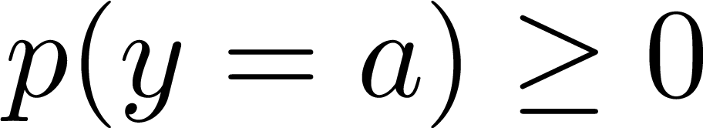
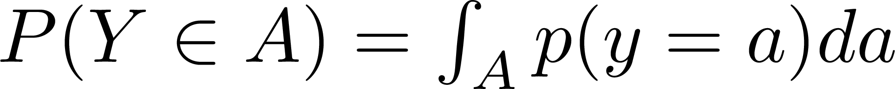
Probabilities in Continuous Land
Probability mass function:
probability mass assigned to a specific value
Discrete random variable (rv) X and continuous rv Y
Probability density function: p(‧)
Relative likelihood of a value near that precise location
To get probabilities for continuous distributions, you calculate the probability it takes a value in some region.
The probability is the integral of the density for a region
Very small change in a
Integral symbol
Region to integrate
Notes:
Also uppercase vs. lowercase – no one is perfect, but try to be
not only notation – some write Y variable in the subscript, but I don’t like that notation…
Note about what you need to know from math

Slide 55
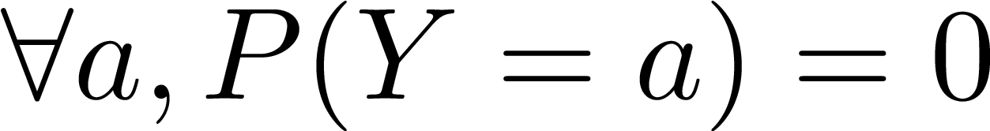
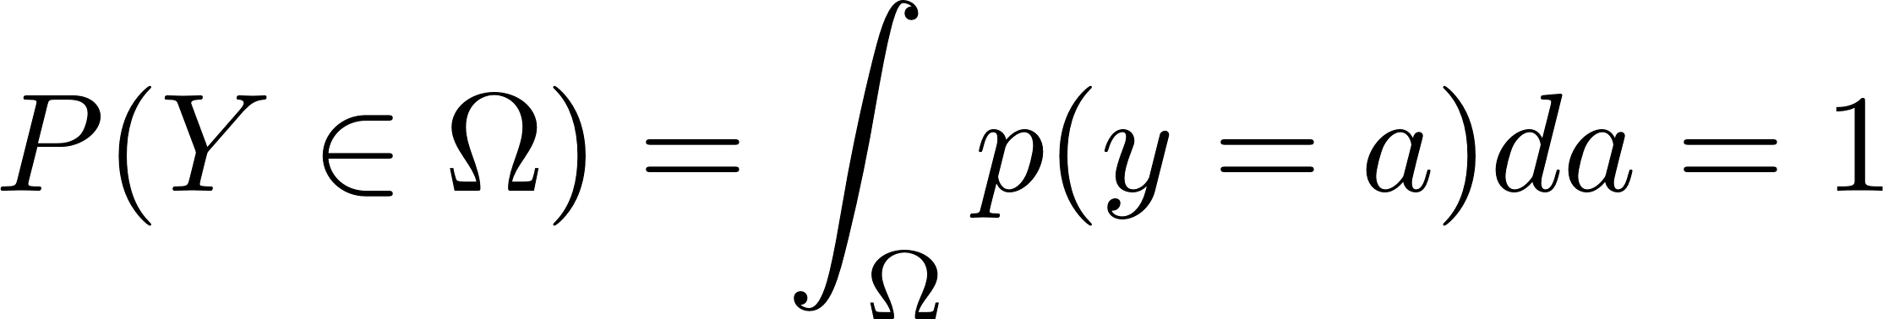
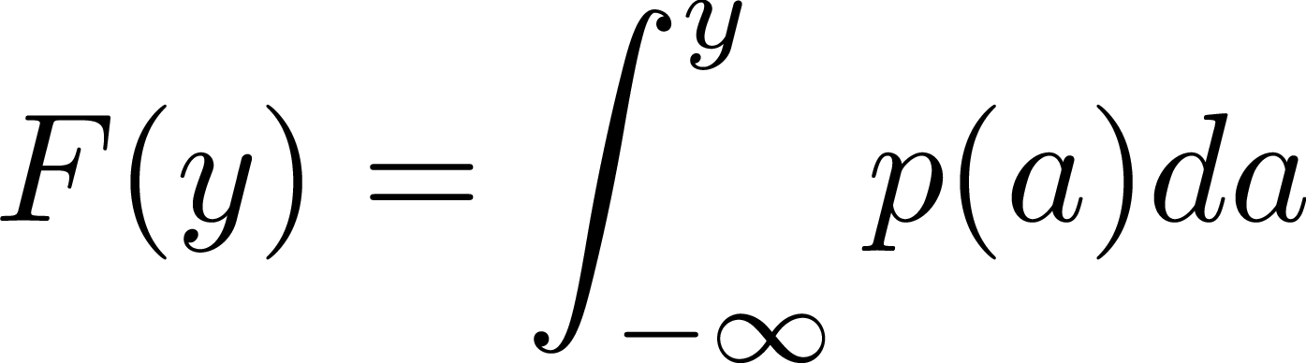
Probabilities in Continuous Land
Probability mass function (PMF):
probability mass assigned to a specific value
Discrete random variable (rv) X and continuous rv Y
Probability density function (PDF):
Relative likelihood of a value near that precise location
Note:
Cumulative distribution function (CDF)
Notes:
Also uppercase vs. lowercase – no one is perfect, but try to be
not only notation – some write Y variable in the subscript, but I don’t like that notation…

Slide 56
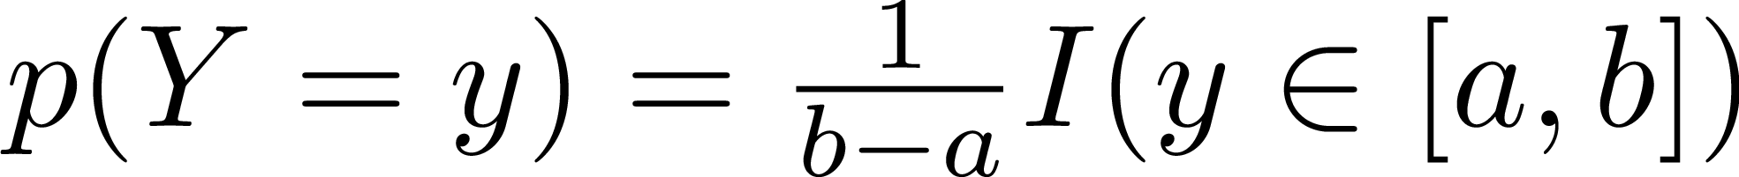
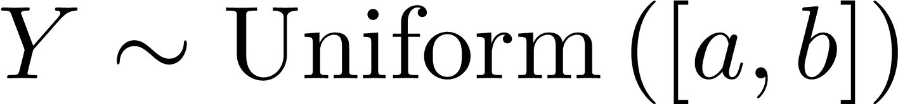
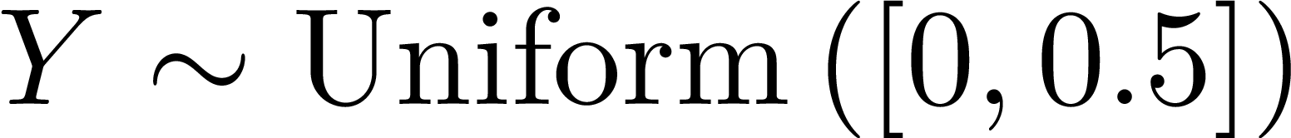
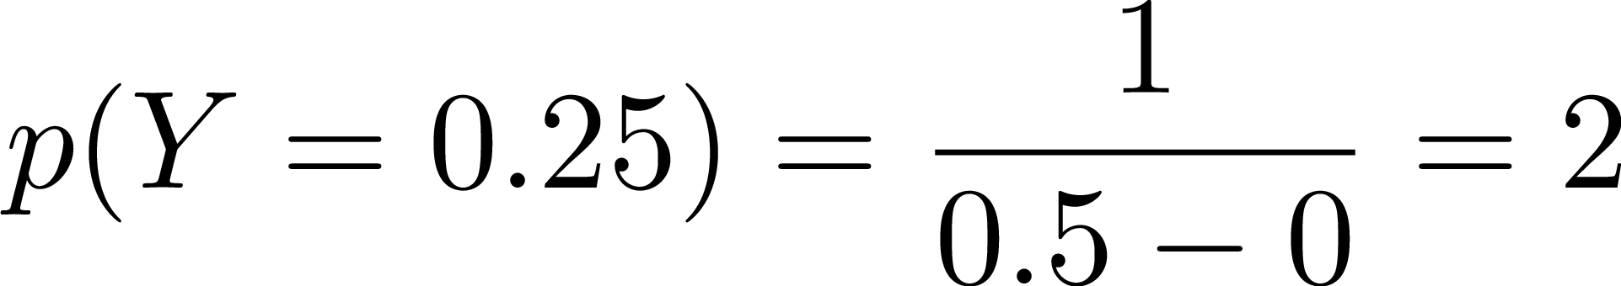
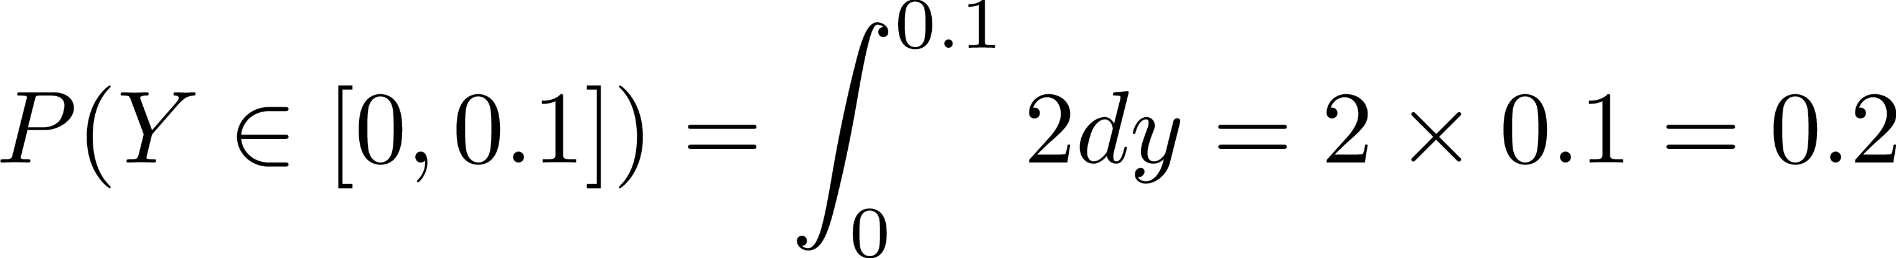
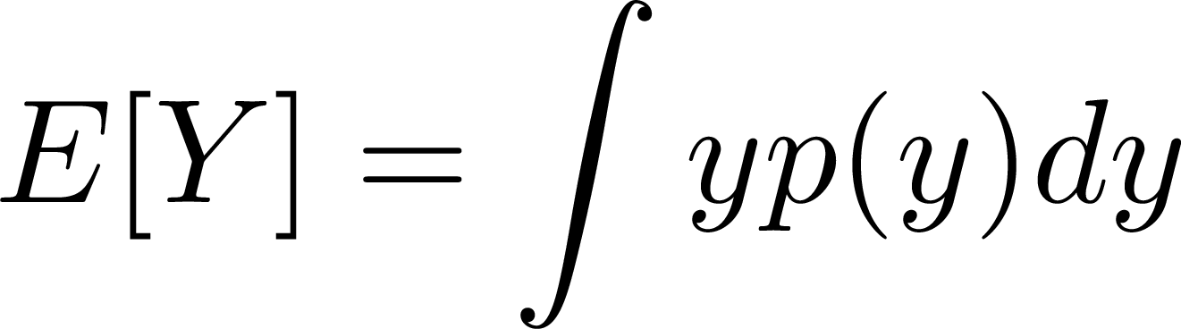

Continuous Uniform Distribution
The continuous uniform distribution over the interval [a,b] is
E.g.,
What does that mean?
How about prob. that Y is less than 0.1?
Expected value?
“distributed as”
Notes:
Will revisit with examples over time.

Slide 57
Admin Matters
Bayes practice and thinking generatively
Levels of analysis
Short rest 1
Math to cover:
Expected value
Continuous probability
Gaussian
Mixture modeling
Beta-Binomial (discrete enters the continuum)
Short rest 2
Student intros + one paper presentation
Go over paper presentation advice here too.

Slide 58
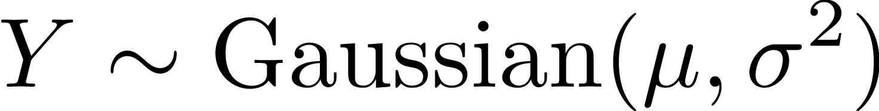
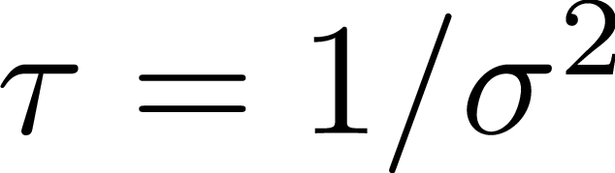
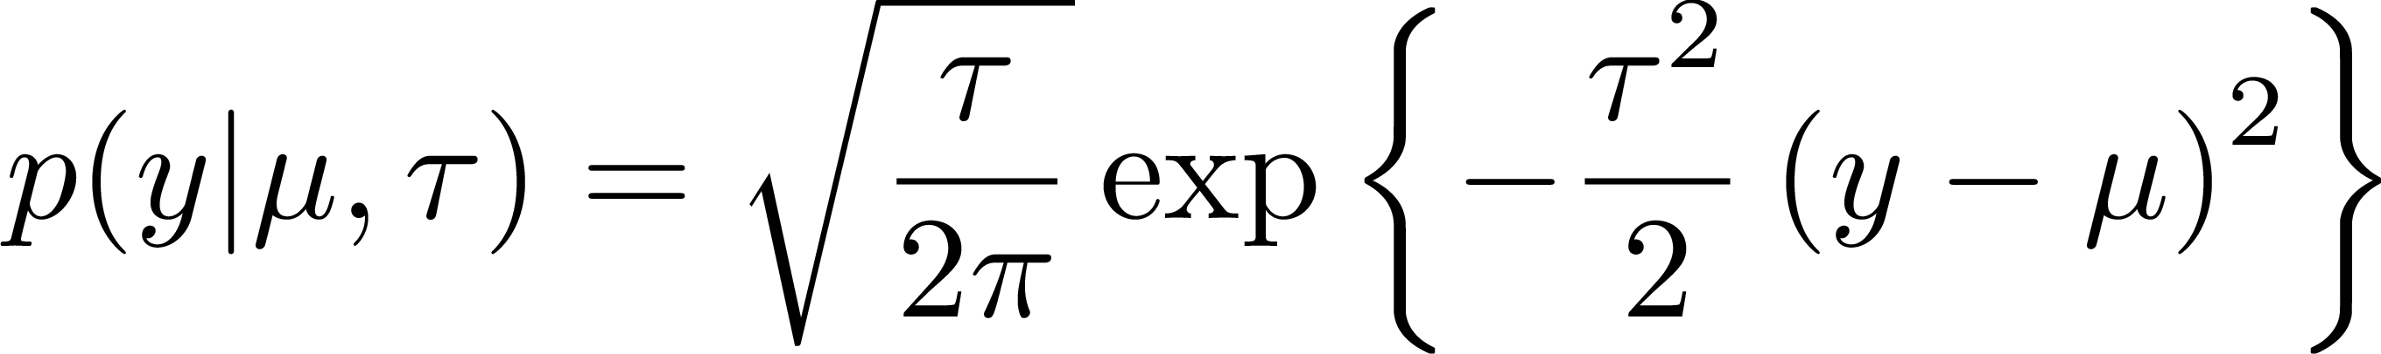
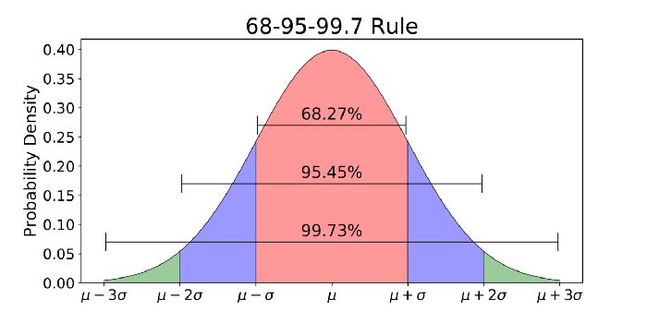

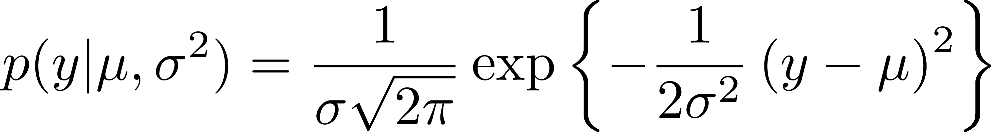



Gaussian/Normal Distribution
Alternative parametrization:
Note: There is no closed form solution for the CDF.
A special case of the CDF is the “Error Function”.
It is often written as .
Image from https://towardsdatascience.com/understanding-the-68-95-99-7-rule-for-a-normal-distribution-b7b7cbf760c2
Notes:
Also uppercase vs. lowercase – no one is perfect, but try to be
not only notation – some write Y variable in the subscript, but I don’t like that notation…

Slide 59
Admin Matters
Bayes practice and thinking generatively
Levels of analysis
Short rest 1
Math to cover:
Expected value
Continuous probability
Gaussian
Mixture modeling
Beta-Binomial (discrete enters the continuum)
Short rest 2
Student intros + one paper presentation
Go over paper presentation advice here too.

Slide 60
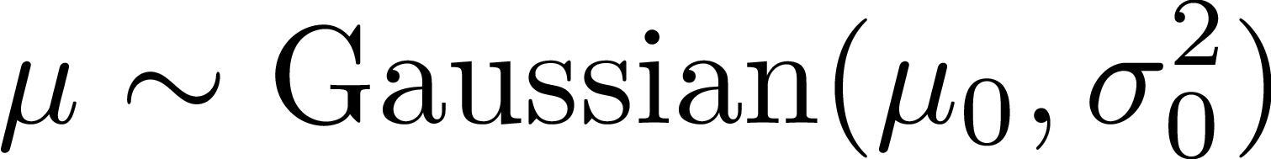
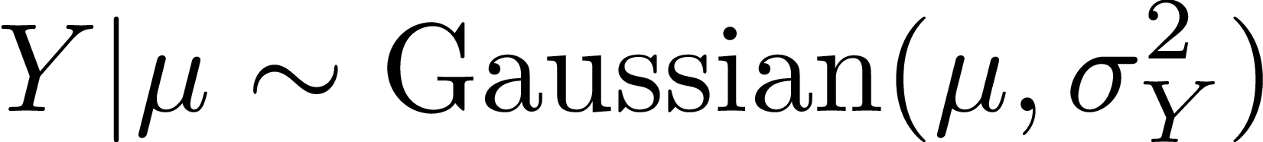
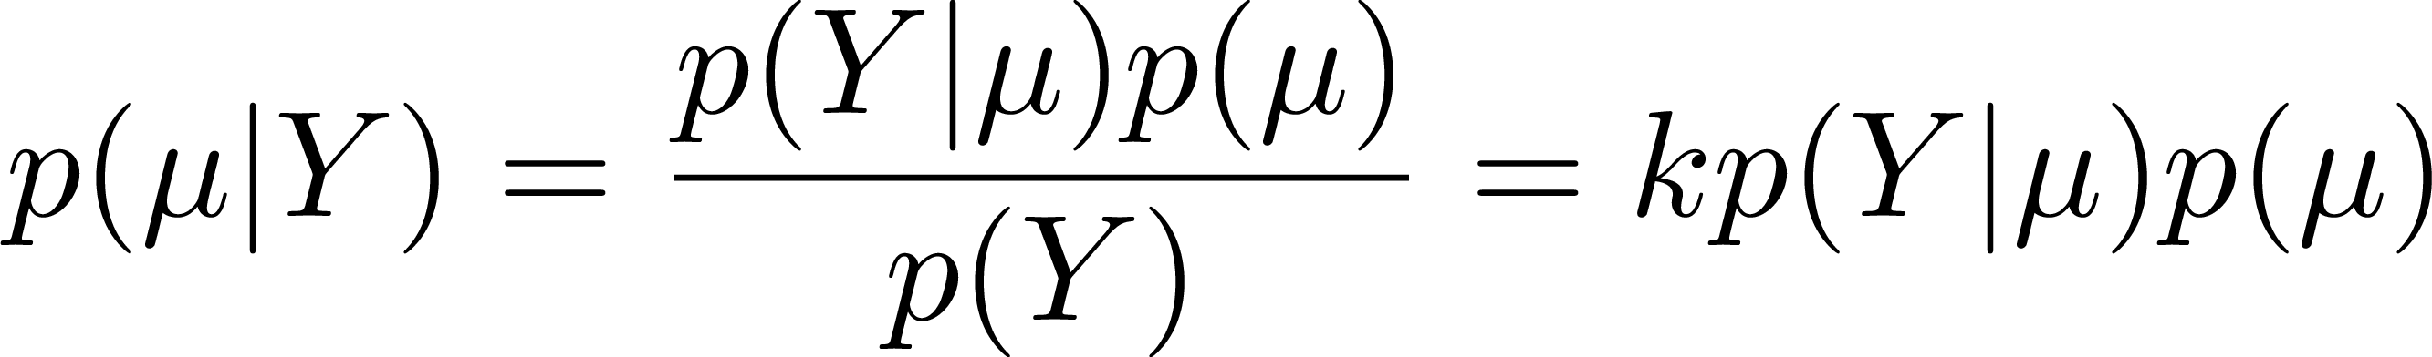

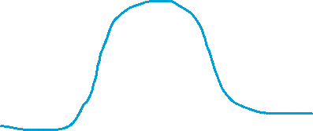
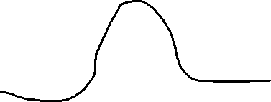

Posterior Mean For Normal Prior Given Known Variances
Varying k just stretches the function vertically – neither changes the functional form nor ordering of which points have greater values than others.
k will be the value that makes the integral of the function 1 for the given Y. WHY?
Notes:
Also uppercase vs. lowercase – no one is perfect, but try to be
not only notation – some write Y variable in the subscript, but I don’t like that notation…

Slide 61
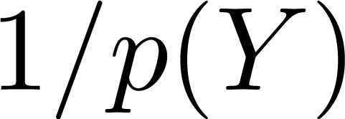


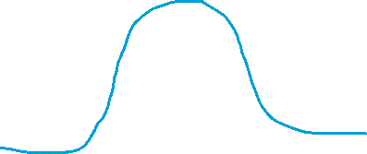
Posterior Mean For Normal Prior Given Known Variances
Varying k just stretches the function vertically – neither changes the functional form nor ordering of which points have greater values than others.
k will be the value that makes the integral of the function 1 for the given Y. WHY?
“normalizing constant” or “partition function”
Notes:
Also uppercase vs. lowercase – no one is perfect, but try to be
not only notation – some write Y variable in the subscript, but I don’t like that notation…

Slide 62
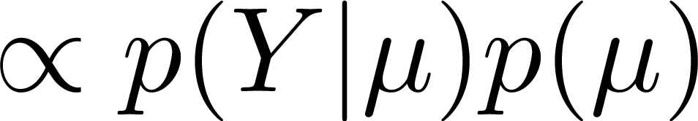
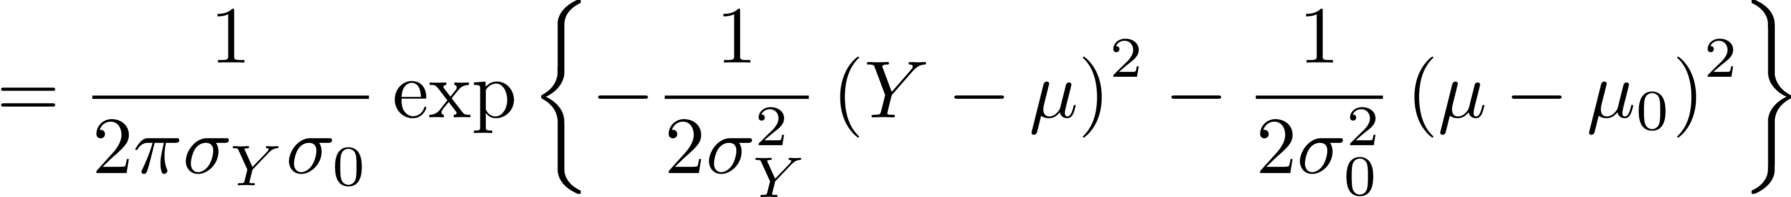
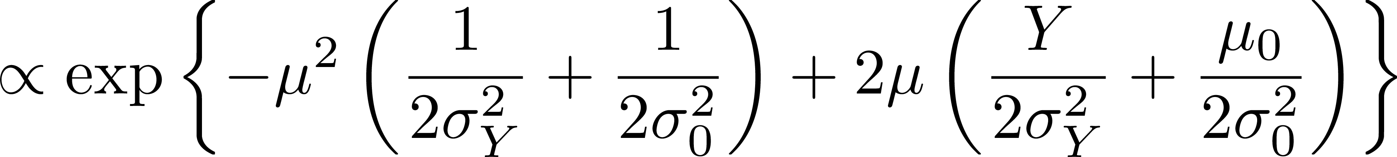
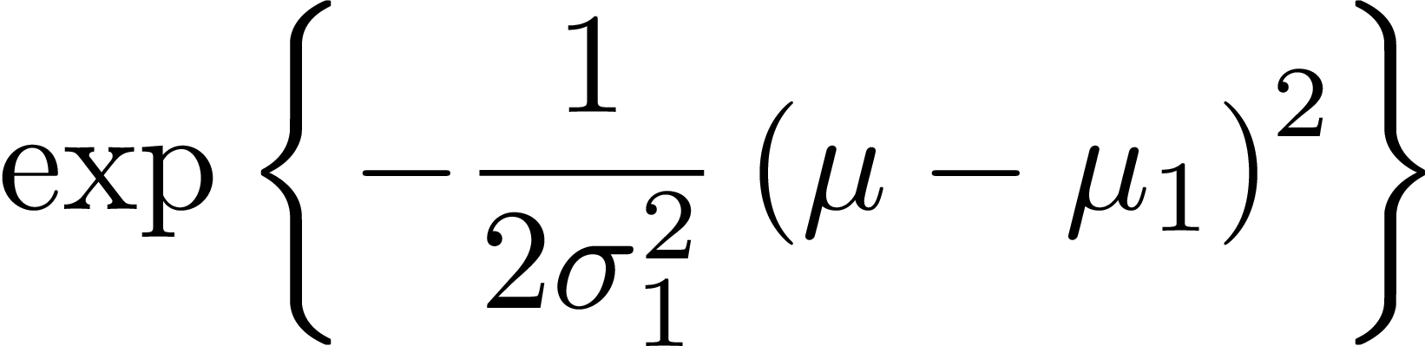


Posterior Mean For Normal Prior Given Known Variances
Notes:
Also uppercase vs. lowercase – no one is perfect, but try to be
not only notation – some write Y variable in the subscript, but I don’t like that notation…

Slide 63
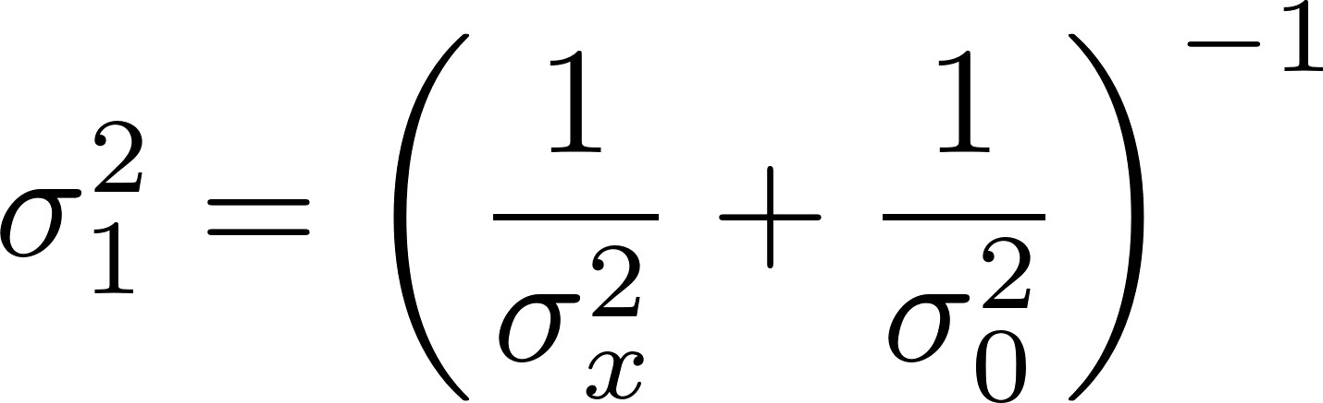
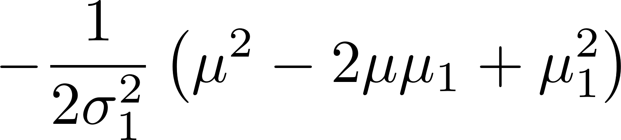
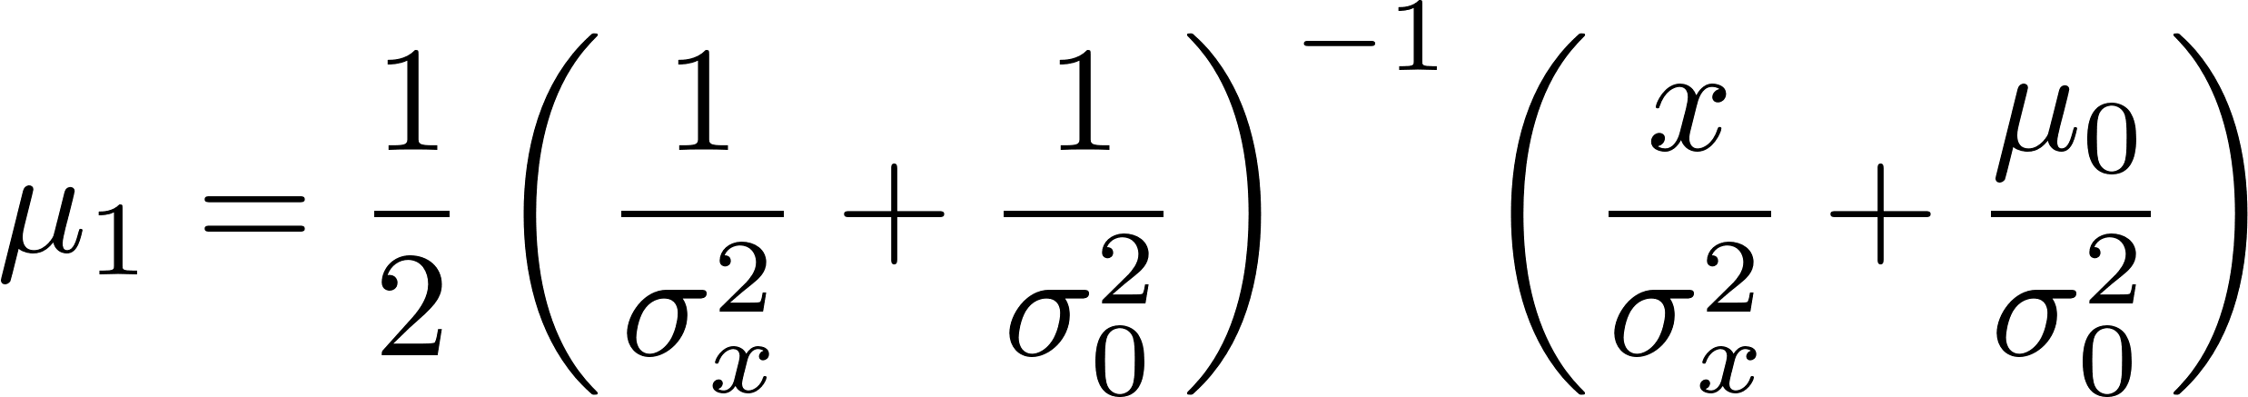


Posterior Mean For Normal Prior Given Known Variances
Notes:
Also uppercase vs. lowercase – no one is perfect, but try to be
not only notation – some write Y variable in the subscript, but I don’t like that notation…

Slide 64
Cluster assignment part 1 walkthrough
https://canvas.wisc.edu/courses/446937/assignments/2579703

Slide 65
Admin Matters
Bayes practice and thinking generatively
Levels of analysis
Short rest 1
Math to cover:
Expected value
Continuous probability
Gaussian
Mixture modeling
Beta-Binomial (discrete enters the continuum)
Short rest 2
Student intros + one paper presentation
Go over paper presentation advice here too.

Slide 66
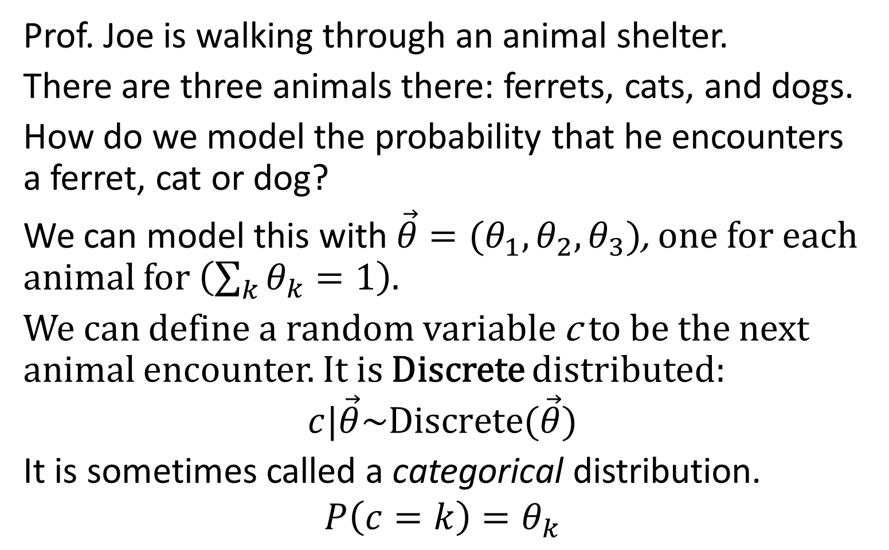
Discrete Distribution
Prof. Joe is walking through an animal shelter.
There are three animals there: ferrets, cats, and dogs.
How do we model the probability that he encounters a ferret, cat or dog?
We can model this with$\vec{θ}=(θ_{1},θ_{2},θ_{3})$, one for each animal for $\left(\sum_{k}{θ_{k}}=1\right)$.
We can define a random variable c to be the next animal encounter. It is Discrete distributed:
$$c|\vec{θ}\sim Discrete(\vec{θ})$$
It is sometimes called a categorical distribution.
$$P\left(c=k\right)=θ_{k}$$

Slide 67
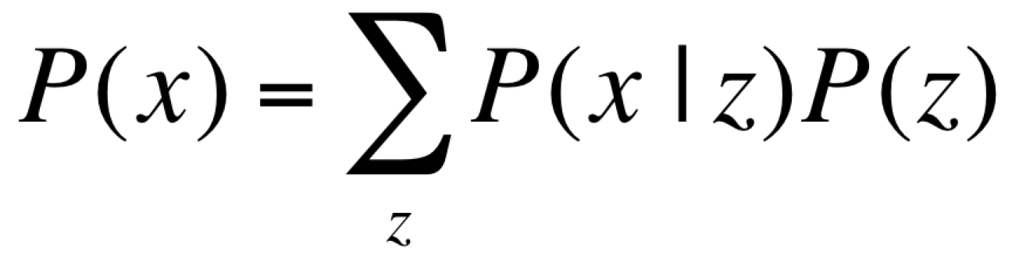
Mixture models
z
P(z)
Latent (unobserved)
x
P(x|z)
Marginalize out
(i.e. sum over)
latent structure
Observed

Slide 68
Plate notation
z₁
z₂
z₃
z_{n}
x₁
x₂
x₃
x_{n}
n=1,2,3

Slide 69
Plate notation
µ
µ
x₁
x₂
x₃
x_{n}
n=1,2,3

Slide 70
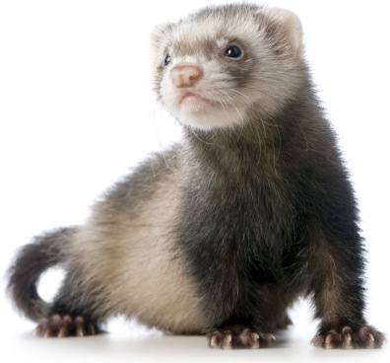
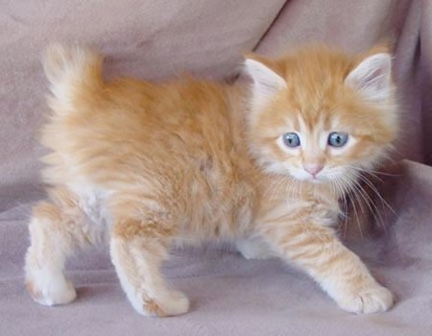





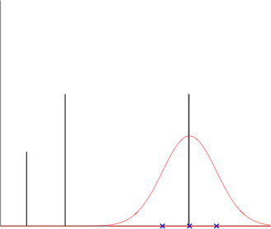

Categorization as Mixture Modeling
1
2
3
To make an animal, first sample which animal we want from
Each animal is created from its associated ideal “snout size” and variance .
This leads to the following generative process for each animal
Prob. of new snout size:
Categorize a new animal
given its snout size:
2
1
3
2
2
3
3
Prob. of snout size
Prob. of snout size
Prob. of snout size
1
1
Snout Size
Snout Size
Snout Size

Slide 71


Mixture distributions
mixture distribution
mixture components
Probability
mixture weights
x

Slide 72
Cluster assignment part 2 walkthrough
https://canvas.wisc.edu/courses/446937/assignments/2579703

Slide 73
Admin Matters
Bayes practice and thinking generatively
Levels of analysis
Short rest 1
Math to cover:
Expected value
Continuous probability
Gaussian
Mixture modeling
Beta-Binomial (discrete enters the continuum)
Short rest 2
Student intros + one paper presentation
Go over paper presentation advice here too.

Slide 74
















Binomial Distribution
# of heads from N coinflips.
Create N - k tails
Create k heads
Count the number of ways you can get k heads with N coinflips. “N choose k”
Number of ways to order N unique items
Number of ways to order N - k tails
Number of ways to order k heads
N! is the “factorial” operator. It counts the number of ways to order N items.
Notes:
Also uppercase vs. lowercase – no one is perfect, but try to be
not only notation – some write Y variable in the subscript, but I don’t like that notation…

Slide 75







Binomial Distribution
k
k
k
What if we don’t know the coinflip bias? (the probability of heads )?
Notes:
Also uppercase vs. lowercase – no one is perfect, but try to be
not only notation – some write Y variable in the subscript, but I don’t like that notation…

Slide 76

The Beta Distribution: A distribution over the probability of a heads
Beta(a, b)
These are Beta(αβ, α(1-β)).
Average Value
β = 0.5
0
0.5
1
0
0.5
1
0
0.5
1
mostly tails
mostly heads
α = 0.5
α = 2
Shape
α = 10

Slide 77

β = 0.8
β = 0.5
0
0.5
1
0
0.5
1
0
0.5
1
mostly tails
mostly heads
α = 0.5
α = 2
α = 10

Slide 78

Gamma function interlude
In all likelihood, never will need to deal with directly.
It is the generalized factorial function.
For positive integer x,
As far as I’m concerned, it is restricted to positive real numbers.
It is the normalization constant for the Gamma distribution.
Some useful facts:

Slide 79








Beta-Binomial Posterior Update
Posterior is of the same functional form as prior (Both are prior).
Parameters are updated to reflect knowledge.
New a adds in the number of heads. New b adds in number of tails.
This is a Conjugate Prior. (more on this next week)

Slide 80
Admin Matters
Bayes practice and thinking generatively
Levels of analysis
Short rest 1
Math to cover:
Expected value
Continuous probability
Gaussian
Mixture modeling
Beta-Binomial (discrete enters the continuum)
Short rest 2
Student intros + one paper presentation
Go over paper presentation advice here too.

Slide 81

Short rest 2

Slide 82
Admin Matters
Bayes practice and thinking generatively
Levels of analysis
Short rest 1
Math to cover:
Expected value
Continuous probability
Gaussian
Mixture modeling
Beta-Binomial (discrete enters the continuum)
Short rest 2
Student intros + one paper presentation
Go over paper presentation advice here too.

Slide 83
Class presentations (2x 5% each)
Present the major results of one of the course readings.
Must be a non-optional reading.
Also, have 4-6 discussion questions at the end.
These should guide discussion.
Being controversial/provocative is encouraged!
Have to give two if you are taking the course for credit.
One if formally auditing.
Each presentation (including discussion) should be no longer than 25 minutes.
You are encouraged to meet with me beforehand.
Must submit to me on Canvas right before or after (8:59pm day of presentation deadline)!

Slide 84
Class presentations (2x 5% each)
Grade is determined by the following factors:
Understanding of the paper (2 pts)
Covering the key aspects of the paper (1 pt)
Presentation clarity (1 pt)
Appropriate discussion questions (0.5 pts)
Appropriate use of time (0.5 pts)
Not using Prezi (10⁹⁹⁹ deduction and have to clean up)
See guidelines and tips document posted online.

Slide 85
Class presentations (2x 5% each)
Focus on the following questions:
1. What is the question that this paper explores? If applicable, what aspect of human behavior are we trying to understand?
2. Any background/context for the paper? Previous work?
3. What is the underlying computational problem being solved? How does the paper formulate it?
4. What is the solution to the computational problem? (Go for intuitions more than rigor.)
5. How is the solution used to answer the question? How does it compare to other approaches/human behavior?
6. What conclusions can we draw from the results? What is your interpretation?
Notes:
JOE : GO THROUGH papers in syllabus after this.

Slide 86
Student introductions
Name, preferred pronouns, undergrad/grad, department
Why are you taking this course?
What is one of your favorite comfort foods?

Slide 87
Admin Matters
Bayes practice and thinking generatively
Levels of analysis
Short rest 1
Math to cover:
Expected value
Continuous probability
Gaussian
Mixture modeling
Beta-Binomial (discrete enters the continuum)
Short rest 2
Student intros + one paper presentation
Go over paper presentation advice here too.

Slide 88
Randomness and Coincidences: Reconciling Intuition and Probability Theory (2001) by Griffiths & Tenenbaum
PSYCH/COMP SCI/BMI 841: Computational Cognitive Science
Joseph Austerweil
January 30, 2025

Slide 89
Which sequence feels more random?
HHHHHHHH
or
HHTHTTTH

Slide 90
Background
People’s perception of randomness deviates from a traditional take from probability theory.
HHTHTTTH feels more random than HHHHHHHH
People tend to perceive sequences that alternate 60% of the time as the most random (Lopes, 1982).
Theories to explain the discrepancy:
Different normative theory for randomness
Representativeness: Sequence similar to the output of a random generating device

Slide 91
Question
What normative theory should be used for randomness and do people deviate from it systematically?

Slide 92
Bayesianism
Bayesian inference is the mathematics of inductive problems.*
Steps to forming a Bayesian model:
1. Formalize the problem that people face.
2. Formalize the types of knowledge people have when solving the problem.
3. Apply Bayes’ rule and see what an ideal learner/observer would learn from the data.
4. How does the ideal learner behave?
5. What types of knowledge (*and/or constraints on learning) must be assumed for the model and people to behave similarly?
Notes:
Ask class how does this fit with hyp. space & prior?

Slide 93





Computational formalization
Evaluate which of two generating processes is more probable given the observation x:
Use odds form of Bayes’ rule to avoid calculating normalizing constant!
Assume equal prior odds
What should P(regular|x) be?

Slide 94





Computational formalization
Assume is a set of possible regularities that might produce a non-random sequence.
What if regular means a coinflip bias that is uniform over possible biases?
So, the integral must be the normalizing constant for a
Beta(H+1, N – H+1) distribution.
Almost N choose H
(inverted)

Slide 95

Computational formalization
Does not vary for sequences of the same length…

Slide 96
Zenith ESP “Experiment”
In 1937, Zenith Corp. broadcasted psychics who transmitted (silently) a sequence of coinflips to listeners.
Listeners sent in what they got from the psychics.
Regularities, but unrelated to the psychics…
Goodfellow (1938)

Slide 97


Modeling the Zenith ESP “Experiment”
Sequentially generated, so Griffiths and Tenenbaum (2000) assume people select H vs. T as the k-th response based on how much more “random” they were when compared to all shorter subsequences.
Response then was mapped through a logistic function to allow for some uniformity over sequences in model behavior.

Slide 98
Modeling the Zenith ESP “Experiment”

Slide 99
Generate digit 0 to 9
Random likelihood is uniform over 0 to 9.
Model is very similar, except now we use number properties of digits from 0 to 9 as our hypothesis space (e.g., multiples of 2, multiples of 3) and then a digit is generated uniformly at random from the digits consistent with the sampled number property.

Slide 100
Coincidences, Randomness, and the Birthday Paradox
How big of a coincidence is it that four people have their birthdays on Oct 4, Oct 4, Oct 4, Oct 4 vs. May 14, Jul 18, Aug 21, and Oct 4?
Basically the same model, except now, regularities are related to patterns in months/dates.
Participants asked how big a coincidence and how random?

Slide 101
Coincidences, Randomness, and the Birthday Paradox

Slide 102
Conclusions
People’s randomness judgments seem at odds with probability theory.
But there is systematicity to it…
If we reformulate the computational problem as randomness AS OPPOSED TO regular, we can capture human judgments.
It generalizes beyond just randomness, but also to coincidences.
Notes:
A bayesian view of sensorimotor learning is consistent with neuro- physiological studies showing that the brain represents the degree of
inputs to the motor output
25–27 uncertainty when estimating rewards and with psychophysical
studies addressing the timing of movements28,29.
require a direct measure of sensory uncertainty before it is integrated with the prior. However, such a measure cannot easily be obtained as even a naive subject would integrate feedback with their natural

Slide 103
Discussion Questions
What is the correct normative problem?
Does modeling randomness judgments even matter? (is this just some weird phenomenon?)
Does this generalize to (any) real-world domains?
What is the set of regularities? How do we learn them for a new domain?
Are randomness judgments an inevitable consequence of an ideal observer looking for patterns in a noisy world? Or is it just irrational?

