Slide 1


Week 2 — Levels of Analysis + Bayes Continued
Prof. Joseph Austerweil
Friday, April 24, 2026
Notes:
Crisp start. Today's backbone is the second half: continuous probability, Gaussian, and the Gaussian-Gaussian update. Marr is a 7-min frame; Chibany meets us at the top.

Slide 2
Agenda
Welcome + meet Chibany
0:00
Marr's three levels
0:08
Notation lock-in
0:15
Joint + marginalization
0:18
Expected value + discrete
0:30
Continuous prob + Gaussian
0:45
Break
1:05
Gaussian-Gaussian update
1:15
Paper presentations
1:40
Admin + Week 3
1:50

Slide 3
Human and Machine Learning SP26 — Week 2
Welcome back + meet Chibany
Notes:
~8 min. First 3 min: syllabus updates + Week 1 pulse. Next 5 min: introduce Chibany and the bento scenario properly, so the rest of the session has a narrative it can actually lean on.

Slide 4
Two changes since Week 1
Paper presentations are in.
Each of you presents one reading once. More at 1:40.
Reflections: 6 of 12, not 8 of 13.
Class is now 2 h × 12 weeks. More at 1:50.
Notes:
State the two facts, move on. If a student asks for detail, say 'I'll get to that at 1:40 / 1:50.' ~1 min.

Slide 5
Meet Chibany
Chibany is a probability-minded professor at our school.
Every day, students bring them bentos.
Chibany is the protagonist of our textbook,
"A Narrative Introduction to Probability" — Tutorial 3 Ch 1.
Notes:
Slide 1: 'Before we do math, meet Chibany. They're the character we'll use as our worked example all semester. They\'re also the protagonist of the textbook, so reading T3 Ch 1 tonight will top this up.'

Slide 6
Meet Chibany
Chibany is a probability-minded professor at our school.
Every day, students bring them bentos.
Chibany is the protagonist of our textbook,
"A Narrative Introduction to Probability" — Tutorial 3 Ch 1.
There's a catch: the bento boxes are OPAQUE.
Chibany can't peek. They want to know the meal — without opening.
Notes:
Slide 2: 'The hook: opaque bentos. Chibany can\'t directly see the meal. Classic hidden-variable setup. Just like last week\'s checkershadow and Heider-Simmel — an inference problem under incomplete information.'

Slide 7
Meet Chibany
Chibany is a probability-minded professor at our school.
Every day, students bring them bentos.
Chibany is the protagonist of our textbook,
"A Narrative Introduction to Probability" — Tutorial 3 Ch 1.
There's a catch: the bento boxes are OPAQUE.
Chibany can't peek. They want to know the meal — without opening.
What Chibany knows (from past semesters):
• Tonkatsu bentos weigh about 500 g
• Hamburger bentos weigh about 350 g
• Students bring tonkatsu about 70% of the time
(overheard two students chatting last week)
Notes:
Slide 3: 'Prior knowledge. Two canonical weights and a 70/30 prior on the meal. Note the prior comes from the world (overheard conversation), not from nowhere — priors are usually knowledge from somewhere else.'

Slide 8
Meet Chibany
Chibany is the protagonist of our textbook,
"A Narrative Introduction to Probability" — Tutorial 3 Ch 1.
There's a catch: the bento boxes are OPAQUE.
Chibany can't peek. They want to know the meal — without opening.
What Chibany knows (from past semesters):
• Tonkatsu bentos weigh about 500 g
• Hamburger bentos weigh about 350 g
• Students bring tonkatsu about 70% of the time
(overheard two students chatting last week)
Chibany's plan: WEIGH THE BENTO.
"If the weight doesn't tell me for sure, it'll at least UPDATE
my belief about today's meal."
That update is Bayes' rule. Same rule as last week — new anchor.
Notes:
Slide 4: 'Chibany\'s strategy: weigh the bento and update. This is the Week 1 sick-friend move, just with a bento instead of a patient. Prior belief, observation, posterior. Same rule. New anchor.'

Slide 9
Agenda
Welcome + meet Chibany
0:00
Marr's three levels
0:08
Notation lock-in
0:15
Joint + marginalization
0:18
Expected value + discrete
0:30
Continuous prob + Gaussian
0:45
Break
1:05
Gaussian-Gaussian update
1:15
Paper presentations
1:40
Admin + Week 3
1:50

Slide 10
Human and Machine Learning SP26 — Week 2
Marr's three levels — frame for the whole course
Notes:
7 min hard cap. Trimmed from the earlier draft to free time for Gaussian visualization. 3 slides (one per level) + check-in. Do NOT let this expand.

Slide 11
Marr L1 — what problem is being solved?
For Chibany: Compute P(meal | weight).
L1 specifies the CORRECT computation — not how to do it,
not how Chibany's brain actually does it.
Different goal ⇒ different L1 ⇒ different normative answer.
Notes:
~2 min. Bayes is the normative answer for 'combine prior + evidence.' Counterfactual: if the goal were 'minimize reaction time,' L1 differs. Choosing L1 IS a modeling move.

Slide 12
Marr L2 — what algorithm?
Same L1 — multiple algorithms:
• Enumerate (today: 2 hypotheses, sum-and-normalize)
• Sample (Week 7 Monte Carlo)
• "Always guess tonkatsu" — an algorithm. A BAD one.
Bayes is L1. Algorithms are L2.
Notes:
~2 min. The bad-algorithm point is important: "always guess tonkatsu" is 70% accurate because of the prior — it's still a well-defined L2, just one that ignores the observation.

Slide 13
Marr L3 — what implementation?
Chibany: neurons, experience, gut feeling.
Our simulation: JAX arrays, floating-point math, Colab.
Three levels — mostly independent.
Right L1 + wrong L2 → systematic human biases.
(Full L3 treatment: Week 11, Deep NNs.)
Notes:
~2 min. FAST. Land the independence point — this is the thread for the rest of the course.

Slide 14
Check-in — the cab problem
Last week: witness says "blue"; 15% blue cabs;
witness accurate 80%. Most of you guessed ~80%.
At which level was the mistake?
Target: L1 = P(blue | report). Actual L1 answer ≈ 0.41.
80% is a wrong-L2 claim (ignore the base rate).
Notes:
~1 min. Fast — elicit the answer. Bridge: "humans systematically use a non-Bayesian L2 on this problem; that gap between L1 and L2 is behavioral economics."

Slide 15
Agenda
Welcome + meet Chibany
0:00
Marr's three levels
0:08
Notation lock-in
0:15
Joint + marginalization
0:18
Expected value + discrete
0:30
Continuous prob + Gaussian
0:45
Break
1:05
Gaussian-Gaussian update
1:15
Paper presentations
1:40
Admin + Week 3
1:50

Slide 16
Human and Machine Learning SP26 — Week 2
Notation lock-in
Notes:
3 min. Quick. No theatrical apology.

Slide 17
Notation — one rule, starting today
From today:
H = hypothesis (hidden — what we want to know)
D = data (observed — what we see)
For Chibany: H = meal, D = weight.
Notes:
Slide 1: 'H = hypothesis, D = data. For Chibany, H is the meal, D is the weight. Simple, consistent.'

Slide 18
Notation — one rule, starting today
From today:
H = hypothesis (hidden — what we want to know)
D = data (observed — what we see)
For Chibany: H = meal, D = weight.
P(H = h | D = d) = P(D = d | H = h) · P(H = h) / P(D = d)
Notes:
Slide 2: 'The formula you saw last week. Same one.'

Slide 19
Notation — one rule, starting today
From today:
H = hypothesis (hidden — what we want to know)
D = data (observed — what we see)
For Chibany: H = meal, D = weight.
P(H = h | D = d) = P(D = d | H = h) · P(H = h) / P(D = d)
posterior = likelihood · prior / evidence
Notes:
Slide 3: 'Name the four pieces. You\'ll see these names the rest of the semester.'

Slide 20
Agenda
Welcome + meet Chibany
0:00
Marr's three levels
0:08
Notation lock-in
0:15
Joint + marginalization
0:18
Expected value + discrete
0:30
Continuous prob + Gaussian
0:45
Break
1:05
Gaussian-Gaussian update
1:15
Paper presentations
1:40
Admin + Week 3
1:50

Slide 21
Human and Machine Learning SP26 — Week 2
Joint + marginalization — Chibany-style
Notes:
12 min. Three build-ups + a Week-1 bridge slide. Now in H/D notation with Chibany — students saw these moves last week in the 2-coin-flip grid and in the sick-friend/cab problems.

Slide 22
Last week's sick-friend problem, in H/D notation
Last week: smoker friend, cough heard, three hypotheses.
In the new notation:
H ∈ { cold, stomach virus, lung cancer }
D = cough
Notes:
Slide 1: 'Quick re-cast. H = disease hypothesis (note: lowercase h from last week is now uppercase H; content unchanged). D = cough. Same problem, new notation.'

Slide 23
Last week's sick-friend problem, in H/D notation
Last week: smoker friend, cough heard, three hypotheses.
In the new notation:
H ∈ { cold, stomach virus, lung cancer }
D = cough
Prior P(H): 0.45 0.10 0.10
Likelihood P(D|H): 0.90 0.45 0.90
Numerators: 0.405 0.045 0.090
Evidence P(D) = 0.540
Notes:
Slide 2: 'Same numbers as last week. Prior, likelihood, multiply, sum 'for the evidence.'

Slide 24
Last week's sick-friend problem, in H/D notation
Last week: smoker friend, cough heard, three hypotheses.
In the new notation:
H ∈ { cold, stomach virus, lung cancer }
D = cough
Prior P(H): 0.45 0.10 0.10
Likelihood P(D|H): 0.90 0.45 0.90
Numerators: 0.405 0.045 0.090
Evidence P(D) = 0.540
Posteriors: 0.75 0.083 0.167
Same answer as last week. Same rule. New labels.
Everything we do today uses this SAME structure.
Notes:
Slide 3: 'Posterior 0.75 / 0.083 / 0.167. Cold wins despite smoking — priors matter, likelihoods matter, neither alone is enough. Now today: same structure, but with Chibany.'

Slide 25
Setup — two-by-two Chibany world
Start simple: discretize weight to TWO buckets.
H ∈ {tonkatsu, hamburger}
D ∈ {heavy, light}
Prior: P(tonkatsu) = 0.7, P(hamburger) = 0.3
Likelihood: P(heavy | tonkatsu) = 0.9, P(heavy | hamburger) = 0.2
Later (Block 6): continuize weight. For now, 2×2.
Notes:
~1 min. The 2×2 is the scaffolding. Structurally the same as last week\'s 2-coin-flip grid {HH, HT, TH, TT} — same moves apply. The difference: different numbers, and meal ≠ weight (two variables, not the same coin twice).

Slide 26
The joint P(H, D) — build the 2×2 table
Four cells:
| heavy | light
tonkatsu | ? | ?
hamburger | ? | ?
Notes:
Slide 1: 'Four combinations of (meal, weight). We want the joint probability of each.'

Slide 27
The joint P(H, D) — build the 2×2 table
Four cells:
| heavy | light
tonkatsu | ? | ?
hamburger | ? | ?
Joint by the product rule: P(H, D) = P(D | H) · P(H)
P(tonk, heavy) = 0.9 · 0.7 = 0.63
P(tonk, light) = 0.1 · 0.7 = 0.07
P(hamb, heavy) = 0.2 · 0.3 = 0.06
P(hamb, light) = 0.8 · 0.3 = 0.24
Notes:
Slide 2: 'Joint = prior times conditional. Multiply across.'

Slide 28
The joint P(H, D) — build the 2×2 table
Four cells:
| heavy | light
tonkatsu | ? | ?
hamburger | ? | ?
Joint by the product rule: P(H, D) = P(D | H) · P(H)
P(tonk, heavy) = 0.9 · 0.7 = 0.63
P(tonk, light) = 0.1 · 0.7 = 0.07
P(hamb, heavy) = 0.2 · 0.3 = 0.06
P(hamb, light) = 0.8 · 0.3 = 0.24
Sanity check: 0.63 + 0.07 + 0.06 + 0.24 = 1.00 ✓
Recognize the shape? Week 1's 2-coin-flip grid had 4 cells too.
Different numbers, same structure.
Notes:
Slide 3: 'Sanity check. Sum to 1. Analogy to last week\'s {HH, HT, TH, TT} — the structure is the same; we\'re just working with asymmetric probabilities.'

Slide 29
Marginalization — sum over what you don't care about
P(heavy) = ?
Sum the joint over H:
P(heavy) = P(tonk, heavy) + P(hamb, heavy)
= 0.63 + 0.06 = 0.69
Notes:
Slide 1: 'What\'s P(heavy) unconditionally? The bento is heavy either because it\'s a heavy tonkatsu OR a heavy hamburger. Sum across H.'

Slide 30
Marginalization — sum over what you don't care about
P(heavy) = ?
Sum the joint over H:
P(heavy) = P(tonk, heavy) + P(hamb, heavy)
= 0.63 + 0.06 = 0.69
P(light) = 0.07 + 0.24 = 0.31
0.69 + 0.31 = 1 ✓
Notes:
Slide 2: 'And P(light). Check it sums to 1.'

Slide 31
Marginalization — sum over what you don't care about
P(heavy) = ?
Sum the joint over H:
P(heavy) = P(tonk, heavy) + P(hamb, heavy)
= 0.63 + 0.06 = 0.69
P(light) = 0.07 + 0.24 = 0.31
0.69 + 0.31 = 1 ✓
The named move: MARGINALIZATION.
Given the joint, sum over the variable you're not asking about.
Week 1 called this the sum rule.
Notes:
Slide 3: 'Named: marginalization. Sum rule. Same move as last week.'

Slide 32
Conditional — restrict and renormalize
Chibany weighs today's bento and reads: D = heavy.
What's P(meal | heavy)?
Same move as Week 1's 2×2 coin-flip grid:
"Restrict to the slice where the observation is true; renormalize."
Notes:
Slide 1: 'Observation arrives. Now ask the conditional question. This is the SAME move as last week\'s P(first=H | at least one H) = 2/3 on the coin-flip grid. Restrict and renormalize.'

Slide 33
Conditional — restrict and renormalize
Chibany weighs today's bento and reads: D = heavy.
What's P(meal | heavy)?
Same move as Week 1's 2×2 coin-flip grid:
"Restrict to the slice where the observation is true; renormalize."
Step 1: keep only the "heavy" column of the joint.
P(tonk, heavy) = 0.63 P(hamb, heavy) = 0.06
Step 2: renormalize by P(heavy) = 0.69.
Notes:
Slide 2: 'Two steps. Slice the joint to keep only rows consistent with the observation; renormalize.'

Slide 34
Conditional — restrict and renormalize
Chibany weighs today's bento and reads: D = heavy.
What's P(meal | heavy)?
Same move as Week 1's 2×2 coin-flip grid:
"Restrict to the slice where the observation is true; renormalize."
Step 1: keep only the "heavy" column of the joint.
P(tonk, heavy) = 0.63 P(hamb, heavy) = 0.06
Step 2: renormalize by P(heavy) = 0.69.
P(tonk | heavy) = 0.63 / 0.69 ≈ 0.913
P(hamb | heavy) = 0.06 / 0.69 ≈ 0.087
Prior 0.70 → posterior 0.91. "Heavy" was very diagnostic.
Notes:
Slide 3: 'Posterior. Observing heavy moved prior 0.70 to posterior 0.91 — strongly diagnostic. Much stronger than the cab problem (0.15 prior → 0.41 posterior). Why? The likelihoods here are more informative, and the prior was less extreme.'

Slide 35
Summary — three operations on the joint
Joint = full picture, P(H, D). All cells sum to 1.
Marginal = sum the joint over the thing you don't care about.
Conditional = slice on your observation, renormalize.
Same Bayes as last week. Now you can SEE it as a table operation.
Notes:
~1 min. Mental model to carry forward. Everything today (and Week 3) is operations on this table — just with infinitely many cells.

Slide 36
Agenda
Welcome + meet Chibany
0:00
Marr's three levels
0:08
Notation lock-in
0:15
Joint + marginalization
0:18
Expected value + discrete
0:30
Continuous prob + Gaussian
0:45
Break
1:05
Gaussian-Gaussian update
1:15
Paper presentations
1:40
Admin + Week 3
1:50

Slide 37
Human and Machine Learning SP26 — Week 2
Expected value + discrete distributions
Notes:
15 min. E[X] (4 slides), Bernoulli (3 slides), Binomial (4 slides + 1 real PMF image). Bernoulli IS the meal draw; Binomial IS a week.

Slide 38
Expected value E[X]
For a discrete RV X with values {xᵢ} and probabilities {pᵢ}:
E[X] = Σᵢ xᵢ · pᵢ
"Weight each value by its probability, then add."
Notes:
Slide 1: 'Expected value. Weighted average. The formula is what you\'d naïvely call an average — but weighted by probability instead of counted equally.'

Slide 39
Expected value E[X]
For a discrete RV X with values {xᵢ} and probabilities {pᵢ}:
E[X] = Σᵢ xᵢ · pᵢ
"Weight each value by its probability, then add."
Chibany: encode meal numerically. tonkatsu = 1, hamburger = 0.
E[meal] = 1 · 0.7 + 0 · 0.3 = 0.7
The expected value of an indicator IS the probability.
Notes:
Slide 2: 'Encode meal as 1/0. Then E[meal] equals the probability. Key trick — we use it constantly in RL and in hypothesis testing.'

Slide 40
Expected value E[X]
For a discrete RV X with values {xᵢ} and probabilities {pᵢ}:
E[X] = Σᵢ xᵢ · pᵢ
"Weight each value by its probability, then add."
Chibany: encode meal numerically. tonkatsu = 1, hamburger = 0.
E[meal] = 1 · 0.7 + 0 · 0.3 = 0.7
The expected value of an indicator IS the probability.
Variance: Var[X] = E[(X − E[X])²] = E[X²] − E[X]²
For Bernoulli(p): Var = p(1 − p)
Bento meal: Var = 0.21, σ ≈ 0.46
Notes:
Slide 3: 'Variance. Spread. For Bernoulli(p), it simplifies to p(1-p). Maxed at p=0.5; smaller at the extremes.'

Slide 41
Expected value E[X]
For a discrete RV X with values {xᵢ} and probabilities {pᵢ}:
E[X] = Σᵢ xᵢ · pᵢ
"Weight each value by its probability, then add."
Chibany: encode meal numerically. tonkatsu = 1, hamburger = 0.
E[meal] = 1 · 0.7 + 0 · 0.3 = 0.7
The expected value of an indicator IS the probability.
Variance: Var[X] = E[(X − E[X])²] = E[X²] − E[X]²
For Bernoulli(p): Var = p(1 − p)
Bento meal: Var = 0.21, σ ≈ 0.46
E[X] = center of mass. Var[X] = spread.
Two numbers that summarize a lot. Used everywhere downstream.
Notes:
Slide 4: 'Mental model: mean = balance point, variance = width.'

Slide 42
Bernoulli distribution
X ~ Bernoulli(p) means:
P(X = 1) = p, P(X = 0) = 1 − p
One flip of a weighted coin. One parameter: p.
Notes:
Slide 1: 'Bernoulli. One parameter.'

Slide 43
Bernoulli distribution
X ~ Bernoulli(p) means:
P(X = 1) = p, P(X = 0) = 1 − p
One flip of a weighted coin. One parameter: p.
Chibany: meal_today ~ Bernoulli(0.7).
P(meal_today = tonkatsu) = 0.7
P(meal_today = hamburger) = 0.3
Notes:
Slide 2: 'The bento meal is Bernoulli(0.7). Every day, a weighted flip.'

Slide 44
Bernoulli distribution
X ~ Bernoulli(p) means:
P(X = 1) = p, P(X = 0) = 1 − p
One flip of a weighted coin. One parameter: p.
Chibany: meal_today ~ Bernoulli(0.7).
P(meal_today = tonkatsu) = 0.7
P(meal_today = hamburger) = 0.3
Today we treat p = 0.7 as GIVEN.
Next week: we ask where p comes from, and infer it from data.
The conjugate prior on p is the Beta distribution — Week 3.
Notes:
Slide 3: 'Flag: in Week 3 we shift gears and INFER p from observed counts. That\'s what conjugacy enables — we\'ll put a prior on p '(Beta distribution) and use Bayes to update.'

Slide 45
Binomial distribution
Chibany counts tonkatsu across 5 days.
Each day: Bernoulli(0.7), independent.
Let Y = total tonkatsu in 5 days. Y ~ Binomial(5, 0.7).
Notes:
Slide 1: 'Zoom out. A single bento is Bernoulli. A WEEK is Binomial. Y counts successes.'

Slide 46
Binomial distribution
Chibany counts tonkatsu across 5 days.
Each day: Bernoulli(0.7), independent.
Let Y = total tonkatsu in 5 days. Y ~ Binomial(5, 0.7).
P(Y = k) = C(n, k) · pᵏ · (1 − p)ⁿ⁻ᵏ
n = 5 (trials)
k (count of successes)
p = 0.7 (per-trial success prob)
C(n, k) counts orderings of k successes among n trials
Notes:
Slide 2: 'Binomial formula. Name each piece. Binomial coefficient C(n,k) = "n choose k" = count of orderings.'

Slide 47
Binomial distribution
Chibany counts tonkatsu across 5 days.
Each day: Bernoulli(0.7), independent.
Let Y = total tonkatsu in 5 days. Y ~ Binomial(5, 0.7).
P(Y = k) = C(n, k) · pᵏ · (1 − p)ⁿ⁻ᵏ
n = 5 (trials)
k (count of successes)
p = 0.7 (per-trial success prob)
C(n, k) counts orderings of k successes among n trials
P(Y = 5) = 1 · 0.7⁵ · 1 ≈ 0.168
P(Y = 4) = 5 · 0.7⁴ · 0.3 ≈ 0.360 ← the MODE
P(Y = 3) = 10 · 0.7³ · 0.3² ≈ 0.309
Why is k=4 more likely than k=5, even though p = 0.7?
There are 5 ways to get 4 tonkatsu in 5 days, but only 1 way to get all 5.
The extra orderings outweigh the smaller (0.7·0.3) factor.
Notes:
Slide 3: 'Plug in for k=3, 4, 5. The mode is k=4 — this surprises students who expect k=5 because p=0.7 > 0.5. The answer: 5 orderings for k=4 vs 1 ordering for k=5. The combinatorics wins over the extra factor of 0.7.'

Slide 48
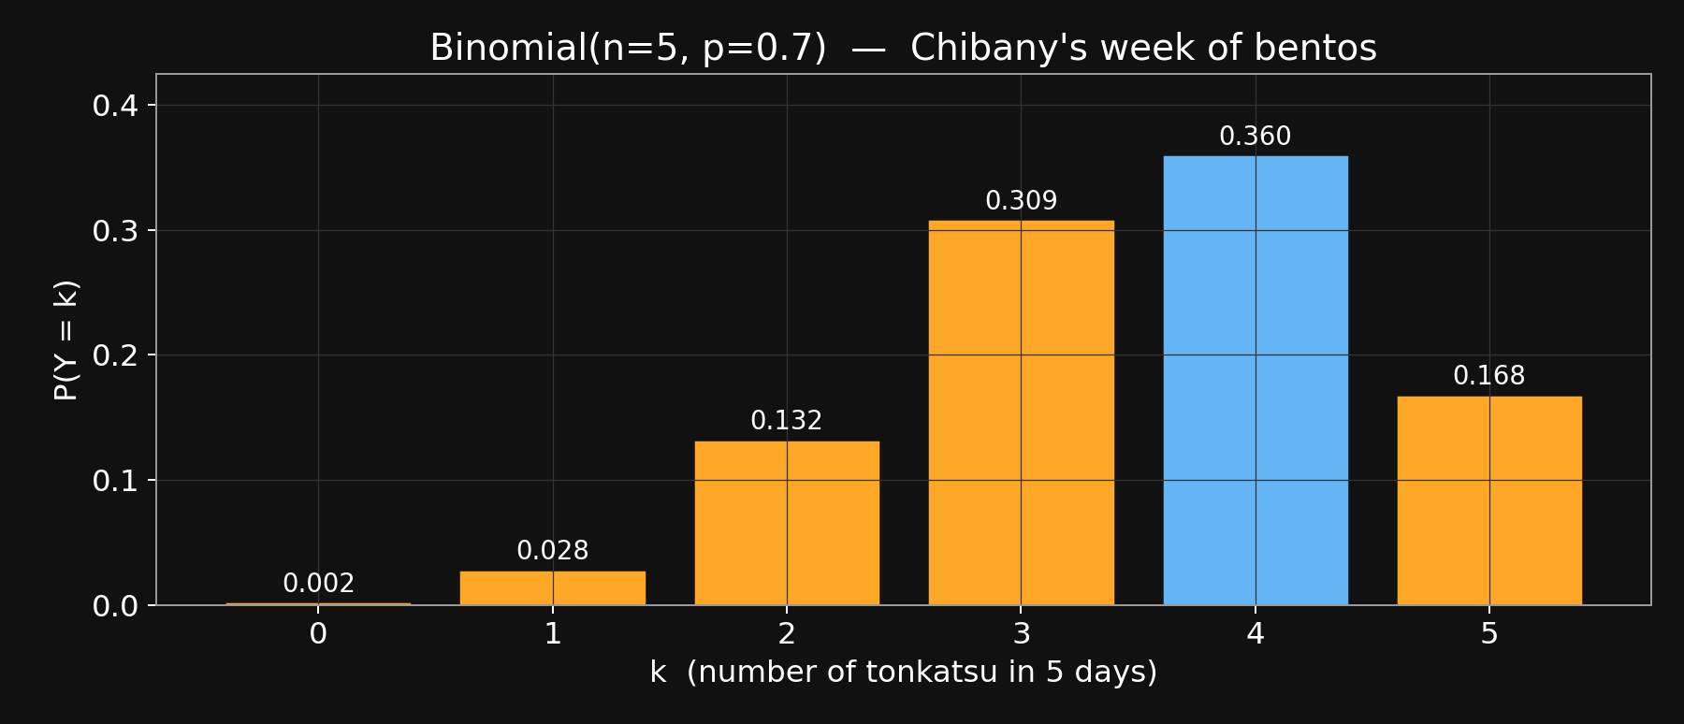
Binomial(5, 0.7) — full PMF
Mode at k=4 (0.360). In Week 3 this PMF becomes the LIKELIHOOD
for inferring p from observed counts. Beta × Binomial = Beta.
Notes:
~1 min. Real bar chart. Let it sit — students can see the shape. Flag the Week-3 connection: when we don\'t KNOW p, this PMF with an unknown p becomes a function of p, and Beta conjugates nicely with it.

Slide 49
Agenda
Welcome + meet Chibany
0:00
Marr's three levels
0:08
Notation lock-in
0:15
Joint + marginalization
0:18
Expected value + discrete
0:30
Continuous prob + Gaussian
0:45
Break
1:05
Gaussian-Gaussian update
1:15
Paper presentations
1:40
Admin + Week 3
1:50

Slide 50
Human and Machine Learning SP26 — Week 2
Continuous probability + the Gaussian
Notes:
20 min. Build: PMF→PDF (4 text + 1 image), Gaussian formula (5 text + 1 image), continuous-Bayes worked (6 text + 1 image). The images are the payoff — do NOT speak over them; pause.

Slide 51
From PMF to PDF — going continuous
Weight isn't heavy-or-light. It's a real number.
We need a different object — a probability DENSITY.
Notes:
Slide 1: 'Weight is continuous. No finite outcome space. We need a new object — the PDF.'

Slide 52
From PMF to PDF — going continuous
Weight isn't heavy-or-light. It's a real number.
We need a different object — a probability DENSITY.
Thought experiment — shrink the bins:
30g bins: coarse histogram, PMF over bins
10g bins: finer, still PMF
2g bins: finer still
bin → 0: PMF → PDF
Notes:
Slide 2: 'Binning thought experiment. Bin the weights. Shrink bins. In the limit: a smooth curve. That curve is the density.'

Slide 53
From PMF to PDF — going continuous
Weight isn't heavy-or-light. It's a real number.
We need a different object — a probability DENSITY.
Thought experiment — shrink the bins:
30g bins: coarse histogram, PMF over bins
10g bins: finer, still PMF
2g bins: finer still
bin → 0: PMF → PDF
The density f(x) is NOT a probability — it's probability PER UNIT.
P(X ∈ [a, b]) = ∫ₐᵇ f(x) dx "area under the density"
PDF values can exceed 1. Probabilities cannot.
Notes:
Slide 3: 'Density ≠ probability. This trips students up. Density is 'probability PER UNIT. You integrate to get a probability. Density values can be > 1 (density of N(0, 0.01) at 0 is ~40).'

Slide 54
From PMF to PDF — going continuous
Weight isn't heavy-or-light. It's a real number.
We need a different object — a probability DENSITY.
Thought experiment — shrink the bins:
30g bins: coarse histogram, PMF over bins
10g bins: finer, still PMF
2g bins: finer still
bin → 0: PMF → PDF
The density f(x) is NOT a probability — it's probability PER UNIT.
P(X ∈ [a, b]) = ∫ₐᵇ f(x) dx "area under the density"
PDF values can exceed 1. Probabilities cannot.
Why P(X = exactly 450g) = 0 for continuous X:
∫₄₅₀⁴⁵⁰ f(x) dx = 0 (integrate over a single point)
But P(X ∈ [449.5, 450.5]) ≈ f(450) · 1
"density × interval width = probability."
Notes:
Slide 4: 'Corollary: probability of ANY exact value is 0 for a continuous RV. But probability of being near any value is f(x) × (small interval). Intuitive and mathematically honest.'

Slide 55
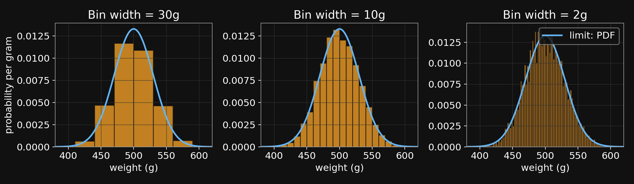
Shrinking bins → PDF as the limit
Same underlying data, three bin widths. Blue curve: limit (PDF).
Notes:
Pause 10 seconds. Let them see the histograms smoothing into the PDF. The blue curve is the same Gaussian in all three panels — the histograms are approaching it from above and below.

Slide 56
The Gaussian (normal) distribution
Chibany's bento weights vary — even within one meal type.
Tonkatsu weight is roughly N(500, 30²) — centered at 500, spread ≈ 30g.
Notes:
Slide 1: 'Real bentos vary. Not every tonkatsu is exactly 500g. The natural distribution for that variation is the Gaussian.'

Slide 57
The Gaussian (normal) distribution
Chibany's bento weights vary — even within one meal type.
Tonkatsu weight is roughly N(500, 30²) — centered at 500, spread ≈ 30g.
N(x | μ, σ²) = ( 1 / √(2π σ²) ) · exp( − (x − μ)² / (2σ²) )
Notes:
Slide 2: 'The formula. Don\'t try to hold the whole thing at once — we\'ll name each piece now.'

Slide 58
The Gaussian (normal) distribution
Chibany's bento weights vary — even within one meal type.
Tonkatsu weight is roughly N(500, 30²) — centered at 500, spread ≈ 30g.
N(x | μ, σ²) = ( 1 / √(2π σ²) ) · exp( − (x − μ)² / (2σ²) )
Name each piece:
μ mean — where the curve peaks
σ² variance — how wide the curve is (σ = std dev)
exp(−(x−μ)²/(2σ²)) peaks at μ, falls off fast outside ±σ
1/√(2π σ²) the normalizer — makes total area = 1
Notes:
Slide 3: 'Four pieces. Mean, variance, the exponential (which does the peaking), and the normalizer (which makes the area equal 1 — 'required of any PDF).'

Slide 59
The Gaussian (normal) distribution
Chibany's bento weights vary — even within one meal type.
Tonkatsu weight is roughly N(500, 30²) — centered at 500, spread ≈ 30g.
N(x | μ, σ²) = ( 1 / √(2π σ²) ) · exp( − (x − μ)² / (2σ²) )
Name each piece:
μ mean — where the curve peaks
σ² variance — how wide the curve is (σ = std dev)
exp(−(x−μ)²/(2σ²)) peaks at μ, falls off fast outside ±σ
1/√(2π σ²) the normalizer — makes total area = 1
Shape facts:
• symmetric around μ
• peak height = 1/√(2π σ²) — sharper curves are TALLER
• ~68% of mass within μ ± σ; ~95% within μ ± 2σ
Notes:
Slide 4: 'Shape. Symmetric around μ. SHARPER (smaller σ) → TALLER peak. The 68-95-99.7 rule — most mass within 1, 2, 3 sigma.'

Slide 60
The Gaussian (normal) distribution
N(x | μ, σ²) = ( 1 / √(2π σ²) ) · exp( − (x − μ)² / (2σ²) )
Name each piece:
μ mean — where the curve peaks
σ² variance — how wide the curve is (σ = std dev)
exp(−(x−μ)²/(2σ²)) peaks at μ, falls off fast outside ±σ
1/√(2π σ²) the normalizer — makes total area = 1
Shape facts:
• symmetric around μ
• peak height = 1/√(2π σ²) — sharper curves are TALLER
• ~68% of mass within μ ± σ; ~95% within μ ± 2σ
Chibany's two bento-weight distributions:
tonkatsu weight ~ N(500, 30²)
hamburger weight ~ N(350, 30²)
Two bell curves. They overlap in the middle — that's where 450g lives.
Notes:
Slide 5: 'Two Gaussians for Chibany. They overlap in the 380-470 range. Next slide: picture.'

Slide 61
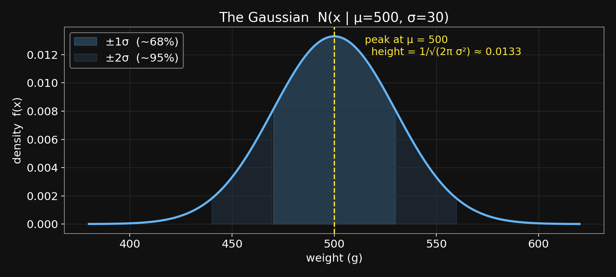
The Gaussian — shape and the 68-95 rule
Dark fill: ±1σ (~68%). Light fill: ±2σ (~95%).
Notes:
Pause. Let them trace the curve and see the shaded bands. The peak height formula 1/√(2πσ²) ≈ 0.013 for σ=30 — visible at the top.

Slide 62
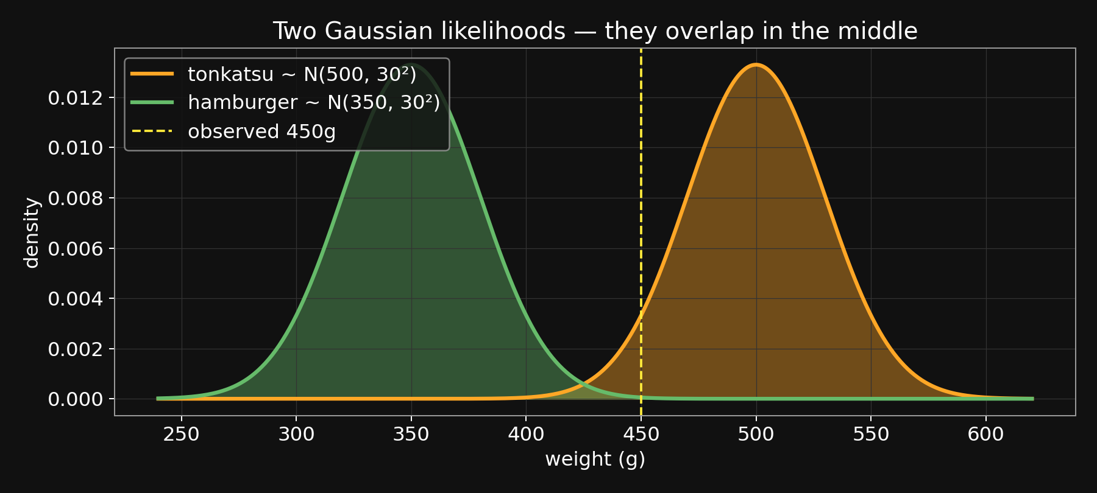
Chibany's two bento-weight likelihoods
Yellow line: observed 450g. Closer to tonkatsu, but within hamburger tail.
Notes:
Key setup image for the continuous-Bayes worked example that follows. 450g sits squarely in the tonkatsu Gaussian, far in the right tail of hamburger. The next slide computes the densities.

Slide 63
Bayes with a continuous likelihood — worked
Today's observation: D = weight = 450g.
What's P(meal | weight = 450g) ?
Notes:
Slide 1: 'New observation: actual weight, 450g. Same Bayesian question.'

Slide 64
Bayes with a continuous likelihood — worked
Today's observation: D = weight = 450g.
What's P(meal | weight = 450g) ?
Prior stays discrete: P(tonkatsu) = 0.7, P(hamburger) = 0.3
Notes:
Slide 2: 'Prior unchanged — still 0.7/0.3 on meal.'

Slide 65
Bayes with a continuous likelihood — worked
Today's observation: D = weight = 450g.
What's P(meal | weight = 450g) ?
Prior stays discrete: P(tonkatsu) = 0.7, P(hamburger) = 0.3
Likelihood is a Gaussian density:
f_T = N(450 | 500, 30²)
= (1/√(2π·900)) · exp(−(−50)²/1800)
= 0.01330 · exp(−1.389) ≈ 0.00332
f_H = N(450 | 350, 30²) ≈ 0.00044
Density values, not probabilities. (Integral → probability.)
Notes:
Slide 3: 'The work: compute each Gaussian density value. I\'m showing the arithmetic for f_T: the normalizer coefficient ≈ 0.0133, the exponent is −(−50)²/1800 = −1.389, exp of that is 0.249, product ≈ 0.00332. f_H comes out to 0.00044 — much smaller because 450 is far from 350.'

Slide 66
Bayes with a continuous likelihood — worked
Today's observation: D = weight = 450g.
What's P(meal | weight = 450g) ?
Prior stays discrete: P(tonkatsu) = 0.7, P(hamburger) = 0.3
Likelihood is a Gaussian density:
f_T = N(450 | 500, 30²)
= (1/√(2π·900)) · exp(−(−50)²/1800)
= 0.01330 · exp(−1.389) ≈ 0.00332
f_H = N(450 | 350, 30²) ≈ 0.00044
Density values, not probabilities. (Integral → probability.)
Numerator = prior · likelihood:
tonkatsu: 0.7 · 0.00332 = 0.00232
hamburger: 0.3 · 0.00044 = 0.000132
Evidence = sum = 0.00246
Notes:
Slide 4: 'Multiply prior by likelihood. Sum for the evidence.'

Slide 67
Bayes with a continuous likelihood — worked
Today's observation: D = weight = 450g.
What's P(meal | weight = 450g) ?
Prior stays discrete: P(tonkatsu) = 0.7, P(hamburger) = 0.3
Likelihood is a Gaussian density:
f_T = N(450 | 500, 30²)
= (1/√(2π·900)) · exp(−(−50)²/1800)
= 0.01330 · exp(−1.389) ≈ 0.00332
f_H = N(450 | 350, 30²) ≈ 0.00044
Density values, not probabilities. (Integral → probability.)
Numerator = prior · likelihood:
tonkatsu: 0.7 · 0.00332 = 0.00232
hamburger: 0.3 · 0.00044 = 0.000132
Evidence = sum = 0.00246
Posterior:
P(tonkatsu | 450g) = 0.00232 / 0.00246 ≈ 0.946
P(hamburger | 450g) = 0.000132 / 0.00246 ≈ 0.054
Notes:
Slide 5: 'Divide. Posterior is 0.95/0.05.'

Slide 68
Bayes with a continuous likelihood — worked
= (1/√(2π·900)) · exp(−(−50)²/1800)
= 0.01330 · exp(−1.389) ≈ 0.00332
f_H = N(450 | 350, 30²) ≈ 0.00044
Density values, not probabilities. (Integral → probability.)
Numerator = prior · likelihood:
tonkatsu: 0.7 · 0.00332 = 0.00232
hamburger: 0.3 · 0.00044 = 0.000132
Evidence = sum = 0.00246
Posterior:
P(tonkatsu | 450g) = 0.00232 / 0.00246 ≈ 0.946
P(hamburger | 450g) = 0.000132 / 0.00246 ≈ 0.054
Prior → Posterior: 0.70 → 0.946 (tonkatsu)
0.30 → 0.054 (hamburger)
Block 4 coarse (heavy-vs-light): 0.70 → 0.91
Block 6 continuous (exact weight): 0.70 → 0.95
Exact continuous value is more informative than a bucket.
Notes:
Slide 6: 'Compare to Block 4 (heavy/light bucketing): 0.91. The continuous exact value moves belief further because it uses the precise weight, not just a bucket.'

Slide 69
Human and Machine Learning SP26 — Week 2
Break — 10 minutes
Notes:
Hard 10. Block 7 is the highest-stakes block of the session. Come back sharp. Double-check the tonk_hamb.png loaded correctly on the projector.

Slide 70
Agenda
Welcome + meet Chibany
0:00
Marr's three levels
0:08
Notation lock-in
0:15
Joint + marginalization
0:18
Expected value + discrete
0:30
Continuous prob + Gaussian
0:45
Break
1:05
Gaussian-Gaussian update
1:15
Paper presentations
1:40
Admin + Week 3
1:50

Slide 71
Human and Machine Learning SP26 — Week 2
Gaussian-Gaussian update — launching Week 3
Notes:
25 min. THE block of the session. Now with: (a) explicit motivation for inferring μ, (b) a derivation SKETCH (complete the square), (c) a real posterior-curve picture, (d) precision visualized, (e) N-observation generalization given its own build-up.

Slide 72
Why would Chibany want to infer μ ?
So far Chibany asks: "what's in TODAY's bento?"
Today's weight, 450g → posterior over today's meal.
Notes:
Slide 1: 'Up to now, the question has been about today\'s meal. A discrete hypothesis.'

Slide 73
Why would Chibany want to infer μ ?
So far Chibany asks: "what's in TODAY's bento?"
Today's weight, 450g → posterior over today's meal.
But to DO that well, Chibany needs to know:
How much DO tonkatsu bentos typically weigh?
(We wrote "500" as if it were known. But is it?)
Notes:
Slide 2: 'But we wrote 500g as if we KNEW it. We don\'t really. This term is an unknown PARAMETER. Call it μ.'

Slide 74
Why would Chibany want to infer μ ?
So far Chibany asks: "what's in TODAY's bento?"
Today's weight, 450g → posterior over today's meal.
But to DO that well, Chibany needs to know:
How much DO tonkatsu bentos typically weigh?
(We wrote "500" as if it were known. But is it?)
Shift in perspective:
• Yesterday's Bayes: H = today's MEAL (discrete hypothesis)
• Today's Bayes: H = tonkatsu's MEAN WEIGHT μ (continuous parameter)
Why Bayesian inference on μ instead of just averaging?
Because Chibany has PRIOR knowledge (last semester), plus LIMITED data.
Averaging throws the prior away. Bayes combines both.
Notes:
Slide 3: 'So now Bayesian inference is shifting: H = μ, a continuous parameter, not a discrete category. Why not just average the weights? Because Chibany has prior knowledge from past experience, and early in the semester they have very few data points. Averaging is what a frequentist would do and it discards the prior. 'Bayes keeps both.'

Slide 75
Step 1 — the prior μ ~ N(μ₀, σ₀²)
Chibany's belief about μ BEFORE observing any new weights:
μ ~ N(μ₀, σ₀²)
"I think μ is around μ₀, give or take σ₀."
Notes:
Slide 1: 'Prior is a Gaussian over μ. Two hyperparameters: μ₀ and σ₀.'

Slide 76
Step 1 — the prior μ ~ N(μ₀, σ₀²)
Chibany's belief about μ BEFORE observing any new weights:
μ ~ N(μ₀, σ₀²)
"I think μ is around μ₀, give or take σ₀."
From last semester's memory:
μ₀ = 500 (best guess) σ₀ = 20 (uncertainty)
Prior: μ ~ N(500, 20²)
Notes:
Slide 2: 'Chibany\'s best guess 500, uncertainty 20. Prior = N(500, 400).'

Slide 77
Step 1 — the prior μ ~ N(μ₀, σ₀²)
Chibany's belief about μ BEFORE observing any new weights:
μ ~ N(μ₀, σ₀²)
"I think μ is around μ₀, give or take σ₀."
From last semester's memory:
μ₀ = 500 (best guess) σ₀ = 20 (uncertainty)
Prior: μ ~ N(500, 20²)
The conceptual leap: priors over PARAMETERS.
The Gaussian is NOT over weights now. It's over μ.
A prior is a distribution over anything hidden —
including parameters of OTHER distributions.
Notes:
Slide 3: 'THIS IS THE BIG MOVE. The density isn\'t over weights now. 'It\'s over the unknown parameter μ. Priors can live on parameters. In Week 4 we\'ll even put a prior on the PRIOR — hierarchical Bayes.'

Slide 78
Step 2 — the likelihood
Chibany weighs one bento: D₁ = 510g.
(Assume σ = 30 is known — we infer μ only.)
Notes:
Slide 1: 'One observation. 510g. We pretend σ is known — only μ is unknown. Week 3 will relax this.'

Slide 79
Step 2 — the likelihood
Chibany weighs one bento: D₁ = 510g.
(Assume σ = 30 is known — we infer μ only.)
Likelihood:
P(D₁ = 510 | μ) = N(510 | μ, 30²)
Notes:
Slide 2: 'Likelihood is the Gaussian density evaluated at the 'observed weight, as a function of μ.'

Slide 80
Step 2 — the likelihood
Chibany weighs one bento: D₁ = 510g.
(Assume σ = 30 is known — we infer μ only.)
Likelihood:
P(D₁ = 510 | μ) = N(510 | μ, 30²)
As a function of μ, this is ALSO a Gaussian —
peaked at μ = 510, width σ = 30.
So we have two Gaussian functions of μ:
prior (peaked at 500, tight)
likelihood (peaked at 510, broader)
Notes:
Slide 3: 'Here\'s the trick: when you treat the likelihood N(D|μ,σ²) as a function of μ for fixed D, it\'s STILL a Gaussian shape — peaked where μ=D. So we have two Gaussians in μ. Multiplying them is the Bayes step.'

Slide 81
Why Gaussian × Gaussian = Gaussian (derivation sketch)
Multiply the two densities (drop the normalizers — collect at end):
P(μ|D) ∝ exp( −(μ − μ₀)² / 2σ₀² ) · exp( −(D − μ)² / 2σ² )
Notes:
Slide 1: 'Multiply the two Gaussian densities. Normalizers are constants in μ — we absorb them into the final normalization later.'

Slide 82
Why Gaussian × Gaussian = Gaussian (derivation sketch)
Multiply the two densities (drop the normalizers — collect at end):
P(μ|D) ∝ exp( −(μ − μ₀)² / 2σ₀² ) · exp( −(D − μ)² / 2σ² )
Combine exponents:
∝ exp( − [ (μ − μ₀)² / 2σ₀² + (D − μ)² / 2σ² ] )
The thing in [ ] is a quadratic in μ — A·μ² − 2B·μ + const.
Notes:
Slide 2: 'Expand the squared terms and combine. You get a quadratic in μ. Form: Aμ² − 2Bμ + constants.'

Slide 83
Why Gaussian × Gaussian = Gaussian (derivation sketch)
Multiply the two densities (drop the normalizers — collect at end):
P(μ|D) ∝ exp( −(μ − μ₀)² / 2σ₀² ) · exp( −(D − μ)² / 2σ² )
Combine exponents:
∝ exp( − [ (μ − μ₀)² / 2σ₀² + (D − μ)² / 2σ² ] )
The thing in [ ] is a quadratic in μ — A·μ² − 2B·μ + const.
Complete the square → exp( −(μ − μ_post)² / 2σ²_post ) + const.
That's the kernel of a Gaussian in μ. Posterior is Gaussian.
Notes:
Slide 3: 'Complete the square — just like in high school algebra. A quadratic in μ inside an exp is the kernel of a Gaussian. So the posterior IS Gaussian. Not magic — algebra.'

Slide 84
Why Gaussian × Gaussian = Gaussian (derivation sketch)
Multiply the two densities (drop the normalizers — collect at end):
P(μ|D) ∝ exp( −(μ − μ₀)² / 2σ₀² ) · exp( −(D − μ)² / 2σ² )
Combine exponents:
∝ exp( − [ (μ − μ₀)² / 2σ₀² + (D − μ)² / 2σ² ] )
The thing in [ ] is a quadratic in μ — A·μ² − 2B·μ + const.
Complete the square → exp( −(μ − μ_post)² / 2σ²_post ) + const.
That's the kernel of a Gaussian in μ. Posterior is Gaussian.
The new mean and variance come from matching coefficients:
1 / σ²_post = 1/σ₀² + 1/σ² (coefficient of μ²)
μ_post = σ²_post · (μ₀/σ₀² + D/σ²) (coefficient of μ)
Full derivation: textbook T3 Ch 4 — read this week.
Notes:
Slide 4: 'The new μ and σ come from matching coefficients. A (coefficient of μ²) gives you 1/σ²_post. B/A (the minimum of the quadratic) gives you μ_post. Full derivation in T3 Ch 4 — read it.'

Slide 85
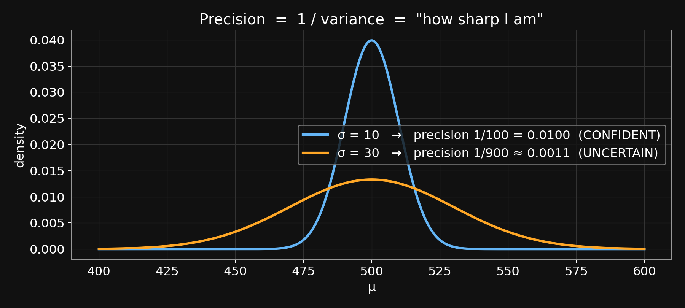
Precision = 1 / variance = "how sharp I am"
Sharper curve = higher precision = more confident (more weight in the update).
Notes:
Pause. Two Gaussians, same mean, different widths. The sharp one is more precise — if you\'re that sharp, you\'re very sure, and in a Bayesian update your view gets more weight. Intuition for the precision-sum formula on the next slide.

Slide 86
Plug in the numbers — posterior = prior × likelihood, rescaled
The update formulas (from the derivation):
1 / σ²_post = 1/σ₀² + 1/σ²
μ_post = σ²_post · ( μ₀/σ₀² + D/σ² )
Intuition: precisions add. μ_post = precision-weighted average.
Notes:
Slide 1: 'The formulas. Precisions add. Posterior mean is precision-weighted average.'

Slide 87
Plug in the numbers — posterior = prior × likelihood, rescaled
The update formulas (from the derivation):
1 / σ²_post = 1/σ₀² + 1/σ²
μ_post = σ²_post · ( μ₀/σ₀² + D/σ² )
Intuition: precisions add. μ_post = precision-weighted average.
Numbers:
σ₀² = 400 (prior), σ² = 900 (data), μ₀ = 500, D = 510
Notes:
Slide 2: 'The inputs.'

Slide 88
Plug in the numbers — posterior = prior × likelihood, rescaled
The update formulas (from the derivation):
1 / σ²_post = 1/σ₀² + 1/σ²
μ_post = σ²_post · ( μ₀/σ₀² + D/σ² )
Intuition: precisions add. μ_post = precision-weighted average.
Numbers:
σ₀² = 400 (prior), σ² = 900 (data), μ₀ = 500, D = 510
Posterior variance:
1/σ²_post = 1/400 + 1/900 = 9/3600 + 4/3600 = 13/3600
σ²_post ≈ 277 σ_post ≈ 16.6
Tighter than both inputs (20 and 30). Adding precisions REDUCES uncertainty.
Notes:
Slide 3: 'Posterior variance. 1/400 + 1/900 combines on 3600. Gets you 13/3600, so σ²_post ≈ 277, σ_post ≈ 16.6. TIGHTER than either input. Combining information reduces uncertainty — that\'s the whole point of Bayesian updating.'

Slide 89
Plug in the numbers — posterior = prior × likelihood, rescaled
The update formulas (from the derivation):
1 / σ²_post = 1/σ₀² + 1/σ²
μ_post = σ²_post · ( μ₀/σ₀² + D/σ² )
Intuition: precisions add. μ_post = precision-weighted average.
Numbers:
σ₀² = 400 (prior), σ² = 900 (data), μ₀ = 500, D = 510
Posterior variance:
1/σ²_post = 1/400 + 1/900 = 9/3600 + 4/3600 = 13/3600
σ²_post ≈ 277 σ_post ≈ 16.6
Tighter than both inputs (20 and 30). Adding precisions REDUCES uncertainty.
Posterior mean:
μ_post = 277 · ( 500/400 + 510/900 )
= 277 · ( 1.250 + 0.567 )
= 277 · 1.817 ≈ 503.1
Moved from prior (500) toward data (510), but stayed closer to prior
— because prior precision (1/400) > data precision (1/900).
Notes:
Slide 4: 'Posterior mean ≈ 503.1. Moved from 500 toward 510 but mostly stayed near the prior. Because the prior was more precise (σ₀=20 vs data σ=30). The more precise source wins.'

Slide 90
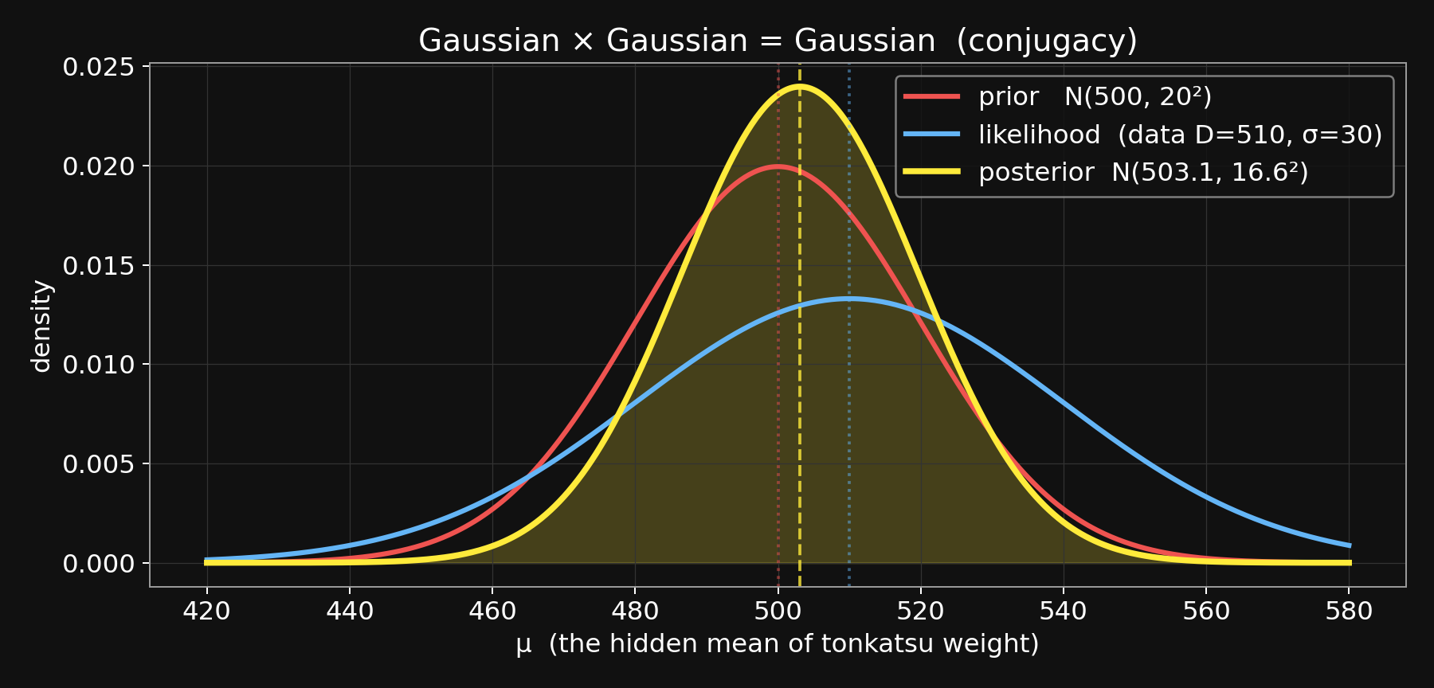
Prior × Likelihood = Posterior
Red = prior. Blue = likelihood. Yellow = posterior (tighter; between both).
Notes:
THE payoff visual. Pause. Red prior, blue likelihood, yellow posterior. The posterior IS tighter than both inputs and lives between them — closer to the prior because the prior is tighter. This one picture replaces 20 minutes of algebra in students\' memory.

Slide 91
N observations — precisions keep adding
One observation: precision added = 1/σ².
Two observations: precision added = 2/σ².
N observations: precision added = N/σ².
Notes:
Slide 1: 'Each independent observation adds precision 1/σ². Two observations = 2/σ² added. N observations = N/σ². This is the key property of conjugate updates.'

Slide 92
N observations — precisions keep adding
One observation: precision added = 1/σ².
Two observations: precision added = 2/σ².
N observations: precision added = N/σ².
1 / σ²_post = 1/σ₀² + N/σ²
μ_post = σ²_post · ( μ₀/σ₀² + Σᵢ Dᵢ / σ² )
Notes:
Slide 2: 'The general formulas. Σ_i D_i is the sum of observed weights.'

Slide 93
N observations — precisions keep adding
One observation: precision added = 1/σ².
Two observations: precision added = 2/σ².
N observations: precision added = N/σ².
1 / σ²_post = 1/σ₀² + N/σ²
μ_post = σ²_post · ( μ₀/σ₀² + Σᵢ Dᵢ / σ² )
As N grows:
• 1/σ²_post → ∞ (posterior gets sharp)
• μ_post → mean of observed weights (data dominates)
More data → sharper posterior, pulled toward sample mean.
This single formula underlies much of Weeks 3 and 4.
Notes:
Slide 3: 'Asymptotic behavior: as N grows, the prior term becomes negligible and the posterior mean approaches the sample mean. You recover the frequentist answer in the limit of much data — but with a Bayesian path there, and a well-calibrated posterior variance 'along the way. This formula IS the skeleton of Week 3\'s conjugate updates and Week 4\'s hierarchical models.'

Slide 94
Closing the arc — same Bayes, new objects
Block 4: H discrete, D discrete. Joint is a 4-cell table.
Block 6: H discrete, D continuous. Likelihood is a density.
Block 7: H continuous, D continuous. Prior, likelihood, posterior
all densities. Updates via precision arithmetic.
Same Bayes rule throughout. The OBJECTS generalized.
Notes:
Slide 1: 'Zoom out. Three flavors of Bayes today. Same rule, progressively more general objects.'

Slide 95
Closing the arc — same Bayes, new objects
Block 4: H discrete, D discrete. Joint is a 4-cell table.
Block 6: H discrete, D continuous. Likelihood is a density.
Block 7: H continuous, D continuous. Prior, likelihood, posterior
all densities. Updates via precision arithmetic.
Same Bayes rule throughout. The OBJECTS generalized.
The named move: CONJUGACY.
Gaussian × Gaussian = Gaussian (today)
Beta × Binomial = Beta (Week 3)
Dirichlet × Multinomial = Dirichlet (Week 3)
Conjugacy = algebra works out; the posterior stays in the prior's family.
Notes:
Slide 2: 'Named: conjugacy. Today was Gaussian-Gaussian. Week 3 we do it on the discrete side (Beta-Binomial, Dirichlet-Multinomial). Beta × Binomial gives Beta — try to see what\'s on your tongue re Bayesian inference on a coin\'s p.'

Slide 96
Agenda
Welcome + meet Chibany
0:00
Marr's three levels
0:08
Notation lock-in
0:15
Joint + marginalization
0:18
Expected value + discrete
0:30
Continuous prob + Gaussian
0:45
Break
1:05
Gaussian-Gaussian update
1:15
Paper presentations
1:40
Admin + Week 3
1:50

Slide 97
Human and Machine Learning SP26 — Week 2
Paper presentations — rubric + signup
Notes:
10 min tight.

Slide 98
Presentations — why and what
Enrollment is 6. Each of you presents ONCE.
20 min presentation + 10-15 min discussion you facilitate.
7.5% of grade. Reflections dropped 15% → 12.5% to make room.
Meet with me in office hours the week before your slot.
Notes:
~2 min.

Slide 99
Rubric — 5 points
Understanding of the paper 1.5
Covering key aspects 1.5
Presentation clarity 1.0
Discussion questions (at least 3) 0.5
Appropriate use of time 0.5
Focus: how the math connects to cognitive science.
Full guidelines: resources/classPresentationGuidelines.pdf (emailed today).
Notes:
~2 min. Email the PDF.

Slide 100
Signup — Weeks 4 through 12
9 slots, 6 students. Three stay open for contemporary-ML content.
Week 4 (May 22) — Generalization + hierarchical Bayes
Week 5 (May 29) — Bayes nets + causal Bayes nets
Week 6 (Jun 5) — Markov chains + networks
Week 7 (Jun 12) — Monte Carlo
Week 8 (Jun 19) — SDT / MDP / RL
Week 9 (Jun 26) — Inverse RL
Week 10 (Jul 3) — Bayesian nonparametrics
Week 11 (Jul 10) — Deep NNs
Week 12 (Jul 17) — Ethics + adversarial ML + project presentations
Notes:
~6 min. Signups on the board. Photograph; transcribe into readings_map.yml.

Slide 101
Agenda
Welcome + meet Chibany
0:00
Marr's three levels
0:08
Notation lock-in
0:15
Joint + marginalization
0:18
Expected value + discrete
0:30
Continuous prob + Gaussian
0:45
Break
1:05
Gaussian-Gaussian update
1:15
Paper presentations
1:40
Admin + Week 3
1:50

Slide 102
Human and Machine Learning SP26 — Week 2
Admin + Week 3 homework
Notes:
10 min.

Slide 103
Syllabus — three things changed
① 12 sessions, not 13.
No class May 1 AND May 8. Week 3 is Friday May 15.
② Reflections: 6 of 12, not 8 of 13.
~200 words, pre-class, pass/fail.
③ Paper presentations exist → 7.5%.
Reflections dropped 15% → 12.5% to make room.
Notes:
~3 min.

Slide 104
Week 3 — readings + homework
Next class: Friday May 15 — Week 3: Conjugate Bayes + Topics.
Required reading:
• Textbook T3 Ch 1 (Chibany's mystery bentos — the full story)
• Textbook T3 Ch 4 (Bayesian learning with Gaussians)
— formalizes what we did in Block 7.
Ungraded self-check: "Intro Probability Theory 1" quiz.
Notes:
~4 min. T3 Ch 1 is added so Chibany\'s backstory is reinforced; T3 Ch 4 derives what we sketched in Block 7.

Slide 105
Preview — the arc from here
Week 3: Conjugacy proper. Beta-Binomial + Gaussian-Gaussian.
Week 4: Hierarchical Bayes. Chibany's distribution of tonkatsu rates.
Week 5: Bayes nets + causal.
Weeks 6-7: Markov chains, Monte Carlo (sampling-based L2).
Weeks 8-10: Decision, RL, IRL, nonparametrics.
Weeks 11-12: Deep NNs, ethics — contemporary ML.
Thanks — see you May 15.
Notes:
~3 min. Close warm.

