Slide 1
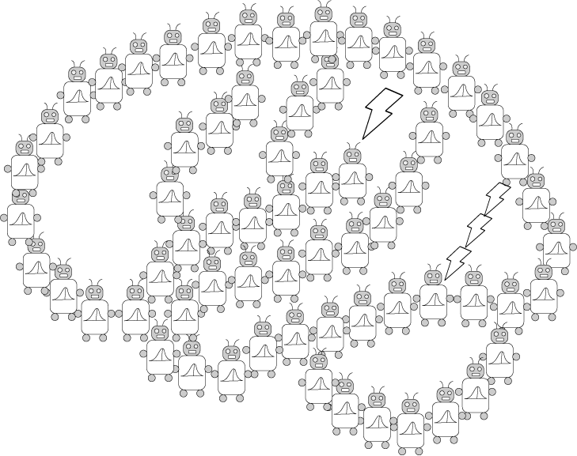
Hierarchical Bayesian Models and Bayesian Networks
PSYCH/COMP SCI/BMI 841: Computational Cognitive Science
Joseph Austerweil
February 20, 2025

Slide 2
Admin Matters
Hierarchical Bayesian Modeling
Bayesian Networks
Short rest 1
Student presentations:
Jess presenting Kemp et al. (2007)
Neha presenting Zhu et al. (2007)

Slide 3
Administrative Matters
Clusters Assignment was due Feb 19 8:59pm
Generalization Assignment due Mar 5 8:59pm
Remember you have three “free” late days for assignments.
Late days do not prorate (used up in 24-hour chunks).
Project proposal due Mar 12 8:59pm
No late days for project proposal (or final paper/presentation)
Questions?

Slide 4
Admin Matters
Hierarchical Bayesian Modeling
Bayesian Networks
Short rest 1
Student presentations:
Jess presenting Kemp et al. (2007)
Neha presenting Zhu et al. (2007)

Slide 5
Hierarchical Bayesian Framework (Kemp & Tenenbaum)
P(form)
F: form
Tree with species at leaf nodes
P(structure | form)
mouse
squirrel
S: structure
chimp
F1
F2
F3
F4
Has T9
hormones
gorilla
P(data | structure)
mouse
squirrel
chimp
gorilla
?
?
?
D: data
…

Slide 6
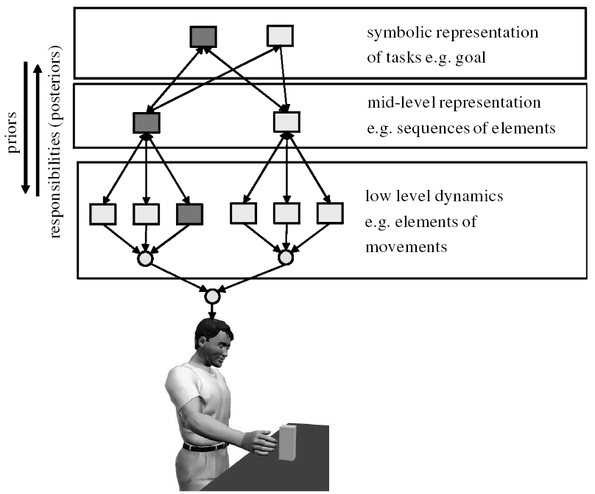
Motor Control
(Wolpert et al., 2003)

Slide 7
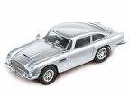
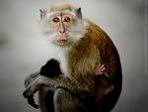

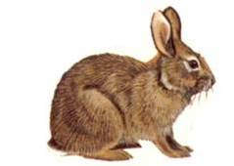

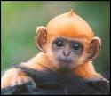

Word learning
Whole-object bias
Shape bias
Words in general
Individual words
car
monkey
duck
gavagai
Data
Notes:
Word learning (with real pictures – including rabbits, cars)
Give the idea that upper levels capture constraints.

Slide 8
Hierarchical Bayes
theory/overhypotheses
hypothesis
hypothesis
hypothesis
data
data
data

Slide 9

Feature variability (Goodman, 1955)
?

Slide 10
Feature variability (Goodman, 1955)
?

Slide 11
Feature variability (Goodman, 1955)
?

Slide 12
A hierarchical Bayesian model
Overhypothesis
Level 2: Bags in general
most bags are homogeneous
mostly
white
mostly
black
mostly
white
mostly
black
…
Level 1: Bag proportions
Data
…

Slide 13
A hierarchical Bayesian model
How to quantify?
Level 2: Bags in general
most bags are homogeneous
Level 1: Bag proportions
0.01
0.99
0.01
0.99
…
Data
y₁
y₂
y₃
y_{new}
…
…

Slide 14
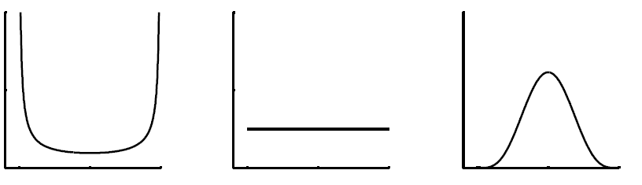
Distributions on bag proportions
Beta distribution?
Beta(a, b)
These are Beta(αβ, α(1-β)).
Average Value
β = 0.5
0
0.5
1
0
0.5
1
0
0.5
1
mostly white
mostly black
α = 0.5
α = 2
Shape
α = 10

Slide 15
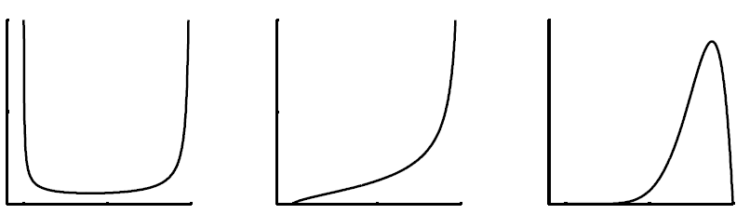
β = 0.8
β = 0.5
0
0.5
1
0
0.5
1
0
0.5
1
mostly white
mostly black
α = 0.5
α = 2
α = 10

Slide 16
A hierarchical Bayesian model
α = 0.1 (within-bag variability)
β = 0.5 (population proportion)
Level 2: Bags in general
Level 1: Bag proportions
…
0.01
0.99
0.01
0.99
Data
y₁
y₂
y₃
y_{new}
…
…

Slide 17
A hierarchical Bayesian model
Level 2: Bags in general
α, β
θ₁
θ₂
θ₃
θ_{new}
…
Level 1: Bag proportions
Data
y₁
y₂
y₃
y_{new}
…
…

Slide 18
Learning
We simultaneously learn α, β, and the θ_{i} :
Level 2: Bags in general
α, β
θ₁
θ₂
θ₃
θ_{new}
…
Level 1: Bag proportions
y₁
y₂
y₃
y_{new}
…
Data
…
Notes:
Split that into p(\theta | \alpha, \beta, y_i) and p(\alpha, \beta)

Slide 19
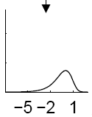
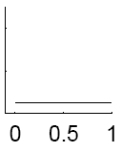
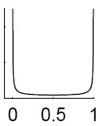

log(α) (within-bag variability)
β (population proportion)
θ₁
θ₂
θ₃
θ₄
Notes:
Pre-observations…

Slide 20
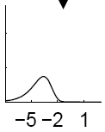
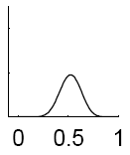
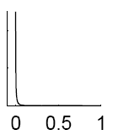

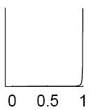
log(α) (within-bag variability)
Remember: negative logs of small probabilities are very tiny #s!
β (population proportion)
You will implement this for Assignment 3!
θ₁
θ₂
θ₃
θ₄
Notes:
Observe bags…

Slide 21
Admin Matters
Hierarchical Bayesian Modeling
Bayesian Networks
Short rest 1
Student presentations:
Jess presenting Kemp et al. (2007)
Neha presenting Zhu et al. (2007)

Slide 22
Admin Matters
Hierarchical Bayesian Modeling
Bayesian Networks
Short rest 1
Student presentations:
Jess presenting Kemp et al. (2007)
Neha presenting Zhu et al. (2007)

Slide 23
Challenges of probabilistic models
Specifying well-defined probabilistic models with many variables is hard (for modelers).
Representing probability distributions over those variables is hard (for computers/learners).
Computing quantities using those distributions is hard (for computers/learners).

Slide 24
Challenges of probabilistic models
Specifying well-defined probabilistic models with many variables is hard (for modelers).
Representing probability distributions over those variables is hard (for computers/learners).
Computing quantities using those distributions is hard (for computers/learners).

Slide 25
How do we use fewer numbers?
One random variable:
X₁ coin toss produces heads
Domain
{0,1}
If I know probability of heads, can I have any value for the probability of tails?
No, it must be 1 – probability of heads.

Slide 26
How do we use fewer numbers?
Two random variables:
X₁ coin toss produces heads
X₄ friend has two-headed coin
Friend is equally likely to have normal or fixed coin.
P(X₁=H, X₄=F) = 0.25 P(X₁=H, X₄=T) = 0.5
P(X₁=T, X₄=F) = 0.25 P(X₁=T, X₄=T) = ????
Domain
{0,1}
{0,1}

Slide 27
How do we use fewer numbers?
Two random variables:
X₁ coin toss produces heads
X₄ friend has two-headed coin
Friend is equally likely to have normal or fixed coin.
P(X₁=H, X₄=F) = 0.25 P(X₁=H, X₄=T) = 0.5
P(X₁=T, X₄=F) = 0.25 P(X₁=T, X₄=T) = 0.0
Domain
{0,1}
{0,1}

Slide 28
How do we use fewer numbers?
Four random variables:
X₁ coin toss produces heads
X₂ pencil levitates
X₃ friend has psychic powers
X₄ friend has two-headed coin
Domain
{0,1}
{0,1}
{0,1}
{0,1}

Slide 29
Joint Probability Distributions
Requires 15 numbers to specify probability of all values x₁,x₂,x₃,x₄
N binary variables, 2^{N}-1 numbers
Similar cost when computing conditional probabilities
0000
0001
0010
0011
0100
0101
0110
0111
1000
1001
1010
1011
1100
1101
1110
1111

Slide 30
Statistical independence
Two random variables X₁ and X₂ are independent if P(x₁|x₂) = P(x₁)
e.g. coinflips: P(x₁= H |x₂= H) = P(x₁ = H) = 0.5
Independence makes it easier to represent and work with probability distributions
We can exploit the product rule:
Notes:
Spell out trick to the product rule for more than two variables…

Slide 31
Statistical independence
Two random variables X₁ and X₂ are independent if P(x₁|x₂) = P(x₁)
e.g. coinflips: P(x₁= H |x₂= H) = P(x₁ = H) = 0.5
Independence makes it easier to represent and work with probability distributions
We can exploit the product rule:
If x₁, x₂, x₃, and x₄ are all independent…
Notes:
Spell out trick to the product rule for more than two variables…

Slide 32
Expressing independence
Statistical independence is the key to efficient probabilistic representation and computation.
This has led to the development of languages for indicating dependencies among variables.
Some of the most popular languages are based on “graphical models.”

Slide 33

Directed graphical models
Express the probabilistic dependency structure among a set of variables as a graph (Pearl, 1988).
Consist of
a set of nodes
a set of edges
a conditional probability distribution for each node, conditioned on its parents, multiplied together to yield the distribution over variables
Constrained to directed acyclic graphs (DAGs)
Acyclic just means that no cycles are allowed.
Called Bayesian networks or Bayes nets
Rumelhart prize winner

Slide 34
The Markov assumption
Every node is conditionally independent of its non-descendants, given its parents
The two representations are equivalent via Hammerly-Clifford’s Theorem…
where Pa(X_{i}) is the set of parents of X_{i}
(via the product rule)

Slide 35
Efficient representation and inference
Four random variables:
X₁ coin toss produces heads
X₂ pencil levitates
X₃ friend has psychic powers
X₄ friend has two-headed coin
Parents of X₁? X₃ and X₄
Parents of X₄? None
P(x₄)
X₄
X₃
P(x₃)
P(x₁|x₃, x₄)
X₁
X₂
P(x₂|x₃)

Slide 36
Efficient representation and inference
Four random variables:
X₁ coin toss produces heads
X₂ pencil levitates
X₃ friend has psychic powers
X₄ friend has two-headed coin
How many values to specify?
1
1
P(x₄)
X₄
X₃
P(x₃)
4
2
P(x₁|x₃, x₄)
X₁
X₂
P(x₂|x₃)
total = 8 (vs 15)
P(x₁, x₂, x₃, x₄) = P(x₁|x₃, x₄)P(x₂|x₃)P(x₃)P(x₄)
Notes:
Why 2 for X_2? Well 1 for each possible value of X_3
Why 4 for X_1? Well 1 for each combination of values of X_3 and X_4

Slide 37
Reading a Bayesian network
Four random variables:
X₁ coin toss produces heads
X₂ pencil levitates
X₃ friend has psychic powers
X₄ friend has two-headed coin
P(x₄)
X₄
X₃
P(x₃)
P(x₁|x₃, x₄)
X₁
X₂
P(x₂|x₃)

Slide 38
Reading a Bayesian network
The structure of a Bayes net can be read as the generative process behind a distribution.
Gives the joint probability distribution over variables obtained by sampling each variable conditioned on its parents.
Simple rules for determining whether two variables are dependent or independent.

Slide 39
Identifying independence
Can identify independence relations for any graph with the rules for all Directed Acyclic Graphs of 3 variables (obs and unobs).
E.g., X₁ is sprinklers were on, X₂ is grass is wet, X₃ is it rained...
X₁ and X₃ dependent
X₁ and X₃ independent
X₁
X₂
X₃
X₁
X₂
X₃
X₁
X₂
X₃
X₁
X₂
X₃
X₁
X₂
X₃
X₁
X₂
X₃
Why?
(shaded variables are observed)
Notes:
Most cases handled here (others are more observed more independence)

Slide 40
Explaining Away
Rained
(yes or no)
Sprinkler
(yes or no)
Rained
(yes or no)
Sprinkler
(yes or no)
Rained
= yes
Sprinkler
(yes or no)
Grass wet
(yes or no)
Grass wet = yes
Grass wet = yes
Corresponding probability relations
Unconditional independence:
P(Rained = yes | Sprinkler = yes) = P(Rained = yes | Sprinkler = no)
After learning effect:
P(Rained = yes | Grass wet = yes) > P(Rained = yes)
After learning effect and one cause:
P(Rained = yes | Grass wet = yes, Sprinkler = yes) = P(Rained = yes)
< P(Rained = yes | Grass wet = yes)
(Pearl, 1988, 2000; Spirtes, Glymour, & Scheines, 1993, Sloman, 2005)
Notes:
Normally conditioning on a variable screens others, but it has the opposite effect for this one special type of causal relationship, a common cause model…

Slide 41
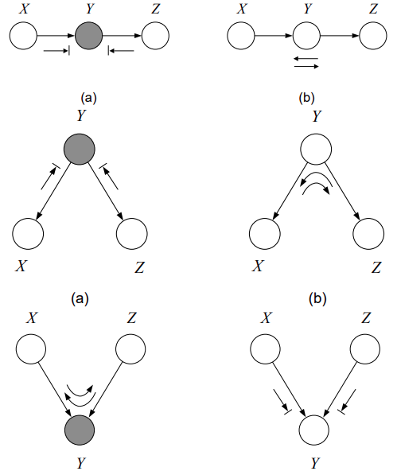
Determining (Conditional) Independence: Bayes Ball Algorithm
In more complex Bayesian networks, how do we know which variables are independent of each other?
Bayes-Ball Algorithm:
Shade conditioned nodes
Place balls at one of two nodes of interest
Follow rules on right
Do balls make it to the other node of interest?
Figure from Sam Roweis Slides

Slide 42
Identifying independence
Four random variables:
X₁ coin toss produces heads
X₂ pencil levitates
X₃ friend has psychic powers
X₄ friend has two-headed coin
X₄
X₃
X₁
X₂
X₄ and X₂ are independent
X₄
X₃
X₄
X₃
X₁
X₂
X₁
X₂
X₄ and X₂ are independent
X₄ and X₂ are dependent
Notes:
X_4 and X_2 are independent bc X_4 and X_3 are and then things downstream from X_3 will be independent by default (unless something else makes it dependent)

Slide 43
Computing with Bayes nets
P(x₄)
X₄
X₃
P(x₃)
P(x₁|x₃, x₄)
X₁
X₂
P(x₂|x₃)
P(x₁, x₂, x₃, x₄) = P(x₁|x₃, x₄)P(x₂|x₃)P(x₃)P(x₄)
Notes:
Skip if short on time

Slide 44
Computing with Bayes nets
sum over 8 values (values for 2, 3, and 4)
P(x₄)
X₄
X₃
P(x₃)
P(x₁|x₃, x₄)
X₁
X₂
P(x₂|x₃)
P(x₁, x₂, x₃, x₄) = P(x₁|x₃, x₄)P(x₂|x₃)P(x₃)P(x₄)

Slide 45
Computing with Bayes nets
P(x₄)
X₄
X₃
P(x₃)
P(x₁|x₃, x₄)
X₁
X₂
P(x₂|x₃)
P(x₁, x₂, x₃, x₄) = P(x₁|x₃, x₄)P(x₂|x₃)P(x₃)P(x₄)

Slide 46
Computing with Bayes nets
sum over 4 values
(instead of 8)
This benefit scales well when
max “width” << num of nodes
P(x₄)
X₄
X₃
P(x₃)
P(x₁|x₃, x₄)
X₁
X₂
P(x₂|x₃)
P(x₁, x₂, x₃, x₄) = P(x₁|x₃, x₄)P(x₂|x₃)P(x₃)P(x₄)

Slide 47

Short rest 1

