Slide 1
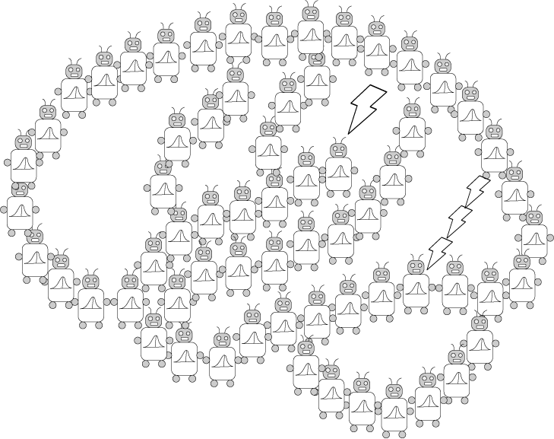
(Causal) Bayesian Networks
PSYCH/COMP SCI/BMI 841: Computational Cognitive Science
Joseph Austerweil
February 27, 2025

Slide 2
Admin Matters
Bayesian Networks
Causal Bayesian Networks
Introduction to Information Theory
Short rest 1
Student presentations:
Elijah presenting Lagnado & Sloman (2002)
Yinsu presenting Tenenbaum & Griffiths (2001)

Slide 3
Administrative Matters
Class ends about 250-3pm (for Joe)
Discussion posts will be a bit delayed this week.
Generalization Assignment due Mar 5 8:59pm
That’s next Wednesday at 8:59pm!
Remember you have three “free” late days for assignments.
Late days do not prorate (used up in 24-hour chunks).
Project proposal due Mar 12 8:59pm
No late days for project proposal (or final paper/presentation)
Questions?

Slide 4
Admin Matters
Bayesian Networks
Causal Bayesian Networks
Introduction to Information Theory
Short rest 1
Student presentations:
Elijah presenting Lagnado & Sloman (2002)
Yinsu presenting Tenenbaum & Griffiths (2001)

Slide 5
The Markov assumption
Every node is conditionally independent of its non-descendants, given its parents
The two representations are equivalent via Hammerly-Clifford’s Theorem…
where Pa(X_{i}) is the set of parents of X_{i}
(via the product rule)

Slide 6
Reading a Bayesian network
The structure of a Bayes net can be read as the generative process behind a distribution.
Gives the joint probability distribution over variables obtained by sampling each variable conditioned on its parents.
Simple rules for determining whether two variables are dependent or independent.

Slide 7
Reading a Bayesian network
Four random variables:
X₁ coin toss produces heads
X₂ pencil levitates
X₃ friend has psychic powers
X₄ friend has two-headed coin
P(x₄)
X₄
X₃
P(x₃)
P(x₁|x₃, x₄)
X₁
X₂
P(x₂|x₃)

Slide 8
Identifying independence
Can identify independence relations for any graph with the rules for all Directed Acyclic Graphs of 3 variables (obs and unobs).
E.g., X₁ is sprinklers were on, X₂ is grass is wet, X₃ it rained...
X₁ and X₃ dependent
X₁ and X₃ independent
X₁
X₂
X₃
X₁
X₂
X₃
X₁
X₂
X₃
X₁
X₂
X₃
X₁
X₂
X₃
X₁
X₂
X₃
Why?
(shaded variables are observed)
Notes:
Most cases handled here (others are more observed more independence)

Slide 9
Explaining Away
Rained
(yes or no)
Sprinkler
(yes or no)
Rained
(yes or no)
Sprinkler
(yes or no)
Rained
= yes
Sprinkler
(yes or no)
Grass wet
(yes or no)
Grass wet = yes
Grass wet = yes
Corresponding probability relations
Unconditional independence:
P(Sprinkler = yes | Rained = yes) = P(Sprinkler = yes | Rained = no)
After learning effect:
P(Sprinkler = yes | Grass wet = yes) > P(Sprinkler = yes)
After learning effect and one cause:
P(Sprinkler= yes | Grass wet = yes, Rained = yes) = P(Sprinkler = yes)
< P(Sprinkler = yes | Grass wet = yes)
(Pearl, 1988, 2000; Spirtes, Glymour, & Scheines, 1993, Sloman, 2005)
Notes:
Normally conditioning on a variable screens others, but it has the opposite effect for this one special type of causal relationship, a common cause model…

Slide 10
Blicket detector (Dave Sobel, Alison Gopnik, and colleagues)
See this? It’s a
blicket machine.
Blickets make it go.
Let’s put this one
on the machine.
Oooh, it’s a
blicket!

Slide 11
“Backwards blocking” (Sobel, Tenenbaum & Gopnik, 2004)
A
B
AB Trial
A Trial
Two objects: A and B
Trial 1: A B on detector – detector active
Trial 2: A on detector – detector active
4-year-olds judge whether each object is a blicket
A: a blicket (100% say yes)
B: probably not a blicket (34% say yes)
Notes:
Bayes predicts B should be at prior level…

Slide 12
Bayes net for backwards blocking
A blicket?
B blicket?
The “causes” for the detector activating are whatever objects are put on it that trial.
Minor note:
Slightly different Bayes nets between trials.
Detector active?

Slide 13
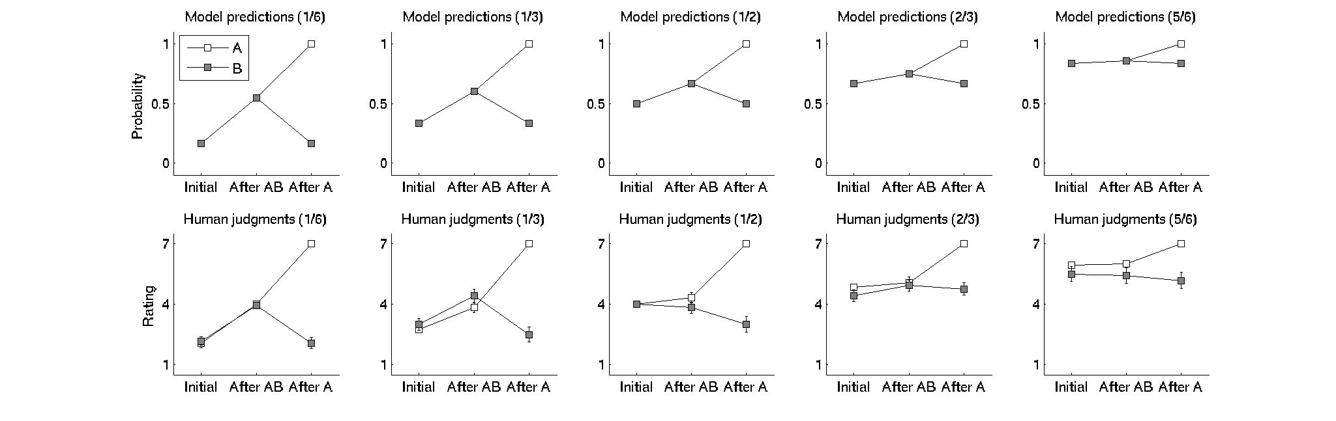
Manipulating prior probability (Griffiths, Sobel, Tenenbaum, & Gopnik, 2011)
Initial
AB Trial
A Trial

Slide 14
Admin Matters
Bayesian Networks
Causal Bayesian Networks
Introduction to Information Theory
Short rest 1
Student presentations:
Elijah presenting Lagnado & Sloman (2002)
Yinsu presenting Tenenbaum & Griffiths (2001)

Slide 15
Causality
Asymmetric relation between variables:
A cause brings about an effect via a mechanism.
Defining these terms is very very tricky...
But, it is critical, pervasive, and domain-general:
The cue ball causes the 8-ball to move
Hot stoves cause burned fingers
Incitement causes violence
Slavery caused the civil war
Smoking causes lung cancer
Genes cause eye color
Notes:
All of these feel causal to us, suggesting that causality is a domain general notion.
Focus of much recent work in cognitive science (learning and reasoning).

Slide 16
A quick word on causality...
An evidential relation: Having yellow teeth is correlated with lung cancer.
Therefore, you should whiten your teeth to lower the probability of getting lung cancer.
What’s wrong with this argument?
Smoking
Lung Cancer
Yellow Teeth
Smoking
Lung Cancer
Yellow Teeth
Notes:
Complete example on this slide.

Slide 17
Bayes Nets as Causal Models
Causal System in the World
The causal structure is represented by by
The statistical relations are represented by
Causal Model of a Causal System
Probability Model
P(A,B,C) = P(B|A)*P(C|A)* P(A)
DNA (A)
Fur (B)
Speed (C)
(Pearl, 1988, 2000; Spirtes, Glymour, & Scheines, 1993, Sloman, 2005)
Notes:
Normative model.
World = causal system to represent.

Slide 18
Limits of causation from mere observation:
Markov equivalence classes
Get evidence of pairwise correlations between smoking, yellow teeth, and lung cancer. What can you infer?
Smoking
(yes or no)
Lung Cancer
(yes or no)
Yellow Teeth
(yes or no)
Yellow Teeth
(yes or no)
Smoking
(yes or no)
Lung Cancer
(yes or no)
Notes:
Show end up with same dependencies in functional form of all joint and marginal probabilities…

Slide 19
Limits of causation from mere observation:
Markov equivalence classes
Get evidence of pairwise correlations between smoking, yellow teeth, and lung cancer. What can you infer?
Yellow Teeth
(yes or no)
Smoking
(yes or no)
Lung Cancer
(yes or no)
Yellow Teeth
(yes or no)
Smoking
(yes or no)
Lung Cancer
(yes or no)
Notes:
Show end up with same dependencies in functional form of all joint and marginal probabilities…

Slide 20
Limits of causation from mere observation:
Markov equivalence classes
Smoking
(yes or no)
Lung Cancer
(yes or no)
Yellow Teeth
(yes or no)
Yellow Teeth
(yes or no)
Smoking
(yes or no)
Lung Cancer
(yes or no)
Yellow teeth
(yes or no)
Smoking
(yes or no)
Lung Cancer
(yes or no)
Notes:
Show end up with same dependencies in functional form of all joint and marginal probabilities…

Slide 21
The Logic of “Doing”
Smoking
Tooth color
Lung cancer
To calculate the causal effect of whitening teeth on lung cancer, first do(Tooth color = white):
1. Set Tooth color to white.
2. Eliminate the causal links to it:
Smoking
Tooth color = white
Lung cancer

Slide 22
Smoking
Tooth color = white
Lung cancer
We see that Lung cancer is unaffected by Tooth color, so
Pr{Lung cancer = yes | do(Tooth color = white)}
= Pr{Lung cancer = yes }
Pearl (2000) calls this a surgery.
People represent autonomous mechanisms so that the effect of interventions can be isolated.
A causal model is an oracle for interventions.
Now can distinguish between chains and common cause!

Slide 23
Limits of causation from mere observation:
Markov equivalence classes
How do you intervene to distinguish between chain and common cause?
Do(Paint teeth)
Yellow Teeth
(yes or no)
Smoking
(yes or no)
Lung Cancer
(yes or no)
Yellow Teeth
(yes or no)
Do(Paint teeth)
Smoking
(yes or no)
Lung Cancer
(yes or no)

Slide 24
Limits of causation from mere observation:
Markov equivalence classes
How do you intervene to distinguish between chain and common cause?
Do(Paint teeth)
Yellow Teeth
= NO
Smoking
(yes or no)
Lung Cancer
(yes or no)
Yellow Teeth
(yes or no)
Smoking
(yes or no)
Lung Cancer
(yes or no)

Slide 25
Limits of causation from mere observation:
Markov equivalence classes
How do you intervene to distinguish between chain and common cause?
Do(Brush teeth)
Yellow Teeth
= NO
Smoking
(yes or no)
Lung Cancer
(yes or no)
Do(Paint teeth)
Yellow Teeth
= NO
Smoking
(yes or no)
Lung Cancer
(yes or no)

Slide 26
Limits of causation from mere observation:
Markov equivalence classes
How do you intervene to distinguish between chain and common cause?
Do(Brush teeth)
Yellow Teeth
= NO
Smoking
(yes or no)
Lung Cancer
(yes or no)
P(S|Y) != P(S)
Do(Paint teeth)
Yellow Teeth
= NO
P(S|Y) = P(S)
Smoking
(yes or no)
Lung Cancer
(yes or no)

Slide 27
Admin Matters
Bayesian Networks
Causal Bayesian Networks
Introduction to Information Theory
Short rest 1
Student presentations:
Elijah presenting Lagnado & Sloman (2002)
Yinsu presenting Tenenbaum & Griffiths (2001)

Slide 28
Uncertainty, Randomness, and Information
Probability takes uncertainty as a basic concept.
How much information do we gain from observing a random event?
Most common measure is Shannon’s Entropy
Remember:

Slide 29
Why Shannon’s Entropy
Follows via an inevitability proof…
If the following things are true:
(1) measure of information is non-negative
(2) Learning the outcome of a deterministic event provides no information
(3) Information of independent events can be “split”:
Shannon proved only H(x) satisfies these three properties.
Note: Shannon’s Entropy isn’t the only one used and there is really interesting research on a broader framework called the “Sharmal-Mittal Framework”

Slide 30
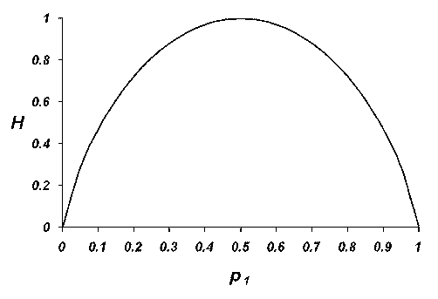
Shannon’s Entropy for Coinflip
Coin flip bias

Slide 31
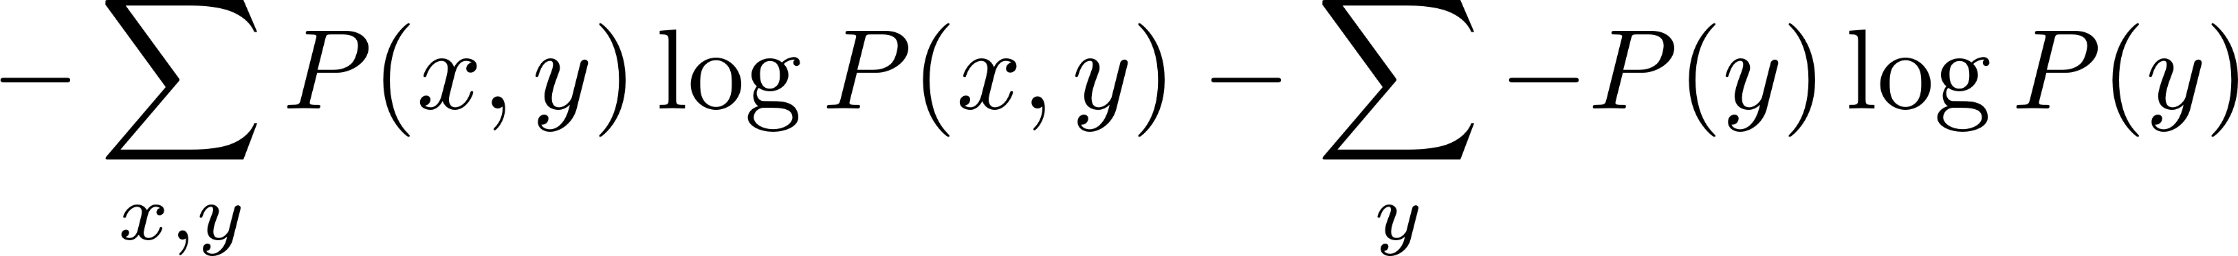
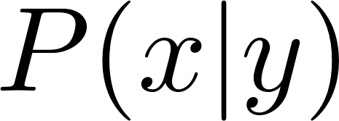

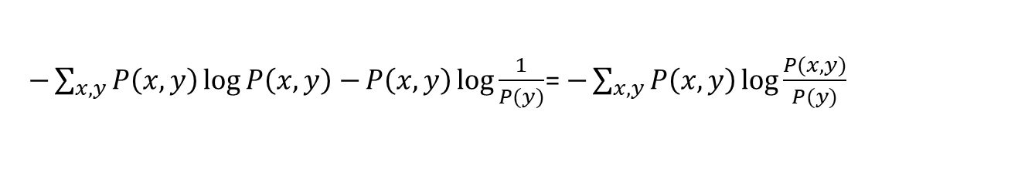

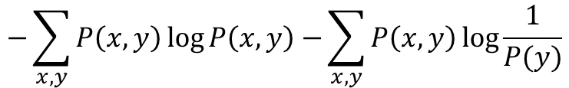
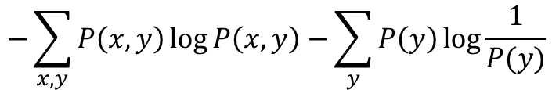
Joint Entropy and Conditional Entropy
Joint and Conditional Entropy are
Note:
$$−\sum_{x,y}{P\left(x,y\right)\log{P\left(x,y\right)}−}\sum_{y}{P\left(y\right)\log{\frac{1}{P(y)}}}$$
$$−\sum_{x,y}{P\left(x,y\right)\log{P\left(x,y\right)}−}\sum_{x,y}{P\left(x,y\right)\log{\frac{1}{P(y)}}}$$
$−\sum_{x,y}{P\left(x,y\right)\log{P\left(x,y\right)}−}P\left(x,y\right)\log{\frac{1}{P(y)}}$= $−\sum_{x,y}{P\left(x,y\right)\log{\frac{P(x,y)}{P(y)}}}$

Slide 32
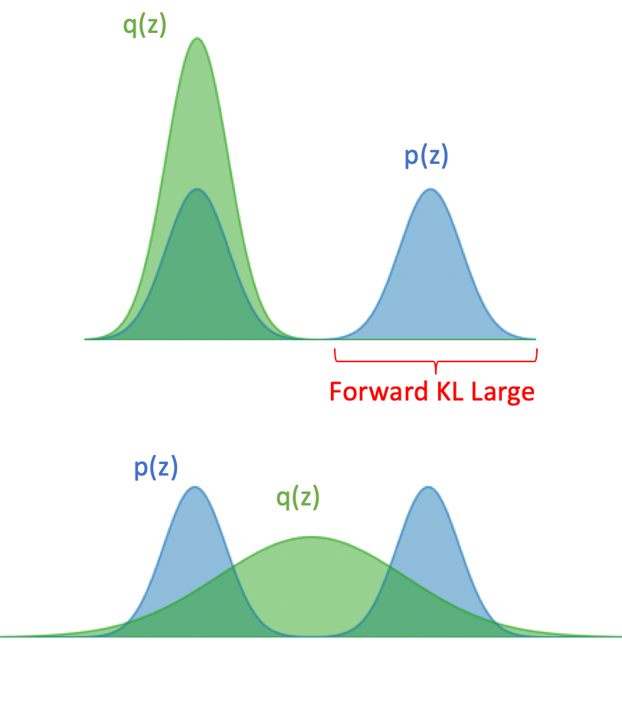
KL-Divergence
KL-Divergence of distribution P(X) relative to some “proxy” Q(X) is written as:
KL-Divergence is NOT a distance metric, but is similar to one.
It is not symmetric and it violates the triangle inequality.
“Forward KL-Divergence”
Q(x) that minimizes
KL with this P(x)

Slide 33
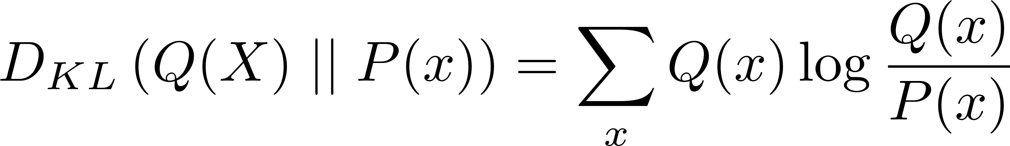
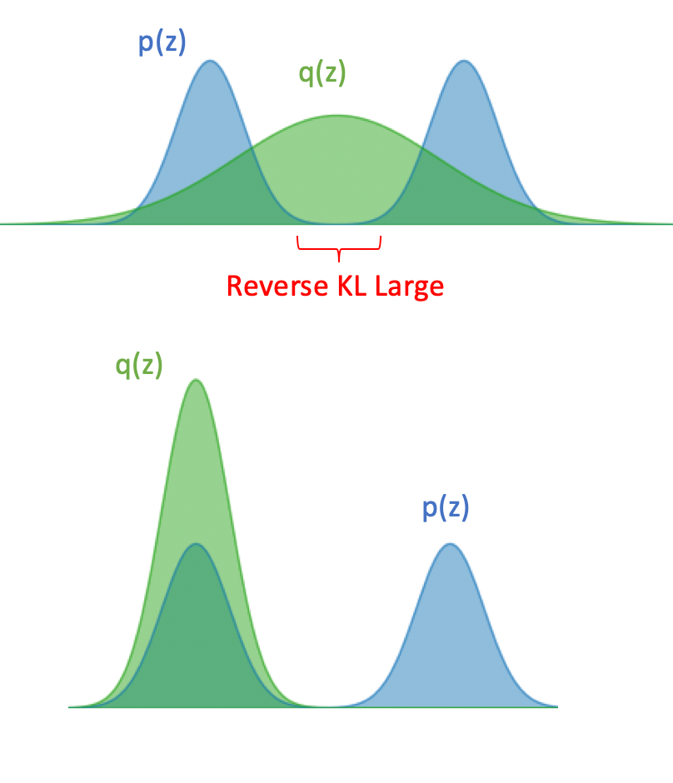
KL-Divergence
KL-Divergence of distribution P(X) relative to some “proxy” Q(X) is written as:
KL-Divergence is NOT a distance metric, but is similar to one.
It is not symmetric and it violates the triangle inequality.
“Reverse KL-Divergence”
Q(x) that minimizes
KL with this P(x)

Slide 34
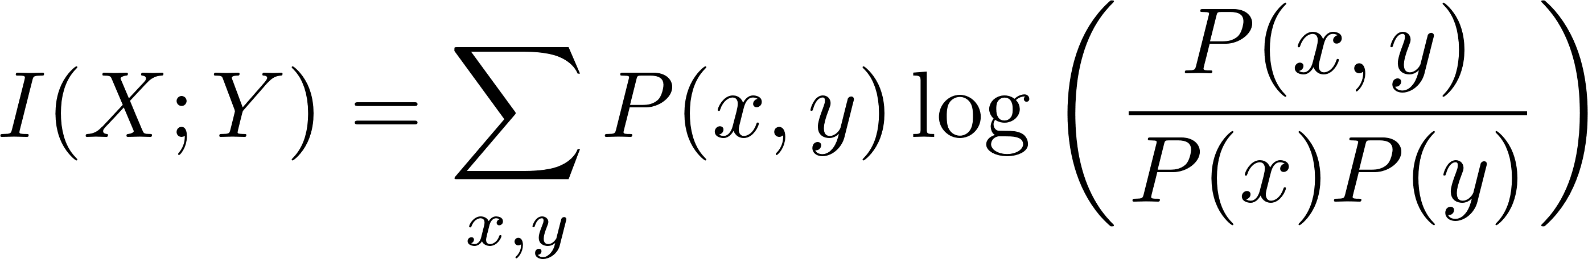
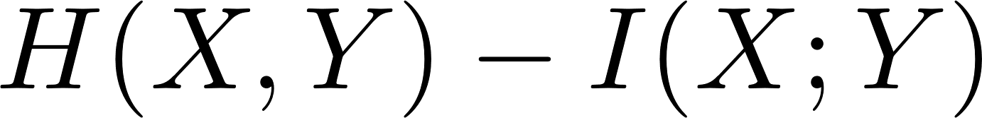
Mutual Information
Mutual information of X and Y is the entropy of their joint distribution as compared to their marginal distributions.
Like KL-Divergence, it is non-negative and is large when the joint distribution is similar to the product of the marginals.
Unlike KL-Divergence, it is symmetric.
To make it a true metric, it often is used to define “variation of information”:

Slide 35
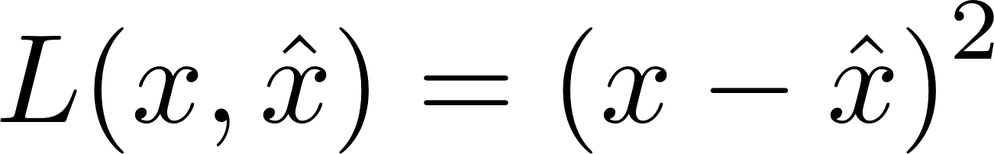
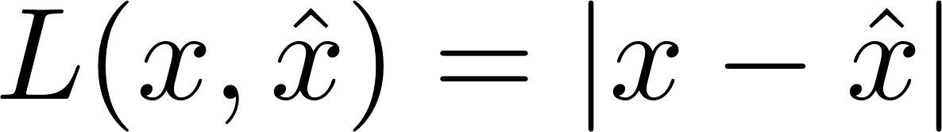
Cross Entropy
The cross-entropy of using a “proxy” Q to stand in for a “true” distribution P.
It is the average amount of information needed to identify an event from source P sent through a noisy channel, resulting in observed distribution Q.
This is often used as a “loss function” in machine learning.
A loss function is a function describing the amount of error for using an estimated quantity rather than the true one.
E.g.,

Slide 36

Lossless and Lossy Compression
Lossless examples: “zip”, “rar”, “flac”
Lossy examples: “jpg”, “mp3”, “mpeg”
Source coding theorem for Lossless Compression:
N outcomes from source X can be compressed without error to N H(X).
Optimal coding is straightforward and (expected) length per bit is H(X) < L(X) < H(X) + 1.
Rate Distortion Theory is the field for lossy compression.

Slide 37
Admin Matters
Bayesian Networks
Causal Bayesian Networks
Introduction to Information Theory
Short rest 1
Student presentations:
Elijah presenting Lagnado & Sloman (2002)
Yinsu presenting Tenenbaum & Griffiths (2001)

Slide 38
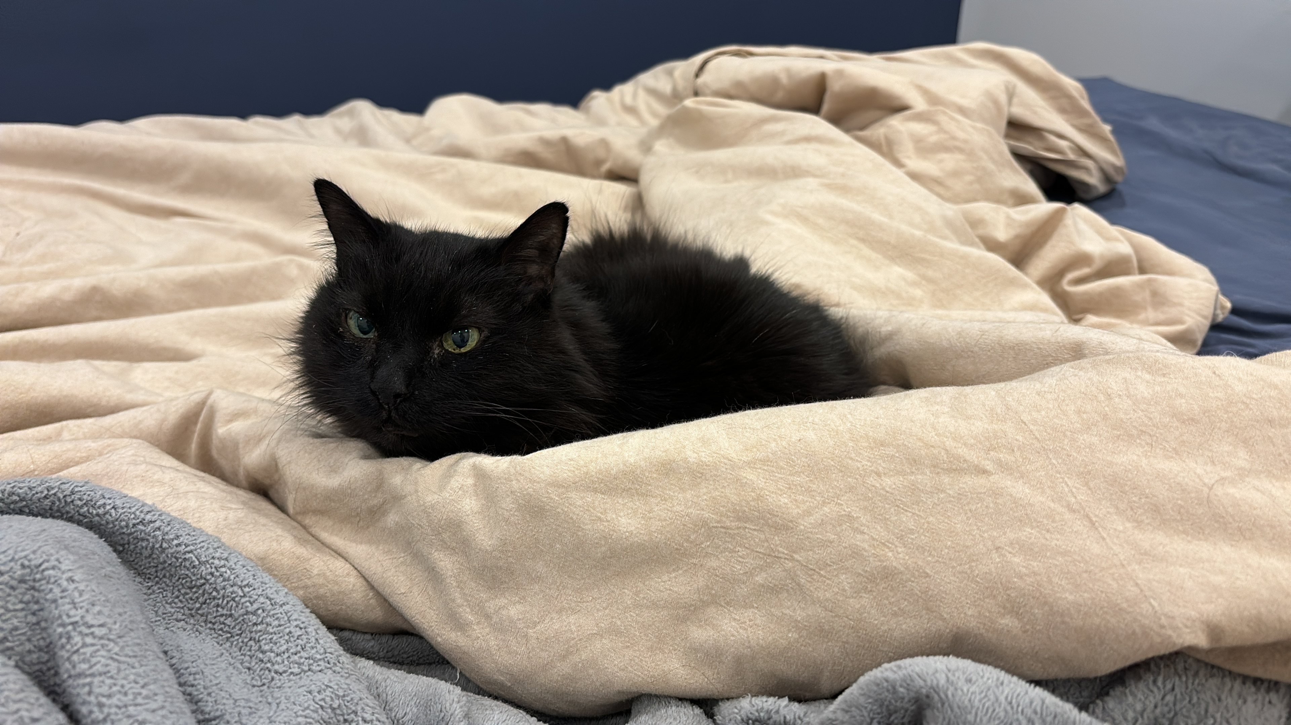
Short rest 1

Slide 39
Admin Matters
Bayesian Networks
Causal Bayesian Networks
Introduction to Information Theory
Short rest 1
Student presentations:
Elijah presenting Lagnado & Sloman (2002)
Yinsu presenting Tenenbaum & Griffiths (2001)

