Slide 1
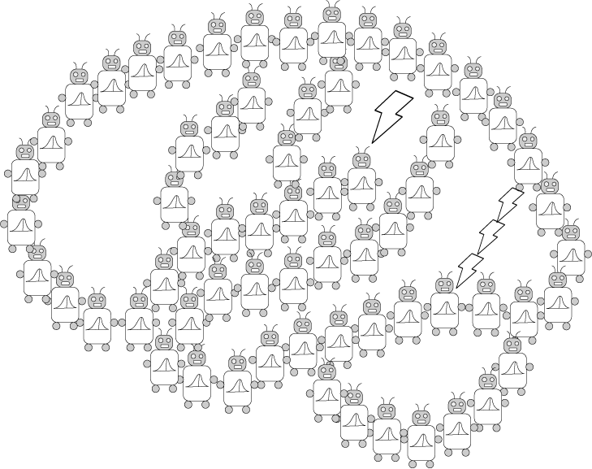
Markov Chains and Networks
PSYCH/COMP SCI/BMI 841: Computational Cognitive Science
Joseph Austerweil
March 6, 2025

Slide 2
Admin Matters
Markov Chains
Network Theory
Short rest 1
Student presentations:
Karl presenting Muhkerjee et al (2017)
Bujji presenting Griffiths et al. (2007)
Short rest 2
Student presentations:
Aakash + Ashwini presenting Abbott et al. (2012)
Caleb presenting Zemla and Austerweil (2019)

Slide 3
Administrative Matters
Caught up on last week’s discussion posts, but now that I’m delayed, it will take a bit to catch up.
Generalization Assignment was due yesterday at 8:59pm
Remember you have three “free” late days for assignments.
Late days do not prorate (used up in 24-hour chunks).
Some folks are still turning this in, so we’ll chat about it next week.
Project proposal due next Wednesday Mar 12 8:59pm
No late days for project proposal (or final paper/presentation)
Assignment 3 just went out and is due April 2 at 8:59pm
Questions?

Slide 4
Admin Matters
Markov Chains
Network Theory
Short rest 1
Student presentations:
Karl presenting Muhkerjee et al (2017)
Bujji presenting Griffiths et al. (2007)
Short rest 2
Student presentations:
Aakash + Ashwini presenting Abbott et al. (2012)
Caleb presenting Zemla and Austerweil (2019)

Slide 5
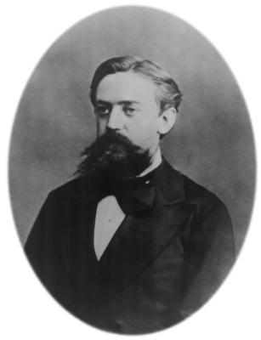
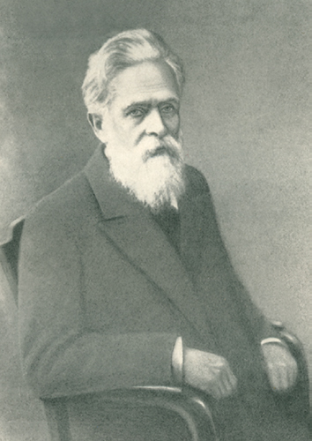
Markov
Really Past
Past
Less Past
Given the present, the future is independent of the past.
Notes:
The future is independent of the past conditioned on the present
Ergodic = aperiodic and positive recurrent
It is also irreducible = positive probability of going between any two states. Bring out a deck for discussion.

Slide 6
Markov chains
x
x
x
x
x
x
x
x
Transition matrix
P = P(x^{(t+1)}|x^{(t)})
Variables x^{(t+1)} independent of history given x^{(t)}
Converges to a stationary distribution in most situations (i.e., if it is ergodic).
Notes:
The future is independent of the past conditioned on the present
Ergodic = aperiodic and positive recurrent
It is also irreducible = positive probability of going between any two states. Bring out a deck for discussion.

Slide 7

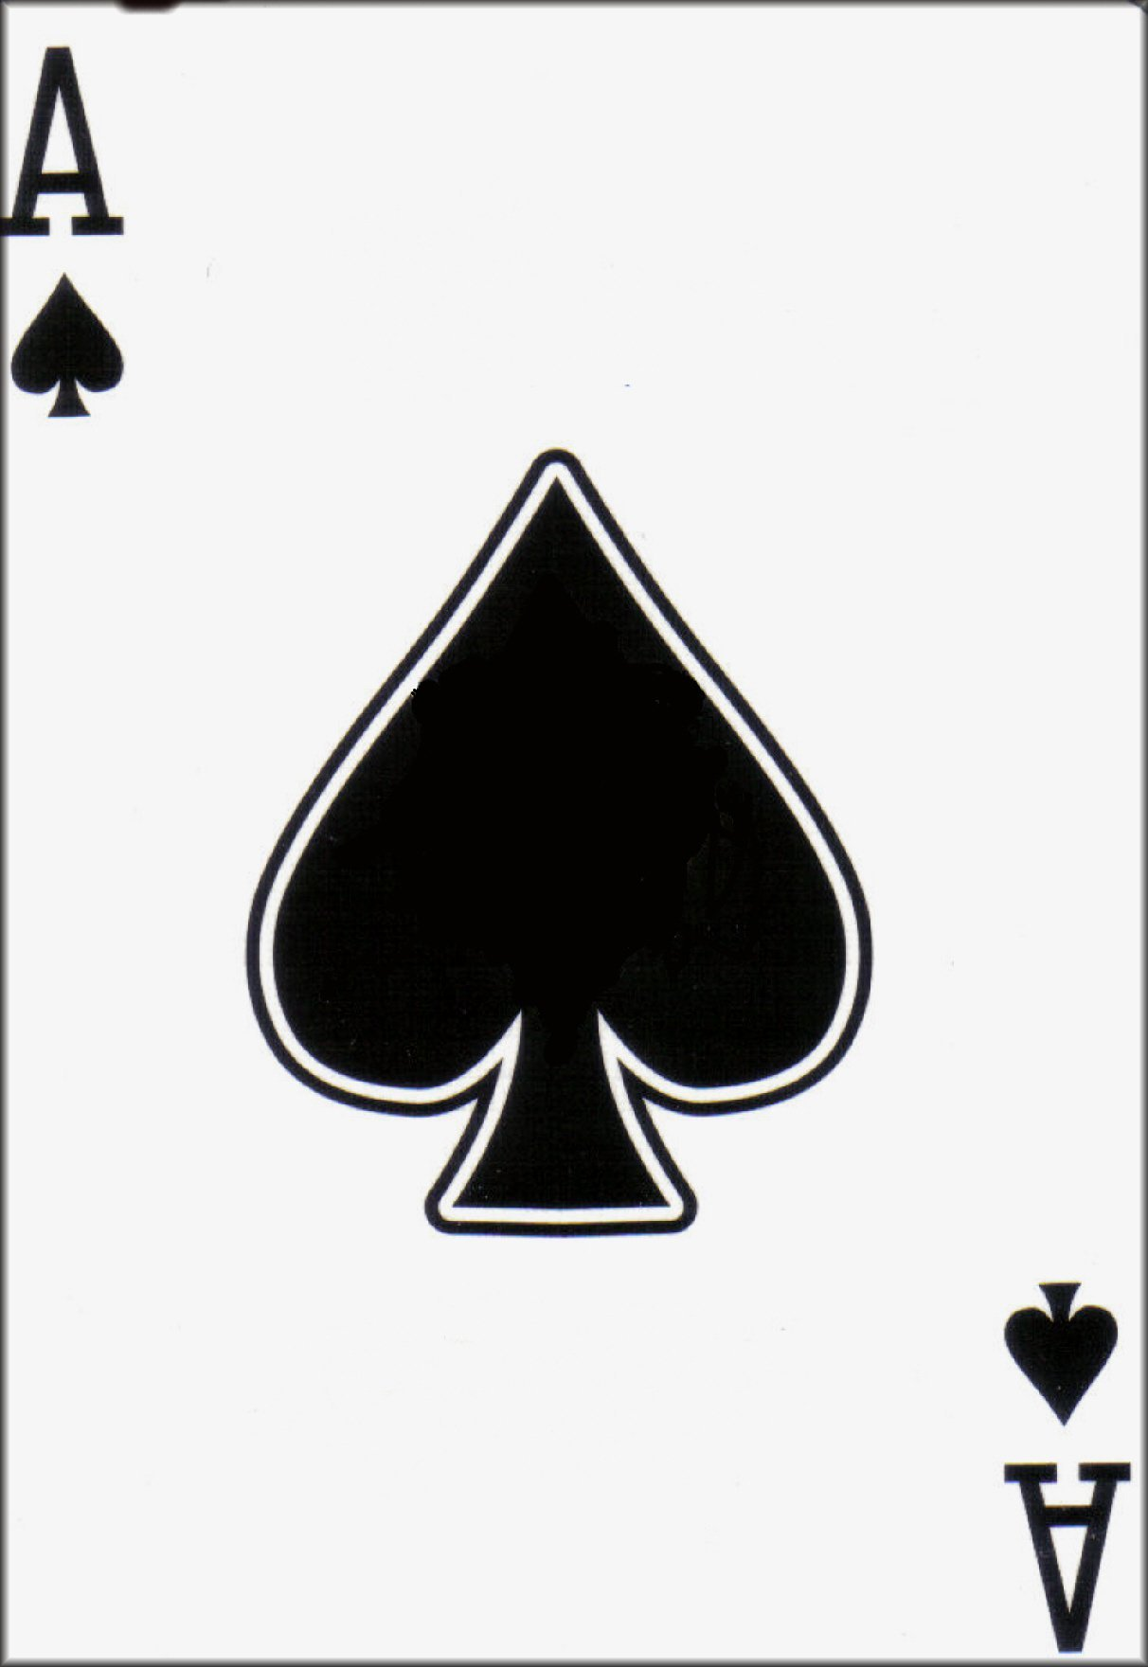

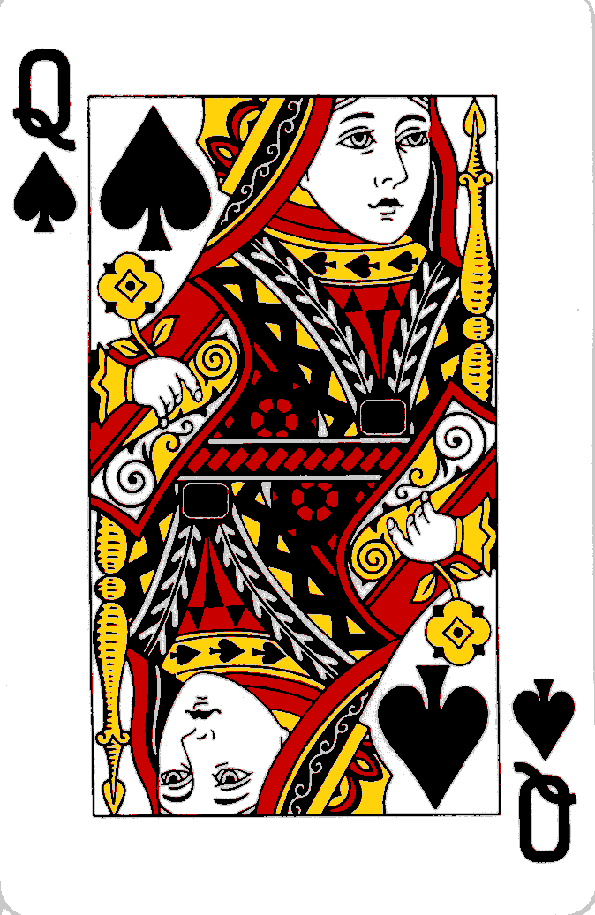
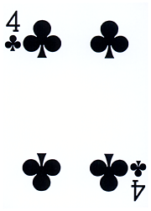
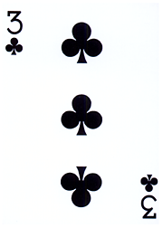
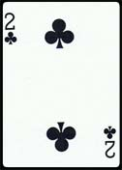
Example: Card Shuffling
A shuffle is a transition matrix of a Markov chain, whose states are the order of cards in a deck.
E.g., Move Random Card to Top
This will converge to a “shuffled deck” (uniform over orderings), which is its stationary distribution!
Notes:
Transition matrix is a very big matrix where rows and columns are all possible orderings of cards in a deck. go from any ordering to the same ordering with a random card on top. (52! By 52!)
There are more efficient sorts. For example, “riffle shuffle,” where cards are interleaved results in convergence to stationary distribution in about 7 shuffles!
Random to top is about 52 log 52

Slide 8
Another look at Markov chains/processes
S_{n}
S_{n+1}
Transition
Matrix
view
Finite state automaton (machine) view
0.1
H
T
0.9
0.9
0.1
Sample U[0,1] = 0.56 < 0.9 =>
Sample U[0,1] = 0.37 < 0.9 =>
Sample U[0,1] = 0.96 > 0.9 =>

Slide 9
Another look at Markov chains/processes
S_{n}
S_{n+1}
0.1
H
T
0.9
0.9
0.1
Samples from this process (starting at H):
HHHHHHHTTTTTTTTTTTTT HHHHHHHHTTTTHHHHHHHH
HHHHHHHHTTTTTHHHTHHH HHHHHHHTTTTTTTTTTTTT
HHHHHHHTTTTTTTTTTTTT HHHHHHHHHTTTTTTTTTTT
HHHHTTTHHHHHHHHHHHHH HHHHHTTTTTTTTTTTTTTT
HHHHHHHHHTTTTTTTTTTT HHTTTTTTTTTTTTTTTTTT

Slide 10
Another look at Markov chains/processes
S_{n}
S_{n+1}
0.1
H
T
0.9
0.9
0.1
What’s the stationary distribution? (intuitively ½, but how to see?)
Notes:
Geometric convergence with rate of eigenvalue 2 over 1 (.8/1, so converges somewhat slowly – due to low mixing between states)

Slide 11
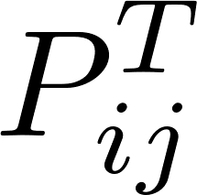
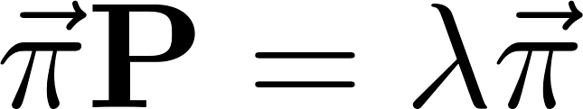




Multi-step Probability and the Stationary Distribution
is the probability of starting in state i and ending in j after T steps
What happens if I multiply P by itself a lot?
Largest eigenvalue is 1.
Property of “stochastic matrices”
Largest Eigenvector
is the relative frequency of visits to state i by the Markov chain after many steps.
Notes:
It’s unique. 0 is defined to not count as an eigenvector.

Slide 12
Note on Eigenvectors
Eigenvectors of a matrix X are those vectors that are “unchanged” when multiplied by X.
They only differ from the original by a scalar.
That scalar is the eigenvector’s eigenvalue.
Eigenvectors and eigenvalues are very useful descriptions of a matrix.
The sum of the eigenvalues is equal to the sum of the diagonal of a matrix (called trace).
The product of eigenvalues is equal to the determinant.
Note: Square matrices with positive values (more generally, positive semidefinite) have real eigenvalues.
Notes:
Assumes full rank.

Slide 13
Visual interpretation
Blue dots = data
Black line = line centered at data with varying slope
Red lines/points = Best fitting points for data where data must live on black line.
Pink/Magenta = largest eigenvector – blue points “spread” on it the most AND has the smallest reconstruction error (minimal sum of red lines).
From https://stats.stackexchange.com/questions/2691/making-sense-of-principal-component-analysis-eigenvectors-eigenvalues

Slide 14

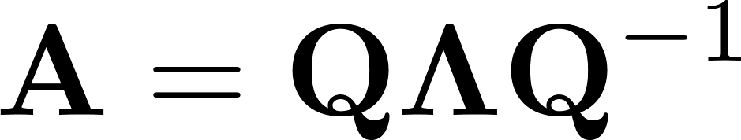
Note on Eigenvectors
Eigenvalue decomposition describes a matrix with its eigenvectors and eigenvalue.
Let A be a square matrix.
Let be a diagonal matrix of A’s eigenvalues.
Let Q be a matrix where each column is an eigenvector of A.
Eigenvector decomposition of the covariance matrix of data is principal component analysis (including only the top k eigenvectors – those with the k largest eigenvalues).

Slide 15
Note on Eigenvectors
Eigenvector decomposition of the covariance matrix of data is principal component analysis (including only the top k eigenvectors – those with the k largest eigenvalues).
Singular value decomposition of data is equivalent to PCA on its covariance matrix.
If X is our data, singular value decomposition (SVD) combines the eigenvector decomposition of XX^{T} and X^{T}X.
Remember that SVD is the non-probabilistic version of topic modeling (latent semantic analysis).

Slide 16
Admin Matters
Markov Chains
Network Theory
Short rest 1
Student presentations:
Karl presenting Muhkerjee et al (2017)
Bujji presenting Griffiths et al. (2007)
Short rest 2
Student presentations:
Aakash + Ashwini presenting Abbott et al. (2012)
Caleb presenting Zemla and Austerweil (2019)

Slide 17
(Semantic) Networks
Represent words and concepts as nodes/vertices in a graph G, with edges indicating relationships.
Can be
undirected
directed
Edges can be weighted
Different kinds of networks:
inheritance hierarchies (Collins & Quillian, 1969)
associative networks (Collins & Loftus, 1975)

Slide 18
From graphs to probabilities
Define a random walk on a graph from its edges:
1. Define matrix L that encodes edge information.
If there’s an edge from node i to node j, let L_{ij} = 1.
You can have other weights instead of just 1.
(they do have to be positive though).
If a graph is symmetric then L_{ij} = L_{ji}
2. Define matrix P that converts L to the transition matrix of a RW on the graph.
Notes:
Recommendation systems

Slide 19
The sequence of states visited by a random walk form a Markov chain

Slide 20
Example: Creating a random walk
Meow
Meow
Lion
Cat
Dog
Meow
Lion
Lion
Cat
Dog
Cat
Dog
Meow
Lion
Cat
Dog
Meow
Lion
Cat
Dog

Slide 21
Example: Creating a random walk
Meow
Lion
Cat
Dog
Meow
Meow
Lion
Lion
Cat
Dog
Cat
Dog
Meow
Lion
Cat
Dog
Meow
Lion
Cat
Walk visits Cat
Dog

Slide 22
Example: Creating a random walk
Meow
Lion
Cat
Dog
Meow
Meow
Lion
Lion
Cat
Dog
Cat
Dog
Meow
Lion
Cat
Dog
Meow
Lion
Cat
Walk visits Cat
Dog

Slide 23
Example: Creating a random walk
Meow
Lion
Cat
Dog
Meow
Meow
Lion
Lion
Cat
Dog
Cat
Dog
Meow
Lion
Cat
Dog
Meow
Lion
Cat
Walk visits Cat, Meow
Dog

Slide 24
Example: Creating a random walk
Meow
Lion
Cat
Dog
Meow
Meow
Lion
Lion
Cat
Dog
Cat
Dog
Meow
Lion
Cat
Dog
Meow
Lion
Cat
Walk visits Cat, Meow
Dog

Slide 25
Example: Creating a random walk
Meow
Lion
Cat
Dog
Meow
Meow
Lion
Lion
Cat
Dog
Cat
Dog
Meow
Lion
Cat
Dog
Meow
Lion
Cat
Walk visits Cat, Meow, Cat
Dog

Slide 26
Example: Creating a random walk
Meow
Lion
Cat
Dog
Meow
Meow
Lion
Lion
Cat
Dog
Cat
Dog
Meow
Lion
Cat
Dog
Meow
Lion
Cat
Walk visits Cat, Meow, Cat
Dog

Slide 27
Example: Creating a random walk
Meow
Meow
Lion
Cat
Dog
Meow
Lion
Lion
Cat
Dog
Cat
Dog
Meow
Lion
Cat
Dog
Meow
Lion
Cat
Dog
Walk visits Cat, Meow, Cat, Dog, ...

Slide 28
Stationary distributions
How often will the RW visit each node?
This is the stationary distribution of the RW.
(remember RW is a Markov model)
The stationary distribution π of a RW on an undirected graph is
In the case of an unweighted graph,
π_{i} is proportional to the # of edges connected to i
(this is also called the node’s degree)
Notes:
Recommendation systems

Slide 29
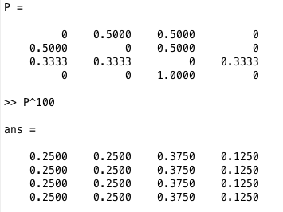
Example
Meow
Lion
Cat
Dog

Slide 30
More network theory as time allows

Slide 31
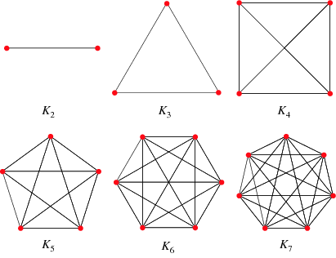

Some network terms
Degree of node i: # of edges connected to i
(directed) in-degree: # of edges into i
(directed) out-degree: # of edges out of i
Complete graph: Graph containing every possible edge. If n nodes, n choose 2 edges.
$\frac{1}{2}n(n−1)$
Edge Density: % of edges in graph compared to complete graph.

Slide 32
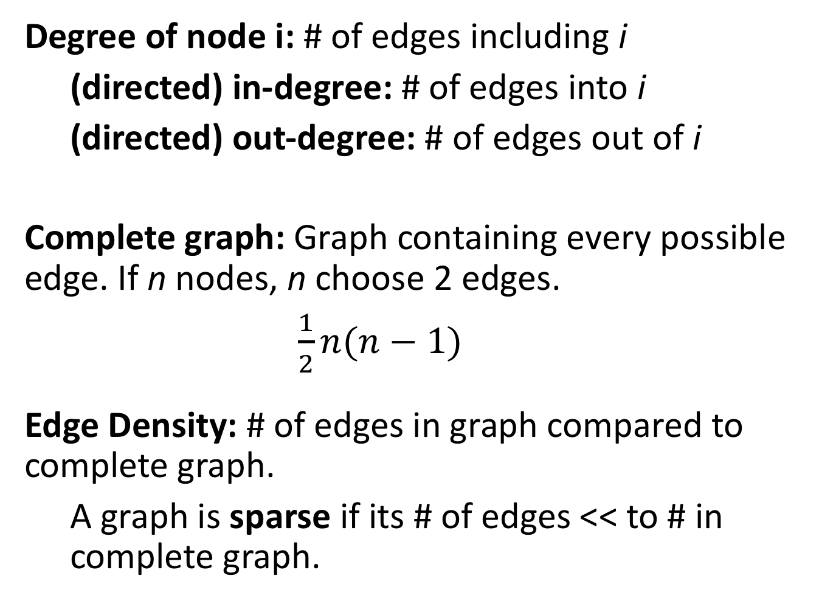
Some network terms
Degree of node i: # of edges including i
(directed) in-degree: # of edges into i
(directed) out-degree: # of edges out of i
Complete graph: Graph containing every possible edge. If n nodes, n choose 2 edges.
$\frac{1}{2}n(n−1)$
Edge Density: # of edges in graph compared to complete graph.
A graph is sparse if its # of edges << to # in complete graph.

Slide 33
Some network terms
Shortest path length (Geodesic distance):
The # of edges on the shortest path between two nodes on a network.
For weighted edges, it is the path with minimal sum of edge weights.
Average shortest path length:
Average of the shortest path between every pair of nodes on a network.
Diameter: Largest path length

Slide 34

Some network terms
Clustering coefficient:
How “clustered” is the network?
(Global): $C=\frac{3 x number of triangles}{number of triplets of nodes}$

Slide 36
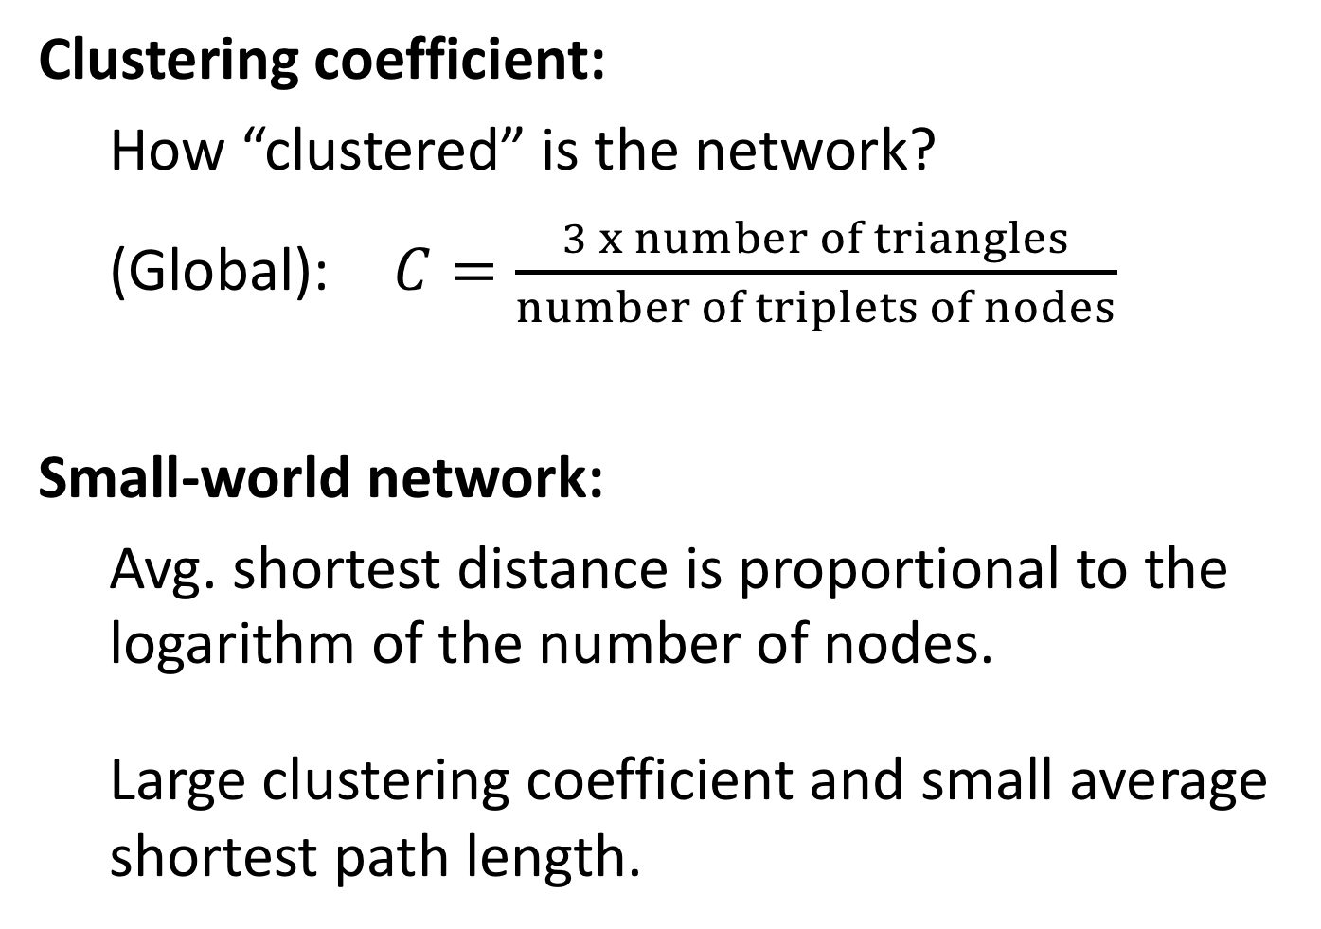
Some network terms
Clustering coefficient:
How “clustered” is the network?
(Global): $C=\frac{3 x number of triangles}{number of triplets of nodes}$
Small-world network:
Avg. shortest distance is proportional to the logarithm of the number of nodes.
Large clustering coefficient and small average shortest path length.

Slide 37
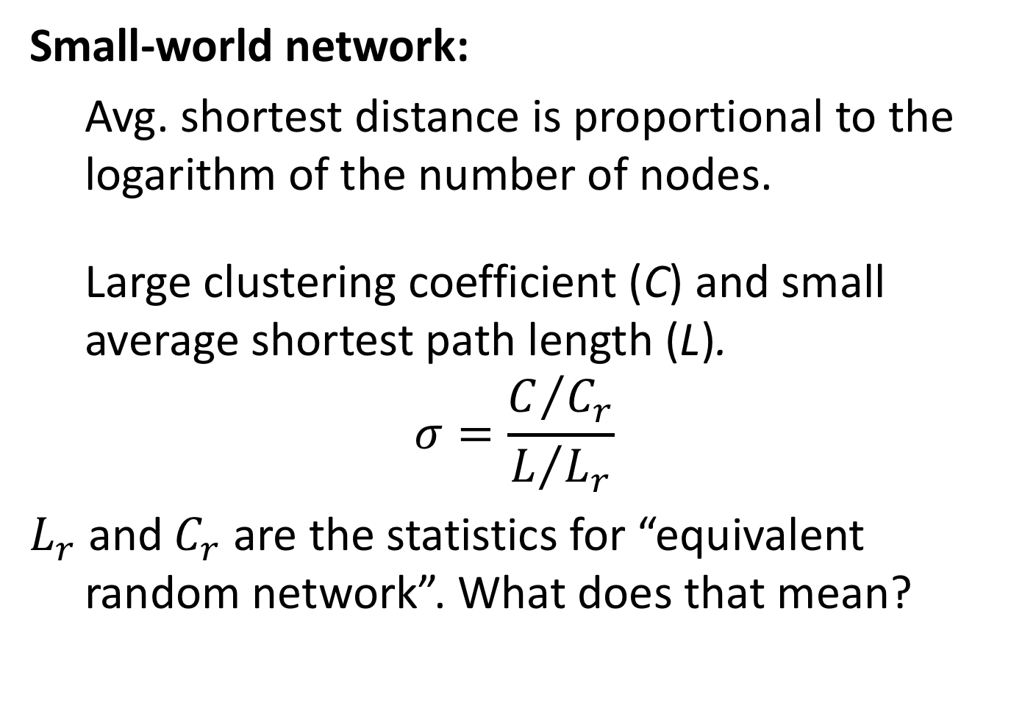
Some network terms
Small-world network:
Avg. shortest distance is proportional to the logarithm of the number of nodes.
Large clustering coefficient (C) and small average shortest path length (L).
$$σ=\frac{C/{C_{r}}}{L/{L_{r}}}$$
$L_{r} \text{and}{ C}_{r}$ are the statistics for “equivalent random network”. What does that mean?

Slide 38
Canonical Random Network: Erdős-Rényi
A Erdős-Rényi network is a network formed from n nodes and m edges where the m edges are assigned at random to pairs of nodes.
A variant instead defines it in terms of number of nodes and probability of an edge between any two nodes.
Who cares?
These networks cannot be sparse and clustered.

Slide 39
Degree distributions
The degree distribution of a network is a histogram of the degree for each node.
Erdős-Rényi have Binomial(n,p) degree distribution.
Real-world networks have scale-free or power-law degree distributions.
Binomial
Scale-free/Power-law
Notes:
Who cares? Height vs. Money.

Slide 40
Erdos-Renyi vs. Power-Law
(Steyvers & Tenenbaum, 2005)
Notes:
Who cares? Height vs. Money.

Slide 41
Network representations: Semantic/Associative Networks
Links represent associations between words or concepts.
Links may or may not be weighted.
(Collins & Loftus, 1975)

Slide 42
Properties of semantic networks
USF Association Network: 5,048 nodes; ~ 63,000 edges
(of ~6 million possible)
Sparse Network contains only a small number of the possible edges between nodes.
For USF network, avg. # of edges per node is 11!
“Small world” The shortest path between any two words tends to be small.
The avg. shortest path between any two nodes is 3!
Power-law Most words have few edges, but a few have
degree many edges.
Clustering Neighbors of a node are likely to be connected by an edge.
(Nelson, McEvoy & Schreiber, 1998; Steyvers & Tenenbaum, 2005)

Slide 43
(Steyvers & Tenenbaum, 2005)

Slide 44
(Steyvers & Tenenbaum, 2005)

Slide 45
What network growth mechanisms result in scale-free, sparse, etc?
Not Erdos-Renyi.
One method (similar to Barabasi & Albert, 1999)
New nodes connect to existing nodes proportional to their degree.
(Steyvers & Tenenbaum, 2005)

Slide 46
Admin Matters
Markov Chains
Network Theory
Short rest 1
Student presentations:
Karl presenting Muhkerjee et al (2017)
Bujji presenting Griffiths et al. (2007)
Short rest 2
Student presentations:
Aakash + Ashwini presenting Abbott et al. (2012)
Caleb presenting Zemla and Austerweil (2019)

