Slide 1
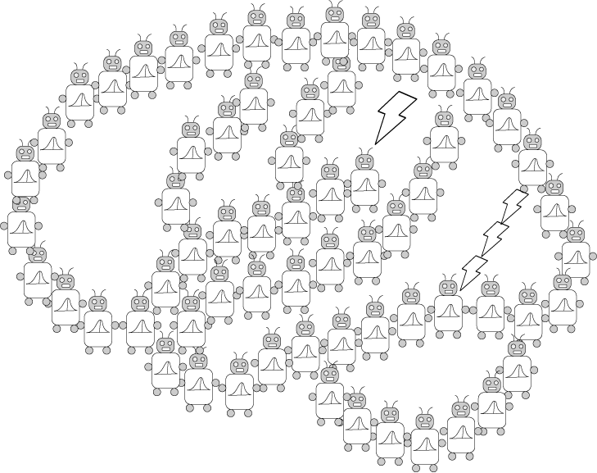
Approximation: Monte Carlo
PSYCH/COMP SCI/BMI 841: Computational Cognitive Science
Joseph Austerweil
March 13, 2025

Slide 2
Timeline
- Administrative Matters
- Why Approximate? (Background / Review)
- Monte Carlo
- Basic sampling
- Importance sampling
- Sequential importance sampling
(aka particle filtering)
Short rest 1
- Markov Chain Monte Carlo
Short rest 2
Two student presentations:
Vul et al 2009 by Martin
Sanborn & Griffiths 2007 by Anirudh

Slide 3
Administrative Matters
Generalization Assignment grading a bit delayed.
Metareviews for cogsci blindsided me.
Thank you for turning in the project proposal.
Will go through these next week
Deadlines for assignments 3 and 4 pushed back a week:
Assignment 3 is due April 9 at 8:59pm
Assignment 4 is due April 23 at 8:59pm
Questions?

Slide 4
Timeline
- Administrative Matters
- Why Approximate? (Background / Review)
- Monte Carlo
- Basic sampling
- Importance sampling
- Sequential importance sampling
(aka particle filtering)
Short rest 1
- Markov Chain Monte Carlo
Short rest 2
Two student presentations:
Vul et al 2009 by Martin
Sanborn & Griffiths 2007 by Anirudh

Slide 5
Marr’s three levels
Background/Review:
Computation
“What is the goal of the computation, why is it appropriate, and what is the logic of the strategy by which it can be carried out?”
Representation and algorithm
“What is the representation for the input and output, and the algorithm for the transformation?”
Implementation
“How can the representation and algorithm be realized physically?”
constrains
constrains

Slide 6
Background/Review:
A top-down approach…
If we want to effectively approximate Bayesian inference, we should:
Adopt good methods for solving Bayesian inference from computer science and statistics.
See if these methods can be interpreted as psychological processes.
The result: “rational process models”
(Sanborn et al., 2010; Shi et al., 2010)

Slide 7
Timeline
- Administrative Matters
- Why Approximate? (Background / Review)
- Monte Carlo
- Basic sampling
- Importance sampling
- Sequential importance sampling
(aka particle filtering)
Short rest 1
- Markov Chain Monte Carlo
Short rest 2
Two student presentations:
Vul et al 2009 by Martin
Sanborn & Griffiths 2007 by Anirudh

Slide 8
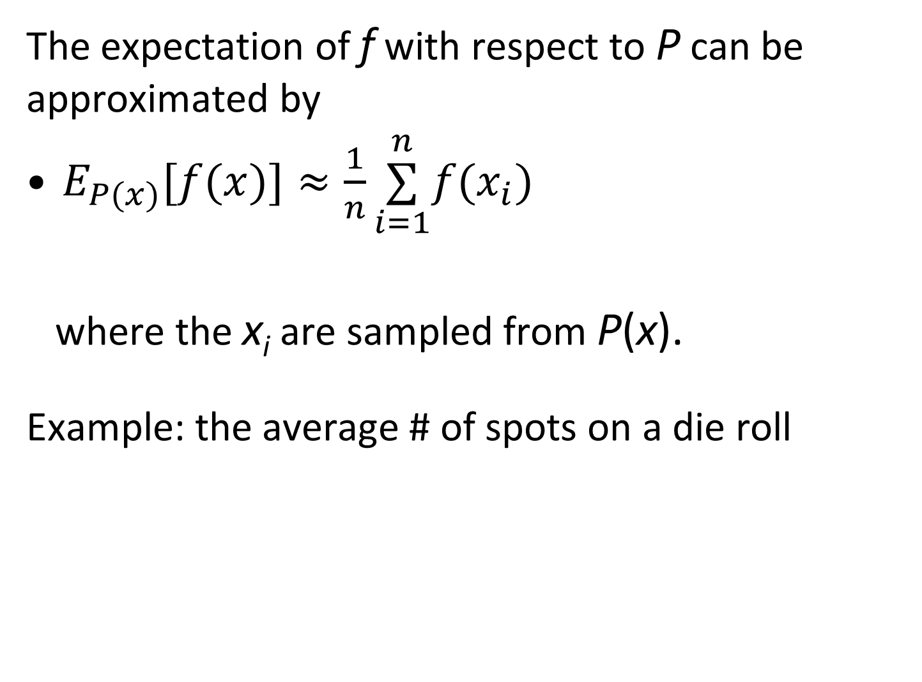
The Monte Carlo principle
The expectation of f with respect to P can be approximated by
$E_{P(x)}[f(x)]≈\frac{1}{n}\overset{n}{\underset{i=1}{∑}}f(x_{i})$
where the x_{i} are sampled from P(x).
Example: the average # of spots on a die roll
Notes:
E_{P(x)}[f(x)]\approx \frac{1}{n}\sum_{i=1}^nf(x_{i})

Slide 9
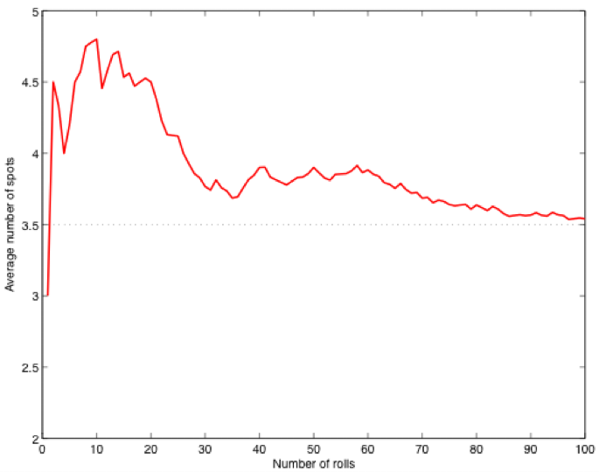
The Monte Carlo principle
The law of large numbers
Average number of spots
Number of rolls

Slide 10
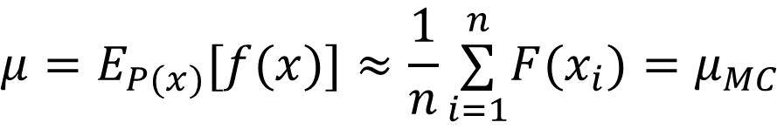

More formally (and words you might read)
$$μ=E_{P(x)}[f(x)]≈\frac{1}{n}\overset{n}{\underset{i=1}{∑}}F(x_{i})=μ_{MC}$$
μ_{MC} is consistent, (μ_{MC} - μ) → 0 as n → ∞
μ_{MC} is unbiased, with E[μ_{MC} ] = μ
μ_{MC} is asymptotically normal*, with
$$\sqrt{n}(μ_{MC}−μ)→N(0,σ_{MC}^{2}$$
in distribution
$$σ_{M}^{2}C=E_{P(x)}[(f(x)−E_{P(x)}[f(x)])^{2}]$$
Under simple standard assumptions
Notes:
Under simple standard assumptions
\mu = E_{P(x)}[f(x)] \approx \frac{1}{n}\sum_{i = 1}^n F(x_{i}) = \mu_{MC}
\sqrt{n} (\mu_{MC} - \mu)\to N(0, \sigma^2_{MC}
\sigma^2_MC = E_{P(x)}[(f(x) - E_{P(x)}[f(x)])^2]

Slide 11
BUT, many times we can’t sample from the distribution. What do we do then?

Slide 12
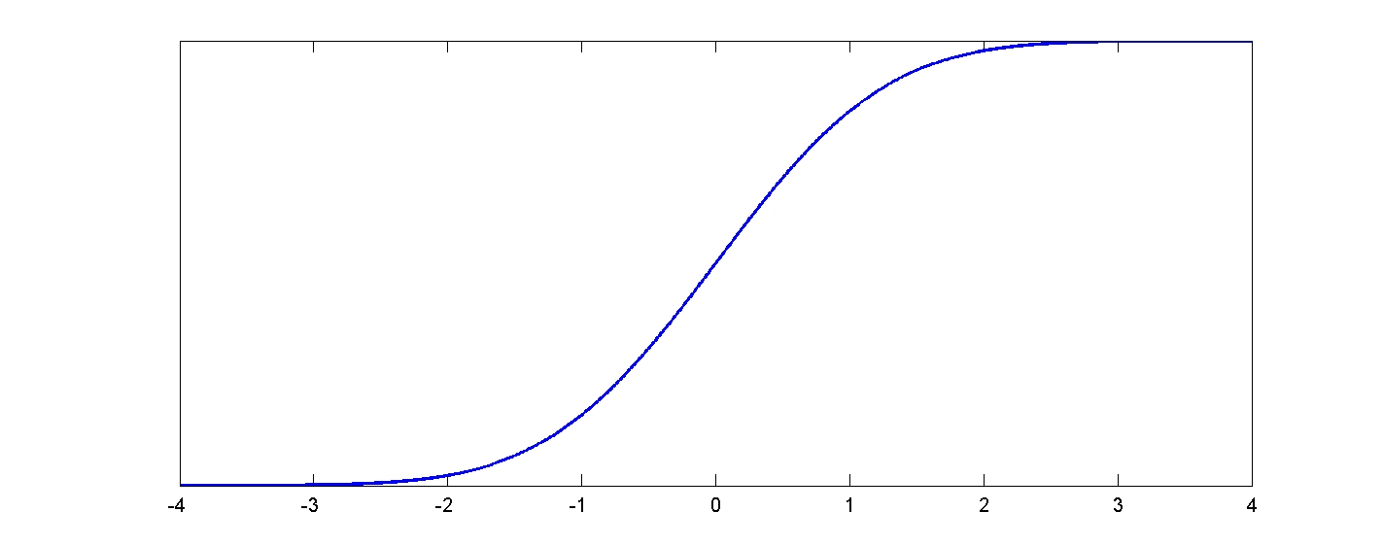
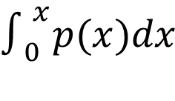
Basic Sampling: Inverse cumulative distribution
Draw a sample y from Uniform(0,1)
Find the value x of the Cumulative Distribution Function (CDF) such that F(x) = y. (i.e., x = F⁻¹(y))
x is a sample from p(x).
1
$$∫_{0}^{x}p(x)dx$$
CDF: F(x) =
0
(requires CDF be invertible)

Slide 13
Example sampling via inverse cumulative distribution function (CDF)
Basic Sampling: Inverse cumulative distribution
How to sample Exponential random variables?
Inverse CDF Method works well for this!
Is this better than importance sampling?
Why yes or why not?

Slide 14
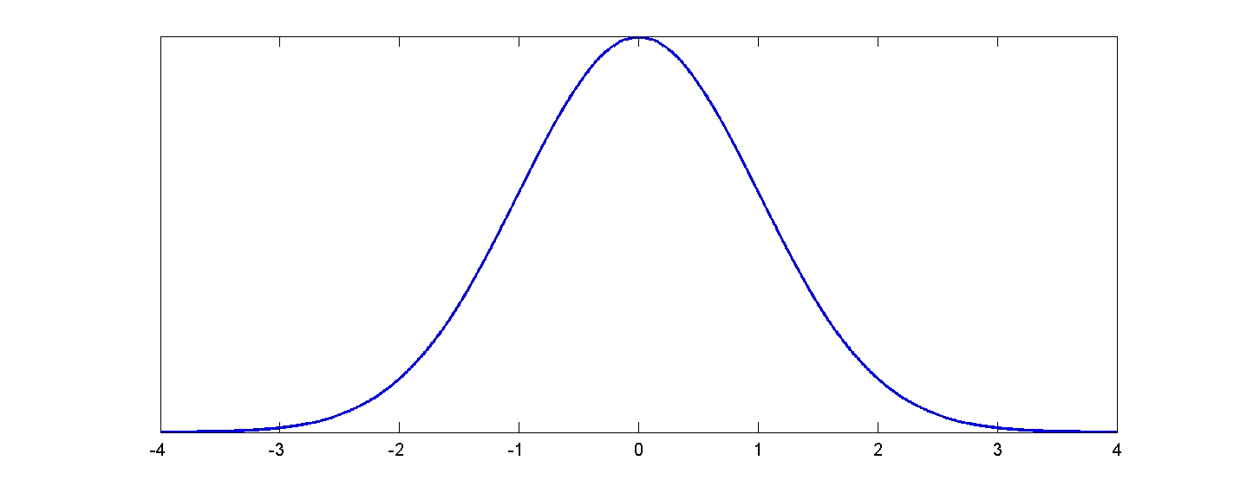
Basic Sampling: Rejection sampling
p(x)
Notes:
Sample uniformly and include it if it is under the distribution curve, otherwise don’t include it. (example with pi)

Slide 15
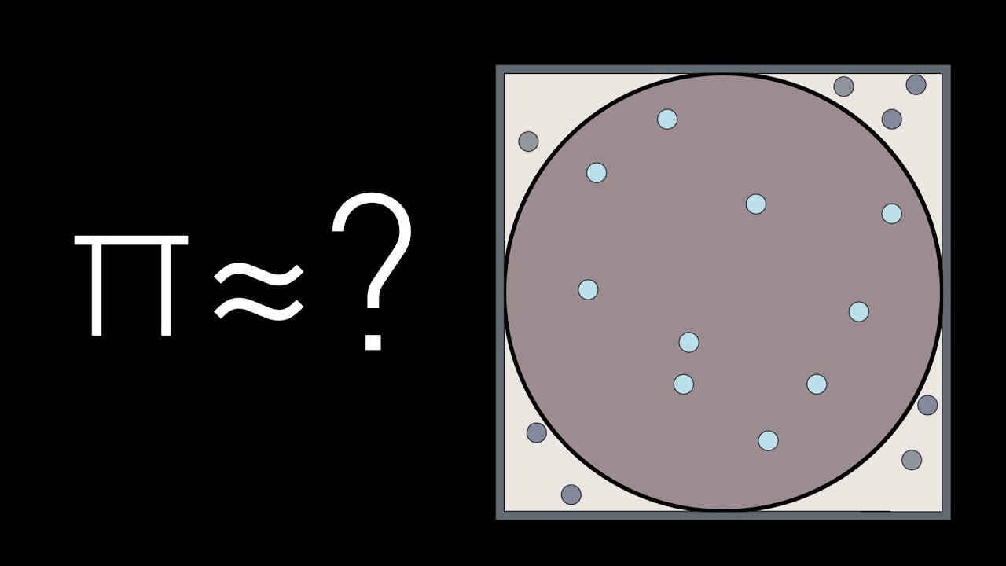

Slide 16
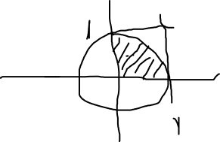
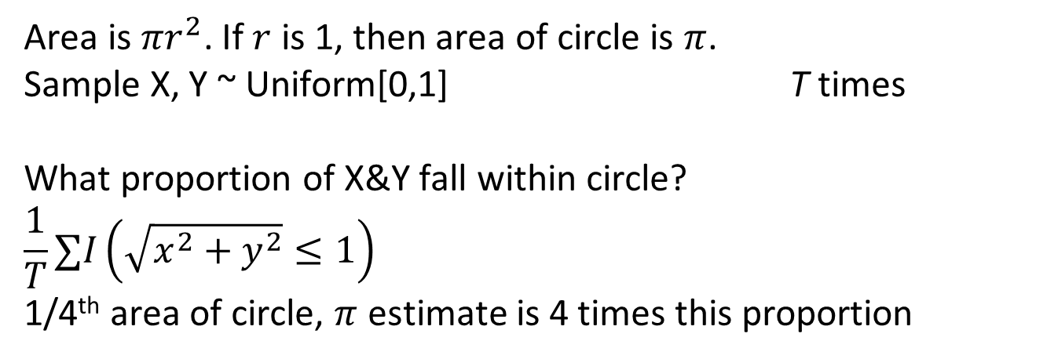
Basic Sampling: Calculating Pi with Rejection Sampling
Area is $πr^{2}$. If $r$ is 1, then area of circle is $π$.
Sample X, Y ~ Uniform[0,1] T times
What proportion of X&Y fall within circle?
$$\frac{1}{T}∑I\left(\sqrt{x^{2}+y^{2}}≤1\right)$$
1/4th area of circle, $π$ estimate is 4 times this proportion

Slide 17
Basic Sampling: Rejection sampling of the posterior
Generate samples of all variables following the generative process in the model.
This follows the joint distribution.
Reject all samples that do not match the observed data.
X₄
X₃
X₁
X₂
Notes:
Many times want P(X_4,X_3,X_2|X_1)

Slide 18
Timeline
- Administrative Matters
- Why Approximate? (Background / Review)
- Monte Carlo
- Basic sampling
- Importance sampling
- Sequential importance sampling
(aka particle filtering)
Short rest 1
- Markov Chain Monte Carlo
Short rest 2
Two student presentations:
Vul et al 2009 by Martin
Sanborn & Griffiths 2007 by Anirudh

Slide 19
Importance sampling
A general scheme for sampling from complex distributions that have simpler relatives.
Simple methods for sampling from posterior distributions in some cases (easy to sample from prior, prior and posterior are close).
Can be more efficient than simple Monte Carlo.
Links to exemplar models in psychology.
Also provides a solution to the question of how people can update beliefs as data come in…

Slide 21
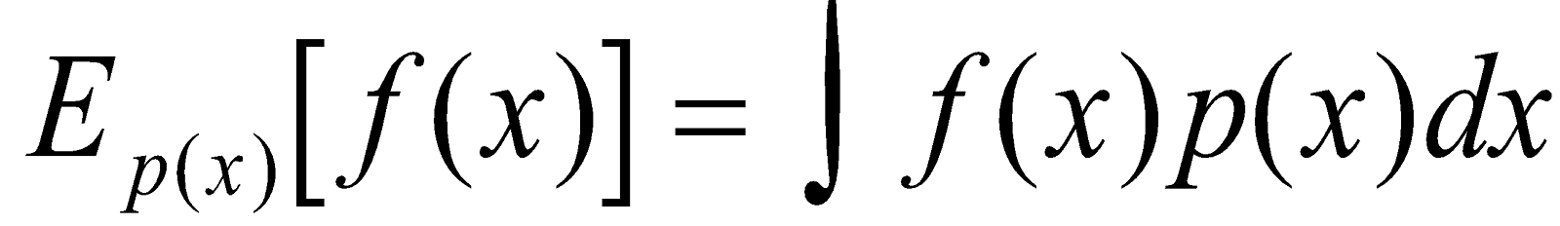
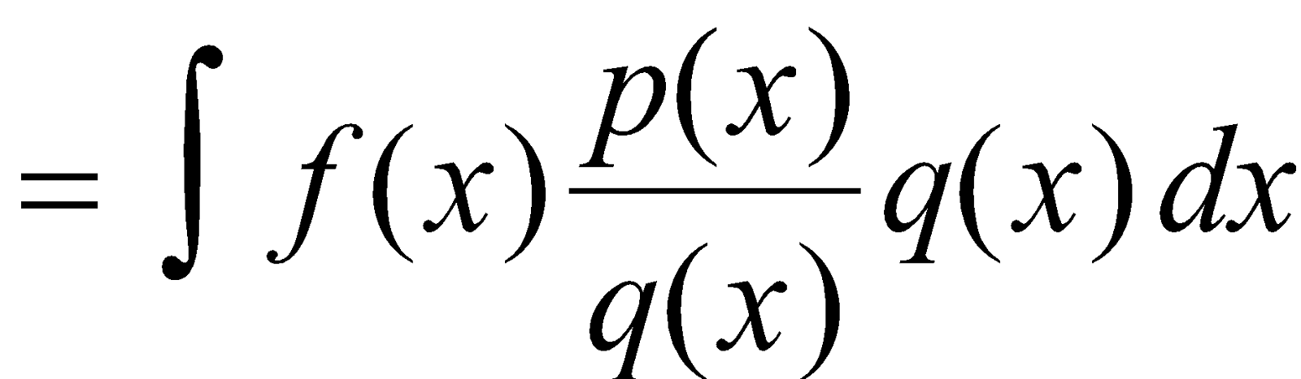
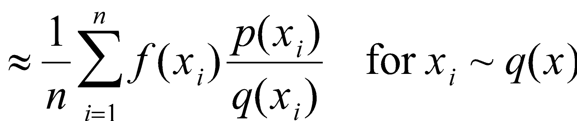
Importance sampling
Basic idea:
1. generate from the wrong distribution q.*
2. assign weights to samples to correct for this.
Notes:
Wrong distribution is required to have same support as p(x)

Slide 22
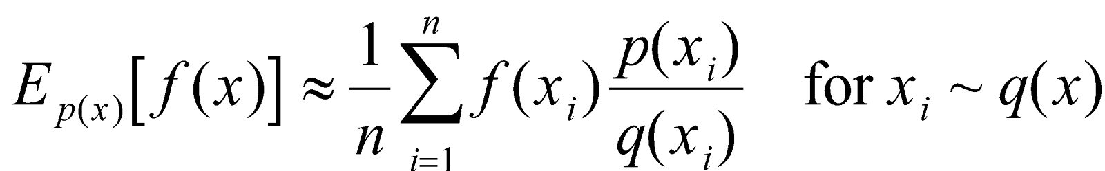
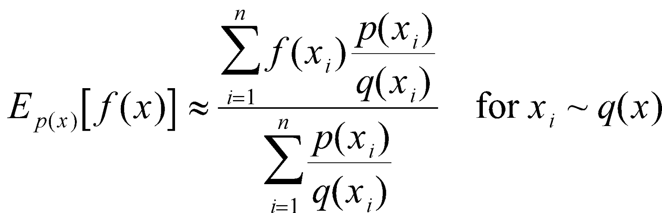
Importance sampling
when p(x) is only known up to a multiplicative constant.
when p(x) is only known up to a multiplicative constant.
Notes:
Sometimes p(x_i)/q(x_i) is called the weight of particle i

Slide 23
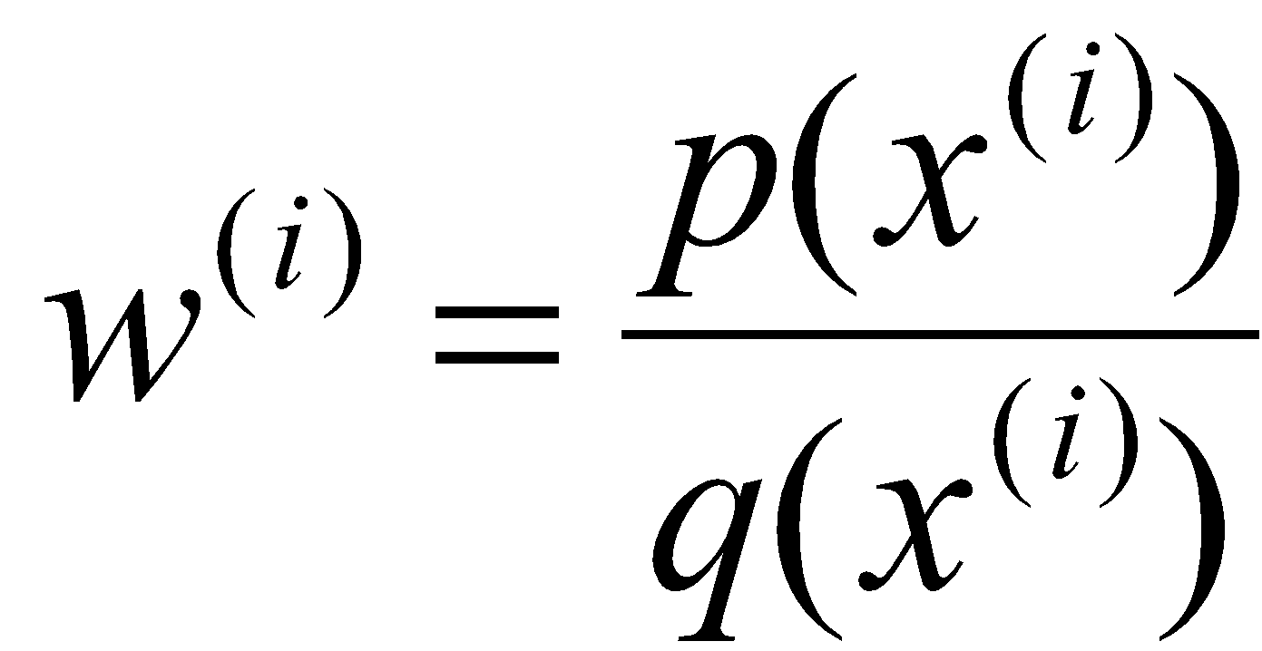
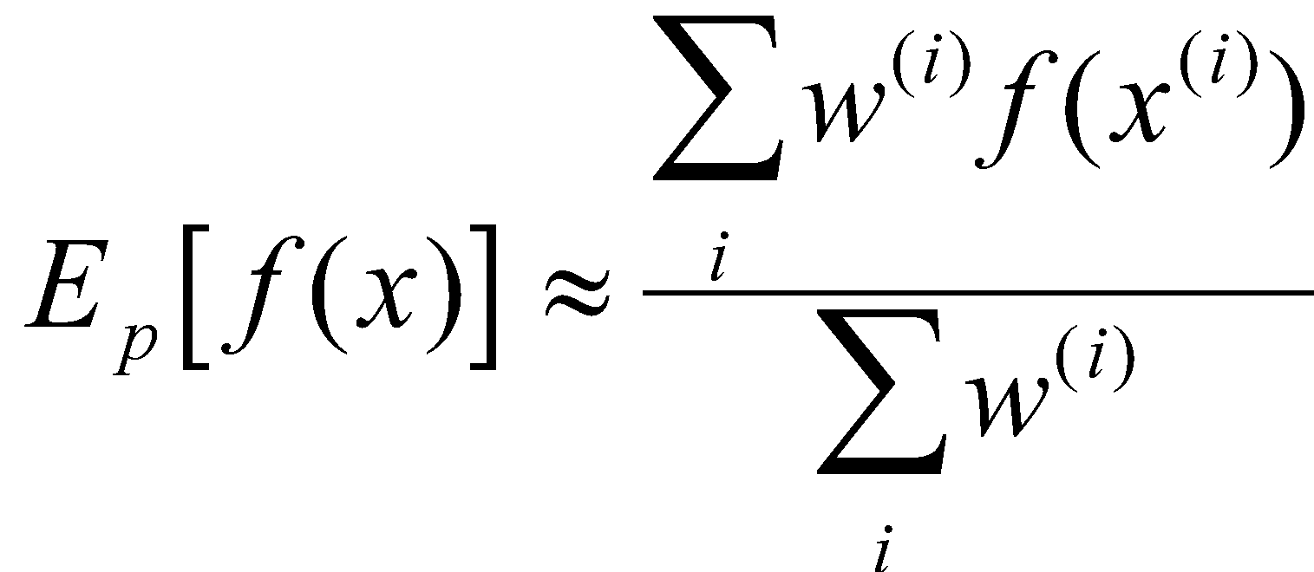
Importance sampling
q(x)
p(x)

Slide 24
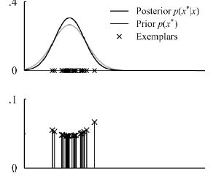
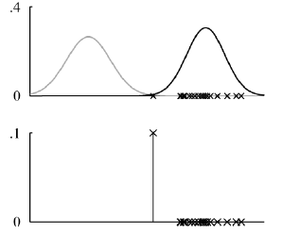
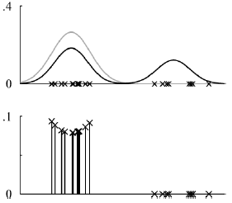
Importance sampling from prior
Overlap
No overlap
Some overlap
P(x)
w(x^{(i)})
Notes:
Gray is target

Slide 25
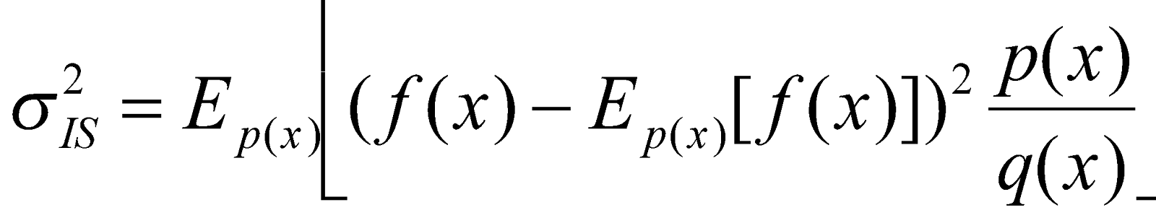
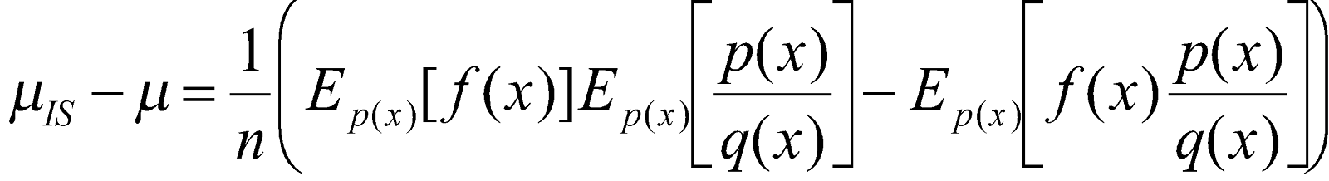
Importance sampling (properties)
μ_{IS} is consistent, (μ_{IS} - μ) → 0 a.s. as n → ∞
μ_{IS} is asymptotically normal, with
μ_{IS} is biased, with
Notes:
Remember p(x)/q(x) is the weight of x, so expected weight

Slide 26
Importance sampling from prior
Overlap
No overlap
Some overlap
P(x)
w(x^{(i)})
Variance of weights gives idea of how good the sampler is…

Slide 27
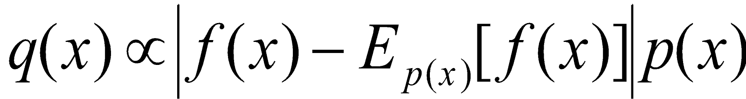
Optimal importance sampling
Asymptotic variance is
This is minimized by

Slide 28
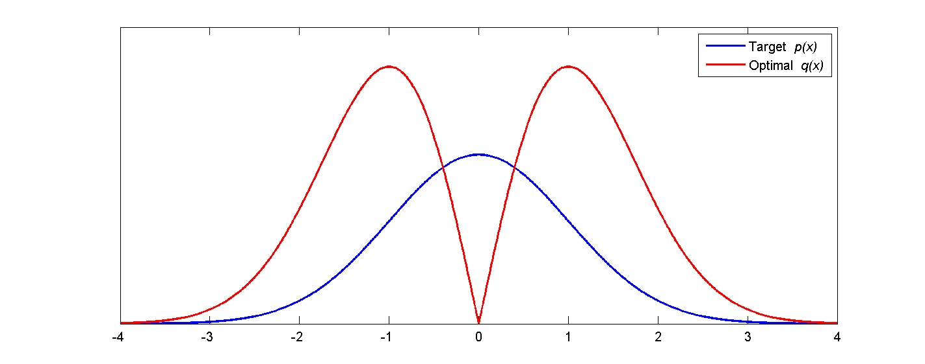
Optimal importance sampling
Task: Estimate the mean and variance of a normal distribution.
What’s the optimal distribution to sample from?
Notes:
Want to know parameters of a normal distribution. Optimal is actually not the distribution itself.

Slide 29
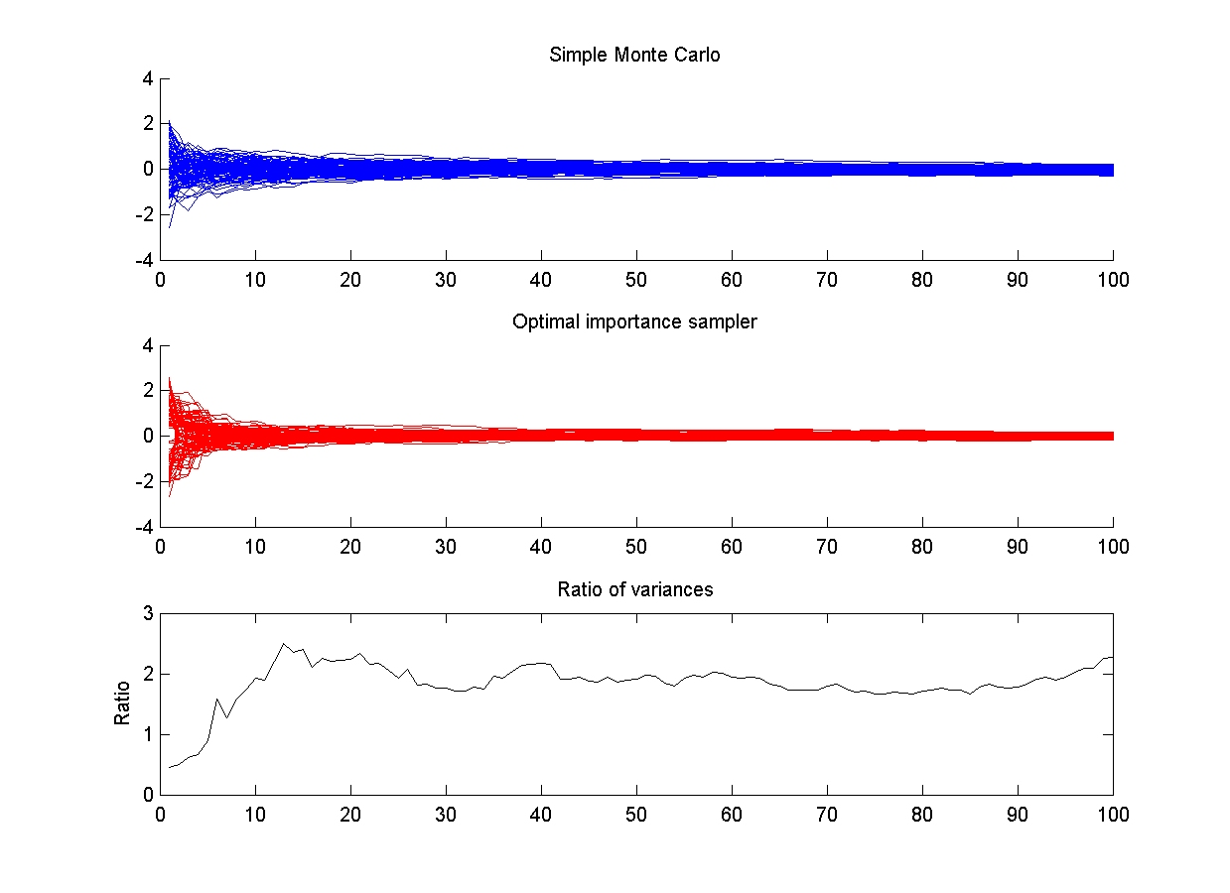
(sampling from actual distribution)

Slide 30
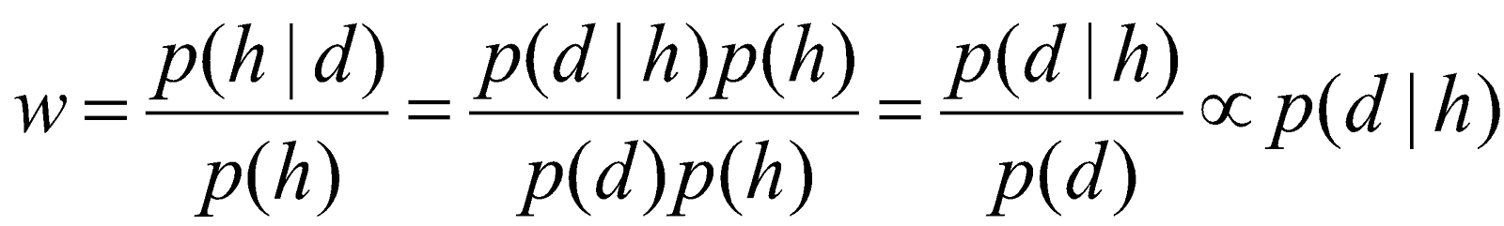
Likelihood weighting
Assume we only know what likelihood is prop. to.
A particularly simple form of importance sampling for posterior distributions (p(h|x)).
Use the prior as the proposal distribution (q=p(h)).
Weights:

Slide 31
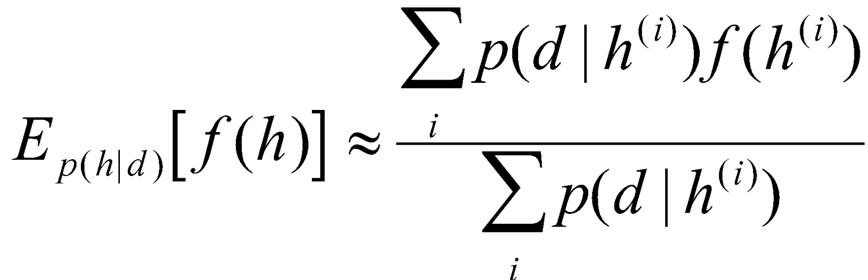
Approximating Bayesian inference
Sample from the prior, weight by the likelihood
Notes:
P(d) would cancel out anyway on next slide because it doesn’t depend on hypotheses and could be pulled out of both sums…

Slide 32
Does that equation remind you of any prior psychological theories?

Slide 33
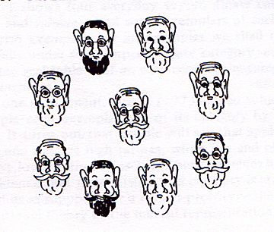
Exemplar theories
Store every member (“exemplar”) of the family
(Armstrong, Gleitman, & Gleitman, 1983)
Notes:
Can mimic prototype models without explicitly representing a prototype

Slide 34
Exemplar theories
Observe:
Store every member (“exemplar”) of the family
(Armstrong, Gleitman, & Gleitman, 1983)
Notes:
Can mimic prototype models without explicitly representing a prototype

Slide 35
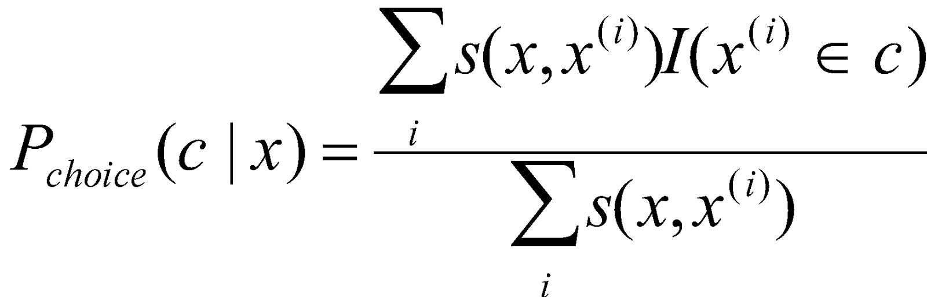
Exemplar models
Assume decisions are made by storing previous events in memory, then activating by similarity.
For example, categorization:
where x^{(i)} are exemplars, s(x,x^{(i)}) is similarity, I(x^{(i)}∈c) is 1 if x^{(i)} is from category c.
(e.g., Nosofsky, 1986)

Slide 36
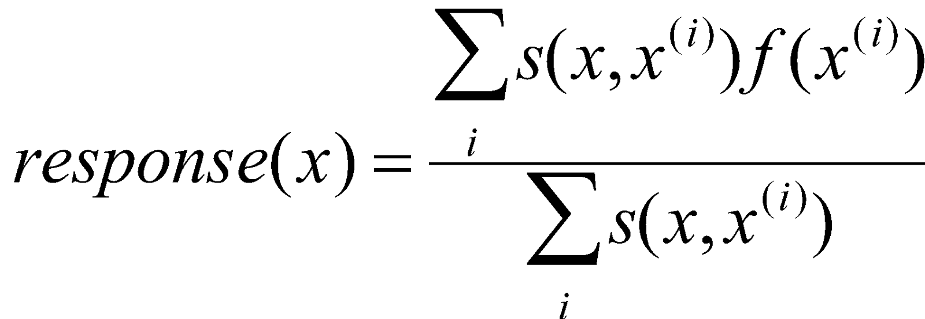
Exemplar models
Assume decisions are made by storing previous events in memory, then activating by similarity.
General version:
where x^{(i)} are exemplars, s(x,x^{(i)}) is similarity, f(x^{(i)}) is quantity of interest.

Slide 37
Equivalence
Exemplar:
IS:
When the samples are hypotheses, exemplar models can be viewed as importance samplers of Bayesian models.

Slide 38
Admin Matters
Why Approximate?
Monte Carlo
Basic sampling
Importance sampling
Sequential importance sampling
(aka particle filtering)
Short rest 1
Markov Chain Monte Carlo
Short rest 2
Two student presentations:
Vul et al 2009 by Martin
Sanborn & Griffiths 2007 by Anirudh

Slide 39
Updating distributions over time…
Computational costs are compounded when data are observed incrementally…
recompute P(h|d₁, …, d_{n}) after observing d_{n}
Exploit “yesterday’s posterior is today’s prior”
Repeatedly using importance sampling results in an algorithm known as a “particle filter.”
Also called “sequential Monte Carlo,” “bootstrap filter,” “condensation,” and “survival of the fittest.”

Slide 40
Dynamic hypotheses
h₁
h₂
h₃
h₄
d₁
d₂
d₃
d₄
Exploit this recursive relation to make a sampling algorithm!
w_{n} is the posterior after n steps.

Slide 41
Particle filter
Initialize M samples (called “particles”) from prior and weights to be uniform over samples.
For data point n = {1, …, N}:
Update each sample’s weight by multiplying it by how probable the current datum is given the sample’s value.
Normalize the weights.
If the weights are becoming “degenerate,” resample (with replacement) particles according to current weight distribution. Reset weights to be uniform.
At end, samples approximate the posterior.

Slide 42
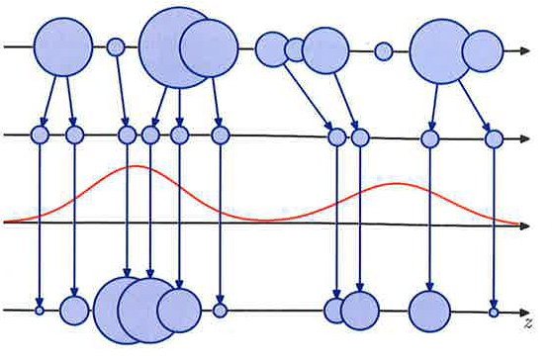
Particle filter
weights from
P(h | d₁,…,d_{n-1})
samples from
P(h | d₁,…,d_{n-1})
likelihood:
P(d_{n} | h)
samples from
P(h | d₁,…,d_{n})
(from Bishop, 2006)

Slide 43
The promise of particle filters
A general scheme for defining rational process models of updating over time. (Sanborn et al., 2006)
Model limited memory, and produce order effects
(cf. Kruschke, 2006)
Used to define rational process models of…
categorization (Sanborn et al., 2006)
associative learning (Daw & Courville, 2008)
changepoint detection (Brown & Steyvers, 2009)
sentence processing (Levy et al., 2009)
And more since 2009…

Slide 44
Want more on particle filters?
7 minute youtube video “Particle filtering without equations”:
https://www.youtube.com/watch?v=aUkBa1zMKv4

Slide 45
Admin Matters
Why Approximate?
Monte Carlo
Basic sampling
Importance sampling
Sequential importance sampling
(aka particle filtering)
Short rest 1
Markov Chain Monte Carlo
Short rest 2
Two student presentations:
Vul et al 2009 by Martin
Sanborn & Griffiths 2007 by Anirudh

Slide 46

Short rest 1

Slide 47
Admin Matters
Why Approximate?
Monte Carlo
Basic sampling
Importance sampling
Sequential importance sampling
(aka particle filtering)
Short rest 1
Markov Chain Monte Carlo
Short rest 2
Two student presentations:
Vul et al 2009 by Martin
Sanborn & Griffiths 2007 by Anirudh

Slide 48
Markov chains
x
x
x
x
x
x
x
x
Transition matrix
T = P(x^{(t+1)}|x^{(t)})
Variables x^{(t+1)} independent of history given x^{(t)}
Converges to a stationary distribution under easily checked conditions (i.e., if it is ergodic).
Notes:
The future is independent of the past conditioned on the present
Ergodic = aperiodic and positive recurrent
It is also irreducible = positive probability of going between any two states. Bring out a deck for discussion.

Slide 49
Markov chain Monte Carlo (MCMC)
Sample from a target distribution P(x) by constructing Markov chain for which P(x) is the stationary distribution
Two main schemes:
Metropolis-Hastings algorithm
Gibbs sampling

Slide 50
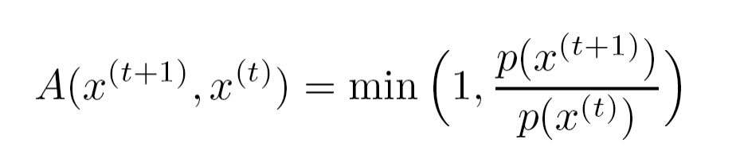
Metropolis-Hastings algorithm (Metropolis et al., 1953; Hastings, 1970)
Step 0: Initialize values for the state of the chain
Step 1: propose a state (we assume symmetrically)
Q(x^{(t+1)}|x^{(t)}) = Q(x^{(t)}|x^{(t+1)})
Step 2: decide whether to accept, with probability

Slide 51
Metropolis-Hastings algorithm
p(x)

Slide 52
Metropolis-Hastings algorithm
p(x)

Slide 53
Metropolis-Hastings algorithm
p(x)

Slide 54
Metropolis-Hastings algorithm
p(x)
A(x^{(t)}, x^{(t+1)}) = 0.5

Slide 55
Metropolis-Hastings algorithm
p(x)

Slide 56
Metropolis-Hastings algorithm
p(x)
A(x^{(t)}, x^{(t+1)}) = 1

Slide 57
Example
Visualizing Metropolis-Hastings/Gibbs Sampling
https://chi-feng.github.io/mcmc-demo/
https://chi-feng.github.io/mcmc-demo/app.html?algorithm=RandomWalkMH&target=standard
Notes:
Initialized to two.

Slide 58
Markov chain Monte Carlo (MCMC)
Sample from a target distribution P(x) by constructing Markov chain for which P(x) is the stationary distribution
Two main schemes:
Metropolis-Hastings algorithm
Gibbs sampling

Slide 59
Gibbs sampling
1. Start a “chain” with a random state.
2. Pick a random variable in state.
3. Resample that variable’s value conditioned on the other
4. Go back to 2 and repeat indefinitely.
For variables x = x₁, x₂, …, x_{n} and target P(x)
Draw x_{i}^{(t+1)} from P(x_{i}|x_{-i})
x_{-i} = x₁^{(t+1)}, x₂^{(t+1)},…, x_{i-1}^{(t+1)}, x_{i+1}^{(t)}, …, x_{n}^{(t)}
(Geman & Geman, 1984)
Notes:
Use example from deck of any shuffling procedure.

Slide 60
Chain
Starts
Notes:
Do this with music

Slide 61
Muted
Chain
Starts
Chain after P1

Slide 62
Chain
Starts
Muted
Chain after P1
Chain after P2

Slide 63
Chain
Starts
Chain after P1
Muted
Chain after P2
Chain after P3

Slide 64
Chain
Starts
Chain after P1
Chain after P2
Muted
Chain after P3
Chain after P8

Slide 65
Chain
Starts
Chain after P1
Chain after P2
Chain after P3
Chain after P8

Slide 66
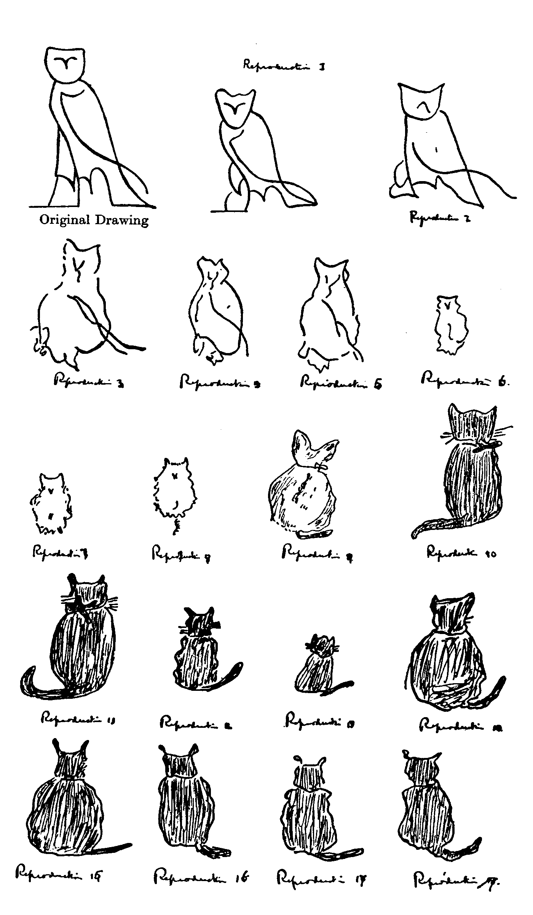
Serial reproduction (Bartlett, 1932)
Participants see stimuli, then reproduce them from memory
Reproductions of one participant are stimuli for the next
Stimuli were interesting, rather than controlled
e.g., “War of the Ghosts”

Slide 67
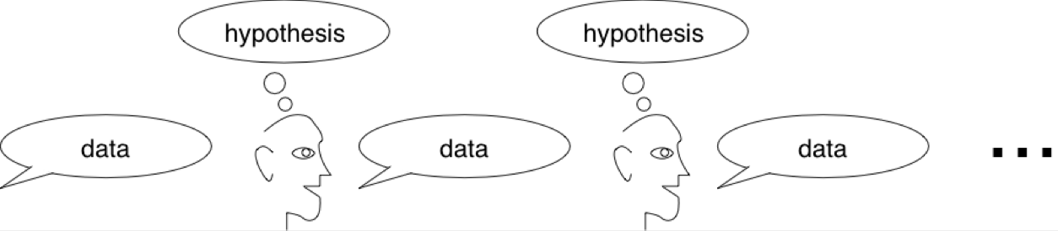
Human MCMC
What are the consequences of learners learning from other learners?
(Bartlett, 1932; Kirby, 2001; Griffiths & Kalish, 2007; …)
Notes:
Remember to mention telephone.

Slide 68
Analyzing Human MCMC
P(h|d)
P(h|d)
P(d|h)
P(d|h)
P(h|d): probability of inferring hypothesis h from data d
P(d|h): probability of generating data d from hypothesis h
(Bartlett, 1932; Kirby, 2001; Griffiths & Kalish, 2007; …)

Slide 69
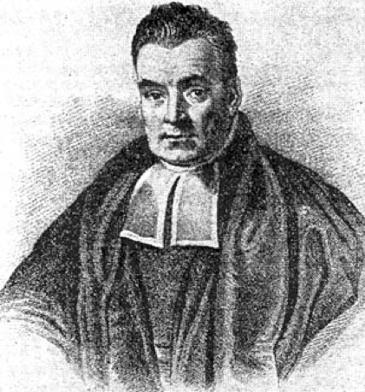
Bayesian MCMC (MCMC with People/”Iterated learning”)
P(h|d)
P(h|d)
P(d|h)
P(d|h)
Assume learners sample from their posterior distribution:
(Bartlett, 1932; Kirby, 2001; Griffiths & Kalish, 2007; …)

Slide 70
Analyzing Human MCMC
d₀
h₁
d₁
h₂
d₂
h₃
P(h|d)
P(d|h)
P(h|d)
P(d|h)
P(h|d)
A Markov chain on hypotheses -> Converges to prior on hyps. P(h)!
h₁
h₂
h₃
Σ_{d} P(d|h)P(h|d)
Σ_{d} P(d|h)P(h|d)
A Markov chain on data -> Converges to prior predictive dist. P(d)!
d₀
d₁
d₂
Σ_{h} P(h|d) P(d|h)
Σ_{h} P(h|d) P(d|h)
Σ_{h} P(h|d) P(d|h)
(Bartlett, 1932; Kirby, 2001; Griffiths & Kalish, 2007; …)
Notes:
Top isn’t a markov chain really bc variable is swapping. Really it’s two markov chains...
Intuition: Original data only influences everything once. Prior bias has influence on every trial -> arbitrarily large influence.
Can be run within-subject or between-subjects!

Slide 71
Admin Matters
Why Approximate?
Monte Carlo
Basic sampling
Importance sampling
Sequential importance sampling
(aka particle filtering)
Short rest 1
Markov Chain Monte Carlo
Short rest 2
Two student presentations:
Vul et al 2009 by Martin
Sanborn & Griffiths 2007 by Anirudh

Slide 72

Short Rest 2

