Slide 1
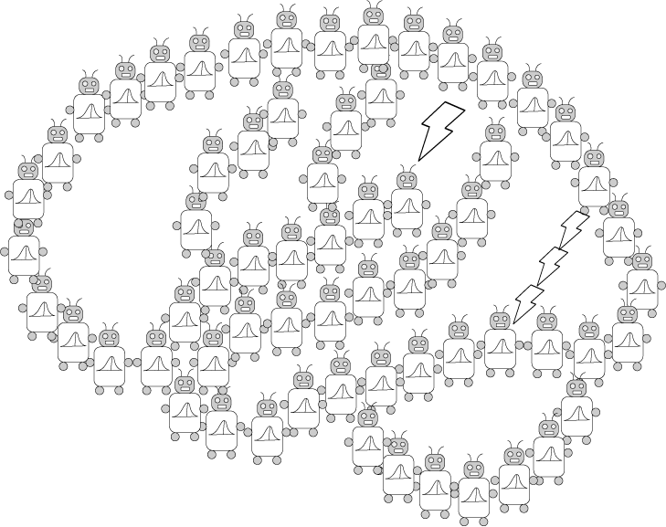
Statistical Decision Theory, Markov Decision Processes, and Reinforcement Learning
PSYCH/COMP SCI/BMI 841: Computational Cognitive Science
Joseph Austerweil
March 20, 2025
Notes:
Hello class, let’s get started. Thanks everyone for being flexible and doing class virtually today. I really appreciate it. It is helping me with getting better.

Slide 2
Admin Matters
Statistical Decision Theory
Markov Decision Processes
Short rest 1
Three student presentations:
Schulz et al 1997 by Ashwini
Ho et al 2015 by Khailanii
Short rest 2
3. Ho et al 2017 by Anirudh
Notes:
For today’s class, we’ll start with some short admin matters, move into statistical decision theory and Markov decision processes/reinforcement learning, and thenhave three student presentations with two short rests.

Slide 3
Administrative Matters
Generalization Assignment grading a bit delayed.
Metareviews for cogsci + illness blindsided me.
Thank you for turning in the project proposal.
Feedback went back to you this weekend
Prioritized this to make sure everyone got timely feedback
Deadlines for assignments 3 and 4 pushed back a week:
Assignment 3 is due April 9 at 8:59pm
Assignment 4 is due April 23 at 8:59pm
Questions?
Notes:
Apologies about the generalization assignment grading being a bit delayed. I’m a metareviewer for the cogsci conference each year. They used to default to 4 or at most 6 papers for meta reviewing. But they increased it to 8 this year and I hadn’t realized. Also, more than half of the papers had split reviewer decisions, which required me to think carefully to evaluate the criticisms and the paper to make a fair recommendation that takes them all into account. At that point, your project proposals came in and getting those back to you first to ensure you got timely feedback and could make progress on those became more important. I’m hoping to get the generalization assignment back to you soon.
Also, we already discussed this, but the due date for assigments 3 and 4 were pushed back a week. Assignment 4 isn’t out yet. It’s pretty straightforward – with a lot of helper code, you reproduce the basic phenomena from the ho et al 2015 paper we’re discussing today and explain why it’s happening. It will go out by the end of spring break (likely sooner).
Any questions?

Slide 4
Admin Matters
Statistical Decision Theory
Markov Decision Processes
Short rest 1
Three student presentations:
Schulz et al 1997 by Ashwini
Ho et al 2015 by Khailanii
Short rest 2
3. Ho et al 2017 by Anirudh

Slide 5

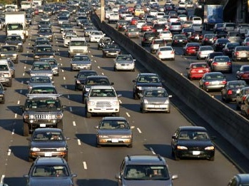
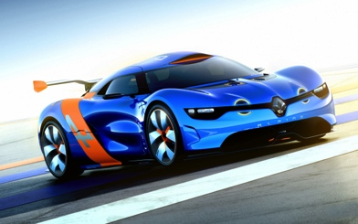


Decisions under uncertainty
Observe: x
Proportion of cars on bridge: θ
Action: Bridge
Bridge traffic cam
Decision rule d(x): Rule based on traffic cam data to take bridge or tunnel.
Loss function L(θ, a): based on state of world and action.
Action: Tunnel
Notes:
So far, everything we’ve discussed has been in service of making predictions. We saw how Bayesian updating be used to make all sorts of predictions, ranging from generalizing properties to causal judgments to memory retrieval. We even started discussing how to approximate these calculations when it’s challenging to do the calculations explicitly.
But, what use is prediction if you can’t do anything about it? In this lecture, we’ll discuss statistical decision theory, which serves as the normative basis for evaluating decision-making. I will give a flavor of what the framework looks like and what one can do with it. This will allow you to delve deeper into the topics later on your own if you’re interested.
To introduce the overall idea, let’s say you’re trying to get to the airport in a city where there are two ways to drive to the airport: you can take the bridge or the tunnel. You need to have a choice or actions one can take to make a decision, so that’s what the bridge vs. tunnel choice is serving.
Let’s assume that the bridge is better as long as the proportion of cars are on it don’t get too high. We can represent how good it is to take the bridge vs. tunnel based on the level of traffic on the bridge by a loss function. It encodes the loss of an action based on the state of the world. So in our example, it might be the extra amount of time it takes to get to the airport based on the traffic. Note that this can capture good decisions too, it would just be a negative amount in this case. Statisticians decided to be more pessimistic and encode everything in terms of negatives.
Now, to make this more interesting, we can introduce observations. It could be noisy. For example, let’s say we have access to the bridge traffic cam at certain points. We could watch that for a bit and estimate the level of traffic that there is on the bridge. That’s effectively learning! Now we can make a decision based on how we learn and examine our loss based on taking those actions and whatever the true state of the world. We can evaluate whether or one decision rule is better than another from this loss and a bit of extra work.

Slide 6
Statistical decision theory
Decision making under uncertainty formalism:
States of world θ (e.g., prop. of traffic on bridge)
Observation x (e.g., current traffic leading to bridge).
Possible actions A (e.g., take tunnel or bridge).
Decision rule d(x) (e.g., take tunnel if x is heavy).
Loss function L(θ, a) = L(θ, d(x))
0-1 loss: 1 for wrong action, 0 for correct action. (e.g., 0 if you take bridge and less traffic on bridge)
For continuous “actions” (estimation):
Squared loss (also called L² norm): (θ - d(x))²
Absolute loss (also called L¹ norm): |θ - d(x)|
Notes:
Next, we connect the intuitive example we began with to the formal components that statistical decision theory uses to define a problem.

Slide 7
Statistical decision theory
How “good” is your rule for deciding from the traffic cam based on the true percent of cars on the bridge?
Risk function: R(θ, d(x)) = E^{x}[L(θ, d(x))]
The risk function provides the expected loss for a decision rule d(x) and a state of the world θ.
How should one pick a decision rule to minimize risk?
Notes:
Now that we have the notation setup, we can move to how one actually prescribes decisions in uncertain situations using statistical decision theory. Before, we talked about getting a single observation x and making a decision based on that, but that ignores the random aspects of the problem. We’re only seeing a little bit of the bridge and making a guess as to the full proportion of cars on the bridge. It may take time to get to the bridge and the percent of cars on it might change a bit in that time. To define how good a decision rule is, we can examine the expected loss we get based on the decision we would make depending on different observations we would get. This is called the risk function –it’s the expected loss we get over different data sets given the true state of the world using our decision rule. This gets us one step closer to our goal of being able to critique different decision rules as now we’re taking account of the different possible observations we could get. But we still have a different risk value for each true state of the world…

Slide 8
Statistical decision theory
Risk function: R(θ, d(x)) = E^{x}[L(θ, d(x))]
How should one pick a decision rule to minimize risk?
Do we have knowledge about the true state of the world?
If yes, can use a Bayesian criterion: minimize expected loss given a prior over the state of the world.
argmin_{d(x)} E^{θ}E^{x}[L(θ, d(x))]
If no, can use a minimax criterion: minimize the worst possible loss over all possible states of the world.
argmin_{d(x)} max_{θ} E^{x}[L(θ, d(x))]
Notes:
To make progress from here, we need to either make assumptions about what states of the world are likely before we observe any data or decide on some sort of alternative goal, like focus on the worst possibility and minimize our loss in that situation. The former corresponds to putting a prior on the states of the world and leads to a Bayesian criterion and the Bayesian perspective. However, some folks don’t feel comfortable doing that or rather focus on bounding the worst loss one could get. This especially makes sense in adversarial situations where “the world” gets to pick the state of the world based on which decision rule you pick to try and make your risk as bad as possible. This corresponds to a minimax criterion and the set of frequentist estimators that you’re familiar with.

Slide 9
Statistical decision theory
Bayesian criterion: minimize expected loss given a prior over the state of the world.
argmin_{d(x)} E^{θ}E^{x}[L(θ, d(x))]
Minimax criterion: minimize the worst possible loss you could have over all possible states of the world.
argmin_{d(x)} max_{θ} E^{x}[L(θ, d(x))]
Exploring the difference between the two criteria graphically…
In the Bayesian case,
assume a uniform prior.
E^{x} [L(θ, d(x))]
θ
Notes:
To understand this graphically, lets say we have two decision rules for different states of the world \theta whose risk functions are given by the magenta and blue curves. Now we can consider each criterion and which decision rule it prefers.
Let’s start with the Bayesian criterion. To use this, we need to assume a prior. For our example here, the blue curve is superior (has less risk) unless we focus on the extreme cases where the magenta curve has less loss. So as long as we use a prior distribution that doesn’t focus too much on the tail regions, the blue curve will have less expected risk. To simplify it, let’s say we use a uniform prior (if you want, you may imagine we set limits on the extremes so we can avoid worrying about a uniform distribution over the continuum). In this case, the blue curve is clearly better according to our Bayesian criterion
Let’s next consider the minimax criterion. In this case, we don’t need to worry about any prior. All we need to do is find the decision rule whose worst or maximal risk is less than the worst or maximal risk of the other decision rules. If we look at these two curves, the blue curve has larger risk in more than one place than the magenta curve. So, the magenta decision rule has better (smaller) worst (maximal) risk than the blue one and the magenta one is the minimax decision rule.
Unless your final project is really using statistical decision theory heavily, you won’t need to worry about this to much. But it helps with understanding papers like the Vul one from last week which are based on this formalism. Also, it helps with understanding how one would need to solve sequential problems if we didn’t use something like the Markov assumption as we do in Markov decision processes. Lastly, we’ll see in a second how some statistical friends you’ve made over the years fit into this framework.

Slide 10
Statistical decision theory
Under Bayesian criterion with typical priors, setup, and given loss function,
0-1 loss: 1 for wrong action, 0 for correct action. (e.g., 0 if you take bridge and less traffic on bridge)
MAP is optimal
Squared loss (also called L² norm): (θ - d(x))²
Mean is optimal
Absolute loss (also called L¹ norm): |θ - d(x)|
Median is optimal
Notes:
So, if we use a Bayesian criterion with typical noninformative priors and look at a discrete setup with what’s called 0-1 loss 1 loss for wrong action and 0 for the correct action. You end up with the maximum a posteriori (or the choice with the largest posterior probability) as the optimal decision rule.
In continuous scenarios where you’re doing something like estimation or regression with uninformative priors and use squared loss (sometimes called L^2 norm) as your loss function, you get the mean as the best estimator.
Conversely, if you’re in the same setup, but use the absolute loss (also known as the L1 norm) as your loss function, then you get the median as the best estimator.
I find it helpful to know these things as people switch between using the mean and median without much explanation usually. Median tends to have a bit more robust properties and that is connected to this assumption of absolute loss.

Slide 11
Admin Matters
Statistical Decision Theory
Markov Decision Processes
Short rest 1
Three student presentations:
Schulz et al 1997 by Ashwini
Ho et al 2015 by Khailanii
Short rest 2
3. Ho et al 2017 by Anirudh

Slide 12
Multiple actions
Statistical decision theory prescribes how we should make an action, but what about an action sequence?
In theory, no real difference.
“Action variable” takes action sequence as value.
But then how do we choose the correct sequence?
Work is in specifying the state dynamics, utilities/loss, and a rule for selecting the optimal sequence of actions.
Probably won’t just be sum of rewards.
Want to discount future rewards.
Would you prefer $10 now or $10 in 1000 years?
Notes:
In the past section, we discussed how statistical decision theory incorporates decisions into uncertain situations to prescribe what action is best to take in a certain condition. But that is just one action. When our actions influence the state of the world, then we need to plan a whole sequence of actions. How can we do this?
Now in some ways, we already solved this. Statistical decision theory doesn’t care about the type of variable or states and their dynamics. If we could formulate everything in the same way we did previously, we could get the correct answers using the same formalism as before. All we need to do is specify the actions and their state dynamics and then calculate the expected loss of every possible action sequence. However, that’s really unrealistic to do because there’s just too many possible sequences! Also, we need to worry about the tradeoff of getting rewards now vs. in the future, even if the future rewards are certain. Because most people and agents should prefer to get $10 now as opposed to after 1000 actions…
This means we’ll want to discount future rewards.

Slide 13
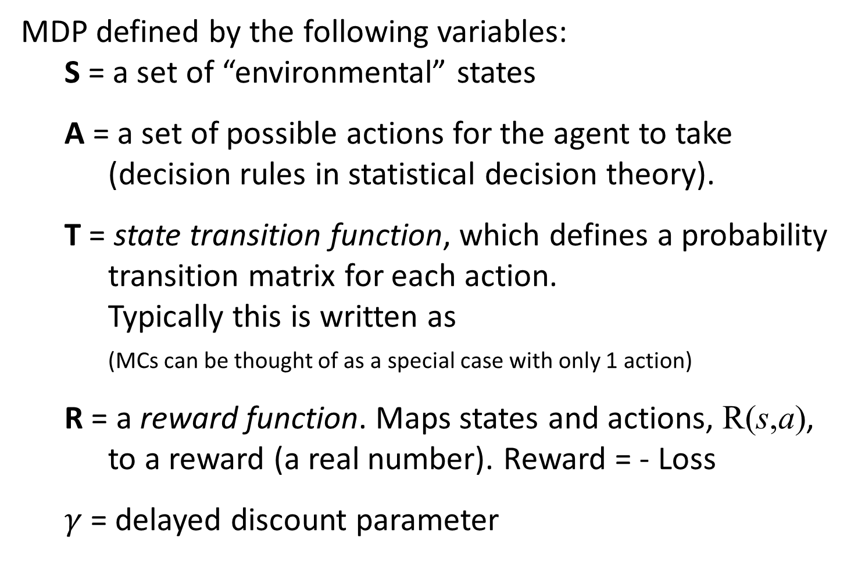
Markov Chains + Decisions + Rewards = Markov Decision Processes (MDPs)
MDP defined by the following variables:
S = a set of “environmental” states
A = a set of possible actions for the agent to take
(decision rules in statistical decision theory).
T = state transition function, which defines a probability transition matrix for each action.
Typically this is written as
(MCs can be thought of as a special case with only 1 action)
R = a reward function. Maps states and actions, R(s,a), to a reward (a real number). Reward = - Loss
$γ$= delayed discount parameter
Notes:
To deal with these issues, we’ll assume the underlying dynamics of our environment can be understood as a Markov chain. If we do that but allow for decisions that affect how states evolve and that both the state and actions we take determining our rewards, we end up defining a Markov decision process. It’s defined by the following variables. You have a set of states S. You have a set of possible actions that an agent can take. These may depend on the state you’re in if you want. You have a state transition function which provides the probability transition matrix for how we get from one state to another depending on the actions. If we only had one possible action, we’d basically have a Markov chain. Next we have a reward function which tells us the immediate goodness of taking an action in each state. This can be probabilistic, but often is just deterministic to simplify things and often just defined to be determined purely by the state (especially in grid world contexts). Lastly, you need to know how much to discount getting a reward on the next time step as opposed to now. That’s given by the \gamma variable.

Slide 14
MDP for final project
Try to leave party?
Fail, but get distracted for a bit by a cute guy
P = 0.8
R = +10
Resist his charms
P = 0.2
R = -3
Back to work?
Party!!!!!
Fail
P = 0.5
R = -1
Too tired ☹
P = 0.1
R = -100
TV
What’s the optimal sequence of actions?
Stay?
Project fail!
Success
P = 0.5
R = -4
Just a little longer
P = 0.9
R = +2
Try, but fail to work
P = 0.7
R = +3
Break!
P = 1.0
R = +4
Try, but fail to work
P = 0.6
R = +2
Start
Project
Work?
Project Half-finished!
Work?
Project finished!
Work success
P = 0.4
R = -2
Work success
P = 0.3
R = +100
State
Outcomes
Actions
Notes:
So to walk through what Markov decision processes could look like, lets walk through a simplified one for working on the final project. From a practical standpoint, we need to define the starting state for our model. Let’s define that and call it the “start project” state. Next we will look at what states we can get from the “start project state”. There could be two possible states we can get to from the start project state, the project half-finished state and the watch TV state. We could have two actions we could take here. We could try to work, and maybe with a 40% chance we end up being successful and finish half the project. Maybe it’s not too fun to actually do work so we lose two reward that way. Alternatively, we might still not get the work done and end up watching TV instead. That happens 60% of the time and gives us some reward +2. But it gives us less reward than if we just watch TV without any guilt of having tried to work. If we just decide to break, then we get +4 reward instead. From there we can only try to get back to work and fail half of the time and start to accumulate a little guilt. When successful, we’re back to the start, but needing to work again which feels bad so -4 reward.
Getting to the project being half-finished leads to another set of difficult choices. The project is due the next day. One possible next state is finishing up the project, but you hear about a party which is an enticing alternative. The party though could lead to the project failing if you stay for too long and can’t finish it in time. You could work, which succeeds 30% of the time and leads to a tasty reward of 100. If you fail at working, you end up at the party state, which still provides some reward for you. There you get some new actions, you can stay which most likely provides you with some more reward, but runs the risk of getting too tired and ultimately failing your project. Even if you leave, you might fail because a cute guy starts talking to you and you get distracted. At least you get a decent reward from that. 20% of the time you resist his charms, which gives some negative feelings.
What is the optimal sequence of steps to take here?
It’s probably just working both times. But trying to work through all the possible sequences is going to be really tricky. Depending on the precise probabilities and reward amounts, it may be worth trying to chase as much reward as you can at the party and hope you don’t fall pray to gambler’s ruin. Knowing how to do that it involves solving for the expected cumulative discounted reward of taking actions in each state.
We’ll move on to that next.

Slide 15
Policies, Values and Actions in MDPs
The actions an agent takes in each state is represented by a policy π, which is a distribution over actions in each state.
Because it is Markov, it only depends on current state.
How do we count (and discount) future rewards?
Let 0 ≤ γ ≤ 1 be the discount factor.
Let G_{t} be the total future discounted reward.
The state-value function, , is the expected reward from state s following policy π.
The action-value function, , is the expected return of taking action a from state s and then following policy π.
Notes:
A solution to a MDP is typically represented as a policy \pi, which provides a probability distribution over the actions to take in each state. Since we are Markov, we only need to know the current state and not the states that were visited before that to know what actions to take.
So how do evaluate a policy so we know how good each one is, compare them, and pick the best one as an agent. Well, we want to look at which one will give us the best, long run rewards. To do that, we define G_t to be the total or cumulative discounted reward, which is the sum of the reward we get immediately from here plus discounted reward from what we get on the next time step + doubly discounted reward form what we get in two time steps and so on. This gives us the following formula for defining the cumulative rewards
Now we can evaluate our policy using this formalism because it defines how to select actions in every state, which in turn defines the states that the agent goes through and therefore also the rewards they receive. We can write this idea as the expected cumulative discounted reward under the distribution of states given by using the policy in the defined MDP. This is often written as a subscript \pi in the expectation. Also, we can define two different views on this. The first is what is called the state-value function, which gives the expected cumulative discounted reward of a policy given you start in state s and use that policy. The second is the action-value or q-function which also takes into account an action you decide to take from state s and then continue to follow the policy.

Slide 16
Policies, Values and Actions in MDPs
The optimal sequence of actions in a MDP can then be defined as the policy π* satisfying
Reinforcement learning methods are methods for finding π*
This sets up a recursive definition, which can be exploited using dynamic programming and iterative updates.
Different learning rules defined via different ways of resolving the random variables S_{t+1} and A_{t+1}.
iterative updates based on reinforcement during exploration is reinforcement learning (RL).
Max = Q-learning; Lots of elaborations from there...
Notes:
With v defined, we can define the solution to a MDP as \pi^*, which is the policy that provides actions in each state that lead to the largest expected cumulative reward.
Reinforcement learning algorithms provide solutions for learning these quantities. Typically we use the action-value or q function or q-values as we want to focus on the best action to take in each state and make that easy to look up. Also, we can look at expanding G_t one step to setup a recursive definition for the q-function. It gets expanded to the next immediate reward plus a discount on the q-value. Now the first q-value is outside of an expectation and the second is within the expectation. Some different RL algorithms, resolve this expectation differently and allow us to setup the recursive equation, which you can then use to . Should we assume that we sample from our current best policy? Or should we select the current best action from our policy? Should we do that all the time or have some percent of time to explore other parts of the state space?
I believe SARSA is the algorithm you get when you sample from the current best policy. Q-learning is what you get when you take the action with the maximal expected q-value according to your current estimate of the q-value function.
Note knowing Q_\pi*(s,a) gives us the optimal policy
There’s always a deterministic optimal policy for any MDP

Slide 17
Reinforcement Learning
Q-learning ( & )
is a matrix of q-values
Initialize to 0*
Select an action. How?
-greedy: Take best action in current state according to with prob. . Take non-optimal action with prob. (break times at chance)
Get reward/feedback from world
Update Q:
A temporal difference algorithm
Class of algorithms that learn the values of each state by updating whenever predicted value differs from observed value.
Notes:
Let’s go through the Q-learning algorithm. It is for discrete states and actions, though there are extensions. To do so, we firs set up a table of our current estimates of the Q-values for each state action pair. We typically will initialize this to zero. I put a * here because in actuality, one simple modification folks do with Q-learning is to initialize the Q-values to be moderate positive values This is called optimistic initialization. It’s good at promoting exploration to ensure that the algorithm explores the part of the state-action space with the best values and doesn’t get stuck exploiting some small reward early that it finds early in learning.
After initialization, the algorithm begins learning by acting in the environment. To do so, it first selects an action. There are a few different schemes for this, but one of the most common is called \epsilon-greedy. According to it, the algorithms selects an optimal action with probability 1-\epsilon given its current state and current Q-value estimates. With probability \epsilon, you select a random suboptimal action. Suboptimal again here means according to your current estimates of the Q-value function.
Once you have your action, you select it. You then get a reward from the environment. Then you update your q-estimates accordingly based on the reward you got, the discounted cumulative reward you expect to get taking the best action in the next state, relative to what your q-estimates predicts should be the expected cumulative reward from taking the action you picked in the state you started. This is sometimes called a temporal difference algorithm because you are comparing your current guess as to the expected cumulative reward of taking the action you took in the current state to the feedback you got and the expected cumulative reward you could get from taking the best action in the next state. To ensure numeric stability, we use a learning rate \alpha less than 1 so that we don’t update too much too quickly. It also forms a fixed-point equation when you do this and you can prove that the changes to the q-table from updates will go to zero in the limit.

Slide 18
Path | Path | Goal
Path | Garden | Garden
Start | Garden | Garden
possXs = 1:3;
possYs = 1:3;
actions = [up = 1; down = 2; right = 3; left = 4];
Q = zeros(length(possYs),length(possXs),length(actions));
Q = fillImpossVals(Q);
discRate = 0.95; % (gamma)
learnRate = 0.9; % (alpha)
randActProb = 0.1 % epsilon
Notes:
Let’s walk through an example of Q-learning. Our setup will be the same as Ho etal 2015, which will hopefully help khailanii with her presentation. In this world we have a 3x3 grid world. Our starting state is in the bottom left corner. We have garden and path tiles, as well as a goal in the top right corner. The environmental rewards will be setup to promote the agent to get to the goal from the start state via the path tiles. We don’t want the agent to walk in the flowers in the garden as they could get trampled.
Setting up this example, we setup the possible x-y values for states and the actions she can take in every state. As some actions are impossible (e.g., going down from the start state), we will handle that by initializing their Q-values to negative infinity, and ensure we never pick those values when taking a random action.
We set our discount and learning rates to reasonable values -- \alpha of 0.9 is a bit large actually, but it works for our purposes here. We set our random action probability, \epsilon, to be 0.1 which is a pretty typical value.

Slide 19
Path | Path | Goal
Path | Garden | Garden
Start X | Garden | Garden
discRate = 0.95; % (gamma)
learnRate = 0.9; % (alpha)
randActProb = 0.1; % epsilon
cur_state = [1, 1];
%1. What are the current actions
% and how good do we believe they are?
[Up Right]; Q([cur_state, (Up, Right)]) = [0 0];
%2. What action do we take?
Random Uniform[0,1] -> 0.16 < 0.9 % YES!
%Which one? ceiling(2*Uniform) = ceiling(1.91) = 2 %RIGHT
%3. Take action, get feedback, and update Q-value/state
new_state <- [1, 2];
% Max Q-value of states next to new_state? 0
% Feedback [-10] (in Garden)
Q([cur_state, R]) += learnRate * (fb + discRate * maxQNext – Q([cur_state, R]);
Q([cur_state, R) = 0 + .9*(-10 + .95*0-0) = -9
Notes:
Lets start learning! It’s a bit laborious, but I think walking through the algorithm helps with understanding how it works and some of the weird situations that can arise with it.
So our agent starts in the start state, which is denoted by the X. We first get the possible actions from the current state and their Q-values. Since we are in the bottom left, that is up and right. When we get them out, we learn that their values are zero and zero. Next we sample to see whether we take an optimal value. Note there are two optimal values here – they are both zero. So we need to pick one of them at random. We end up getting right. So our next state is [1 ,2] (our first dimension is y here and second is x. apologies for any confusion).
With our action and next state, we also get our environmental feedback of -10. We walked into the garden, so it makes sense we would be punished. To complete our q-update, we also need to get the max q-value of states we can reach from our new state. Since this is our first update, it’ll be the same initial value of 0. Now we can combine the pieces together, and use the q-learning formula. That gives us 0 (current value) + 0.9 learning rate * (-10 feedback + 0.95 discount rate * 0 the maximal q-value achievable from the next state based on our current Q-table - 0 current value) which gives us a new q-value update -9 for going right from our current state. Great, I’m going to denote that with a sizeable red arrow for going right at the starting state.

Slide 20
Path | Path | Goal
Path | Garden | Garden
Start | Garden X | Garden
discRate = 0.95; % (gamma)
learnRate = 0.9; % (alpha)
randActProb = 0.1; % epsilon
cur_state = [1, 2];
%1. What are the current actions
% and how good do we believe they are?
[U L R]; Q([cur_state, (U,L,R)]) = [0, 0, 0];
%2. What action do we take?
Random Uniform[0,1] -> 0.74 < 0.9 % Optimal (U,L,R)
%Which one? ceiling(3*Uniform) = ceiling(2.3) = 3 %RIGHT
%3. Take action, get feedback, and update Q-value/state
new_state <- [1, 3];
% Max Q-value of states next to new_state? 0
% Feedback [-10] (in Garden)
Q([cur_state, R]) += learnRate * (fb + discRate * maxQNext – Q([cur_state, R]);
Q([cur_state, R) = 0 + .9*(-10 + .95*0-0) = -9
Notes:
Let’s repeat the procedure here. Now we have 3 possible next states of up left and right and they all have value 0 as they have not changed from initialization
We sample whether to take an optimal action, and get that we take an optimal action. We then sample one of the optimal actions. As this is our first time visiting the state, all 3 actions look the same and are optimal and so we pick one of them at random. We get right.
So we move right. Look at the maximal possible Q-value based on our current Q-value estimates from the bottom right corner. That’s still zero as we can get zero from any of the potential states after it (including this current one, as up and left are still zero).
We get our -10 feedback. We end up with the same q-update as before, but now for the bottom center tile rather than the bottom left start tile. I record that with a red right arrow from the bottom center tile.

Slide 21
Path | Path | Goal
Path | Garden | Garden
Start | Garden | Garden X
discRate = 0.95; % (gamma)
learnRate = 0.9; % (alpha)
randActProb = 0.1; % epsilon
cur_state = [1, 3];
%1. What are the current actions
% and how good do we believe they are?
[U L]; Q([cur_state, (U, L)]) = [0, 0];
%2. What action do we take?
Random Uniform[0,1] -> 0.14 < 0.9 % Optimal (U,L)
%Which one? ceiling(2*Uniform) = ceiling(0.78) = 1 U
%3. Take action, get feedback, and update Q-value/state
new_state <- [2, 3];
% Max Q-value of states next to new_state? 0
% Feedback [-10] (in Garden)
Q([cur_state, U]) += learnRate * (fb + discRate * maxQNext – Q([cur_state, U]);
Q([cur_state, U) = 0 + .9*(-10 + .95*0-0) = -9
Notes:
Let’s repeat the procedure here. Now we are in the bottom right state and so there we have 2 possible next states of up and left. they all have value 0 as they have not changed from initialization
We sample whether to take an optimal action, and get that we take an optimal action. We then sample one of the optimal actions. As this is our first time visiting the state, both possible actions look the same and are optimal and so we pick one of them at random. We get up.
So we move up. Look at the maximal possible Q-value based on our current Q-value estimates from the middle right tile. That’s still zero as we can get zero from any of the potential states after it
We get our -10 feedback. We end up with the same q-update as before, but now for the bottom right tile rather than the bottom middle tile. I record that with a red up arrow from the bottom right tile.

Slide 22
Path | Path | Goal
Path | Garden | Garden X
Start | Garden | Garden
discRate = 0.95; % (gamma)
learnRate = 0.9; % (alpha)
randActProb = 0.1; % epsilon
cur_state = [2, 3];
%1. What are the current actions
% and how good do we believe they are?
[U, D, L]; Q([cur_state, (U, D, L)]) = [0, 0, 0];
%2. What action do we take?
Random Uniform[0,1] -> 0.42 < 0.9 % Optimal (U, D, L)
%Which one? ceiling(3*Uniform) = ceiling(2.11) = 3 %LEFT
%3. Take action, get feedback, and update Q-value/state
new_state <- [2, 2];
% Max Q-value of states next to new_state? 0
% Feedback [-10] (in Garden)
Q([cur_state, L]) += learnRate * (fb + discRate * maxQNext – Q([cur_state, L]);
Q([cur_state, L) = 0 + .9*(-10 + .95*0-0) = -9
Notes:
Let’s repeat the procedure here. Now we are in the center right state and so there we have 3 possible next states of up down and left. they all have value 0 as they have not changed from initialization
We sample whether to take an optimal action, and get that we take an optimal action. We then sample one of the optimal actions. As this is our first time visiting the state, both possible actions look the same and are optimal and so we pick one of them at random. We get left.
So we move left. Look at the maximal possible Q-value based on our current Q-value estimates from the middle right tile. That’s still zero as we can get zero from any of the potential states after it
We get our -10 feedback. We end up with the same q-update as before, but now for the middle right tile. I record that with a red left arrow in it.

Slide 23
Path | Path | Goal
Path | Garden X | Garden
Start | Garden | Garden
discRate = 0.95; % (gamma)
learnRate = 0.9; % (alpha)
randActProb = 0.1; % epsilon
cur_state = [2, 2];
%1. What are the current actions
% and how good do we believe they are?
[U,D,L,R]; Q([cur_state, (U,D,L,R)]) = [0,0,0,0];
%2. What action do we take?
Random Uniform[0,1] -> 0.96 < 0.9 % SUBOPTIMAL (U,D,L,R)
%Which one? ceiling(4*Uniform) = ceiling(1.07) = 2 %D
%3. Take action, get feedback, and update Q-value/state
new_state <- [1, 2];
% Max Q-value of states next to new_state? 0
% Feedback [-10] (in Garden)
Q([cur_state, D) += learnRate * (fb + discRate * maxQNext – Q([cur_state, D]);
Q([cur_state, D) = 0 + .9*(-10 + .95*0-0) = -9
Notes:
Let’s repeat the procedure here. Now we are in the center tile and so there we have 4 possible next states of up down left and right. they all have value 0 as they have not changed from initialization
We sample whether to take an optimal action, and get that we take a suboptimal action. What are the set of suboptimal actions? Well it’s a little weird because everything has equal q-values. So the distinction between optimal and suboptimal just doesn’t mean a lot at the moment. So we sample at random from the possible actions. We get down
So we move down. Look at the maximal possible Q-value based on our current Q-value estimates from the middle right tile. That’s still zero as we can get zero from any of the potential states after it.
We get our -10 feedback. We end up with the same q-update as before, but now for the middle tile. I record that with a red down arrow in it.

Slide 24
Path | Path | Goal
Path | Garden | Garden
Start | Garden X | Garden
discRate = 0.95; % (gamma)
learnRate = 0.9; % (alpha)
randActProb = 0.1; % epsilon
cur_state = [1, 2];
%1. What are the current actions
% and how good do we believe they are?
[U,L,R]; Q([cur_state, (U,L,R)]) = [0,0,-9];
%2. What action do we take?
Random Uniform[0,1] -> 0.05 < 0.9 % OPTIMAL (U,L)
%Which one? ceiling(3*Uniform) = ceiling(0.19) = 1 %U
%3. Take action, get feedback, and update Q-value/state
new_state <- [2, 2];
% Max Q-value of states next to new_state? 0
% Feedback [-10] (in Garden)
Q([cur_state, U]) += learnRate * (fb + discRate * maxQNext – Q([cur_state, U]);
Q([cur_state, U) = 0 + .9*(-10 + .95*0-0) = -9
Notes:
Let’s repeat the procedure here. Now we are in the bottom center state for the second time. we have 3 possible next states of up left and right. Up and left have a value of 0 as they have not changed from initialization, but right was updated to have value -9.
We sample whether to take an optimal action, and get that we take an optimal action. We then sample one of the optimal actions. There are two optimal actions according to our current q-value estimates: up and left. We pick up.
So we move up. Look at the maximal possible Q-value based on our current Q-value estimates from the middle right tile. That’s still zero as we can get zero from any of the potential states after it
We get our -10 feedback. We end up with the same q-update as before, but now for going up from the bottom middle tile. I record that with a red uparrow in it.

Slide 25
Path | Path | Goal
Path | Garden X | Garden
Start | Garden | Garden
discRate = 0.95; % (gamma)
learnRate = 0.9; % (alpha)
randActProb = 0.1; % epsilon
cur_state = [2, 2];
%1. What are the current actions
% and how good do we believe they are?
[U,D,L,R]; Q([cur_state, (U,D,L,R)]) = [0,-9,0,0];
%2. What action do we take?
Random Uniform[0,1] -> 0.82 < 0.9 % OPTIMAL (U,L,R)
%Which one? ceiling(3*Uniform) = ceiling(0.79) = 1 %U
%3. Take action, get feedback, and update Q-value/state
new_state <- [3, 2];
% Max Q-value of states next to new_state? 0
% Feedback [+10] (onto Path)
Q([cur_state, U]) += learnRate * (fb + discRate * maxQNext – Q([cur_state, U]);
Q([cur_state, U) = 0 + .9*(-10 + .95*0-0) = 9
Notes:
Let’s repeat the procedure here. Now we are back in the center state for the second time. we have 4 possible next states of up left and right. Up left and right have a value of 0 as they have not changed from initialization, but down has have value -9.
We sample whether to take an optimal action, and get that we take an optimal action. We then sample one of the optimal actions. There are three optimal actions according to our current q-value estimates: up and left and right. We pick up.
So we move up. Look at the maximal possible Q-value based on our current Q-value estimates from the middle right tile. That’s still zero as we can get zero from any of the potential states after it
We get our +10 feedback our first reward! Sweet! We end up with +9 for our update now for going up from the center tile. I record that with a blue up arrow in it.

Slide 26
Path | Path X | Goal
Path | Garden X | Garden
Start | Garden | Garden
discRate = 0.95; % (gamma)
learnRate = 0.9; % (alpha)
randActProb = 0.1; % epsilon
cur_state = [3, 2];
And so on...

Slide 27
Reinforcement Learning
Q-learning updates taking action that gives largest expected value according to current estimates.
Lots of variants -> lots of similar, but slightly different RL methods (e.g., SARSA).
“Model-free” because we do not propagate updates throughout the state space.
“Model-based” methods propagates reward signals beyond the immediate state based on what states can get to the immediate state in one (two, three, etc.) step(s).
Notes:
Currently, we’ve been using model-free versions of these algorithms because we are not propagating updates through the state space. The rewards stick precisely to the state-action and rewards and do not propagate to other states excerpt indirectly when we look at how good possible next states when updating the q-value in the current state.
One might imagine that we know what next states we can get to via the transition function. We could propagate feedback beyond the immediate states to make learning potentially faster. This is called model-based learning.
If you’re interested in learning more about it,

Slide 28
Reinforcement Learning
“Model-free” because we do not propagate updates throughout the state space.
“Model-based” methods propagates reward signals beyond the immediate state based on what states can get to the immediate state in one (two, three, etc.) step(s).
Why does this matter?
In real-world applications, we don’t know the transition and reward functions.
If we did, we could just sit and simulate to compute the optimal policy before acting! => no learning
We estimate those as we go. If we do, we get model- based approaches...
Notes:
This year no one signed up for the daw paper, but that is the classic paper and task for exploring when people use model-free vs. model-based RL. It’s a nice read if you’re interested, and a very influential paper in the literature. The short is that people use model-based RL sometimes, but less than one might think.

Slide 29
What if there are parts of the state (or rewards or transitions) that we do not observe? Enter: Partially Observable Markov Decision Processes (POMDPs)

Slide 30
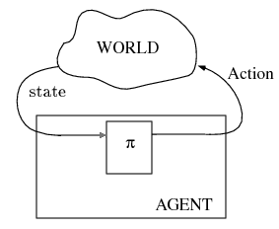
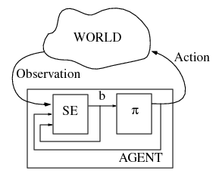
MDP setup
POMDP setup
Can we convert one into the other?
Yes! A POMDP can be turned into an MDP, where belief over states (in the POMDP) are the states of the equivalent MDP.
This is one way to solve POMDPs, but in general, it is really hard...
http://www.pomdp.org/ is a useful resource for code and tutorials...
Notes:
In the Marko decision process setup, the agent gets to know with certainty what state they are in. they use their policy \pi to select actions, which then results in new states that they get to observe from the world.
In a partially observable Markov decision process, the agent only gets a noisy observation that is somehow related to the possible states of the world. Using their policy the action they took, and the observation, they estimate the state they might be in and update their beliefs in it and then use the same sort of procedure from there. As the state of the world is uncertain and estimating the wrong state several steps ago could mean you are way off in how you’re interpreting the current information from the environment about your state, these are much harder. One can actually convert a POMDP to a MDP where now the fully observed states of “the environment” are the belief states of the learner. It’s much more difficult. We’ll talk a bit more about these next time.

Slide 31
Admin Matters
Statistical Decision Theory
Markov Decision Processes
Short rest 1
Three student presentations:
Schulz et al 1997 by Ashwini
Ho et al 2015 by Khailanii
Short rest 2
3. Ho et al 2017 by Anirudh

Slide 32

Short Rest 1

Slide 33
Admin Matters
Statistical Decision Theory
Markov Decision Processes
Short rest 1
Three student presentations:
Schulz et al 1997 by Ashwini
Ho et al 2015 by Khailanii
Short rest 2
3. Ho et al 2017 by Anirudh

