Slide 1
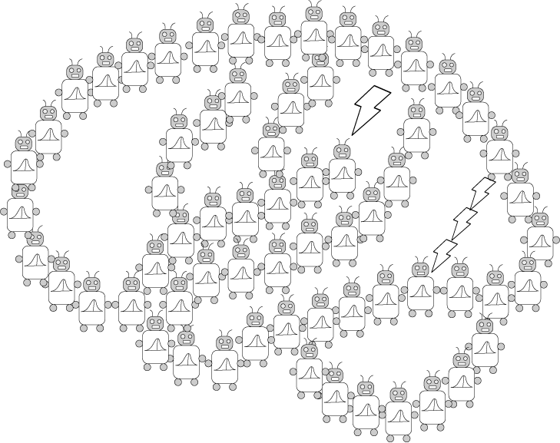
Bias-Variance Dilemma and an Introduction to Bayesian Nonparametrics
PSYCH/COMP SCI/BMI 841: Computational Cognitive Science
Joseph Austerweil
April 10, 2025

Slide 2
Admin Matters
The bias-variance dilemma
Short rest 1
Intro to Bayesian Nonparametrics
Gaussian Processes
Short rest 2
Feature construction
One student presentation:
Kemp & Tenenbaum 2003 by Zihan/Neuki
Notes:
To date, we’ve focused on probabilistic models where we can specify the family of distributions that our parameters and data come from. For the remainder of the semester, we will venture into nonparametric or practically nonparametric models (artificial neural network ones). To setup this transition, we’re first going to discuss a famous dilemma in statistical modeling – the bias-variance dilemma. We’ll then introduce nonparametric estimation very briefly and the Bayesian form of it. We’ll cover Bayesian nonparametric mixture modeling, which is one of the most common uses. Then I’ll briefly cover Gaussian processes so you have some exposure to them. Their most often used for reaction-time modeling as they are used in the drift-diffusion modeling framework pioneered by Ratcliff. As one of our student presenters is sick, depending on time, we may go into feature construction and conclude with a paper presentation by Neuki.

Slide 3
Administrative Matters
Assignment 3 was due April 9 at 8:59pm
Assignment 4 is due April 23 at 8:59pm
2 more discussion posts left
Only need to pass 5 through class for full credit
Any unused quiz points will be free points to your final grade.
Final project presentations May 1
Your project does NOT need to be complete by then
Final project papers due May 6 at 8:59pm
Questions?
Notes:
My health is continuing to improve, but it’s slow.
There’s still a few folks turning in the monte carlo approximation assignment. Please don’t forget about assignment 4 which is due in a bit under two weeks
There are only two more discussion posts left!
As mentioned earlier, any unused quiz points will end up being free points to your final grade.
After today’s class, we have two more lecture and discussions. Then the last class will be student final project presentations. Please note that your final project does not need to be complete by then. The goal is for everyone to share what they are working on and what they’ve found so far.
A reminder that your final project papers will be due on May 6 at 8:59pm

Slide 4
Admin Matters
The bias-variance dilemma
Short rest 1
Intro to Bayesian Nonparametrics
Gaussian Processes
Short rest 2
Feature construction
One student presentation:
Kemp & Tenenbaum 2003 by Zihan/Neuki
Notes:
To date, we’ve focused on probabilistic models where we can specify the family of distributions that our parameters and data come from. For the remainder of the semester, we will venture into nonparametric or practically nonparametric models (artificial neural network ones). To setup this transition, we’re first going to discuss a famous dilemma in statistical modeling – the bias-variance dilemma. We’ll then introduce nonparametric estimation very briefly and the Bayesian form of it. We’ll cover Bayesian nonparametric mixture modeling, which is one of the most common uses. Then I’ll briefly cover Gaussian processes so you have some exposure to them. Their most often used for reaction-time modeling as they are used in the drift-diffusion modeling framework pioneered by Ratcliff. As one of our student presenters is sick, depending on time, we may go into feature construction and conclude with a paper presentation by Neuki.

Slide 5
Learning mapping inputs to outputs
Regression:
data D are n pairs (x,y)
hypothesis space of functions, y = g(x)
error: C = (y - g(x))²
learning algorithm picks function g using data D
Minimize prediction error
y
x
Notes:
The standard setup for the Bias-variance tradeoff is learning a function or mapping of input to output. So in this case, we are doing regression. We get a data set D which is comprised of n pairs of (x,y) values. Our model has some hypothesis space of possible functions g that map x values to y values. We’ll assume that our error or loss function is squared error. A learning algorithm uses the observed data D to pick a function g that minimizes the expected loss. That’s the same thing as the prediction error, which is written out as an integral below. If this feels familiar, it should! It’s the same setup as we went over in statistical decision theory.

Slide 6
A learning strategy
Choose the function g(x) in the hypothesis space that minimizes the training error
Different hypothesis spaces define different learning algorithms
Neural networks correspond to the case where the hypothesis space is functions that can be produced by the network
Notes:
A common strategy for learning is to select the function g(x) that minimizes the training error. So we can pick a function g, evaluate it at every x_i to get its predicted y_i, take the squared difference as the error for that data point and average that up over all the n data points.
One way to define different learning algorithms is by the set of hypothesized functions available to them. So for example, linear regression is the set of lines – say varying the slope and intersect. Neural networks typically have a lot more parameters and nonlinear relations that the inputs get mapped through. This corresponds then to a very large set of potential functions to use.

Slide 7
Some hypothesis spaces
Linear functions
Quadratic functions
8th degree polynomials
Notes:
To show case how hypothesis spaces of different sizes learn from limited data amounts of data, we’ll explore three simple hypothesis spaces for regression. Linear functions with two adjustable parameters, quadratic ones with three adjustable parameters, and 8-th degree polynomials with 9 adjustable parameters.

Slide 8
Minimizing training error
Notes:
Now we have an example data set – 10 data points of x-y pairs. Let’s see how each of the learning algorithms fit these data.

Slide 9
Minimizing training error
Notes:
The best fitting line looks as follows. Not too shabby, but it also seems to miss the bit of curve to the data.

Slide 10
Minimizing training error
Notes:
The quadratic seems to fit the data quite nicely!

Slide 11
Minimizing training error
Notes:
And the 8th degree polynomial fits the data points even nicer! Almost no error at all.

Slide 12
What about prediction error?
Notes:
So I superimposed the true function that was use to generate the points in black. You can see that it’s actually a quadratic. So if we looked at the prediction error of our algorithms, the 8th degree polynomial is doing quite poorly. That is despite it being the best algorithm when we looked at training error.

Slide 13
What happened?
The set of 8th degree polynomials contains almost all functions through 10 points.
Our data are some true function, plus noise.
Fitting the noise gives us the wrong function.
This is called overfitting.

Slide 14
More formally…
Assume y = f(x) + ε, where E(ε) = 0, E(ε²) = σ ²
(assume error is normally distributed)
Notes:
We can say more about this than simply having a lot of parameters relative to the number of data points is bad. To do so, we’re going to walk through a derivation (with some hand waving). We start with some basic assumptions, that our data points are generated from some true function with some unbiased noise added to it. We’ll assume that this error is normally distributed, though a lot of these assumptions can be weakened and still get similar results.
What are we interested in? We’re interested in having a small prediction error. We’ll represent that as the expected squared error across different (x,y) values between the true y and the one learned by our learning algorithm. Next we do a typical trick in this area. We add and subtract in the true function. That’s just adding and subtracting by zero. But, we will group each of our terms with f(x) instead and expand the quadratic that way. So we treat (y-f(x)) as one term of our quadratic and f(x)-g(x) as the other.
Now, I put down the quadratic expansion as a reminder. We’ll treat y-f(x) as A and f(x) – g(x) as B.
That leaves us with these three terms. I can separate their expectations because they are just added together and expectations are linear.
Now I’m not going to go into great detail here, but the expected value of this middle term is actually zero. The reason is that the first term of the middle term is \epsilon and it is uncorrelated with the difference between the true function f(x) and the one selected by our learning algorithm. If that’s confusing for you, that’s ok. It’s worth just trusting me on that one then.

Slide 15
More formally…
Assume y = f(x) + ε, where E(ε) = 0, E(ε²) = σ ²
(i.e., error is normally distributed)
A good algorithm makes (f(x) - g(x))² small
Notes:
And so, we are now left with two terms. That first term is \epsilon^2 as y = f(x) + \epsilon. By definition, the expected value of \epsilon^2 is \sigma^2. That’s our irreducible error. We don’t have any control on it as it doesn’t depend on our learning algorithm.
So what we want to do to minimize prediction error is make the expected squared difference between the true function and the one our learning algorithm selects as small as possible. In some ways, this may feel like a lot of work for something we already knew, but we will see that it can help us get some insight.

Slide 16
Bias and variance
A good algorithm makes (f(x) - g(x))² small.
g is chosen on the basis of the data D.
Evaluate algorithms by the expectation of (f(x) - g(x))² over data D generated from f.
Bias: how similar is the true function to the estimated function?
Variance: how much is the estimated function expected to vary across possible observations?
bias²
variance
Notes:
Although I’m not going into the details of the next steps of the derivation, by some similar logic, you can decompose the rest of the prediction error into these two terms. The first term is the difference between the true function and the expected function learned by the algorithm, all squared. We typically would like our learning algorithm to be expected to be the same as the true function. In statistics this term is called the bias, so with it being squared, it’s the bias squared.
The second term is the a bit different. It says across different data sets, how much should I expect the function selected by my learning algorithm to vary? This is the variance term. What’s fascinating about this is that one might have thought that only being expected to get the correct function would matter. That’s what the bias term includes and it is important. But we also have an equally important term for reducing prediction error – the amount of variability in the estimated function across training sets.

Slide 17
Making things more intuitive…
The next few slides were generated by:
choosing a true function f(x)
generating a number of datasets D from p(x,y) defined by uniform p(x), p(y|x) f(x) plus noise
finding the function g(x) in the hypothesis space that minimized the training error
Comparing average of g(x) to f(x) reveals bias
Spread of g(x) around average is the variance
Notes:
To make this a bit more intuitive, lets visualize this process by sampling according to the generative process, finding the function in each hypothesis space by minimizing the training error.
We will compare the expected learned function, the average of the learned function to the true one to see how much bias the learning method has.
We can also see how far g(x) varies from set to set to examine the amount of variance there is.

Slide 18
Linear functions (n = 10)
pink is g(x) for each dataset
red is average g(x)
black is f(x)
y
}
}
bias
variance
x
Notes:
Here is what it looks like when minimizing training error with a hypothesis space of linear functions. Each data set had 10 points. Each pink line is a learned g(x) for a data set and the red is their average. We can see that the red line is probably the closest one to the true function, but that there still is a good amount of error there. That’s to be expected – the true function is not possible to represent within the learning algorithm’s hypothesis space.

Slide 19
Quadratic functions (n = 10)
pink is g(x) for each dataset
red is average g(x)
black is f(x)
y
x
Notes:
Here is what it looks like when minimizing training error with a hypothesis space of quadratic functions. Each data set had 10 points. Each pink curve is a learned g(x) for a data set and the red is their average. The red curve is exactly on top of the black true function and so we can’t see it. We can see there’s very little variability around the true function too. So the bias and the variance are both low. It turns out that having a small hypothesis space that also includes the true function makes it a lot to easier to do well in minimize prediction error.

Slide 20
8-th degree polynomials (n = 10)
pink is g(x) for each dataset
red is average g(x)
black is f(x)
y
x
Notes:
Here is what it looks like when minimizing training error with a hypothesis space of 8th degree polynomials functions. Each data set had 10 points. Each pink curve is a learned g(x) for a data set and the red is their average. Despite all the pink curves going all over the place, the average of all the learned 8-th degree polynomials curves, in red is actually pretty close to the true function plotted in black. So, the bias from this learning algorithm is still very small. That makes sense! The true function is within the hypothesis space of 8-th degree polynomials.
But the variance is astronomical. It’s the whole plot. It’s a lot larger than the variance for when we used lines. And so, the prediction error will be very large still.

Slide 21
Bias and variance
(quadratic f(x), with n = 10)
Linear functions
high bias, medium variance
Quadratic functions
low bias, low variance
8-th order polynomials
low bias, super-high variance
Notes:
In summary, when we use a quadratic function and generate data sets of 10 points each with Gaussian noise around each point and learn by minimizing training error, we get the following bias and variances

Slide 22
In general…
More flexible learning algorithms have higher variance, but low bias across several f(x)
The bias-variance dilemma or tradeoff:
if we want an algorithm that has low bias on a range of problems, we pay a price in variance
Note: This is mainly an issue when n is small
Notes:
Thus, although it might seem like it would be best to use the most flexible learning algorithm possible so we can capture any possible function, we will ultimately pay a cost in variance and end up doing poorly during prediction.
This is known as the bias-variance dilemma or tradeoff
I should note that this is an issue, but it is more of an issue when the number of parameters is similar to the amount of data. When we have a lot more data, say 100 data points per data set,

Slide 23
Quadratic functions (n = 100)
pink is g(x) for each dataset
red is average g(x)
black is f(x)
y
x
Notes:
Using the space of quadratic functions does really well on both variance and bias

Slide 24
8-th degree polynomials (n = 100)
pink is g(x) for each dataset
red is average g(x)
black is f(x)
y
x
Notes:
And so does the hypothesis space of 8-th degree polynomials.

Slide 25
The moral
General purpose learning mechanisms do not work well with small amounts of data
So, the most flexible algorithm isn’t always the best.
To make good predictions from small amounts of data, you need algorithms with bias that matches the problem being solved
What does this mean for learning agents?
Notes:
So the moral is that having the most flexible general purpose learning mechanisms may not work well with small amounts of data without something to guide which hypotheses are better ahead of time.
To make good predictions from small amounts of data, you need algorithms with bias that matches the problem being solved

Slide 26
The moral
General purpose learning mechanisms do not work well with small amounts of data.
So, the most flexible algorithm isn’t always the best.
To make good predictions from small amounts of data, you need algorithms with bias that matches the problem being solved.
What does this mean for learning agents?
This suggests a different approach to studying induction might be profitable.
(what people learn as n → 0, rather than n → ∞)
Notes:
What does this mean for learning agents? Well, when we have the ability to comb through the entire internet worth of data, it might not be such a big deal to use a huge number of parameters. We’ve seen that deep learning methods can have a lot of success using large parameter sets. But it means that if we’re interested in how people act we should do so relative to the amount of data we believe they are exposed to. If we believe they are exposed to a limited amount of data, then we will need to look at how to constrain really flexible algorithms so that they can still be effective when learning from such small data sets too.

Slide 27
Short rest 1

Slide 28
Admin Matters
The bias-variance dilemma
Short rest 1
Intro to Bayesian Nonparametrics
Gaussian Processes
Short rest 2
Feature construction
One student presentation:
Kemp & Tenenbaum 2003 by Zihan/Neuki
Notes:
To date, we’ve focused on probabilistic models where we can specify the family of distributions that our parameters and data come from. For the remainder of the semester, we will venture into nonparametric or practically nonparametric models (artificial neural network ones). To setup this transition, we’re first going to discuss a famous dilemma in statistical modeling – the bias-variance dilemma. We’ll then introduce nonparametric estimation very briefly and the Bayesian form of it. We’ll cover Bayesian nonparametric mixture modeling, which is one of the most common uses. Then I’ll briefly cover Gaussian processes so you have some exposure to them. Their most often used for reaction-time modeling as they are used in the drift-diffusion modeling framework pioneered by Ratcliff. As one of our student presenters is sick, depending on time, we may go into feature construction and conclude with a paper presentation by Neuki.

Slide 29
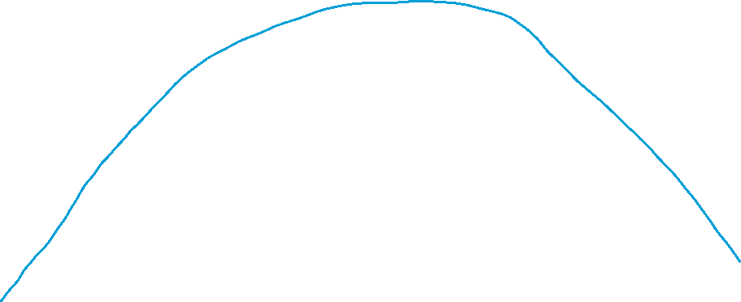
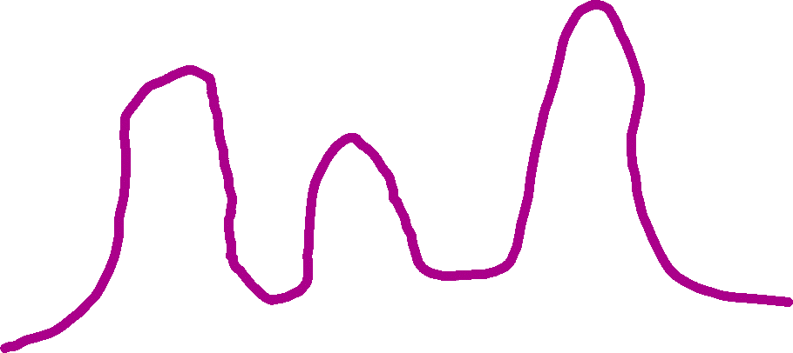
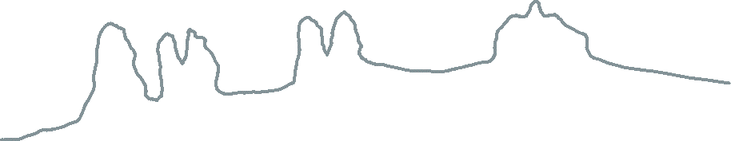
Notes:
Lets say we are getting data points from some source, but we don’t’ really know too much about it. We see these data points here. There are different approaches we could take to estimating the distribution of these data. We could make strong assumptions about the nature of the data and assume they are all from a single gaussian distribution, like this blue curve.
Maybe we believe the data come from a mixture of three Gaussians and we fit those to these data. That would lead us to something like the purple curve. Alternatively we could think there are 9 Gaussians, one centered at each data point. We couldn’t easily estimate the variance then (we have fewer data points than parameters), but that’s ok, we could just assume some value and form a distribution like the gray one plotted above. That’s called a kernel density estimation technique.
Or we might not believe that there could be any variability in our data points and only expect them again precisely in the same form. That would lead us to something like the orange distribution where we sort of have a discrete distribution. That’s known as an empirical distribution function and is the assumption we use when we do something like bootstrapping.
All of these are reasonable probabilistic models for estimating a distribution. Some of them are limited to certain families of distributions, like in the case of the single Gaussian or mixture of 3 Gaussians. These are called parametric models. They work fine when they can adjust their parameters to capture the data because the data are within the family of distributions that is formed from varying the parameters in different ways.
The gray and orange models are different from the others. They are creating a new component to the distribution each time a new data point arrives. They might assume a small amount of variability around the observed data point is possible or simply believe that precisely the same data point will be observed again. These are more flexible. They can capture more distributions, but also have high variance. They are nonparametric estimators.

Slide 30
What is a Bayesian Nonparametric Model?
Nonparametric - a model that can encode any* probability distribution (using arbitrarily complex representations).
E.g., Kernel methods
Bayesian - priors constrain which latent representations are preferred.
Bayes NP are nonparametric models that prefer to use simpler representations.
Types of latent structure and corresponding Bayes NP prior:
One discrete per datum (categories, trees, etc.) -> Dirichlet process
Multiple discrete per datum (features) -> Beta process
Continuous/Functions -> Gaussian process
Notes:
To date, we’ve focused on probabilistic models where we can specify the family of distributions that our parameters and data come from. For the remainder of the semester, we will venture into nonparametric or practically nonparametric models (artificial neural network ones). Nonparametric models still have parameters – in fact it might be more accurate to state that they have a massive number of parameters. Unlike their parametric counterparts which can only capture distributions within some family (say Gaussians with varied means or two Gaussians with varying means and variances), they have stronger guarantees in terms of converging to arbitrary families of distributions. This flexibility comes with a cost: they are mathematically much more difficult and approximation methods are more challenging.
Bayesian nonparametric models are both Bayesian and nonparametric. They are nonparametric in that they can encode any probability distributions using arbitrarily complex representations. I put a * there because if we were being really technical we would need to qualify that a bit more. Suffice it to say that they can capture many more distributions than being restricted to some family of distributions. For a finite set of data, different nonparametric methods form distributions that all capture the observed data to some extent. Bayesian nonparametric methods are also Bayesian in that in they have biases or priors that favor certain solutions over others.
They are Bayesian in that they are biased towards certain representations over others. For example, in the prior slide, we had two nonparametric distribution estimators: we had the gray kernel one that put little gaussians on every data point and also the orange one that put a stick on each distribution. A Bayesian nonparametric estimator allows one to favor one of these over the other and for that to potentially depend on the amount of data you’ve observed.
Most Bayesian nonparametric models are defined by the type of latent structure they are over. If you have one discrete latent property assigned per data point (whether that be a category, a place in a tree, or whatever), then you are usually in the family of Dirichlet process models. If you have multiple discrete properties per data point, which is usually what is used in feature representations, then you are using a Beta process. Both of these are actually built off of Poisson processes, which form the basis for Bayesian nonparametric models with discrete latent representations.
If we have continuous latent structure, then the corresponding Bayesian nonparametric process is a Gaussian process.

Slide 31
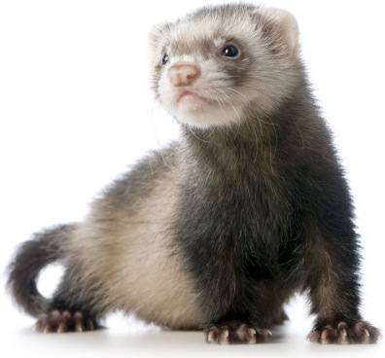
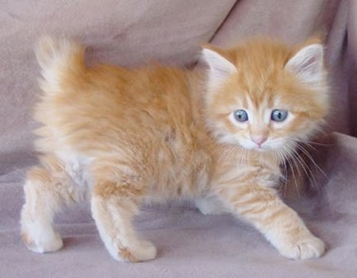
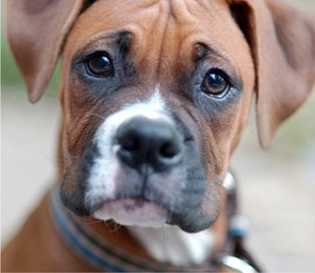




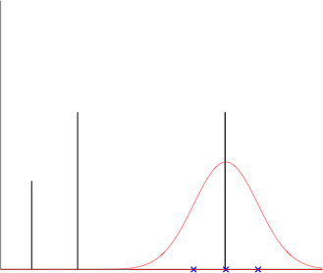
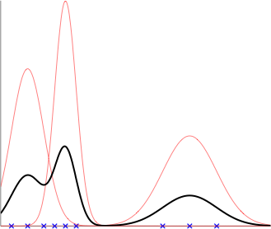
Categorization as Mixture Modeling
1
2
3
To make an animal, first sample which animal we want from
Each animal is created from its associated ideal “snout size” and variance .
This leads to the following generative process for each animal
Prob. of new snout size:
Categorize a new animal
given its snout size:
2
1
3
2
2
3
3
Prob. of snout size
Prob. of snout size
Prob. of snout size
1
1
Snout Size
Snout Size
Snout Size
Notes:
To motivate the Dirichlet process mixture model, we’ll return to the animal shelter example we discussed earlier in the semester. In it, we were representing different animals based on the size of their snouts. So, as a 1-d continuous value. Each animal’s snouts were assumed to be Gaussian distributed with their own mean and variance. We assumed there were 3 different types of animals and that each animal has its own Gaussian associated with it. We assumed that there was some distribution on the frequency of observing each animal and from there had the following generative process for the animal nose sizes. That allowed us to form a mixture distribution over snout sizes and given a snout size, predict which animal cluster/category it belongs to.

Slide 32
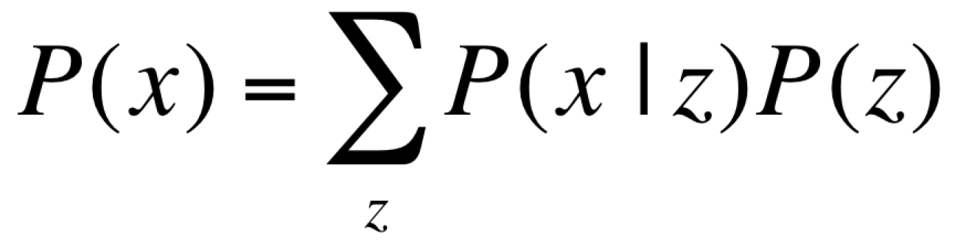
Latent variable models
z
P(z)
Latent (unobserved)
x
P(x|z)
Marginalize out
(i.e. sum over)
latent structure
Observed
z is each x’s cluster index
How do we put a prob. on clusterings?
Notes:
More generally, this is an example of a latent variable model where the observed data are generated by some latent unobserved structure. In this case, is the category or cluster that the animal belongs to. But what if we didn’t know what species there were? What if we were an alien that arrived on Earth and placed into the animal shelter. We wouldn’t know how many animal types or clusters there should be. How can we infer that along with which cluster each observed animal belongs to?
If we want to be Bayesian about it, and in the class we basically usually want to be Bayesian, we’ll want to put a probability distribution on clusterings that grows with the number of items we observe.

Slide 33
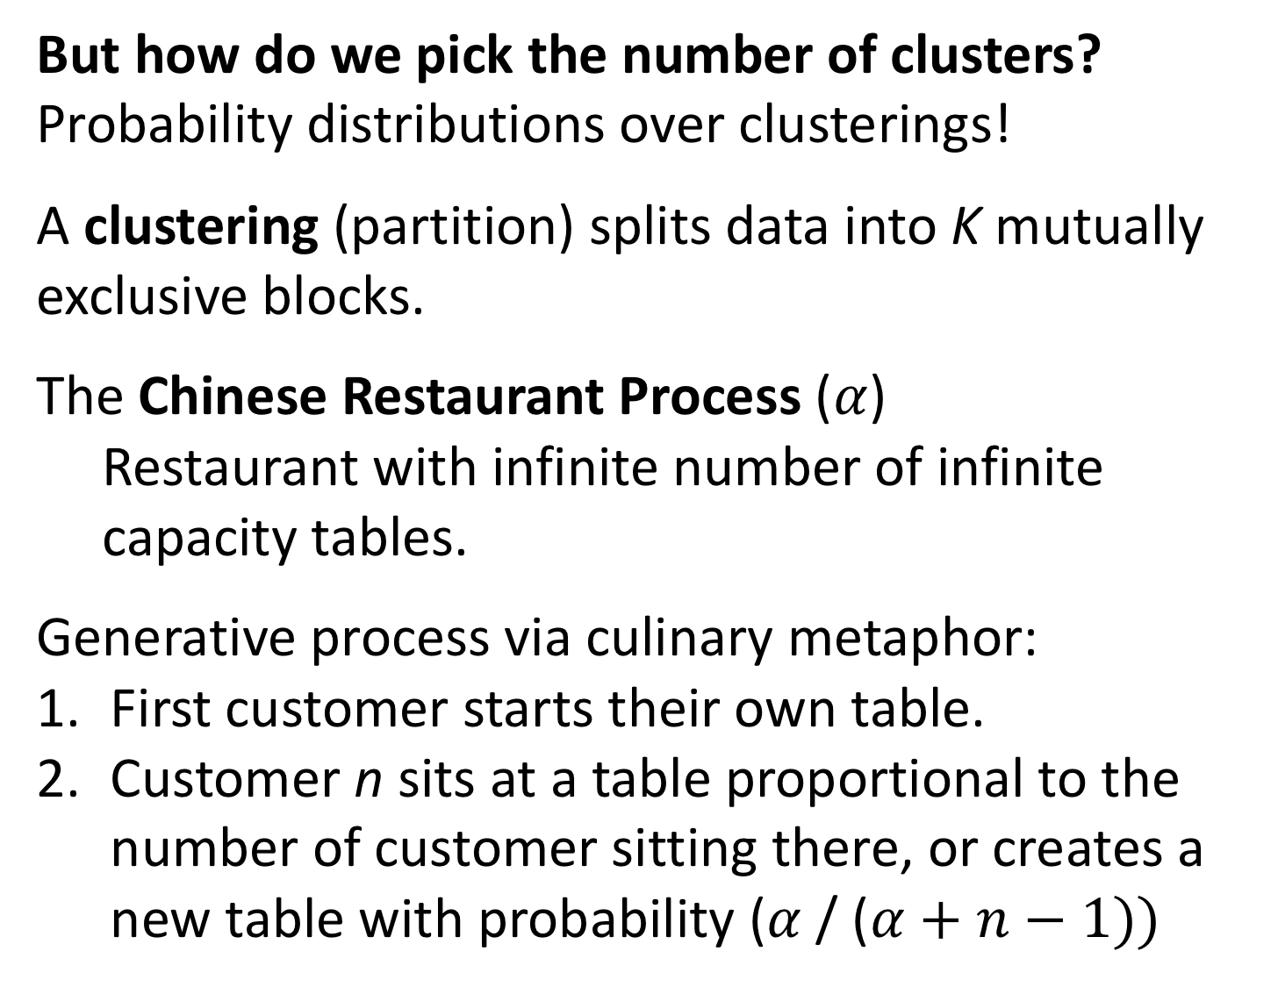
But how do we pick the number of clusters?
Probability distributions over clusterings!
A clustering (partition) splits data into K mutually exclusive blocks.
The Chinese Restaurant Process ($α$)
Restaurant with infinite number of infinite capacity tables.
Generative process via culinary metaphor:
First customer starts their own table.
Customer n sits at a table proportional to the number of customer sitting there, or creates a new table with probability ($α$/ ($α+n−1))$
Notes:
So how do we pick the number of clusters and the probability distribution over how items are clustered?
A bit on terminology. In statistics and combinatorics, this is usually referred to splitting the data into a partition, where the items are placed into K mutually exclusive sets that when combined together form the full data set again.
This is actually really tricky because the number of possible clusters for even a small number of items grows super exponentially. It’s given by the n-th Bell number and even with 10 items, there are over 100k ways of putting them into clusters!
One popular scheme for forming an exchangeable distribution over partitions is called the Chinese Restaurant Process. It has a single parameter \alpha. The name comes from two Berkeley statisticians, David Aldous and Jim Pitman, who loved going to dim sum restaurants in nearby Oakland. The restaurants are extremely large and feel like they have an infinite number of tables. Also, it seemed like they could always squeeze more people into a table no matter what. Inspired by these restaurants, they described a generative process for forming an exchangeable distribution on partitions that is defined sequentially. In the metaphor, customers are data points. The tables correspond to blocks or clusters. The arrangement of customers to tables defines a partition. It works as follows. The first customer comes in and sits and their own table. When the n-th customer comes in, they sit at each occupied table with probability proportional to the number of people sitting there.

Slide 34




A (in)finite mixture model
Suppose there are objects and clusters.
Let denote that object is in cluster .
(each object is in one cluster)
Let define the probability an object is in cluster .
Let be the number of objects in cluster .
where is the number of “used” clusters.
This probability distribution is equivalent to the one given by the Chinese restaurant process (CRP).
Customers (objects) arrive at a restaurant with an infinite number of infinitely-sized tables (clusters).
A customer sits down at an occupied table with probability proportional to the number of occupants.
A customer starts a new table with probability proportional to .
Blackwell & MacQueen (1973), Aldous (1985), Neal (1992), Griffiths & Ghahramani (2005)
Notes:
It turns out this procedure that was defined by the statisticians can be derived from the mixture model generative process we were working with before!
In general, we suppose there are N objects that belong to one of K clusters. For now, we’re not going to worry about the data distribution itself, we’re just worrying about how data points are assigned to clusters. We assume we do NOT know the mixture weights for our clusters. So we put a Dirichlet prior on them with parameter \alpha. The parameters for the Dirichlet distribution will depend on the number of clusters we have so far, so \alpha is more like the total amount of mass that the Dirichlet distribution has to distribute across the different clusters. It’s symmetric, so each of the parameter associated with each of our clusters is \alpha/K. The derivation for this model were covered in that intro tutorial I gave you with the Dirichlet-multinomial model. We don’t have time to go through this integral again, but if you work through it like we did in that tutorial, you end up with the following equation that is the ratio of normalizing constants for the Dirichlet distribution prior and the updated one based on the cluster assignments.
Now what is neat is you can take the infinite limit here. This takes a bit of care, which is why you have the * there, but the basic intuition is you separate those clusters that have at least one object in them from those that do not have any object associated with them. Since the number of objects is finite, you know that there’s only a finite number of clusters that have at least one object in them. I call these “used” clusters and it is denoted by K+.
Now it turns out this is equivalent to the CRP we defined earlier. It may not look that way here, but you can show they are identical. The intuition for it is as follows. Everytime you create a new table or cluster to use for a customer or data point, you multiply by \alpha. There are K+ of those, so that’s where \alpha^K+ comes from. Now every time we assign an item to an existing cluster, we get a term that is the number of items that had been in the cluster before it gets assigned (so that’s where the minus 1 comes from). We do that for each item that gets assigned to that cluster and so we get a factorial there. The ratio of gamma functions is the another way of writing the normalization term you get on each step of the process. That’s 1 for the first customer times 1/(1+\alpha) for the second customer times 1/(2+ \alpha) for the third all the way to 1/(N-1+\alpha) for the Nth customer. And voila, they are the same!

Slide 35
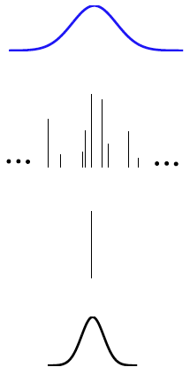

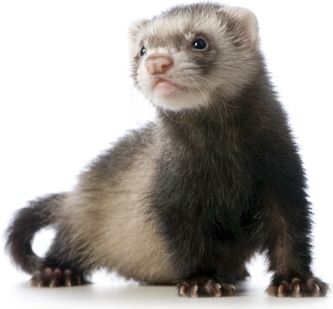
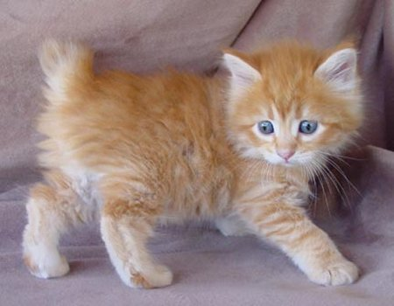
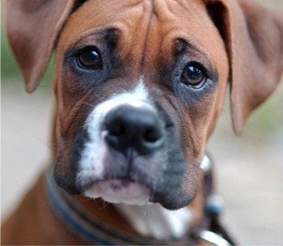
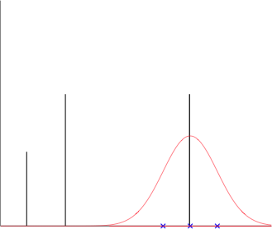
Connecting the CRP to mixture models
Prior over parameters
Gaussian prior on params.
Prob. of snout size
2
3
CRP w/ dishes
1
Distribution for datum using drawn dish as parameter.
2
3
Prob. of snout size
1
DP
Snout Size
Mixture distribution with two components.
DP Mixture Model
When the tables are labeled with parameters drawn iid from some distribution, this generates the Dirichlet process or the Polya Urn.
(Jordan, 2010)
Notes:
Now to complete the story and how we get to a Dirichlet process and Dirichlet process mixture models, we need to add a little bit extra to the generative process. We assume that there is one dish that it served at each table. That dish is the parameter that defines the data distribution for customers or data points at that table or cluster. Typically we do that by assuming there is some prior over the parameter space. Like in this and our prior examples, we used a Gaussian prior, but it doesn’t need to be that. We can then sample a bunch of dishes or parameter values which gives us a sticky distribution, because they are samples from a distribution. The size of the stick corresponds to the number of customers at the corresponding table or the mixture weight of that cluster. That’s like the different stick sizes we had for the different animals in the animal shelter we had before. Then we can generate a data point within that cluster by using the parameter associated with the dish, which in case of the animal shelter would be the location for the mean of the snout size. Then we can form a mixture distribution by using this as our prior over the mixture components and their sizes. As the number of clusters was never specified, it will grow with the data as we get observations.
From a technical perspective, the Chinese restaurant process refers purely to the distribution on the block sizes within a partition. The Dirichlet process is what you get when you add the parameter values sampled for each block or table to it. It’s also known as a Polya Urn and is also fairly close to the Kingman paintbox. Using this as your prior in a mixture model and adding the data generation component gives us a Dirichlet process mixture model.

Slide 36
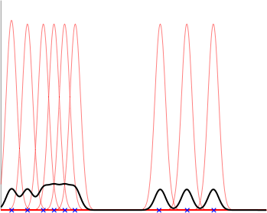
Categorization as Mixture Modeling
Parametric
Nonparametric
Bayesian Nonparametric
Prob. of snout size
Snout Size
Snout Size
Snout Size
Definition:
Restricted family of distributions
Can express any distribution
Structure grows with data.*
Examples:
Finite Gaussian mixture models (prototypes)
Kernel methods (exemplar models)
Dirichlet process (rational categorization model)
Efficient learning;
More robust to noise
Can learn any distribution.
Can learn any distribution.
Less prone to overfitting.
Pros:
Cons:
Cannot represent every distribution.
Inefficient learning;
Prone to overfitting
Inference is hard.
Notes:
To summarize, here is a description of what parametric nonparametric and Bayesian nonparametric models look like from the perspective of categorization or distribution estimation. Parametric models are ones that are restricted to a given family of distribution. That’s primarily what we’ve worked with so far in class and the finite Gaussian mixture model or prototype models fall are examples of this class of model. Their relative strength is that learning tends to be more efficient, they are more robust to noise and tend to have less variance. However, their weakness is that they can’t represent distributions outside of the defined family. So they can have a high bias when the true distribution is far from the what can be encoded by them.
Nonparametric models can express any distribution. A common example of these is kernel methods which you might be familiar with as exemplar models. The Gaussian form of this occurs when you put a little Gaussian bump on every data point and use that to form your distribution. The pros for it is that you can learn any distribution with this type of model and it’s not restricted to an explicit family. So it has a low bias. However, these models tend to be more inefficient in terms of how much data they need to have good prediction error and are prone to over fitting and have a large variance from the bias-variance dilemma perspective.
Bayesian nonparametric approaches attempt to include the best of both worlds. They can also express any distribution like nonparametric models. Their structure tends to grow with data. In fact, in the machine learning community, some define Bayesian nonparametric approaches in this manner. But that’s not how they were first defined in statistics and you can have a lot of models whose structure grow with data that are neither Bayesian nor nonparametric (in some sense the nonparametric exemplar models do this). An example is the Dirichlet process or Dirichlet process mixture model. It was independently created by John Anderson as the Rational Categorization Model in the early 1990s. Radford Neal noticed their correspondence, except that the approach John Anderson used to do model inference was greedy and not proper statistical inference. The pros is that these types of models can have low bias by being able to learn any distribution like the nonparametric ones. They also have prior expectations built into them that allows them to be less prone to overfitting and thus have lower variance in the bias-variance dilemma sense. But, inference is hard with these models. They also tend to be very finnicky mathematically and have counterintuitive properties. For example, although the Dirichlet process mixture model is consistent in terms of its distribution, estimators for the number of clusters diverge and are not consistent.

Slide 37
What does nonparametric mean?
How does it differ from parametric?
Nonparametric models can learn any possible distribution.*
Parametric models are restricted to a family (e.g., Gaussians with different means).
What is “Bayesian” about Bayesian nonparametrics?
Bayesian nonparametric models can learn any possible distribution,
but they are biased towards particular types of distributions.
Are there no parameters in Bayesian nonparametric models?
Nonparametric models have parameters. They just have an infinite number of them!
Are Gibbs samplers a type of Bayesian nonparametric model?
Gibbs sampling is an inference method. It is applied to models.
What is the distinction between models and inference?
Models specify a probability distribution over data and possibly latent factors.
Inference methods sample from (or find the max) the posterior distribution.
*Nonparametric can also mean models whose structure grow with the amount of data.
These two definitions are strongly, but not perfectly correlated.
Notes:
I like to go over these points to assure that folks don’t end up with some of the common misconceptions that I’ve heard in the literature.
Read through each question and answer.

Slide 38
Admin Matters
The bias-variance dilemma
Short rest 1
Intro to Bayesian Nonparametrics
Gaussian Processes
Short rest 2
Feature construction
One student presentation:
Kemp & Tenenbaum 2003 by Zihan/Neuki
Notes:
To date, we’ve focused on probabilistic models where we can specify the family of distributions that our parameters and data come from. For the remainder of the semester, we will venture into nonparametric or practically nonparametric models (artificial neural network ones). To setup this transition, we’re first going to discuss a famous dilemma in statistical modeling – the bias-variance dilemma. We’ll then introduce nonparametric estimation very briefly and the Bayesian form of it. We’ll cover Bayesian nonparametric mixture modeling, which is one of the most common uses. Then I’ll briefly cover Gaussian processes so you have some exposure to them. Their most often used for reaction-time modeling as they are used in the drift-diffusion modeling framework pioneered by Ratcliff. As one of our student presenters is sick, depending on time, we may go into feature construction and conclude with a paper presentation by Neuki.

Slide 39
One-Dimensional GP
Lets look at a simple* one-d GP:
Well what’s that mean?
Lets say we want the value of f at .
Well we actually have enough info to sample...
From Rasmussen’s 2006 NIPS Tutorial
*simple isn’t even that simple
Notes:
Formally, a Gaussian process is a collection of random variables where any finite subset of them is Gaussian distributed. They are typically defined in terms of a mean and a kernel matrix, which serves to provide the covariance between points that are a certain distance apart. A simple kernel function for providing this covariance matrix is the squared exponential one which is written above (although there typically are a few parameters the control aspects of the variability that I have omitted for clarity).
We can sample example functions based on this generative process. So let’s say we want samples from this function for xs ranging from -5 to 5 in steps of 0.2. We can form the covariance matrix via the definition.

Slide 40
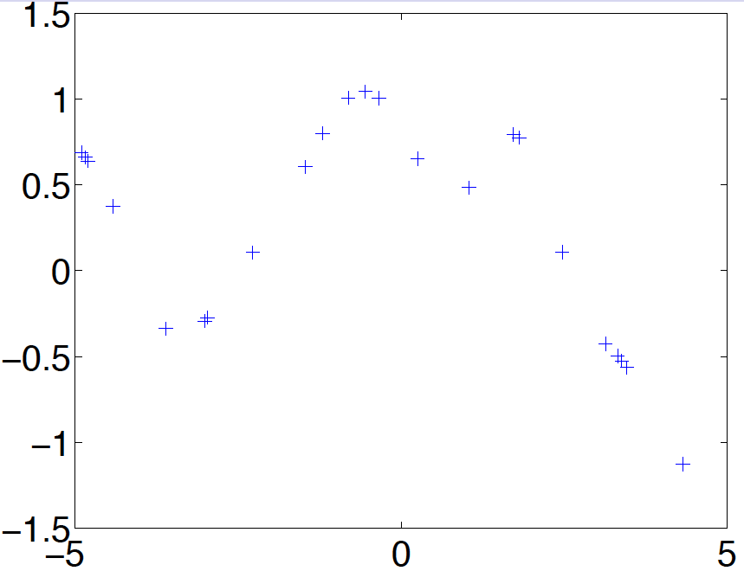
One-Dimensional GP
From Rasmussen’s 2006 NIPS Tutorial
Notes:
Here is what one sample from this looks like. You get things centered around zero, but that wiggle around it in a continuous manner.

Slide 41
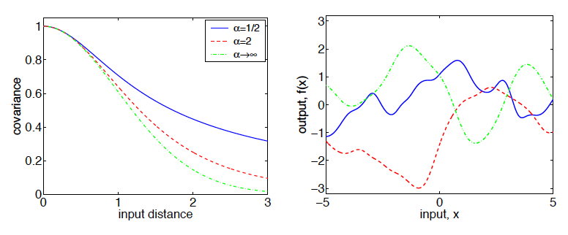
Lots of different kernel functions
We already met the Gaussian covariance function.
Another is the Rational Quadratic
Kernel behavior
Sampled functions
From Rasmussen’s 2006 NIPS Tutorial
Notes:
There are a ton of kernel and covariance functions that people use here. Another popular one is the rational quadratic. It allows for longer-range influence of points than you might get from the Gaussian one due to its heavy tail.

Slide 42
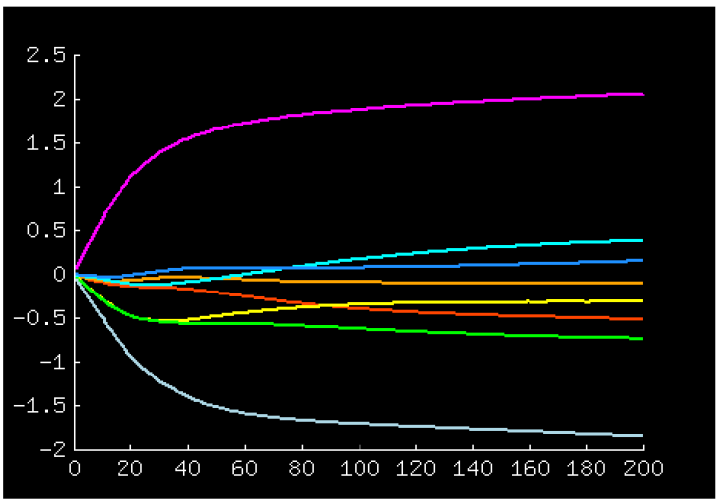
What about Neural Networks (NN)?
A NN with 1 infinite hidden layer is a GP with kernel function.
Sampled functions
From Mackay’s Tutorial
Notes:
One neat result is that a 1-layer nonlinear neural network (I believe with a sigmoidal nonlinearity function) with an infinite number of hidden nodes in that layer is actually equivalent to a Gaussian process. The kernel function is written above. It tends to give you smoothly changing functions that saturate at a certain point.
Based on this and other connections, there are some researchers who develop different learning algorithms by adapting approaches from Gaussian processes for deep NNs. In some cases, different approximation heuristics that were used have been understood from this perspective.

Slide 43
https://chi-feng.github.io/gp-demo/
Notes:
There are some nice demos for exploring how Gaussian processes update with data. Here’s one that updates nicely and you can play with the different parameters.

Slide 44
Short rest 2

Slide 45
Admin Matters
The bias-variance dilemma
Short rest 1
Intro to Bayesian Nonparametrics
Gaussian Processes
Short rest 2
Feature construction
One student presentation:
Kemp & Tenenbaum 2003 by Zihan/Neuki
Notes:
To date, we’ve focused on probabilistic models where we can specify the family of distributions that our parameters and data come from. For the remainder of the semester, we will venture into nonparametric or practically nonparametric models (artificial neural network ones). To setup this transition, we’re first going to discuss a famous dilemma in statistical modeling – the bias-variance dilemma. We’ll then introduce nonparametric estimation very briefly and the Bayesian form of it. We’ll cover Bayesian nonparametric mixture modeling, which is one of the most common uses. Then I’ll briefly cover Gaussian processes so you have some exposure to them. Their most often used for reaction-time modeling as they are used in the drift-diffusion modeling framework pioneered by Ratcliff. As one of our student presenters is sick, depending on time, we may go into feature construction and conclude with a paper presentation by Neuki.

Slide 46
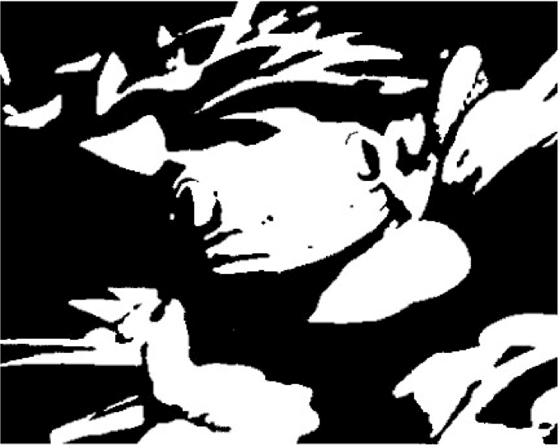
Representing input is hard
Rubin, Nakayama, and Shapley (2002)
Notes:
To motivate, I want to start with an example of the power of representations. When first looking at this image, can you tell what it is of?

Slide 47
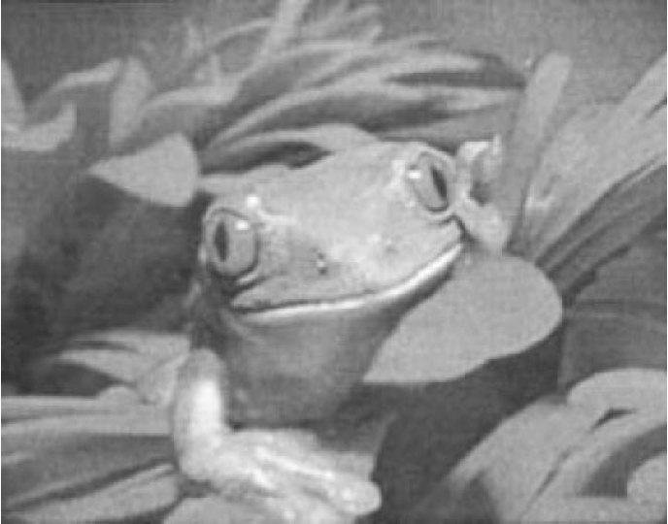
Representing input is hard
Rubin, Nakayama, and Shapley (2002)

Slide 48
Why infer features?
Input
[sensory data]
Output
[behavior]
The mind
Notes:
Lets take a step back. What exactly is our goal?

Slide 49



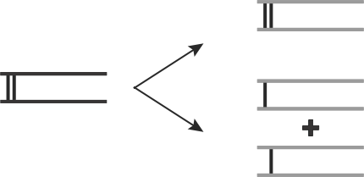

Why infer features?
Representations
Input
[sensory data]
Output
[behavior]
OR
This is a dax.
Is this a dax?
The mind
Notes:
How do we account for the mind using different representations to encode the same stimuli, depending on context?

Slide 50
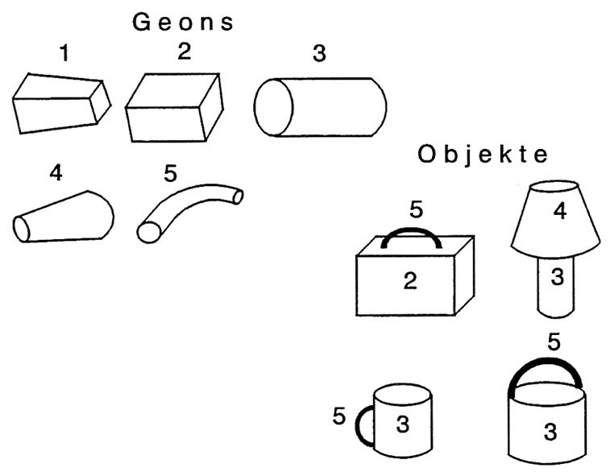
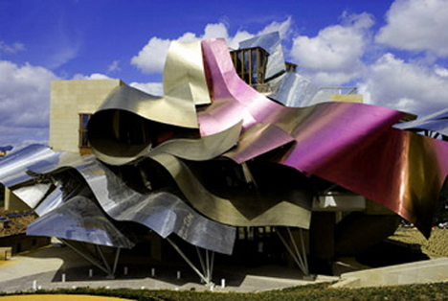

How do people infer useful features?
Six criteria for a computational model of human feature inference
Primitives from sensory
input (Hoffman & Richards,1985;
Schyns et al., 1998)
geon
Frank Gehry
2. Unlimited features
(Goldmeier, 1936; Goodman, 1972;
Murphy & Medin, 1985)
A mug has a handle,
is heavier than a mosquito,
is smaller than a bread box...
(Austerweil & Griffiths, 2013)
Notes:
Others include incremental learning and types of features

Slide 51

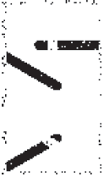

How do people infer useful features?
Six criteria for a computational model of human feature inference
3. Context sensitivity
(Garner, 1974; Palmer, 1975;
Selfridge, 1955; Tversky, 1977)
4. Prior expectations
(Chater & Vitanyi, 2003; Goldstone, 2000;
Hochberg & McAlister, 1953)
(Austerweil & Griffiths, 2013)
Notes:
Others include incremental learning and types of features

Slide 52
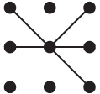
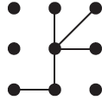
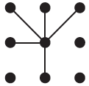
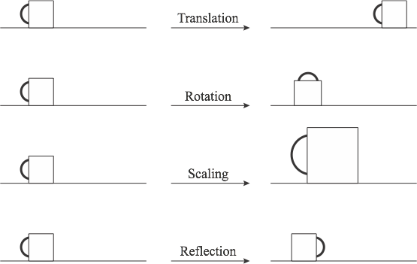
How do people infer useful features?
Six criteria for a computational model of human feature inference
5. Category diagnosticity
(Petzow & Goldstone, 1994; Schyns & Murphy, 1994)
cat 2
cat 1
6. Transformational invariance
(Palmer, 1983; Rock, 1973; Rust & Stocker, 2010)
reflection
Substitutive, incremental learning, hierarchies...
(Austerweil & Griffiths, 2013)
Notes:
Others include incremental learning and types of features

Slide 53





























Feature inference
Inscriptions found on a Martian cave wall:
Same cave?
Same cave?
Same cave?
Same cave?
P
O
P
P
(Austerweil & Griffiths, 2011)
Notes:
Seen, unseen, and CONTROL

Slide 54
Feature inference
Inscriptions found on a Martian cave wall:
Hypothesis:
inferred features depend on how parts covary.
Correlated parts
represented as a single feature
Independent parts
represented as separate features
(Austerweil & Griffiths, 2011)
Notes:
Seen, unseen, and CONTROL

Slide 55

Generating experiment stimuli
Part 6
Each image is composed of 1 shared part and 3 out of 6 other parts.
Part 3
Part 4
Part 2
Part 1
Part 5
Shared part
[Color only for demo only]
Image construction:
+Noise
(Austerweil & Griffiths, 2011)
Notes:
We created objects in both sets by taking combinations of three out of a set of six features. Here is an image that has all six features and the bias and here is it how it decomposes into the separate features and the bias. The two sets you saw have very different distributional properties. The first set you saw, the correlated set, is one training condition for our experiment. Here, the feature ownership matrix is correlated and has the same properties as the one in Shiffrin and Lightfoot’s experiment. It has four copies of these images each with its own added unique noise. The second set you saw, the independent set, is created by combining three of the six features independently. In total there are twenty such objects because 6 choose 3 is 20, but participants only see 16 of them including the four objects from the correlated set.

Slide 56

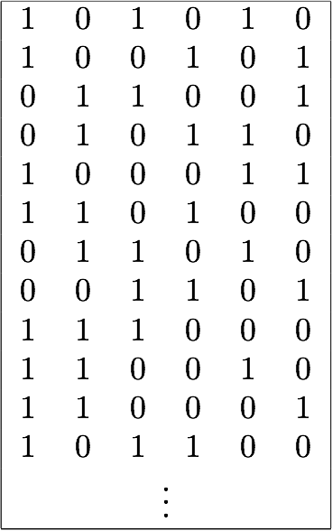

Experiment training sets
Ownership matrix
Parts
Img. 1
Img. 1
Images
Img. 2
Img. 2
(Austerweil & Griffiths, 2011)
Notes:
We created objects in both sets by taking combinations of three out of a set of six features. Here is an image that has all six features and the bias and here is it how it decomposes into the separate features and the bias. The two sets you saw have very different distributional properties. The first set you saw, the correlated set, is one training condition for our experiment. Here, the feature ownership matrix is correlated and has the same properties as the one in Shiffrin and Lightfoot’s experiment. It has four copies of these images each with its own added unique noise. The second set you saw, the independent set, is created by combining three of the six features independently. In total there are twenty such objects because 6 choose 3 is 20, but participants only see 16 of them including the four objects from the correlated set.

Slide 57



Experiment training sets
Parts
Images
(Austerweil & Griffiths, 2011)
Notes:
We created objects in both sets by taking combinations of three out of a set of six features. Here is an image that has all six features and the bias and here is it how it decomposes into the separate features and the bias. The two sets you saw have very different distributional properties. The first set you saw, the correlated set, is one training condition for our experiment. Here, the feature ownership matrix is correlated and has the same properties as the one in Shiffrin and Lightfoot’s experiment. It has four copies of these images each with its own added unique noise. The second set you saw, the independent set, is created by combining three of the six features independently. In total there are twenty such objects because 6 choose 3 is 20, but participants only see 16 of them including the four objects from the correlated set.

Slide 58




Experiment training sets
Correlated
Independent
(Austerweil & Griffiths, 2011)
Notes:
We created objects in both sets by taking combinations of three out of a set of six features. Here is an image that has all six features and the bias and here is it how it decomposes into the separate features and the bias. The two sets you saw have very different distributional properties. The first set you saw, the correlated set, is one training condition for our experiment. Here, the feature ownership matrix is correlated and has the same properties as the one in Shiffrin and Lightfoot’s experiment. It has four copies of these images each with its own added unique noise. The second set you saw, the independent set, is created by combining three of the six features independently. In total there are twenty such objects because 6 choose 3 is 20, but participants only see 16 of them including the four objects from the correlated set.

Slide 59



Experiment training sets
Parts
Correlated set
16 objects
(4 copies)
Independent set
4 objects
(1 copy)
Unseen set
Objects
Independent set
12 objects
(1 copy)
All 20 Possible Objects
Austerweil & Griffiths (2011)
Notes:
We created objects in both sets by taking combinations of three out of a set of six features. Here is an image that has all six features and the bias and here is it how it decomposes into the separate features and the bias. The two sets you saw have very different distributional properties. The first set you saw, the correlated set, is one training condition for our experiment. Here, the feature ownership matrix is correlated and has the same properties as the one in Shiffrin and Lightfoot’s experiment. It has four copies of these images each with its own added unique noise. The second set you saw, the independent set, is created by combining three of the six features independently. In total there are twenty such objects because 6 choose 3 is 20, but participants only see 16 of them including the four objects from the correlated set.

Slide 60
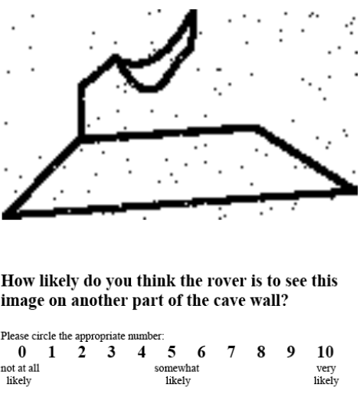
Experiment procedure
1. Training phase: exploration
2. Testing phase: generalization
Two groups of participants:
Correlated
Independent
Three types of images:
Seen
Unseen
Control (shuffled parts)
Austerweil & Griffiths (2011)

Slide 61
Computational framework
Representations
Objects
Objects
Representations
Representations
Challenge: How to form a set over possible representations?
Use flexible hypothesis spaces from Bayesian nonparametrics.
Austerweil & Griffiths (2011; 2013)
Notes:
Forming representations is an inductive problem, and, context dependent. Bayesian inference gives us the optimal solution:
Right now using matrix factorization,
BNP allows for the creation of symbolic units from raw sensory input as needed to explain data.

Slide 62

Given a set of images, how should we represent it?
Encode images using two components:
Feature ownership
matrix Z
Feature image matrix Y
Features
Pixels
Images
Img. 1
Features
Img. 2
Each element (image i, feature k) denotes whether image i has feature k.
Encodes perceptual consequences of having each feature.
Notes:
So, we are going to assume that all we are given is a set of images. To simplify the problem, we are going to assume that each of these images is a long string of binary pixels. So if the image was originally some 2-D representations, we are going to flatten it out into one dimension. And so the output we want is a set of features of to represent these objects, a vector of feature assignments for each image, and each feature’s corresponding image. We are also going to simplify the problem once more by assuming that feature ownership is binary (you either have it or you don’t); however, our framework is general enough to be extended to these more complicated cases.

Slide 63




Computational framework
Posterior
Representation for the image set.
Feature image prior
encodes expectations about feature images.
Pixel independence
Or use an Ising model (Geman & Geman, 1984).
Feature ownership prior
encodes expectations about feature ownership.
Biased towards fewer features.
Use the Indian buffet process, a Bayesian
nonparametric process (Griffiths & Ghahramani, 2005).
Likelihood recreates images despite noise.
P(image pixel) grows with the number of features that have the pixel.
Images composed via OR (Pearl, 2000; Wood, et al., 2006).
Use standard machine learning techniques to infer the best representation for an image set, once probabilities are specified.
Austerweil & Griffiths (2011; 2013)
Notes:
So, we are going to assume that all we are given is a set of images. To simplify the problem, we are going to assume that each of these images is a long string of binary pixels. So if the image was originally some 2-D representations, we are going to flatten it out into one dimension. And so the output we want is a set of features of to represent these objects, a vector of feature assignments for each image, and each feature’s corresponding image. We are also going to simplify the problem once more by assuming that feature ownership is binary (you either have it or you don’t); however, our framework is general enough to be extended to these more complicated cases.

Slide 64




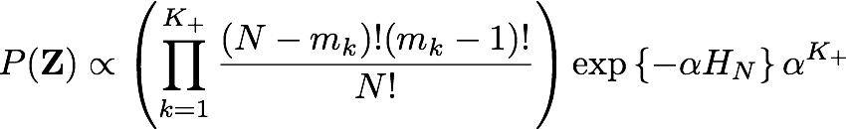
The Indian buffet process (IBP)
“Buffet” of features
Feature 1
Feature 2
Feature 3
Feature 4
Feature 5
Feature 6
1/2
2/3
3/4
1/2
1/2
1/2
1/3
1/4
1/3
1/3
2/4
2/4
2/3
2/4
2/3
3/4
N customers (objects) take dishes (features) from an Indian buffet....
customer i takes
“Old” features
“New” features
Customer 1 (takes 4 dishes): N/A Samples 4
Customer 2 (takes 5 dishes): 1,3,4 Samples 2
Customer 3 (takes 4 dishes): 1,2,4,6 Samples 0
old feature term
new feature term
Griffiths & Ghahramani (2005)

Slide 65

Stick-breaking for the CRP and IBP
A process that generates the CRP and IBP, but does not integrate out the latent weights:
CRP
IBP
0
1
Although is strictly decreasing, is not (in the example, )!
Distribution on is also called the Griffiths-Engel-McCloskey (GEM) distribution.
McCloskey (1965), Teh et al. (2007)

Slide 66










Correlated
IBP Inferred Features
Independent
Austerweil & Griffiths (2011)

Slide 67



















IBP Features
PCA Features
ICA Features
Correlated
Parts 1 & 2 are negatively correlated.
Independent
Parts 1 & 2 negatively are correlated.
Parts 4 & 5 negatively are correlated.
What do they predict?
Austerweil & Griffiths (2011)
Parts 1 & 2 negatively are correlated.
Notes:
Can go faster...

Slide 68
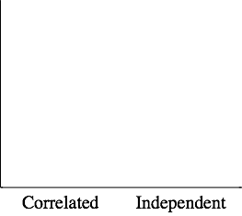








Results
All models only have one parameter fit to participant results.
IBP also outperforms exemplar and prototype models.
no diff.
seen
seen
large diff.
no diff.
seen
unseen
large diff.
seen
unseen
control
unseen
Ratings
control
unseen
control
control
Correlated
Independent
Correlated
Independent
seen
seen
seen
seen
unseen
unseen
unseen
unseen
control
control
control
control
Correlated
Independent
Correlated
Independent
Austerweil & Griffiths (2011)
Notes:
On individual test items:
IBP r = 0.92ish; PCA r = 0.8ish; ICA r = 0.8ish Exemplar = 0.8ish prototype = 0.7ish

Slide 69
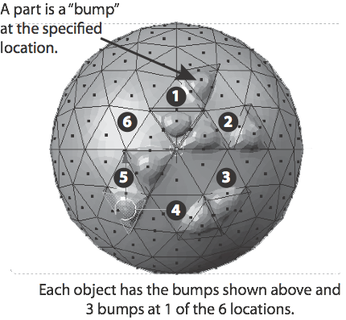
Domain generality?
3-D Rendered Objects
Concepts
(1) Lays eggs.
(2) Moves fast.
(3) Has small claws.
(4) Spends most time on land.
(5) Has scaly skin.
(6) Is a small herbivore.
Austerweil & Griffiths (2011)

Slide 70




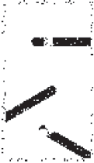
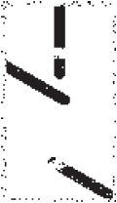
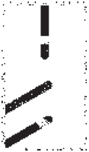





Capturing prior expectations: contiguity
Visual search for objects with correlated parts
(Shiffrin & Lightfoot, 1997).
Features inferred without proximity constraint.
coin flip bias
Features inferred with proximity constraint.
adj. pixels share value
Austerweil & Griffiths (2011)
Notes:
DON”T DESCRIBE VISUAL SEARCH TASK, JUST GIVE RESULTS.

Slide 71
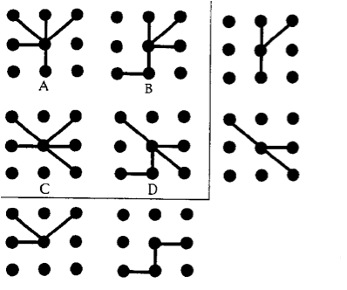


Category diagnosticity
cat 1 = {A, C}
cat 2 = {B, D}
cat 1 = {A, B}
cat 2 = {C, D}
Task: Object categorization with feedback
Result: Participants learn features appropriate to their training condition.
Pevtzow & Goldstone (1994)

Slide 72




Category diagnosticity
cat 1 = {A, C}
cat 2 = {B, D}
cat 1 = {A, B}
cat 2 = {C, D}
Include category label as part of an object’s “sensory inputs.”
... but, only representing an object with its diagnostic feature is not enough!
How else can categorization influence the features inferred by a model?

Slide 73
The Indian buffet franchise
(Austerweil & Griffiths, in rev.)
Shared Chinese restaurant process
...
Features
Features
Obj. 1
Obj. 1
Obj. 2
Obj. 2
Category 1’s Indian buffet process
Category 2’s Indian buffet process
... But should feature images be shared across categories? If so, how?
Assume that the feature images come from a common source:
a Chinese restaurant process (Aldous, 1983).
This method for sharing information across categories is used to model human learning of hierarchical categories (Griffiths et al., 2011).

Slide 74
Category diagnosticity
cat 1 = {A, C}
cat 2 = {B, D}
Category 1
Both
cat 1 = {A, B}
Category 2
Both
cat 2 = {C, D}
Both
Both
Category 1
Category 2

Slide 75


Learning transform invariant features
Previous work focused on inferring features that occur the same way across presentations.
However, features can be transformed across presentations (Palmer, 1983).
Position
Orientation
Size
Reflection

Slide 76
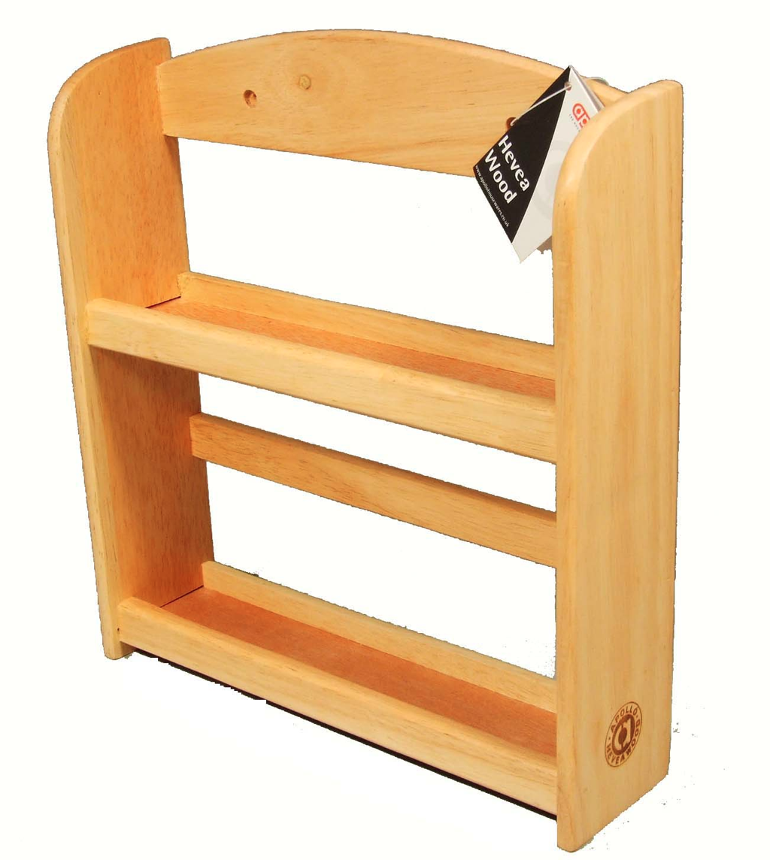


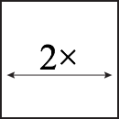


The transformed Indian buffet process
“Buffet” of features
Spice rack
Feature 1
Feature 2
Set of transformations
Austerweil & Griffiths (2010; 2013)

Slide 77
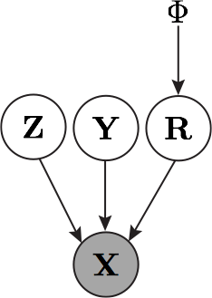
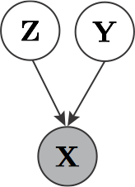
The transformed Indian buffet process
IBP
transformed IBP
Austerweil & Griffiths (2010; 2013)

Slide 78
Learning transformation-invariant features
Features occur differently across presentations.
Are parts separate features or the same feature with different transformations?
Input
[sensory data]
Representations
Output
[behavior]
OR
This is a dax.
Is this a dax?
The mind
Austerweil & Griffiths (2010; 2013)

Slide 79
Experiment Stimuli
Two object sets
Unitized: vertical bars translated together
Separate: vertical bars translated independently
Hypothesis
People infer the representation that encodes the observed objects with the fewest features.
Austerweil & Griffiths (2010; 2013)

Slide 80
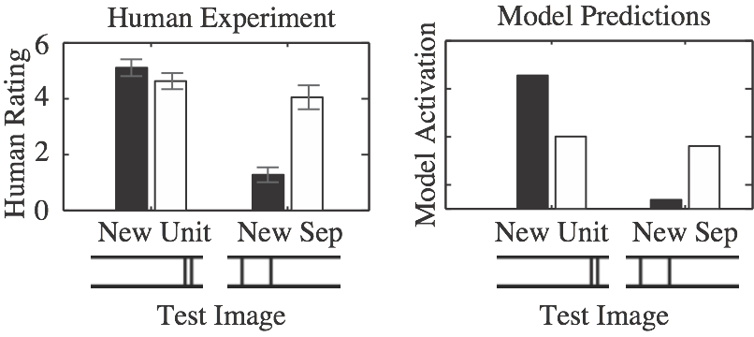
Learning transformation-invariant features
Human Experiment
Model Prediction
6
4
Human Rating
Model Activation
2
0
New Unitized
New Separate
New Unitized
New Separate
Unitized
Separate
Austerweil & Griffiths (2010; 2013)
Notes:
Breathe. Point out model broken part. Mention also learn types of invariance.

Slide 81
Learning feature transformation structure
Should all transformations be included? (More invariance the better?)
5
5
d
d
Hypothesis: people infer which transformations a feature undergoes.
Square or diamond? (Mach, 1914)
Training Set
Test Set
Rotation
or
New Rotation
New
Size
Size
Austerweil & Griffiths (2010)

Slide 82
Learning feature transformation structure
Training Set
Rotation
Size
Human Experiment
Model Prediction
6
4
Human Rating
Model Activation
2
0
New Rotation
New
Size
New Rotation
New
Size
Austerweil & Griffiths (2010)

Slide 83
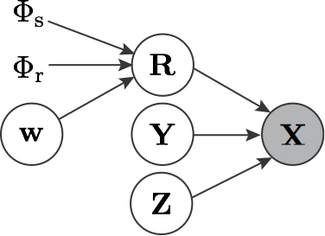
Learning feature transformation structure
Indicates type of transformation for feature .
is a prior on rotation transformations.
is a prior on scaling transformations.
Human Experiment
Model Prediction
6
4
Human Rating
Model Activation
2
0
New Rotation
New
Size
New Rotation
New
Size
Austerweil & Griffiths (2010)

Slide 84
Learning feature transformation structure
Sometimes information is shared between the types of transformations.
Smith (2005) taught children the name of a new object, which either moved horizontally or vertically.
Children generalized to novel objects that were scaled in the same direction that the original object was moved.
Information about translation transformations was shared with scaling transformations!
0.78 | 0.24
0.2 | 0.81
Children generalization probabilities.
Austerweil & Griffiths (in revision)

Slide 85

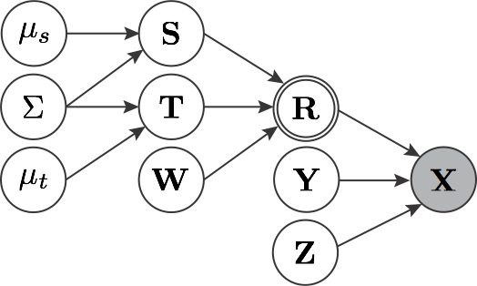



Learning feature transformation structure
0.78 | 0.24
0.2 | 0.81
0.87 | 0.12
0.12 | 0.87
Children generalization probabilities
Model generalization probabilities
Austerweil & Griffiths (in revision)

