Slide 1
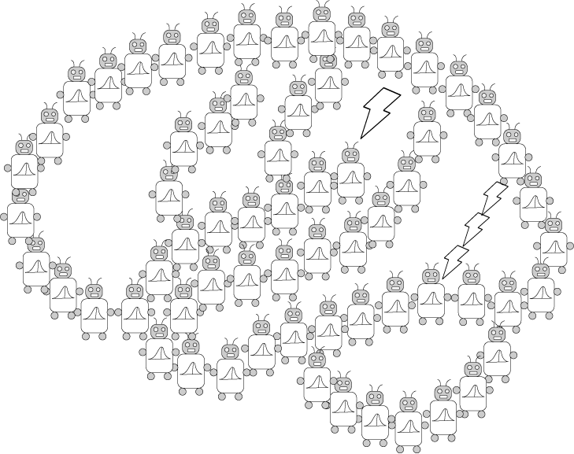
Introduction to Bayesian Nonparametrics
PSYCH/COMP SCI/BMI 841: Computational Cognitive Science
Joseph Austerweil
April 10, 2025

Slide 2
Admin Matters
The bias-variance dilemma
Short rest 1
Intro to Bayesian Nonparametrics
Gaussian Processes
Feature construction
Short rest 2
One student presentation:
Kemp & Tenenbaum 2003 by Zihan
Notes:
To date, we’ve focused on probabilistic models where we can specify the family of distributions that our parameters and data come from. For the remainder of the semester, we will venture into nonparametric or practically nonparametric models (artificial neural network ones). To setup this transition, we’re first going to discuss a famous dilemma in statistical modeling – the bias-variance dilemma. We’ll then introduce nonparametric estimation very briefly and the Bayesian form of it

Slide 3
Administrative Matters
Assignment 3 was due April 9 at 8:59pm
Assignment 4 is due April 23 at 8:59pm
2 more discussion posts left
Only need to pass 5 through class for full credit
Any unused quiz points will be free points to your final grade.
Final project presentations May 1
Your project does NOT need to be complete by then
Final project papers due May 6 at 8:59pm
Questions?

Slide 4
Admin Matters
The bias-variance dilemma
Short rest 1
Intro to Bayesian Nonparametrics
Short rest 2
Two student presentations:
Kemp & Tenenbaum 2003 by Zihan
Austerweil & Griffiths 2009 by Yinsu

Slide 5
Learning mapping inputs to outputs
Regression:
data D are n pairs (x,y)
hypothesis space of functions, y = g(x)
error: C = (y - g(x))²
learning algorithm picks function g using data D
Minimize prediction error
y
x
Notes:
The standard setup for the Bias-variance tradeoff is learning a function or mapping of input to output. So in this case, we are doing regression. We get a data set D which is comprised of n pairs of (x,y) values. Our model has some hypothesis space of possible functions g that map x values to y values. We’ll assume that our error or loss function is squared error. A learning algorithm uses the observed data D to pick a function g that minimizes the expected loss. That’s the same thing as the prediction error, which is written out as an integral below. If this feels familiar, it should! It’s the same setup as we went over in statistical decision theory.

Slide 6
A learning strategy
Choose the function g(x) in the hypothesis space that minimizes the training error
Different hypothesis spaces define different learning algorithms
Neural networks correspond to the case where the hypothesis space is functions that can be produced by the network
Notes:
A common strategy for learning is to select the function g(x) that minimizes the training error. So we can pick a function g, evaluate it at every x_i to get its predicted y_i, take the squared difference as the error for that data point and average that up over all the n data points.
One way to define different learning algorithms is by the set of hypothesized functions available to them. So for example, linear regression is the set of lines – say varying the slope and intersect. Neural networks typically have a lot more parameters and nonlinear relations that the inputs get mapped through. This corresponds then to a very large set of potential functions to use.

Slide 7
Some hypothesis spaces
Linear functions
Quadratic functions
8th degree polynomials
Notes:
To show case how hypothesis spaces of different sizes learn from limited data amounts of data, we’ll explore three simple hypothesis spaces for regression. Linear functions with two adjustable parameters, quadratic ones with three adjustable parameters, and 8-th degree polynomials with 9 adjustable parameters.

Slide 8
Minimizing training error
Notes:
Now we have an example data set – 10 data points of x-y pairs. Let’s see how each of the learning algorithms fit these data.

Slide 9
Minimizing training error
Notes:
The best fitting line looks as follows. Not too shabby, but it also seems to miss the bit of curve to the data.

Slide 10
Minimizing training error
Notes:
The quadratic seems to fit the data quite nicely!

Slide 11
Minimizing training error
Notes:
And the 8th degree polynomial fits the data points even nicer! Almost no error at all.

Slide 12
What about prediction error?
Notes:
So I superimposed the true function that was use to generate the points in black. You can see that it’s actually a quadratic. So if we looked at the prediction error of our algorithms, the 8th degree polynomial is doing quite poorly. That is despite it being the best algorithm when we looked at training error.

Slide 13
What happened?
The set of 8th degree polynomials contains almost all functions through 10 points.
Our data are some true function, plus noise.
Fitting the noise gives us the wrong function.
This is called overfitting.

Slide 14
More formally…
Assume y = f(x) + ε, where E(ε) = 0, E(ε²) = σ ²
(assume error is normally distributed)
Notes:
We can say more about this than simply having a lot of parameters relative to the number of data points is bad. To do so, we’re going to walk through a derivation (with some hand waving). We start with some basic assumptions, that our data points are generated from some true function with some unbiased noise added to it. We’ll assume that this error is normally distributed, though a lot of these assumptions can be weakened and still get similar results.
What are we interested in? We’re interested in having a small prediction error. We’ll represent that as the expected squared error across different (x,y) values between the true y and the one learned by our learning algorithm. Next we do a typical trick in this area. We add and subtract in the true function. That’s just adding and subtracting by zero. But, we will group each of our terms with f(x) instead and expand the quadratic that way. So we treat (y-f(x)) as one term of our quadratic and f(x)-g(x) as the other.
Now, I put down the quadratic expansion as a reminder. We’ll treat y-f(x) as A and f(x) – g(x) as B.
That leaves us with these three terms. I can separate their expectations because they are just added together and expectations are linear.
Now I’m not going to go into great detail here, but the expected value of this middle term is actually zero. The reason is that the first term of the middle term is \epsilon and it is uncorrelated with the difference between the true function f(x) and the one selected by our learning algorithm. If that’s confusing for you, that’s ok. It’s worth just trusting me on that one then.

Slide 15
More formally…
Assume y = f(x) + ε, where E(ε) = 0, E(ε²) = σ ²
(i.e., error is normally distributed)
A good algorithm makes (f(x) - g(x))² small
Notes:
And so, we are now left with two terms. That first term is \epsilon^2 as y = f(x) + \epsilon. By definition, the expected value of \epsilon^2 is \sigma^2. That’s our irreducible error. We don’t have any control on it as it doesn’t depend on our learning algorithm.
So what we want to do to minimize prediction error is make the expected squared difference between the true function and the one our learning algorithm selects as small as possible. In some ways, this may feel like a lot of work for something we already knew, but we will see that it can help us get some insight.

Slide 16
Bias and variance
A good algorithm makes (f(x) - g(x))² small.
g is chosen on the basis of the data D.
Evaluate algorithms by the expectation of (f(x) - g(x))² over data D generated from f.
Bias: how similar is the true function to the estimated function?
Variance: how much is the estimated function expected to vary across possible observations?
bias²
variance
Notes:
Although I’m not going into the details of the next steps of the derivation, by some similar logic, you can decompose the rest of the prediction error into these two terms. The first term is the difference between the true function and the expected function learned by the algorithm, all squared. We typically would like our learning algorithm to be expected to be the same as the true function. In statistics this term is called the bias, so with it being squared, it’s the bias squared.
The second term is the a bit different. It says across different data sets, how much should I expect the function selected by my learning algorithm to vary? This is the variance term. What’s fascinating about this is that one might have thought that only being expected to get the correct function would matter. That’s what the bias term includes and it is important. But we also have an equally important term for reducing prediction error – the amount of variability in the estimated function across training sets.

Slide 17
Making things more intuitive…
The next few slides were generated by:
choosing a true function f(x)
generating a number of datasets D from p(x,y) defined by uniform p(x), p(y|x) f(x) plus noise
finding the function g(x) in the hypothesis space that minimized the training error
Comparing average of g(x) to f(x) reveals bias
Spread of g(x) around average is the variance
Notes:
To make this a bit more intuitive, lets visualize this process by sampling according to the generative process, finding the function in each hypothesis space by minimizing the training error.
We will compare the expected learned function, the average of the learned function to the true one to see how much bias the learning method has.
We can also see how far g(x) varies from set to set to examine the amount of variance there is.

Slide 18
Linear functions (n = 10)
pink is g(x) for each dataset
red is average g(x)
black is f(x)
y
}
}
bias
variance
x
Notes:
Here is what it looks like when minimizing training error with a hypothesis space of linear functions. Each data set had 10 points. Each pink line is a learned g(x) for a data set and the red is their average. We can see that the red line is probably the closest one to the true function, but that there still is a good amount of error there. That’s to be expected – the true function is not possible to represent within the learning algorithm’s hypothesis space.

Slide 19
Quadratic functions (n = 10)
pink is g(x) for each dataset
red is average g(x)
black is f(x)
y
x
Notes:
Here is what it looks like when minimizing training error with a hypothesis space of quadratic functions. Each data set had 10 points. Each pink curve is a learned g(x) for a data set and the red is their average. The red curve is exactly on top of the black true function and so we can’t see it. We can see there’s very little variability around the true function too. So the bias and the variance are both low. It turns out that having a small hypothesis space that also includes the true function makes it a lot to easier to do well in minimize prediction error.

Slide 20
8-th degree polynomials (n = 10)
pink is g(x) for each dataset
red is average g(x)
black is f(x)
y
x
Notes:
Here is what it looks like when minimizing training error with a hypothesis space of 8th degree polynomials functions. Each data set had 10 points. Each pink curve is a learned g(x) for a data set and the red is their average. Despite all the pink curves going all over the place, the average of all the learned 8-th degree polynomials curves, in red is actually pretty close to the true function plotted in black. So, the bias from this learning algorithm is still very small. That makes sense! The true function is within the hypothesis space of 8-th degree polynomials.
But the variance is astronomical. It’s the whole plot. It’s a lot larger than the variance for when we used lines. And so, the prediction error will be very large still.

Slide 21
Bias and variance
(quadratic f(x), with n = 10)
Linear functions
high bias, medium variance
Quadratic functions
low bias, low variance
8-th order polynomials
low bias, super-high variance
Notes:
In summary, when we use a quadratic function and generate data sets of 10 points each with Gaussian noise around each point and learn by minimizing training error, we get the following bias and variances

Slide 22
In general…
More flexible learning algorithms have higher variance, but low bias across several f(x)
The bias-variance dilemma or tradeoff:
if we want an algorithm that has low bias on a range of problems, we pay a price in variance
Note: This is mainly an issue when n is small
Notes:
Thus, although it might seem like it would be best to use the most flexible learning algorithm possible so we can capture any possible function, we will ultimately pay a cost in variance and end up doing poorly during prediction.
This is known as the bias-variance dilemma or tradeoff
I should note that this is an issue, but it is more of an issue when the number of parameters is similar to the amount of data. When we have a lot more data, say 100 data points per data set,

Slide 23
Quadratic functions (n = 100)
pink is g(x) for each dataset
red is average g(x)
black is f(x)
y
x
Notes:
Using the space of quadratic functions does really well on both variance and bias

Slide 24
8-th degree polynomials (n = 100)
pink is g(x) for each dataset
red is average g(x)
black is f(x)
y
x
Notes:
And so does the hypothesis space of 8-th degree polynomials.

Slide 25
The moral
General purpose learning mechanisms do not work well with small amounts of data
So, the most flexible algorithm isn’t always the best.
To make good predictions from small amounts of data, you need algorithms with bias that matches the problem being solved
What does this mean for learning agents?
Notes:
So the moral is that having the most flexible general purpose learning mechanisms may not work well with small amounts of data without something to guide which hypotheses are better ahead of time.
To make good predictions from small amounts of data, you need algorithms with bias that matches the problem being solved

Slide 26
The moral
General purpose learning mechanisms do not work well with small amounts of data.
So, the most flexible algorithm isn’t always the best.
To make good predictions from small amounts of data, you need algorithms with bias that matches the problem being solved.
What does this mean for learning agents?
This suggests a different approach to studying induction might be profitable.
(what people learn as n → 0, rather than n → ∞)
Notes:
What does this mean for learning agents? Well, when we have the ability to comb through the entire internet worth of data, it might not be such a big deal to use a huge number of parameters. We’ve seen that deep learning methods can have a lot of success using large parameter sets. But it means that if we’re interested in how people act we should do so relative to the amount of data we believe they are exposed to. If we believe they are exposed to a limited amount of data, then we will need to look at how to constrain really flexible algorithms so that they can still be effective when learning from such small data sets too.

Slide 27
Admin Matters
The bias-variance dilemma
Short rest 1
Intro to Bayesian Nonparametrics
Short rest 2
Two student presentations:
Kemp & Tenenbaum 2003 by Zihan
Austerweil & Griffiths 2009 by Yinsu

Slide 28
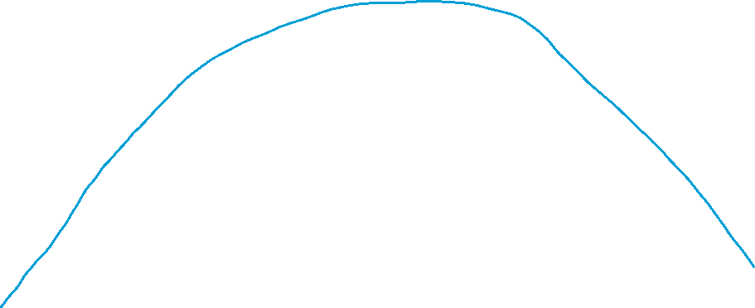
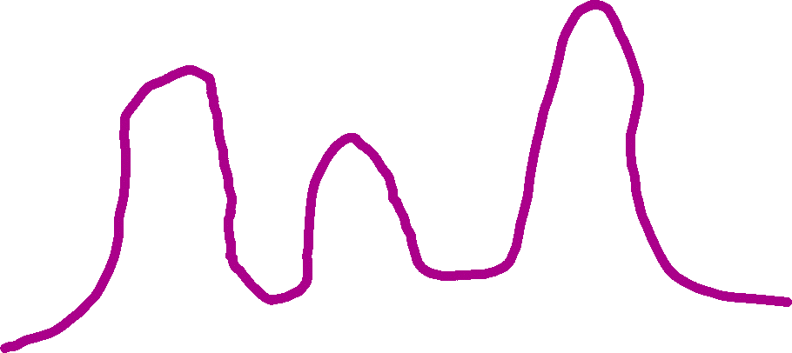
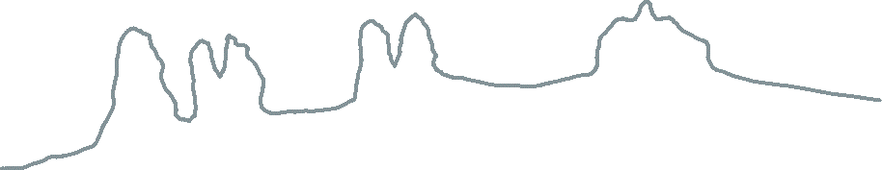
Notes:
Lets say we are getting data points from some source, but we don’t’ really know too much about it. We see these data points here. There are different approaches we could take to estimating the distribution of these data. We could make strong assumptions about the nature of the data and assume they are all from a single gaussian distribution, like this blue curve.
Maybe we believe the data come from a mixture of three Gaussians and we fit those to these data. That would lead us to something like the purple curve. Alternatively we could think there are 9 Gaussians, one centered at each data point. We couldn’t easily estimate the variance then (we have fewer data points than parameters), but that’s ok, we could just assume some value and form a distribution like the gray one plotted above. That’s called a kernel density estimation technique.
Or we might not believe that there could be any variability in our data points and only expect them again precisely in the same form. That would lead us to something like the orange distribution where we sort of have a discrete distribution. That’s known as an empirical distribution function and is the assumption we use when we do something like bootstrapping.
All of these are reasonable probabilistic models for estimating a distribution. Some of them are limited to certain families of distributions, like in the case of the single Gaussian or mixture of 3 Gaussians. These are called parametric models. They work fine when they can adjust their parameters to capture the data because the data are within the family of distributions that is formed from varying the parameters in different ways.
The gray and orange models are different from the others. They are creating a new component to the distribution each time a new data point arrives. They might assume a small amount of variability around the observed data point is possible or simply believe that precisely the same data point will be observed again. These are more flexible. They can capture more distributions, but have f

Slide 29
What is a Bayesian Nonparametric Model?
Nonparametric - a model that can encode any* probability distribution (using arbitrarily complex representations).
E.g., Kernel methods
Bayesian - priors constrain which latent representations are preferred.
Bayes NP are nonparametric models that prefer to use simpler representations.
Types of latent structure and corresponding Bayes NP prior:
One discrete per datum (categories, trees, etc.) -> Dirichlet process
Multiple discrete per datum (features) -> Beta process
Continuous/Functions -> Gaussian process
Notes:
To date, we’ve focused on probabilistic models where we can specify the family of distributions that our parameters and data come from. For the remainder of the semester, we will venture into nonparametric or practically nonparametric models (artificial neural network ones). Nonparametric models still have parameters – in fact it might be more accurate to state that they have a massive number of parameters. Unlike their parametric counterparts which can only capture distributions within some family (say Gaussians with varied means or two Gaussians with varying means and variances), they have stronger guarantees in terms of converging to arbitrary families of distributions. This flexibility comes with a cost: they are mathematically much more difficult and approximation methods are more challenging.
Bayesian nonparametric models are both Bayesian and nonparametric. They are nonparametric in that they can encode any probability distributions using arbitrarily complex representations. I put a * there because if we were being really technical we would need to qualify that a bit more. Suffice it to say that they can capture many more distributions than being restricted to some family of distributions. For a finite set of data, different nonparametric methods form distributions that all capture the observed data to some extent. Bayesian nonparametric methods are also Bayesian in that in they have biases or priors that favor certain solutions over others.
They are Bayesian in that they are biased towards certain representations over others. For example, in the prior slide, we had two nonparametric distribution estimators: we had the gray kernel one that put little gaussians on every data point and also the orange one that put a stick on each distribution. A Bayesian nonparametric estimator allows one to favor one of these over the other and for that to potentially depend on the amount of data you’ve observed.
Most Bayesian nonparametric models are defined by the type of latent structure they are over. If you have one discrete latent property assigned per data point (whether that be a category, a place in a tree, or whatever), then you are usually in the family of Dirichlet process models. If you have multiple discrete properties per data point, which is usually what is used in feature representations, then you are using a Beta process. Both of these are actually built off of Poisson processes, which form the basis for Bayesian nonparametric models with discrete latent representations.
If we have continuous latent structure, then the corresponding Bayesian nonparametric process is a Gaussian process.

Slide 30
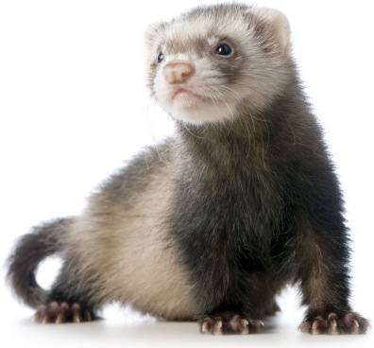
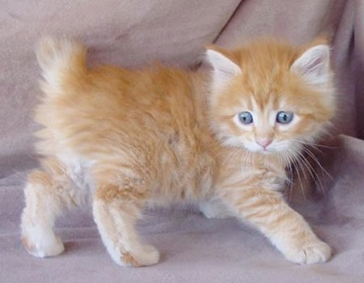
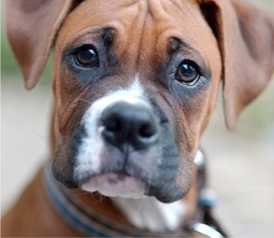




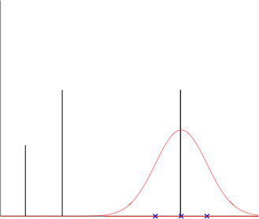
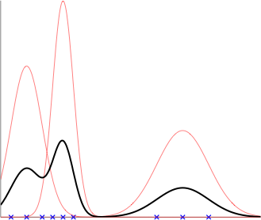
Categorization as Mixture Modeling
1
2
3
To make an animal, first sample which animal we want from
Each animal is created from its associated ideal “snout size” and variance .
This leads to the following generative process for each animal
Prob. of new snout size:
Categorize a new animal
given its snout size:
2
1
3
2
2
3
3
Prob. of snout size
Prob. of snout size
Prob. of snout size
1
1
Snout Size
Snout Size
Snout Size
Notes:
To motivate the Dirichlet process mixture model, we’ll return to the animal shelter example we discussed earlier in the semester. In it, we were representing different animals based on the size of their snouts. So, as a 1-d continuous value. Each animal’s snouts were assumed to be Gaussian distributed with their own mean and variance. We assumed there were 3 different types of animals and that each animal has its own Gaussian associated with it. We assumed that there was some distribution on the frequency of observing each animal and from there had the following generative process for the animal nose sizes. That allowed us to form a mixture distribution over snout sizes and given a snout size, predict which animal cluster/category it belongs to.

Slide 31
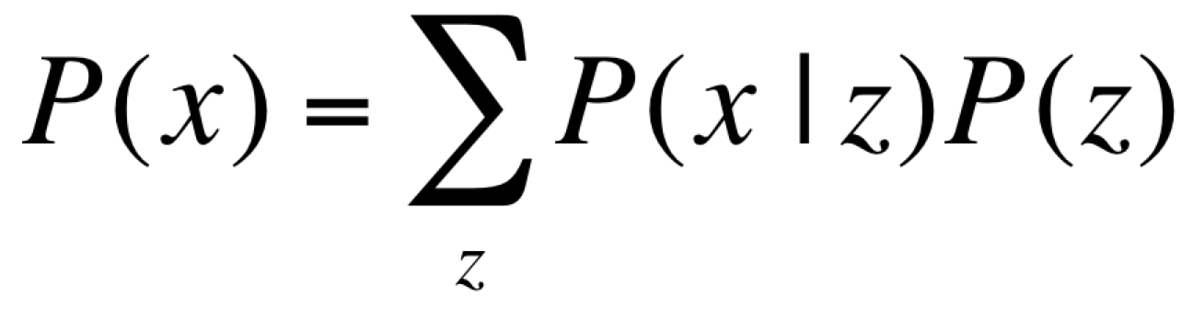
Latent variable models
z
P(z)
Latent (unobserved)
x
P(x|z)
Marginalize out
(i.e. sum over)
latent structure
Observed
z is each x’s cluster index
How do we put a prob. on clusterings?
Notes:
More generally, this is an example of a latent variable model where the observed data are generated by some latent unobserved structure. In this case, is the category or cluster that the animal belongs to. But what if we didn’t know what species there were? What if we were an alien that arrived on Earth and placed into the animal shelter. We wouldn’t know how many animal types or clusters there should be. How can we infer that along with which cluster each observed animal belongs to?
If we want to be Bayesian about it, and in the class we basically usually want to be Bayesian, we’ll want to put a probability distribution on clusterings that grows with the number of items we observe.

Slide 32
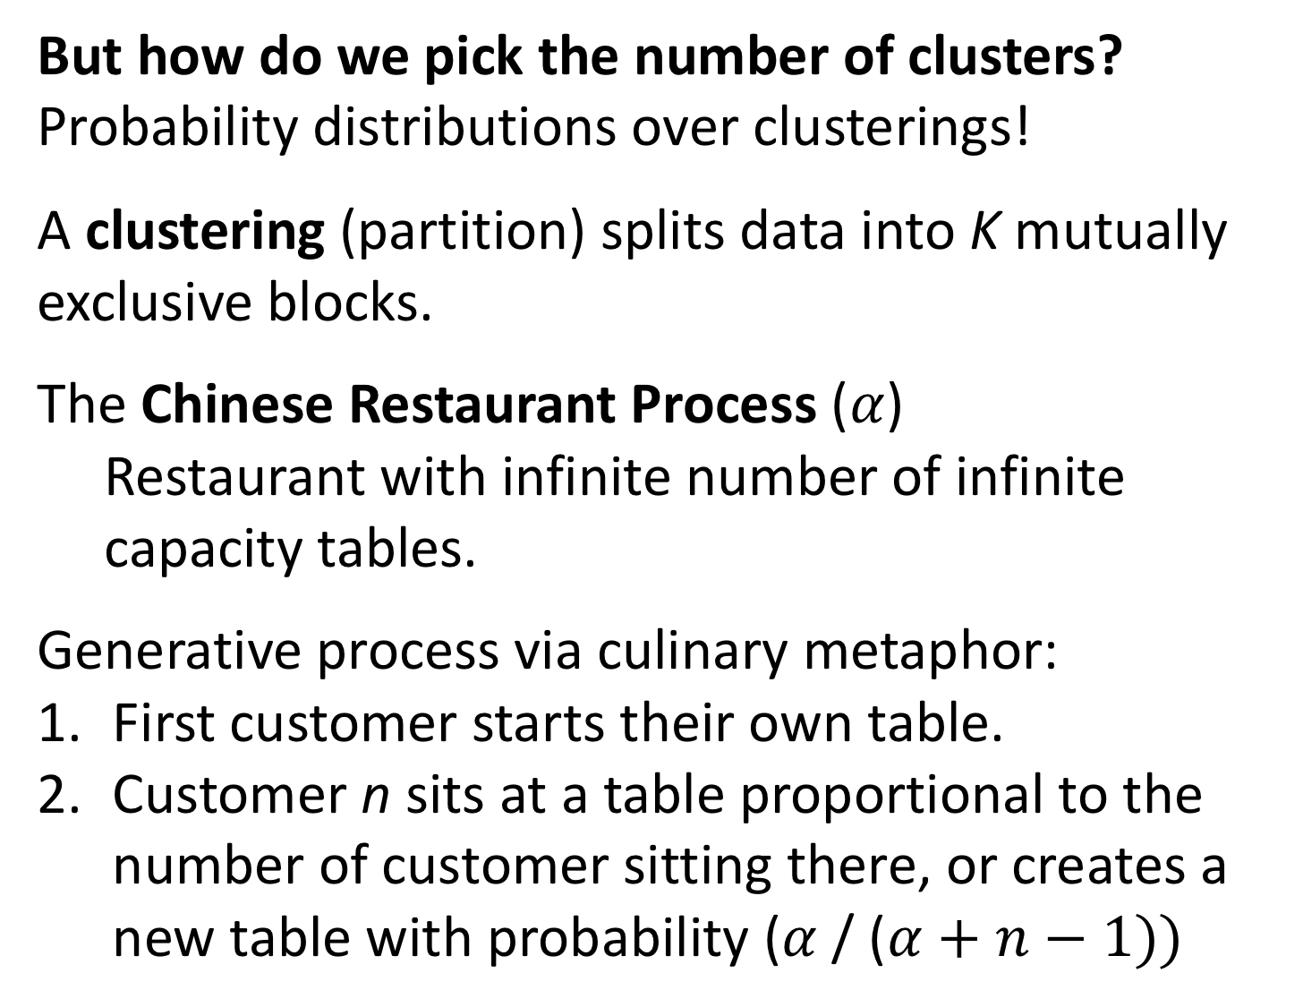
But how do we pick the number of clusters?
Probability distributions over clusterings!
A clustering (partition) splits data into K mutually exclusive blocks.
The Chinese Restaurant Process ($α$)
Restaurant with infinite number of infinite capacity tables.
Generative process via culinary metaphor:
First customer starts their own table.
Customer n sits at a table proportional to the number of customer sitting there, or creates a new table with probability ($α$/ ($α+n−1))$
Notes:
So how do we pick the number of clusters and the probability distribution over how items are clustered?
A bit on terminology. In statistics and combinatorics, this is usually referred to splitting the data into a partition, where the items are placed into K mutually exclusive sets that when combined together form the full data set again.
This is actually really tricky because the number of possible clusters for even a small number of items grows super exponentially. It’s given by the n-th Bell number and even with 10 items, there are over 100k ways of putting them into clusters!
One popular scheme for forming an exchangeable distribution over partitions is called the Chinese Restaurant Process. It has a single parameter \alpha. The name comes from two Berkeley statisticians, David Aldous and Jim Pitman, who loved going to dim sum restaurants in nearby Oakland. The restaurants are extremely large and feel like they have an infinite number of tables. Also, it seemed like they could always squeeze more people into a table no matter what. Inspired by these restaurants, they described a generative process for forming an exchangeable distribution on partitions that is defined sequentially. In the metaphor, customers are data points. The tables correspond to blocks or clusters. The arrangement of customers to tables defines a partition. It works as follows. The first customer comes in and sits and their own table. When the n-th customer comes in, they sit at each occupied table with probability proportional to the number of people sitting there.

Slide 33




A (in)finite mixture model
Suppose there are objects and clusters.
Let denote that object is in cluster .
(each object is in one cluster)
Let define the probability an object is in cluster .
Let be the number of objects in cluster .
where is the number of “used” clusters.
This probability distribution is equivalent to the one given by the Chinese restaurant process (CRP).
Customers (objects) arrive at a restaurant with an infinite number of infinitely-sized tables (clusters).
A customer sits down at an occupied table with probability proportional to the number of occupants.
A customer starts a new table with probability proportional to .
Blackwell & MacQueen (1973), Aldous (1985), Neal (1992), Griffiths & Ghahramani (2005)
Notes:
It turns out this procedure that was defined by the statisticians can be derived from the mixture model generative process we were working with before!
In general, we suppose there are N objects that belong to one of K clusters. For now, we’re not going to worry about the data distribution itself, we’re just worrying about how data points are assigned to clusters. We assume we do NOT know the mixture weights for our clusters. So we put a Dirichlet prior on them with parameter \alpha. The parameters for the Dirichlet distribution will depend on the number of clusters we have so far, so \alpha is more like the total amount of mass that the Dirichlet distribution has to distribute across the different clusters. It’s symmetric, so each of the parameter associated with each of our clusters is \alpha/K. The derivation for this model were covered in that intro tutorial I gave you with the Dirichlet-multinomial model. We don’t have time to go through this integral again, but if you work through it like we did in that tutorial, you end up with the following equation that is the ratio of normalizing constants for the Dirichlet distribution prior and the updated one based on the cluster assignments.
Now what is neat is you can take the infinite limit here. This takes a bit of care, which is why you have the * there, but the basic intuition is you separate those clusters that have at least one object in them from those that do not have any object associated with them. Since the number of objects is finite, you know that there’s only a finite number of clusters that have at least one object in them. I call these “used” clusters and it is denoted by K+.
Now it turns out this is equivalent to the CRP we defined earlier. It may not look that way here, but you can show they are identical. The intuition for it is as follows. Everytime you create a new table or cluster to use for a customer or data point, you multiply by \alpha. There are K+ of those, so that’s where \alpha^K+ comes from. Now every time we assign an item to an existing cluster, we get a term that is the number of items that had been in the cluster before it gets assigned (so that’s where the minus 1 comes from). We do that for each item that gets assigned to that cluster and so we get a factorial there. The ratio of gamma functions is the another way of writing the normalization term you get on each step of the process. That’s 1 for the first customer times 1/(1+\alpha) for the second customer times 1/(2+ \alpha) for the third all the way to 1/(N-1+\alpha) for the Nth customer. And voila, they are the same!

Slide 34
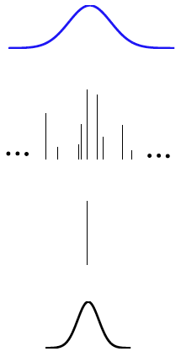

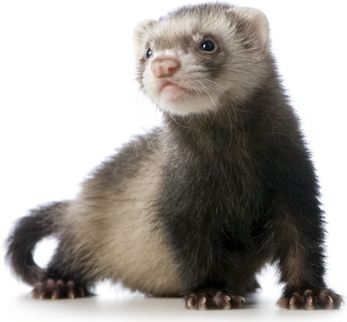
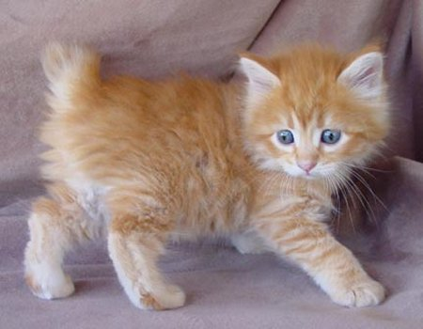
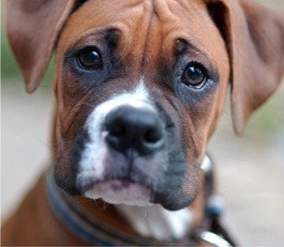
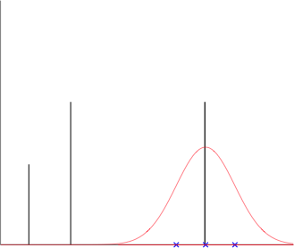
Connecting the CRP to mixture models
Prior over parameters
Gaussian prior on params.
Prob. of snout size
2
3
CRP w/ dishes
1
Distribution for datum using drawn dish as parameter.
2
3
Prob. of snout size
1
DP
Snout Size
Mixture distribution with two components.
DP Mixture Model
When the tables are labeled with parameters drawn iid from some distribution, this generates the Dirichlet process or the Polya Urn.
(Jordan, 2010)

Slide 35
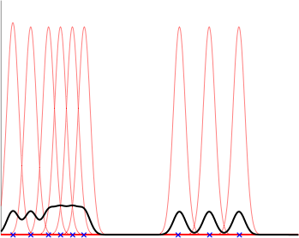
Categorization as Mixture Modeling
Parametric
Nonparametric
Bayesian Nonparametric
Prob. of snout size
Snout Size
Snout Size
Snout Size
Definition:
Restricted family of distributions
Can express any distribution
Structure grows with data.
Examples:
Finite Gaussian mixture models (prototypes)
Kernel methods (exemplar models)
Dirichlet process (rational categorization model)
Efficient learning;
More robust to noise
Can learn any distribution.
Can learn any distribution.
Less prone to overfitting.
Pros:
Cons:
Cannot represent every distribution.
Inefficient learning;
Prone to overfitting
Inference is hard.

Slide 36
What does nonparametric mean?
How does it differ from parametric?
Nonparametric models can learn any possible distribution.*
Parametric models are restricted to a family (e.g., Gaussians with different means).
What is “Bayesian” about Bayesian nonparametrics?
Bayesian nonparametric models can learn any possible distribution,
but they are biased towards particular types of distributions.
Are there no parameters in nonparametric Bayesian models?
Nonparametric models have parameters. They just have an infinite number of them!
Are Gibbs samplers a type of nonparametric Bayesian model?
Gibbs sampling is an inference method. It is applied to models.
What is the distinction between models and inference?
Models specify a probability distribution over data and possibly latent factors.
Inference methods sample from (or find the max) the posterior distribution.
*Nonparametric can also mean models whose structure grow with the amount of data.
These two definitions are strongly, but not perfectly correlated.

Slide 37
https://medium.com/@albertoarrigoni/dirichlet-processes-917f376b02d2

Slide 40
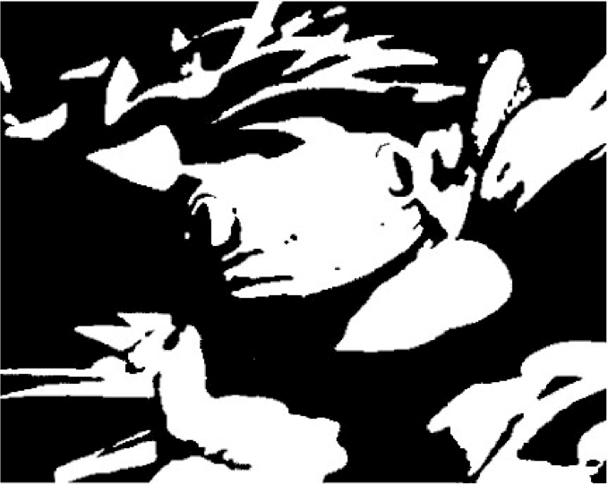
Representing input is hard
Rubin, Nakayama, and Shapley (2002)

Slide 41
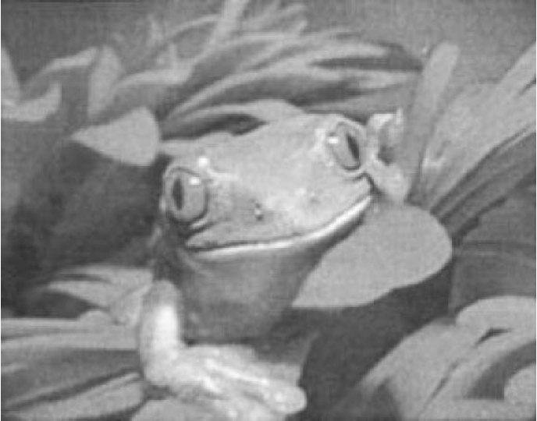
Representing input is hard
Rubin, Nakayama, and Shapley (2002)

Slide 42
Computational cognitive psychology
Input
[sensory data]
Output
[behavior]
The mind
Notes:
Lets take a step back. What exactly is our goal?

Slide 43



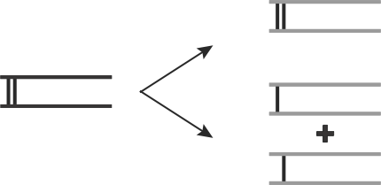

Computational cognitive psychology
Representations
Input
[sensory data]
Output
[behavior]
OR
This is a dax.
Is this a dax?
The mind
Notes:
How do we account for the mind using different representations to encode the same stimuli, depending on context?

Slide 44
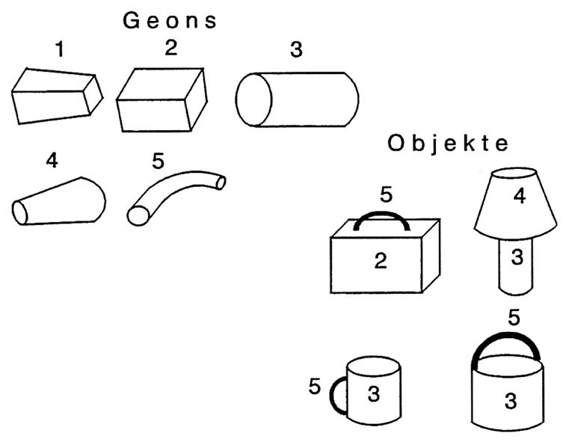
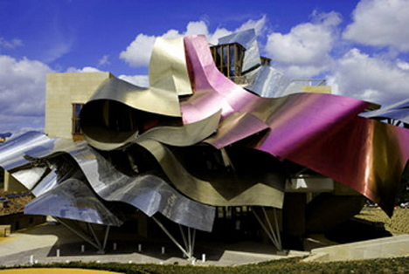

How do people infer useful features?
Six criteria for a computational model of human feature inference
Primitives from sensory
input (Hoffman & Richards,1985;
Schyns et al., 1998)
geon
Frank Gehry
2. Unlimited features
(Goldmeier, 1936; Goodman, 1972;
Murphy & Medin, 1985)
A mug has a handle,
is heavier than a mosquito,
is smaller than a bread box...
(Austerweil & Griffiths, 2013)
Notes:
Others include incremental learning and types of features

Slide 45

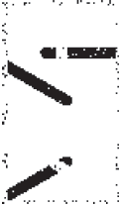

How do people infer useful features?
Six criteria for a computational model of human feature inference
3. Context sensitivity
(Garner, 1974; Palmer, 1975;
Selfridge, 1955; Tversky, 1977)
4. Prior expectations
(Chater & Vitanyi, 2003; Goldstone, 2000;
Hochberg & McAlister, 1953)
(Austerweil & Griffiths, 2013)
Notes:
Others include incremental learning and types of features

Slide 46
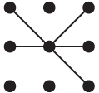
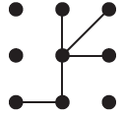
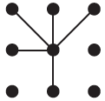
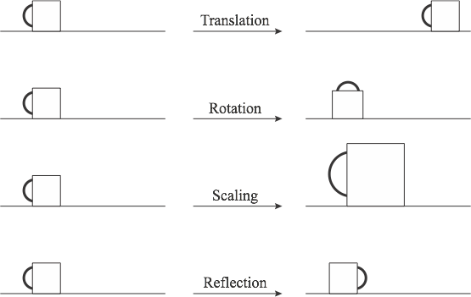
How do people infer useful features?
Six criteria for a computational model of human feature inference
5. Category diagnosticity
(Petzow & Goldstone, 1994; Schyns & Murphy, 1994)
cat 2
cat 1
6. Transformational invariance
(Palmer, 1983; Rock, 1973; Rust & Stocker, 2010)
reflection
Substitutive, incremental learning, hierarchies...
(Austerweil & Griffiths, 2013)
Notes:
Others include incremental learning and types of features

Slide 47





























Feature inference
Inscriptions found on a Martian cave wall:
Same cave?
Same cave?
Same cave?
Same cave?
P
O
P
P
(Austerweil & Griffiths, 2011)
Notes:
Seen, unseen, and CONTROL

Slide 48
Feature inference
Inscriptions found on a Martian cave wall:
Hypothesis:
inferred features depend on how parts covary.
Correlated parts
represented as a single feature
Independent parts
represented as separate features
(Austerweil & Griffiths, 2011)
Notes:
Seen, unseen, and CONTROL

Slide 49

Generating experiment stimuli
Part 6
Each image is composed of 1 shared part and 3 out of 6 other parts.
Part 3
Part 4
Part 2
Part 1
Part 5
Shared part
[Color only for demo only]
Image construction:
+Noise
(Austerweil & Griffiths, 2011)
Notes:
We created objects in both sets by taking combinations of three out of a set of six features. Here is an image that has all six features and the bias and here is it how it decomposes into the separate features and the bias. The two sets you saw have very different distributional properties. The first set you saw, the correlated set, is one training condition for our experiment. Here, the feature ownership matrix is correlated and has the same properties as the one in Shiffrin and Lightfoot’s experiment. It has four copies of these images each with its own added unique noise. The second set you saw, the independent set, is created by combining three of the six features independently. In total there are twenty such objects because 6 choose 3 is 20, but participants only see 16 of them including the four objects from the correlated set.

Slide 50

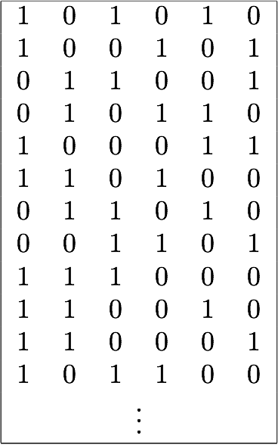

Experiment training sets
Ownership matrix
Parts
Img. 1
Img. 1
Images
Img. 2
Img. 2
(Austerweil & Griffiths, 2011)
Notes:
We created objects in both sets by taking combinations of three out of a set of six features. Here is an image that has all six features and the bias and here is it how it decomposes into the separate features and the bias. The two sets you saw have very different distributional properties. The first set you saw, the correlated set, is one training condition for our experiment. Here, the feature ownership matrix is correlated and has the same properties as the one in Shiffrin and Lightfoot’s experiment. It has four copies of these images each with its own added unique noise. The second set you saw, the independent set, is created by combining three of the six features independently. In total there are twenty such objects because 6 choose 3 is 20, but participants only see 16 of them including the four objects from the correlated set.

Slide 51



Experiment training sets
Parts
Images
(Austerweil & Griffiths, 2011)
Notes:
We created objects in both sets by taking combinations of three out of a set of six features. Here is an image that has all six features and the bias and here is it how it decomposes into the separate features and the bias. The two sets you saw have very different distributional properties. The first set you saw, the correlated set, is one training condition for our experiment. Here, the feature ownership matrix is correlated and has the same properties as the one in Shiffrin and Lightfoot’s experiment. It has four copies of these images each with its own added unique noise. The second set you saw, the independent set, is created by combining three of the six features independently. In total there are twenty such objects because 6 choose 3 is 20, but participants only see 16 of them including the four objects from the correlated set.

Slide 52




Experiment training sets
Correlated
Independent
(Austerweil & Griffiths, 2011)
Notes:
We created objects in both sets by taking combinations of three out of a set of six features. Here is an image that has all six features and the bias and here is it how it decomposes into the separate features and the bias. The two sets you saw have very different distributional properties. The first set you saw, the correlated set, is one training condition for our experiment. Here, the feature ownership matrix is correlated and has the same properties as the one in Shiffrin and Lightfoot’s experiment. It has four copies of these images each with its own added unique noise. The second set you saw, the independent set, is created by combining three of the six features independently. In total there are twenty such objects because 6 choose 3 is 20, but participants only see 16 of them including the four objects from the correlated set.

Slide 53



Experiment training sets
Parts
Correlated set
16 objects
(4 copies)
Independent set
4 objects
(1 copy)
Unseen set
Objects
Independent set
12 objects
(1 copy)
All 20 Possible Objects
Austerweil & Griffiths (2011)
Notes:
We created objects in both sets by taking combinations of three out of a set of six features. Here is an image that has all six features and the bias and here is it how it decomposes into the separate features and the bias. The two sets you saw have very different distributional properties. The first set you saw, the correlated set, is one training condition for our experiment. Here, the feature ownership matrix is correlated and has the same properties as the one in Shiffrin and Lightfoot’s experiment. It has four copies of these images each with its own added unique noise. The second set you saw, the independent set, is created by combining three of the six features independently. In total there are twenty such objects because 6 choose 3 is 20, but participants only see 16 of them including the four objects from the correlated set.

Slide 54
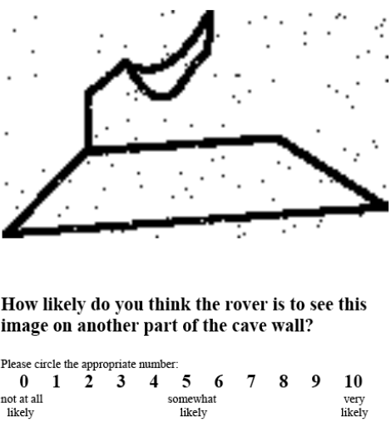
Experiment procedure
1. Training phase: exploration
2. Testing phase: generalization
Two groups of participants:
Correlated
Independent
Three types of images:
Seen
Unseen
Control (shuffled parts)
Austerweil & Griffiths (2011)

Slide 55
Computational framework
Representations
Objects
Objects
Representations
Representations
Challenge: How to form a set over possible representations?
Use flexible hypothesis spaces from Bayesian nonparametrics.
Austerweil & Griffiths (2011; 2013)
Notes:
Forming representations is an inductive problem, and, context dependent. Bayesian inference gives us the optimal solution:
Right now using matrix factorization,
BNP allows for the creation of symbolic units from raw sensory input as needed to explain data.

Slide 56

Given a set of images, how should we represent it?
Encode images using two components:
Feature ownership
matrix Z
Feature image matrix Y
Features
Pixels
Images
Img. 1
Features
Img. 2
Each element (image i, feature k) denotes whether image i has feature k.
Encodes perceptual consequences of having each feature.
Notes:
So, we are going to assume that all we are given is a set of images. To simplify the problem, we are going to assume that each of these images is a long string of binary pixels. So if the image was originally some 2-D representations, we are going to flatten it out into one dimension. And so the output we want is a set of features of to represent these objects, a vector of feature assignments for each image, and each feature’s corresponding image. We are also going to simplify the problem once more by assuming that feature ownership is binary (you either have it or you don’t); however, our framework is general enough to be extended to these more complicated cases.

Slide 57




Computational framework
Posterior
Representation for the image set.
Feature image prior
encodes expectations about feature images.
Pixel independence
Or use an Ising model (Geman & Geman, 1984).
Feature ownership prior
encodes expectations about feature ownership.
Biased towards fewer features.
Use the Indian buffet process, a Bayesian
nonparametric process (Griffiths & Ghahramani, 2005).
Likelihood recreates images despite noise.
P(image pixel) grows with the number of features that have the pixel.
Images composed via OR (Pearl, 2000; Wood, et al., 2006).
Use standard machine learning techniques to infer the best representation for an image set, once probabilities are specified.
Austerweil & Griffiths (2011; 2013)
Notes:
So, we are going to assume that all we are given is a set of images. To simplify the problem, we are going to assume that each of these images is a long string of binary pixels. So if the image was originally some 2-D representations, we are going to flatten it out into one dimension. And so the output we want is a set of features of to represent these objects, a vector of feature assignments for each image, and each feature’s corresponding image. We are also going to simplify the problem once more by assuming that feature ownership is binary (you either have it or you don’t); however, our framework is general enough to be extended to these more complicated cases.

Slide 58




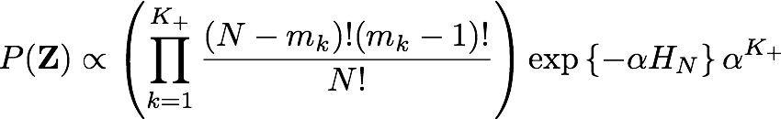
The Indian buffet process (IBP)
“Buffet” of features
Feature 1
Feature 2
Feature 3
Feature 4
Feature 5
Feature 6
1/2
2/3
3/4
1/2
1/2
1/2
1/3
1/4
1/3
1/3
2/4
2/4
2/3
2/4
2/3
3/4
N customers (objects) take dishes (features) from an Indian buffet....
customer i takes
“Old” features
“New” features
Customer 1 (takes 4 dishes): N/A Samples 4
Customer 2 (takes 5 dishes): 1,3,4 Samples 2
Customer 3 (takes 4 dishes): 1,2,4,6 Samples 0
old feature term
new feature term
Griffiths & Ghahramani (2005)

Slide 59

Stick-breaking for the CRP and IBP
A process that generates the CRP and IBP, but does not integrate out the latent weights:
CRP
IBP
0
1
Although is strictly decreasing, is not (in the example, )!
Distribution on is also called the Griffiths-Engel-McCloskey (GEM) distribution.
McCloskey (1965), Teh et al. (2007)

Slide 60










Correlated
IBP Inferred Features
Independent
Austerweil & Griffiths (2011)

Slide 61



















IBP Features
PCA Features
ICA Features
Correlated
Parts 1 & 2 are negatively correlated.
Independent
Parts 1 & 2 negatively are correlated.
Parts 4 & 5 negatively are correlated.
What do they predict?
Austerweil & Griffiths (2011)
Parts 1 & 2 negatively are correlated.
Notes:
Can go faster...

Slide 62
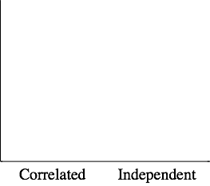








Results
All models only have one parameter fit to participant results.
IBP also outperforms exemplar and prototype models.
no diff.
seen
seen
large diff.
no diff.
seen
unseen
large diff.
seen
unseen
control
unseen
Ratings
control
unseen
control
control
Correlated
Independent
Correlated
Independent
seen
seen
seen
seen
unseen
unseen
unseen
unseen
control
control
control
control
Correlated
Independent
Correlated
Independent
Austerweil & Griffiths (2011)
Notes:
KAREN: Split correlated and idependent into different slides
On individual test items:
IBP r = 0.92ish; PCA r = 0.8ish; ICA r = 0.8ish Exemplar = 0.8ish prototype = 0.7ish

Slide 63
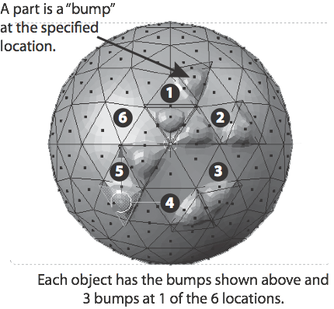
Domain generality?
3-D Rendered Objects
Concepts
(1) Lays eggs.
(2) Moves fast.
(3) Has small claws.
(4) Spends most time on land.
(5) Has scaly skin.
(6) Is a small herbivore.
Austerweil & Griffiths (2011)

Slide 64
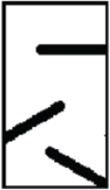



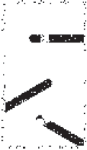
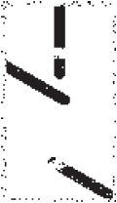
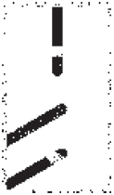

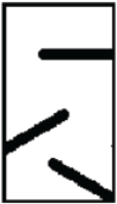



Capturing prior expectations: contiguity
Visual search for objects with correlated parts
(Shiffrin & Lightfoot, 1997).
Features inferred without proximity constraint.
coin flip bias
Features inferred with proximity constraint.
adj. pixels share value
Austerweil & Griffiths (2011)
Notes:
DON”T DESCRIBE VISUAL SEARCH TASK, JUST GIVE RESULTS.

Slide 66
Correlated
IBP Inferred Features
Independent
Austerweil & Griffiths (2011)

Slide 67
IBP Features
PCA Features
ICA Features
Correlated
Parts 1 & 2 are negatively correlated.
Independent
Parts 1 & 2 negatively are correlated.
Parts 4 & 5 negatively are correlated.
What do they predict?
Austerweil & Griffiths (2011)
Parts 1 & 2 negatively are correlated.

Slide 68
control
Results
All models only have one parameter fit to participant results.
no diff.
seen
large diff.
seen
seen
unseen
seen
Ratings
unseen
control
unseen
control
unseen
control
control
Correlated
Independent
Correlated
Independent
Given raw pixel data of images, the IBP infers the same features as people do,
but PCA and ICA do not.
seen
seen
no diff.
large diff.
seen
seen
unseen
unseen
unseen
control
unseen
control
control
control
Correlated
Independent
Correlated
Independent
Austerweil & Griffiths (2011)

Slide 69
Domain generality?
3-D Rendered Objects
Concepts
(1) Lays eggs.
(2) Moves fast.
(3) Has small claws.
(4) Spends most time on land.
(5) Has scaly skin.
(6) Is a small herbivore.
Austerweil & Griffiths (2011)

Slide 70




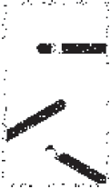
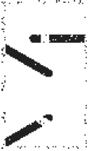
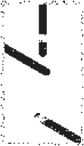
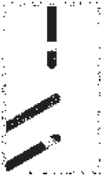




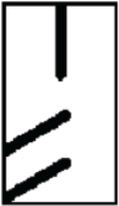

Capturing prior expectations: contiguity
Visual search for objects with correlated parts
(Shiffrin & Lightfoot, 1997).
Features inferred without proximity constraint.
coin flip bias
Features inferred with proximity constraint.
adj. pixels share value
Austerweil & Griffiths (2009; 2011)

Slide 71
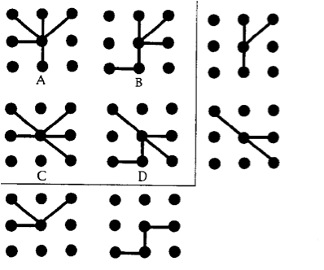


Category diagnosticity
cat 1 = {A, C}
cat 2 = {B, D}
cat 1 = {A, B}
cat 2 = {C, D}
Task: Object categorization with feedback
Result: Participants learn features appropriate to their training condition.
Pevtzow & Goldstone (1994)

Slide 72




Category diagnosticity
cat 1 = {A, C}
cat 2 = {B, D}
cat 1 = {A, B}
cat 2 = {C, D}
Include category label as part of an object’s “sensory inputs.”
... but, only representing an object with its diagnostic feature is not enough!
How else can categorization influence the features inferred by a model?

Slide 73
The Indian buffet franchise
(Austerweil & Griffiths, in rev.)
Shared Chinese restaurant process
...
Features
Features
Obj. 1
Obj. 1
Obj. 2
Obj. 2
Category 1’s Indian buffet process
Category 2’s Indian buffet process
... But should feature images be shared across categories? If so, how?
Assume that the feature images come from a common source:
a Chinese restaurant process (Aldous, 1983).
This method for sharing information across categories is used to model human learning of hierarchical categories (Griffiths et al., 2011).

Slide 74
Category diagnosticity
cat 1 = {A, C}
cat 2 = {B, D}
Category 1
Both
cat 1 = {A, B}
Category 2
Both
cat 2 = {C, D}
Both
Both
Category 1
Category 2

Slide 75


Learning transform invariant features
Previous work focused on inferring features that occur the same way across presentations.
However, features can be transformed across presentations (Palmer, 1983).
Position
Orientation
Size
Reflection

Slide 76
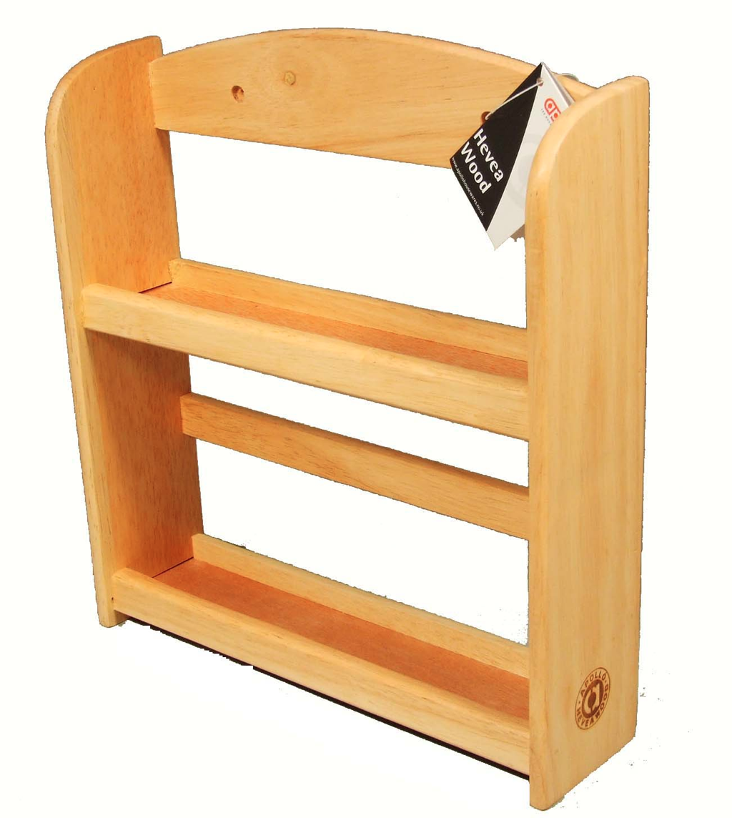


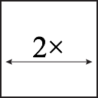


The transformed Indian buffet process
“Buffet” of features
Spice rack
Feature 1
Feature 2
Set of transformations
Austerweil & Griffiths (2010; 2013)

Slide 77
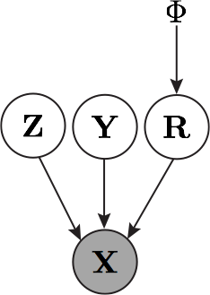
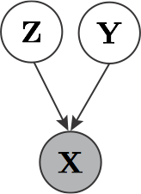
The transformed Indian buffet process
IBP
transformed IBP
Austerweil & Griffiths (2010; 2013)

Slide 78
Learning transformation-invariant features
Features occur differently across presentations.
Are parts separate features or the same feature with different transformations?
Input
[sensory data]
Representations
Output
[behavior]
OR
This is a dax.
Is this a dax?
The mind
Austerweil & Griffiths (2010; 2013)

Slide 79
Experiment Stimuli
Two object sets
Unitized: vertical bars translated together
Separate: vertical bars translated independently
Hypothesis
People infer the representation that encodes the observed objects with the fewest features.
Austerweil & Griffiths (2010; 2013)

Slide 80
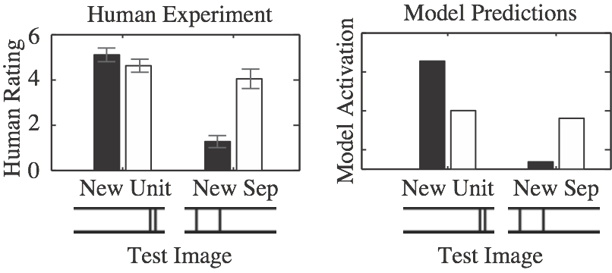
Learning transformation-invariant features
Human Experiment
Model Prediction
6
4
Human Rating
Model Activation
2
0
New Unitized
New Separate
New Unitized
New Separate
Unitized
Separate
Austerweil & Griffiths (2010; 2013)
Notes:
Breathe. Point out model broken part. Mention also learn types of invariance.

Slide 81
Learning feature transformation structure
Should all transformations be included? (More invariance the better?)
5
5
d
d
Hypothesis: people infer which transformations a feature undergoes.
Square or diamond? (Mach, 1914)
Training Set
Test Set
Rotation
or
New Rotation
New
Size
Size
Austerweil & Griffiths (2010)

Slide 82
Learning feature transformation structure
Training Set
Rotation
Size
Human Experiment
Model Prediction
6
4
Human Rating
Model Activation
2
0
New Rotation
New
Size
New Rotation
New
Size
Austerweil & Griffiths (2010)

Slide 83
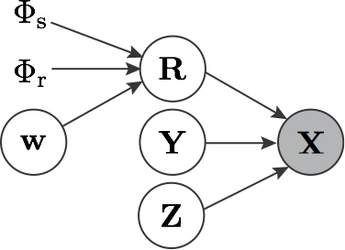
Learning feature transformation structure
Indicates type of transformation for feature .
is a prior on rotation transformations.
is a prior on scaling transformations.
Human Experiment
Model Prediction
6
4
Human Rating
Model Activation
2
0
New Rotation
New
Size
New Rotation
New
Size
Austerweil & Griffiths (2010)

Slide 84
Learning feature transformation structure
Sometimes information is shared between the types of transformations.
Smith (2005) taught children the name of a new object, which either moved horizontally or vertically.
Children generalized to novel objects that were scaled in the same direction that the original object was moved.
Information about translation transformations was shared with scaling transformations!
0.78 | 0.24
0.2 | 0.81
Children generalization probabilities.
Austerweil & Griffiths (in revision)

Slide 85





Learning feature transformation structure
0.78 | 0.24
0.2 | 0.81
0.87 | 0.12
0.12 | 0.87
Children generalization probabilities
Model generalization probabilities
Austerweil & Griffiths (in revision)

Slide 86

Inferring substitutive features
Previous models used additive features to compose objects.
For example...
Cat features:
HAS WHISKERS
MEOWS
HAS SHORT HAIR
HAS TAIL
IS HAIRLESS
MANX ≅ HAS SHORT HAIR & MEOWS & HAS WHISKERS
Is any valid combinations of features a cat?
No—
Cat cannot have HAS SHORT HAIR and IS HAIRLESS.
Notes:
CHECK TIME

Slide 87
Inferring substitutive features
Additive features only have one value
E.g., has tail [yes, no]
Substitutive features take one of multiple values
E.g., cat hair type [long hair, short hair, hairless]
line style [ ____ _ _ _ _ ........]
political party [Republican, Democrat, Independent]
Question: While learning feature sets, how do people infer which whether features additive vs. substitutive?
Garner (1978)
Additive/substitutive features influence processes in higher-level cognition (e.g., category learning; Kemp, 2012).

Slide 88
A model for inferring substitutive features
For simplicity, assume each feature takes one of two values.
F is encode which value each feature has for a given object.
Feature values 1
Gating matrix
(product is elementwise)
Feature values 2
Note: Additive features are a special case where the second feature value is empty.
(Qian & Austerweil, 2015)
Notes:
GO FAST CHECK TIME

Slide 90
One-Dimensional GP
Lets look at a simple* one-d GP:
Well what’s that mean?
Lets say we want the value of f at .
Well we actually have enough info to sample...
From Rasmussen’s 2006 NIPS Tutorial
*simple isn’t even that simple
Notes:
Formally, a collection of random variables where any finite subset are Gaussian distributed

Slide 91

One-Dimensional GP
From Rasmussen’s 2006 NIPS Tutorial
Notes:
Formally, a collection of random variables where any finite subset are Gaussian distributed

Slide 92

Lots of different covariance functions
We already met the Gaussian covariance function.
Another is the Rational Quadratic
Kernel behavior
Sampled functions
From Rasmussen’s 2006 NIPS Tutorial
Notes:
RQ = integrate over l^{-2} with Gamma prior

Slide 93

What about NNs?
A NN with infinite hidden layer is a GP with kernel function.
Sampled functions
From Mackay’s Tutorial
Notes:
RQ = integrate over l^{-2} with Gamma prior

Slide 94
https://chi-feng.github.io/gp-demo/

Slide 95
What does nonparametric mean?
How does it differ from parametric?
Nonparametric models can learn any possible distribution.*
Parametric models are restricted to a family (e.g., Gaussians with different means).
What is “Bayesian” about Bayesian nonparametrics?
Bayesian nonparametric models can learn any possible distribution,
but they are biased towards particular types of distributions.
Are there no parameters in nonparametric Bayesian models?
Nonparametric models have parameters. They just have an infinite number of them!
Are Gibbs samplers a type of nonparametric Bayesian model?
Gibbs sampling is an inference method. It is applied to models.
What is the distinction between models and inference?
Models specify a probability distribution over data and possibly latent factors.
Inference methods sample from (or find the max) the posterior distribution.
*Nonparametric can also mean models whose structure grow with the amount of data.
These two definitions are strongly, but not perfectly correlated.

Slide 98
Latent variable models
z
P(z)
Latent (unobserved)
x
P(x|z)
Marginalize out
(i.e. sum over)
latent structure
Observed

Slide 99

Dirichlet distribution
Multidimensional extension of Beta distribution.
It is a prob dist over k-dim prob dists.
Conjugate to Multinomial (multidimensional version of Binomial)
Discrete = multidimensional version of a coin flip (Bernoulli)

Slide 100

This probability distribution can be generated by the Chinese restaurant process (CRP).
Customers (objects) arrive at a restaurant with an infinite number of infinitely-sized tables (categories).
A customer sits down at an occupied table with probability proportional to the number of occupants.
A customer starts a new table with probability proportional to $α$ .
where is the number of “used” categories.

Slide 101




Internal models in acquisition and extinction
The central argument is that animals build internal models of their environments that describe causal relationships between cues, reinforcers, contexts and latent causes.
Classical conditioning procedures lead to changes in the structure of an animal’s internal model
Slides from Sam Gershman
Notes:
How do we formally specify the computational problem? One approach is to posit that the animal is building an internal model of the world. Classical conditioning procedures then cause the animal to modify its internal model to match the structure of the environment. Most tangibly, conditioned responses may represent predictions about the probability or magnitude of a US occurrence.

Slide 102

What do animals learn about their environment in classical conditioning?
Slides from Sam Gershman
Notes:
The question now is: what kind of internal model are animals building in their brains? I like this cartoon because it illustrates the vast range of internal models an animal could theoretically build.

Slide 103
The challenge
Animals need internal models of the environment that are both flexible enough to capture the richness of its structure while being constrained so as to disallow implausible inferences.
Slides from Sam Gershman

Slide 104

What do animals learn during classical conditioning?
Slides from Sam Gershman
Notes:
The point is that even in a simple classical conditioning experiment, many possible structures can be inferred.

Slide 105

Some possibilities
Bell (a) causes shock (b)
Shock causes bell
Something else (z) causes both bell and shock
a
a
a
z
b
b
b
Slides from Sam Gershman

Slide 106
Some possibilities
Bell (a) causes shock (b)
Shock causes bell
Something else (z) causes both bell and shock
a
a
a
z
b
b
b
Too constrained
Too flexible?
Slides from Sam Gershman

Slide 107



Too flexible?
a
b
...
Slides from Sam Gershman

Slide 108

Conditioning as clustering
Only one latent cause active on a given trial
Potentially infinite number of causes
Simplicity bias:
prefer a small number of causes
Slides from Sam Gershman
Notes:
An internal model specified in this way leads directly to a mechanistic model of learning: the animal is dividing its observations into different groups (clusters) based on their statistics. The mechanism here is precisely Bayes’ rule, which dictates how to take a generative model and invert it to recover the latent causes of one’s observations. Importantly, our model allows the animal to flexibly infer new latent causes when the statistics of its observations change.

Slide 109
The model
Bayes’ rule inverts internal model to recover latent causes:
P(cause|data) ∝ P(data|cause)P(cause)
P(data|cause): the probability that the observed data was generated by a hypothetical latent cause
P(cause): the prior probability of a cause. They use the CRP, a prior that prefers fewer causes but allows infinitely many.
Generative process
Inference
(Bayes’ rule)
Slides from Sam Gershman

Slide 110



Case study: extinction
Acquisition (box A)
Extinction (box B)
Test
Slides from Sam Gershman
Notes:
Now I want to go over an example that is problematic for internal models that assume direct associations between CS and US.

Slide 111




Conditioned responding is renewed!
Acquisition (box A)
Extinction (box B)
The rat hasn’t unlearned its conditioned response; it appears that it has learned something new.
(Bouton & Bolles, 1979)
Slides from Sam Gershman

Slide 112
Acquisition (box A)
Slides from Sam Gershman

Slide 113
Acquisition (box A)
Extinction (box B)
Slides from Sam Gershman

Slide 114
Acquisition (box A)
Extinction (box B)
Test
(box A)
Slides from Sam Gershman

Slide 115
Acquisition (box A)
Extinction (box B)
Test
(box A)
The crucial role of context: disambiguating latent causes
Slides from Sam Gershman

Slide 116

Modeling renewal
(Bouton & Bolles, 1979; Gershman, Blei & Niv, 2010)
Slides from Sam Gershman
Notes:
We implemented an algorithm that implements Bayes’ rule, and whose outputs are predictions about the probability of US occurrence. We took this probabiliistic prediction as a proxy for the conditonal response.

Slide 117

Clustering in the brain
Our model’s explanation of renewal relies on the animal’s ability to flexibly infer new latent causes.
Evidence suggests that the hippocampal formation supports this ability.
Slides from Sam Gershman

Slide 118

Pre-training lesions of hippocampus abolish renewal
control
hippocampal
lesion
This can be explained by handicapping the model’s ability to infer new clusters
(Ji & Maren, 2005)
Slides from Sam Gershman

Slide 119
Pre-training lesions of hippocampus abolish renewal
control
hippocampal
lesion
control
hippocampal
lesion
This can be explained by handicapping the model’s ability to infer new clusters
(Ji & Maren, 2005; Gershman, Blei & Niv, 2010)
Slides from Sam Gershman

Slide 120
Beyond renewal…
Several other important behavioral and lesion findings can be explained by the model:
Context-specificity of latent inhibition (impaired by hippocampal lesions)
Development of renewal and latent inhibition: preweanling rats don’t infer new clusters
Slides from Sam Gershman

Slide 121

Latent Inhibition
Acquisition
Pre-exposure (box A)
Same
This is like extinction training, but with the extinction phase before the acquisition phase
Different
Slides from Sam Gershman

Slide 122

Modeling latent inhibition
(the two lines overlap completely here)
(Honey & Good, 1993; Gershman, Blei & Niv, 2010)
Slides from Sam Gershman
Notes:
Our model explains this finding by assuming that the animal infers that the pre-exposure and training phases in the “same” condition were generated by the same latent cause, and hence it will take more experience to override the no-US prediction learned in the pre-exposure phase. In contrast, in the “different” condition, the two phases are inferred to be generated by different latent causes, and hence the learning during the training phase is “protected” from the predictions learned in the pre-exposure phase.

Slide 123
Modeling latent inhibition
(the two lines overlap completely here)
(Honey & Good, 1993; Gershman, Blei & Niv, 2010)
Notes:
Again, this relies on the animal’s ability to flexibly infer new clusters, so it predicts a role for the hippocampus.

Slide 124

Development of renewal
Training (in A) at 16 /
Extinction (in B) at 22 /
Test (in A or B) at 23
Renewal only occurs if extinction is performed after the preweanling period (~20 days postnatal).
For preweanling rats, extinction = unlearning?
(Yap & Richardson, 2007)
Slides from Sam Gershman
Notes:
ABA vs. ABB
Only see renewal if extinction phase is performed when the animal can infer new clusters (~21)

Slide 125
Modeling development of renewal
Training (in A) at 16 /
Extinction (in B) at 22 /
Test (in A or B) at 23
(Yap & Richardson, 2007; Gershman, Blei & Niv, 2010)
Slides from Sam Gershman
Notes:
ABA vs. ABB
Only see renewal if extinction phase is performed when the animal can infer new clusters (~21)

Slide 126

Modeling development of latent inhibition
Pre-exposure at 25 /
Acqisition at 25 /
Test at 25
(Yap & Richardson, 2005; Gershman, Blei & Niv, 2010)
Slides from Sam Gershman
Notes:
Only see context-dependent LI when acquisition is performed when the animal can infer new clusters

Slide 127
Conclusions
The computational problem faced by animals in classical conditioning is framed as inference over possible causal structures
Context plays a crucial role by disambiguating latent causes
The hippocampus supports the ability to infer the existence of new causes
Slides from Sam Gershman
Notes:
To summarize: I have argued that animals build an internal model of the world and use this model to make predictions about reinforcement, among other things. This has a mechanistic counterpart: using Bayes’ rule to infer the latent causal structure of the world from observational data. One such source of data is context, which strongly constrains the animal’s inferences. Finally, an internal model would be unrealistically brittle if it couldn’t infer new latent causes when the need arises; this played a crucial role in explaining most of these results, and I’ve suggested that the hippocampus supports the ability to infer new latent causes.
Needless to say, this model is incomplete and overly simplistic. However, my hope is that a normative approach will prove fruitful for developing, refining and testing experimentally these findings, which nicely complement the purely mechanistic models that have been dominant in animal learning theory.

