Slide 1
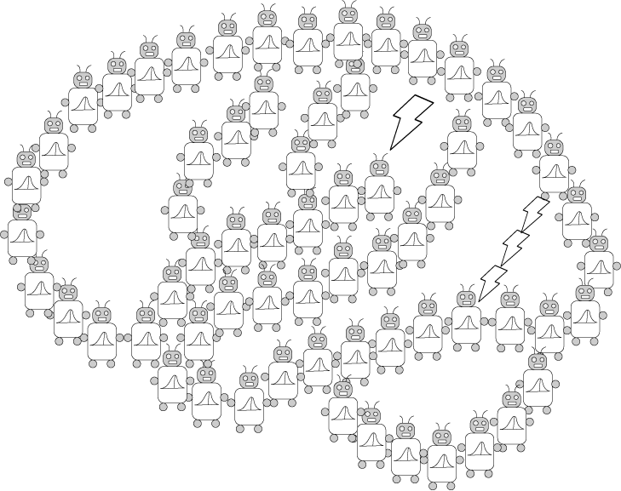
Introduction to Neural Networks
PSYCH/COMP SCI/BMI 841: Computational Cognitive Science
Joseph Austerweil
April 17, 2025
Notes:
Hi class,
Today’s our first of two classes discussing artificial neural network models.

Slide 2
Admin Matters
Connectionism and neural network basics
Linear neural networks
Nonlinearity and Backpropagation
Convolutional and Recurrent neural networks
Short rest 1
Three student presentations:
Lake et al 2015 by Ruijia
Linzen et al by Elijah
Short rest 2
3. Schulz Buschoff et al by Khailanii
Notes:
For today’s class, after admin matters, we’ll cover the basic philosophical principles around the connectionist approach to the mind and the basic definition of artificial neural network models. Then we’ll discuss the linear variant of neural networks – how they work, learning, and their limitations. Then we’ll take a non-linear turn to them and discuss how to train multilayer artificial neural network models with backpropagation. Then we’ll discuss two special case architectures for artificial neural networks that have played a large role in vision and language applications: convolutional and recurrent neural networks, respectively.
Remember ruijia needs to start their presentation at 130pm. Short rest 1 might come after that depending on timing.
Have 3 student presentations today.

Slide 3
Administrative Matters
Assignment 3 was due April 9 at 8:59pm
Assignment 4 is due April 23 at 8:59pm
One more discussion post left
Only need to pass 5 through class for full credit
Any unused quiz points will be free points to your final grade.
Final project presentations May 1
Your project does NOT need to be complete by then
Final project papers due May 6 at 8:59pm
Questions?
Notes:
My health is continuing to improve, but it’s slow.
Grading assignment 3 has started. It will take a bit as it is a bit more intensive than the other assignments. I’ll post solutions as always. If you struggled to complete it correctly, it would be good for you to look it over.
Assignment 4 is due next week
There is only one more discussion posts left!
As mentioned earlier, any unused quiz points will end up being free points to your final grade.
After today’s class, we have one more lecture and discussion. Then the last class will be student final project presentations. Please note that your final project does not need to be complete by then. The goal is for everyone to share what they are working on and what they’ve found so far.
A reminder that your final project papers will be due on May 6 at 8:59pm

Slide 4
Admin Matters
Connectionism and neural network basics
Linear neural networks
Nonlinearity and Backpropagation
Convolutional and Recurrent neural networks
Short rest 1
Three student presentations:
Lake et al 2015 by Ruijia
Linzen et al by Elijah
Short rest 2
3. Schulz Buschoff et al by Khailanii

Slide 5


honeycomb
termite mound
Notes:
So far in class, we’ve taken the perspective of understanding complex systems, such as aspects of the human mind, by reverse engineering them as the optimal solution to different statistical learning problems. That requires us to look at the result and what sort of problem it could be considered solving. But, it does not feel like this is the correct viewpoint for understanding some systems. For example, take a honeycomb. One might try and explain the form of a honeycomb from the perspective of optimal packing or some other sort of geometric solution. However, it might be more fruitful to understand it instead as the consequence of many individual actors completing a simple task. In the case of the honeycomb, it turns out if you think of bees being arranged uniformly in 3d space expanding tiny bubbles that expand as far as they can until they hit another bubble. When those spheres intersect with one another you end up getting the hexagonal honeycomb structure.
Another example is a termite mound. If you haven’t read about termite mound communities before, I recommend taking a long dive into their Wikipedia page when you have some time to waste. They have been found to be as large as 17 feet. 33 lbs. The nest is underneath. They develop ventilation which includes not just controlling air movement but also moisture control. They cultivate “fungal gardens” and end up with wood storage facilities. Just absolutely fascinating and incredible collective behavior. If you puncture one, soldiers spill out and workers fill the hole. All of this happens without any central executive organizing everything. It’s the collective behavior of lots of individual “dumb” agents.

Slide 6
Connectionism (Parallel Distributed Processing)
Think about cognitive processes as the result of computations performed by a large number of interconnected simple units.
Activation of each unit depends on the activation of units with links to that unit.
Inspired by the way that neurons work.
- leads to models called “artificial neural networks.”
Notes:
It’s examples like the structure of honeycombs and termite mounds that lead researchers in cognitive science to use complex systems of simple interacting units to try to understand the mind. Due to their explanations relying on the large amounts of simple interacting units, these approaches gained the names such as connectionism and parallel distributed processing. It’s inspired by how people imagine neurons might work. Brains seem to be filled with lots of neurons. Each neuron having a lot of neurons connecting into it and it connecting to many other neurons. Although there’s debate about precisely what is being computed by a neuron based on its input and how it transmits that computation, given how many of them the brain has, researchers tend to assume they must each be doing something relatively simple.

Slide 7
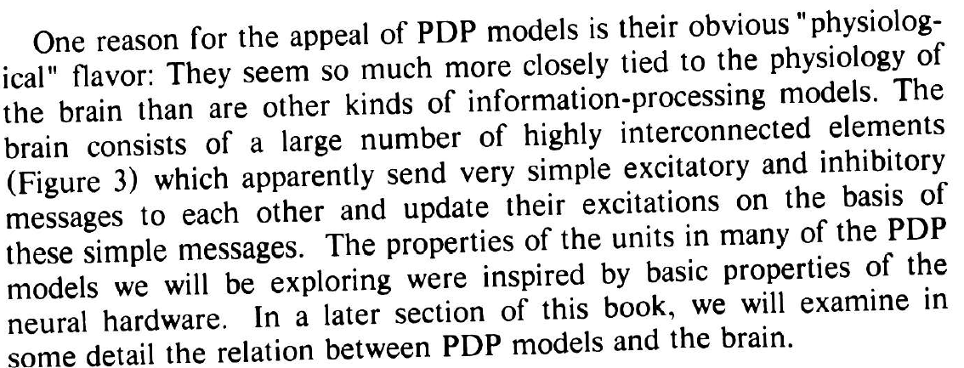
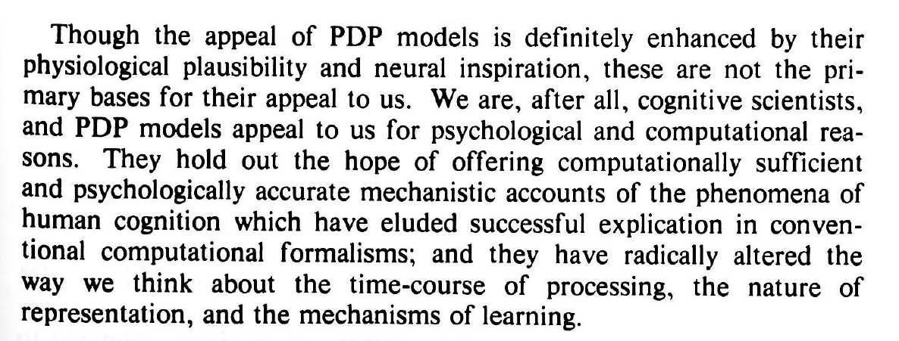
A caution on biological connections
(McClelland, Rumelhart, & Hinton, 1986)
Notes:
Read quote from McClelland Rumelhart and Hinton

Slide 8
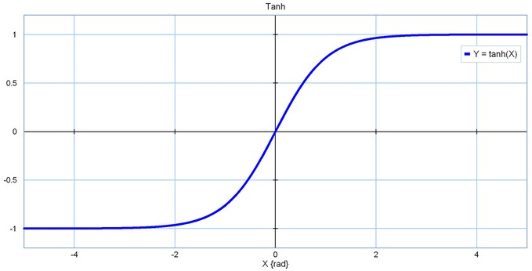
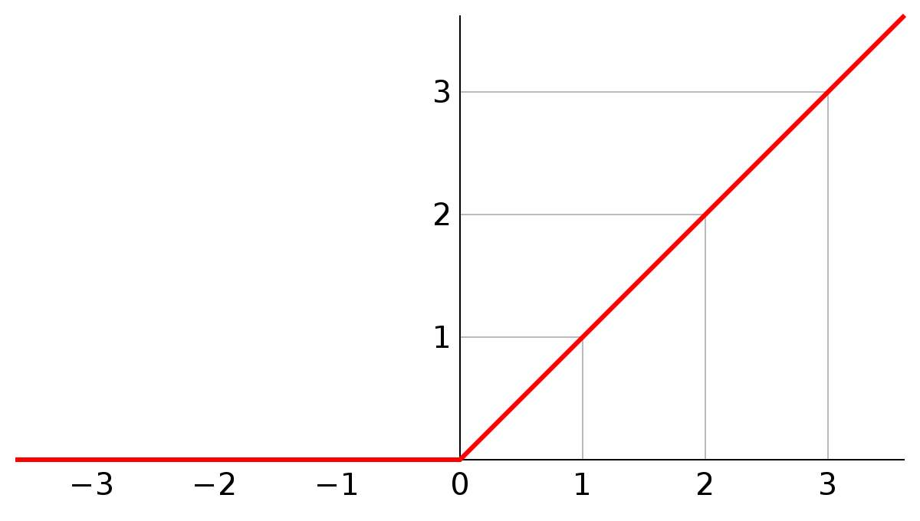
Artificial neural networks
tanh(x)
activation of node i
activation function
node i
a_{i}
w_{ij}
sum over j
a_{j}
weight of link from i to j
node j
Rectified linear: g(x) = max(0,x)
Notes:
The fundamental definition of an artificial neural network having two or more layers of nodes of variables that are linked together through weights. For example, we might have a node j in one layer that feeds into node i in a later layer. There are typically a lot of other nodes in each layer. I’ll denote each of the nodes in the same layer as j with a line, but am not drawing the nodes for simplicity. They each have their own weight. a_j contributes to a_i’s value as the combination of two factors. There is the activation node j has, which might come directly from inputs or from other nodes in an earlier layer. One can think of that activation spreading to a_i modulated by the weight of the link between the two nodes. That is encoded by the value of the weight w_{ij}. Now there are a bunch of these nodes feeding into a_i all with their own activation values and weights. The sum of those activations each modulated by the weight of the edge is the input to node i.
Node i’s activation then is determined a function g of this input. This is called the activation function. g could be the identity function. We’ll explore this choice, but as we’ll see there are issues with using this if we want the artificial neural network to be able to encode a complex set of functions when the weights are varied. If we make g a non-linear function, the class of functions that can be captured by even a 2-layer neural network becomes quite rich. One class of functions that was used a lot in the 1980s were sigmoidal and hyperbolic tangent functions. These were used mostly due to their mathematical properties – when they are differentiated they have nice mathematical properties that allowed folks to derive some of the first learning rules for the weights and also prove about the computational complexity of functions they could emulate and statistical consistency.
Modern artificial neural networks started using the rectified linear function as it tended to be more efficient than using a sigmoidal function lookup, and yield better results such as resulting in more robust learning. There are many variants that are still being examined. For example, one function that’s gained in popularity over the last 5 years is the “swish” function. It’s simply x times the sigmoidal activation function.
Lots of variants on everything. It’s an active area of research – probably the most successful right now is a generalization of rectified linear called

Slide 9
A very simple neural network
y₂
y₁
y₂
y₁
weights
x₂
x₁
x₂
x₁
Notes:
If we have 2 nodes for an input and 2 nodes for the output, we can represent them graphically in a straightforward way. The x_1 and x_2 of the input layer are essentially the x and y coordinates. The neural network then uses its weights and activation function to transform the first layer into two new values, y_1 and y_2. it does so by having y_1 be the sum of x_1 * weight of x_1 to y_1 and x_2 * weight of x_2 to y_1 and then similarly for y_2 except with different weights. Each could go through an activation function before arriving at its final value, but it doesn’t have to do that – we’ll for now just think of the activation function as being the identity function. So that way we get a y_1 and y_2 value for that x_1 and x_2 that we had inputted. So we can our original data point mapped to a new point with its own values for y_1 and y_2 which is determined by the weights of the neural network.

Slide 10
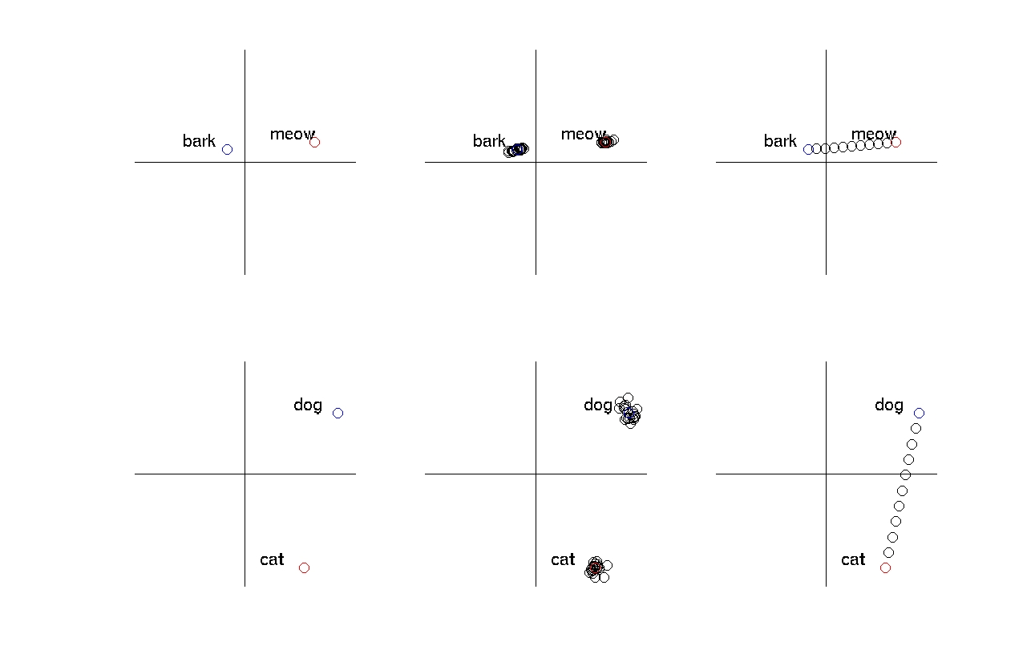
Distributed representations
timbre
Behavioral
pitch
noise
tolerance
representation
interpolation
Snout-size
Perceptual
Body size
Notes:
Now lets try an example. Let’s say we have a neural network for storing the behavioral properties of animals. Here we assume our inputs are perceptual properties. So maybe the body-size and snout-size of an animal. We can map cats and dogs onto this space. Cats are a bit smaller than dogs, but overall have much smaller snouts. But dogs and cats make different sounds. We might have a representation of sounds different animals make that differ in pitch and timbre. Although the timbre of barks and meows differ some, the biggest difference between them is the pitch. With appropriately selected weights, we could map the snout and body-sizes near cat to meow and the snout- and body-sizes near dog to bark. In many ways, this is the sense of representation that occurs in artificial neural networks. The pattern of how node and weight activations interact resulting in a linking between some informative property in the input of the neural network, such as a cat, and an informative property to be encoded or represented, such as the properties of the sound it makes.
Perceptual: x = size, y = snout length
Behavioral axes: x = pitch, y = animal-like

Slide 11
Distributed representations
timbre
Behavioral
pitch
noise
tolerance
representation
interpolation
Snout-size
Perceptual
Body size
Notes:
Some benefits to encoding properties this way is you get a certain amount of noise tolerance for free. Things that are cat-like will get associated with points near cat and still get mapped to points near meow. Things that are dog-like will get associated with points near dog and still get mapped to points near bark. This contrasts with a pure symbolic perspective where you may have some fragility that something is either a cat or a dog and the ability to handle noise may not come so easily.
You also can explore interpolations between cats and dogs and explore the expected sounds they might make. As the weights can apply to any point, you typically get some sensible interpolation between cat and dog sounds, assuming such a thing makes sense.

Slide 12
Different representations
dog
dog
Snout-size
cat
body
length
cat
Distributed
One pattern of activation per concept
Interpretable as points in space
Localist
One node per concept
Notes:
One important distinction within connectionist models is the type of representation for a layer. So far we’ve been discussing distributed representations. The activation of a node in a layer by itself isn’t really interpretable. It’s the pattern of activation that’s interpretable. In connectionist circles this is the most pure form of connectionist representation.
But folks also sometimes use a localist representation in that case we might have the first node being active stand for dog and the second node stand for cat. This is essentially the same as typical feature representations.

Slide 13
Admin Matters
Connectionism and neural network basics
Linear neural networks
Nonlinearity and Backpropagation
Convolutional and Recurrent neural networks
Short rest 1
Three student presentations:
Lake et al 2015 by Ruijia
Linzen et al by Elijah
Short rest 2
3. Schulz Buschoff et al by Khailanii

Slide 14
Perceptrons
The simplest kind of “feed forward” neural network
Originally introduced by Frank Rosenblatt (1958)
+1 = cat, -1 = dog
y
x₁
x₂
perceptual features
Notes:
We’re going to dig more into the details of neural networks by starting with one of the first ones ever invented: The perceptron. In this neural network, we assume we get a set of labelled data. A bunch of images and which category they belong to. We assume it’s just a binary distinction, so lets say a bunch of images of cats and dogs with labels for each image as to whether it is a cat or dog in the image. It was first invented by Rosenblatt at Cornell who made it as a physical device. I believe he originally did it for pixelated images of digits. With the weights set and with an image, it would spit out a prediction as to whether it was cat or a dog. Further, he created a learning rule for figuring out the weights given a data set of labelled data.

Slide 15

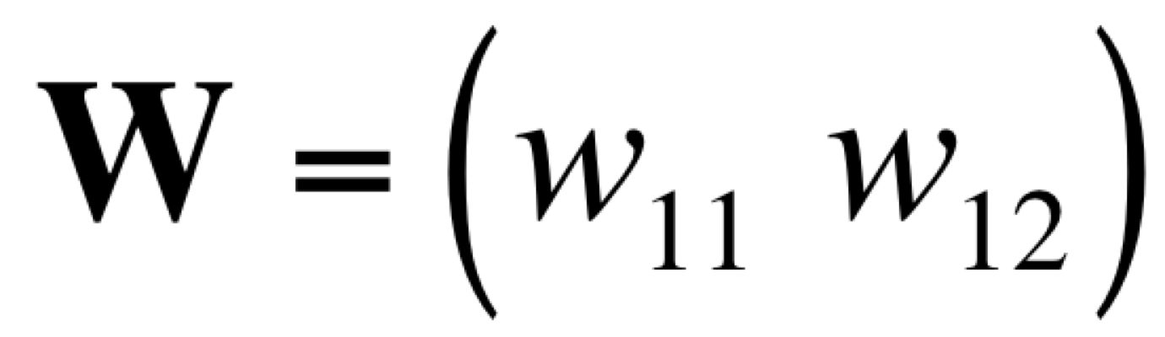
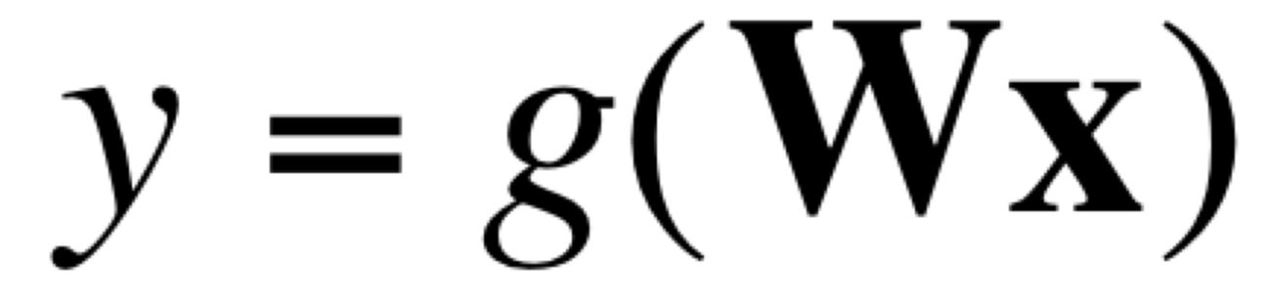
A linear classifier
With just one output
g(Wx) will be constant for x orthogonal to w
+1 = cat, -1 = dog
y
dog
cat
y
Min Distance to classifying line
x₂
x₁
x₂
x₁
perceptual features
Notes:
This type of model is called a linear classifier because you have in general, weight matrix (in this case just a vector for the weight of x1 to y and x2 to y) is multiplying the x. Our activation function will just be the identity matrix. So it’s matrix multiplication. g in this case converts the output of the matrix algebra, which is a scalar number to either negative one or positive one to denote dog or cat. That’s often just done by taking the sign of the output.
Essentially, each image becomes a point in the 2-d space. We can end up interpreting the weight matrix as a line in this space. Since it’s 2 values, it literally is a line here, but this interpretation still works with more dimensions. Those of you with some linear algebra background should follow that. If you aren’t familiar and are interested, happy to help you with learning that offline. Then taking the sign means one side of the line gets classified as a cat and the other side as a dog.
A related perspective on the problem is that multiplying our input by our weight matrix is giving us the scalar y output. We can map the points onto that and depending on which side of the origin the point gets mapped to, we end up having the image be classified as a cat or a dog.

Slide 16
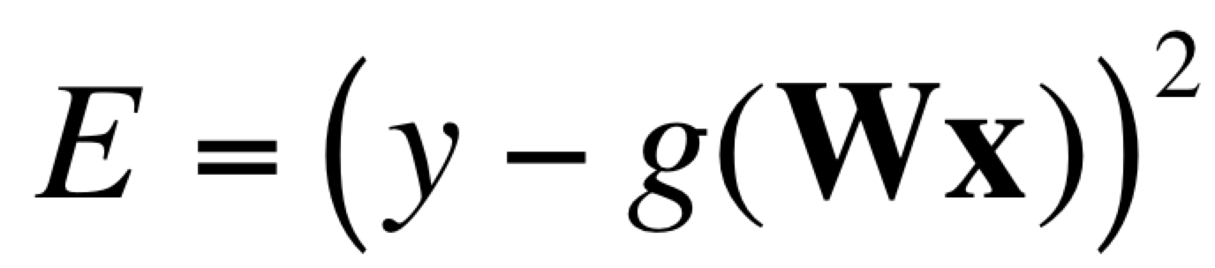
Error-driven learning
Define a measure of error in output, and find weights that minimize error
+1 = cat, -1 = dog
error:
y
dog
cat
y
Min Distance to classifying line
x₂
x₁
x₂
x₁
perceptual features
Notes:
So far, we assumed we have the correct weights, but what if wanted to learn or estimate them?
If we have a data set and an error function defined – let’s say squared error, we could look at how to change our weights to minimize the error from the classifier on the given data set.

Slide 17
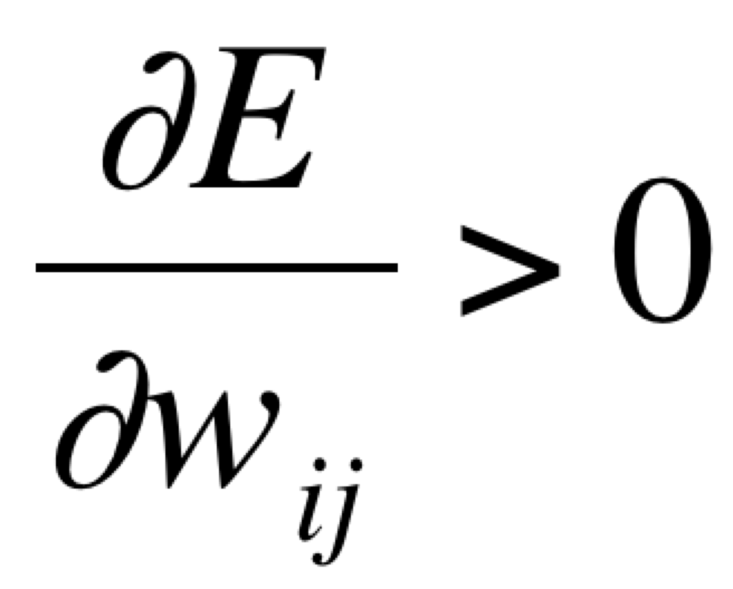
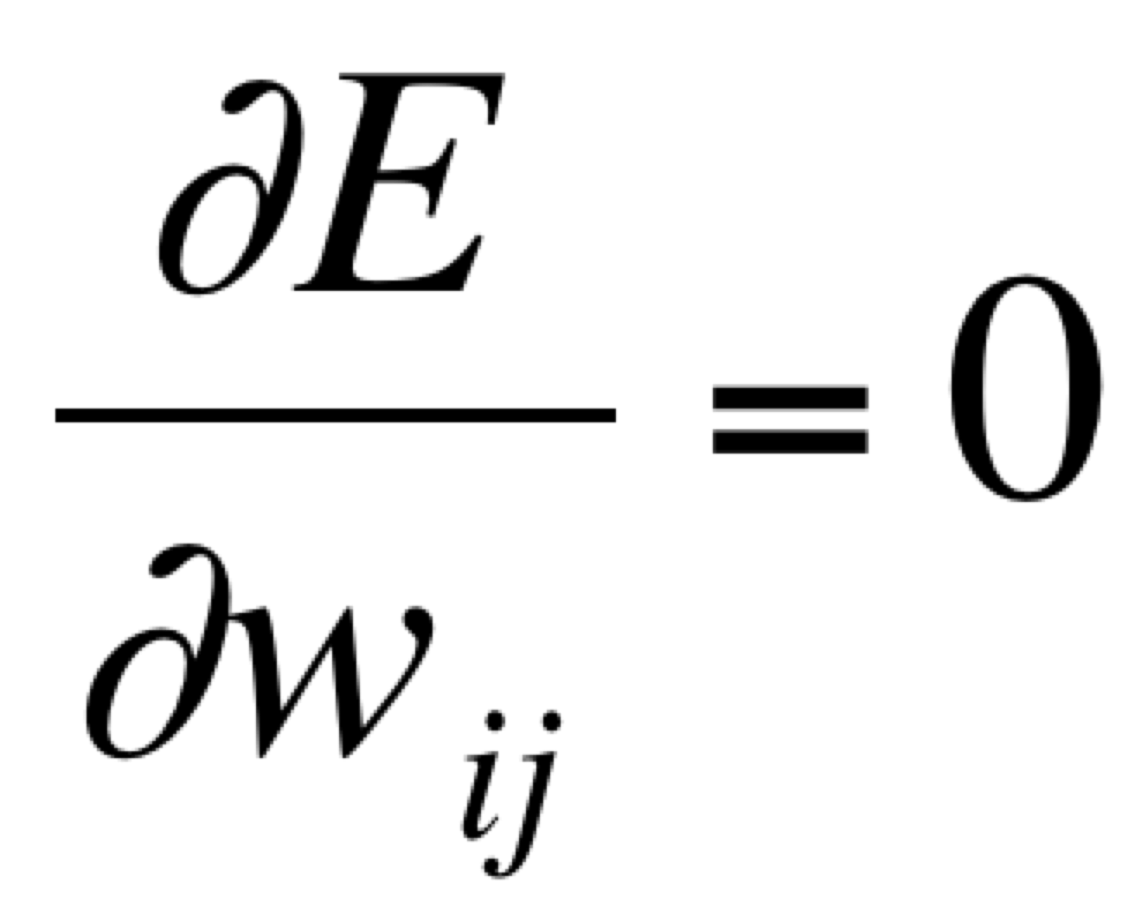
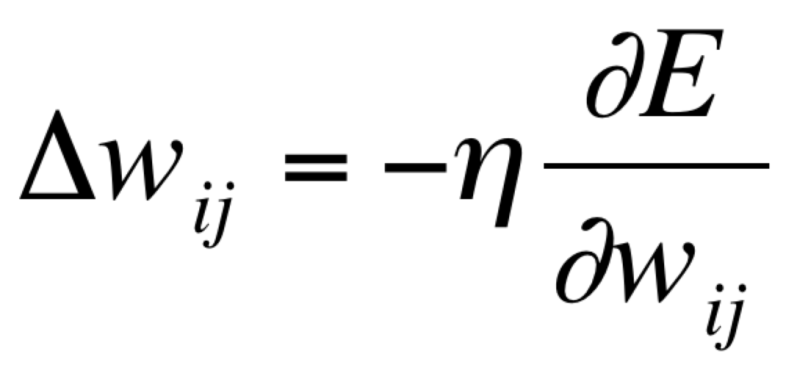
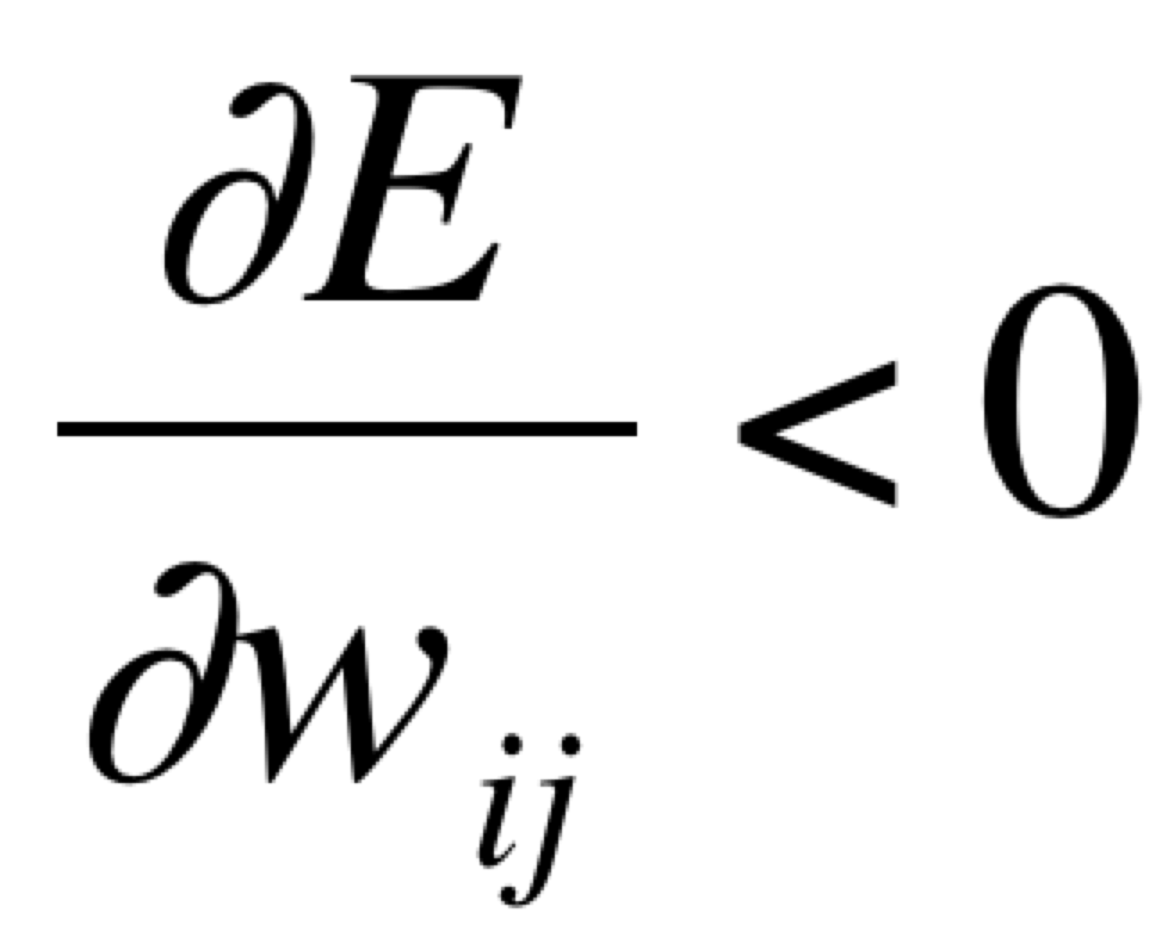
Gradient descent
E (error)
(η is learning rate)
w_{ij}
A straightforward algorithm for finding a minimum:
move in a direction where E decreases
stop if no such direction exists
Notes:
A straightforward way to try and set weights is to change them in a way that ends up decreasing your error. This is what gradient descent techniques do – they follow the gradient or slope of the error function and keep moving in directions that decrease it until you can’t decrease the error any further. The derivative of the error function with respect to the weight we’re interested in learning will be less than zero if moving the weight in that direction will lower the error, greater than zero if it will increase the error. The derivative hits zero when we can’t decrease the error any further no matter what direction we move. We can stop running our algorithm at that point. This is how gradient descent learning works. It selects weights by descending on the gradient or slope of the error function.
In practice, we end up changing our weights to decrease the error function. Just like with Q-learning, we have a learning rate so that changes to the weights don’t happen too quickly.

Slide 18
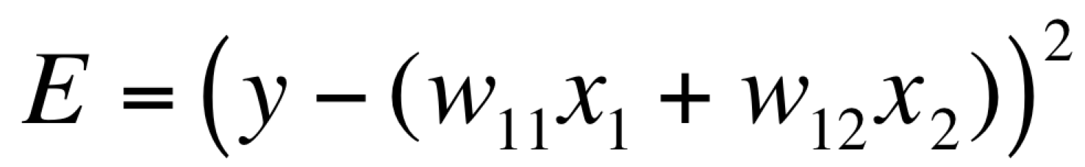
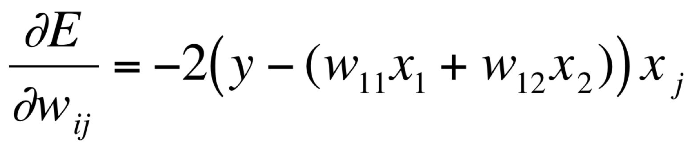
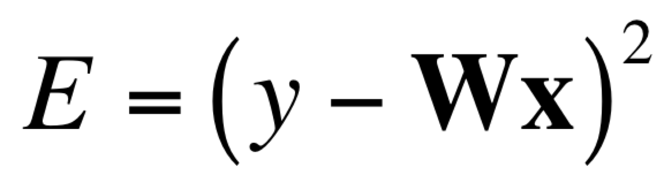
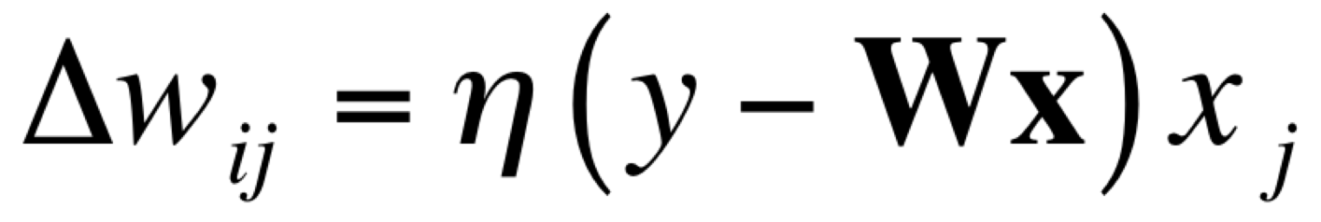
With a linear output…
+1 = cat, -1 = dog
y
x₁
x₂
perceptual features
output
error
influence
of input
Notes:
Using a linear output, we can derive the weight change rule in a straightforward manner. So, we start with the error function. As we’re linear and taking the sign, we’ll replace g with the identity, which means we can just drop it. Then we can expand our matrix multiplication for our case here so that it’s simpler to see.
To take the derivative of that error with respect to w_{ij}, we use the chain rule. Since it is with respect to w_{ij}, we first get -2 times the function and then derivative of that function with respect tto w_{ij}. i in this case is just 1, and then everything unrelated to w_{1j} is going to have derivative zero. The only thing related to it will be the x_{j} corresponding to w_{ij}.
Putting it together, we get that we should change our weight j then to minimize the output error, the difference between the y we observed in our data set and the predicted y modulated by how much influence the j-th dimension of the data point had for the prediction or x_j.

Slide 19
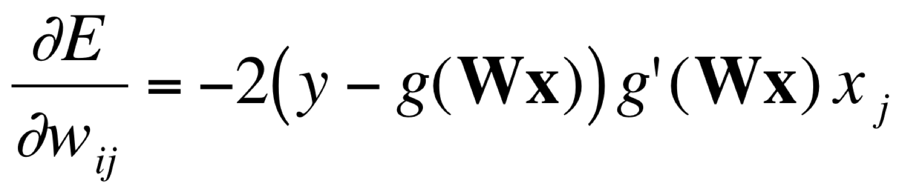
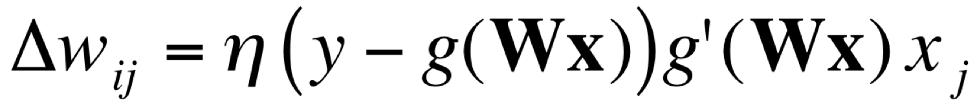
The Delta Rule
+1 = cat, -1 = dog
y
for any function g with derivative g′
x₁
x₂
perceptual features
output
error
influence
of input
Notes:
Now if we wanted to do this for any arbitrary g, we use the chain rule and leave things explicit. That way we can plug in the derivative for whatever nonlinear function we decided to use as our activation function. That gives us a similar answer, but now we have the activation function and its derivative as part of the weight update rule. We still update according to the output error and modulate it based on the influence of the j-th dimension of our input. But now we also need to include a term to correct for how quickly things change in our activation function. So our input influence is now weighted also by the derivative of the space in that region.

Slide 20
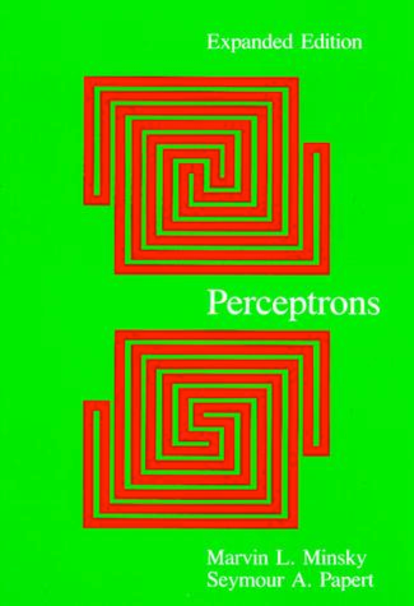

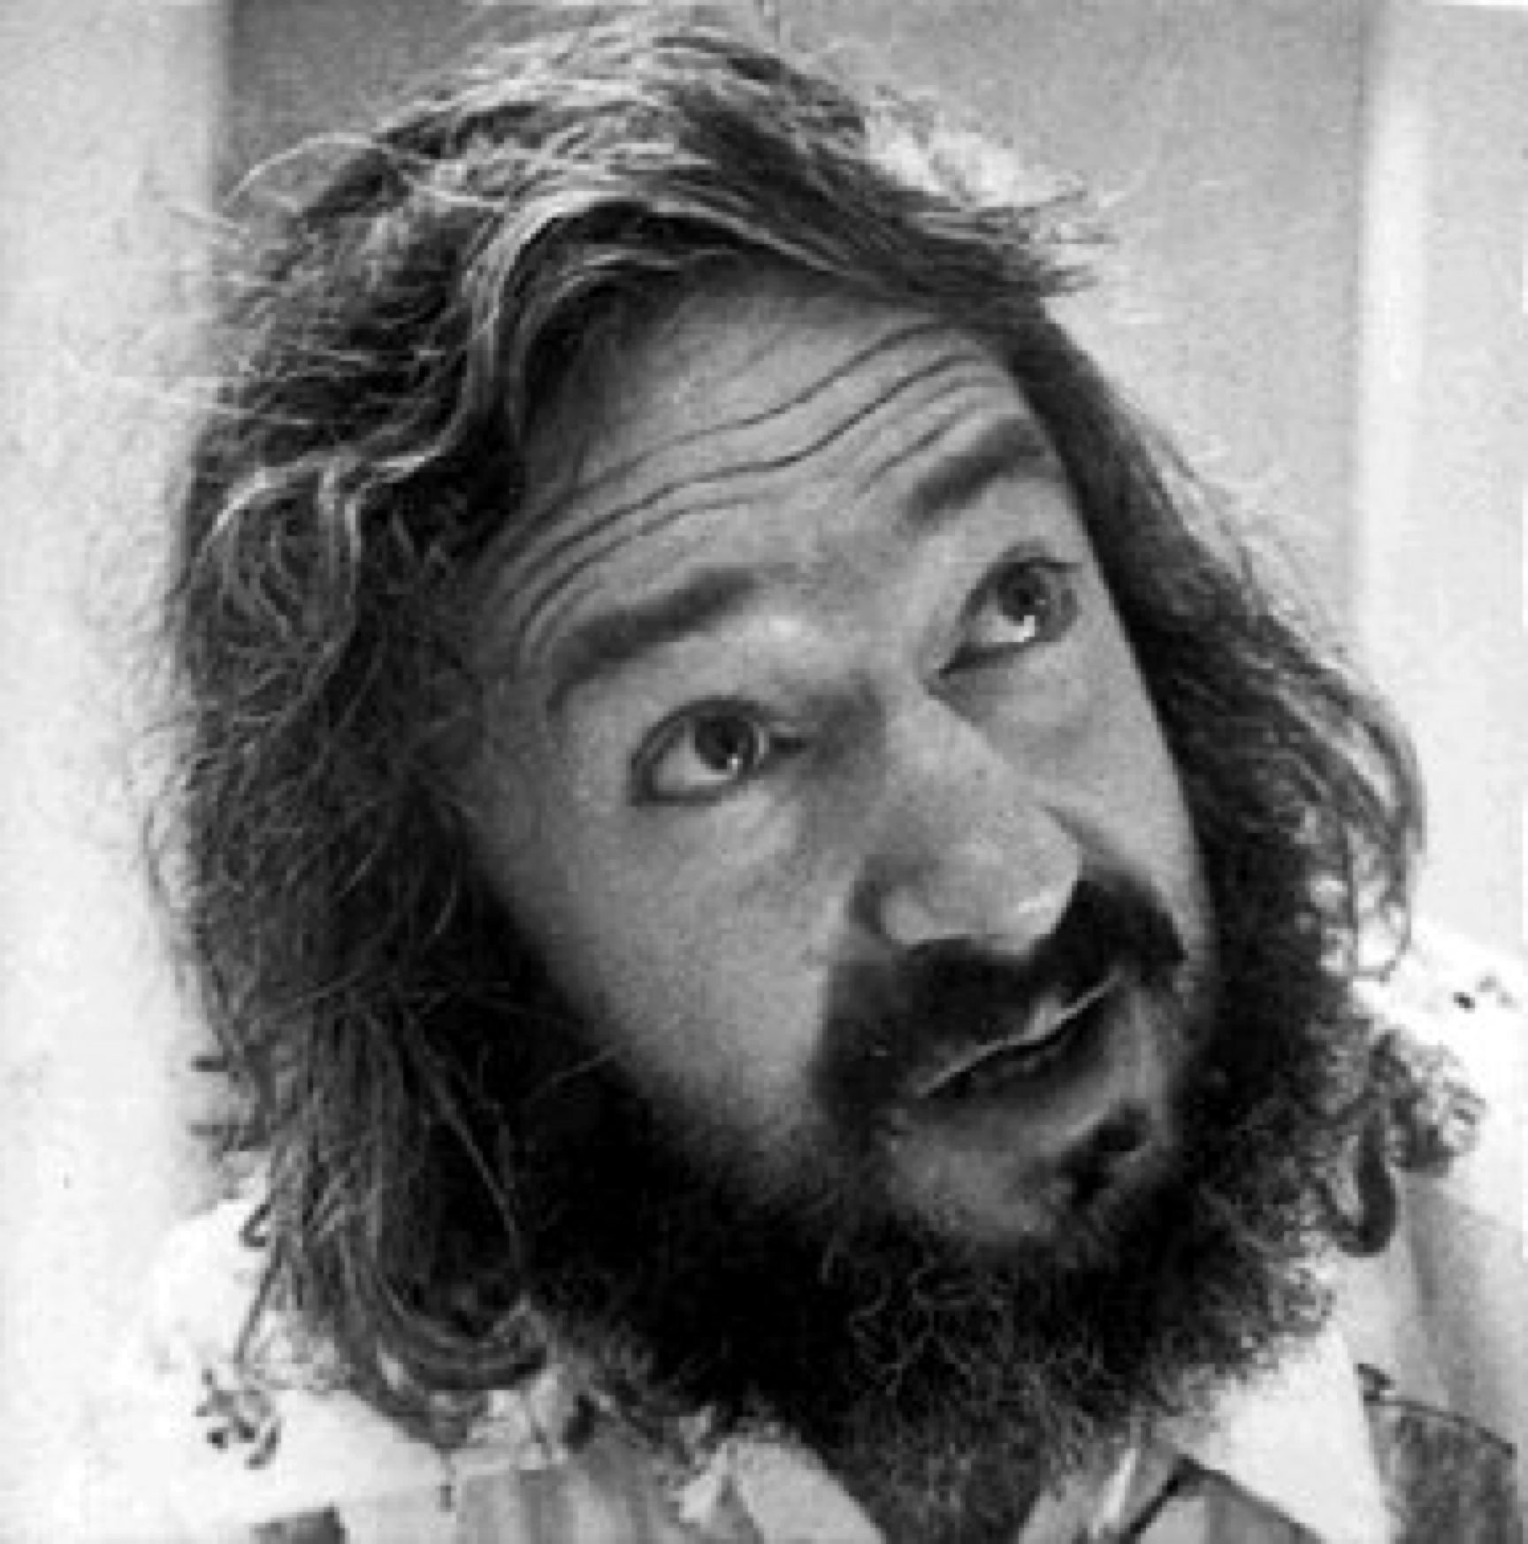
Problems with simple networks
Marvin Minsky
Seymour Papert
(1969)
Notes:
Although there was a good deal of interest with learning in these simple neural networks, researchers typically used linear ones only at the time. Two very influential AI researchers, Marvin Minsky – one of the founders of AI and Seymour Papert, analyzed the properties of these linear neural networks and argued quite convincingly that the linear ones couldn’t do some very basic things we would want them to do.

Slide 21
Problems with simple networks
y
x₂
x₁
x₁
x₂
Some kinds of data are not linearly separable
AND
OR
XOR
x₂
x₂
x₂
x₁
x₁
x₁
Notes:
Linear neural networks have a limitation – they are linear. That means that they can’t capture functions that are nonlinear. That means they can capture some logic functions. For example, if we want to capture AND, we can set a line as follows so everything below the line is negative or false and everything above the line is positive or true. OR can be captured by shifting down and to the left. Then we can get positive for having just x_1 on or x_2 without needing both of them to be on. But let’s say we want to do something like exclusive OR or XOR. Then we want to have a function such that it is only true when one, but not both, of the inputs are on. In that case there’s no line you can form and thus, you can’t compute functions like XOR with a linear neural network. Minsky and Papert argued that important cognitive abilities, such as telling if a shape is connected or not, rely on using functions like XOR.

Slide 22
Problems with linear networks
Does adding layers help?
Notes:
Another thing one might think about doing is say, ok let’s add another layer. So instead of having our output y be directly from the input applied to a single weight matrix w, let’s have it go through a hidden layer h that then feeds into our output. What does that end up looking like in total? Well our function is this second function applied to the first function’s output when applied to x. If we work through it, h is the output from the first layer of processing. The result of this is formed by multiplying the matrix W to x. Then we multiply h to a second weight vector w ( I’m just using w as a vector rather than a matrix because we’ve been using a single dimensional output – it’d be a matrix otherwise and a different one from the large W)
At any rate, that means our function is the multiplication of x with the weight matrix and that multiplied with the second layer’s weight vector. But we can re-represent that as a simple vector multiplication of x with a w’ vector, where w’ is the result of applying W matrix with w.
What does this all mean? Well, adding another layer didn’t do anything useful. We could have just used a vector of weights to capture its effect and so in the case of linear neural networks, adding more layers does not make our network any more expressible than what we can express with a single linear layer.

Slide 23
A solution: multiple layers + nonlinearity
output layer
y
y
h₂
Linear!
hidden layer
h₁
h₁
h₂
x₂
Non-linear!
input layer
x₁
x₂
x₁
Notes:
But, if we add a layer AND a non-linearity for the activation at the hidden layer, then we can deal with XOR. Here’s what the basic process looks like. We map the original space into a new space with a nonlinearity that allows us to put the points that need to be classified together closer together. Once that has been done, we can now draw a line that discriminates between the positive and negative values. And bam, we can put the positive on one side of the boundary and the negative on the other.

Slide 24
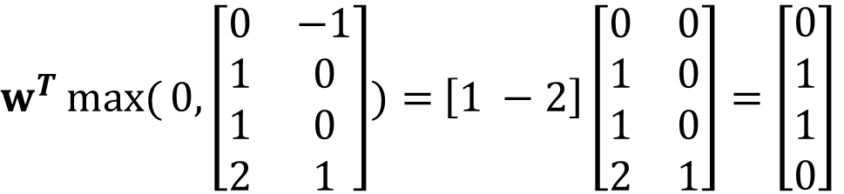
A solution: multiple layers
y
h₂
h₁
x₂
$w^{T}\max{(}0,\left[\begin{matrix}0 & −1 \\ 1 & 0 \\ 1 & 0 \\ 2 & 1\end{matrix}\right])=$ $\left[1 −2\right]\left[\begin{matrix}0 & 0 \\ 1 & 0 \\ 1 & 0 \\ 2 & 1\end{matrix}\right]=\left[\begin{matrix}0 \\ 1 \\ 1 \\ 0\end{matrix}\right]$
x₁
Notes:
What does this look like in practice? Well to do that, we need to select a non-linearity for the hidden layer. Let’s use the rectified linear one. You can see the output of the hidden layer after the activation function has been applied then being run through a linear layer before we get the output.
One solution for this is to have a weight matrix W that basically adds the x values together and have that for both dimensions. The first dimension you leave as it is. The second one you subtract by one. That second dimension being non zero when either both inputs are false or true allows one to ultimately compute XOR once things pass through the nonlinearity. Here’s how that works.
So we can write out all the Xs we could have. I apologize I shifted to zero being false rather than -1 in this example. We have false false, false true, true false, and true true. When we multiply that with our weight matrix, we get the sum of the Xs twice, so that gives us 0,0; 1, 1; 1, 1; and 2, 2. Then we add our bias term to each of the Xs. That gives us an output of 0 -1; 1 0; 1 0; and 2 1;. Now we need to put that through the rectified linear function nonlinearity and then we can multiply that with our second layer’s weights. The second layer’s weights are 1 and -2. The output from the nonlinearity just changes the one -1 that’s there to a zero. Now when we do the matrix multiplication for the final layer in a linear way, we get zero for the first. The second and third give is 1 and then the last one gives us 0 again (1 times 2 is 2 and -2 times 1 is -2 and together they make zero again).
And voila! We can easily capture XOR using artificial neural networks once we have a nonlinearity -- even something as simple as a max with zero.

Slide 25
y
How do we learn the weights for a perceptron with multiple layers?
z₁
z₂
x₁
x₂
Notes:
Although we discusse dhow to learn weights even for non-linear neural networks, we didn’t discuss how to do that for neural networks with more than one layer.

Slide 26

David Rumelhart
Explored mathematical models of cognition
One of the discoverers of backpropagation
widely used in cognitive and computer science
Inspiration for the annual Rumelhart Prize
Notes:
David Rumelhart was one of the most influential computational modelers in cognition. He primarily focused on connectionist models during his career, though some of his earlier work did involve some symbolic style computational models.
He was a really fascinating professor. Speaking to some of his advisees, they described him as the sort of advisor who would be quietly working on a blackboard in your office because he liked your blackboard better than the one in his office. After working for a few weeks on something he’d suddenly get ecstatic with an idea and explain it to you and then you’d work on it with him as your dissertation work.
One such project was discovering the backpropagation method for training multilayer nonlinear neural networks. With Jay McClelland and Geoff Hinton, they ushered in the second wave of excitement in artificial neural networks in the late 1980s. One of my favorite papers of all time in cognitive science is one he did in the PDP bible where they examined how unsupervised feature learning works with backpropagation. His impact on the field was immense. Sadly, he had developed a rare neurodegenerative disease called Pick’s disease that he actually studied at one point and passed away too young. Many prizes got named after him to honor his legacy.
Although backpropagation is no longer used to train multilayer neural networks, he inspired many to start working with multilayer neural networks and train them. I remember in 2013 while doing a short stint at Stanford as a postdoc chatting with Jay McClelland about deep neural networks and whether he was considering working with them. He said of course, he had been already been working with them throughout his career. Just the computational power to work with these techniques grew dramatically.

Slide 27
Training multi-layer networks
y
compute error
use delta rule
z₁
z₂
“propagate” error to hidden layer
use generalized delta rule
(updating inputs according to their role in causing the hidden layer to have errors)
x₁
x₂
“Backpropagation”
(Rumelhart, Hinton, & Wilson, 1986)
Notes:
The overall logic for training multi-layer networks is to feed labeled data through the multi-layer networks. Examine the error with the current weights for the inputs. Use the delta rule that we discussed earlier to adjust the weights for each hidden layer’s variables and then propagate the error each input’s influence on each hidden unit backwards to the next layer using a generalized form of the delta rule. In essence we want to update the input weights according to their role in having caused the hidden layer to have errors. The idea of feeding data forward and then propagating errors backwards to update all the weights based on that is where the name backpropagation came from.

Slide 28
Defining our terms
output layer
y₁
w_{ij}
hidden layer
z₁
z₂
w_{jk}
input layer
x₁
x₂
Notes:
Ok, lets define the weights that connect our hidden layer to the output layer as w_{ij} and then our input layer to the hidden layer as w_{jk}

Slide 29
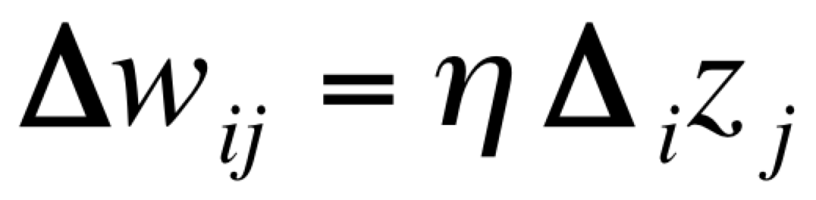
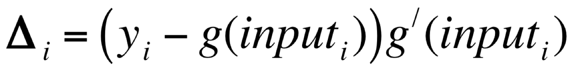
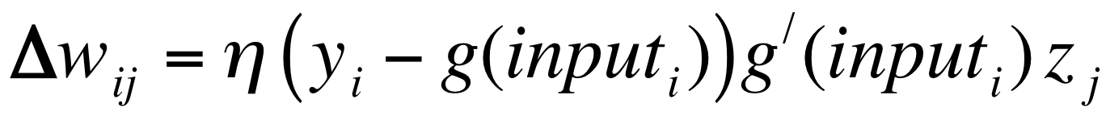
Backpropagation (generalized delta rule)
Delta rule:
Define a modified error term:
We can write the delta rule as:
How do we work out the “error” for a hidden unit?
Notes:
To calculate the update for w_{ij}, we can follow the same logic as before, except instead of x_j we have z_j. Everythign else could be deifned as before and we can summarize it with the modified error term and z_j. But what is the correct value for z_j? When we had x_j, we knew what that value was because it was given in the input, but what is the error that z_j is responsible for?

Slide 30
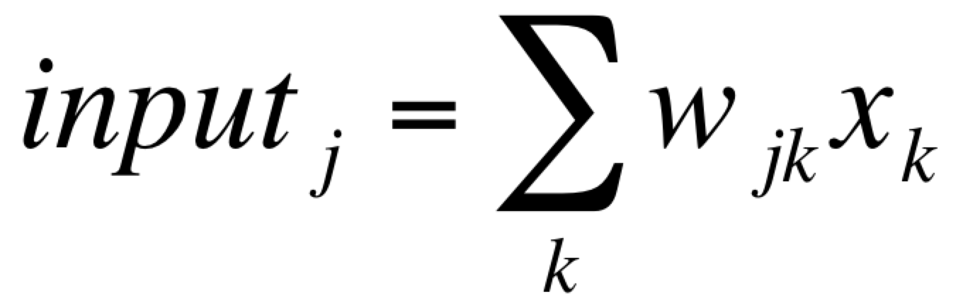
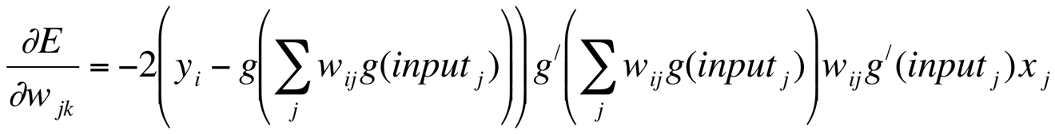
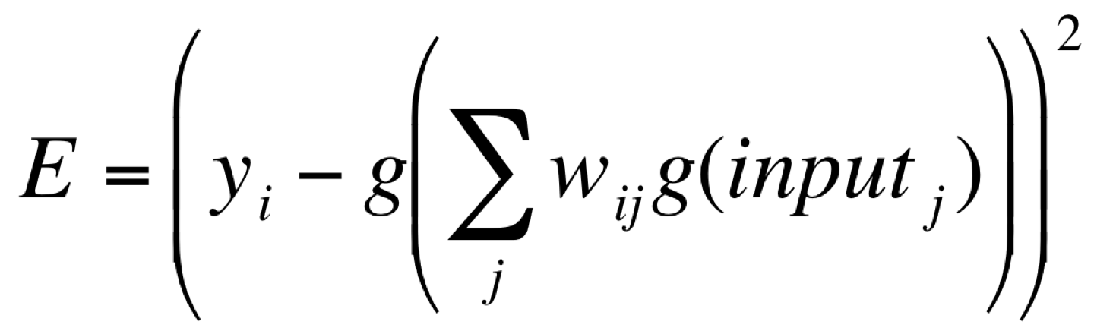
A little math
With two layers, we can write the error as
where
and then apply the chain rule…
Notes:
Well, with a little math, we can write the full function from input to predicted output . Then we can derive the update for the w_{jk} by working through the chain rule with this function. We won’t go through it all as it’s a lot of the same, but at least then we can do the update for the w_{jk} using the x_j. So we can still make the updates for the first layer’s weights.
But we already could do that before in some ways… so how does this help us with learning the weights in the second layer and the issue we had with z_j?

Slide 31
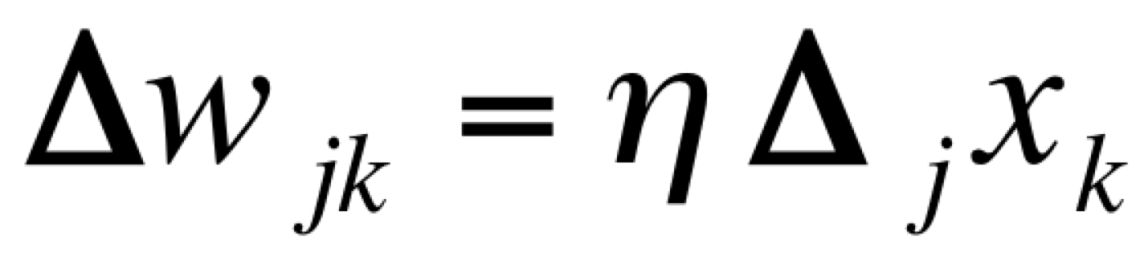
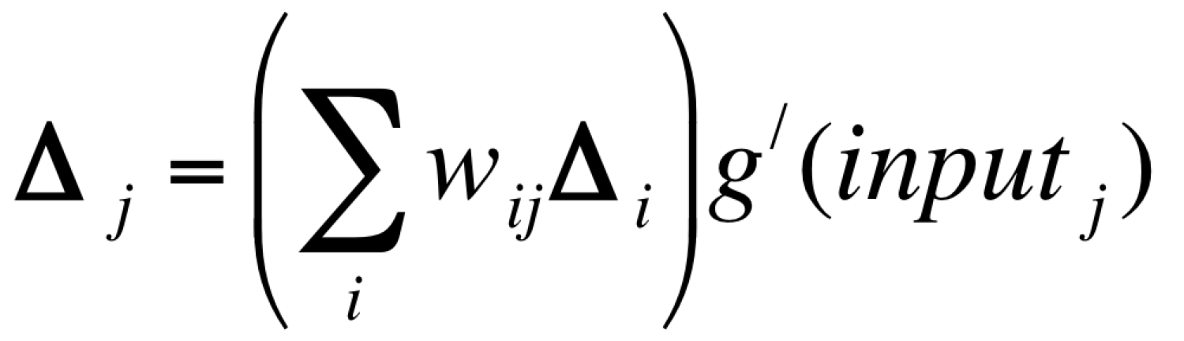
Backpropagation (generalized delta rule)
The appropriate error term is
Each hidden unit is apportioned some blame!
Error is propagated “back” to hidden units…
We can write the generalized delta rule as:
Notes:
I’m going to end up handwaving this a bit. But overall, the way that we end up propagating the updates is by using the w_{ij} and the portion of the error w_{ij} had. So for each of the w_{ij} that our w_{jk} is connected to, we end up getting a bit of that blame and adjust our term accordingly. We add those together to get our \delta_j term (all weighted by the appropriate derivative for the curvature of that region). Then we can bring x_k back with us and use that to make our update. And voila! We now can propagate the error back from the first layer to the second layer to train the weights of the second layer.
In principle, this could be done an arbitrary number of times, which would get us to neural networks of arbitrary size. But there are computational difficulties that arise. For example, needing to spread the blame over and over can lead to computational issues of vanishing gradients. There are a lot of ways of getting around these issues that folks have explored in the NN community.

Slide 32
Training multi-layer networks
y
compute error
use delta rule
z₁
z₂
propagate error to hidden layer
use generalized delta rule
x₁
x₂
“Backpropagation”
(Rumelhart, Hinton, & Wilson, 1986)
Notes:
In summary, can train multilayer neural networks for as many layers as we want using the backpropagation algorithm. We do so by computing the error at the output, using the delta rule and generalized delta rule to update the weights in the first layer, propagate the error that each hidden node in the next layer was responsible for and then update the weights in the next layer by proportioning partial blame to each of the units as we discussed in the last slide.

Slide 33
Admin Matters
Connectionism and neural network basics
Linear neural networks
Nonlinearity and Backpropagation
Convolutional and Recurrent neural networks
Short rest 1
Three student presentations:
Lake et al 2015 by Ruijia
Linzen et al by Elijah
Short rest 2
3. Schulz Buschoff et al by Khailanii
Notes:
Modern NNs moved from using these feedforward fully connected layer to layer networks to ones with special architectures. Two ones that have played a large role are convolutional and recurrent neural networks. We’ll explore both of these which are used for visual perception and language applications, respectively.

Slide 34
Convolutional Neural Networks
Convolutional Neural Networks are neural networks that use “convolution” instead of standard matrix multiplication.
Convolution
Say x(t) is the noisy sensor of the location of a spaceship
If we want the best estimate of the location at time t, we probably want to combine a few values.
Convolution is a way of doing this -- we could combine the weights at different times near t.
(larger values at t and decay as we go further away from t).
x is the input.
w is called the kernel (or sometimes a feature map/image)
Notes:
Over the years, researchers have integrated operations other than matrix multiplication, typically designed for special purposes. One particular special purpose is sensing, especially visual perception. In that case, we might have a feature or other shape we’re trying to detect. We may want our agent to act similarly to some shape regardless of what part of their retina it falls on. One way to do that is to implement what’s called a convolution operator that connects the same feature detecting portion of an artificial neural network to many different parts of the image at different offsets for the x and y position within the image.
Convolution had been a mathematical operator for a long time. One place it had been used was in RADAR or SONAR. In this sort of application, we typically are trying to track the location of an object far from us, say a spaceship. We can get a noisy estimate of its location at different times. We could then combine those together to try and estimate its location. For simplicity, lets say that we are sitting still, but you could imagine correcting for our motion if we wanted to make it more complicated.
So lets say we have a noisy sensory that can approximate the distance between us and the spaceship. We want to get the best estimate of the location at the current time t. We have some estimates of its location in prior times. Since our estimate is noisy, we should take into account the prior estimates to some extent. But the further we go back in time, the less up to date the estimate is, so should weight those less. Convolution is a mathematical operator for doing this operation. It moves through a dimension, say time or space, and computes the estimate at each time point to be the weighted average of the time points near it based on the inputs over time. Intuitively we want those weights to be large when we’re close to the current time point, and less when we are further back in time. If we represent the input as x, we’ll encode the weights for how much to prioritize the current time over previous estimates as w. This is called the kernel of the convolution. For visual applications it is sometimes called the feature map or image.
The equation below formalizes the process we just talked through. S(t) is the answer from the convolution for time t ( for example, the estimate of the spaceship’s location at time t). That is the weighted average (or integral as we’re in continuous time) of the current estimate for the location times the weight for the current time averaged over all the other time offsets into the past we could have with the estimate from our sensor during those time points. I use a here as the variable to denote the time offset that is being integrated over. Often the kernel w goes to zero after a bit, so the integral isn’t usually going over a huge amount of space. If you read papers using convolutions, you might see the final notation for it. But don’t worry about it otherwise – I just put it there in case you come across it one day so you aren’t too confused.

Slide 35
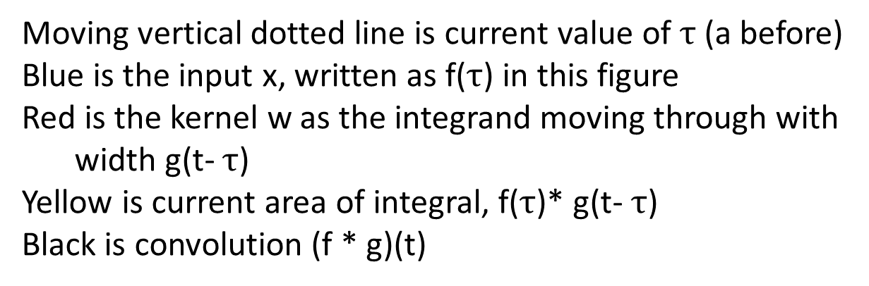
Moving vertical dotted line is current value of $τ$ (a before)
Blue is the input x, written as f($τ$) in this figure
Red is the kernel w as the integrand moving through with
width g(t- $τ$)
Yellow is current area of integral, f($τ$)* g(t- $τ$)
Black is convolution (f * g)(t)
Notes:
Here is an example of what a convolution operation looks like over time. We assume ther’es an input that’s on from -0.5 to 0.5. That’s plotted in blue and is denoted as f(\tau) in the animated gif that is illustrating the convolution on the slide. The sliding kernel or weight which is moving with the integrand. In this case it’s an on-off one with a moving window. The result for some t is the area of overlap between blue and red. As it slides by that result is plotted in black. As you can see, it results in a largest value at the center of the input and moves down to zero as we move away from it in both directions.

Slide 36
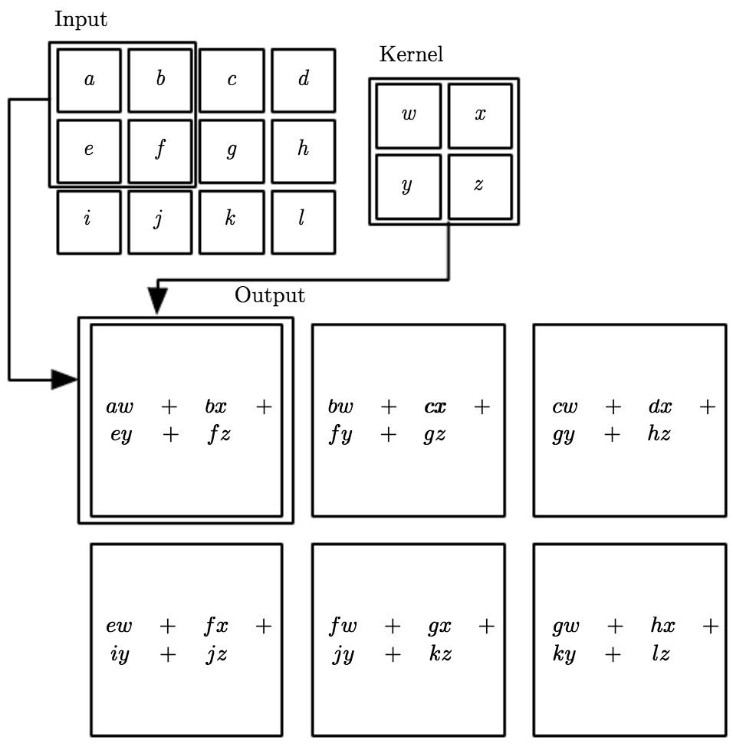
Convolutional Neural Networks
Convolutional Neural Networks are neural networks that use “convolution” instead of standard matrix multiplication.
They are often used in machine learning using images.
Notes:
In the context of images, the kernel gets applied with the same weights to multiple parts of an input image. So in the example here, you can see the 2x2 image kernel gets applied to each 2x2 region of the 3x4 input. So we get the first output node of a * w + b*x + e * y + f*z. Then we get it applied to the right with b * w + c * x + f * y + g * z. And so on. If this were a feature detector, it would then detect whether that feature is present in each of the 2x2 regions of the input image.

Slide 37
Convolutional Neural Networks
Convolutional Neural Networks are neural networks that use “convolution” instead of standard matrix multiplication.
They are often used in machine learning using images.
One interpretation is that you force multiple units that connect to different parts of the image to share the same weights.
It enables units that are invariant to types of transformation.
Translation
Notes:
This is how translational invariance can be encoded in artificial neural networks. It is invariant in the sense that the output does not vary despite the input changing. By forcing the feature weights to be the same across multiple regions of an image, you can learn the weights that then detect for some sort of feature in any part of the image.

Slide 38
A different computational problem
Learning language is a sequential prediction problem
A grammar is a function from previous words to the next word
Words are represented as points in space (vectors, distributed or local representations)
A grammar can be encoded as a set of weights in a neural network
Notes:
As opposed to classifying or categorizing images, language poses a different kind of problem for artificial neural networks. Until now, the artificial neural networks we’ve been working with have had no notion of time. An input goes in, it feeds its activation forward. It doesn’t matter what other inputs were put in immediately before it – the same answer is given. But language poses a different sort of problem. Predicting the next word depends on the previous words before it. Language obeys a grammar which is set of complex relations between the previous and upcoming words of an utterance. For artificial neural networks, words ultimately get encoded as the pattern of activation over each layer of a neural network. That amounts to a sequence of points in spaces. Grammar can be thought of then as being implicit in the weights of the neural network. Certain patterns of next words are possible based on the previous words depending on the weights.
But to get to having the immediately prior input having an influence of how the next input activates the neural network, we need to introduce a new tool: recurrence into our neural network.

Slide 39
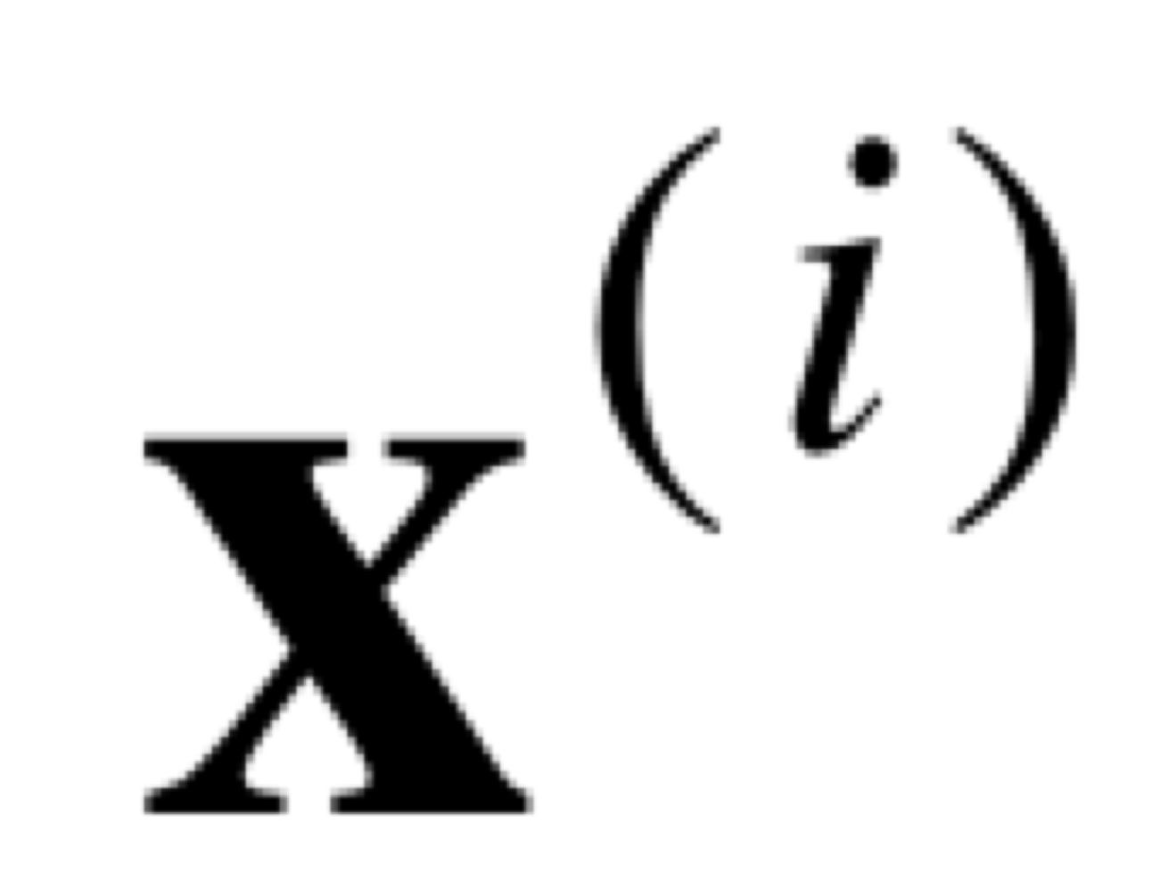
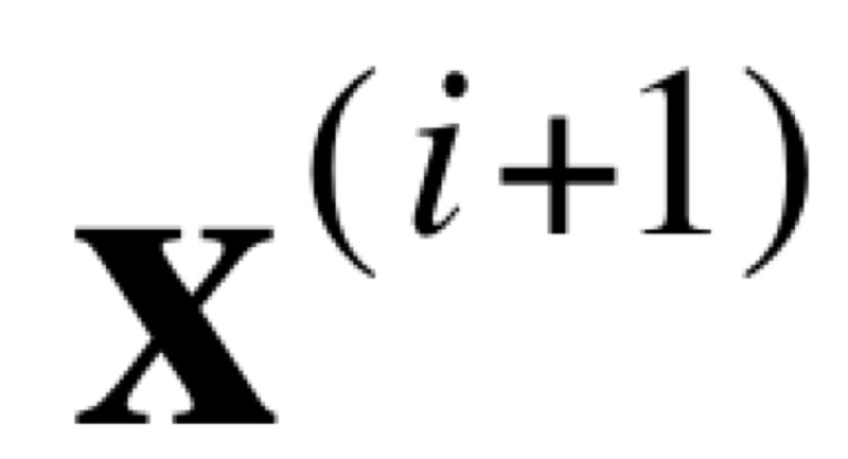
Simple recurrent networks
output layer
x₁
x₂
copy
hidden layer
z₁
z₂
context units
input
input layer
x₁
x₂
(Rumelhart et al., 1986; Elman, 1990)
Notes:
The setup for a simple recurrent network is similar to those that we’ve explored so far. We have an input, which might be a word. It goes through the hidden layer and often the goal is to predict then what the next word should be in the output layer. What a simple recurrent neural network does special is it introduces a second type of layer: the context units. After a word is processed, the context units copy the values of the hidden layer and that is used at the next time step. So, now, rather than the hidden layer only having the input of the current word, it has the hidden layer’s representation of the previous word as additional input. Those get processed together to then predict the next word. Again the hidden layer then gets copied into the context units and the process repeats to keep on predicting more and more words. The idea is that the hidden layer and context units end up encoding the gist of the sentence so far and the overall context for interpreting the current word in how it should be used to predict the next word.

Slide 40
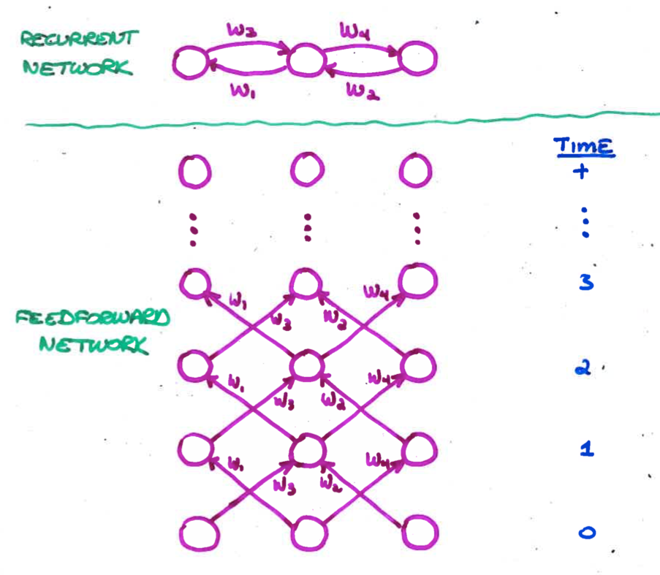
Unfolding A Recurrent Net
Requires duplication of hardware (units and weights)
one layer for each discrete time step
Unfolded net has dynamics identical to that of recurrent net run for a fixed number of time steps
BP may violate the constraint that corresponding weights are equal.
To enforce the constraint, assume a single set of underlying parameters
Unfolding is necessary only during learning.
Once weights are trained, can run as an ordinary RNN
Slide from Michael Mozer
Notes:
To train recurrent neural networks, one often unfolds them into an equivalent feedforward neural network and adapt the training rules from there. So if we have a recurrent neural network with weights projecting in both directions, we can imagine them as a feedforward network that is unfolding more and more over time. The weights between nodes are selected and copied from its equivalent recurrent neural network to make the operations identical. Then backpropagation can be run to learn. Once learning has occurred, can use the weights as normal as a RNN.

Slide 41
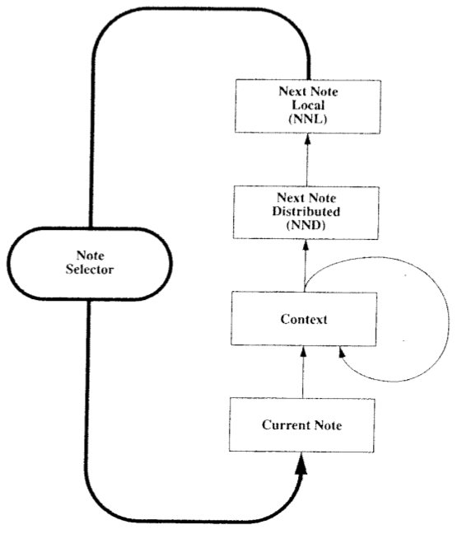
Neural Network Music Composition (Mozer, 1994)
Slide from Michael Mozer
Notes:
One interesting old example for using simple recurrent neural networks for sequential information was midi music composition. In it, the input was the current note and it combined with a hidden and a context layer. Afterwards it went through a hidden layer that encoded the next note in a distributed fashion. To get the next note in the composition from the distributed layer, it went through one more layer to a one hot localist representation layer of the next note. So, a little different from the simple recurrent neural net we were discussing earlier, but pretty similar.

Slide 42
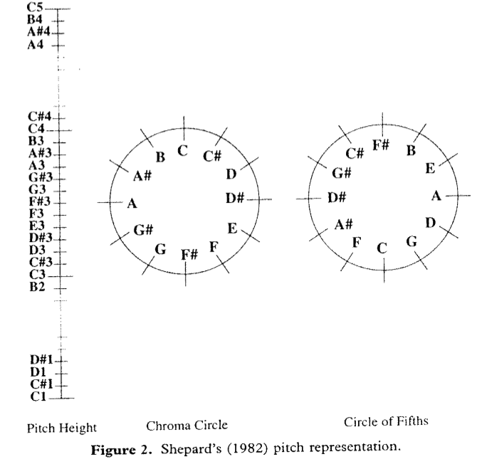
Psychologically Grounded Representation Of Pitch
Each pitch as point in 5 dimensional space
Slide from Michael Mozer
Notes:
In it, he used a 5-node representation for each pitch to match psychologically-validated representation of pitch based on work from roger shepard and krumhansl in the late 70s and 80s

Slide 43
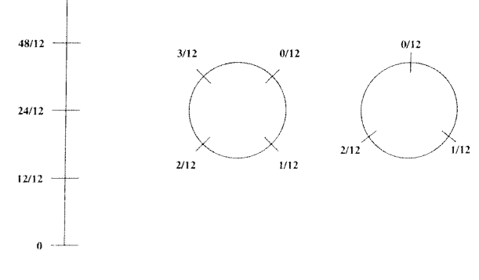
Analogous Representation Of Duration
Slide from Michael Mozer
Notes:
He used a similar basis to represent the note duration in the layer as well.

Slide 44

Simulation Experiments
All pieces transposed to common key
C major or A minor
Bach (10 training examples)
European folk melodies (25 examples)
Waltzes (25 examples with harmonic accompaniment)
Outcome
Network learns local structure but not global structure of musical organization
Slide from Michael Mozer
Notes:
More recent work for music generation based on large scale training corpora and deep NNs with many more parameters has produced rich music that can emulate a lot of the global structure of classical music organization.

Slide 45
Regularization in Deep Nets
Some sort of “Error” or “loss” function (e.g., sum squared error, “cross-entropy”)
is called a “regularizer”
is a hyperparameter controlling strength of regularizer
Some example regularizers:
L² norm (squared):
L¹ norm :
L¹ leads to sparse representations (few non-zero items).
Early stopping: Stopping before training error is minimum is implicit regularization.
Notes:
Cross-entropy is joint entropy and basically equivalent to what’s called KL-divergence – a measure of how different two distributions. Expectation is over empirical distribution and q is the learned distribution

