Slide 1
DungeonPy
Hayden Rogers
Marlan McInnes-Taylor

Slide 2
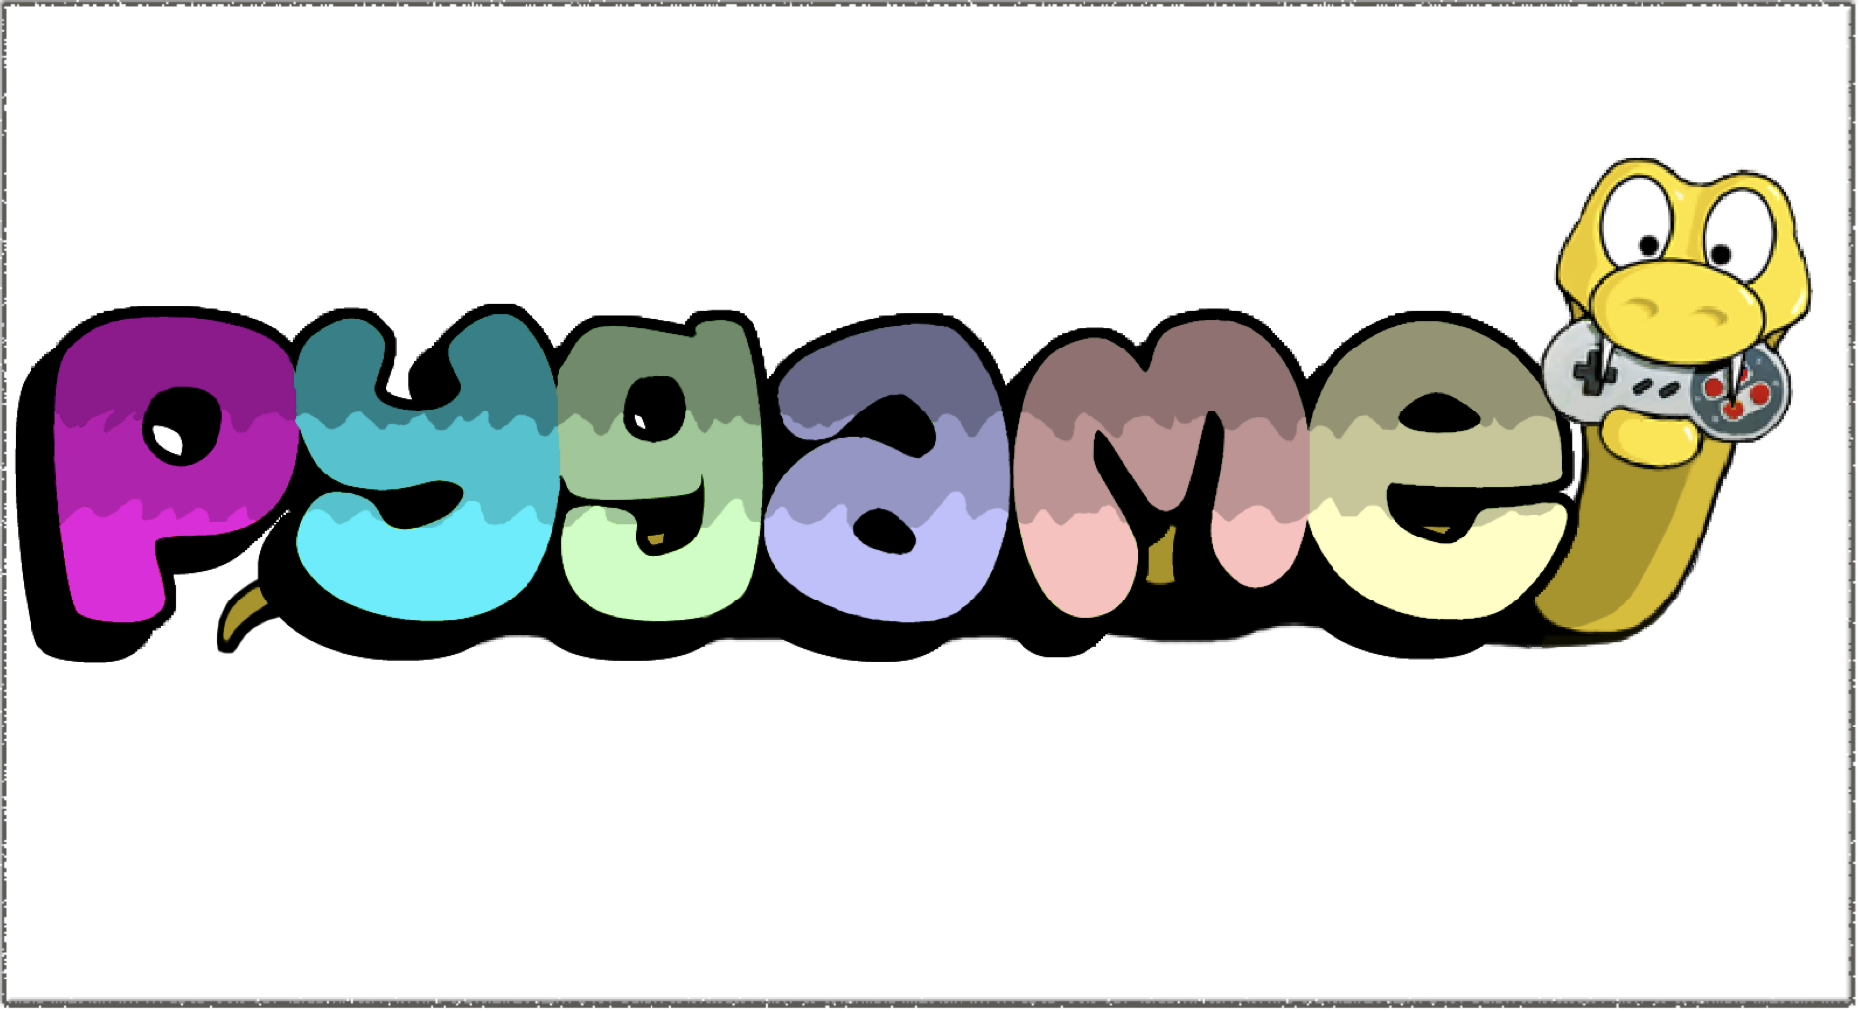
2D DragonQuest style RPG

Slide 3

Tools, Libraries & References
VS Code
Tiled
Pygame
Pytmx
Pyscroll
Os
Random
Fortuna
The Stolen Crown
KidsCanCode - Pygame
pygame.org
Pyscroll quest tutorial

Slide 4
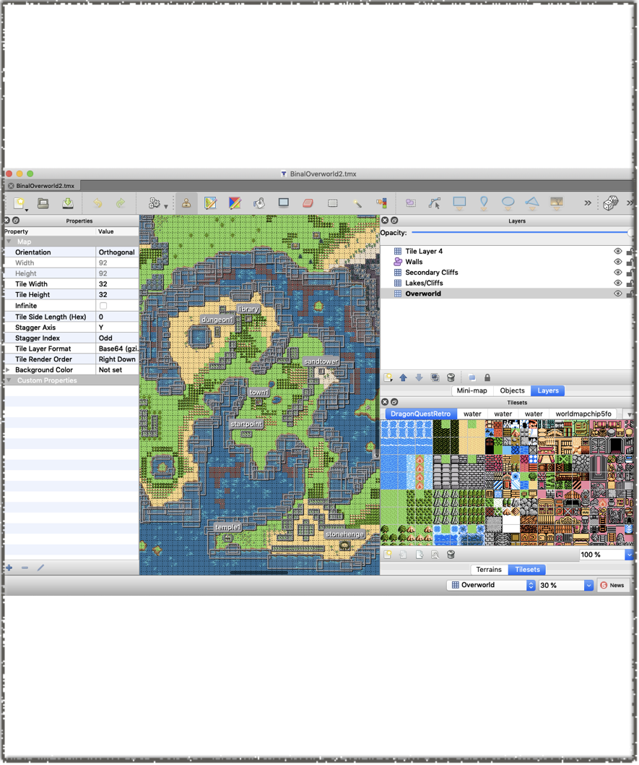
Map Creation
Tiled freeware application
Create layered texture maps
Utilizes an object layer for collision detection

Slide 5
Current Functionality
Movement
Transport
Maps
Collision
Sound

Slide 6
Planned Functionality
NPC Battle system
Random encounters
Leveling
Magic system

Slide 7
Challenges
File path issues with TMX files
RPG Complexity
Scope
Things that seem easy sometimes aren’t
How game development works

Slide 8
Demonstration

