Slide 1
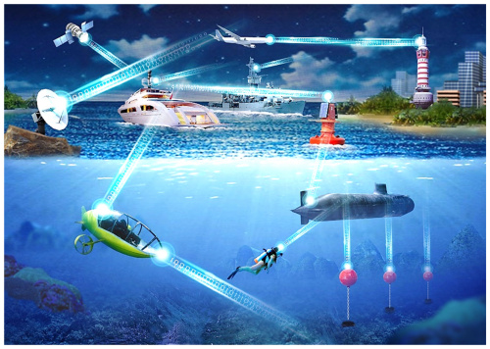
MAC Protocol Simulation in Undersea Environments
Wireless Communications, DAT610

Slide 2
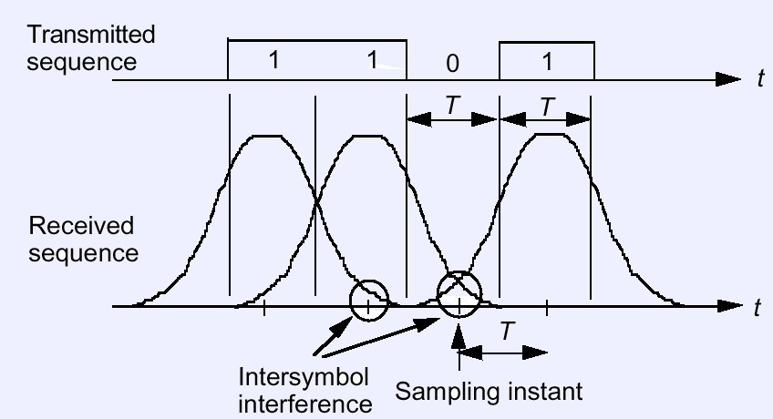
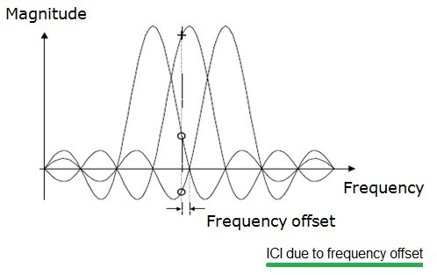
UWAC
Acoustic Waves
Multipath Propagation
Doppler Effect

Slide 3
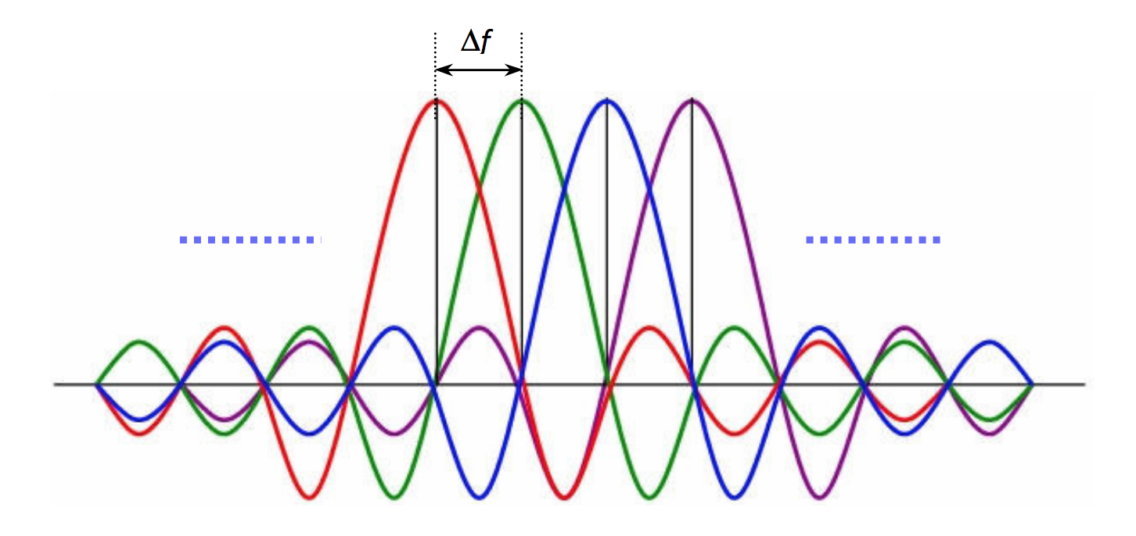
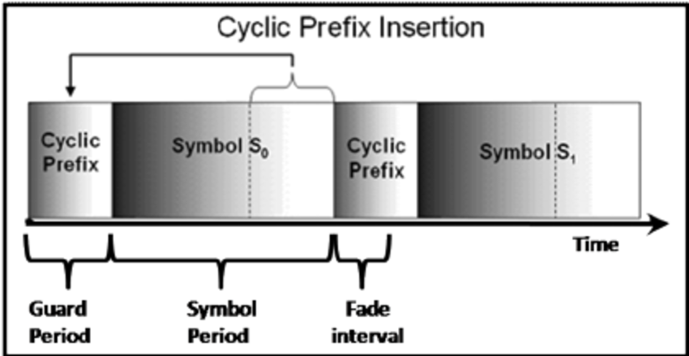
CP-OFDM
Substreams
Orthogonal Subcarriers
Cyclic Prefix
Implementation
Advantages
Disadvantages

Slide 4
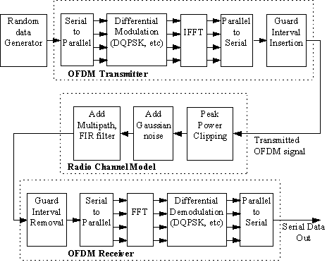
Implementation

Slide 5
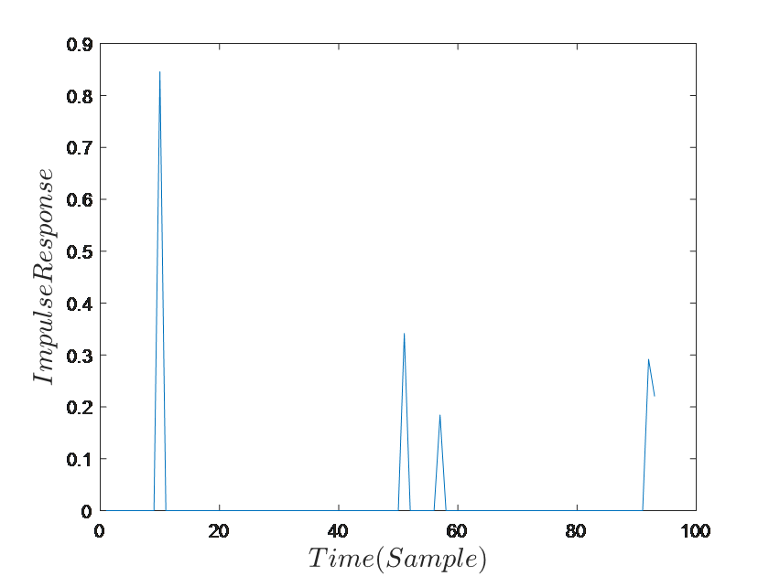
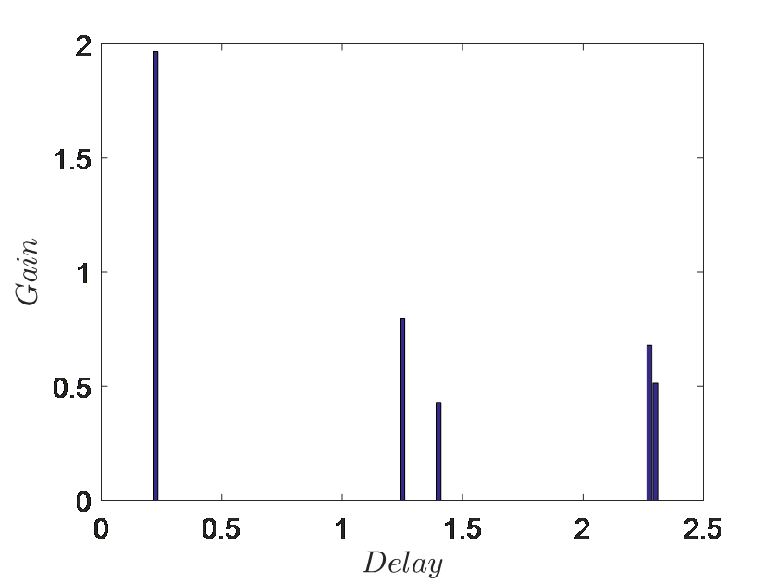
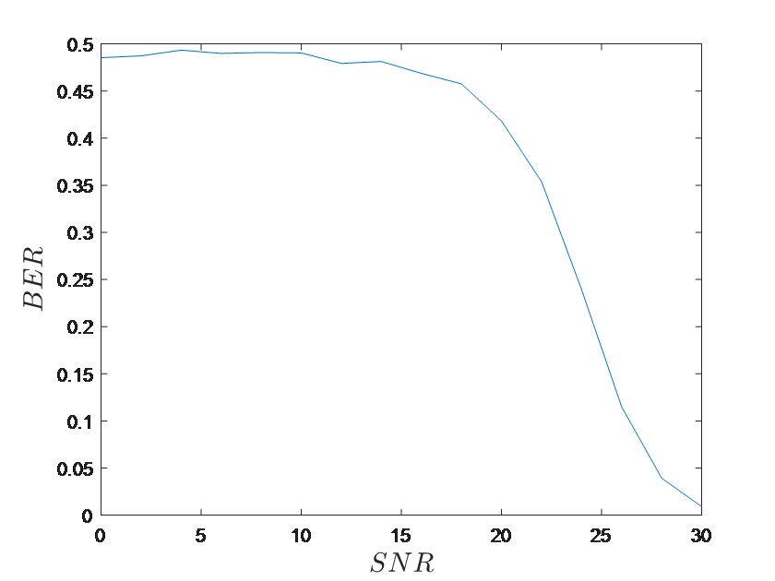
Test Results

Slide 6

Summary
Spectral Efficiency
ISI
ICI
PAPR
Acoustic channel

Slide 7
Image Sources
https://www.osapublishing.org/oe/fulltext.cfm?uri=oe-24-22-25502&id=353195
http://www.revolutionwifi.net/revolutionwifi/2015/3/how-ofdm-subcarriers-work
https://www.researchgate.net/figure/Insertion-of-cyclic-prefix-in-guard-interval_fig1_220902525
http://technews365.info/intersymbol-interference/#prettyPhoto/0/
http://www.rfwireless-world.com/Terminology/ISI-vs-ICI.html
http://www.skydsp.com/publications/4thyrthesis/chapter2.htm

