Slide 1

An Introduction to Search Engine Advertising Campaigns for Business Executives
by Will Hennessy and Stephen Herring
Prepared as an assignment for CS410: Text Information Systems in Spring 2016

Slide 2
“How do search engines affect
my global business?”
Notes:
Audience: educated, non-technical business owners, executives, and managers
Purpose: teach business men 1) what is a search engine 2) why and how it effects their business 3) what to do about it

Slide 3
Overview
How Search Engines Work
Google PageRank
What is Relevance
How Search Engines Impact Your Business
Online Advertising Industry
Customer Beliefs and Biases in Search
Indirect Benefits of Search Advertising
What Your Business Must Do
Optimal Search Engine Marketing Strategy
How to Create Search Ad Campaigns
How to Boost Your Ranking
How to Optimize Ad Success Rates
Consider Contracting an SEO Firm
Search Engine Marketing for Travel Companies

Slide 4
I. How Search Engines Work
Notes:
Audience: educated, non-technical business owners, executives, and managers
Purpose: teach business men 1) what is a search engine 2) why and how it effects their business 3) what to do about it

Slide 5
PageRank
Search engine creates a citation graph of hyperlinks on the Worldwide Web
Your PageRank is proportional to the number of times your site is linked from another website
Works well because citations are created by people
Anchor text is the blue text you read on the page
Search engine examines this text because it summarizes a page content
Determines relevance of content like images
Notes:
Paper 1: The Anatomy of a Large-scale Hypertextual Web Search Engine

Slide 6
What is Relevance?
How do search engine providers define relevance?
What factors motivate a new feature or change to the ranking algorithm?
Interviewed 11 technical executives from all of the major search engine companies
(Google, Yahoo!, MSN, Ask Jeeves, etc.)
Discovered three schemas for thinking about search engine quality: market, science, war
Notes:
Paper 2: Is Relevance Relevant? Market, Science, and War: Discourses of Search Engine Quality
So PageRank explains how they operate at a basic level, but search engine providers like Google have been constantly tweaking the engine for over a decade in order to increase relevance. What is relevance? Relevance is a metric defined internally by the Search Engine Provider (SEP) to quantify how useful and effective the search results are to the user. This measure includes a variety of factors, including both objective and subjective components.
However, search engine providers are businesses themselves, so relevance is not the only factor that influences design. This paper surveyed
What changes do they make and why? Understanding the motive of these search engines will help a business owner plan for it.
This paper surveyed engineering and business directors at all the major search engine providers and asked what factors dictate the design of their search engine.
We attempt to get inside of the head of these search engines and understand WHY they operate the way they do.

Slide 7
What is Relevance?
Schemas (Paradigms) for Search Engine Quality
Objective
Subjective
Market
Science
Blacklists
Whitelists
Topic-specific Weights
Law Suits
Revenue
Costs
Conversions
Click-throughs
Experiment
Feasibility
Recall
Precision
War
Competitive Advantage
Research & Development
Notes:
Paper 2: Is Relevance Relevant? Market, Science, and War: Discourses of Search Engine Quality

Slide 8
II. How Search Engines Impact Your Business
Notes:
Audience: educated, non-technical business owners, executives, and managers
Purpose: teach business men 1) what is a search engine 2) why and how it effects their business 3) what to do about it

Slide 9
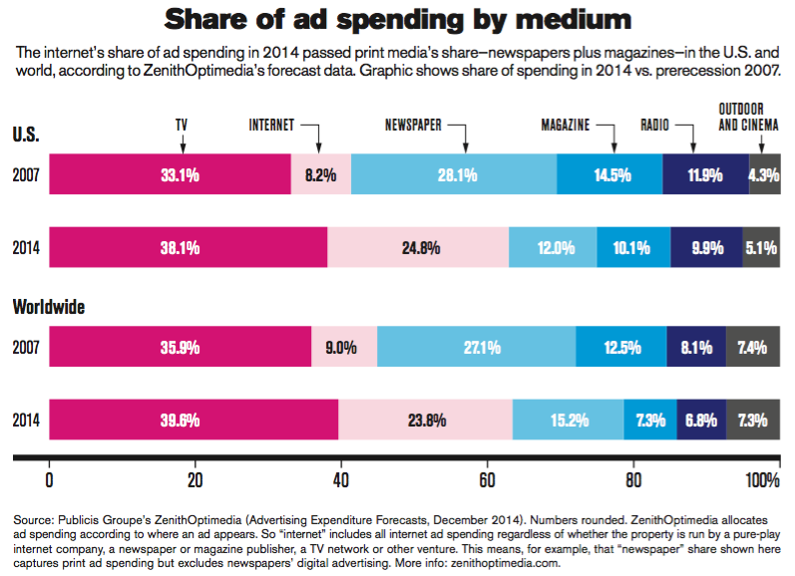
Online Advertising Industry
Notes:
Paper 4: The Online Advertising Industry: Economics, Evolution, and Privacy
This graph is not from the paper, it is from AdvertisingAge Marketing Fact Pack, 2015 Edition.

Slide 10
Online Advertising Industry
Media companies spent $545 billion on ads
Newspaper and magazines have been dominated by Internet ads in search engines
Advertising is a matching game between merchants and consumers
Search engines are extremely efficient at matching because they know consumer information and intent to purchase
Notes:
Paper 4: The Online Advertising Industry: Economics, Evolution, and Privacy
The old model required merchants to buy a million newspaper ads with the hope that a small fraction of the population is interested. The search engine has changed this game entirely. Merchants are now able to identify individual consumers who are interested in the product by matching their search queries or registered account information. This ability to detect a consumer’s interest and intent to purchase a product has transformed advertising campaigns from mass market tools into focused, personalized ads. The search engines are an intelligent intermediary in this lucrative matching game.

Slide 11
Beliefs and Biases in Web Search
Consumers trust search results
Top ranked result provided by search engine only correct 45% of the time
After the first result, consumers rarely change their opinion
Search engines produce positively biased results
Positive results three times as likely as negative results

Slide 12
Indirect Benefits of Search Advertising
Direct type-in visitation: when a user directly types in the URL instead of searching for it
Empirical study of dataset from e-commerce website in automotive industry
599 of the 3,186 keywords were linked to fluctuations in direct type-in traffic
Significant keywords include company’s brand name and broad words like “buy car Toyota”
Estimated yield of $90,000 which was 50% of the firm’s annual paid search budget
Notes:
Paper 7: Modeling Indirect Effects of Paid Search Advertising: Which Keywords Lead to More Future Visits?
Search ads increase the occurrence of these events, but this benefit is not quantified by traditional metrics of quality. This study found that
Search advertising increases direct type-in vistations
These visitations are extremely valuable (financially and also in terms of brand loyalty)
What types of keywords increase direct type-in visitations

Slide 13
III. What Your Business Must Do
Notes:
Audience: educated, non-technical business owners, executives, and managers
Purpose: teach business men 1) what is a search engine 2) why and how it effects their business 3) what to do about it

Slide 14
Optimal Search Engine Marketing Strategy
Many ways to market on search engines
Keyword-related banner advertisements
Paid submission for regular updates
Search engine optimization (SEO)
Paid product placements
SEO has the most potential of these options

Slide 15
Optimal Search Engine Marketing Strategy
SEM only worth investing in under certain circumstances:
Buyers have low search intensity
Product sold is provided by many other providers
Product is of low value
For niche markets, SEM is not worth investing

Slide 16
How to Boost Your Ranking
Register your site with search engine indexes
Give reputable sites a compelling reason to link to your site
Use keywords in the <title> block
Use <meta> tags to provide extra information
Place important information near the top
The site must be interesting to retain users
Notes:
Paper 6: So You Want to Get Involved in E-commerce?

Slide 17
How to Create Search Ad Campaigns
Define an objective
“increase sales of product X by 10%”
Set a budget
“$30 million in 2016”
Divide the budget across media types
40% TV, 30% search, 15% radio, 15% newspaper
Based on expected Return on Investment for each medium
Select top keywords for product, allocating budget to the best keywords
Monitor conversion rate and tweak keyword allocation to maximize sales
Notes:
Paper 4: The Online Advertising Industry: Economics, Evolution, and Privacy
The old model required merchants to buy a million newspaper ads with the hope that a small fraction of the population is interested. The search engine has changed this game entirely. Merchants are now able to identify individual consumers who are interested in the product by matching their search queries or registered account information. This ability to detect a consumer’s interest and intent to purchase a product has transformed advertising campaigns from mass market tools into focused, personalized ads. The search engines are an intelligent intermediary in this lucrative matching game.

Slide 18
How to Optimize Ad Success Rates
Optimize click-through rate
Retailer-specific terms increase rate by 28%
Brand-specific terms do not affect click-through rate
Length of the keyword is inversely proportional to click-through rate
Optimize conversion rate
Rank of an ad has huge impact on conversation rate
Landing page quality influences rate
High click-through rate leads to high conversion rate
Brand-specific terms affect conversion rate

Slide 19
Consider Contracting an SEO Firm
SEO = Search Engine Optimization firm, often contracted by a business to consult and improve its search engine ranking
Algorithm Robustness: a search engine’s ability to exclude the noise created by SEOs
Created a model to estimate impact of SEOs. Results:
Search engines combat SEO manipulation by investing in algorithm robustness
This increases search engine profits and diminishes the effect of SEOs
However, SEO still generates value for business owners and is often a worthwhile investment for advertising
Notes:
Paper 10: The Impact of Search Engine Optimization on Online Advertising Market
Researchers created a model to estimate impact of SEOs

Slide 20
Search Engine Marketing for Travel Companies
Two categories of travel search
Core queries: transportation and accommodation
Specialty queries: context-dependent
Search engines are the most popular source of information for travelers
“Touristic level” metric of city calculated as
Tourism-related queries / Total queries in city
SEM strategies depend on destination
Size of destination
“Touristic level” of destination
Notes:
Paper 6: So You Want to Get Involved in E-commerce?

Slide 21
Conclusions
Search engines are complex, but a basic understanding is invaluable to the modern business executive
Virtually every modern consumer business should advertise in search engines because they are the first and most efficient source of contact with the customer
If you invest resources, planning time, and evaluation efforts into a search ad campaign, then you can directly influence the success of your campaign.

Slide 22
Future Work
Create walkthrough tutorials for creating and evaluating a campaign in real-world advertising tools like Google AdWords
Develop case studies of successful online advertising campaigns
Research industry-specific advertising advice
Research successful trends in advertising campaigns
Monitor major changes to the major search engine ranking algorithms over time
Survey of campaign evaluation tools on the market

Slide 23
References
Brin, Sergey, and Lawrence Page. ”Reprint of: The anatomy of a large-scale hypertextual web search engine.” Computer networks 56.18 (2012): 3825-3833.
Wilson, Susan G., and Ivan Abel. ”So you want to get involved in e-commerce.” Industrial marketing management 31.2 (2002): 85-94.
Van Couvering, Elizabeth. ”Is relevance relevant? Market, science, and war: Discourses of search engine quality.” Journal of Computer-Mediated Communication 12.3 (2007): 866-887.
White, Ryen. ”Beliefs and biases in web search.” Proceedings of the 36th international ACM SIGIR conference on Research and development in information retrieval. ACM, 2013.
Evans, David S. ”The online advertising industry: Economics, evolution, and privacy.” Journal of Economic Perspectives (2009).
Sen, Ravi. ”Optimal search engine marketing strategy.” International Journal of Electronic Com- merce 10.1 (2005): 9-25.

Slide 24
References
Rutz, Oliver J., Michael Trusov, and Randolph E. Bucklin. ”Modeling indirect effects of paid search advertising: which keywords lead to more future visits?.” Marketing Science 30.4 (2011): 646-665.
Ghose, Anindya, and Sha Yang. ”An empirical analysis of sponsored search performance in search engine advertising.” Proceedings of the 2008 International Conference on Web Search and Data Mining. ACM, 2008.
Xiang, Zheng, and Bing Pan. ”Travel queries on cities in the United States: Implications for search engine marketing for tourist destinations.” Tourism Management 32.1 (2011): 88-97.
Xing, Bo, and Zhangxi Lin. ”The impact of search engine optimization on online advertising market.” Proceedings of the 8th international conference on Electronic commerce: The new e- commerce: innovations for conquering current barriers, obstacles and limitations to conducting successful business on the internet. ACM, 2006.
https://www.xpastor.org/wp-content/uploads/2014/10/Businessman-looking-at-city.jpg

