Slide 1
MEG-AHAT: Propagation of spectral flicker during visual- and non-visual cognitive tasks
Mark Alexander Henney^{1,2,4}
Eelke Spaak³
Robert Oostenveld (PI)⁴
1 Technical University of Denmark, Department of Applied Mathematics and Computer Science, Section for Cognitive Systems
2 OptoCeutics ApS
3 Radboud University, Donders Institute, Donders Centre for Cognition
4 Radboud University, Donders Institute, Donders Centre for Cognitive Neuroimaging

Slide 2
MEG-AHAT
Background
Non-invasive 40 Hz sensory stimulation has been proposed as treatment for Alzheimer’s disease (AD)^{1,2}.
In mouse models of AD, plaque load is reduced³, synaptic density is preserved, and learning and memory behaviour is improved⁴.
Stroboscopic flicker is strenuous to look at for extended durations.
Invisible spectral flicker (ISF) was proposed as an alternative with reduced perceived flicker⁵.
EEG has shown comparable propagation patterns for strobe and ISF⁶, but EEG has limited spatial resolution.
Visual- and non-visual tasks increase propagation of 40 Hz signal from strobe compared to rest (recorded by EEG), and modulate propagation to deep structures (recorded by implanted electrodes)⁷.
[1] Sahu & Tseng 2023, Frontiers in Integrative Neuroscience; https://doi.org/10.3389%2Ffnint.2023.1146687
[2] Adaikkan & Tsai 2020, Trends in Neuroscience; https://doi.org/10.1016/j.tins.2019.11.001
[3] Iaccarino et. al. 2016, Nature; https://doi.org/10.1038/nature20587
[4] Addaikan & Tsai 2019; Trends in Neuroscience: https://doi.org/10.1016/j.tins.2019.11.001
[5] Carstensen et. al. 2020, Proc. SPIE; https://doi.org/10.1117/12.2544338
[6] Agger et. al. 2022, Journal of Alzheimer’s Disease; https://doi.org/10.3233/jad-220081
[7] Khachatryan et. al. 2022, Frontiers in Aging Neuroscience; https://doi.org/10.3389/fnagi.2022.1010765
Notes:
Stroboscopic flicker (square wave with 100% modulation depth, 50% duty cycle, 300–1200 lux)
The perceived flicker is reduced by temporal mixing white colours that are spectrally different to lower the critical flicker-fusion frequency.
Deep structures: hippocampus,

Slide 3
MEG-AHAT
Research Question(s)
Does attention modulate the 40 Hz response propagation from visible and invisible flicker?
Given the use of the visual pathway for stimulation; is the modulation effect based on the task being visual, or is it dependent on the difficulty?
Is the effect on propagation caused by the cognitive engagement or by a specifically visual task?
How does 40 Hz flicker affect cognitive performance?
We consider the three types of visual stimulation as somewhat ordinal. Static light is the lower extreme, visible (i.e. stroboscopic) flicker is the upper extreme, and invisible spectral flicker is the middleground.
Notes:
We consider the three types of stimulation as
S.1: Do we see a difference in the behavioural response (such as detection accuracy) when stimulating with 40 Hz visible flicker? Is it improved or reduced? What about invisible flicker? Is the response pattern for invisible flicker more like visible flicker or continuous light?

Slide 4


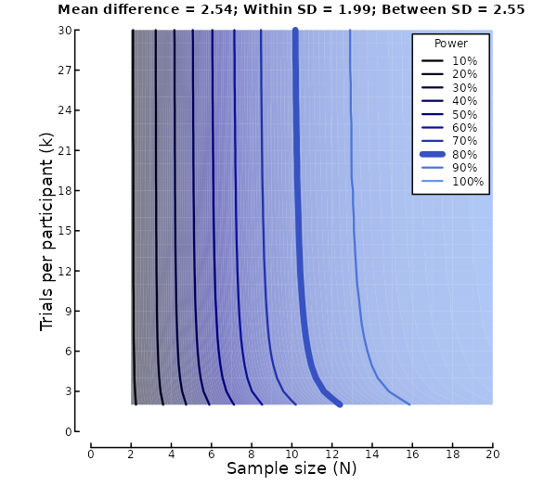
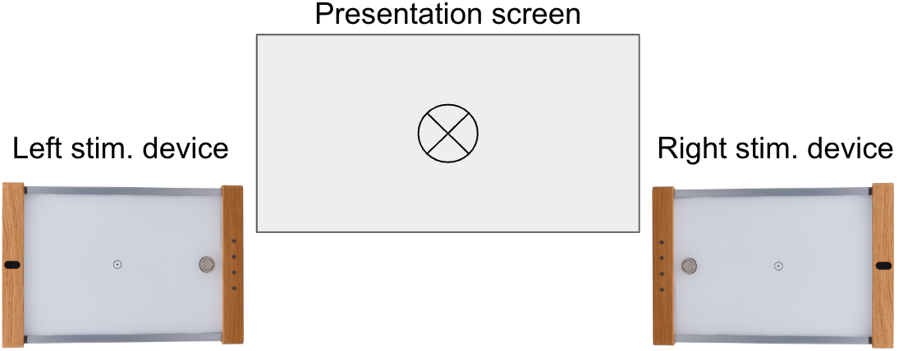
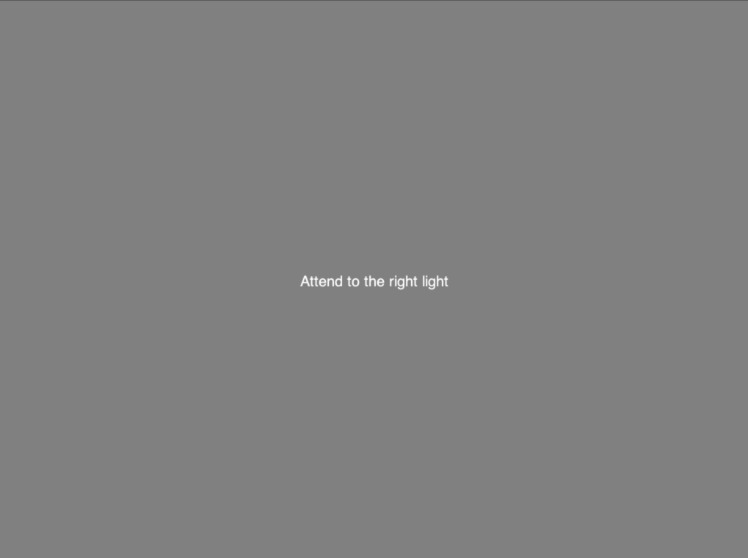
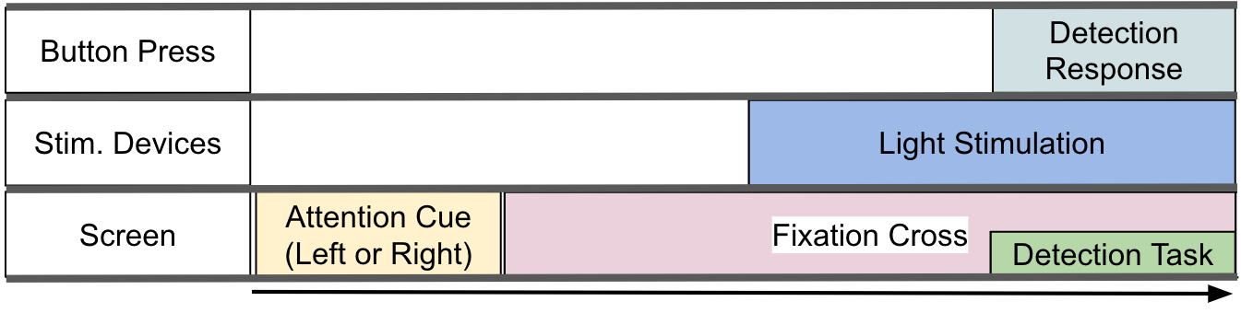
MEG-AHAT
Methods: Experiment 1/2
MEG experiment of 2 x 3 (x 2) factorial design
Lateralised top-down attention (Left/Right),
Three types of (bi-lateral) light stimulation (40 Hz stroboscopic flicker, 40 Hz ISF, continuous light)
(Lateralised detection task (congr./in-congr.))
Power estimates are based on:
Between- and within-subject variance of global 40 Hz EEG power from ISF in Hansen et. al. 2023 (in review @ Scientific Reports).
Effect size of difference in MEG relative SSVEF power between attended vs. unattended hemifield from Moratti et. al. 2023, Psychophysiology; https://doi.org/10.1111/psyp.14452
Notes:
By presented instruction, attention is given to left or right stimulation device.
A fixation mark (static grating with plus/minus 45 deg orientation) is shown.
The light stimulation devices are turned on.
After some seconds of stimulation with top-down attention to one side, another gradient appears in the bottom corner on the side of attention. The grating will be of lower contrast to make it more difficult to detect, and the orientation will be either identical or opposite to the fixation mark grating.
The participant answers by button press whether the two gratings are the same or different.
Power estimates are based on:
Between- and within-subject variance of global 40 Hz EEG power from ISF in Hansen et. al. 2023 (in review @ Scientific Reports).
Effect size (cohen’s d) of difference in MEG relative SSVEF power between attended vs. unattended hemifield from Moratti et. al. 2023, Psychophysiology; https://doi.org/10.1111/psyp.14452

Slide 5
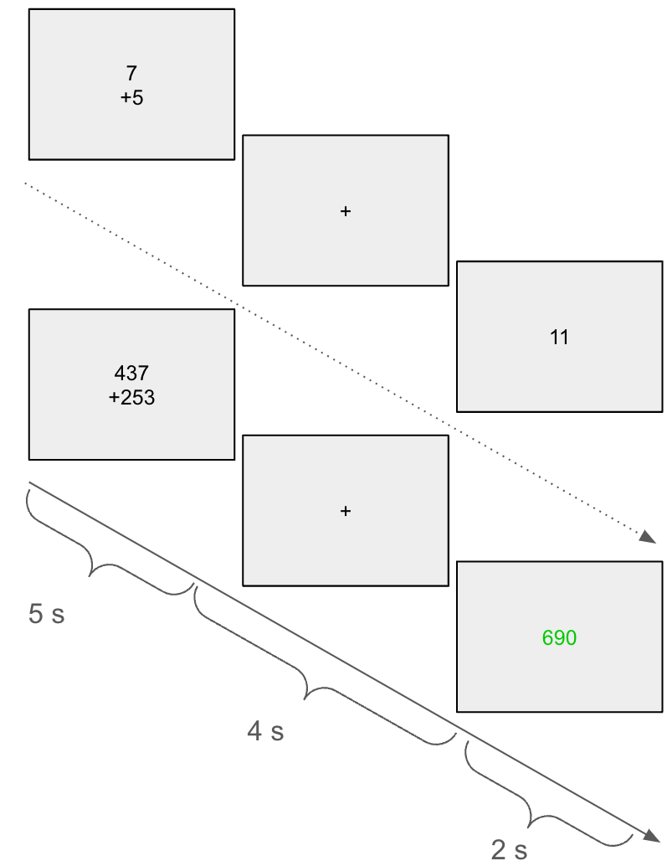
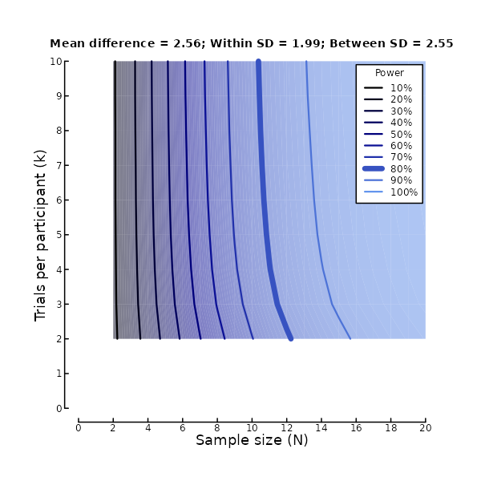
MEG-AHAT
Methods: Experiment 2/2
3x2 (or 3x3) factorial design with three difficulties of working memory (WM) tasks and same light stimulation during MEG:
(Rest,) single-digit addition, three-digit addition⁸.
40 Hz stroboscopic flicker, 40 Hz ISF, continuous.
Addition task is presented, followed by fixation cross, followed by a result. The participant replies whether the presented result is correct.
Power estimates are based on:
Between- and within-subject variance of global 40 Hz EEG power from Strobe and ISF in Hansen et. al. 2023 (in review @ Scientific Reports).
40 Hz SSVEP Power difference of representative central electrode between rest and WM task during Strobe from [7]
[8] Dimitrakopoulos et. al. 2023, Applied Sciences; https://doi.org/10.3390/app13042129
Notes:
All results are presented neutrally (though here, a correct result is shown in green).

Slide 6
MEG-AHAT
Data Analysis
40 Hz source power is estimated with beamformer pr. trial (from stimulus onset to response)
Mixed linear models with 40 Hz power as the dependent variable and stimulus (fixed effect), task (fixed effect), and subject (random effect) as independent variables. All two-way interactions are included initially, but will be attempted reduced.
Notes:
Using coherence to distinguish phases from left and right light?
(Requires control of the phase – need to check the ease of that)

Slide 7
MEG-AHAT
How outcomes are informative for the questions
Research Question 1:
If we find that the 40 Hz response propagation from visible and invisible flicker is modulated by lateral visual attention, it suggests that clinical efficacy may be affected (improved?) by attending to the stimulation.
If we (as expected) find that the 40 Hz response propagation from visible flicker is higher than from invisible flicker, clinical efficacy may be affected (improved) by visible flicker.
If we find that the 40 Hz response propagation from visible flicker is modulated by lateral visual attention to a different degree than invisible flicker, it suggests that improved clinical efficacy of attending to the stimulus is dependent on visibility of the flicker.
Research Question 2:
If we find that the 40 Hz response propagation from visible and invisible flicker is modulated by difficulty of a working memory task, it suggests that clinical efficacy may be affected (improved?) by cognitive load, irrespective of attention to the stimulation.
If we (as expected) find that the 40 Hz response propagation from visible flicker is higher than from invisible flicker, clinical efficacy may be affected (improved) by visible flicker.
If we find that the 40 Hz response propagation from visible flicker is modulated by cognitive load to a different degree than invisible flicker, it suggests that improved clinical efficacy of cognitive load during stimulation is dependent on visibility of the flicker.

Slide 8
Thanks for your attention!

