Slide 1
MEG-AHAT: Propagation of spectral flicker during visual- and non-visual cognitive tasks
Mark Alexander Henney^{1,2,4}
Eelke Spaak³
Robert Oostenveld (PI)⁴
1 Technical University of Denmark, Department of Applied Mathematics and Computer Science, Section for Cognitive Systems
2 OptoCeutics ApS
3 Radboud University, Donders Institute, Donders Centre for Cognition
4 Radboud University, Donders Institute, Donders Centre for Cognitive Neuroimaging
Notes:
Enrolled as a PhD student at the Technical University of Denmark, Department of Applied Mathematics and Computer Science, Section for Cognitive Systems.
Disclosures:
Mark Henney is an industrial PhD student sponsored primarily by the Danish Innovation Fund but also in part by the Danish company, OptoCeutics ApS, and holds stock options in this company.

Slide 2
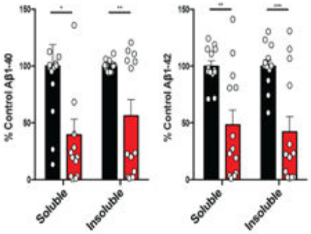
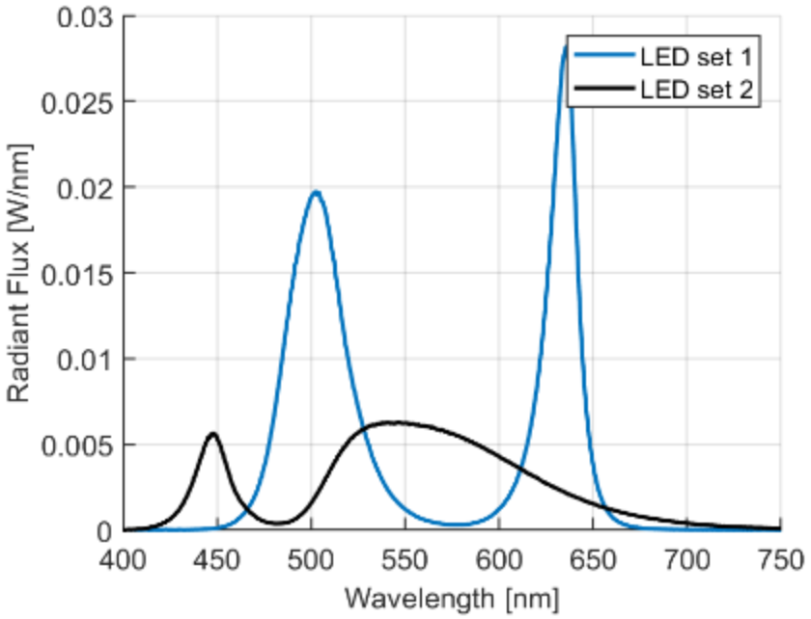
MEG-AHAT
Background
Alzheimer’s Disease (AD)
Non-invasive 40 Hz sensory stimulation has been proposed as treatment for AD^{1,2}
From figure 4 i+j of [3]
Pre-clinical evidence of positive impact on plaques³, synaptic density, and behaviour⁴
Invisible spectral flicker was proposed as an alternative with reduced perceived flicker⁵
EEG showed comparable propagation for stroboscopic- and spectral flicker⁶, but EEG has limited spatial resolution
Visible stroboscopic flicker combined with a cognitive task, increases propagation of 40 Hz signal⁷
From figure 6 a of [5]
[1] Sahu & Tseng 2023, Frontiers in Integrative Neuroscience; https://doi.org/10.3389%2Ffnint.2023.1146687
[2] Adaikkan & Tsai 2020, Trends in Neuroscience; https://doi.org/10.1016/j.tins.2019.11.001
[3] Iaccarino et. al. 2016, Nature; https://doi.org/10.1038/nature20587
[4] Addaikan & Tsai 2019; Trends in Neuroscience: https://doi.org/10.1016/j.tins.2019.11.001
[5] Carstensen et. al. 2020, Proc. SPIE; https://doi.org/10.1117/12.2544338
[6] Agger et. al. 2022, Journal of Alzheimer’s Disease; https://doi.org/10.3233/jad-220081
[7] Khachatryan et. al. 2022, Frontiers in Aging Neuroscience; https://doi.org/10.3389/fnagi.2022.1010765
Notes:
AD is a progressive, neurological disorder that eventually leads to dementia and death. Current treatment is symptomatic (based on cholinesterase inhibitors), though there has been recent progress with anti
Stroboscopic flicker is strenuous to look at (square wave with 100% modulation depth, 50% duty cycle, 300–1200 lux)
The perceived flicker is reduced by temporal mixing white colours that are spectrally different to lower the critical flicker-fusion frequency.
In [7], they use both EEG and deep electrodes (in one subject). They have two tasks (and no task): One visual attention (odd-ball) task, and one non-visual (mental counting) task. 40 Hz strobe.

Slide 3
MEG-AHAT
Research Questions
Does spatial attention modulate the 40 Hz response propagation from visible stroboscopic flicker and invisible spectral flicker?
Is the effect on propagation caused by the cognitive engagement or by a specifically visual task?
How does 40 Hz flicker affect cognitive performance?
We consider the three types of visual stimulation as somewhat ordinal. Static light is the lower extreme, visible stroboscopic flicker is the upper extreme, and invisible spectral flicker is the middle ground.
Notes:
We consider the three types of stimulation as
S.1: Do we see a difference in the behavioural response (such as detection accuracy) when stimulating with 40 Hz visible flicker? Is it improved or reduced? What about invisible flicker? Is the response pattern for invisible flicker more like visible flicker or continuous light?

Slide 4
MEG-AHAT
Research Questions
Does spatial attention modulate the 40 Hz response propagation from visible stroboscopic flicker and invisible spectral flicker?
Is the effect on propagation caused by the cognitive engagement or by a specifically visual task?
How does 40 Hz flicker affect cognitive performance?
We consider the three types of visual stimulation as somewhat ordinal. Static light is the lower extreme, visible stroboscopic flicker is the upper extreme, and invisible spectral flicker is the middle ground.
Notes:
We consider the three types of stimulation as
S.1: Do we see a difference in the behavioural response (such as detection accuracy) when stimulating with 40 Hz visible flicker? Is it improved or reduced? What about invisible flicker? Is the response pattern for invisible flicker more like visible flicker or continuous light?

Slide 5
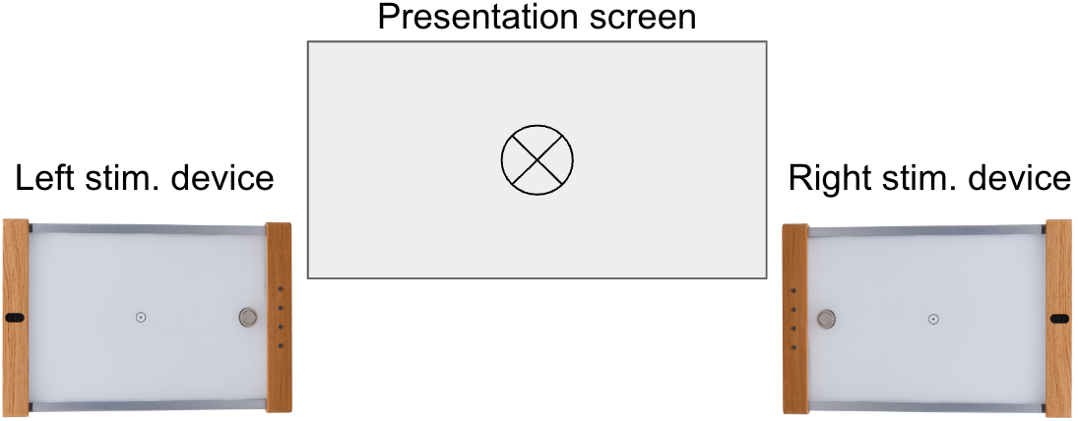



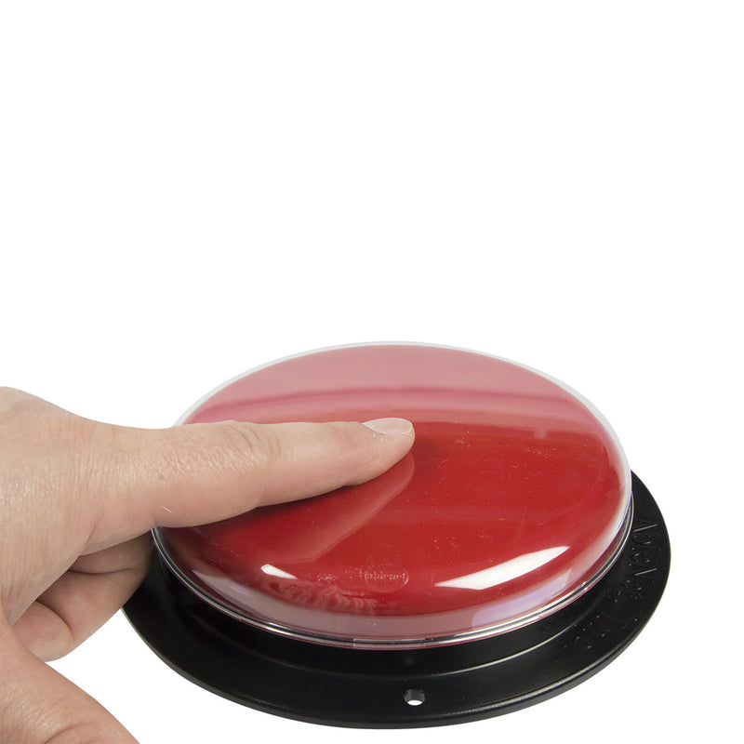
MEG-AHAT
Methods: Experiment 1/2
MEG experiment of 2 x 3 factorial design:
Lateralised attention
Three types of flicker conditions (stroboscopic- and spectral flicker, and static light with no flicker)
Screen | Fixation Cross | Lateral Cue | Fixation Grating |  | Fixation Grating + Discrimination Grating
Stim. Devices | Light Stimulation | Light Stimulation
Button Press |  |  |  |  | Indicate Congruence or Incongruence of Grating
Duration (ms) | 200 | 500 | 500 – 2500 *,** |  | 750 (0)**
Between trials: Rest period of 3 seconds with fixation cross
* With 10% probability, the fixation grating will only last 500 – 1000 ms (uniform distribution), otherwise 1000 – 2500 ms (uniform distribution)
** Given the fixation grating duration exceeds 1000 ms, there is 10 % chance the fixation grating lasts 2500 ms, and the discrimination grating never shows

Slide 6
MEG-AHAT
Research Questions
Does spatial attention modulate the 40 Hz response propagation from visible stroboscopic flicker and invisible spectral flicker?
Is the effect on propagation caused by the cognitive engagement or by a specifically visual task?
How does 40 Hz flicker affect cognitive performance?
We consider the three types of visual stimulation as somewhat ordinal. Static light is the lower extreme, visible stroboscopic flicker is the upper extreme, and invisible spectral flicker is the middle ground.
Notes:
We consider the three types of stimulation as
S.1: Do we see a difference in the behavioural response (such as detection accuracy) when stimulating with 40 Hz visible flicker? Is it improved or reduced? What about invisible flicker? Is the response pattern for invisible flicker more like visible flicker or continuous light?

Slide 7
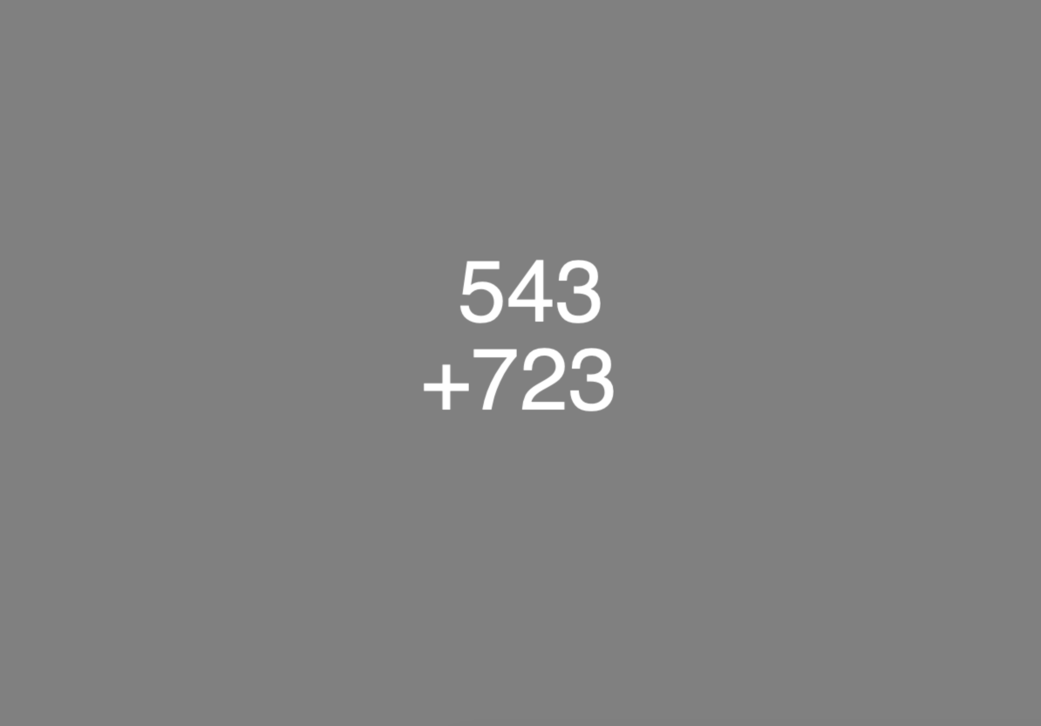

MEG-AHAT
Methods: Experiment 2/2
MEG experiment of 2 x 3 factorial design:
Mental arithmetic at two levels of difficulty,
Three types of flicker conditions
Screen | Fixation Cross | Sum | Fixation Cross |  | Result
Stim. Devices | Light Stimulation | Light Stimulation
Button Press |  |  |  |  | Indicate Correctness of Summation Result
Duration (ms) | 500 | 5000 | 2000 |  | 750
Between trials: Rest period of 3 seconds with fixation cross

Slide 8
MEG-AHAT
Research Questions
Does spatial attention modulate the 40 Hz response propagation from visible stroboscopic flicker and invisible spectral flicker?
Is the effect on propagation caused by the cognitive engagement or by a specifically visual task?
How does 40 Hz flicker affect cognitive performance?
Notes:
We consider the three types of stimulation as
S.1: Do we see a difference in the behavioural response (such as detection accuracy) when stimulating with 40 Hz visible flicker? Is it improved or reduced? What about invisible flicker? Is the response pattern for invisible flicker more like visible flicker or continuous light?

Slide 9
MEG-AHAT
Resources
Duration:
MEG: 1.5 hrs / person, single session (incl. prep.)
Structural MRI: 30 min / person, single session (incl. prep.)
Participants:
Conservatively, we choose N = 30*
Lab time:
1.5 hrs x 30 = 45 hrs MEG lab
30 min x 30 = 15 hrs
*Sample size estimate should be based on effect size of attention contrast during 40 Hz invisible spectral stimulation, but that effect is not previously recorded.
Notes:
A cohen’s d of 0.95 is reported in [8] for stroboscopic flicker at 12 and 15 Hz, but we must expect a lower effect size for spectral flicker at 40 Hz.

Slide 10
MEG-AHAT
Data Analysis
Stimulation artefacts are expected but are orthogonal to the design of the experiment and will be suppressed by spatial filtering such as beamforming.
Mixed linear models with 40 Hz power as the dependent variable and stimulus (fixed effect), task (fixed effect), and subject (random effect) as independent variables.

Slide 11
MEG-AHAT
Impact
Informative for the understanding of how 40 Hz stimulation may affect Alzheimer’s disease
May influence the implementation of at-home 40 Hz stimulation:
Is the amount of (visible) flicker important?
Should the user attend to the stimulation?
Should the user do cognitively demanding work during stimulation?
Does not directly inform about the clinical efficacy of 40 Hz stimulation, but this is pursued in ongoing clinical trials*
* See ClinicalTrials.gov IDs: NCT03543878, NCT05637801, NCT03556280, NCT04574921, NCT05260177

Slide 12
Thanks for your attention!

