Slide 1
Generative AI in Cybersecurity
Module 2A: LLMs, Prompt templates, Langchain
Henning Thomsen
hth@ucn.dk
5. May 2025
Pba IT-security @ UCN

Slide 2
Agenda
Prompting and prompt templates
Langchain
Retrieval Augmented Generation (RAG)
Afternoon lecture

Slide 3
LangChain
Python module for application developent using LLMs and Agents

Slide 4

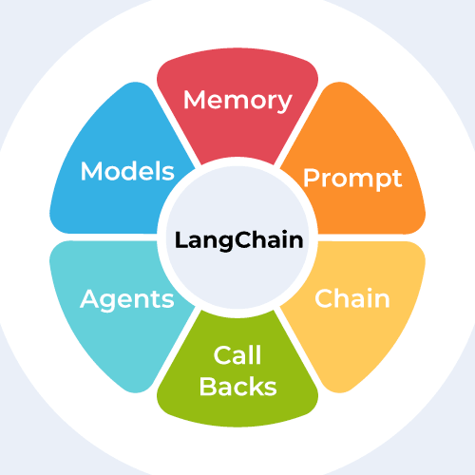
LangChain
Framework for Building LLM-Powered Applications
https://python.langchain.com
Also for JavaScript
Call LLMs using Python
Purpose: Use LLMs in Python applications

Slide 5
LangChain libraries
langchain-core
langchain-openai, langchain-groq
langchain
langchain-community
Langgraph (next lecture)

Slide 6
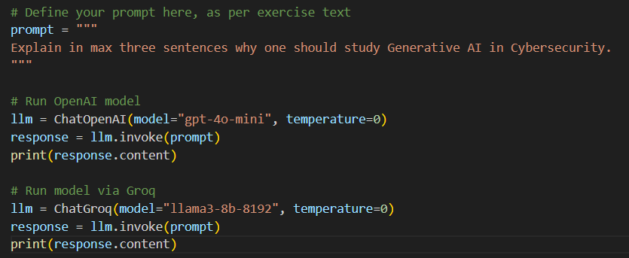
LangChain

Slide 7
LLM constructor
from langchain_openai import ChatOpenAI
llm = ChatOpenAI(
model="gpt-4o",
temperature=0,
max_tokens=None,
timeout=None,
max_retries=2,
# api_key="...“
# base_url="...",
# organization="...",
# other params...
)

Slide 8
LLM invocation
messages = [
(
"system",
"You are a helpful assistant that translates English to French. Translate the user sentence.",
),
("human", "I love programming."),
]
ai_msg = llm.invoke(messages)
ai_msg

Slide 9
LLM response (object)
AIMessage(content="J'adore la programmation.", additional_kwargs={'refusal': None}, response_metadata={'token_usage': {'completion_tokens': 5, 'prompt_tokens': 31, 'total_tokens': 36}, 'model_name': 'gpt-4o-2024-05-13', 'system_fingerprint': 'fp_3aa7262c27', 'finish_reason': 'stop', 'logprobs': None}, id='run-63219b22-03e3-4561-8cc4-78b7c7c3a3ca-0', usage_metadata={'input_tokens': 31, 'output_tokens': 5, 'total_tokens': 36})

Slide 10
LLM response (object)
AIMessage(content="J'adore la programmation.", additional_kwargs={'refusal': None}, response_metadata={'token_usage': {'completion_tokens': 5, 'prompt_tokens': 31, 'total_tokens': 36}, 'model_name': 'gpt-4o-2024-05-13', 'system_fingerprint': 'fp_3aa7262c27', 'finish_reason': 'stop', 'logprobs': None}, id='run-63219b22-03e3-4561-8cc4-78b7c7c3a3ca-0', usage_metadata={'input_tokens': 31, 'output_tokens': 5, 'total_tokens': 36})

Slide 11
LLM response (object)
AIMessage(content="J'adore la programmation.", additional_kwargs={'refusal': None}, response_metadata={'token_usage': {'completion_tokens': 5, 'prompt_tokens': 31, 'total_tokens': 36}, 'model_name': 'gpt-4o-2024-05-13', 'system_fingerprint': 'fp_3aa7262c27', 'finish_reason': 'stop', 'logprobs': None}, id='run-63219b22-03e3-4561-8cc4-78b7c7c3a3ca-0', usage_metadata={'input_tokens': 31, 'output_tokens': 5, 'total_tokens': 36})
print(ai_msg.content)
J'adore la programmation.

Slide 12
Prompt Templates
Define prompts as templates
Go from static prompts to prompts with variables
from langchain_core.prompts import ChatPromptTemplate
system_template = (
"You are a cybersecurity assistant specializing in {specialty}. "
"Analyze the following input for threats related to {threat_type} and provide detailed recommendations."
)
prompt_template = ChatPromptTemplate.from_messages(
[("system", system_template), ("user", "{log_data}")]
)

Slide 13
Prompt Templates
Variable assignment
formatted_prompt = prompt_template.format(
specialty="cloud infrastructure security",
threat_type="unauthorized access and privilege escalation",
log_data="User 'admin' logged in from unknown IP 203.0.113.5 at 03:14 AM..."
)

Slide 14
Prompt Templates
Let’s look at the complete example
02_prompt_templates.py

Slide 15
Spam Classification
Giving the LLM examples via the prompt (Few-shot examples)
Workflow
Load API-keys
Define LLM and its parameters
Define prompt template
Format the prompt template
Invoke LLM
This is a one-shot operation

Slide 16
Prompt Templates
Where is the variable?
prompt_template = """
Classify the given email message as either spam or legitimate.
Examples are given below:
Message: "Hi Alex, just confirming our meeting tomorrow at 10 AM—let me know if anything changes."
Classification: Legitimate
Message: "Your account has been compromised—click here immediately to verify your identity and avoid suspension!"
Classification: Spam
Message: {message}
Classification:
"""

Slide 17
Prompt Templates
Where is the variable?
prompt_template = """
Classify the given email message as either spam or legitimate.
Examples are given below:
Message: "Hi Alex, just confirming our meeting tomorrow at 10 AM—let me know if anything changes."
Classification: Legitimate
Message: "Your account has been compromised—click here immediately to verify your identity and avoid suspension!"
Classification: Spam
Message: {message}
Classification:
"""
spam_classification_prompt_template = PromptTemplate(
input_variables = ["message"],
template = prompt_template
)

Slide 18
Prompt Templates
The message we want to classify
prompt_template = """
Classify the given email message as either spam or legitimate.
Examples are given below:
Message: "Hi Alex, just confirming our meeting tomorrow at 10 AM—let me know if anything changes."
Classification: Legitimate
Message: "Your account has been compromised—click here immediately to verify your identity and avoid suspension!"
Classification: Spam
Message: {message}
Classification:
"""
spam_classification_prompt_template = PromptTemplate(
input_variables = ["message"],
template = prompt_template
)
spam_classification_prompt = spam_classification_prompt_template.format(message="Hey. Nice to see you! Best regards, Rick.")

Slide 19
Prompt Templates
Invocation
prompt_template = """
Classify the given email message as either spam or legitimate.
Examples are given below:
Message: "Hi Alex, just confirming our meeting tomorrow at 10 AM—let me know if anything changes."
Classification: Legitimate
Message: "Your account has been compromised—click here immediately to verify your identity and avoid suspension!"
Classification: Spam
Message: {message}
Classification:
"""
spam_classification_prompt_template = PromptTemplate(
input_variables = ["message"],
template = prompt_template
)
spam_classification_prompt = spam_classification_prompt_template.format(message="Hey. Nice to see you! Best regards, Rick.")
result = llm.invoke(spam_classification_prompt)

Slide 20
Chat Prompt Templates
Instead of a plain string, structure the chat session using tuples.
prompt_template = """
Classify the given email message as either spam or legitimate.
Examples are given below:
Message: "Hi Alex, just confirming our meeting tomorrow at 10 AM—let me know if anything changes."
Classification: Legitimate
Message: "Your account has been compromised—click here immediately to verify your identity and avoid suspension!"
Classification: Spam
Message: {message}
Classification:
"""

Slide 21
Chat Prompt Templates
Instead of a plain string, structure the chat session using tuples.
chat_prompt_template = ChatPromptTemplate.from_messages([
("system",
"Classify the given email message as either spam or legitimate."),
("human",
"Message: Hi Alex, just confirming our meeting tomorrow at 10 AM—let me know if anything changes."),
("ai",
"Legitimate"),
("human",
"Message: Your account has been compromised—click here immediately to verify your identity and avoid suspension!"),
("ai",
"Spam"),
("human",
"Message: {message}")
])

Slide 22

Chat Prompt Templates
Why would we want to use ChatPromptTemplate?
Better structure and role-tagging
Use with memory (relevant for (interactive) chat sessions)
Can it reduce risk of prompt injection attacks?

Slide 23
LangChain Expression Language
Composable Syntax for chaining LLM calls, input, parsers etc.
Output of one call is input of subsequent call
Message
Prompt Template
LLM invocation
Output parser

Slide 24
LangChain Expression Language
Composable Syntax for chaining LLM calls, input, parsers etc.
Output of one call is input of subsequent call
Message
Prompt Template
LLM invocation
Output parser
from langchain_openai import ChatOpenAI
from langchain_core.prompts import ChatPromptTemplate
llm = ChatOpenAI(model="gpt-4o-mini", temperature=0.1)
prompt = ChatPromptTemplate.from_template("What is the capital in {country}?")
chain = prompt | llm
chain.invoke({"country": "Denmark"})

Slide 25
LangChain Expression Language
Output parsing using StrOutputParser
Message
Prompt Template
LLM invocation
Output parser
from langchain_openai import ChatOpenAI
from langchain_core.prompts import ChatPromptTemplate
from langchain_core.output_parsers.string import StrOutputParser
llm = ChatOpenAI(model="gpt-4o-mini", temperature=0.1)
prompt = ChatPromptTemplate.from_template("What is the capital in {country}?")
chain = prompt | llm | StrOutputParser()
chain.invoke({"country": "Denmark"})

Slide 26
LangGraph
Orchestrating LLM apps

Slide 27

LangGraph
Low-level orchestration framework
Memory and state
Agents
Agent orchestration
Tool-calling
Human-in-the-loop
https://langchain-ai.github.io/langgraph/

