Slide 1
Generative AI in Cybersecurity
Module 2B: Retrieval Augmented Generation
Henning Thomsen
hth@ucn.dk
5. May 2025
Pba IT-security @ UCN

Slide 2
Agenda
Retrieval Augmented Generation (RAG)
Document loading
Chunking
Vector stores
Document querying

Slide 3
Retrieval Augmented Generation
Augment LLM with (relevant) results from a database

Slide 4

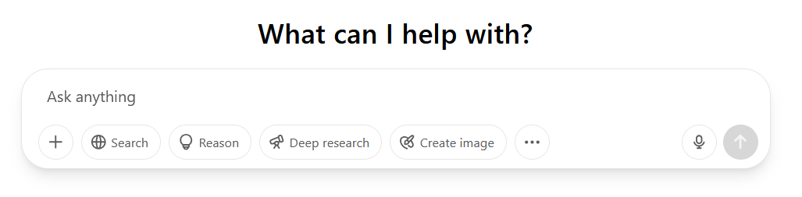
ChatGPT
Extra tools added

Slide 5
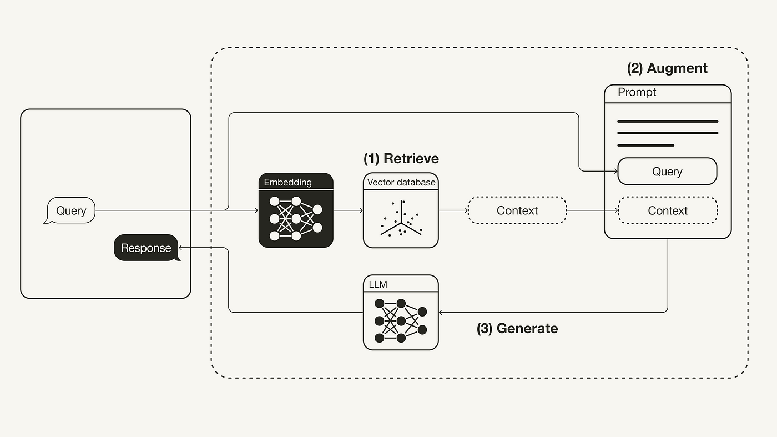
What is RAG?

Slide 6
Recall spam example
prompt_template = """
Classify the given email message as either spam or legitimate.
Examples are given below:
Message: "Hi Alex, just confirming our meeting tomorrow at 10 AM—let me know if anything changes."
Classification: Legitimate
Message: "Your account has been compromised—click here immediately to verify your identity and avoid suspension!"
Classification: Spam
Message: {message}
Classification:
"""

Slide 7
Limitations
Context length related to token cost
Limited context length (is it sufficient)?
Size of context vs. maximum context window

Slide 8
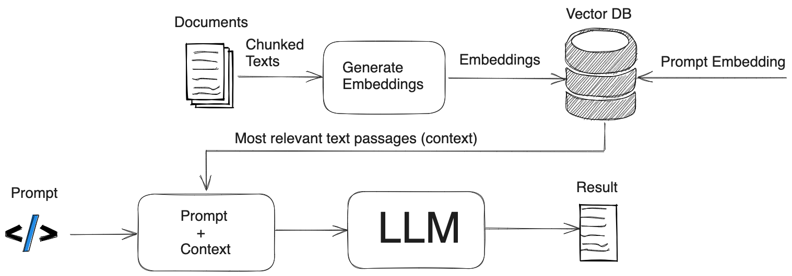
What is RAG?
Figure from https://safjan.com/understanding-retrieval-augmented-generation-rag-empowering-llms/

Slide 9
Vector embeddings
LLMs only accept floating point values as input
At the most basic level
Want to convert our context (data) to these vectors
Could be: TXT, PDF, DOC, XLS etc.

Slide 10
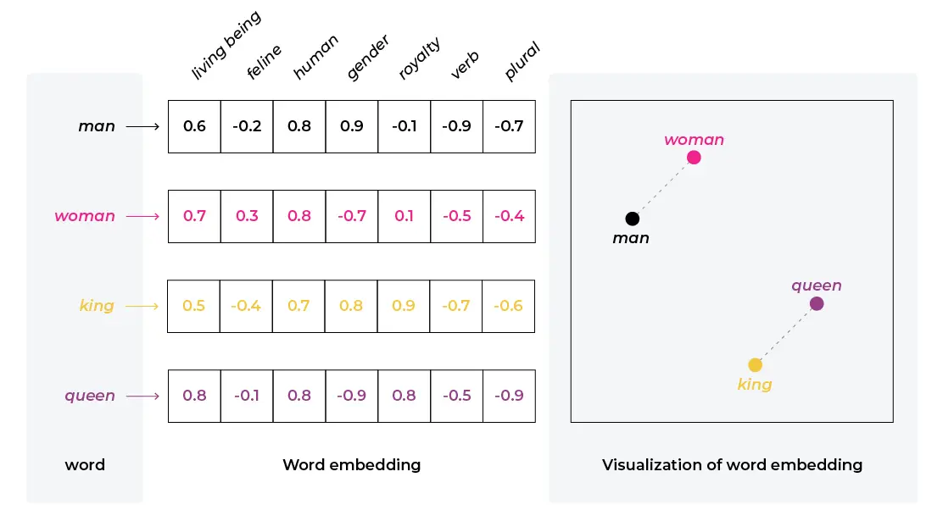
Vector embeddings
Figure from https://arize.com/blog-course/embeddings-meaning-examples-and-how-to-compute/

Slide 11
Indexing a vector database
Uses an embedding to map documents to vectors
OpenAIEmbeddings
OllamaEmbeddings
Need to choose among vector stores
Chroma
FAISS
Qdrant
…

Slide 12

Loading documents
from langchain_community.document_loaders import PyPDFLoader
file_path = (
"A-Survey-of-Large-Language-Models.pdf"
)
loader = PyPDFLoader(file_path)
pages = loader.load()

Slide 13
Splitting documents
from langchain_text_splitters import RecursiveCharacterTextSplitter
text_splitter = RecursiveCharacterTextSplitter(
chunk_size=1000, chunk_overlap=200, add_start_index=True
)
all_splits = text_splitter.split_documents(pages)
Demo: https://chunkviz.up.railway.app/

Slide 14
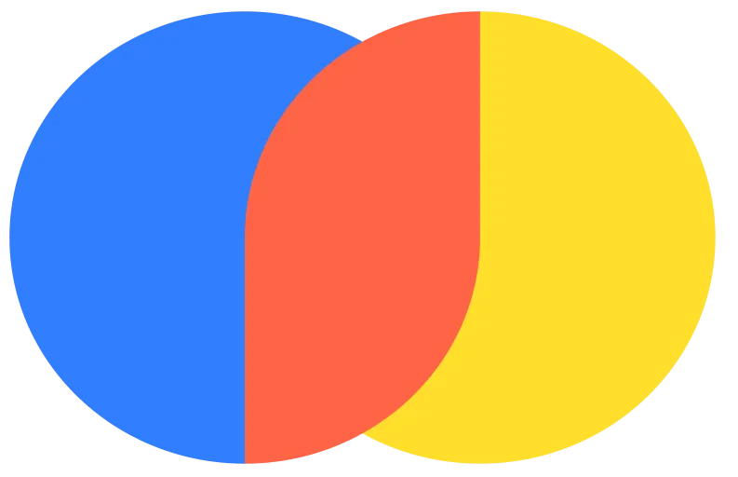
Vector DB ingestion
from langchain_openai import OpenAIEmbeddings
from langchain_community.vectorstores import Chroma
vectorstore = Chroma.from_documents(documents=all_splits, embedding=OpenAIEmbeddings())

Slide 15
Querying documents from DB
retriever = vectorstore.as_retriever(search_type="similarity", search_kwargs={"k": 6})
retrieved_docs = retriever.invoke("What are neural language models?")

Slide 16
A simple RAG application using LCEL
vectorstore = Chroma.from_documents(documents=all_splits, embedding=OpenAIEmbeddings())
retriever = vectorstore.as_retriever()
chain = (
{"context": retriever, "question": RunnablePassthrough()}
| prompt
| llm
| StrOutputParser()
)
result = chain.invoke("What are neural language models?")

Slide 17
Persistence of DB
vectorstore = Chroma.from_documents(documents=all_splits, embedding=OpenAIEmbeddings())
retriever = vectorstore.as_retriever()
chain = (
{"context": retriever, "question": RunnablePassthrough()}
| prompt
| llm
| StrOutputParser()
)
result = chain.invoke("What are neural language models?")

