Slide 1
서울시 거주자 건강제품 마케팅 대상추출
한국폴리텍대학 광명융합기술교육원 데이터분석과 2021학년 2160340104 이해니

Slide 2

오염사업장이 가장 많은 지역구 구하기
-- 최종 : 오염물질 배출 설치 사업장이 가장 많은 구
SELECT GU FROM (
SELECT COUNT(*), GU FROM(
SELECT NVL(ADDR1, ADDR2) AS GU FROM (
SELECT * FROM (
SELECT LOCATION_ADDR, ROAD_ADDR, SUBSTR(LOCATION_ADDR,7,3) AS ADDR1, SUBSTR(ROAD_ADDR,7,3) AS ADDR2 FROM
(SELECT * FROM POLLUTION WHERE LOCATION_ADDR LIKE '%서울특별시%' OR ROAD_ADDR LIKE '%서울특별시%')
)
)
) GROUP BY GU ORDER BY COUNT(*) DESC
) WHERE ROWNUM = 1;

Slide 3
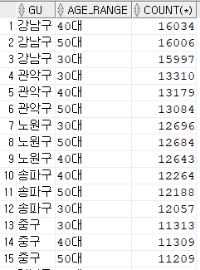
연령대별, 지역구별 고객 수 추출하기
-- 연령대별, GU별 고객 수 추출
SELECT GU, AGE_RANGE, COUNT(*) FROM (
SELECT GU,
CASE
WHEN AGE BETWEEN 10 AND 19 THEN '10대'
WHEN AGE BETWEEN 20 AND 29 THEN '20대'
WHEN AGE BETWEEN 30 AND 39 THEN '30대'
WHEN AGE BETWEEN 40 AND 49 THEN '40대'
WHEN AGE BETWEEN 50 AND 59 THEN '50대'
WHEN AGE BETWEEN 60 AND 69 THEN '60대'
WHEN AGE BETWEEN 70 AND 79 THEN '70대'
ELSE '기타'
END AS AGE_RANGE
FROM (
SELECT substr(ADDRESS1, 4,3) as GU, trunc((sysdate - BIRTH_DT) / 365) as AGE FROM (
SELECT * FROM (SELECT * FROM CUSTOMER WHERE SUBSTR(ADDRESS1, 0,2) = '서울') SEOUL
)
)
)
GROUP BY GU, AGE_RANGE
ORDER BY COUNT(*) DESC;

Slide 4

고객(Customer) 데이터와 연계(Join)
-- 두 개 JOIN : 페기물이 가장 많은 지역의 => 고객 연령대별가 가장 많은 분포 구하기 => 50대
SELECT AGE_RANGE FROM (SELECT GU, AGE_RANGE, COUNT(*) AS COUNT FROM (
SELECT GU,
CASE
WHEN AGE BETWEEN 10 AND 19 THEN '10대'
WHEN AGE BETWEEN 20 AND 29 THEN '20대'
WHEN AGE BETWEEN 30 AND 39 THEN '30대'
WHEN AGE BETWEEN 40 AND 49 THEN '40대'
WHEN AGE BETWEEN 50 AND 59 THEN '50대'
WHEN AGE BETWEEN 60 AND 69 THEN '60대'
WHEN AGE BETWEEN 70 AND 79 THEN '70대'
ELSE '기타'
END AS AGE_RANGE
FROM (
SELECT substr(ADDRESS1, 4,3) as GU, trunc((sysdate - BIRTH_DT) / 365) as AGE FROM (
SELECT * FROM (SELECT * FROM CUSTOMER WHERE SUBSTR(ADDRESS1, 0,2) = '서울') SEOUL
)
)
)
GROUP BY GU, AGE_RANGE
ORDER BY COUNT(*) DESC) C
INNER JOIN (SELECT GU FROM (
SELECT COUNT(*), GU FROM(
SELECT NVL(ADDR1, ADDR2) AS GU FROM (
SELECT * FROM (
SELECT LOCATION_ADDR, ROAD_ADDR, SUBSTR(LOCATION_ADDR,7,3) AS ADDR1, SUBSTR(ROAD_ADDR,7,3) AS ADDR2 FROM
(SELECT * FROM POLLUTION WHERE LOCATION_ADDR LIKE '%서울특별시%' OR ROAD_ADDR LIKE '%서울특별시%')
)
)
) GROUP BY GU ORDER BY COUNT(*) DESC
) WHERE ROWNUM = 1) P ON
C.GU = P.GU
WHERE ROWNUM = 1;

Slide 5
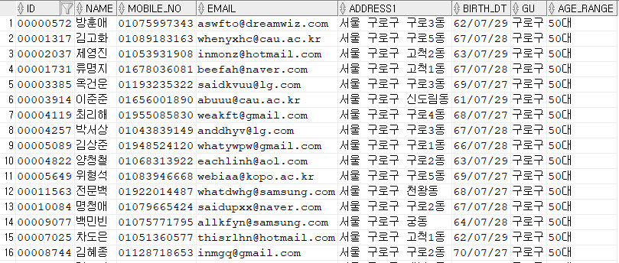
마케팅 대상자 구하기
SELECT * FROM (
SELECT ID, NAME, MOBILE_NO, EMAIL, ADDRESS1,BIRTH_DT, GU,
CASE
WHEN AGE BETWEEN 10 AND 19 THEN '10대'
WHEN AGE BETWEEN 20 AND 29 THEN '20대'
WHEN AGE BETWEEN 30 AND 39 THEN '30대'
WHEN AGE BETWEEN 40 AND 49 THEN '40대'
WHEN AGE BETWEEN 50 AND 59 THEN '50대'
WHEN AGE BETWEEN 60 AND 69 THEN '60대'
WHEN AGE BETWEEN 70 AND 79 THEN '70대'
ELSE '기타'
END AS AGE_RANGE
FROM (
SELECT ID, NAME, MOBILE_NO, EMAIL, ADDRESS1,BIRTH_DT,substr(ADDRESS1, 4,3) as GU, trunc((sysdate - BIRTH_DT) / 365) as AGE FROM (
SELECT * FROM (SELECT * FROM CUSTOMER WHERE SUBSTR(ADDRESS1, 0,2) = '서울') SEOUL
)
)
)
WHERE AGE_RANGE = (
SELECT AGE_RANGE FROM (SELECT GU, AGE_RANGE, COUNT(*) AS COUNT FROM (
SELECT GU,
CASE
WHEN AGE BETWEEN 10 AND 19 THEN '10대'
WHEN AGE BETWEEN 20 AND 29 THEN '20대'
WHEN AGE BETWEEN 30 AND 39 THEN '30대'
WHEN AGE BETWEEN 40 AND 49 THEN '40대'
WHEN AGE BETWEEN 50 AND 59 THEN '50대'
WHEN AGE BETWEEN 60 AND 69 THEN '60대'
WHEN AGE BETWEEN 70 AND 79 THEN '70대'
ELSE '기타'
END AS AGE_RANGE
FROM (
SELECT substr(ADDRESS1, 4,3) as GU, trunc((sysdate - BIRTH_DT) / 365) as AGE FROM (
SELECT * FROM (SELECT * FROM CUSTOMER WHERE SUBSTR(ADDRESS1, 0,2) = '서울') SEOUL
)
)
)
GROUP BY GU, AGE_RANGE
ORDER BY COUNT(*) DESC) C
INNER JOIN (SELECT GU FROM (
SELECT COUNT(*), GU FROM(
SELECT NVL(ADDR1, ADDR2) AS GU FROM (
SELECT * FROM (
SELECT LOCATION_ADDR, ROAD_ADDR, SUBSTR(LOCATION_ADDR,7,3) AS ADDR1, SUBSTR(ROAD_ADDR,7,3) AS ADDR2 FROM
(SELECT * FROM POLLUTION WHERE LOCATION_ADDR LIKE '%서울특별시%' OR ROAD_ADDR LIKE '%서울특별시%')
)
)
) GROUP BY GU ORDER BY COUNT(*) DESC
) WHERE ROWNUM = 1) P ON
C.GU = P.GU
WHERE ROWNUM = 1
) AND GU = (
SELECT GU FROM (
SELECT COUNT(*), GU FROM(
SELECT NVL(ADDR1, ADDR2) AS GU FROM (
SELECT * FROM (
SELECT LOCATION_ADDR, ROAD_ADDR, SUBSTR(LOCATION_ADDR,7,3) AS ADDR1, SUBSTR(ROAD_ADDR,7,3) AS ADDR2 FROM
(SELECT * FROM POLLUTION WHERE LOCATION_ADDR LIKE '%서울특별시%' OR ROAD_ADDR LIKE '%서울특별시%')
)
)
) GROUP BY GU ORDER BY COUNT(*) DESC
) WHERE ROWNUM = 1
);

Slide 6
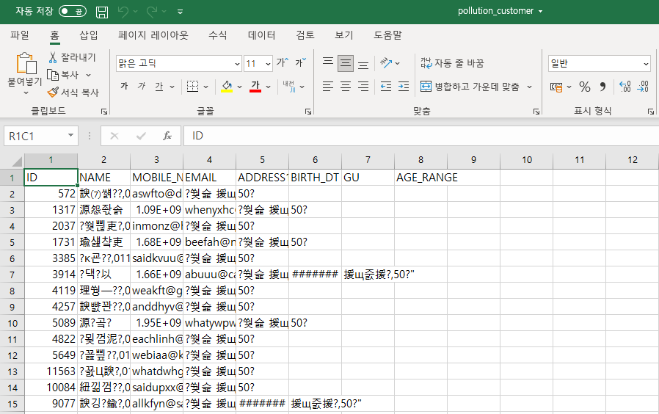
CSV 파일로 SPOOL => 실패
-- 한글 깨지는 오류 발생… 해결 방법은 찾는 중!
SET FEEDBACK OFF
SET HEAD ON
SPOOL C:\kopo-04-database\project-2\pollution_customer.CSV
SELECT /*csv*/ * FROM (
SELECT ID, NAME, MOBILE_NO, EMAIL, ADDRESS1,BIRTH_DT, GU,
CASE
WHEN AGE BETWEEN 10 AND 19 THEN '10대'
WHEN AGE BETWEEN 20 AND 29 THEN '20대'
WHEN AGE BETWEEN 30 AND 39 THEN '30대'
WHEN AGE BETWEEN 40 AND 49 THEN '40대'
WHEN AGE BETWEEN 50 AND 59 THEN '50대'
WHEN AGE BETWEEN 60 AND 69 THEN '60대'
WHEN AGE BETWEEN 70 AND 79 THEN '70대'
ELSE '기타'
END AS AGE_RANGE
FROM (
SELECT ID, NAME, MOBILE_NO, EMAIL, ADDRESS1,BIRTH_DT,substr(ADDRESS1, 4,3) as GU, trunc((sysdate - BIRTH_DT) / 365) as AGE FROM (
SELECT * FROM (SELECT * FROM CUSTOMER WHERE SUBSTR(ADDRESS1, 0,2) = '서울') SEOUL
)
)
)
WHERE AGE_RANGE = (
SELECT AGE_RANGE FROM (SELECT GU, AGE_RANGE, COUNT(*) AS COUNT FROM (
SELECT GU,
CASE
WHEN AGE BETWEEN 10 AND 19 THEN '10대'
WHEN AGE BETWEEN 20 AND 29 THEN '20대'
WHEN AGE BETWEEN 30 AND 39 THEN '30대'
WHEN AGE BETWEEN 40 AND 49 THEN '40대'
WHEN AGE BETWEEN 50 AND 59 THEN '50대'
WHEN AGE BETWEEN 60 AND 69 THEN '60대'
WHEN AGE BETWEEN 70 AND 79 THEN '70대'
ELSE '기타'
END AS AGE_RANGE
FROM (
SELECT substr(ADDRESS1, 4,3) as GU, trunc((sysdate - BIRTH_DT) / 365) as AGE FROM (
SELECT * FROM (SELECT * FROM CUSTOMER WHERE SUBSTR(ADDRESS1, 0,2) = '서울') SEOUL
)
)
)
GROUP BY GU, AGE_RANGE
ORDER BY COUNT(*) DESC) C
INNER JOIN (SELECT GU FROM (
SELECT COUNT(*), GU FROM(
SELECT NVL(ADDR1, ADDR2) AS GU FROM (
SELECT * FROM (
SELECT LOCATION_ADDR, ROAD_ADDR, SUBSTR(LOCATION_ADDR,7,3) AS ADDR1, SUBSTR(ROAD_ADDR,7,3) AS ADDR2 FROM
(SELECT * FROM POLLUTION WHERE LOCATION_ADDR LIKE '%서울특별시%' OR ROAD_ADDR LIKE '%서울특별시%')
)
)
) GROUP BY GU ORDER BY COUNT(*) DESC
) WHERE ROWNUM = 1) P ON
C.GU = P.GU
WHERE ROWNUM = 1
) AND GU = (
SELECT GU FROM (
SELECT COUNT(*), GU FROM(
SELECT NVL(ADDR1, ADDR2) AS GU FROM (
SELECT * FROM (
SELECT LOCATION_ADDR, ROAD_ADDR, SUBSTR(LOCATION_ADDR,7,3) AS ADDR1, SUBSTR(ROAD_ADDR,7,3) AS ADDR2 FROM
(SELECT * FROM POLLUTION WHERE LOCATION_ADDR LIKE '%서울특별시%' OR ROAD_ADDR LIKE '%서울특별시%')
)
)
) GROUP BY GU ORDER BY COUNT(*) DESC
) WHERE ROWNUM = 1
);
SPOOL OFF;
EXIT;

Slide 7
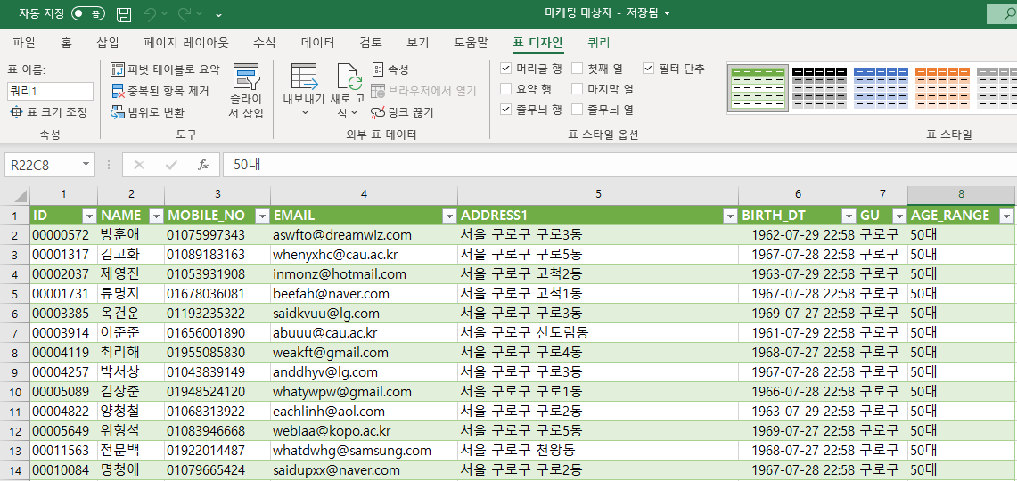
ODBC, Excel로 고객 목록 출력

Slide 8
ODBC, Excel로 데이터 시각화
SELECT GU, AGE_RANGE, COUNT(*) FROM (
SELECT GU,
CASE
WHEN AGE BETWEEN 10 AND 19 THEN '10대'
WHEN AGE BETWEEN 20 AND 29 THEN '20대'
WHEN AGE BETWEEN 30 AND 39 THEN '30대'
WHEN AGE BETWEEN 40 AND 49 THEN '40대'
WHEN AGE BETWEEN 50 AND 59 THEN '50대'
WHEN AGE BETWEEN 60 AND 69 THEN '60대'
WHEN AGE BETWEEN 70 AND 79 THEN '70대'
ELSE '기타'
END AS AGE_RANGE
FROM (
SELECT substr(ADDRESS1, 4,3) as GU, trunc((sysdate - BIRTH_DT) / 365) as AGE FROM (
SELECT * FROM (SELECT * FROM CUSTOMER WHERE SUBSTR(ADDRESS1, 0,2) = '서울') SEOUL
)
)
)
GROUP BY GU, AGE_RANGE
ORDER BY COUNT(*) DESC;

Slide 9
ODBC, Excel로 데이터 시각화

