Slide 1

Assessing the Impact of Dataset Characteristics —Homogeneity Composition and Data Sparsity— on AI Model Transparency, Fairness, and Bias Evaluation Examining Bias and Unfairness in Explainable Artificial Intelligence (XAI) Due to Imbalanced Training Data and Misleading Effects of Small Sample Sizes
Purwadi, Henny

Slide 2
Abstract
Addressing the Characteristics of the Dataset, including its homogeneity composition and Data Sparsity, is critical for a comprehensive approach to Responsible AI (XAI).
1. Homogeneity Composition: balanced vs imbalanced datasets.
2. Data Sparsity: small vs large datasets.

Slide 3
Agenda
Introduction
Literature Review
Methodology
Result Findings
Discussions
Conclusions
Bibliography

Slide 4
01. Introduction

Slide 5
This study proposes the incorporation of dataset characteristics to be documented into Responsible AI and Explainable AI (XAI) practices, especially the homogeneity composition, whether the dataset is balanced or imbalanced, and data sparsity, whether small or large samples, for transparency at both the data and model levels

Slide 6
Research Questions
1. How does the dataset homogeneity composition (balance vs. imbalanced) impact the AI model transparency and fairness in decision-making systems?
2. What is the relationship between data sparsity/ dataset’s size and the accuracy of bias evaluation in AI models, when the training data is class-imbalanced ?
3. How do small sample sizes mislead the bias evaluation for models trained on class-imbalanced datasets?

Slide 7
02. Literature Review

Slide 8
2.1. Overview of Relevant Previous Study
Based on research studied by Miao, Y., Cao, H., and Tang, M. (2022), the imbalance ratio (IR) influences the performance and stability of the model. The models like Logistic Regression, Decision Trees, and Support Vector Classifiers show less stability, while Naive Bayes, Random Forests, and Gradient Boosting Decision Trees showed more stable performance.
The study by Lin (2018) with title "Bias caused by sampling error in meta-analysis with small sample sizes" warned that too small sample sizes can create significant bias.

Slide 9
2.2. Terminology and Definition
Accuracy shows the overall correctness of the model.
Precision is a metric that measures how often a predicted label is correct.
Recall is a metric that measures how often a true label is correctly predicted.
F1-score is the harmonic mean of precision and recall.
AUC-PR is PRECISION-RECALL curve, SHOWS overall performance of the model.
A higher AUC value indicates better performance.

Slide 10
03. Methodology

Slide 11
Methodology
Synthetic/ Artificial Datasets
Small Balanced Datasets (n = 10000) vs Large Balanced Datasets (n = 1000000)
Small Imbalanced Datasets (n = 10000) vs Large Imbalanced Datasets (n = 1000000)
Logistic Regression
LIME (local interpretable model-agnostic explanations)

Slide 12
04. Result Findings

Slide 13
Large Size Dataset

Slide 14
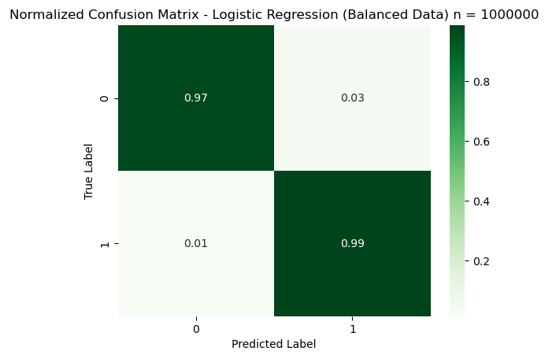
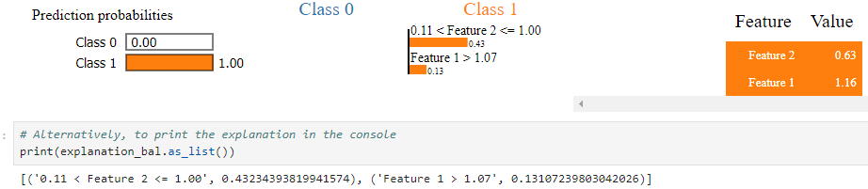
Large and Class-Balanced Dataset
Good for all classes.
LIME's explanation for large balanced dataset shows that both features contribute to both classes.
No class was ignored.

Slide 15
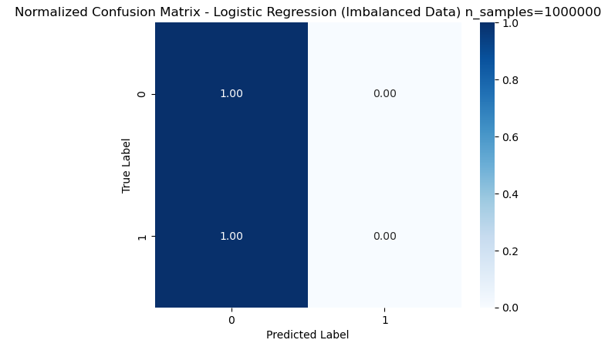
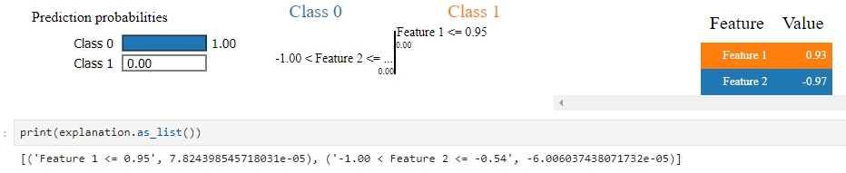
Large and Class-Imbalanced Dataset
There is a bias towards the majority class in Class-Imbalanced Dataset.
The model predicts Class 0 with 100% confidence.
Probability of Class 1 is zero.
Class 1 is the minority class, and the model learned to totally ignores the probability of class 1 completely.

Slide 16
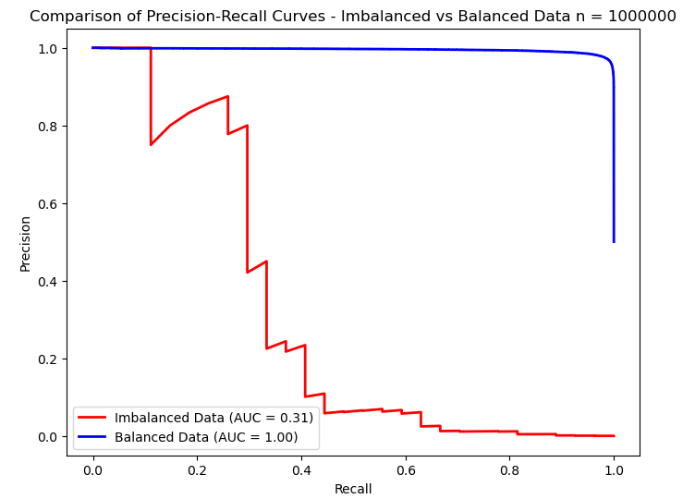
Large Size Dataset Comparison
A low AUC value means that the prediction for the class is poor and has bias. A high AUC value means that the prediction for the class is good and has no bias.
The area under the curve (AUC) for Class-Balanced Data is higher than Class-Imbalanced Data.
The model performs very well when the dataset is balanced.
The model's true inability to predict the minority class becomes obvious, with a significant drop in AUC from 0.97 to 0.31.

Slide 17
Small size Dataset

Slide 18
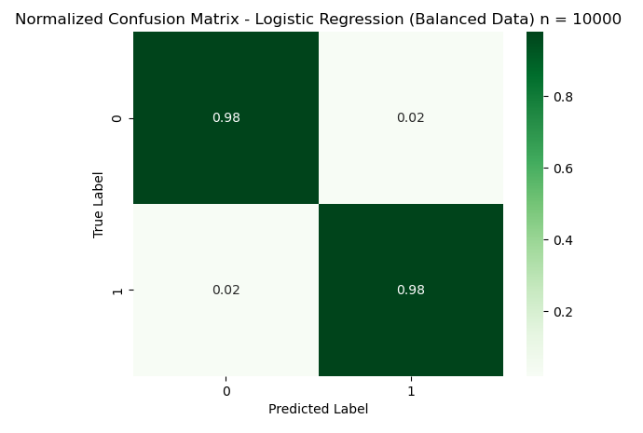
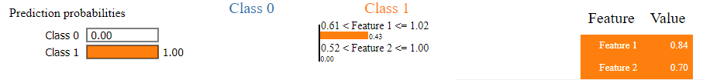
Small and Class-Balanced Dataset
The model can considering all features.
Both features contribute to all classes. No class was ignored.

Slide 19
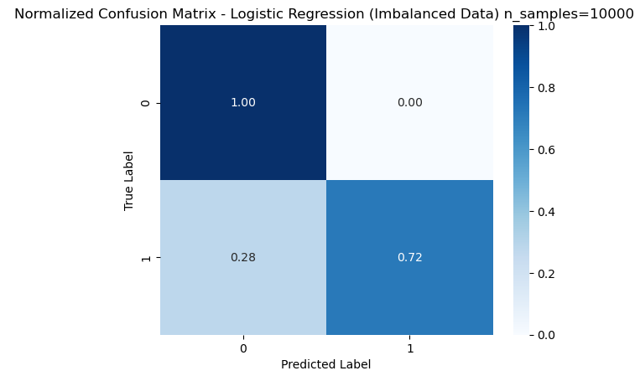
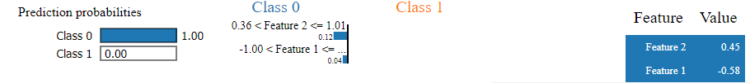
Small and Class-Imbalanced Dataset
There is a bias in class-imbalanced dataset. But the small sample size can’t detect it.
In small sample size, the performance metrics fakes the bias on class-imbalanced dataset.

Slide 20
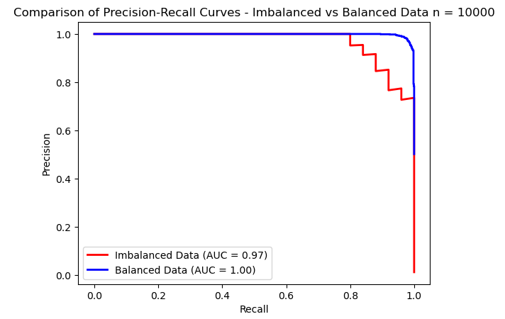
Small sample size Dataset Comparison
Smaller sample sizes can fake the bias of class imbalance,
making fake perception of model fairness.

Slide 21
Result
Dataset Characteristic | AUC
Small Balanced | 1.00
Small Imbalanced | 0.97
Large Balanced | 1.00
Large Imbalanced | 0.31
There is bias in class-imbalance dataset. But small sample size can’t detect it.
Large data set can show the true face of the bias, provides more accurate and reliable evaluation of models.
In small and imbalanced datasets, model often shows a fake high performances metrics, gives misleading results.

Slide 22
05. Discussions

Slide 23
A significant impact of dataset composition on model fairness and transparency
Class-Imbalanced data set results in bias in the model that discriminatively and unfairly predicts directly for the majority class. Minority groups are not represented, resulting in low accuracy.
Small Sample Size gave misleading impression of fairness, because it can fake the model's performance on minority classes, when in fact it does not.
Bias Evaluation is failed when using small class-imbalanced data sets

Slide 24
Discussion of Limitation Several limitations of this research
This study only evaluates two types of data characteristics, which are only data homogeneity and data sparsity
This study only use logistic regression model
The study was also limited to only the use of synthetic (artificial) datasets.

Slide 25
06. Conclusions

Slide 26
Broader Impact on XAI
This research found the important and needs for more data documentation standard in Responsible AI practices. Usually, AI fairness has focused on model transparency and explainability, but this research shows that documenting dataset composition is also very important.
By not addressing dataset homogeneity/ imbalance and how small sample sizes is, the biases can go undetected, and then leading to discriminative result in critical decision-making processes.
The study underlines the importance of moving beyond model explainability. Transparency at both the model and dataset levels is essential for building fair AI systems.

Slide 27
Recommendation for Future Research
1.Bias Mitigation Techniques:
develop bias mitigation techniques in more detail, for example, Synthetic Minority Over-sampling (SMOTE) or Under-sampling Technique.
2.Exploring Other Models
This study was performed using logistic regression; while future research should include similar analysis of more complex models.
3. Explore the Impact of other Dataset Characteristics:
investigate how the differences in the dataset’s characteristics such as feature noise, multivariate normality, correlation between features etc.

Slide 28
07. Bibliography

Slide 29
[1] Burkov,A. 2019. The Hundred-Page Machine Learning Book. Retrieved on October 12, 2024, from [2] Dadkhahnikoo, Neama. (2019-11-11). Incident Number 92. In McGregor, S. (ed.) Artificial Intelligence Incident Database. Responsible AI Collaborative. Retrieved on October 12, 2024, from https://incidentdatabase.ai/cite/92. [3] Johnson, J.M. and Khoshgoftaar, T.M. 2019. Survey on deep learning with class imbalance. Journal of Big Data. 6, 27 (2019). https://doi.org/10.1186/s40537-019-0192-5 [4] Jurafsky, D., & Martin, J. H. (2024, August 20). Logistic Regression. In Speech and Language Processing (3rd ed.). Retrieved from https://web.stanford.edu/~jurafsky/slp3/5.pdf. [5] Kou, G., Yang, P., Peng, Y., Xiao, F., Chen, Y., and Alsaadi, F.E. 2019. Evaluation of feature selection methods for text classification with small datasets using multiple criteria decision-making methods. Applied Soft Computing 86, 105836. DOI: https://doi.org/10.1016/j.asoc.2019.105836. [6] Lee, Y., and Sun, H. 2023. A survey on imbalanced learning: latest research, applications, and future directions. Artificial Intelligence Review 56, 4, 721–739. [7] Lin, L. 2018. Bias caused by sampling error in meta-analysis with small sample sizes. DOI: https://doi.org/10.1371/journal.pone.0204056. [8] Murphey, Y., and Anand, S. 2021. The class imbalance problem in deep learning. Machine Learning 44, 3, 123–134. DOI: [9] Miao, Y., Cao, H., and Tang, M. 2022. A method for analyzing the performance impact of imbalanced binary data on machine learning models. Axioms 11, 11, 607. DOI: https://doi.org/10.3390/axioms11110607. [10]National Institute of Standards and Technology (NIST). 2021. Four Principles of Explainable Artificial Intelligence. NIST Internal Report 8312, 1–23. Available at: https://nvlpubs.nist.gov/nistpubs/ir/2021/NIST.IR.8312.pdf. [11] Oreski, D., Oreski, S., and Klicek, B. 2017. Effects of dataset characteristics on the performance of feature selection techniques. Applied Soft Computing 52, 109-119. DOI: https://doi.org/10.1016/j.asoc.2016.12.023. [12]Prashant. 2019. Explain Your Model Predictions with LIME. Retrieved from https://www.kaggle.com/code/prashant111/explain-your-model-predictions-with-lime/notebook. [13]The Conference Board. 2023. Explainability in AI: The Key to Trustworthy AI Decisions. Retrieved from https://www.conference-board.org/publications/explainability-in-ai.

Slide 30
Thank you
Purwadi, Henny
202370140

