Slide 2
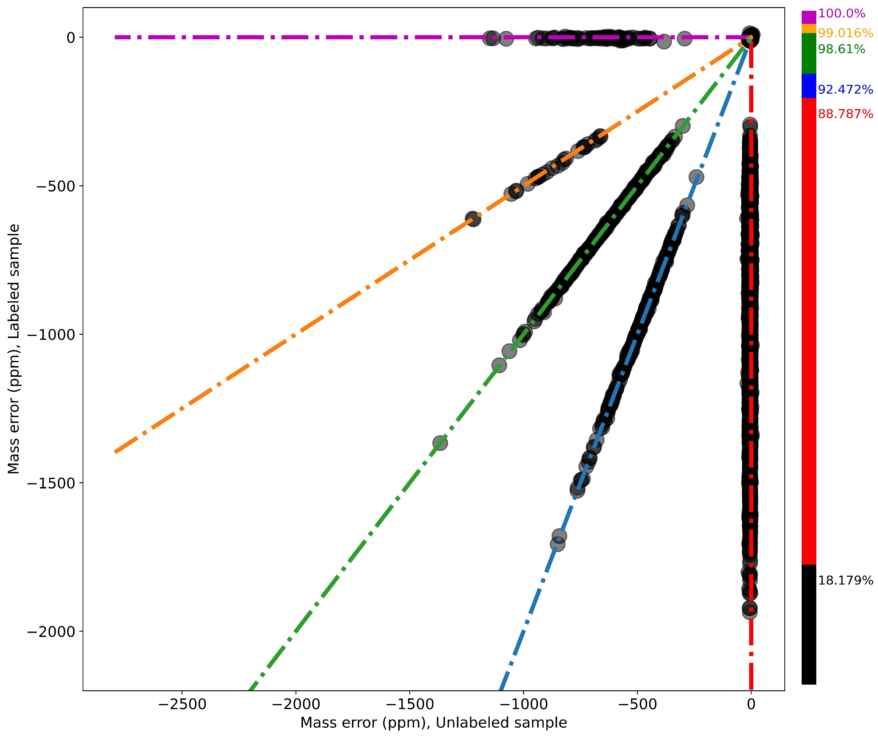
M^{u}_{i>0}, M^{L}_{j=0}
HEART
M^{u}₂, M^{L}₁
M^{u}_{i>0}, M^{L}_{j=i}
M^{u}₀, M^{L}_{j>0}
M^{u}₁, M^{L}₂

Slide 3
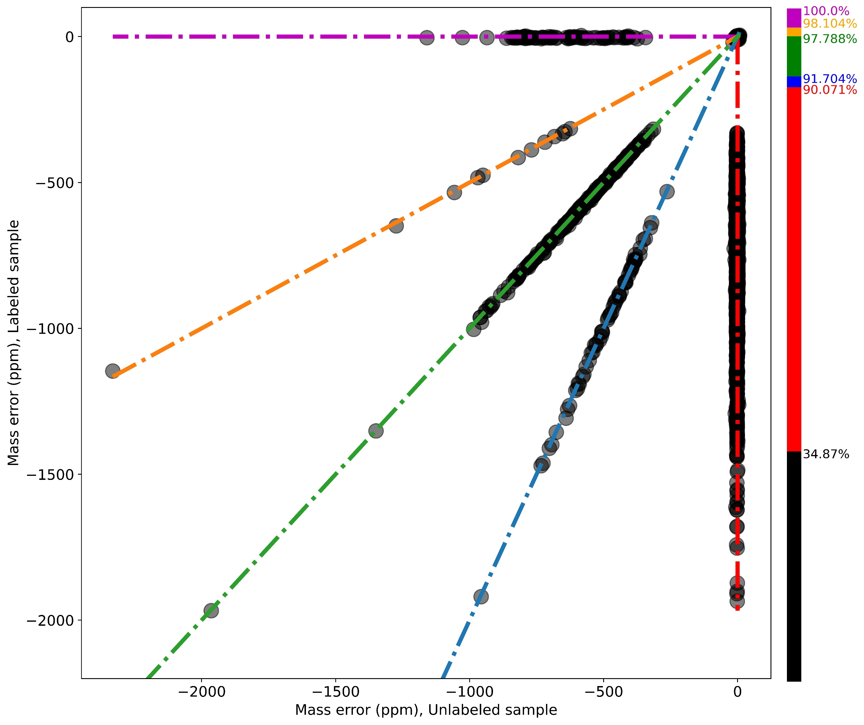
M^{u}_{i>0}, M^{L}_{j=0}
muscle
M^{u}₂, M^{L}₁
M^{u}_{i>0}, M^{L}_{j=i}
M^{u}₀, M^{L}_{j>0}
M^{u}₁, M^{L}₂

Slide 4
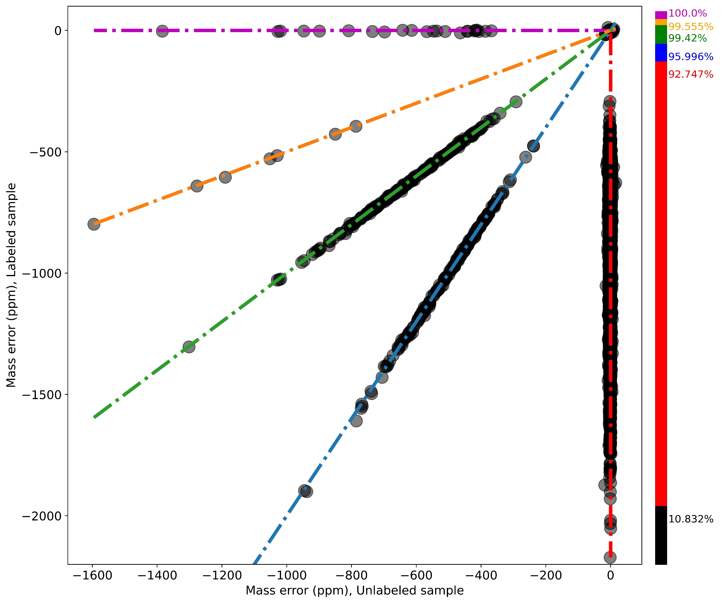
M^{u}_{i>0}, M^{L}_{j=0}
M^{u}₂, M^{L}₁
Kidney
M^{u}_{i>0}, M^{L}_{j=i}
M^{u}₀, M^{L}_{j>0}
M^{u}₁, M^{L}₂

