Slide 2
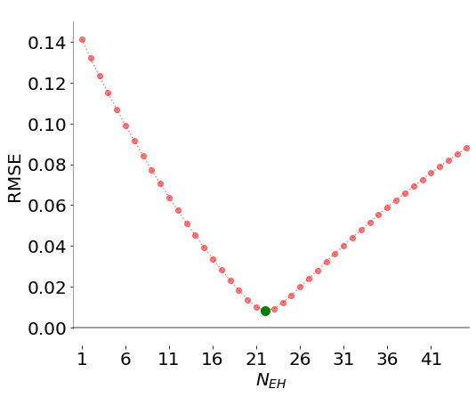
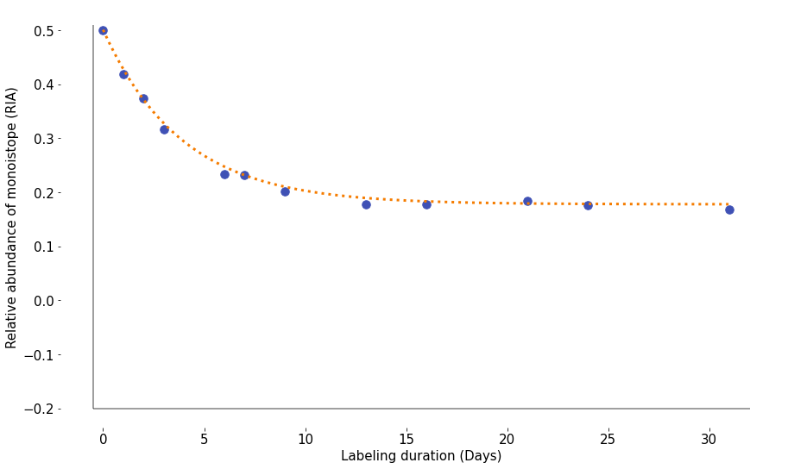
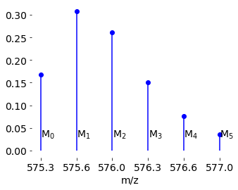
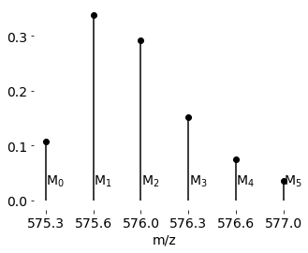
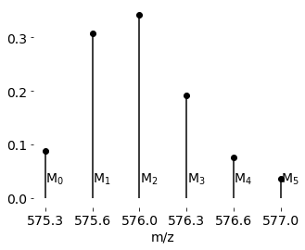
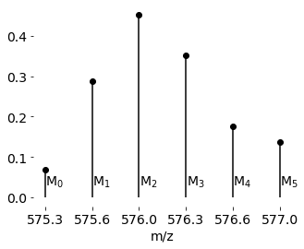
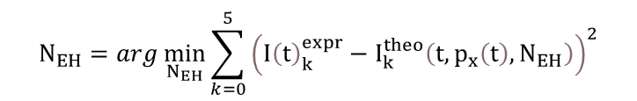
$$N_{EH}=arg\min_{N_{EH}}{\sum_{k=0}^{5}{{\left({I\left(t\right)}_{k}^{expr}−I_{k}^{theo}\left(t,p_{x}\left(t\right),N_{EH}\right)\right)}^{2}}}$$
+
+
+ …
=

Slide 3
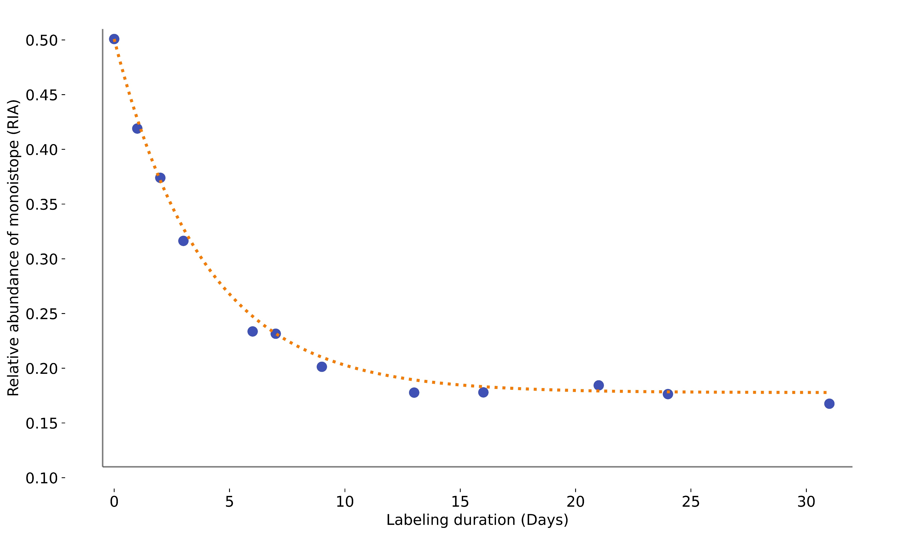
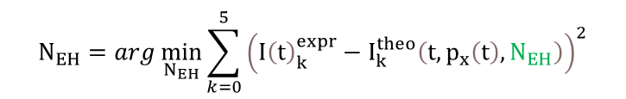






$$I_{0}\left(0\right)$$
$$N_{EH}=arg\min_{N_{EH}}{\sum_{k=0}^{5}{{\left({I\left(t\right)}_{k}^{expr}−I_{k}^{theo}\left(t,p_{x}\left(t\right),N_{EH}\right)\right)}^{2}}}$$
2
1
NNLS (${\{I}_{0}\left(0\right),…{\{I}_{0}\left(t_{i}\right)\},\{0,…t_{i}\}$) $I_{0}^{asymp}$, $k$
$$I_{0}^{asymp}=I_{0}\left(0\right){∗\left(1−p_{W}/(1−p_{H})\right)}^{N_{EH}}$$
$$I_{0}\left(t\right)={ I}_{0}^{asymp}+ \left({I_{0}\left(0\right)− I}_{0}^{asymp}\right)e^{−kt}$$
$$I_{0}^{asymp}$$
$x_{k}= \left({N_{EH} \atop k}\right){p_{w}}^{k}(1−p_{w})^{N_{EH}−k}$
3
$N_{EH}=\frac{2\left(1−p_{w}\right)}{p_{w}}\frac{x_{2}}{x_{1}} +1$
²H₁
+
²H₂
+
+ …
=

Slide 4





$$I_{0}\left(0\right)$$
$$N_{EH}=arg\min_{N_{EH}}{\sum_{k=0}^{5}{{\left({I\left(t\right)}_{k}^{expr}−I_{k}^{theo}\left(t,p_{x}\left(t\right),N_{EH}\right)\right)}^{2}}}$$
1
NNLS (${\{I}_{0}\left(0\right),…{\{I}_{0}\left(t_{i}\right)\},\{0,…t_{i}\}$) $I_{0}^{asymp}$, $k$
2
$$I_{0}^{asymp}=I_{0}\left(0\right){∗\left(1−p_{W}/(1−p_{H})\right)}^{N_{EH}}$$
$$I_{0}\left(t\right)={ I}_{0}^{asymp}+ \left({I_{0}\left(0\right)− I}_{0}^{asymp}\right)e^{−kt}$$
$$I_{0}^{asymp}$$
$x_{k}= \left({N_{EH} \atop k}\right){p_{w}}^{k}(1−p_{w})^{N_{EH}−k}$
3
$N_{EH}=\frac{2\left(1−p_{w}\right)}{p_{w}}\frac{x_{2}}{x_{1}} +1$
²H₁
+
²H₂
+
+ …
=

Slide 5
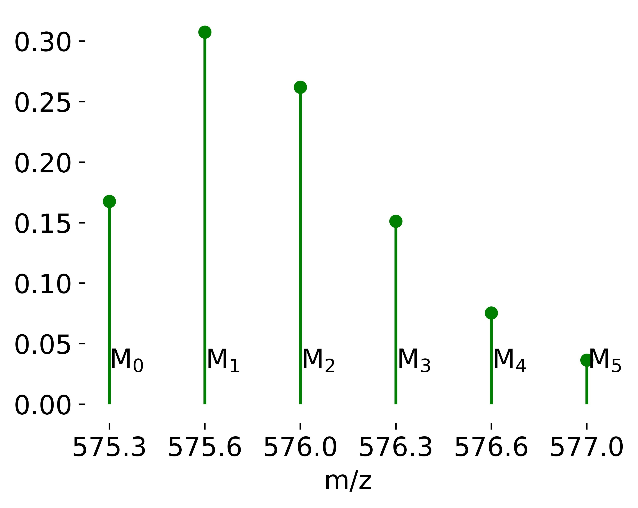
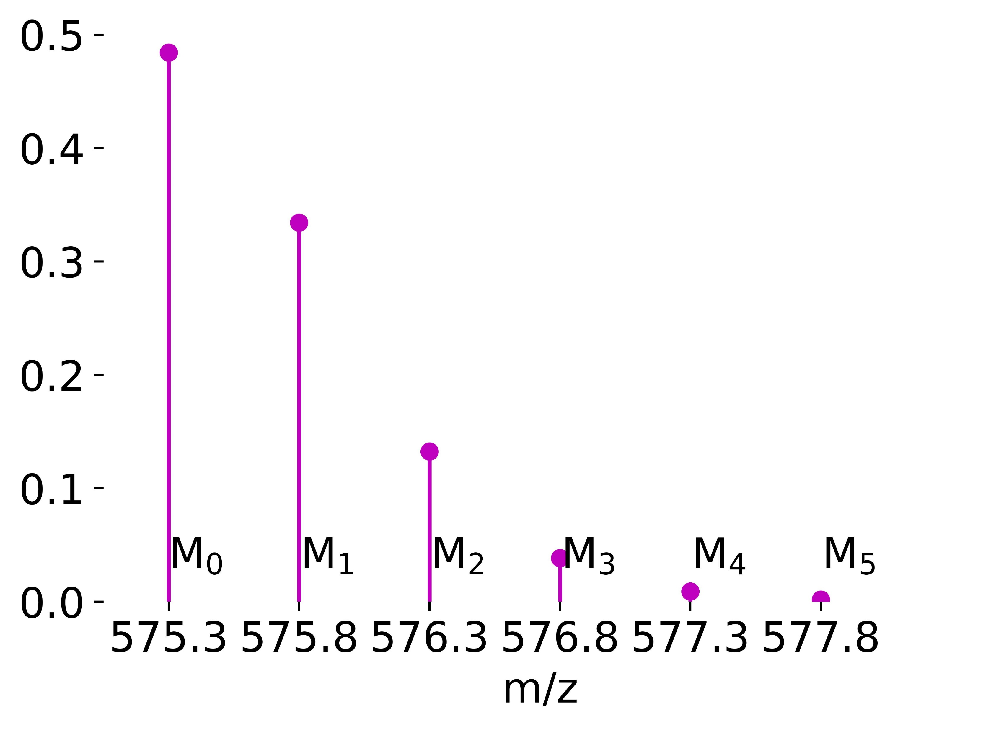
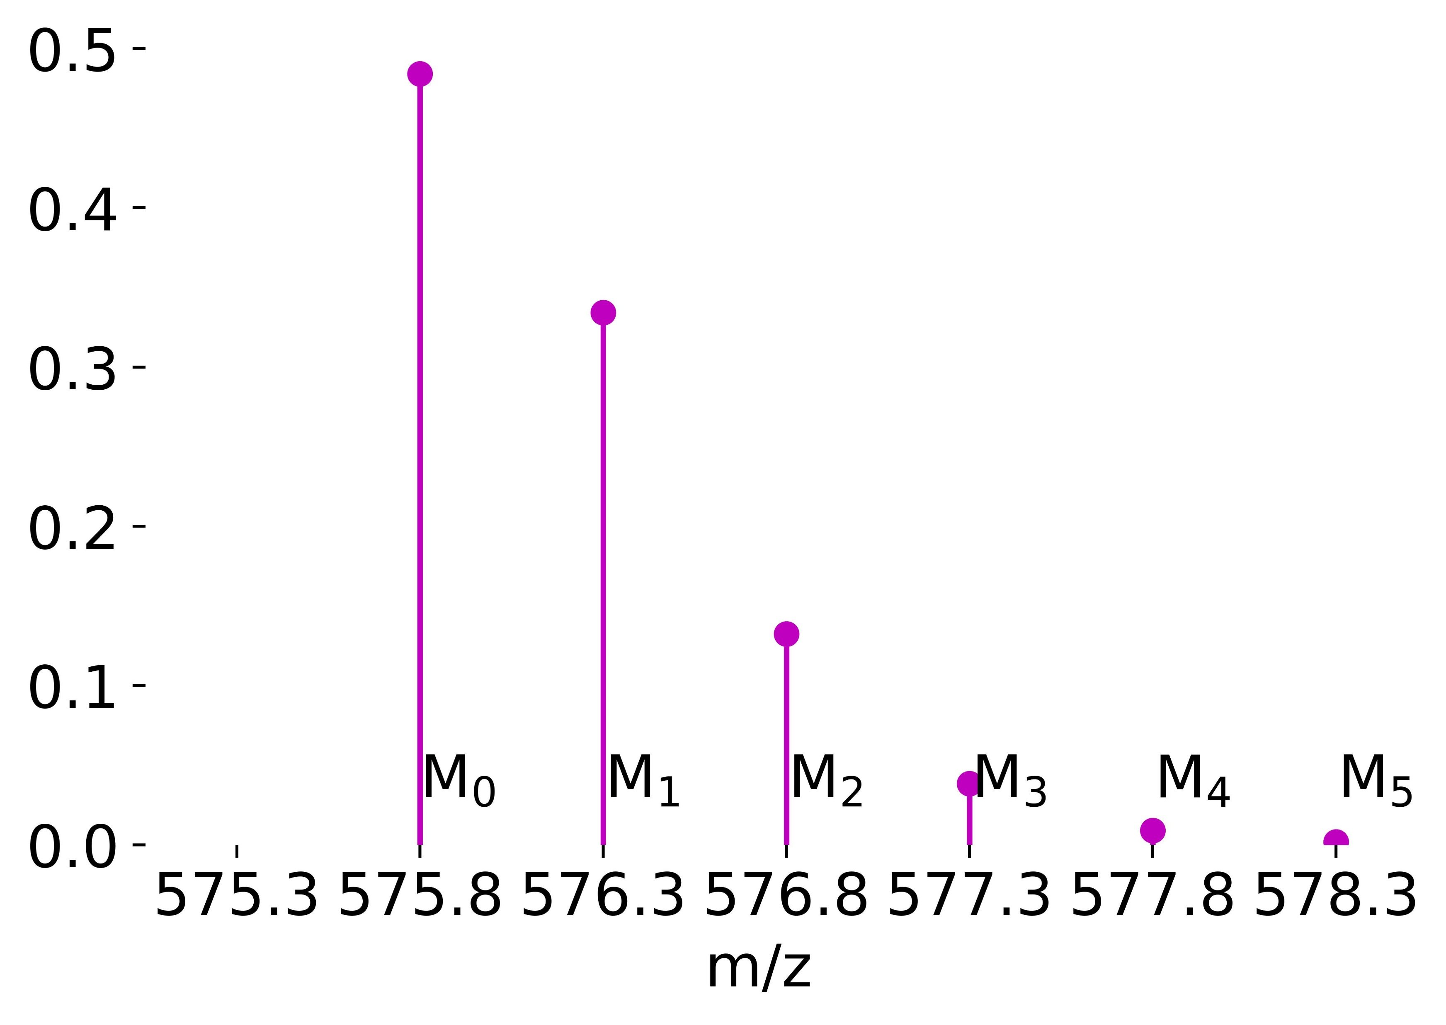
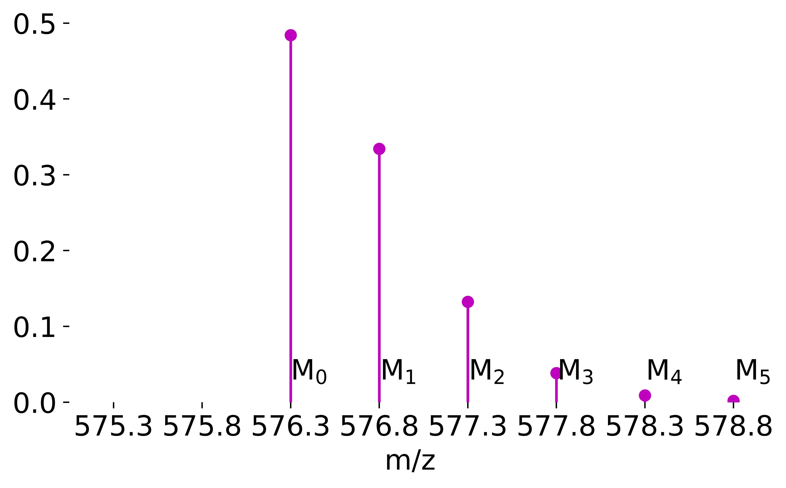



$$I_{0}\left(0\right)$$
$$N_{EH}=arg\min_{N_{EH}}{\sum_{k=0}^{5}{{\left({I\left(t\right)}_{k}^{expr}−I_{k}^{theo}\left(t,p_{x}\left(t\right),N_{EH}\right)\right)}^{2}}}$$
1
NNLS (${\{I}_{0}\left(0\right),…{\{I}_{0}\left(t_{i}\right)\},\{0,…t_{i}\}$) $I_{0}^{asymp}$, $k$
2
$$I_{0}^{asymp}=I_{0}\left(0\right){∗\left(1−p_{W}/(1−p_{H})\right)}^{N_{EH}}$$
$$I_{0}\left(t\right)={ I}_{0}^{asymp}+ \left({I_{0}\left(0\right)− I}_{0}^{asymp}\right)e^{−kt}$$
$$I_{0}^{asymp}$$
$x_{k}= \left({N_{EH} \atop k}\right){p_{w}}^{k}(1−p_{w})^{N_{EH}−k}$
3
$N_{EH}=\frac{2\left(1−p_{w}\right)}{p_{w}}\frac{x_{2}}{x_{1}} +1$
$x_{0}$ *
+
$x_{1}$ *
+
$x_{1}$ *
+ …
=
Natural
²H₁
²H₂
Labeled

Slide 6









$$I_{0}\left(0\right)$$
$$N_{EH}=arg\min_{N_{EH}}{\sum_{k=0}^{5}{{\left({I\left(t\right)}_{k}^{expr}−I_{k}^{theo}\left(t,p_{x}\left(t\right),N_{EH}\right)\right)}^{2}}}$$
1
NNLS (${\{I}_{0}\left(0\right),…{\{I}_{0}\left(t_{i}\right)\},\{0,…t_{i}\}$) $I_{0}^{asymp}$, $k$
2
$$I_{0}^{asymp}=I_{0}\left(0\right){∗\left(1−p_{W}/(1−p_{H})\right)}^{N_{EH}}$$
$$I_{0}\left(t\right)={ I}_{0}^{asymp}+ \left({I_{0}\left(0\right)− I}_{0}^{asymp}\right)e^{−kt}$$
$$I_{0}^{asymp}$$
$x_{k}= \left({N_{EH} \atop k}\right){p_{w}}^{k}(1−p_{w})^{N_{EH}−k}$
3
$N_{EH}=\frac{2\left(1−p_{w}\right)}{p_{w}}\frac{x_{2}}{x_{1}} +1$
$x_{0}$ *
+
$x_{1}$ *
+
$x_{2}$ *
+ …
=
Natural
²H₁
²H₂
Labeled

Slide 7


$$I_{0}\left(0\right)$$
$$N_{EH}=arg\min_{N_{EH}}{\sum_{k=0}^{5}{{\left({I\left(t\right)}_{k}^{expr}−I_{k}^{theo}\left(t,p_{x}\left(t\right),N_{EH}\right)\right)}^{2}}}$$
1
NNLS ($I_{0}\left(0\right),…I_{0}\left(t_{i}\right)$) $I_{0}^{asymp}$, $k$
2
$$N_{EH}=\frac{ln \left(I_{0}^{asymp}\right)−ln\left(I_{0}\left(0\right)\right)}{ln \left( 1− \frac{p_{W}}{1−p_{H}}\right)}$$
$$I_{0}\left(t\right)={ I}_{0}^{asymp}+ \left({I_{0}\left(0\right)− I}_{0}^{asymp}\right)e^{−kt}$$
$$I_{0}^{asymp}$$
$x_{k}= \left({N_{EH} \atop k}\right){p_{w}}^{k}(1−p_{w})^{N_{EH}−k}$
3
$N_{EH}=\frac{2\left(1−p_{w}\right)}{p_{w}}\frac{x_{2}}{x_{1}} +1$
$x_{0}$ *
+
$x_{1}$ *
+
$x_{2}$ *
+ …
=
Natural
²H₁
²H₂
Labeled

Slide 8
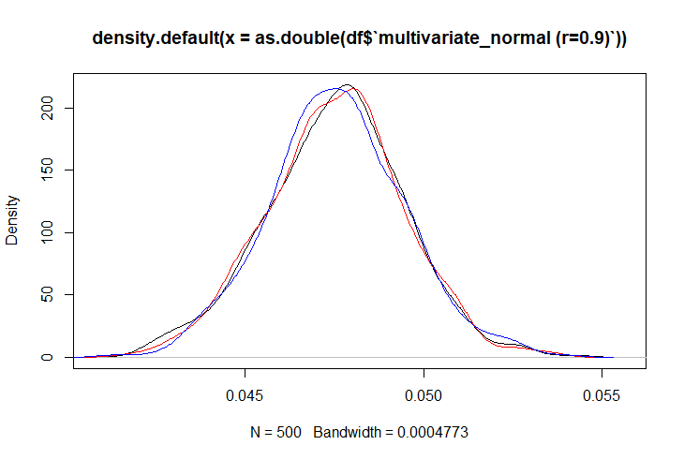
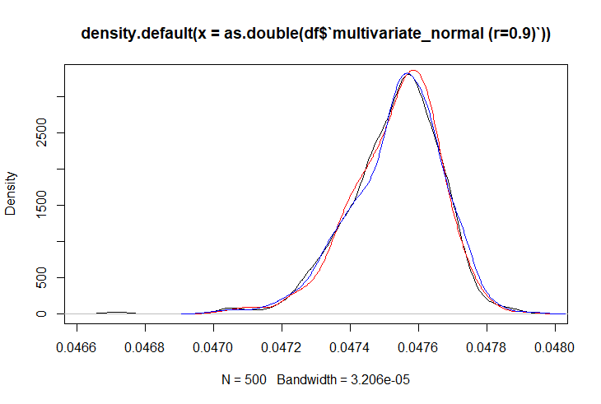

Slide 11
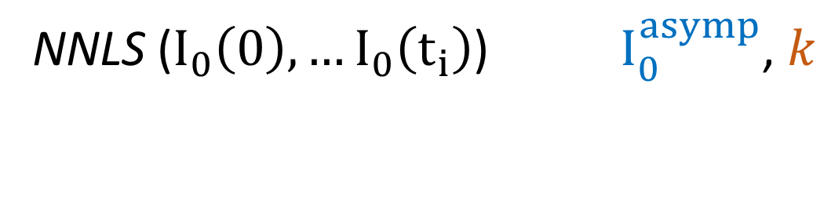
NNLS ($I_{0}\left(0\right),…I_{0}\left(t_{i}\right)$) $I_{0}^{asymp}$, $k$

Slide 12

$$I_{0}\left(0\right)$$
$$N_{EH}=arg\min_{N_{EH}}{\sum_{k=0}^{5}{{\left({I\left(t\right)}_{k}^{expr}−I_{k}^{theo}\left(t,p_{x}\left(t\right),N_{EH}\right)\right)}^{2}}}$$
1
NNLS ($I_{0}\left(0\right),…I_{0}\left(t_{i}\right)$) $I_{0}^{asymp}$, $k$
2
$$N_{EH}=\frac{ln \left(I_{0}^{asymp}\right)−ln\left(I_{0}\left(0\right)\right)}{ln \left( 1− \frac{p_{W}}{1−p_{H}}\right)}$$
$$I_{0}\left(t\right)={ I}_{0}^{asymp}+ \left({I_{0}\left(0\right)− I}_{0}^{asymp}\right)e^{−kt}$$
$$I_{0}^{asymp}$$
$x_{k}= \left({N_{EH} \atop k}\right){p_{w}}^{k}(1−p_{w})^{N_{EH}−k}$
3
$N_{EH}=\frac{2\left(1−p_{w}\right)}{p_{w}}\frac{x_{2}}{x_{1}} +1$
$x_{0}$ *
+
$x_{1}$ *
+
$x_{2}$ *
+ …
=
Natural
²H₁
²H₂
Labeled

