Slide 1
Diabetic Class classification Summary

Slide 2
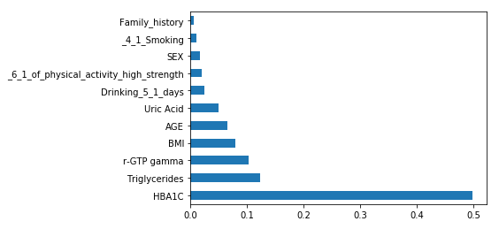
Diabetic class classification
Selected features
HBA1C,
Triglycerides,
BMI,
SBP,
DBP,
r-GTP gamma,
SEX,
AGE,
Uric Acid,
SGPT,
Smoking,
Drinking,
Physical_activity_high_strength,
Family history

Slide 3
Diabetic class classification
Total data size: (535,169, 404)
Data size after (Diabetic, Hypertension and Hyperlipidemia case removed): (466,680, 405)
Data size after the 11 features are selected and null values are dropped: (142,724, 12)
Class distribution of the dataset
Class 2: 2,451
Class 1: 36,237
Class 0: 104,036
Train test dataset split
 | Training size | Test size
Class 0 | 1951 | 500
Class 1 | 1951 | 500
Class 2 | 1951 | 500

Slide 4
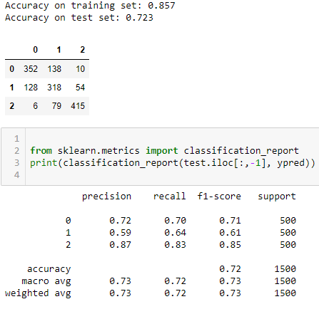
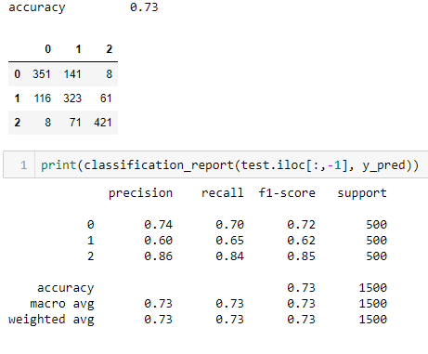
Diabetic class classification result
Random Forest Classifier
XGBClassifier

Slide 5
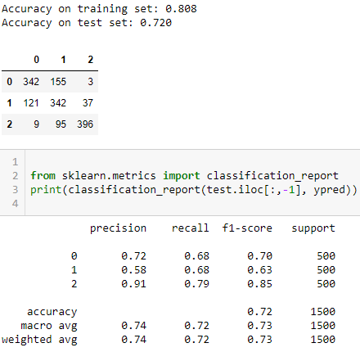
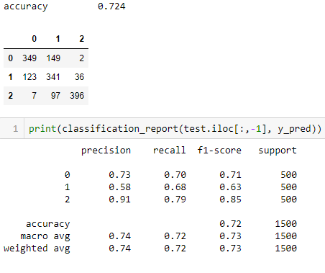
Diabetic class classification – with synthetic data
Synthetic Minority Over-sampling Technique for Nominal and Continuous is used to generate additional dataset
 | Training size | Test size
Class 0 | 10,000 | 500
Class 1 | 10,000 | 500
Class 2 | 10,000 | 500
Random Forest Classifier
XGBClassifier

Slide 6
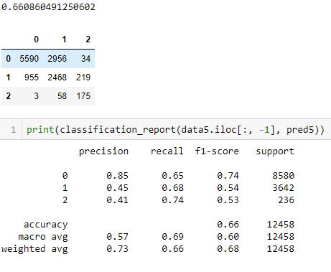
Diabetic class classification – test On predicted next year features values
The result on this section shows the result of the pretrained classifier model on the forecasted next year feature values
Random Forest Classifier
 | Generated test size
Class 0 | 8,580
Class 1 | ‭3,642‬
Class 2 | 236

Slide 7
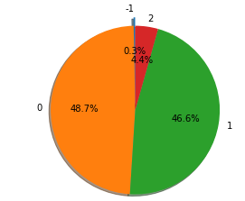
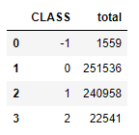
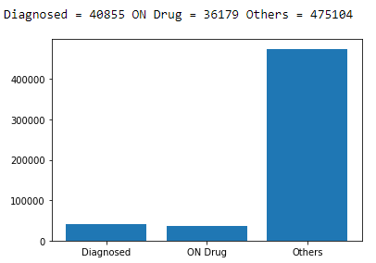
Hypertension data summary
Classification rule
SBP | DBP | CLASS
< 120 | < 80 | 0
>= 120 & < 140 | < 80 | 1
< 120 | >= 80 & < 90 | 1
>= 120 & < 140 | >= 80 & < 90 | 1
>= 120 & < 140 | >= 90 | 2
>= 140 | >= 80 & < 90 | 2
>= 140 | >= 90 | 2
 |  | -1

Slide 8
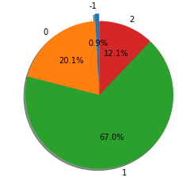
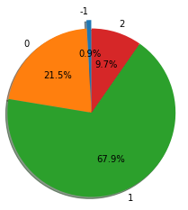
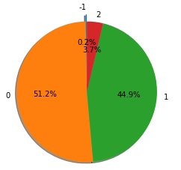
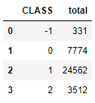
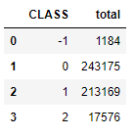
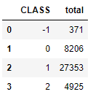
Hypertension data summary
Hypertensive people who are diagnosed
Hypertensive people who are on drugs
Others

