Slide 1
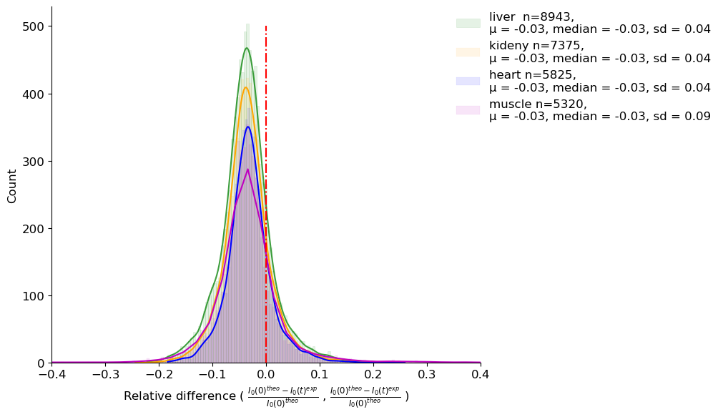
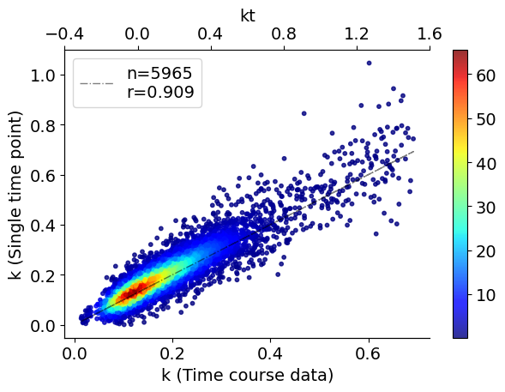
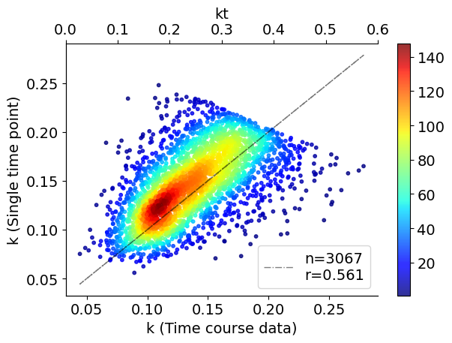
All Data (R² > 0.95)
Liver, Day 2
k ( approx.) = ln(1-FSR)
K (d2ome) | k ( approx.)
2622 | 2444
After Filter, I0(t)< I0(0) – SD & I0(t) > I0(0) – 0.5 * (I0(0) - I0^{asmyp})

Slide 2
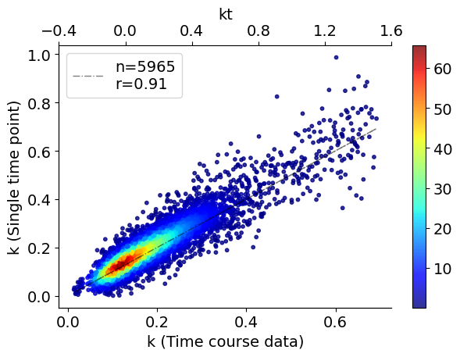

After Filter, I0(t)< I0(0) – SD & I0(t) > I0(0) – 0.5 * (I0(0) - I0^{asmyp})
All Data (R² > 0.95)
Liver, Day 2
k ( approx.) = x + x²/2 .. + x¹⁰/10
K (d2ome) | k ( approx.)
2622 | 2444

Slide 3
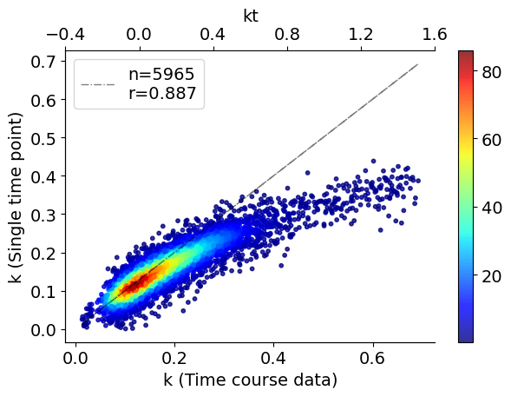
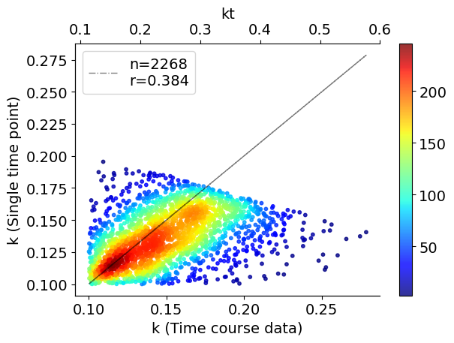
All Data (R² > 0.95)
After Filter, I0(t)< I0(0) – SD & I0(t) > I0(0) – 0.5 * (I0(0) - I0^{asmyp})
Liver, Day 2
k ( approx.) = x
K (d2ome) | k ( approx.)
2622 | 2268

