Slide 1
Chapter ONE
What is Organizational Behavior?

Slide 2

After studying this chapter, you should
be able to:
Describe what managers do.
Define organizational behavior (OB).
Explain the value of the systematic study of OB.
Identify the contributions made by major behavioral science disciplines to OB.
List the major challenges and opportunities for managers to use OB concepts.
L E A R N I N G O B J E C T I V E S

Slide 3
What Managers Do
Managers (or administrators)
Individuals who achieve goals through other people.
Managerial Activities
Make decisions
Allocate resources
Direct activities of others to attain goals

Slide 4
Where Managers Work
Organization
A consciously coordinated social unit, composed of two or more people, that functions on a relatively continuous basis to achieve a common goal or set of goals.

Slide 5
Management Functions
Planning
Organizing
Management
Functions
Controlling
Leading

Slide 6

Management Functions (cont’d)
Planning
A process that includes defining goals, establishing strategy, and developing plans to coordinate activities.

Slide 7

Management Functions (cont’d)
Organizing
Determining what tasks are to be done, who is to do them, how the tasks are to be grouped, who reports to whom, and where decisions are to be made.

Slide 8
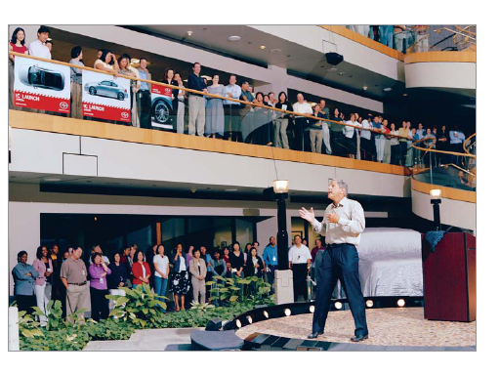
Management Functions (cont’d)
Leading
A function that includes motivating employees, directing others, selecting the most effective communication channels, and resolving conflicts.

Slide 9
Management Functions (cont’d)
Controlling
Monitoring activities to ensure they are being accomplished as planned and correcting any significant deviations.

Slide 10
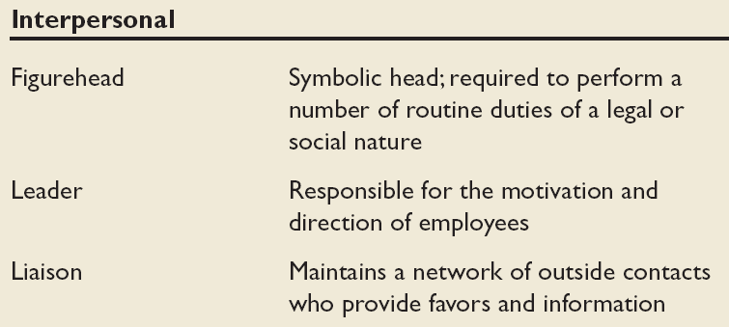
Mintzberg’s Managerial Roles
Source: Adapted from The Nature of Managerial Work by H. Mintzberg. Copyright © 1973 by H. Mintzberg. Reprinted by permission of Pearson Education.
E X H I B I T 1–1

Slide 11
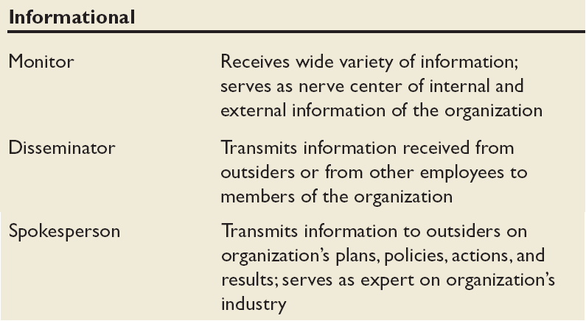
Mintzberg’s Managerial Roles (cont’d)
Source: Adapted from The Nature of Managerial Work by H. Mintzberg. Copyright © 1973 by H. Mintzberg. Reprinted by permission of Pearson Education.
E X H I B I T 1–1 (cont’d)

Slide 12
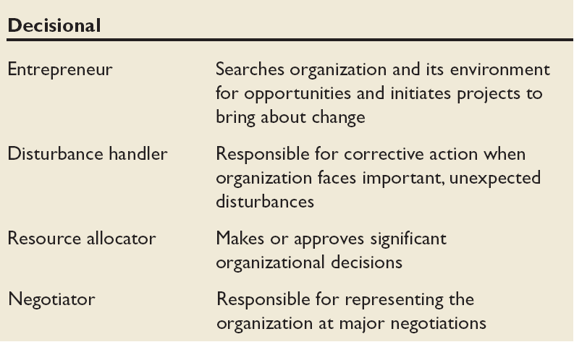
Mintzberg’s Managerial Roles (cont’d)
Source: Adapted from The Nature of Managerial Work by H. Mintzberg. Copyright © 1973 by H. Mintzberg. Reprinted by permission of Pearson Education.
E X H I B I T 1–1 (cont’d)

Slide 13

Management Skills
Technical skills
The ability to apply specialized knowledge or expertise.
Human skills
The ability to work with, understand, and motivate other people, both individually and in groups.
Conceptual Skills
The mental ability to analyze and diagnose complex situations.

Slide 14
Effective Versus Successful Managerial Activities (Luthans)
Traditional management
  Decision making, planning, and controlling
Communication
  Exchanging routine information and processing paperwork
Human resource management
  Motivating, disciplining, managing conflict, staffing, and training
Networking
  Socializing, politicking, and interacting with others

Slide 15
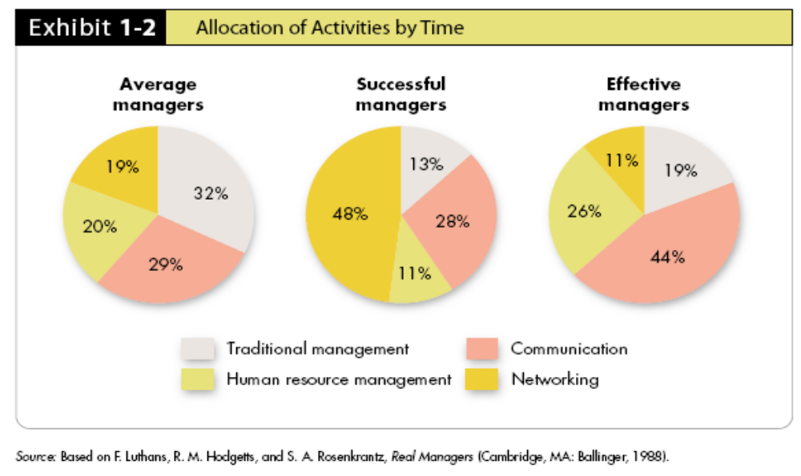
Allocation of Activities by Time

Slide 16
Enter Organizational Behavior
Organizational behavior (OB)
A field of study that investigates the impact that individuals, groups, and structure have on behavior within organizations, for the purpose of applying such knowledge toward improving an organization’s effectiveness.

Slide 17
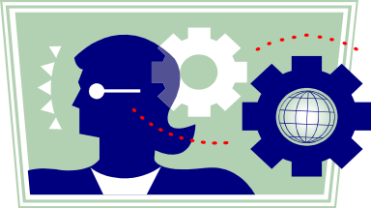
Complementing Intuition with Systematic Study
Intuition
“Gut” feelings about “why I do what I do” and “what makes others tick”.
Systematic study
Looking at relationships, attempting to attribute causes and effects, and drawing conclusions based on scientific evidence.
Provides a means to predict behaviors.

Slide 18
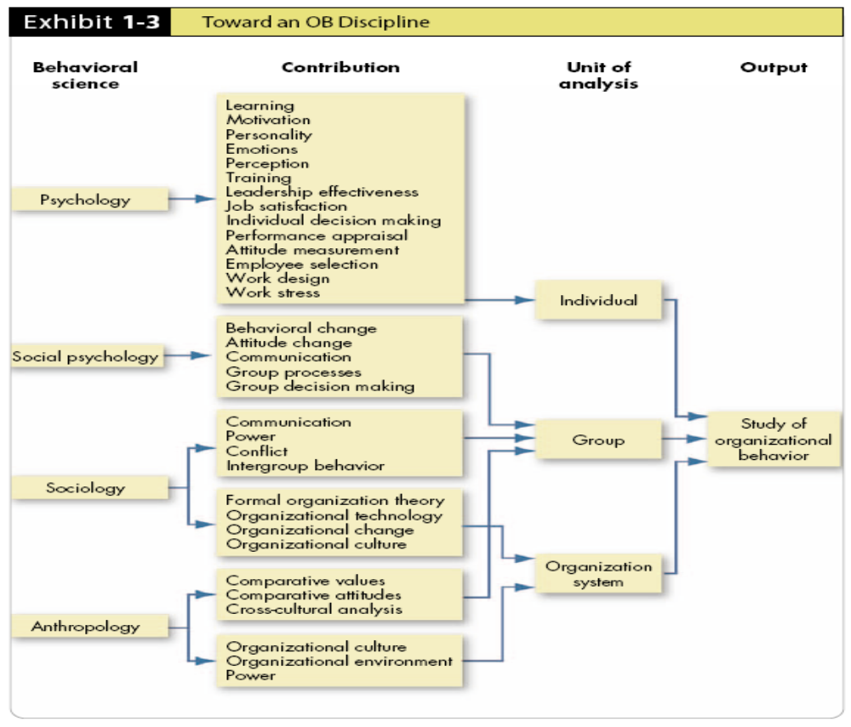

Slide 19
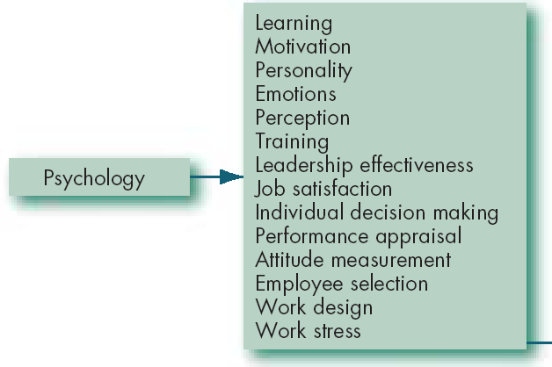
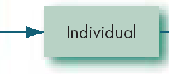
Contributing Disciplines to the OB Field
Psychology
The science that seeks to measure, explain, and sometimes change the behavior of humans and other animals.
E X H I B I T 1–3 (cont’d)

Slide 20
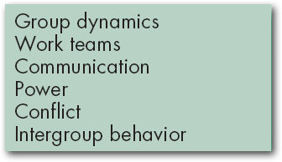


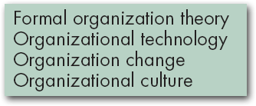

Contributing Disciplines to the OB Field (cont’d)
Sociology
The study of people in relation to their fellow human beings.
E X H I B I T 1–3 (cont’d)

Slide 21
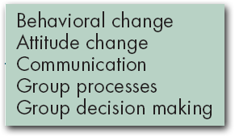

Contributing Disciplines to the OB Field (cont’d)
Social Psychology
An area within psychology that blends concepts from psychology and sociology and that focuses on the influence of people on one another.
E X H I B I T 1–3 (cont’d)

Slide 22
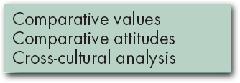


Contributing Disciplines to the OB Field (cont’d)
Anthropology
The study of societies to learn about human beings and their activities.
E X H I B I T 1–3 (cont’d)

Slide 23
There Are Few Absolutes in OB
Contingency variables: "It Depends!!!"
Situational factors that make the main relationship between two variables change---e.g., the relationship may hold for one condition but not another.
x
y
In
Country 1
May be related to
x
y
In
Country 2
May NOT be related to

Slide 24
Challenges and Opportunities for OB
Responding to Globalization
  Increased foreign assignments
  Working with people from different cultures
  Coping with anti-capitalism backlash
  Overseeing movement of jobs to countries with low-cost labor
  Managing people during the war on terror.
Managing Workforce Diversity
  Embracing diversity
  Changing U.S. demographics
  Implications for managers
    Recognizing and responding to differences

Slide 25
Major Workforce Diversity Categories
Gender
National
Origin
Disability
Age
Non-Christian
Race
Domestic
Partners
E X H I B I T 1–4

Slide 26

Challenges and Opportunities for OB (cont’d)
Improving Quality and Productivity
  Quality management (QM)
  Process reengineering
Responding to the Labor Shortage
  Changing work force demographics
  Fewer skilled laborers
  Early retirements and older workers
Improving Customer Service
  Increased expectation of service quality
  Customer-responsive cultures

Slide 27
What Is Quality Management?
Intense focus on the customer.
Concern for continuous improvement.
Improvement in the quality of everything the organization does.
Accurate measurement.
Empowerment of employees.
E X H I B I T 1–6

Slide 28
Challenges and Opportunity for OB (cont’d)
Improving People Skills
Empowering People
Stimulating Innovation and Change
Coping with “Temporariness”
Working in Networked Organizations
Helping Employees Balance Work/Life Conflicts
Improving Ethical Behavior
Managing People during the War on Terrorism

Slide 29
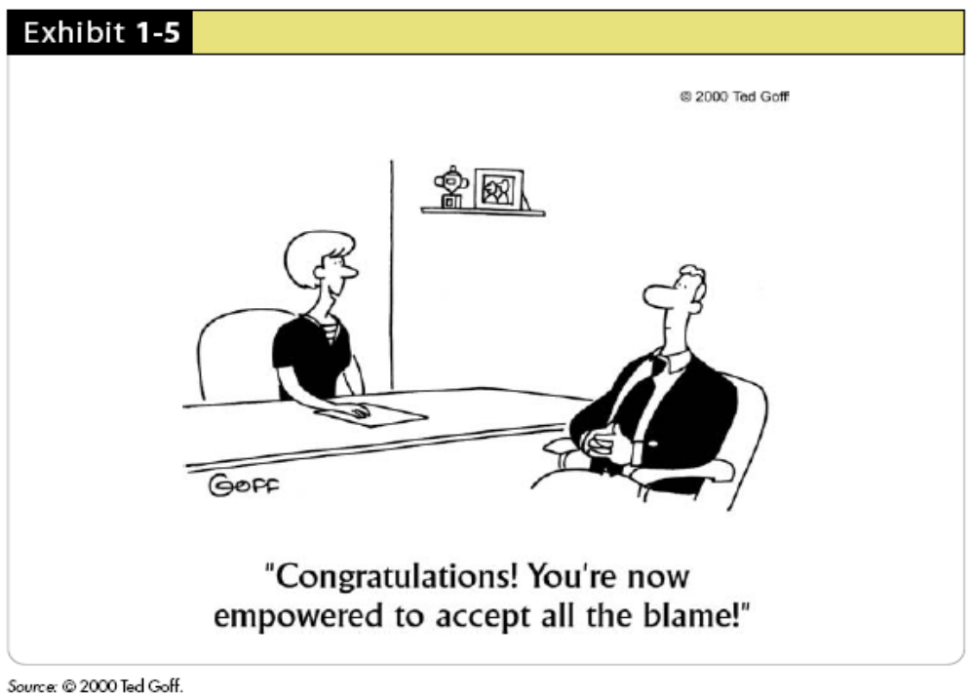
A Downside to Empowerment?

Slide 30
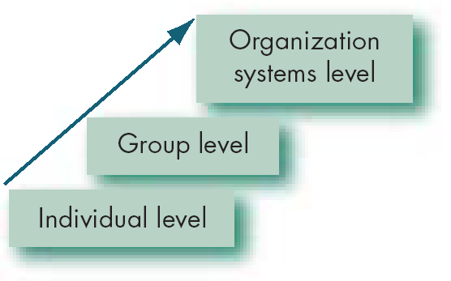
Basic OB Model, Stage I
Model
An abstraction of reality.
A simplified representation of some real-world phenomenon.
E X H I B I T 1-6

Slide 31
The Dependent Variables
Dependent variable
A response that is affected by an independent variable (what organizational behavior researchers try to understand).
y
x

Slide 32

The Dependent Variables (cont’d)
Productivity
A performance measure that includes effectiveness and efficiency.
Effectiveness
Achievement of goals.
Efficiency
Meeting goals at a low cost.

Slide 33


The Dependent Variables (cont’d)
Absenteeism
The failure to report to work.
Turnover
The voluntary and involuntary permanent withdrawal from an organization.

Slide 34

The Dependent Variables (cont’d)
Deviant Workplace Behavior Voluntary behavior that violates significant organizational norms and thereby threatens the well-being of the organization and/or any of its members.

Slide 35

The Dependent Variables (cont’d)
Organizational citizenship behavior (OCB)
Discretionary behavior that is not part of an employee’s formal job requirements, but that nevertheless promotes the effective functioning of the organization.

Slide 36

The Dependent Variables (cont’d)
Job satisfaction
A general attitude (not a behavior) toward one’s job; a positive feeling of one's job resulting from an evaluation of its characteristics.

Slide 37
The Independent Variables
Independent variable
The presumed cause of some change in the dependent variable; major determinants of a dependent variable.
Independent
Variables Can Be
Individual-Level Variables
Group-Level
Variables
Organization
System-Level
Variables

Slide 38
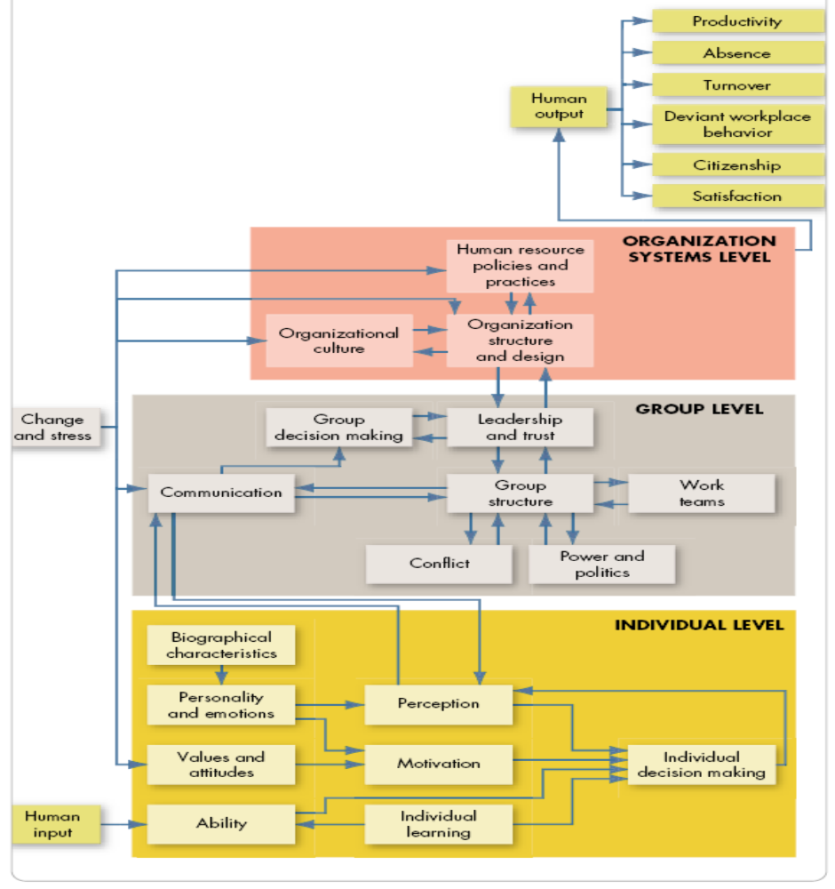
Basic OB Model, Stage II
E X H I B I T 1-7

