Slide 1
Project Management and Planning

Slide 2
Introduction
Project management is application of knowledge, skills, tools and techniques to project activities to achieve project requirements.
Project management is accomplished through the application and integration of the project management processes of initiating, planning, executing, monitoring and controlling, and closing.

Slide 3
Cont’d ….
Project planning is the process of defining an orderly arrangement of activities and resources to deliver a unique product or service.
The project planning organizes the project’s deliverables and resources within realistic time frames.
The planning prepares the project for successful implementation.
It links the resources to the project’s activities.
The purpose of project planning is therefore to define the exact parameters of a project and ensure that all the pre-requisites for project execution are in place.

Slide 4
Cont’d ….
Planning a project involves answering key questions such as:
What work to be performed?
Who will be responsible for each piece of work?
In what order should the work be completed?
How long will it take to complete each item of the work?
What resources are needed to complete each item of the work?
How can the work be scheduled to meet the requested deadline?

Slide 5
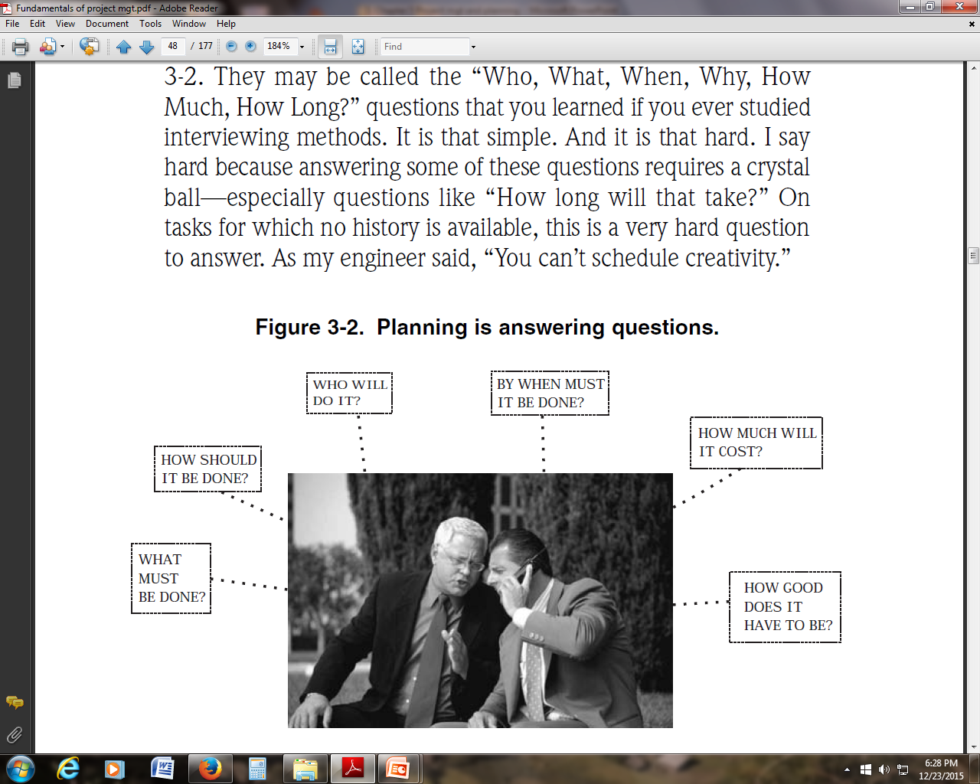
Planning is answering the following questions

Slide 6
Cont’d…
Project planning develops management procedures and plans.
All documents created during project planning are compiled into the Project Plan
Project plan is developed to be utilized in project execution phase of the project.

Slide 7
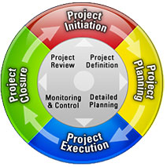
Project Life Cycle Chapter 5

Slide 8
Project Definition Phase
Initiate the project Identify the Project Manager Develop the Project Charter Conduct a Feasibility Study Define Planning Phase Sign off on the Project Charter

Slide 9
Project Planning Phase
Organize and staff the project
Develop a Project Plan
Sign off on the Project Plan

Slide 10
Project Execution Phase
Execute the Project Plan Manage the Project Plan Implement the project’s results Sign off on project’s completion

Slide 11
Project Close-out Phase
Document the lessons learned during the project After-implementation review Provide performance feedback Close-out contracts Complete administrative close-out Deliver project completion report

Slide 12
Project Management knowledge Areas

Slide 14
5.1. Project Scope Management

Slide 15
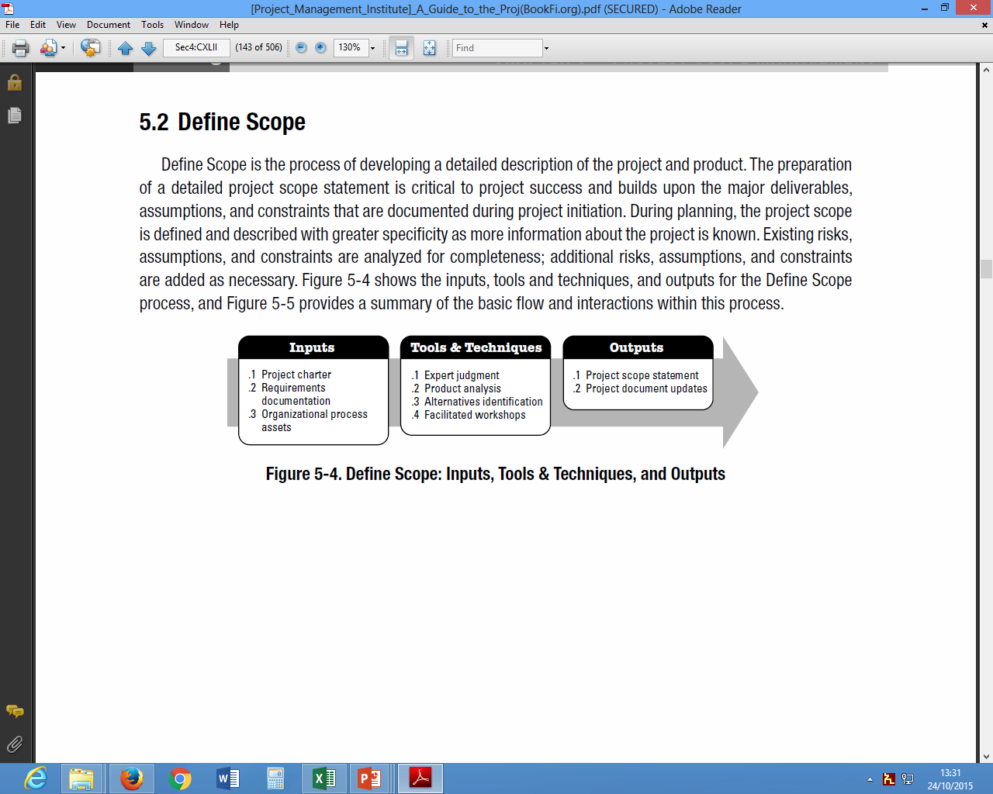
Scope definition…..

Slide 16
What is Project Scope Management?
Scope refers to all the work involved in creating the products or a deliverable of the project and the processes used to create them.
a deliverable is a product produced as part of a project, such as hardware or software, planning documents, or meeting minutes, building, ….
Project scope management includes the processes involved in defining and controlling what is or is not included in a project.

Slide 17
Project Scope Management Processes
Scope planning: Deciding how the scope will be defined, verified, and controlled.
Scope definition: Reviewing the project charter and preliminary scope statement and adding more information as requirements are developed and change requests are approved.
Creating the WBS: Subdividing the major project deliverables into smaller, more manageable components.
Scope verification: Formalizing acceptance of the project scope.
Scope control: Controlling changes to project scope.

Slide 18
Step 1: Scope Planning and the Scope Management Plan
The scope management plan is a document that includes descriptions of how the team will prepare the project scope statement, create the WBS, verify completion of the project deliverables, and control requests for changes to the project scope.
Key inputs include the project charter, preliminary scope statement, and project management plan.

Slide 19
Project Charter
A Project Charter is a statement of the scope, objectives and participants in a project and is a critical document to ensure that everyone involved in the project is aware of its purpose and objectives.
It outlines the project objectives, identifies the main stakeholders, and defines the authority of the project manager.
It serves as a reference of authority for the future of the project and its management.
The detail within the charter should be proportionate with the size of the project

Slide 20
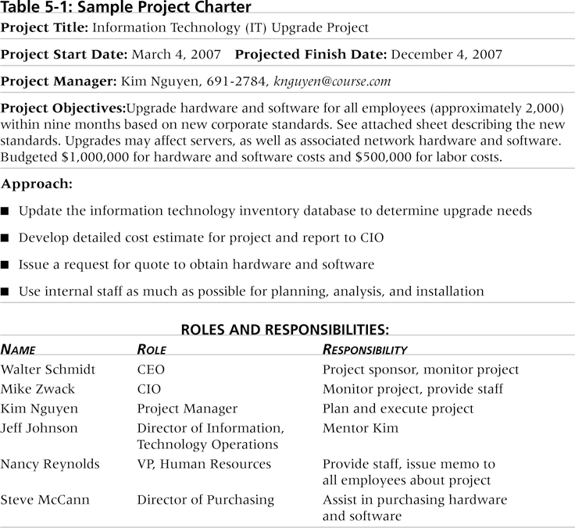
Table 1: Sample Project Charter

Slide 21
Step 2: Scope Definition and the Project Scope Statement
The preliminary scope statement, project charter, organizational process assets, and approved change requests provide a basis for creating the project scope statement.
As time progresses, the scope of a project should become clearer and more specific.

Slide 22
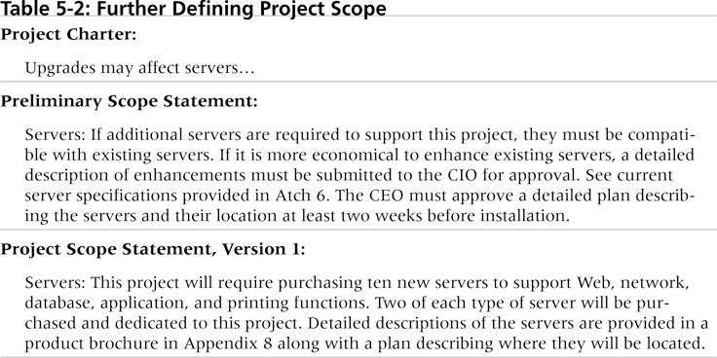
Table 2. Further Defining Project Scope

Slide 23
Step 3: Creating the Work Breakdown Structure (WBS)
A WBS is a deliverable-oriented grouping of the work involved in a project that defines the total scope of the project.
The WBS is a hierarchical description of all the work that must be done to complete the project.
It is a foundation document that provides the basis for planning and managing project schedules, costs, resources, and changes.

Slide 24
Work Breakdown Structure (WBS)…..
Steps in WBS Development
Develop Level 1 of the WBS
Decompose WBS: Decomposition is subdividing project deliverables into smaller pieces. Involves listing the sub activities or tasks for major activities
Assign Responsibility
Define WBS Elements

Slide 25
WBS…..
The characteristics of a complete WBS are:
The unit of a task must be measurable in terms of cost, effort, resources and time
it must result in a single end product which can be checked
it must be the responsibility of a single individual or functional group.

Slide 26
WBS Format
There are two methods of presenting the WBS:
Graphic
Text indents

Slide 27
Example (text indent)
1.0.0. House Project
1.1. Civil
1.1.1. Foundation
1.1.2. Walls and Roofs
1.2. Plumbing
1.2.1. Piping
1.2.2. Sewerage
1.3. Electrical
1.3.1. Wiring
1.3.2. Appliance

Slide 28
Example

Slide 29
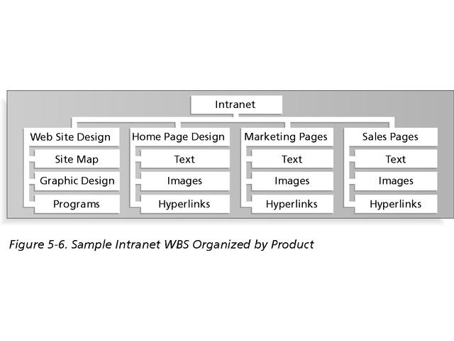
Figure 1. Sample Intranet WBS Organized by Product

Slide 30
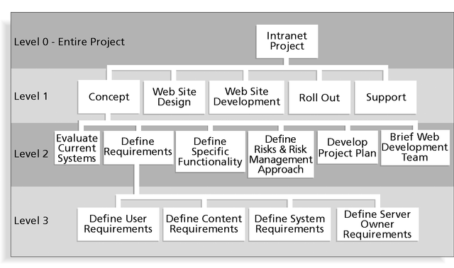
Figure 2. Sample Intranet WBS Organized by Phase

Slide 31
Table 3. Intranet WBS in Tabular Form
1.0 Concept
1.1 Evaluate current systems
1.2 Define requirements
1.2.1 Define user requirements
1.2.2 Define content requirements
1.2.3 Define system requirements
1.2.4 Define server owner requirements
1.3 Define specific functionality
1.4 Define risks and risk management approach
1.5 Develop project plan
1.6 Brief Web development team
2.0 Web Site Design
3.0 Web Site Development
4.0 Roll Out
5.0 Support

Slide 32
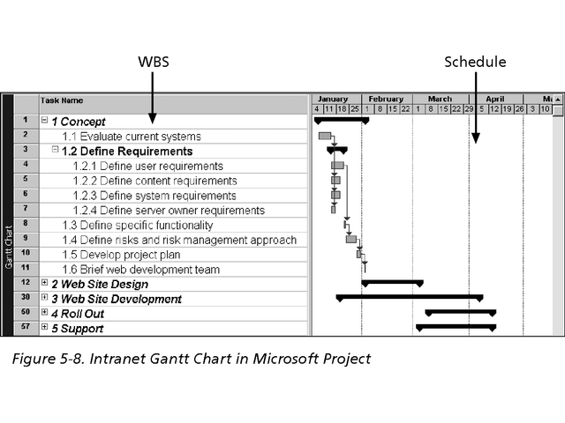
Figure 3. Intranet WBS and Gantt Chart in Project xx
Project 98 file

Slide 33
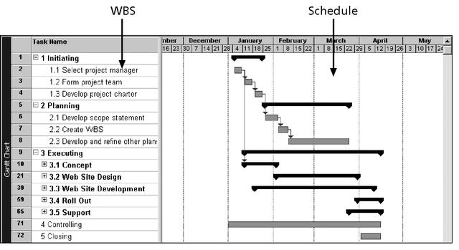
Figure 4. Intranet Gantt Chart Organized by Project Management Process Groups

Slide 34
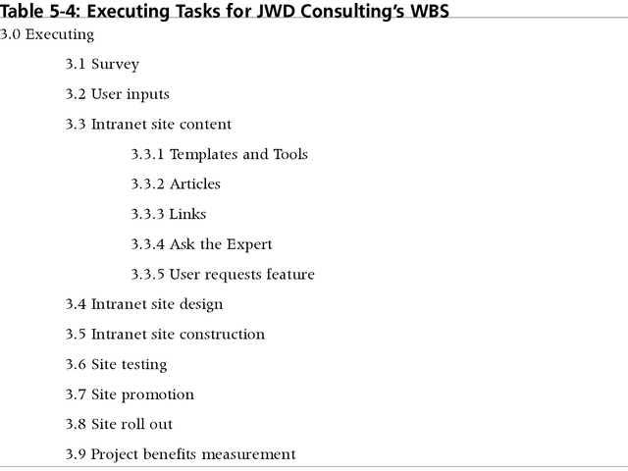
Table 4. WBS….

Slide 35
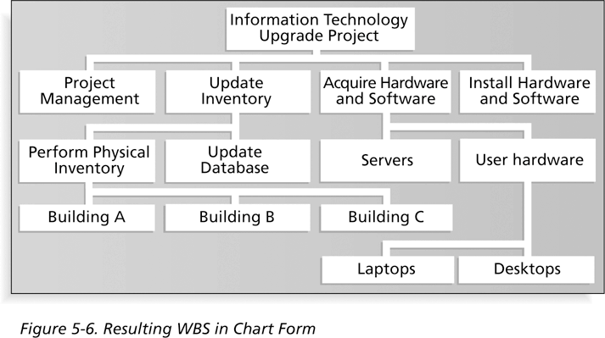
Figure 6. Resulting WBS in Chart Form

Slide 36
The WBS Dictionary and Scope Baseline
Many WBS tasks are vague and must be explained in more detail so people know what to do and can estimate how long the work will take and what it will cost.
A WBS dictionary is a document that describes detailed information about each WBS item.
The approved project scope statement and its WBS and WBS dictionary form the scope baseline, which is used to measure performance in meeting project scope goals.

Slide 37
Advice for Creating a WBS and WBS Dictionary
A unit of work should appear in only one place in the WBS.
The work content of a WBS item is the sum of the WBS items below it.
A WBS item is the responsibility of only one individual, even though many people may be working on it.
The WBS must be consistent with the way in which work is actually going to be performed; it should serve the project team first, and other purposes only if practical.

Slide 38
Advice for Creating a WBS and WBS Dictionary (cont’d….)
Project team members should be involved in developing the WBS to ensure consistency and buy-in.
Each WBS item must be documented in a WBS dictionary to ensure accurate understanding of the scope of work that is included and not included in that item.
The WBS must be a flexible tool to accommodate inevitable changes while properly maintaining control of the work content in the project according to the scope statement.

Slide 39
What are the benefits of WBS?
Clarify ambiguity
Facilitate resource allocation to specific activities
It makes easier to hold people accountable for completing tasks
It helps in setting up of project organization
It helps to identify activities that are individually and/or collectively carried out in order to ensure the timely completion of the project.

Slide 40
Step 4: Scope Verification
It is very difficult to create a good scope statement and WBS for a project.
It is even more difficult to verify project scope and minimize scope changes.
Many projects suffer from scope creep and poor scope verification

Slide 41
Step 5: Scope Control
Scope control involves controlling changes to the project scope.
Goals of scope control are to:
Influence the factors that cause scope changes.
Ensure changes are processed according to procedures developed as part of integrated change control.
Manage changes when they occur.
Variance is the difference between planned and actual performance.

Slide 42
Group Activity
Develop a work break down structure for you project idea.

Slide 43
Summary
Project scope management includes the processes required to ensure that the project addresses all the work required—and only the work required—to complete the project successfully.
Main processes include:
Scope planning
Scope definition
WBS creation
Scope verification
Scope control

Slide 44
……. END …….

Slide 45
2. Project Time Management
PM knowledge areas

Slide 46
Learning Objectives
Understand the importance of project schedules and good project time management.
Define activities as the basis for developing project schedules.
Describe how project managers use network diagrams and dependencies to assist in activity sequencing.
Understand the relationship between estimating resources and project schedules.
Explain how various tools and techniques help project managers perform activity duration estimating.

Slide 47
Learning Objectives
Use a Gantt chart for planning and tracking schedule information, find the critical path for a project, and describe how critical chain scheduling and the Program Evaluation and Review Technique (PERT) affect schedule development.
Discuss how reality checks and people issues are involved in controlling and managing changes to the project schedule.
Describe how project management software can assist in project time management and review words of caution before using this software.

Slide 48
Introduction
Time management is not the right term to use because it implies personal efforts to manage one’s time.
For projects, time mgt refers to developing a schedule that can be met, then controlling work to ensure that this happens!
It’s that simple. Because everyone refers to this as scheduling, it should really be called schedule management.

Slide 49
Importance of Project Schedules
Managers often cite delivering projects on time as one of their biggest challenges.
Most projects suffer a problem of completing on time.
Schedule issues are the main reason for conflicts on projects, especially during the second half of projects.
Time has the least amount of flexibility; it passes no matter what happens on a project.

Slide 50
Project Time Management Processes
Activity definition: Identifying the specific activities that the project team members and stakeholders must perform to produce the project deliverables.
Activity sequencing: Identifying and documenting the relationships between project activities.
Activity resource estimating: Estimating how many resources a project team should use to perform project activities.
Activity duration estimating: Estimating the number of work periods that are needed to complete individual activities.
Schedule development: Analyzing activity sequences, activity resource estimates, and activity duration estimates to create the project schedule.
Schedule control: Controlling and managing changes to the project schedule.

Slide 51
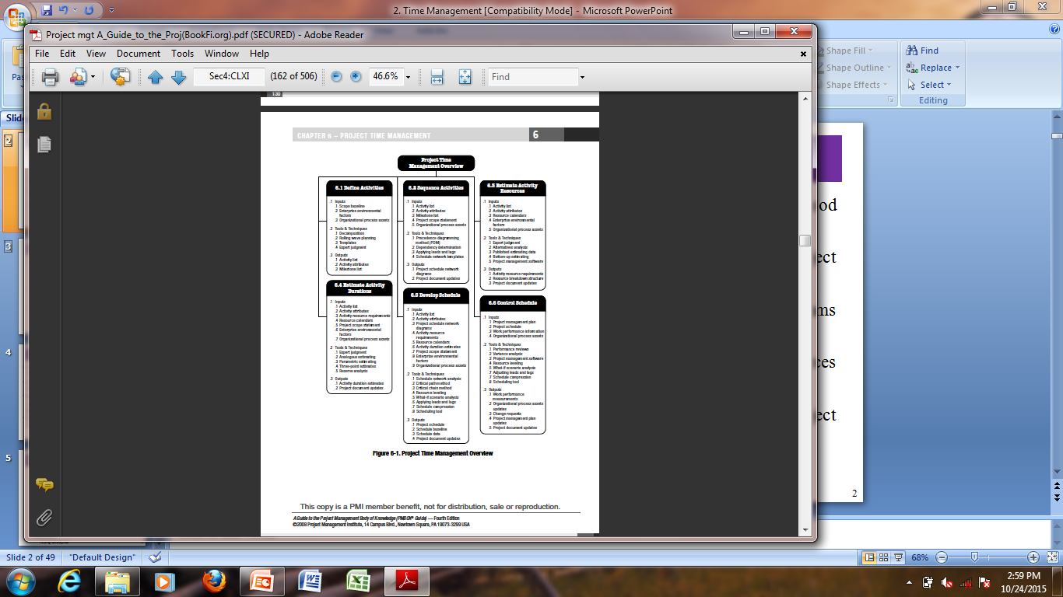
Project time management

Slide 52
1. Activity identification & Definition
An activity or task is an element of work normally found on the WBS that has an expected duration, a cost, and resource requirements.
Project schedules grow out of the basic documents that initiate a project.
The project charter includes start and end dates and budget information.
The scope statement and WBS help define what will be done.
Activity definition involves developing a more detailed WBS and supporting explanations to understand all the work to be done, so you can develop realistic cost and duration estimates.

Slide 53
Identification of Activities ……..
Example: For the irrigation project Nine activities are identified
A. Field survey & design B. Repair of canal earth works C. Detailed design of drainage system D. Repair barrage E. Lay road foundation F. Build canal structures (including lining) G. Construction of drainage system H. Road paving I. Trial operations

Slide 54
2. Activity Lists and Attributes
An activity list is a tabulation of activities to be included on a project schedule. The list should include:
The activity name
An activity identifier or number
A brief description of the activity
Activity attributes provide more information about each activity, such as predecessors, successors, logical relationships, leads and lags, resource requirements, constraints, imposed dates, and assumptions related to the activity.

Slide 55
3. Milestones
A milestone is a significant event that normally has no duration.
It often takes several activities and a lot of work to complete a milestone.
Milestones are useful tools for setting schedule goals and monitoring progress.
Examples include completion and customer sign-off on key documents and completion of specific products.

Slide 56
4. Estimating Activity Duration
Key concepts:
Duration includes the actual amount of time worked on an activity plus the elapsed time.
Duration of Activities: A number of approaches can be used to estimate the time required in carrying out a project activity.
Effort is the number of workdays or work hours required to complete a task.
Effort does not normally equal duration.
People doing the work should help create estimates, and an expert should review them.

Slide 57
Activity duration …..
Once the WBS is complete, the next step is estimating the time required to complete each task.
Estimating the work time
Gives an idea of the level of effort required to complete a project
Enable to produce realistic plan
Is the basis for developing a project implementation schedule.

Slide 58
Factors to consider in estimating Activity duration
The following factors should be considered when estimating the time required for project activities
Availability of non-labor support
Complexity of the work
Degree of available information to estimate
Degree of uncertainty or risk in achieving the outcome
Experience knowledge and expertise of the team members of the project
Priority of tasks
Number of people assigned to the task
Project size

Slide 59
Techniques of estimating time
Single estimate also called Deterministic approach - this estimate is done by an expert based on previous experiences and historical data.

Slide 60
Techniques…..
2. Multiple estimate/probabilistic Approach/PERT
- Here probabilities are used to each of the multiple estimate.
Program Evaluation and Review Technique (PERT) is a network analysis technique used to estimate project duration when there is a high degree of uncertainty about the individual activity duration estimates.
Duration estimates based on using optimistic, most likely, and pessimistic estimates of activity durations, or a three-point estimate.

Slide 61
Cont’d….
Here probabilities are used to each of the multiple estimate.
The most likely time (m): This represents the most likely estimate and is known as modal value in statistics.
Optimistic time (a): This is the minimum time required to complete the activity under most favorable conditions.
Pessimistic Time (b): This represents the maximum time needed to complete the project activity under unfavorable situations.

Slide 62
Cont’d…
The single expected time (t) required is given by the following formula as follows.
t= (a+4m+b)
6
The table below provides the three values and the single expected value t for each activity of the irrigation project we presented earlier.
Note that the single expected values of the last columns shall be used in this approach.

Slide 64
5. Activity Sequencing
Involves reviewing activities and determining dependencies.
A dependency or relationship relates to the sequencing of project activities or tasks.
You must determine dependencies in order to use critical path analysis.

Slide 65
Three Types of Dependencies
Mandatory dependencies: Inherent in the nature of the work being performed on a project; sometimes referred to as hard logic.
Discretionary dependencies: Defined by the project team; sometimes referred to as soft logic and should be used with care because they may limit later scheduling options.
External dependencies: Involve relationships between project and non-project activities.

Slide 66
Network Diagrams
Network diagrams are the preferred technique for showing activity sequencing.
A network diagram is a schematic display of the logical relationships among, or sequencing of, project activities.
Two main formats are the arrow and precedence diagramming methods. We will use arrow method;

Slide 67
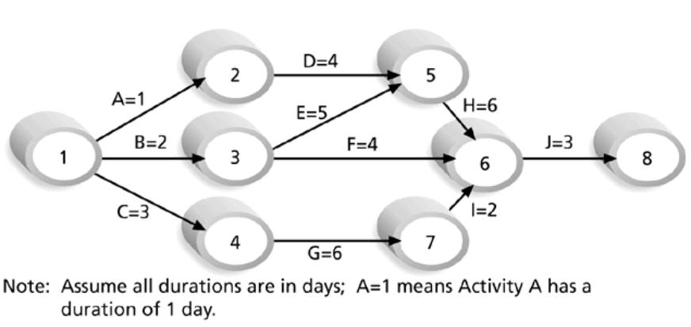
Figure 2. Sample Activity-on-Arrow (AOA) Network Diagram for Project X

Slide 68
Work Breakdown Structure
Start a New Business
Strategic Plan
Define Business Opportunity
Plan for Action
Proceed With Startup Plan
Provide Staffing
Provide Physical Facilities
Establish Business Structure
Develop Marketing Plan
Install Operating Control Base
Select Bank
Select Name
Find Location
Figure 8.2

Slide 69
X Hospital construction project
Notes:
9
The next series of slides presents Example 4.1. The series builds in steps to the conclusion of the Example showing the development of key equations along the way.
This slide advances automatically.

Slide 70
X Hospital project
Immediate
Activity Description Predecessor(s) Responsibility
A Select administrative and medical staff.
B Select site and do site survey.
C Select equipment.
D Prepare final construction plans and layout.
E Bring utilities to the site.
F Interview applicants and fill positions in
nursing, support staff, maintenance,
and security.
G Purchase and take delivery of equipment.
H Construct the hospital.
I Develop an information system.
J Install the equipment.
K Train nurses and support staff.
Example 8.1
Notes:
10
The first step is to create the list of activities and the required predecessors.

Slide 71
XYZ Hospital project
Immediate
Activity Description Predecessor(s) Responsibility
A Select administrative and medical staff. — Yohannes
B Select site and do site survey. — Taye
C Select equipment. A Adamu
D Prepare final construction plans and layout. B Taye
E Bring utilities to the site. B Bulti
F Interview applicants and fill positions in A Yohammes
nursing, support staff, maintenance,
and security.
G Purchase and take delivery of equipment. C Adamu
H Construct the hospital. D Taye
I Develop an information system. A Simon
J Install the equipment. E,G,H Adamu
K Train nurses and support staff. F,I,J Yohannes
Notes:
11

Slide 72
St. Adolf’s Hospital
Immediate
Activity Description Predecessor(s) Responsibility
AOA Network
A Select administrative and medical staff. — Johnson
B Select site and do site survey. — Taylor
C Select equipment. A Adams
D Prepare final construction plans and layout. B Taylor
E Bring utilities to the site. B Burton
F Interview applicants and fill positions in A Johnson
nursing, support staff, maintenance,
and security.
G Purchase and take delivery of equipment. C Adams
H Construct the hospital. D Taylor
I Develop an information system. A Simmons
J Install the equipment. E,G,H Adams
K Train nurses and support staff. F,I,J Johnson
Example 8.1
Notes:
25
For comparison we build an AOA network of the same project.
This series builds Figure 4.3.
This slide advances automatically.

Slide 73
St. Adolf’s Hospital
Immediate
Activity Description Predecessor(s) Responsibility
AOA Network
2
A Select administrative and medical staff. — Johnson
B Select site and do site survey. — Taylor
C Select equipment. A Adams
D Prepare final construction plans and layout. B Taylor
E Bring utilities to the site. B Burton
F Interview applicants and fill positions in A Johnson
nursing, support staff, maintenance,
and security.
G Purchase and take delivery of equipment. C Adams
H Construct the hospital. D Taylor
I Develop an information system. A Simmons
J Install the equipment. E,G,H Adams
K Train nurses and support staff. F,I,J Johnson
A
Start
1
Example 8.1
Notes:
32

Slide 74
St. Adolf’s Hospital
Immediate
Activity Description Predecessor(s) Responsibility
AOA Network
2
A Select administrative and medical staff. — Johnson
B Select site and do site survey. — Taylor
C Select equipment. A Adams
D Prepare final construction plans and layout. B Taylor
E Bring utilities to the site. B Burton
F Interview applicants and fill positions in A Johnson
nursing, support staff, maintenance,
and security.
G Purchase and take delivery of equipment. C Adams
H Construct the hospital. D Taylor
I Develop an information system. A Simmons
J Install the equipment. E,G,H Adams
K Train nurses and support staff. F,I,J Johnson
A
Start
1
B
4
Example 8.1
Notes:
32

Slide 75
St. Adolf’s Hospital
Immediate
Activity Description Predecessor(s) Responsibility
AOA Network
2
A Select administrative and medical staff. — Johnson
B Select site and do site survey. — Taylor
C Select equipment. A Adams
D Prepare final construction plans and layout. B Taylor
E Bring utilities to the site. B Burton
F Interview applicants and fill positions in A Johnson
nursing, support staff, maintenance,
and security.
G Purchase and take delivery of equipment. C Adams
H Construct the hospital. D Taylor
I Develop an information system. A Simmons
J Install the equipment. E,G,H Adams
K Train nurses and support staff. F,I,J Johnson
C
A
3
Start
1
5
B
D
4
Example 8.1
Notes:
32

Slide 76
St. Adolf’s Hospital
Immediate
Activity Description Predecessor(s) Responsibility
AOA Network
F
2
8
A Select administrative and medical staff. — Johnson
B Select site and do site survey. — Taylor
C Select equipment. A Adams
D Prepare final construction plans and layout. B Taylor
E Bring utilities to the site. B Burton
F Interview applicants and fill positions in A Johnson
nursing, support staff, maintenance,
and security.
G Purchase and take delivery of equipment. C Adams
H Construct the hospital. D Taylor
I Develop an information system. A Simmons
J Install the equipment. E,G,H Adams
K Train nurses and support staff. F,I,J Johnson
I
C
A
3
7
Start
1
G
H
5
6
B
E
D
4
Example 8.1
Notes:
32

Slide 77
St. Adolf’s Hospital
Immediate
Activity Description Predecessor(s) Responsibility
AOA Network
F
2
8
A Select administrative and medical staff. — Johnson
B Select site and do site survey. — Taylor
C Select equipment. A Adams
D Prepare final construction plans and layout. B Taylor
E Bring utilities to the site. B Burton
F Interview applicants and fill positions in A Johnson
nursing, support staff, maintenance,
and security.
G Purchase and take delivery of equipment. C Adams
H Construct the hospital. D Taylor
I Develop an information system. A Simmons
J Install the equipment. E,G,H Adams
K Train nurses and support staff. F,I,J Johnson
I
C
A
3
7
J
Start
1
G
H
5
6
B
E
D
4
Example 8.1
Notes:
32

Slide 78
St. Adolf’s Hospital
Immediate
Activity Description Predecessor(s) Responsibility
AOA Network
F
2
8
A Select administrative and medical staff. — Johnson
B Select site and do site survey. — Taylor
C Select equipment. A Adams
D Prepare final construction plans and layout. B Taylor
E Bring utilities to the site. B Burton
F Interview applicants and fill positions in A Johnson
nursing, support staff, maintenance,
and security.
G Purchase and take delivery of equipment. C Adams
H Construct the hospital. D Taylor
I Develop an information system. A Simmons
J Install the equipment. E,G,H Adams
K Train nurses and support staff. F,I,J Johnson
I
Dummy
C
A
3
7
J
Start
1
G
H
5
6
B
E
D
4
Example 8.1
Notes:
31

Slide 79
St. Adolf’s Hospital
Immediate
Activity Description Predecessor(s) Responsibility
AOA Network
F
2
8
A Select administrative and medical staff. — Johnson
B Select site and do site survey. — Taylor
C Select equipment. A Adams
D Prepare final construction plans and layout. B Taylor
E Bring utilities to the site. B Burton
F Interview applicants and fill positions in A Johnson
nursing, support staff, maintenance,
and security.
G Purchase and take delivery of equipment. C Adams
H Construct the hospital. D Taylor
I Develop an information system. A Simmons
J Install the equipment. E,G,H Adams
K Train nurses and support staff. F,I,J Johnson
I
Dummy
C
K
A
3
7
J
Start
1
G
Finish
9
H
5
6
B
E
D
4
Notes:
32

Slide 80
St. Adolf’s Hospital
Immediate
Activity Description Predecessor(s) Responsibility
Completion Time
I
15
A Select administrative and medical staff. — Johnson
B Select site and do site survey. — Taylor
C Select equipment. A Adams
D Prepare final construction plans and layout. B Taylor
E Bring utilities to the site. B Burton
F Interview applicants and fill positions in A Johnson
nursing, support staff, maintenance,
and security.
G Purchase and take delivery of equipment. C Adams
H Construct the hospital. D Taylor
I Develop an information system. A Simmons
J Install the equipment. E,G,H Adams
K Train nurses and support staff. F,I,J Johnson
A
12
F
10
K
6
Start
C
10
G
35
Finish
B
9
D
10
H
40
J
4
E
24
Notes:
39
We start with the completed project as shown in Figure 4.4.

Slide 81
St. Adolf’s Hospital
Immediate
Activity Description Predecessor(s) Responsibility
Completion Time
I
15
A Select administrative and medical staff. — Johnson
B Select site and do site survey. — Taylor
C Select equipment. A Adams
D Prepare final construction plans and layout. B Taylor
E Bring utilities to the site. B Burton
F Interview applicants and fill positions in A Johnson
nursing, support staff, maintenance,
and security.
G Purchase and take delivery of equipment. C Adams
H Construct the hospital. D Taylor
I Develop an information system. A Simmons
J Install the equipment. E,G,H Adams
K Train nurses and support staff. F,I,J Johnson
A
12
F
10
K
6
Start
C
10
G
35
Finish
B
9
D
10
H
40
J
4
E
24
Notes:
39
We can then trace all the possible paths through the project.
This sequence is not shown in the text but can be a useful learning tool for students.

Slide 82
St. Adolf’s Hospital
Immediate
Activity Description Predecessor(s) Responsibility
Completion Time
I
15
A Select administrative and medical staff. — Johnson
B Select site and do site survey. — Taylor
C Select equipment. A Adams
D Prepare final construction plans and layout. B Taylor
E Bring utilities to the site. B Burton
F Interview applicants and fill positions in A Johnson
nursing, support staff, maintenance,
and security.
G Purchase and take delivery of equipment. C Adams
H Construct the hospital. D Taylor
I Develop an information system. A Simmons
J Install the equipment. E,G,H Adams
K Train nurses and support staff. F,I,J Johnson
A
12
F
10
K
6
Start
C
10
G
35
Finish
B
9
D
10
H
40
J
4
E
24
Notes:
39

Slide 83
St. Adolf’s Hospital
Immediate
Activity Description Predecessor(s) Responsibility
Completion Time
I
15
A Select administrative and medical staff. — Johnson
B Select site and do site survey. — Taylor
C Select equipment. A Adams
D Prepare final construction plans and layout. B Taylor
E Bring utilities to the site. B Burton
F Interview applicants and fill positions in A Johnson
nursing, support staff, maintenance,
and security.
G Purchase and take delivery of equipment. C Adams
H Construct the hospital. D Taylor
I Develop an information system. A Simmons
J Install the equipment. E,G,H Adams
K Train nurses and support staff. F,I,J Johnson
A
12
F
10
K
6
Start
C
10
G
35
Finish
B
9
D
10
H
40
J
4
E
24
Notes:
39

Slide 84
St. Adolf’s Hospital
Immediate
Activity Description Predecessor(s) Responsibility
Completion Time
I
15
A Select administrative and medical staff. — Johnson
B Select site and do site survey. — Taylor
C Select equipment. A Adams
D Prepare final construction plans and layout. B Taylor
E Bring utilities to the site. B Burton
F Interview applicants and fill positions in A Johnson
nursing, support staff, maintenance,
and security.
G Purchase and take delivery of equipment. C Adams
H Construct the hospital. D Taylor
I Develop an information system. A Simmons
J Install the equipment. E,G,H Adams
K Train nurses and support staff. F,I,J Johnson
A
12
F
10
K
6
Start
C
10
G
35
Finish
B
9
D
10
H
40
J
4
E
24
Notes:
39

Slide 85
St. Adolf’s Hospital
Immediate
Activity Description Predecessor(s) Responsibility
Completion Time
I
15
A Select administrative and medical staff. — Johnson
B Select site and do site survey. — Taylor
C Select equipment. A Adams
D Prepare final construction plans and layout. B Taylor
E Bring utilities to the site. B Burton
F Interview applicants and fill positions in A Johnson
nursing, support staff, maintenance,
and security.
G Purchase and take delivery of equipment. C Adams
H Construct the hospital. D Taylor
I Develop an information system. A Simmons
J Install the equipment. E,G,H Adams
K Train nurses and support staff. F,I,J Johnson
A
12
F
10
K
6
Start
C
10
G
35
Finish
B
9
D
10
H
40
J
4
E
24
Notes:
39

Slide 86
X Hospital
Path Expected Time (wks)
A-F-K 28
A-I-K 33
A-C-G-J-K 67
B-D-H-J-K 69
B-E-J-K 43
Immediate
Activity Description Predecessor(s) Responsibility
Completion Time
I
15
A Select administrative and medical staff. — Johnson
B Select site and do site survey. — Taylor
C Select equipment. A Adams
D Prepare final construction plans and layout. B Taylor
E Bring utilities to the site. B Burton
F Interview applicants and fill positions in A Johnson
nursing, support staff, maintenance,
and security.
G Purchase and take delivery of equipment. C Adams
H Construct the hospital. D Taylor
I Develop an information system. A Simmons
J Install the equipment. E,G,H Adams
K Train nurses and support staff. F,I,J Johnson
A
12
F
10
K
6
Start
C
10
G
35
Finish
B
9
D
10
H
40
J
4
E
24
Notes:
39
The path with the longest time, B-D-H-J-K, is the critical path.

Slide 87
St. Adolf’s Hospital
Path Expected Time (wks)
A-F-K 28
A-I-K 33
A-C-G-J-K 67
B-D-H-J-K 69
B-E-J-K 43
Immediate
Activity Description Predecessor(s) Responsibility
Completion Time
I
15
A Select administrative and medical staff. — Johnson
B Select site and do site survey. — Taylor
C Select equipment. A Adams
D Prepare final construction plans and layout. B Taylor
E Bring utilities to the site. B Burton
F Interview applicants and fill positions in A Johnson
nursing, support staff, maintenance,
and security.
G Purchase and take delivery of equipment. C Adams
H Construct the hospital. D Taylor
I Develop an information system. A Simmons
J Install the equipment. E,G,H Adams
K Train nurses and support staff. F,I,J Johnson
A
12
F
10
K
6
Start
C
10
G
35
Finish
B
9
D
10
H
40
J
4
E
24
Notes:
39
This slide advances automatically.

Slide 88
St. Adolf’s Hospital
Immediate
Activity Description Predecessor(s) Responsibility
Completion Time
I
15
A Select administrative and medical staff. — Johnson
B Select site and do site survey. — Taylor
C Select equipment. A Adams
D Prepare final construction plans and layout. B Taylor
E Bring utilities to the site. B Burton
F Interview applicants and fill positions in A Johnson
nursing, support staff, maintenance,
and security.
G Purchase and take delivery of equipment. C Adams
H Construct the hospital. D Taylor
I Develop an information system. A Simmons
J Install the equipment. E,G,H Adams
K Train nurses and support staff. F,I,J Johnson
A
12
F
10
K
6
Start
C
10
G
35
Finish
B
9
D
10
H
40
J
4
E
24
Notes:
39
This slide advances automatically.

Slide 89
X Hospital
Notes:
44
The next series of slides presents Example 4.2. The series builds in steps to the conclusion of the Example showing the development of key equations along the way.
This slide advances automatically.

Slide 90
X Hospital
I
15
A
12
F
10
K
6
C
10
G
35
Start
Finish
B
9
D
10
H
40
J
4
Earliest Start
and
Earliest Finish Times
E
24
Example 8.2
Notes:
45
We can calculate the earliest possible starting times and earliest possible finishing times for each activity.

Slide 91
X Hospital
I
15
Earliest start time
A
12
F
10
K
6
0
C
10
G
35
Start
Finish
B
9
D
10
H
40
J
4
Earliest Start
and
Earliest Finish Times
E
24
Example 8.2
Notes:
46

Slide 92
X Hospital
I
15
Earliest start time
Earliest finish time
A
12
F
10
K
6
0 12
C
10
G
35
Start
Finish
B
9
D
10
H
40
J
4
Earliest Start
and
Earliest Finish Times
E
24
Notes:
47

Slide 93
St. Adolf’s Hospital
I
15
A
12
F
10
K
6
0 12
C
10
G
35
Start
Finish
B
9
D
10
H
40
J
4
0 9
Earliest Start
and
Earliest Finish Times
E
24
Notes:
48

Slide 94
St. Adolf’s Hospital
I
15
A
12
F
10
K
6
0 12
C
10
G
35
Start
Finish
B
9
D
10
H
40
J
4
0 9
9 19
Earliest Start
and
Earliest Finish Times
E
24
9 33
Notes:
49
The calculations must proceed through the network after earlier activities are calculated. For example, activity D can not start until activity B is complete.

Slide 95
St. Adolf’s Hospital
I
15
12 27
A
12
F
10
K
6
0 12
12 22
C
10
G
35
Start
12 22
Finish
B
9
D
10
H
40
J
4
0 9
9 19
Earliest Start
and
Earliest Finish Times
E
24
9 33
Notes:
50

Slide 96
St. Adolf’s Hospital
I
15
12 27
A
12
F
10
K
6
0 12
12 22
C
10
G
35
Start
12 22
Finish
B
9
D
10
H
40
J
4
0 9
9 19
19 59
Earliest Start
and
Earliest Finish Times
E
24
9 33
Notes:
51

Slide 97
St. Adolf’s Hospital
I
15
12 27
A
12
F
10
K
6
0 12
12 22
C
10
G
35
Start
12 22
22 57
Finish
B
9
D
10
H
40
J
4
0 9
9 19
19 59
Earliest Start
and
Earliest Finish Times
E
24
9 33
Example 8.2
Notes:
52

Slide 98
St. Adolf’s Hospital
I
15
12 27
A
12
F
10
K
6
0 12
12 22
C
10
G
35
Start
12 22
22 57
Finish
B
9
D
10
H
40
J
4
0 9
9 19
19 59
59 63
Earliest Start
and
Earliest Finish Times
E
24
9 33
Example 8.2
Notes:
53

Slide 99
St. Adolf’s Hospital
I
15
Earliest start time
12 27
Earliest finish time
A
12
F
10
K
6
0 12
12 22
63 69
C
10
G
35
Start
12 22
22 57
Finish
Critical path
B
9
D
10
H
40
J
4
0 9
9 19
19 59
59 63
Earliest Start
and
Earliest Finish Times
E
24
9 33
Notes:
54
In this way ES and EF times can be completed for the entire network.

Slide 100
St. Adolf’s Hospital
I
15
12 27
A
12
F
10
K
6
0 12
12 22
63 69
C
10
G
35
Start
12 22
22 57
Finish
B
9
D
10
H
40
J
4
0 9
9 19
19 59
59 63
Latest Start
and
Latest Finish Times
E
24
9 33
Example 8.3
Notes:
55
In much the same fashion, late start and late finish times can be calculated working backward through the network. This is Example 4.3 in the text.
This slide advances automatically.

Slide 101
St. Adolf’s Hospital
I
15
12 27
A
12
F
10
K
6
0 12
12 22
63 69
63 69
Latest
finish
time
C
10
G
35
Start
12 22
22 57
Finish
B
9
D
10
H
40
J
4
0 9
9 19
19 59
59 63
Latest Start
and
Latest Finish Times
E
24
9 33
Example 8.3
Notes:
56

Slide 102
St. Adolf’s Hospital
I
15
12 27
A
12
F
10
Latest
start
time
K
6
0 12
12 22
63 69
63 69
Latest
finish
time
C
10
G
35
Start
12 22
22 57
Finish
B
9
D
10
H
40
J
4
0 9
9 19
19 59
59 63
Latest Start
and
Latest Finish Times
E
24
9 33
Example 8.3
Notes:
57

Slide 103
St. Adolf’s Hospital
I
15
12 27
48 63
A
12
F
10
K
6
0 12
12 22
63 69
53 63
63 69
C
10
G
35
Start
12 22
22 57
Finish
B
9
D
10
H
40
J
4
0 9
9 19
19 59
59 63
Latest Start
and
Latest Finish Times
59 63
E
24
9 33
Example 8.3
Notes:
58

Slide 104
St. Adolf’s Hospital
I
15
12 27
48 63
A
12
F
10
K
6
0 12
12 22
63 69
53 63
63 69
C
10
G
35
Start
12 22
22 57
Finish
24 59
B
9
D
10
H
40
J
4
0 9
9 19
19 59
59 63
Latest Start
and
Latest Finish Times
19 59
59 63
E
24
9 33
35 59
Example 8.3
Notes:
59

Slide 105
St. Adolf’s Hospital
I
15
12 27
48 63
A
12
F
10
K
6
0 12
12 22
63 69
53 63
63 69
C
10
G
35
Start
12 22
22 57
Finish
14 24
24 59
B
9
D
10
H
40
J
4
0 9
9 19
19 59
59 63
Latest Start
and
Latest Finish Times
9 19
19 59
59 63
E
24
9 33
35 59
Example 8.3
Notes:
60

Slide 106
St. Adolf’s Hospital
I
15
Earliest start time
12 27
Earliest finish time
48 63
Latest start time
Latest finish time
A
12
F
10
K
6
0 12
12 22
63 69
2 14
53 63
63 69
C
10
G
35
Start
12 22
22 57
Finish
Critical path
14 24
24 59
B
9
D
10
H
40
J
4
0 9
9 19
19 59
59 63
0 9
9 19
19 59
59 63
Latest Start
and
Latest Finish Times
E
24
9 33
35 59
Figure 8.8
Notes:
61

Slide 107
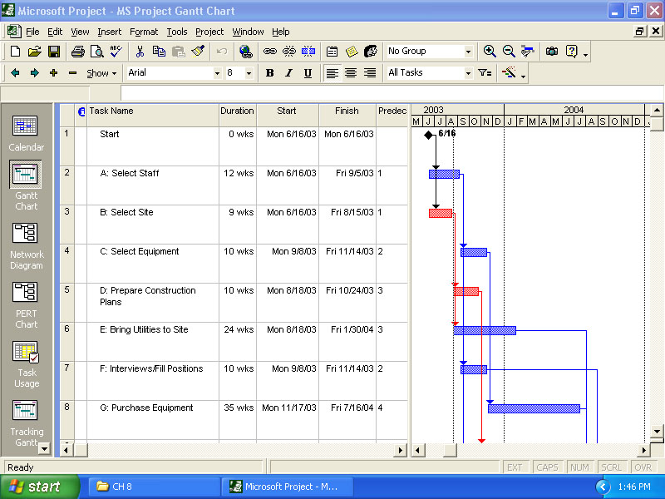
St. Adolf’s Hospital
Gantt Charts
Figure 8.9(a)
Notes:
61
Figure 4.8 is a screen shot from Project showing a Gantt chart for Example 4.3.
This slide advances automatically.

Slide 108
X Hospital
I
15
12 27
48 63
A
12
F
10
K
6
0 12
12 22
63 69
2 14
53 63
63 69
C
10
G
35
Start
12 22
22 57
Finish
14 24
24 59
B
9
D
10
H
40
J
4
0 9
9 19
19 59
59 63
0 9
9 19
19 59
59 63
Activity Slack Analysis
E
24
9 33
35 59
Notes:
62
Having these sets of times it is possible to analyze slack for the network. This starts the presentation of Example 4.4. The series first shows the manual development of activity slack and then presents the screen shot of the Project output, Figure 4.9.
This slide advances automatically.

Slide 109
St. Adolf’s Hospital
Activity Slack
I
15
12 27
48 63
A
12
F
10
K
6
0 12
12 22
63 69
2 14
53 63
63 69
C
10
G
35
12 22
22 57
Finish
Start
14 24
24 59
B
9
D
10
H
40
J
4
0 9
9 19
19 59
59 63
0 9
9 19
19 59
59 63
Activity Slack Analysis
E
24
9 33
35 59
Notes:
68

Slide 110
St. Adolf’s Hospital
Activity Slack
I
15
12 27
48 63
Slack = LS – ES
or
Slack = LF – EF
A
12
F
10
K
6
0 12
12 22
63 69
2 14
53 63
63 69
C
10
G
35
12 22
22 57
Finish
Start
14 24
24 59
B
9
D
10
H
40
J
4
0 9
9 19
19 59
59 63
0 9
9 19
19 59
59 63
Activity Slack Analysis
E
24
9 33
35 59
Notes:
68

Slide 111
St. Adolf’s Hospital
Activity Slack
I
15
12 27
48 63
Slack_{K} = 63 – 63
or
Slack_{K} = 69 – 69
A
12
F
10
K
6
0 12
12 22
63 69
2 14
53 63
63 69
C
10
G
35
12 22
22 57
Finish
Start
14 24
24 59
B
9
D
10
H
40
J
4
0 9
9 19
19 59
59 63
0 9
9 19
19 59
59 63
Activity Slack Analysis
E
24
9 33
35 59
Notes:
68
Using either the ES/LS or EF/LF pairs results in the same analysis.

Slide 112
St. Adolf’s Hospital
Activity Slack
I
15
12 27
48 63
Slack_{K} = 0
or
Slack_{K} = 0
A
12
F
10
K
6
0 12
12 22
63 69
2 14
53 63
63 69
C
10
G
35
12 22
22 57
Finish
Start
14 24
24 59
B
9
D
10
H
40
J
4
0 9
9 19
19 59
59 63
0 9
9 19
19 59
59 63
Activity Slack Analysis
E
24
9 33
35 59
Notes:
68

Slide 113
St. Adolf’s Hospital
I
15
12 27
48 63
A
12
F
10
K
6
0 12
12 22
63 69
2 14
53 63
63 69
C
10
G
35
12 22
22 57
Finish
Start
14 24
24 59
B
9
D
10
H
40
J
4
0 9
9 19
19 59
59 63
0 9
9 19
19 59
59 63
Activity Slack Analysis
E
24
9 33
35 59
Notes:
68
This slide advances automatically.

Slide 114
St. Adolf’s Hospital
Node Duration ES LS Slack
I
15
12 27
48 63
A
12
F
10
K
6
0 12
12 22
63 69
2 14
53 63
63 69
C
10
G
35
12 22
22 57
Finish
Start
14 24
24 59
B
9
D
10
H
40
J
4
0 9
9 19
19 59
59 63
0 9
9 19
19 59
59 63
Activity Slack Analysis
E
24
9 33
35 59
Notes:
68
Completing the analysis for the entire network, these are the results.

Slide 115
St. Adolf’s Hospital
Node Duration ES LS Slack
A 12 0 2 2
B 9 0 0 0
C 10 12 14 2
D 10 9 9 0
E 24 9 35 26
F 10 12 53 41
G 35 22 24 2
H 40 19 19 0
I 15 12 48 36
J 4 59 59 0
K 6 63 63 0
I
15
12 27
48 63
A
12
F
10
K
6
0 12
12 22
63 69
2 14
53 63
63 69
C
10
G
35
12 22
22 57
Finish
Start
14 24
24 59
B
9
D
10
H
40
J
4
0 9
9 19
19 59
59 63
0 9
9 19
19 59
59 63
Activity Slack Analysis
E
24
9 33
35 59
Notes:
68

Slide 116
St. Adolf’s Hospital
Node Duration ES LS Slack
A 12 0 2 2
B 9 0 0 0
C 10 12 14 2
D 10 9 9 0
E 24 9 35 26
F 10 12 53 41
G 35 22 24 2
H 40 19 19 0
I 15 12 48 36
J 4 59 59 0
K 6 63 63 0
I
15
12 27
48 63
F
10
K
6
12 22
63 69
53 63
63 69
C
10
G
35
12 22
22 57
Finish
14 24
24 59
B
9
D
10
H
40
J
4
0 9
9 19
19 59
59 63
0 9
9 19
19 59
59 63
Critical Path
E
24
9 33
35 59
Example 8.4
Notes:
69
The critical path will be the path with zero slack.

Slide 117
X Hospital
I
15
12 27
48 63
A
12
F
10
K
6
0 12
12 22
63 69
2 14
53 63
63 69
C
10
G
35
Start
12 22
22 57
Finish
14 24
24 59
B
9
D
10
H
40
J
4
0 9
9 19
19 59
59 63
0 9
9 19
19 59
59 63
Critical Path
E
24
9 33
35 59
Notes:
69

Slide 118
X Hospital
Probabilistic Time Estimates
I
A
F
K
Mean
a + 4m + b
6
Start
C
G
Finish
t_{e} =
B
D
H
J
Variance
E
( )
b – a
6
²
σ² =
Notes:
75
Often referred to as the PERT technique, the use of probabilistic time estimates allows for additional analysis of the project network.

Slide 119
X Hospital
Probabilistic Time Estimates
I
A
F
K
Activity B
Most
Optimistic Likely Pessimistic
(a) (m) (b)
7 8 15
Start
C
G
Finish
B
D
H
J
E
Notes:
75
Often referred to as the PERT technique, the use of probabilistic time estimates allows for additional analysis of the project network.

Slide 120
X Hospital
Probabilistic Time Estimates
I
A
F
K
Activity B
Most
Optimistic Likely Pessimistic
(a) (m) (b)
7 8 15
Start
C
G
Finish
B
D
H
J
7 + 4(8) + 15
6
t_{e} = = 9 weeks
E
( )
15 - 7
6
²
σ² = = 1.78
Notes:
77

Slide 121
X Hospital
Time Estimates (wk) Activity Statistics
Optimistic Likely Pessimistic Expected Variance
Activity (a) (m) (b) Time (t_{e} ) (σ² )
A 11 12 13 12 0.11
B 7 8 15 9 1.78
C 5 10 15 10 2.78
D 8 9 16 10 1.78
E 14 25 30 24 7.11
F 6 9 18 10 4.00
G 25 36 41 35 7.11
H 35 40 45 40 2.78
I 10 13 28 15 9.00
J 1 2 15 4 5.44
K 5 6 7 6 0.11
Example 8.6
Notes:
79
This table shows all the expected task times and variances for use in the probabilistic calculations.

Slide 122
X Hospital
Probabilities
Critical Path = B - D - H - J - K
T = 72 days T_{E} = 69 days
T – T_{E}
σ²
σ² = Σ (variances of activities)
z =
σ² = 1.78 + 1.78 + 2.78 + 5.44 + 0.11 = 11.89
72 – 69
11.89
z =
Notes:
83
This slide advances automatically.

Slide 123
X Hospital
Probabilities
Critical Path = B - D - H - J - K
T = 72 days T_{E} = 69 days
T – T_{E}
σ²
σ² = Σ (variances of activities)
z =
σ² = 1.78 + 1.78 + 2.78 + 5.44 + 0.11 = 11.89
72 – 69
11.89
From Appendix 2
P_{z} = .8078 ≈ .81
z = = 0.87
Notes:
85

Slide 124
St. Adolf’s Hospital
Probabilities
Normal distribution: Mean = 69 weeks;
σ = 3.45 weeks
Critical Path = B - D - H - J - K
Length of critical path
T = 72 days T_{E} = 69 days
T – T_{E}
σ²
Probability of meeting the schedule is 0.8078
σ² = Σ (variances of activities)
Probability of exceeding 72 weeks is 0.1922
z =
σ² = 1.78 + 1.78 + 2.78 + 5.44 + 0.11 = 11.89
72 – 69
11.89
From Appendix 2
P_{z} = .8078 ≈ .81
z = = 0.87
69
72
Project duration (weeks)
Figure 8.13
Notes:
86
Here Figure 18.9 is overlaid to illustrate the current analysis.

Slide 125
X Hospital
Probabilities
Path = A - C - G - J - K
T = 72 days T_{E} = 67 days
T – T_{E}
σ²
σ² = Σ (variances of activities)
z =
σ² = 0.11 + 2.78 + 7.11 + 5.44 + 0.11 = 15.55
72 – 67
15.55
From Appendix 2
P_{z} = .8980 ≈ .90
z = = 1.27
Notes:
87

Slide 126
St. Adolf’s Hospital
TABLE 8.2 SLACK CALCULATIONS AFTER ACTIVITIES A AND B HAVE BEEN COMPLETED
I
Activity Duration Earliest Start Latest Start Slack
C 10 16 14 –2
G 35 26 24 –2
J 4 61 59 –2
K 6 65 63 –2
D 10 10 9 –1
H 40 20 19 –1
E 24 10 35 25
I 15 16 48 32
F 10 16 53 37
A
F
K
Start
C
G
Finish
B
D
H
J
E
Notes:
87
This series of slides present Table 4.2 from the text showing the slack calculations after Activities A and B have been completed with longer than expected times.

Slide 127
Arrow Diagramming Method (ADM)
Also called activity-on-arrow (AOA) network diagram.
Activities are represented by arrows.
Nodes or circles are the starting and ending points of activities.
Can only show finish-to-start dependencies.

Slide 128
Process for Creating AOA Diagrams
Find all of the activities that start at node 1. Draw their finish nodes and draw arrows between node 1 and those finish nodes. Put the activity letter or name and duration estimate on the associated arrow.
Continuing drawing the network diagram, working from left to right. Look for bursts and merges. A burst occurs when a single node is followed by two or more activities. A merge occurs when two or more nodes precede a single node.
Continue drawing the project network diagram until all activities that have dependencies are included in the diagram.
As a rule of thumb, all arrowheads should face toward the right, and no arrows should cross in an AOA network diagram.

Slide 129
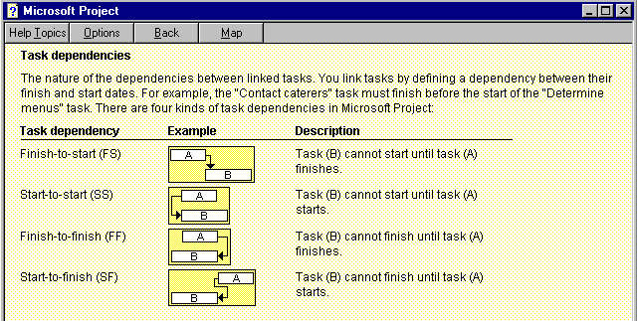
Figure 3. Task Dependency Types

Slide 130
6. Activity Resource Estimating
Before estimating activity durations, you must have a good idea of the quantity and type of resources that will be assigned to each activity.
Consider important issues in estimating resources:
How difficult will it be to complete specific activities on this project?
What is the organization’s history in doing similar activities?
Are the required resources available?

Slide 131
7. Schedule Development
Uses results of the other time management processes to determine the start and end dates of the project.
Ultimate goal is to create a realistic project schedule that provides a basis for monitoring project progress for the time dimension of the project.
Important tools and techniques include Gantt charts, critical path analysis (CPM), and PERT analysis.

Slide 132
7.1. Gantt Charts
Gantt charts provide a standard format for displaying project schedule information by listing project activities and their corresponding start and finish dates in a calendar format.
Symbols include:
Black diamonds: Milestones
Thick black bars: Summary tasks
Lighter horizontal bars: Durations of tasks
Arrows: Dependencies between tasks

Slide 133
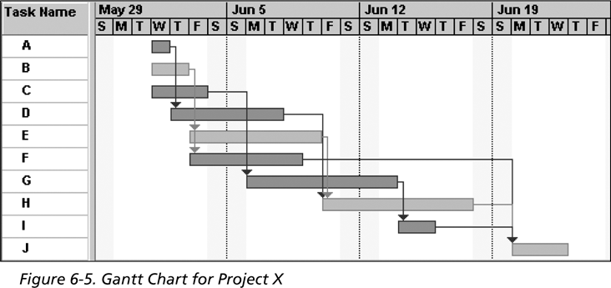
Figure: Gantt Chart for Project X

Slide 134
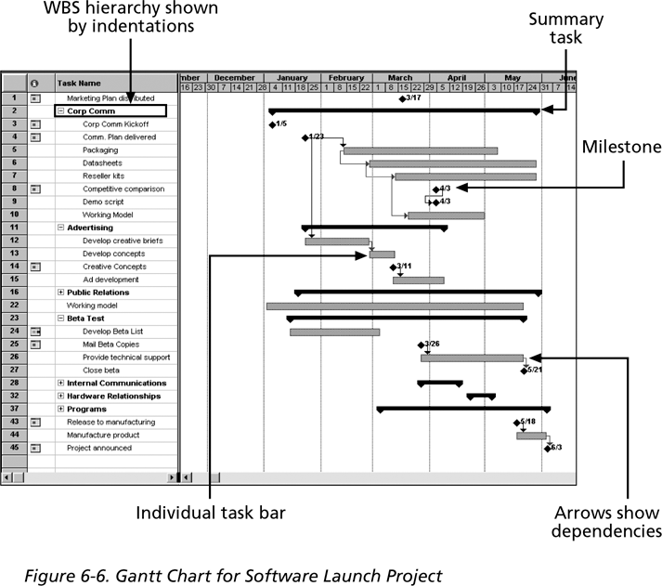
Figure: Gantt Chart for Software Launch Project

Slide 135
Adding Milestones to Gantt Charts
Many people like to focus on meeting milestones, especially for large projects.
Milestones emphasize important events or accomplishments in projects.
You typically create milestone by entering tasks that have a zero duration, or you can mark any task as a milestone.

Slide 136
SMART Criteria
Milestones should be:
Specific
Measurable
Assignable
Realistic
Time-framed

Slide 137
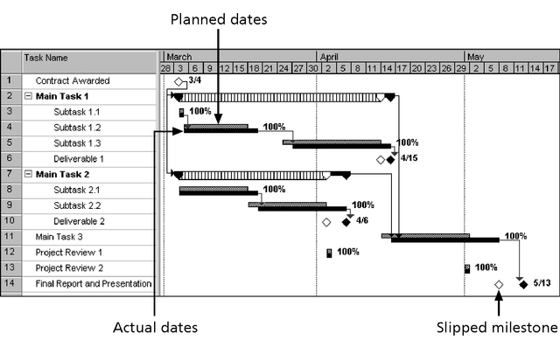
Figure: Sample Tracking Gantt Chart

Slide 138
7.2. Critical Path Method (CPM)
CPM is a network diagramming technique used to predict total project duration.
A critical path for a project is the series of activities that determines the earliest time by which the project can be completed.
The critical path is the longest path through the network diagram and has the least amount of slack or float.
Slack or float is the amount of time an activity can be delayed without delaying a succeeding activity or the project finish date.

Slide 139
Calculating the Critical Path
Develop a good network diagram.
Add the duration estimates for all activities on each path through the network diagram.
The longest path is the critical path.
If one or more of the activities on the critical path takes longer than planned, the whole project schedule will slip unless the project manager takes corrective action.

Slide 140
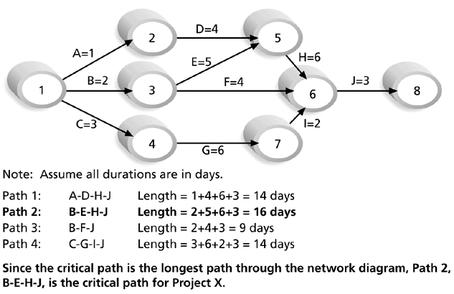
Figure: Determining the Critical Path for Project X

Slide 141
More on the Critical Path ….
The critical path does not necessarily contain all the critical activities; it only accounts for time.
There can be more than one critical path if the lengths of two or more paths are the same.
The critical path can change as the project progresses.

Slide 142
Using Critical Path Analysis to Make Schedule Trade-offs
Free slack or free float is the amount of time an activity can be delayed without delaying the early start of any immediately following activities.
Total slack or total float is the amount of time an activity can be delayed from its early start without delaying the planned project finish date.
A forward pass through the network diagram determines the early start and finish dates.
A backward pass determines the late start and finish dates.

Slide 143
Reading Assignment
Read about Calculating Early and Late Start and Finish Dates

Slide 144
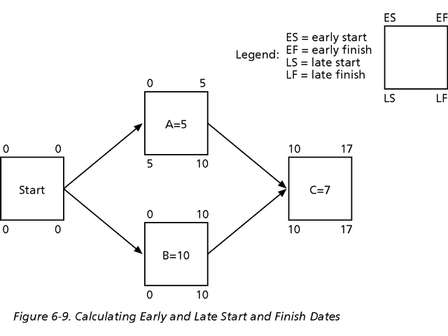
Figure: Calculating Early and Late Start and Finish Dates

Slide 145
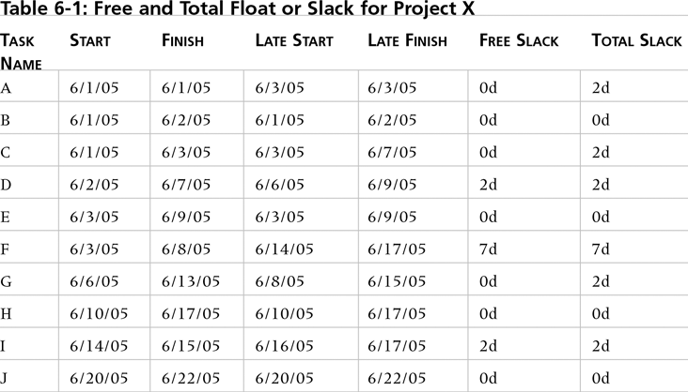
Table 1. Free and Total Float or Slack for Project X

Slide 146
Using the Critical Path to Shorten a Project Schedule
Three main techniques for shortening schedules:
Shortening the duration of critical activities or tasks by adding more resources or changing their scope.
Crashing activities: by obtaining the greatest amount of schedule compression for the least incremental cost. [read the calculation]
Fast tracking activities: by doing them in parallel or overlapping them.

Slide 147
Many Horror Stories Related to Project Schedules
Creating realistic schedules and sticking to them is a key challenge of project management.
Crashing and fast tracking often cause more problems, resulting in longer schedules.
Organizational issues often cause schedule problems.

Slide 148
Importance of Updating Critical Path Data
It is important to update project schedule information to meet time goals for a project.
The critical path may change as you enter actual start and finish dates.
If you know the project completion date will slip, negotiate with the project sponsor.

Slide 149
Buffers and Critical Chain
A buffer is additional time to complete a task.
Murphy’s Law states that if something can go wrong, it will.
Parkinson’s Law states that work expands to fill the time allowed.
In traditional estimates, people often add a buffer to each task and use the additional time whether it’s needed or not.
Critical chain scheduling removes buffers from individual tasks and instead creates:
A project buffer or additional time added before the project’s due date.
Feeding buffers or additional time added before tasks on the critical path.

Slide 150
Schedule Control
Perform reality checks on schedules.
Allow for contingencies.
Don’t plan for everyone to work at 100 percent capacity all the time.
Hold progress meetings with stakeholders and be clear and honest in communicating schedule issues.

Slide 151
Schedule Control (Cont’d…..)
Goals are to know the status of the schedule, influence factors that cause schedule changes, determine that the schedule has changed, and manage changes when they occur.
Tools and techniques include:
Progress reports.
A schedule change control system.
Project management software, including schedule comparison charts, such as the tracking Gantt chart.
Variance analysis, such as analyzing float or slack.
Performance management, such as earned value

Slide 152
Reality Checks on Scheduling
Review the draft schedule or estimated completion date in the project charter.
Prepare a more detailed schedule with the project team.
Make sure the schedule is realistic and followed.
Alert top management well in advance if there are schedule problems.

Slide 153
Using Software to Assist in Time Management
Software for facilitating communication helps people exchange schedule-related information.
Decision support models help analyze trade-offs that can be made.
Project management software can help in various time management areas.

Slide 154
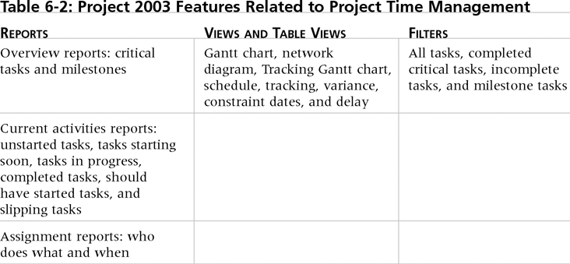
Table 2. Project 2003 Features Related to Project Time Management

Slide 155
Words of Caution on Using Project Management Software
Many people misuse project management software because they don’t understand important concepts and have not had training.
You must enter dependencies to have dates adjust automatically and to determine the critical path.
You must enter actual schedule information to compare planned and actual progress.

Slide 156
Summary
Project time management is often cited as the main source of conflict on projects, and most projects exceed time estimates.
Main processes include:
Activity definition
Activity sequencing
Activity resource estimating
Activity duration estimating
Schedule development
Schedule control

Slide 157
Exercise

Slide 158
3. Project Cost Management
Project Management Knowledge areas

Slide 159
What is Project Cost Management?
Project cost management includes the processes required to ensure that a project team completes a project within an approved budget.
There are four project cost management processes:
Resource planning
Cost estimating
Cost budgeting
Cost control

Slide 160
1. Resource Planning
Resource planning involves determining what resources (people, equipment, and materials) a project team should use to perform project activities and the quantities of each resource.
The main output of the resource planning process is a list of resource requirements, including people, equipment, and materials.
The nature of the project and the organization will affect resource planning.
Expert judgment and the availability of alternatives are the only real tools available to assist in resource planning.
The people who help determine what resources are necessary include people who have experience and expertise in similar projects and with the organization performing the project.

Slide 161
2. Cost Estimating
Cost estimating involves developing an approximation or estimate of the costs of the resources needed to complete a project.
The main outputs of the cost estimating process are:
Cost estimates;
Supporting detail; and
A cost management plan
Types of cost estimates are:
Rough order of magnitude (ROM) estimate;
Budgetary estimate; and
Definitive estimate

Slide 162
Types of Cost Estimates
Rough order of magnitude (ROM) Estimate
ROM estimate provides a rough idea of what a project will cost.
This type of estimate is done very early in a project or even before a project is officially started.
Project managers and top management use this estimate to help make project selection decisions.
The timeframe for this type of estimate is often three or more years prior to project completion.

Slide 163
Types of Cost Estimates (Cont.)
Budgetary estimate
A budgetary estimate is used to allocate money into an organization’s budget.
Many organizations develop budgets at least two years into the future.
Budgetary estimates are made one to two years prior to project completion.

Slide 164
Cont’d…..
Definitive estimate
A definitive estimate provides an accurate estimate of project costs.
Definitive estimates are used for making many purchasing decisions for which accurate estimates are required and for estimating final project costs.
Definitive estimates are made one year or less prior to project completion.
A definitive estimate should be the most accurate of the three types of estimates.

Slide 165
Cont’d….
Supporting detail
It is very important to include supporting details with all cost estimates because it would make it easier to prepare an updated estimate or similar estimate as needed.
The supporting details include:
The ground rules and assumptions used in creating the estimate;
A description of the project (scope statement, WBS, and so on) used as a basis for the estimate; and
Details on the cost estimation tools and techniques used to create the estimate.
A cost management plan is a document that describes how the organization will manage cost variances on the project.

Slide 166
Cost Estimation Tools & Techniques
Top-down estimates
Using the actual cost of a previous, similar project as the basis for estimating the cost of the current project
Requiring much of expert judgment
Being generally less costly but less accurate than others are
Bottom-up estimating
Involving estimating individual work items and summing them to get a project total
Being more accurate with smaller work items
Being usually time-intensive and therefore expensive to develop
Parametric modeling
Using project characteristics (parameters) in a mathematical model to estimate project costs
Being most reliable when:
The historical info. that was used to create the model is accurate;
The parameters are readily quantifiable; and
The model is flexible in terms of the size of the project

Slide 167
3. Cost Budgeting
Cost budgeting involves allocating the overall project cost estimate to individual work items to prepare budgetary estimates and to establish a cost baseline for measuring project performance.
These work items are based on the WBS (a required input to the cost budgeting process) for the project.
The main output of the cost budgeting process is a cost baseline.
A cost baseline is a time-phased budget that project managers use to measure and monitor cost performance.

Slide 168
4. Cost Control
Cost control involves controlling changes to the project budget.
Project cost control includes:
Monitoring cost performance;
Ensuring that only appropriate project changes are included in a revised cost baseline; and
Informing project stakeholders of authorized changes to the project that will affect costs.
The inputs to the cost control process are the cost baseline, performance reports, change requests, and the cost management plan.
The main outputs of the cost control process are revised cost estimates, budget updates, corrective action, revised estimates for project completion, and lessons learned.

Slide 169
END

Slide 170
4: Project Human Resource Management
Project Management Knowledge areas

Slide 171
Learning Objectives
Explain the importance of good human resource management on projects, including the current state and future implications of human resource management
Define project HRM and understand its processes.
Discuss human resource planning and be able to create a project organizational chart, responsibility assignment matrix, and resource histogram.
Understand important issues involved in project staff acquisition and explain the concepts of resource assignments, resource loading, and resource leveling.
Assist in team development with training, team-building activities, and reward systems.
Explain and apply several tools and techniques to help manage a project team and summarize general advice on managing teams.
Describe how project management software can assist in project human resource management.

Slide 172
Group activity
Why HRM in project mgt?
What are the elements/activities of HRM?
What are the challenges of project HRM?

Slide 173
1. What is Project HRM?
It focuses on making the most effective use of the people involved with a project.
HRM Processes include:
Human resource planning: Identifying and documenting project roles, responsibilities, and reporting relationships.
Acquiring the project team: Getting the needed personnel assigned to and working on the project.
Developing the project team: Building individual and group skills to enhance project performance.
Managing the project team: Tracking team member performance, motivating team members, providing timely feedback, resolving issues and conflicts, and coordinating changes to help enhance project performance.

Slide 174
2. Keys to Managing People
Psychologists and management theorists have devoted much research and thought to the field of managing people at work.
Important areas related to project management include:
Motivation
Influence and power
Effectiveness

Slide 175
Motivating HR

Slide 176
1. Intrinsic and Extrinsic Motivation
Intrinsic motivation causes people to participate in an activity for their own enjoyment.
Extrinsic motivation causes people to do something for a reward or to avoid a penalty.

Slide 177
Maslow’s Hierarchy of Needs
Abraham Maslow argued that human beings possess unique qualities that enable them to make independent choices, thus giving them control of their destiny.
Maslow developed a hierarchy of needs, which states that people’s behaviors are guided or motivated by a sequence of needs.

Slide 178
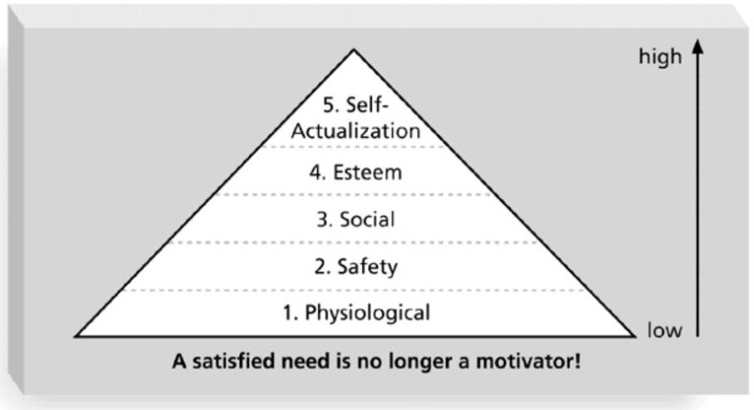
Figure 1. Maslow’s Hierarchy of Needs

Slide 179
Herzberg’s Motivational and Hygiene Factors
Frederick Herzberg wrote several famous books and articles about worker motivation. He distinguished between:
Motivational factors: Achievement, recognition, the work itself, responsibility, advancement, and growth. These factors produce job satisfaction.
Hygiene factors: Larger salaries, more supervision, and a more attractive work environment. These factors cause dissatisfaction if not present, but do not motivate workers to do more.

Slide 180
McClelland’s Acquired-Needs Theory
Specific needs are acquired or learned over time and are shaped by life experiences. The following are the main categories of acquired needs:
Achievement (nAch): People with a high need for achievement like challenging projects with attainable goals and lots of feedback.
Affiliation (nAff): People with high need for affiliation desire harmonious relationships and need to feel accepted by others, so managers should try to create a cooperative work environment for them.
Power (nPow): People with a need for power desire either personal power (not good) or institutional power (good for the organization). Provide institutional power seekers with management opportunities.

Slide 181
McGregor’s Theory X and Y
Douglas McGregor popularized the human relations approach to management in the 1960s.
Theory X: Assumes workers dislike and avoid work, so managers must use coercion, threats, and various control schemes to get workers to meet objectives.
Theory Y: Assumes individuals consider work as natural as play or rest and enjoy the satisfaction of esteem and self-actualization needs.
Theory Z: Introduced in 1981 by William Ouchi and is based on the Japanese approach to motivating workers, which emphasizes trust, quality, collective decision making, and cultural values.

Slide 182
Thamhain and Wilemon’s Ways to Have Influence on Projects
Authority: The legitimate hierarchical right to issue orders.
Assignment: The project manager's perceived ability to influence a worker's later work assignments.
Budget: The project manager's perceived ability to authorize others' use of discretionary funds.
Promotion: The ability to improve a worker's position.
Money: The ability to increase a worker's pay and benefits.

Slide 183
Thamhain and Wilemon’s Ways (cont’d)
Penalty: The project manager's ability to cause punishment.
Work challenge: The ability to assign work that capitalizes on a worker's enjoyment of doing a particular task.
Expertise: The project manager's perceived special knowledge that others deem important.
Friendship: The ability to establish friendly personal relationships between the project manager and others.

Slide 184
Influence and Power

Slide 185
Ways to Influence that Help and Hurt Projects
Projects are more likely to succeed when project managers influence people using:
Expertise
Work challenge
Projects are more likely to fail when project managers rely too heavily on:
Authority
Money
Penalty

Slide 186
Power
Power is the potential ability to influence behavior to get people to do things they would not otherwise do.
Types of power include:
Coercive power
Legitimate power
Expert power
Reward power
Referent power

Slide 187
Effectiveness

Slide 188
Improving Effectiveness: Covey’s Seven Habits
Project managers can apply Covey’s seven habits to improve effectiveness on projects.
Be proactive
Begin with the end in mind
Put first things first
Think win/win
Seek first to understand, then to be understood.
Synergize
Sharpen the saw

Slide 189
Empathic Listening and Rapport
Good project managers are empathic listeners, meaning they listen with the intent to understand.
Before you can communicate with others, you have to have rapport, which is a relation of harmony, conformity, accord, or affinity.
Mirroring is the matching of certain behaviors of the other person, and is a technique used to help establish rapport.
IT professionals need to develop empathic listening and other people skills to improve relationships with users and other stakeholders.

Slide 190
Project HRM Functions
Acquisition
Training and Development
Compensation

Slide 191
Acquiring the Project Team
Acquiring qualified people for teams is crucial.
The project manager who is the smartest person on the team has done a poor job of recruiting!
Staffing plans and good hiring procedures are important, as are incentives for recruiting and retention.
Some companies give their employees one dollar for every hour that a new person who they helped hire works.
Some organizations allow people to work from home as an incentive.

Slide 192
Why People Leave Their Jobs?
They feel they do not make a difference.
They do not get proper recognition.
They are not learning anything new or growing as a person.
They do not like their coworkers.
They want to earn more money.

Slide 193
Developing the Project Team
The main goal of team development is to help people work together more effectively to improve project performance.
It takes teamwork to successfully complete most projects.

Slide 194
Tuckman Model of Team Development
Forming involves the introduction of team members.
Storming occurs as team members have different opinions as to how the team should operate. People test each other, and there is often conflict within the team.
Norming is achieved when team members have developed a common working method, and cooperation and collaboration replace the conflict and mistrust of the previous phase.
Performing occurs when the emphasis is on reaching the team goals, rather than working on team process. Relationships are settled, and team members are likely to build loyalty towards each other. The team is able to manage tasks that are more complex and cope with greater change.
Adjourning involves the break-up of the team after they successfully reach their goals and complete the work.

Slide 195
HR Training and development
Training can help people understand themselves and each other, and understand how to work better in teams.
Team building activities include:
Physical challenges
Psychological preference indicator tools

Slide 196
Reward and Recognition Systems
Team-based reward and recognition systems can promote teamwork.
Focus on rewarding teams for achieving specific goals.
Allow time for team members to mentor and help each other to meet project goals and develop human resources.

Slide 197
Managing the Project Team
Project managers must lead their teams in performing various project activities.
After assessing team performance and related information, the project manager must decide:
If changes should be requested to the project.
If corrective or preventive actions should be recommended.
If updates are needed to the project management plan or organizational process assets.

Slide 198
Tools and Techniques for Managing Project Teams
Observation and conversation
Project performance appraisals
Conflict management
Issue logs

Slide 199
General Advice on Teams
Be patient and kind with your team.
Fix the problem instead of blaming people.
Establish regular, effective meetings.
Allow time for teams to go through the basic team-building stages.
Limit the size of work teams to three to seven members.

Slide 200
General Advice on Teams (cont’d)
Plan some social activities to help project team members and other stakeholders get to know each other better.
Stress team identity.
Nurture team members and encourage them to help each other.
Take additional actions to work with virtual team members.

Slide 201
Summary
Project human resource management includes the processes required to make the most effective use of the people involved with a project.
Main processes include:
Human resource planning
Acquiring the project team
Developing the project team
Managing the project team

Slide 202
5. Project Communications Management
Project Knowledge area

Slide 203
Learning Objectives
Understand the importance of good communications in projects.
Explain the elements of project communications planning, including how to create a communications management plan and perform a stakeholder communications analysis.
Describe various methods for distributing project information and the advantages and disadvantages of each, discuss the importance of addressing individual communication needs, and calculate the number of communications channels in a project.

Slide 204
The Communication Process
5.
Feedback travels
to sender
Stimulus
Stimulus
1.
Sender has idea
2.
Sender encodes idea in message
3.
Message travels over channel
4.
Receiver decodes message into idea
6.
Possible additional feedback to receiver

Slide 205
Importance of Good Communications
The greatest threat to many projects is a failure to communicate.
There is a belief that project managers lack communication skills
Research shows that project professionals must be able to communicate effectively to succeed in their positions.
Strong verbal skills are a key factor in career advancement

Slide 206
Project Communications Management Processes
Communications planning: Determining the information and communications needs of the stakeholders.
Information distribution: Making needed information available to project stakeholders in a timely manner.
Performance reporting: Collecting and disseminating performance information, including status reports, progress measurement, and forecasting.
Managing stakeholders: Managing communications to satisfy the needs and expectations of project stakeholders and to resolve issues.

Slide 207
1. Communications Planning
Every project should include some type of communications management plan, a document that guides project communications.
Creating a stakeholder analysis for project communications also aids in communications planning.

Slide 208
Communications Management Plan Contents
Stakeholder communications requirements.
Information to be communicated, including format, content, and level of detail.
The people who will receive the information and who will produce it.
Suggested methods or technologies for conveying the information.

Slide 209
Communications Management Plan Contents (cont’d)
Frequency of communication.
Escalation procedures for resolving issues.
Revision procedures for updating the communications management plan.
A glossary of common terminology.

Slide 210
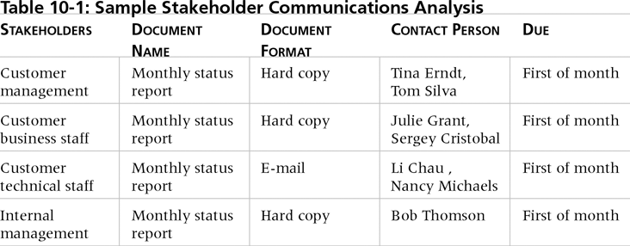
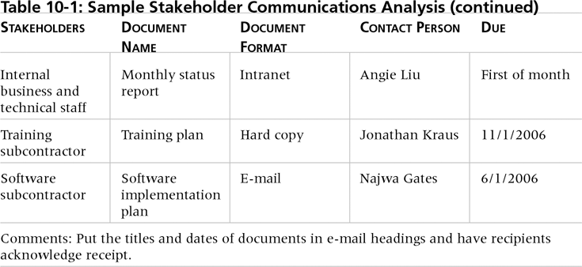
Table 1. Sample Stakeholder Analysis for Project Communications

Slide 211
2. Information Distribution
Getting the right information to the right people at the right time and in a useful format is just as important as developing the information in the first place.
Important considerations include:
Using technology to enhance information distribution.
Formal and informal methods for distributing information.

Slide 212
Distributing Information in an Effective and Timely Manner
Don’t bury crucial information.
Don’t be afraid to report bad information.
Oral communication via meetings and informal talks helps bring important information—good and bad—out into the open.

Slide 213
Importance of Face-to-Face Communication
Research says that in a face-to-face interaction:
58 percent of communication is through body language.
35 percent of communication is through how the words are said.
7 percent of communication is through the content or words that are spoken.
Pay attention to more than just the actual words someone is saying.
A person’s tone of voice and body language say a lot about how he or she really feels.

Slide 214
Encouraging More Face-to-Face Interactions
Short, frequent meetings are often very effective in projects.
meetings force people to focus on what they really need to communicate.
Some companies have policies preventing the use of e-mail between certain hours or even entire days of the week.

Slide 215
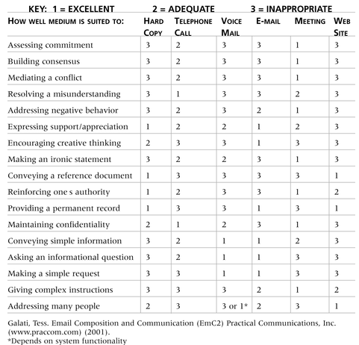
Table 2. Media Choice Table

Slide 216
Personal Preferences Affect Communication Needs
Introverts like more private communications, while extroverts like to discuss things in public.
Intuitive people like to understand the big picture, while sensing people need step-by-step details.
Thinkers want to know the logic behind decisions, while feeling people want to know how something affects them personally.
Judging people are driven to meet deadlines while perceiving people need more help in developing and following plans.

Slide 217
Other Communication Considerations
Rarely does the receiver interpret a message exactly as the sender intended.
Geographic location and cultural background affect the complexity of project communications.
Different working hours
Language barriers
Different cultural norms

Slide 218
Determining the Number of Communications Channels
As the number of people involved increases, the complexity of communications increases because there are more communications channels or pathways through which people can communicate.
Number of communications channels = n(n-1)
2 where n is the number of people involved.

Slide 219
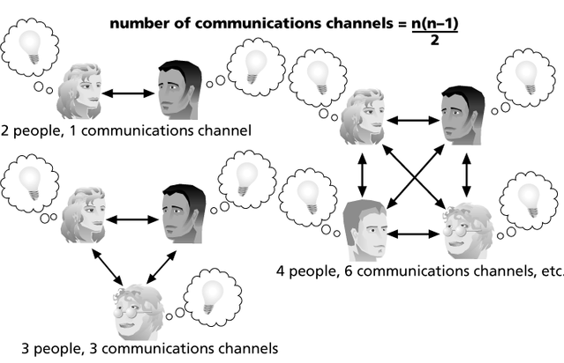
Figure 1. The Impact of the Number of People on Communications Channels

Slide 220
3. Performance Reporting
Performance reporting keeps stakeholders informed about how resources are being used to achieve project objectives.
Status reports describe where the project stands at a specific point in time.
Progress reports describe what the project team has accomplished during a certain period of time.
Forecasts predict future project status and progress based on past information and trends.

Slide 221
Managing Stakeholders
Project managers must understand and work with various stakeholders.
Need to devise a way to identify and resolve issues with stakeholders.

Slide 222
END

Slide 223
6: Project Risk Management
Project Knowledge areas

Slide 224
Learning Objectives
Understand what risk is and the importance of good project risk management.
Discuss the elements involved in risk management planning and the contents of a risk management plan.
List common sources of risks in projects.
Describe the risk identification process, tools, and techniques to help identify project risks
Discuss the qualitative and quantitative risk analysis process and explain how to calculate risk factors, create probability/impact matrixes, apply the Top Ten Risk Item Tracking technique, and use expert judgment to rank risks.
Discuss what is involved in risk monitoring and control.
Describe how software can assist in project risk management.

Slide 225
The Importance of Project Risk Management
Project Risk can be defined as:
An uncertain event or condition that, if it occurs, has a positive or negative effect on the project objectives.
Project risk management is the art and science of identifying, analyzing, and responding to risk throughout the life of a project and in the best interests of meeting project objectives.
Risk management is often overlooked in projects, but it can help improve project success by helping select good projects, determining project scope, and developing realistic estimates.

Slide 226
The Need to Improve Project Risk Management
study found that majority of projects that have significant cost or schedule overruns did no risk management at all.

Slide 227
Table 1. Project Management Maturity by Industry Group and Knowledge Area
KEY: 1 = LOWEST MATURITY RATING 5 = HIGHEST MATURITY RATING
Knowledge Area | Engineering/ Construction | Telecommunications | Information Systems | Hi-Tech Manufacturing
Scope | 3.52 | 3.45 | 3.25 | 3.37
Time | 3.55 | 3.41 | 3.03 | 3.50
Cost | 3.74 | 3.22 | 3.20 | 3.97
Quality | 2.91 | 3.22 | 2.88 | 3.26
Human Resources | 3.18 | 3.20 | 2.93 | 3.18
Communications | 3.53 | 3.53 | 3.21 | 3.48
Risk | 2.93 | 2.87 | 2.75 | 2.76
Procurement | 3.33 | 3.01 | 2.91 | 3.33
*Ibbs, C. William and Young Hoon Kwak. “Assessing Project Management Maturity,”
Project Management Journal (March 2000).

Slide 228
Negative Risk
A dictionary definition of risk is “the possibility of loss or injury.”
Negative risk involves understanding potential problems that might occur in the project and how they might impede project success.
Negative risk management is like a form of insurance; it is an investment.

Slide 229
Risk Can Be Positive
Positive risks are risks that result in good things happening; sometimes called opportunities.
A general definition of project risk is an uncertainty that can have a negative or positive effect on meeting project objectives.
The goal of project risk management is to minimize potential negative risks while maximizing potential positive risks.

Slide 230
Risk Utility
Risk utility or risk tolerance is the amount of satisfaction or pleasure received from a potential payoff.
Utility rises at a decreasing rate for people who are risk-averse.
Those who are risk-seeking have a higher tolerance for risk and their satisfaction increases when more payoff is at stake.
The risk-neutral approach achieves a balance between risk and payoff.

Slide 231
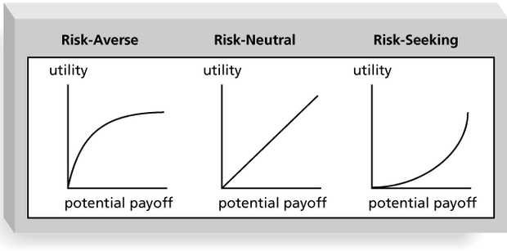
Figure 2. Risk Utility Function and Risk Preference

Slide 232
Project Risk Management Processes
Risk management planning: Deciding how to approach and plan the risk management activities for the project.
Risk identification: Determining which risks are likely to affect a project and documenting the characteristics of each.
Qualitative risk analysis: Prioritizing risks based on their probability and impact of occurrence.

Slide 233
cont’d….
Quantitative risk analysis: Numerically estimating the effects of risks on project objectives.
Risk response planning: Taking steps to enhance opportunities and reduce threats to meeting project objectives.
Risk monitoring and control: Monitoring identified and residual risks, identifying new risks, carrying out risk response plans, and evaluating the effectiveness of risk strategies throughout the life of the project.

Slide 234
1. Risk Management Planning
The main output of risk management planning is a risk management plan—a plan that documents the procedures for managing risk throughout a project.
The project team should review project documents and understand the organization’s and the sponsor’s approaches to risk.
The level of detail will vary with the needs of the project.

Slide 235
Table 2. Topics Addressed in a Risk Management Plan
Methodology
Roles and responsibilities
Budget and schedule
Risk categories
Risk probability and impact
Risk documentation

Slide 236
Contingency and Fallback Plans, Contingency Reserves
Contingency plans are predefined actions that the project team will take if an identified risk event occurs.
Fallback plans are developed for risks that have a high impact on meeting project objectives, and are put into effect if attempts to reduce the risk are not effective.
Contingency reserves or allowances are provisions held by the project sponsor or organization to reduce the risk of cost or schedule overruns to an acceptable level.

Slide 237
Broad Categories of Risk
Market risk
If the IT project is to produce a new product or service, will it be useful to the organization or marketable to other?
Will user accept and use the product or service?
Will someone else create a better product or service faster?
Financial risk
Can organization afford to undertake the project?
How confident are stakeholders in the financial projections?
Will the project meet NPV, ROI, and payback estimates?
Technology risk
Is the project technically feasible?
Will it use mature, leading edge, or bleeding edge technologies
Will hardware, software, and networks function properly?
Will the technology be available in time to meet project objectives?

Slide 238
Broad Categories of Risk …..
People risk
Does the organization have or can they find people with appropriate skills to complete the project successfully?
Do people have the proper managerial and technical skills?
Do they have enough experience?
Does senior management support the project?
Structure/process risk
What is the degree of change the new project will introduce into user areas and business procedure?
How many distinct user groups does the project need to satisfy?
Does the organization have processes in place to complete the project successfully?

Slide 239
Risk Breakdown Structure
A risk breakdown structure is a hierarchy of potential risk categories for a project.
Similar to a work breakdown structure but used to identify and categorize risks.

Slide 240
Figure 3. Sample Risk Breakdown Structure
IT Project
Business
Competitors
Suppliers
Cash flow
Technical
Hardware
Software
Network
Organizational
Executive
support
User support
Team support
Project
Management
Estimates
Communication
Resources

Slide 241
Table 4. Potential Negative Risk Conditions Associated With Each Knowledge Area

Slide 242
2. Risk Identification
Risk identification is the process of understanding what potential events might hurt or enhance a particular project.
Risk identification tools and techniques include:
Brainstorming
The Delphi Technique
Nominal Group Technique
Interviewing
SWOT analysis
Cause and Effect Diagram

Slide 243
Brainstorming
Brainstorming is a technique by which a group attempts to generate ideas or find a solution for a specific problem by amassing ideas spontaneously and without judgment.
An experienced facilitator should run the brainstorming session.
Be careful not to overuse or misuse brainstorming.
Psychology literature shows that individuals produce a greater number of ideas working alone than they do through brainstorming in small, face-to-face groups.
Group effects often inhibit idea generation.

Slide 244
Delphi Technique
The Delphi Technique is used to derive a consensus among a panel of experts who make predictions about future developments.
Provides independent and anonymous input regarding future events.
Uses repeated rounds of questioning and written responses and avoids the biasing effects possible in oral methods, such as brainstorming.

Slide 245
Nominal Group Technique (NGT)
a. Each individual silently writes her or his ideas on a piece of paper
b. Each idea is then written on a board or flip chart one at a time in a round-robin fashion until each individual has listed all of his or her ideas.
c. The group then discusses and clarifies each of the ideas.
d. Each individual then silently ranks and prioritizes the ideas.
e. The group then discusses the rankings and priorities of the ideas.
f. Each individual ranks and prioritizes the ideas again.
g. The rankings and prioritizations are then summarized for the group.

Slide 246
Interviewing
Interviewing is a fact-finding technique for collecting information in face-to-face, phone, e-mail, or instant-messaging discussions.
Interviewing people with similar project experience is an important tool for identifying potential risks.

Slide 247

SWOT Analysis
SWOT analysis (strengths, weaknesses, opportunities, and threats) can also be used during risk identification.
Helps identify the broad negative and positive risks that apply to a project.

Slide 248
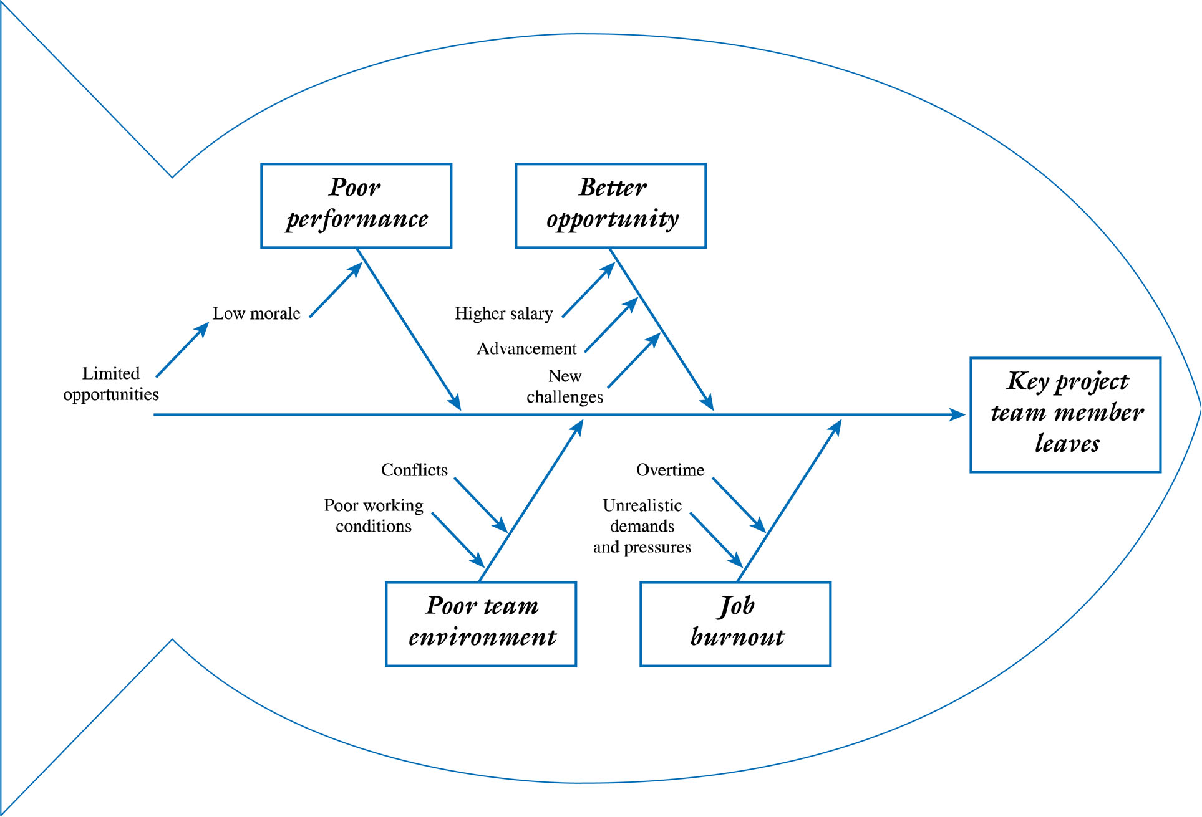
Cause and Effect Diagram

Slide 249
Risk Register
The main output of the risk identification process is a list of identified risks and other information needed to begin creating a risk register.
A risk register is:
A document that contains the results of various risk management processes and that is often displayed in a table or spreadsheet format.
A tool for documenting potential risk events and related information.
Risk events refer to specific, uncertain events that may occur to the detriment or enhancement of the project.

Slide 250
Risk Register Contents
An identification number for each risk event.
A rank for each risk event.
The name of each risk event.
A description of each risk event.
The category under which each risk event falls.
The root cause of each risk.

Slide 251
Risk Register Contents (cont’d)
Triggers for each risk; triggers are indicators or symptoms of actual risk events.
Potential responses to each risk.
The risk owner or person who will own or take responsibility for each risk.
The probability and impact of each risk occurring.
The status of each risk.

Slide 252
Table 5. Sample Risk Register
No. | Rank | Risk | Description | Category | Root Cause | Triggers | Potential Responses | Risk Owner | Probability | Impact | Status
R44 | 1
R21 | 2
R7 | 3

Slide 253
Qualitative Risk Analysis
Assess the likelihood and impact of identified risks to determine their magnitude and priority.
Risk quantification tools and techniques include:
Probability/impact matrixes
The Top Ten Risk Item Tracking
Expert judgment

Slide 254
Probability/Impact Matrix
A probability/impact matrix or chart lists the relative probability of a risk occurring on one side of a matrix or axis on a chart and the relative impact of the risk occurring on the other.
List the risks and then label each one as high, medium, or low in terms of its probability of occurrence and its impact if it did occur.
Can also calculate risk factors:
Numbers that represent the overall risk of specific events based on their probability of occurring and the consequences to the project if they do occur.

Slide 255
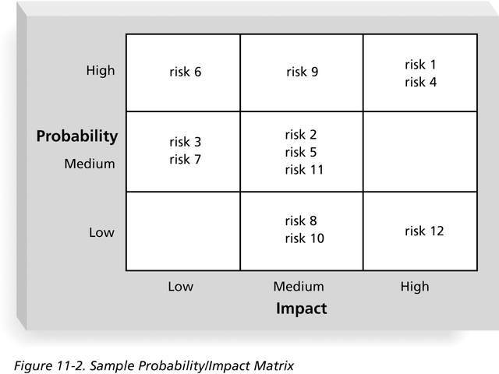
Figure 4. Sample Probability/Impact Matrix

Slide 256
Expert Judgment
Many organizations rely on the intuitive feelings and past experience of experts to help identify potential project risks.
Experts can categorize risks as high, medium, or low with or without more sophisticated techniques.
Can also help create and monitor a watch list, a list of risks that are low priority, but are still identified as potential risks.

Slide 257
Quantitative Risk Analysis
Often follows qualitative risk analysis, but both can be done together.
Large, complex projects involving leading edge technologies often require extensive quantitative risk analysis.
Main techniques include:
Decision tree analysis
Simulation
Sensitivity analysis

Slide 258
Decision Trees and Expected Monetary Value (EMV)
A decision tree is a diagramming analysis technique used to help select the best course of action in situations in which future outcomes are uncertain.
Estimated monetary value (EMV) is the product of a risk event probability and the risk event’s monetary value.
You can draw a decision tree to help find the EMV.

Slide 259
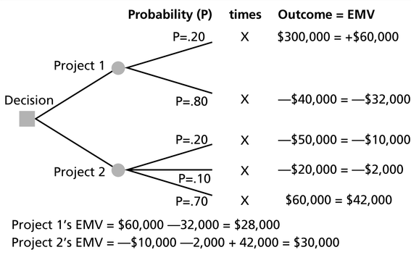
Figure 6. Expected Monetary Value (EMV) Example

Slide 260
Simulation
Simulation uses a representation or model of a system to analyze the expected behavior or performance of the system.
Monte Carlo analysis simulates a model’s outcome many times to provide a statistical distribution of the calculated results.
To use a Monte Carlo simulation, you must have three estimates (most likely, pessimistic, and optimistic) plus an estimate of the likelihood of the estimate being between the most likely and optimistic values.

Slide 261
Steps of a Monte Carlo Analysis
Assess the range for the variables being considered.
Determine the probability distribution of each variable.
For each variable, select a random value based on the probability distribution.
Run a deterministic analysis or one pass through the model.
Repeat steps 3 and 4 many times to obtain the probability distribution of the model’s results.

Slide 262
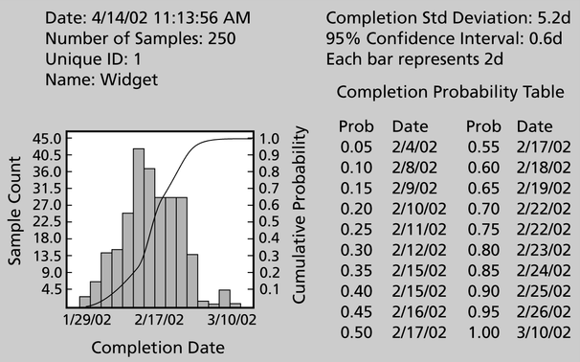
Figure 7. Sample Monte Carlo Simulation Results for Project Schedule

Slide 263
Sensitivity Analysis
Sensitivity analysis is a technique used to show the effects of changing one or more variables on an outcome.
For example, many people use it to determine what the monthly payments for a loan will be given different interest rates or periods of the loan, or for determining break-even points based on different assumptions.
Spreadsheet software, such as Excel, is a common tool for performing sensitivity analysis.

Slide 264
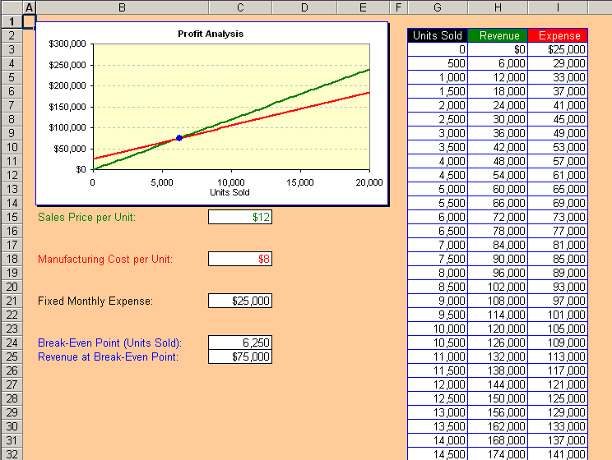
Figure 8. Sample Sensitivity Analysis for Determining Break-Even Point

Slide 265
3. Risk Response Planning
After identifying and quantifying risks, you must decide how to respond to them.
Four main response strategies for negative risks:
Risk avoidance
Risk acceptance
Risk transference
Risk mitigation

Slide 266
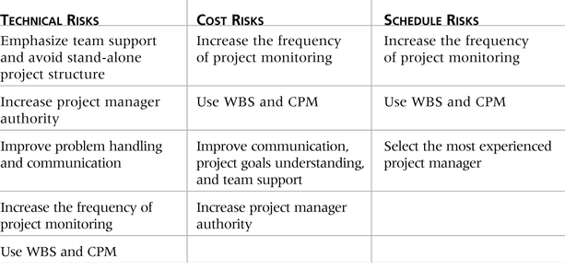
Table 8. General Risk Mitigation Strategies for Technical, Cost, and Schedule Risks

Slide 267
Response Strategies for Positive Risks
Risk exploitation: doing whatever you can to make sure the positive risk happens.
Risk sharing: allocating ownership of the risk to another party.
Risk enhancement: changing the size of the opportunity by identifying and maximizing key drivers of the positive risk.
Risk acceptance: the project team cannot or choose not to take any action toward a risk.

Slide 268
5. Risk Monitoring and Control
Monitoring risks involves knowing their status.
Workarounds are unplanned responses to risk events that must be done when there are no contingency plans.
Main outputs of risk monitoring and control are:
Requested changes.
Recommended corrective and preventive actions.
Updates to the risk register, project management plan, and organizational process assets.

Slide 269
Risk Monitoring and Control…..
Tools for monitoring and controlling project risk
Risk Audits by external people
Risk Reviews by internal team members
Risk Status Meetings and Reports

Slide 270
Using Software to Assist in Project Risk Management
Risk registers can be created in a simple Word or Excel file or as part of a database.
More sophisticated risk management software, such as Monte Carlo simulation tools, help in analyzing project risks.
The PMI Risk Specific Interest Group’s Web site at www.risksig.com has a detailed list of software products to assist in risk management.

Slide 271
Results of Good Project Risk Management
Unlike crisis management, good project risk management often goes unnoticed.
Well-run projects appear to be almost effortless, but a lot of work goes into running a project well.
Project managers should strive to make their jobs look easy to reflect the results of well-run projects.

Slide 272
Chapter Summary
Project risk management is the art and science of identifying, analyzing, and responding to risk throughout the life of a project and in the best interests of meeting project objectives.
Main processes include:
Risk management planning
Risk identification
Qualitative risk analysis
Quantitative risk analysis
Risk response planning
Risk monitoring and control

Slide 273
Chapter 7: Project Procurement Management
Project Management Knowledge areas

Slide 274
Learning Objectives
Understand the importance of project procurement management and the increasing use of outsourcing projects.
Describe the work involved in planning purchases and acquisitions for projects, the contents of a procurement management plan and contract statement of work, and calculations involved in a make-or-buy analysis.
Discuss what is involved in planning contracting, including the creation of various procurement documents and evaluation criteria for sellers.
Understand the process of requesting seller responses and the difference between proposals and bids.
Describe the seller selection process and recognize different approaches for evaluating proposals or selecting suppliers.
Discuss the importance of good contract administration.

Slide 275
Importance of Project Procurement Management
Procurement means acquiring goods and/or services from an outside source.
Other terms include purchasing and outsourcing.
Experts predict that global spending on computer software and services will continue to grow.

Slide 276
Why Outsource?
To reduce both fixed and recurrent costs.
To allow the client organization to focus on its core business.
To access skills and technologies.
To provide flexibility.
To increase accountability.

Slide 277
Contracts
A contract is a mutually binding agreement that obligates the seller to provide the specified products or services and obligates the buyer to pay for them.
Contracts can clarify responsibilities and sharpen focus on key deliverables of a project.
Because contracts are legally binding, there is more accountability for delivering the work as stated in the contract.
A recent trend in outsourcing is the increasing size of contracts.

Slide 278
Project Procurement Management Processes
Project procurement management: Acquiring goods and services for a project from outside the performing organization.
Processes include:
Planning purchases and acquisitions: Determining what to procure, when, and how.
Planning contracting: Describing requirements for the products or services desired from the procurement and identifying potential sources or sellers (contractors, suppliers, or providers who provide goods and services to other organizations).

Slide 279
cont’d…
Requesting seller responses: Obtaining information, quotes, bids, offers, or proposals from sellers, as appropriate.
Selecting sellers: Choosing from among potential suppliers through a process of evaluating potential sellers and negotiating the contract.
Administering the contract: Managing the relationship with the selected seller.
Closing the contract: Completing and settling each contract, including resolving any open items.

Slide 280
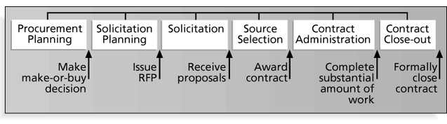
Project Procurement Management Processes

Slide 281
Planning Purchases and Acquisitions
Identifying which project needs can best be met by using products or services outside the organization.
If there is no need to buy any products or services from outside the organization, then there is no need to perform any of the other procurement management processes.

Slide 282
Tools and Techniques for Planning Purchases and Acquisitions
Make-or-buy analysis: General management technique used to determine whether an organization should make or perform a particular product or service inside the organization or buy from someone else.
Often involves financial analysis.
Experts, both internal and external, can provide valuable inputs in procurement decisions.

Slide 283
Make-or-Buy Example
Assume you can lease an item you need for a project for Br. 800/day. To purchase the item, the cost is Br.12,000 plus a daily operational cost of Br. 400/day.
How long will it take for the purchase cost to be the same as the lease cost?

Slide 284
Make-or Buy Solution
Set up an equation so both options, purchase and lease, are equal.
In this example, use the following equation. Let d be the number of days to use the item:
Br.12,000 + Br. 400d = Br. 800d
Subtracting Br. 400d from both sides, you get:
Br. 12,000 = Br. 400d
Dividing both sides by Br. 400, you get:
d = 30
If you need the item for more than 30 days, it is more economical to purchase it.

Slide 285
Types of Contracts
Different types of contracts can be used in different situations:
Fixed price or lump sum contracts: Involve a fixed total price for a well-defined product or service.
Cost reimbursable contracts: Involve payment to the seller for direct and indirect costs.
Time and material contracts: Hybrid of both fixed price and cost reimbursable contracts, often used by consultants.
Unit price contracts: Require the buyer to pay the seller a predetermined amount per unit of service.
A single contract can actually include all four of these categories, if it makes sense for that particular procurement.

Slide 286
Contract Clauses
Contracts should include specific clauses to take into account issues unique to the project.
Can require various educational or work experience for different pay rights.
A termination clause is a contract clause that allows the buyer or supplier to end the contract.

Slide 287
Procurement Management Plan
Describes how the procurement processes will be managed, from developing documentation for making outside purchases or acquisitions to contract closure.
Contents varies based on project needs.

Slide 288
Contract Statement of Work (SOW)
A statement of work is a description of the work required for the procurement.
If a SOW is used as part of a contract to describe only the work required for that particular contract, it is called a contract statement of work.
A SOW is a type of scope statement.
A good SOW gives bidders a better understanding of the buyer’s expectations.

Slide 289
Figure 2. Statement of Work (SOW) Template

Slide 290
Planning Contracting
Involves preparing several documents needed for potential sellers to prepare their responses and determining the evaluation criteria for the contract award.
Request for Proposals: Used to solicit proposals from prospective sellers.
A proposal is a document prepared by a seller when there are different approaches for meeting buyer needs.
Requests for Quotes: Used to solicit quotes or bids from prospective suppliers.
A bid, also called a tender or quote (short for quotation), is a document prepared by sellers providing pricing for standard items that have been clearly defined by the buyer.

Slide 291
Figure 3. Request for Proposal (RFP) Template

Slide 292
Evaluation Criteria
It’s important to prepare some form of evaluation criteria, preferably before issuing a formal RFP or RFQ.
Beware of proposals that look good on paper; be sure to evaluate factors, such as past performance and management approach.
Can require a technical presentation as part of a proposal.

Slide 293
Requesting Seller Responses
Deciding whom to ask to do the work, sending appropriate documentation to potential sellers, and obtaining proposals or bids.
Organizations can advertise to procure goods and services in several ways:
Approaching the preferred vendor.
Approaching several potential vendors.
Advertising to anyone interested.
A bidders’ conference can help clarify the buyer’s expectations.

Slide 294
Selecting Sellers
Also called source selection.
Involves:
Evaluating proposals or bids from sellers.
Choosing the best one.
Negotiating the contract.
Awarding the contract.

Slide 295
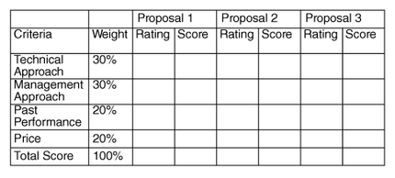
Figure 4. Sample Proposal Evaluation Sheet

Slide 296
Seller Selection Process
Organizations often do an initial evaluation of all proposals and bids and then develop a short list of potential sellers for further evaluation.
Sellers on the short list often prepare a best and final offer (BAFO).
Final output is a contract signed by the buyer and the selected seller.

Slide 297
Administering the Contract
Ensures that the seller’s performance meets contractual requirements.
Contracts are legal relationships, so it is important that legal and contracting professionals be involved in writing and administering contracts.
Many project managers ignore contractual issues, which can result in serious problems.

Slide 298
Suggestions for Change Control in Contracts
Changes to any part of the project need to be reviewed, approved, and documented by the same people in the same way that the original part of the plan was approved.
Evaluation of any change should include an impact analysis. How will the change affect the scope, time, cost, and quality of the goods or services being provided?
Changes must be documented in writing. Project team members should also document all important meetings and telephone phone calls.

Slide 299
cont’d….
Project managers and teams should stay closely involved to make sure the new system will meet business needs and work in an operational environment.
Have backup plans.
Use tools and techniques, such as a contract change control system, buyer-conducted performance reviews, inspections and audits, and so on.

Slide 300
Closing the Contract
Involves completing and settling contracts and resolving any open items.
The project team should:
Determine if all work was completed correctly and satisfactorily.
Update records to reflect final results.
Archive information for future use.
The contract itself should include requirements for formal acceptance and closure.

Slide 301
Tools to Assist in Contract Closure
Procurement audits identify lessons learned in the procurement process.
A records management system provides the ability to easily organize, find, and archive procurement-related documents.

Slide 302
Using Software to Assist in Project Procurement Management
Word processing software helps write proposals and contracts, spreadsheets help evaluate suppliers, databases help track suppliers, and presentation software helps present procurement-related information.
E-procurement software does many procurement functions electronically.
Organizations also use other Internet tools to find information on suppliers or auction goods and services.

Slide 303
QUALITY MANAGEMENT
Quality
the extent to which the final deliverable conforms to the customer’s requirements.
Quality perspectives:
the quality of each deliverable produced for the customer and
the quality of the management processes undertaken to produce each deliverable.
quality plan
defines the approach taken to ensure the level of quality of each deliverable,
highlights the management processes required to influence deliverable quality, such as change, risk and issue management.
summarizes the quality targets to be met and the management processes to be undertaken,
Quality planning process
1. Defining deliverable quality
2. Identifying Quality targets
3. Developing Quality assurance plan
4. Develop Quality control plan
5. Define process quality
303

Slide 304
END of Chapter 5

