Slide 1
Ottawa, Ontario, Carleton University, ARC ms.1
Letycia Henriques (040911776)
Internet Applications
25 April 2018

Slide 2
About the Website
Client: Carleton University; Archives and Research Collections
Purpose: Digital exhibit for Ottawa, Ontario, Carleton University, ARC ms.1
Target Audience: Students, faculty, researchers, anyone interested in medieval manuscripts

Slide 3
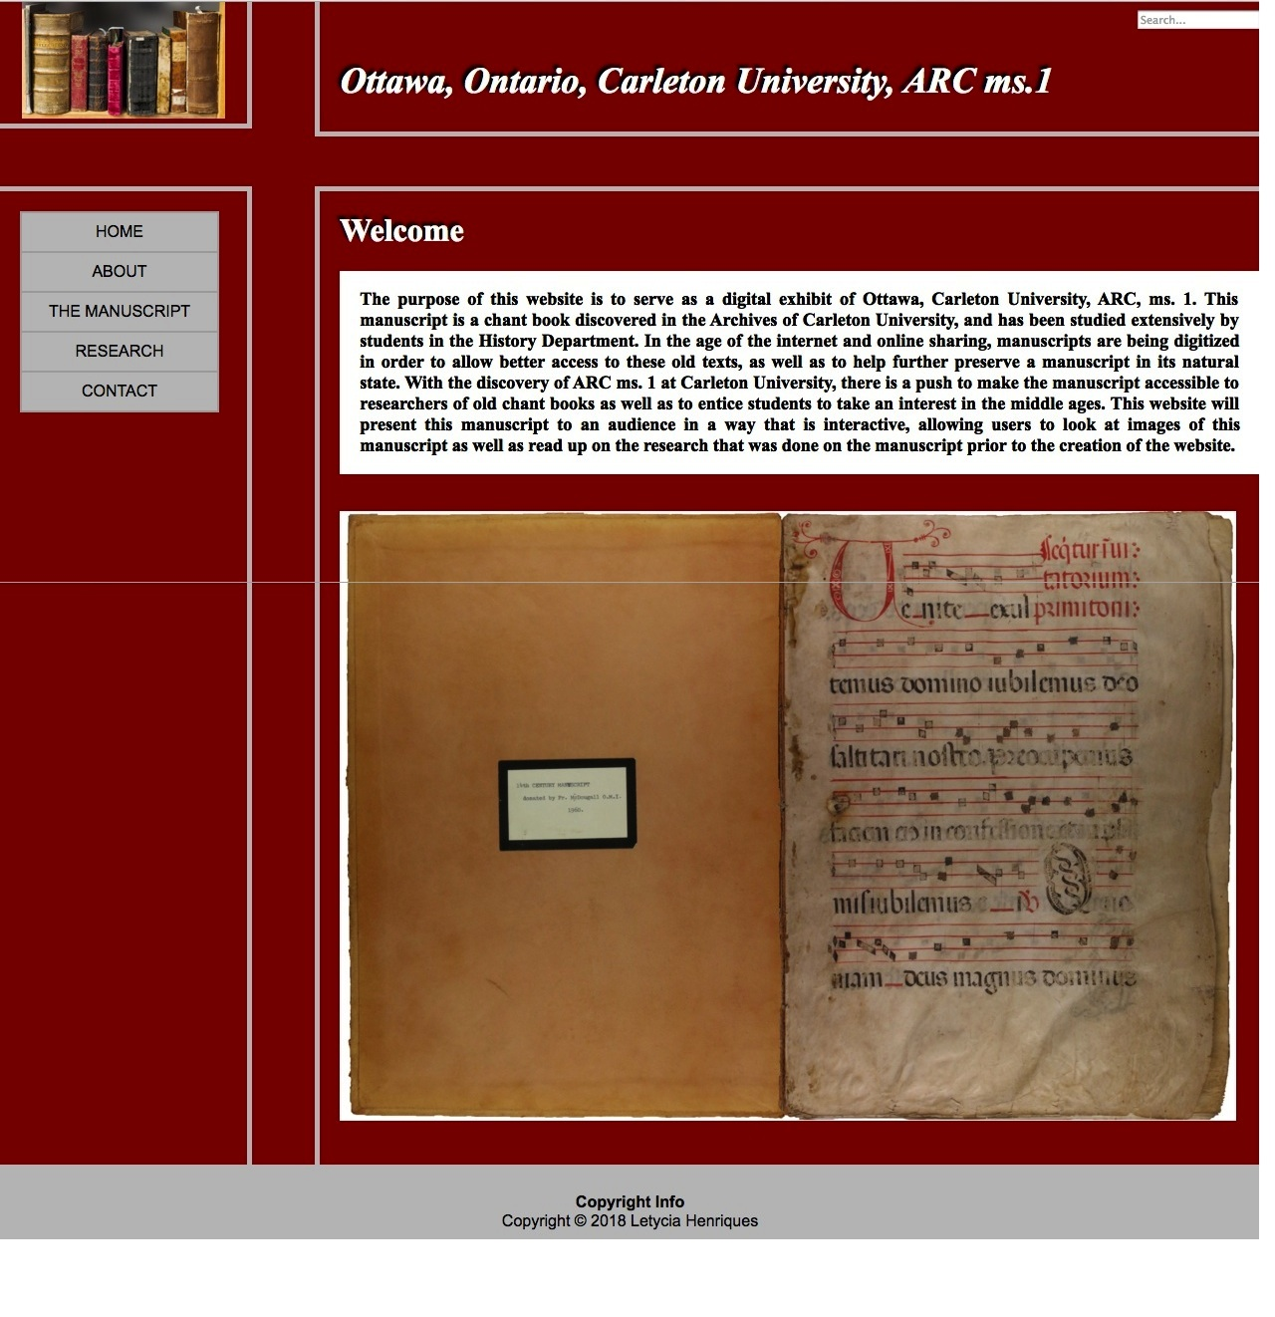
Home Page

