Slide 1
Hadoop MapReduce
“From Scratch”
Chu Zihao
Deng Ruofan
Wang Fu

Slide 2
Idea
01
Demo
02
CONTENTS
Results
03
Improvements
04

Slide 3
Idea
/01

Slide 4

1.1 Objective
Trivial method : Quick sort without recurrence on one processor
Map-Reduce method : Solve problems using many processors
Text here
Text here

Slide 5
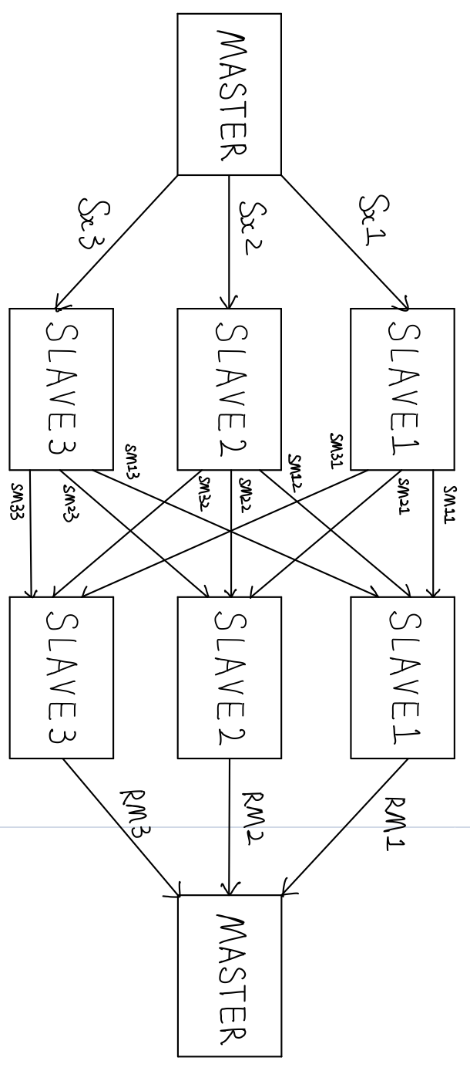
1.2 System diagram
Design
SLAVEs：
Three containers of docker
Virtual network
Mapping ( R & i )
Reducing
scp service
MASTER：
Splitting and distribution (1/3)
Final sorting

Slide 6
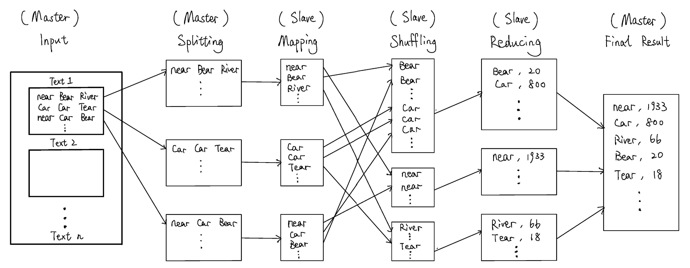
1.3 Overall MapReduce word count process

Slide 7
Demo
/02

Slide 8
Results
/03

Slide 9

3.1 Time Consumption of Trivial Method
Stable

Slide 10
3.2 Time Consumption of MapReduce Method
Stable

Slide 11
3.2 Comparison of the Two Methods
File Size
117B
8.2MB
193.8MB
Trivial Method
161.4ms
2649.5ms
17308.5ms
MapReduce Method
11420.2ms
17566.4ms
43754.7ms
Why the trivial method looks better?

Slide 12
3.2 Comparison of the Two Methods
Too much time for file input, creation and
Work done in only one PC with docker
Small file size
Resource allocation of the OS

Slide 13
Improvements
/04

Slide 14
4 Improvements
More slaves
Use different computers
Use larger files
We can distribute the files without reading them
In the mapping step, we divide the words by the first letter ‘R’ and ‘I’, that may not be the best choice

