Slide 1


HydroShare: Advancing Hydrology through Collaborative Data and Model Sharing
David Tarboton, Ray Idaszak, Jeffery Horsburgh, Dan Ames, Jon Goodall, Larry Band, Venkatesh Merwade, Alva Couch, Rick Hooper, David Maidment, Pabitra Dash, Michael Stealey, Hong Yi, Tian Gan, Tony Castronova, Brian Miles, Zhiyu Li, Mohamed Morsy
USU, RENCI, BYU, UNC, UVA, CUAHSI, Tufts, Texas, Purdue, Caktus
http://www.hydroshare.org
OCI-1148453
OCI-1148090
2012-2017

Slide 2

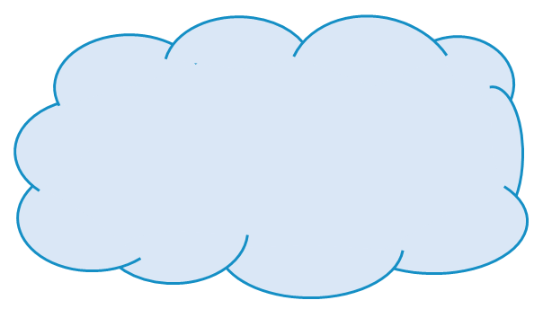
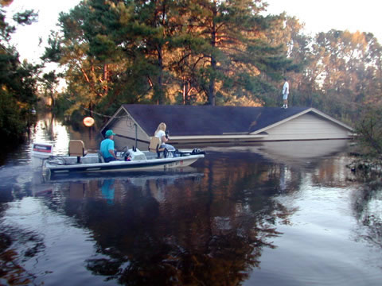
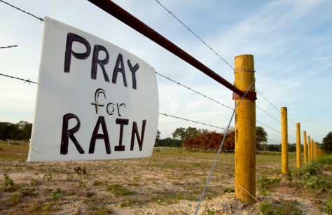
Motivation
Advancing Hydrologic Understanding
requires integration of information from multiple sources
is data and computationally intensive
requires collaboration and working as a team/community
Analysis
Data
Models
Grand challenge (NRC 2001): Better hydrologic forecasting that quantifies effects and consequences of land surface change on hydrologic processes and conditions
Floods and Droughts

Slide 3
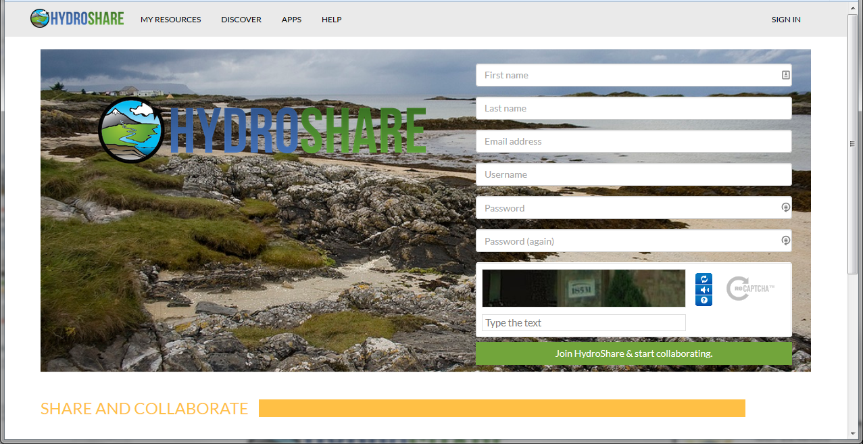
Web based collaboration environment
www.hydroshare.org
Enable more rapid advances in hydrologic understanding through collaborative data sharing, analysis and modeling
Being collaboratively developed by USU, RENCI, BYU, UNC, UVA, CUAHSI, Tufts, Texas, Purdue, Caktus
Open Development at http://github.com/hydroshare (contributors are welcome)

Slide 4

HydroShare Goals
To provide a cyberinfrastructure platform for hydrologic research to solve problems of size and scope not otherwise solvable using desktop computing through
Software as a service
Data as a service
Models as a service
Visualization and analysis services
To enable more rapid advances in hydrologic understanding through collaborative data sharing, analysis and modeling
To address community cyberinfrastructure needs

Slide 5
Functionality
Sharing and publication of data
Social discovery and added value
Model sharing
Model input data preparation
Model execution
Visualization and analysis (best of practice tools)
Collaboration
Server/Cloud Computation
Platform independence
Big data
Reproducibility
Reduce needs for software installation and configuration
My talk IN51C-04 tomorrow expands on Server/Cloud computation

Slide 6
Architecture
Organize and annotate your content
Manage access
Web software to operate on content you have access to (Apps)
Extensibility
Django website
API
HydroShare Apps
Resource exploration
Actions on Resources
Empower everyone with Apps (Dawn Wright)
OAuth
API
API
Distributed file storage
iRODS “Network File System”
Anyone can set up a server/app platform (software service) to operate on HydroShare resources through iRODS and API
Parallels the paradigm for how PC’s are used

Slide 7
At its heart, HydroShare is a system for sharing Resources and Collaborating
Files and sets of files structured to represent a hydrologic process, model, or element in the hydrologic environment
Standard data models enhance interoperability and support functionality “hydro value added”
Tools (Web apps) that act on resources to visualize, modify and create new resources
Encode standard/best practices
Access control and sharing model

Slide 8
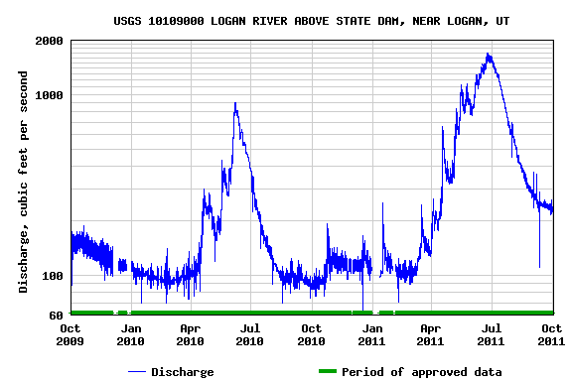
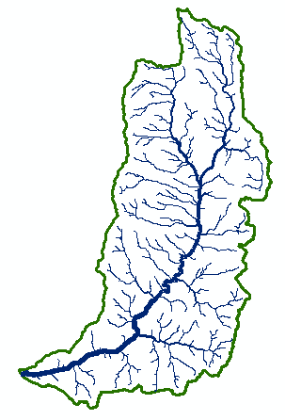
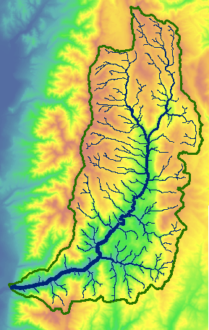

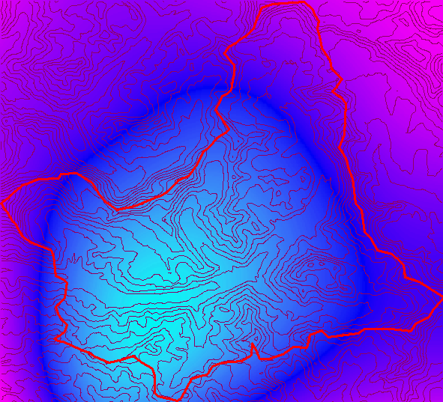
Types of data supported as resources
Resource Types
Generic ✓
Geographic Raster ✓
Time Series ✓
Multidimensional ✓
Model program ✓
Model instance ✓
SWAT Model Instance ✓
Web App ✓
Geographic Feature ✓
Referenced Time Series (CUAHSI HIS web service link)
River Geometry
Sample based observations (ODM2 and CZO)
Composite resources (Collections of resources)
t
y
x

Slide 9
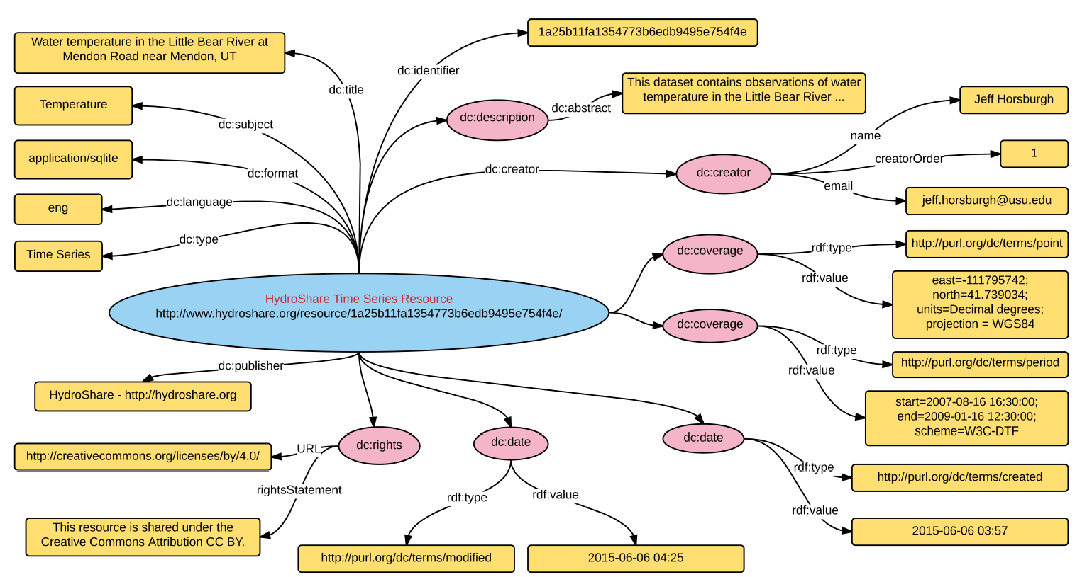
Resource Data Model holds all the information for formal publication with DOI
Open Archives Initiative – Object Reuse and Exchange (OAI-ORE) - standards for the description and exchange of aggregations of Web resources
BagIt – hierarchical file packaging format designed to support disk-based or network-based storage and transfer of generalized digital content
Compatible with DataOne
Horsburgh, J. S., et al., (2015), "Hydroshare: Sharing Diverse Environmental Data Types and Models as Social Objects with Application to the Hydrology Domain," JAWRA, http://dx.doi.org/10.1111/1752-1688.12363.

Slide 10

Collaborative data analysis and publication use case
Share and Collaborate
Analyze
Observe
Store
Model
Reproducibly Publish and Archive (DOI)
Manage Access
Annotate (metadata)
- - -
- - -
- - -
Journal Paper
- - -
- - -
- - -
Citable data

Slide 11
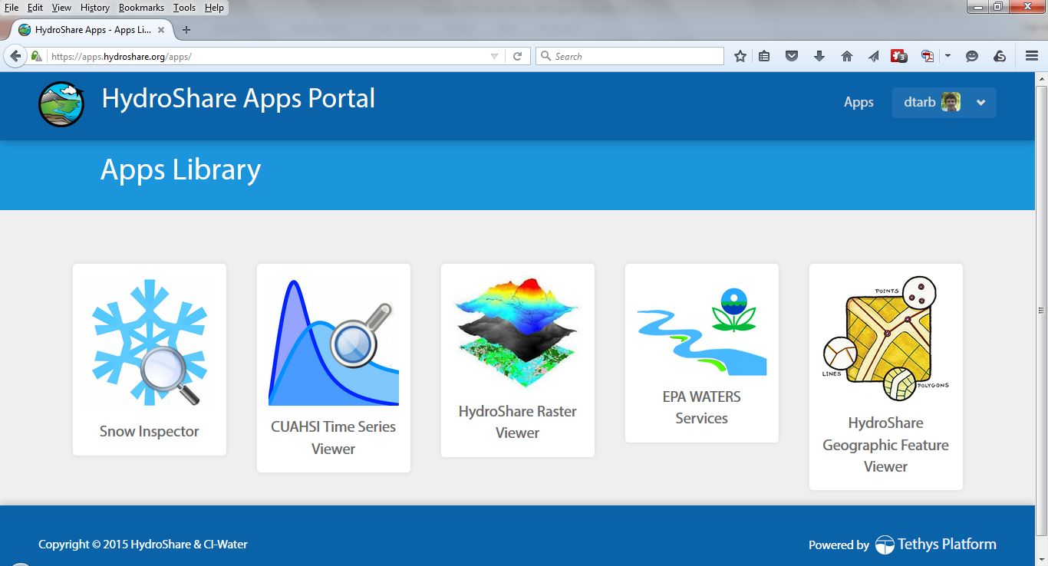
http://apps.hydroshare.org supports web based visualization and analysis working with HydroShare Resources

Slide 12
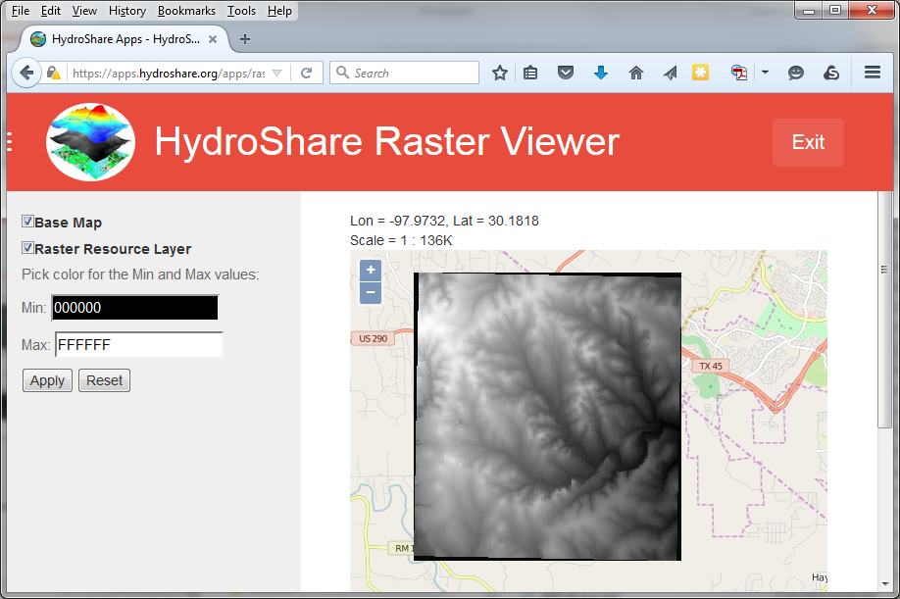
Tethys/Geoserver Raster Viewer display of Raster Resources

Slide 13
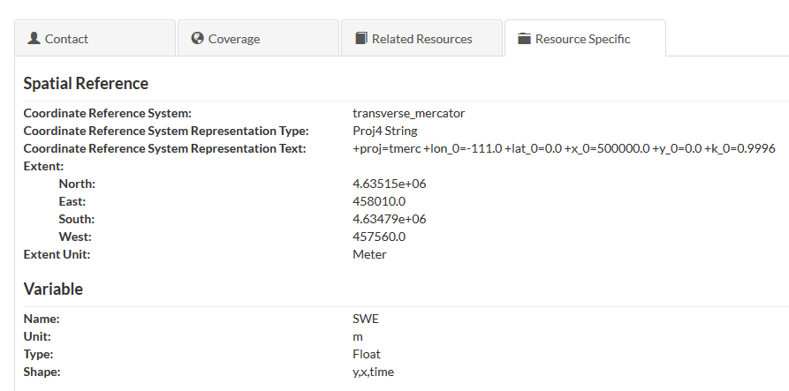
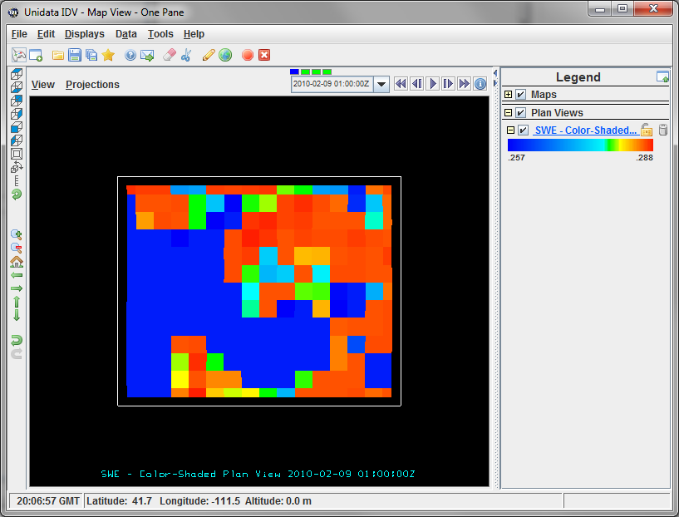
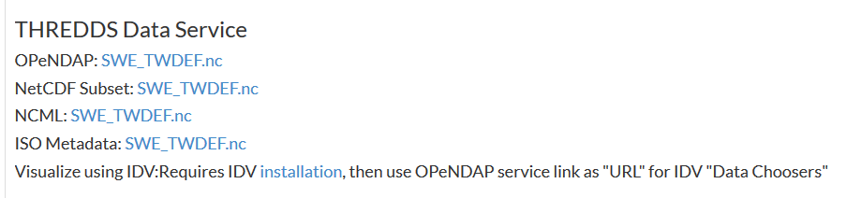
THREDDS Server link to act on Multidimensional resources in netCDF format

Slide 14
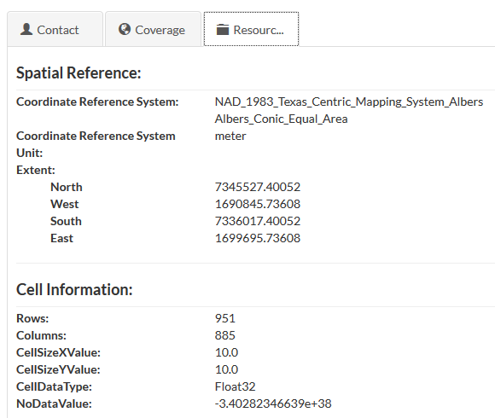
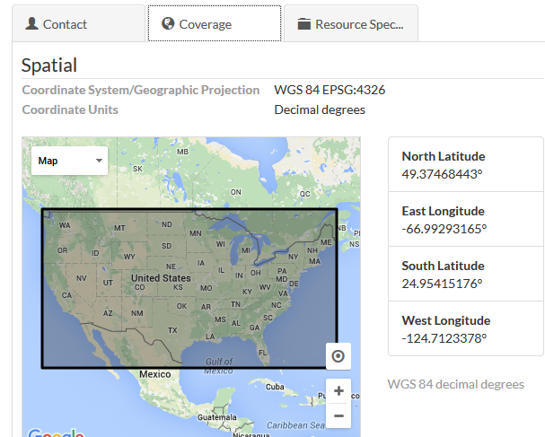
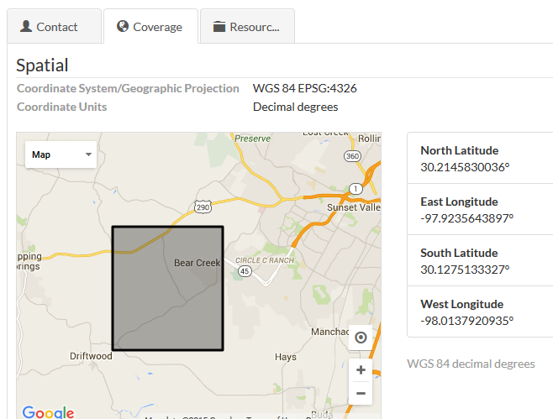
Automatic and natural metadata gathering eases some of the pain of metadata entry
For geographic raster WGS 84 Coverage information automatically harvested from GeoTIFF coordinate system information
For multidimensional netCDF data with CF convention metadata the HydroShare RDM metadata can be fully and automatically completed

Slide 15
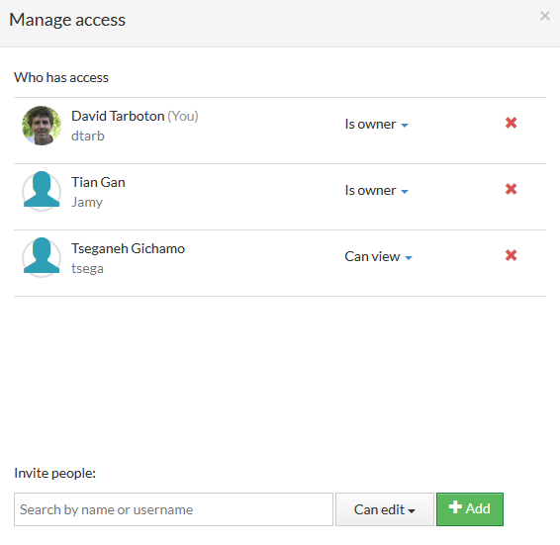
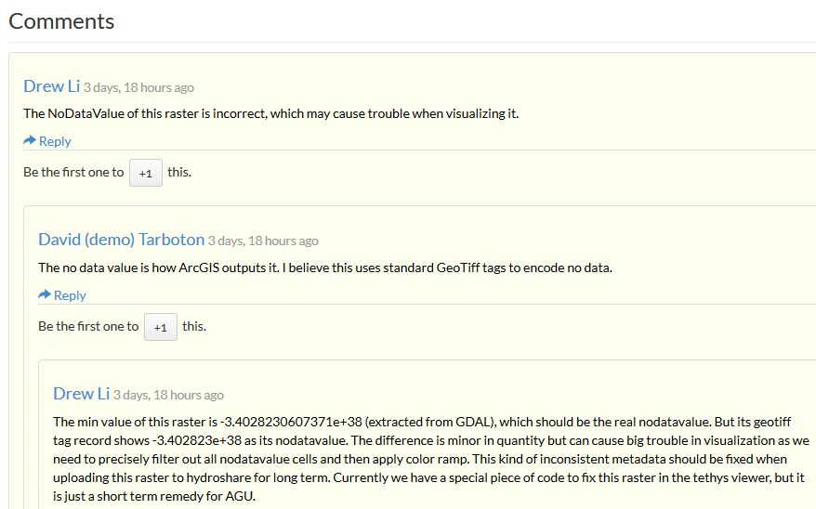
Collaborative “social” functions for access control, commenting and rating.

Slide 16
Summary
A new, web-based system for advancing model and data sharing
Access multiple types of hydrologic data using standards compliant data formats and interfaces
Flexible discovery functionality
Model sharing and execution
Facilitate and ease access to use of high performance computing
Social media and collaboration functionality
Links to other data and modeling systems
Talk tomorrow: Clearing your Desk! Software and Data Services for Collaborative Web Based GIS Analysis. (IN51C-04 8:43 am)

Slide 17
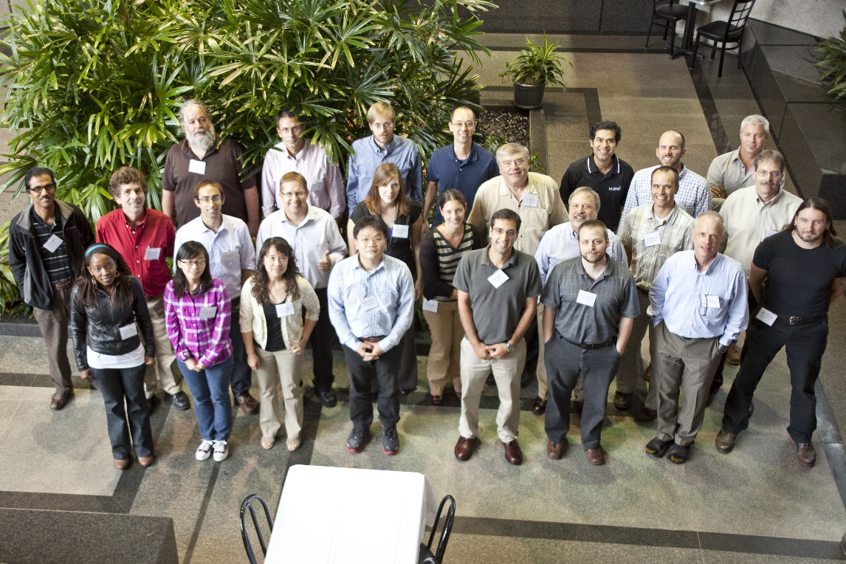
Thanks to the HydroShare team!
USU
RENCI/UNC
CUAHSI
BYU
Tufts
UVA
Texas
Purdue
SDSC
Talk tomorrow: Clearing your Desk! Software and Data Services for Collaborative Web Based GIS Analysis. (IN51C-04 8:43 am)
http://www.hydroshare.org
OCI-1148453
OCI-1148090
2012-2017
Notes:
The HydroShare project is part of a broad effort in CUAHSI in the area of Hydrologic Information Systems. We have a team of developers and domain scientists from eight universities working on HydroShare. This is part of the even broader focus in NSF on data management, Cyberinfrastructure and sustainable software.

