Slide 1

AI MAINTENANCE COMPANION
Every technician,
an expert beside them.
Instant access to the technical knowledge needed to maintain
industrial equipment.
ASK • VERIFY • MAINTAIN
Turning equipment manuals into maintenance intelligence.

Slide 2



THE PROBLEM
Maintenance information is hard to access
The knowledge exists. The technician loses time finding it.
TECHNICIAN NEEDS
TODAY
RESULT
Torque
Clearance
Procedure
Measurements
Tools
Find the manual
Search hundreds of pages
Check model & revision
Cross-check values
Lost time
Delayed repairs
Reliance on experts
Risk of missed information
AI MAINTENANCE COMPANION
2

Slide 3
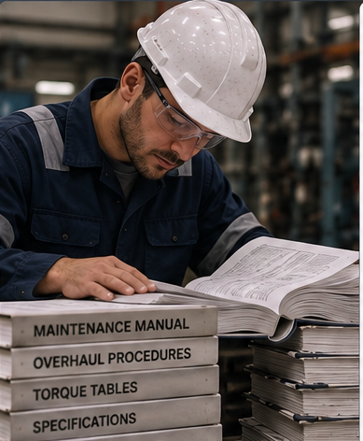
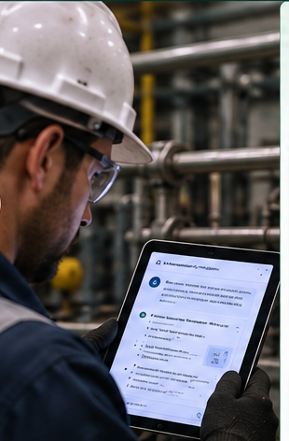


REAL-WORLD USE CASE
Installing a piston: the information bottleneck
A 2-hour job becomes a 3+ hour job when finding the right information takes over an hour.
THE OLD WAY
WITH AI COMPANION
3+ hours total
~2 hours total
Find the right manual
Search hundreds of pages
Cross-check model & revision
Locate exact values
Ask in plain language
Get procedure, values & tools at once
Verify against source manual
Keep working — no lost time
Over 1 hour spent just finding information
“It’s like having an expert next to me.”
33% less total job time — same job, less time spent searching instead of repairing
AI MAINTENANCE COMPANION
3

Slide 4


THE SOLUTION
Ask while you work
The companion retrieves the exact information from the equipment's approved documentation.
ASK
GET
VERIFY
“What are the piston installation procedure, clearances, torque values, measurements and required tools?”
Procedure
Clearances
Torque
Measurements
Tools
Manual
Section
Table
Page
Revision
The source is part of the answer.
AI MAINTENANCE COMPANION
4

Slide 5
THE VALUE
Less searching. More maintenance.
Same job. Less non-value-adding time.
OLD WAY
AI COMPANION
Over 1 hr searching
Answers while working
+
+
2 hr repair
2 hr repair
= 3+ hr total
= ~2 hr total
≈33% LESS TOTAL JOB TIME
Illustrative case: assumes the 1+ hour search is avoided.
AI MAINTENANCE COMPANION
5

Slide 6


WHY IT MATTERS
Faster access to knowledge improves the maintenance workflow
FASTER REPAIRS
BETTER EXECUTION
LOWER MTTR
Less time searching
→ quicker return to service
Right procedure
Right values
Right revision
Remove information-search time
→ shorter maintenance cycle
AI MAINTENANCE COMPANION
6

Slide 7



WHY NOW
The technology has caught up with the problem
AI
RETRIEVAL
INDUSTRIAL KNOWLEDGE
Understands natural-language technical questions.
Finds relevant information inside proprietary manuals.
The information already exists. It is simply difficult to access.
NOW: PUT AN INTELLIGENT INTERFACE ON INDUSTRIAL KNOWLEDGE.
AI MAINTENANCE COMPANION
7

Slide 8

THE WEDGE
Start with manuals. Build maintenance intelligence.
1
MANUALS
2
EQUIPMENT CONTEXT
3
INTELLIGENCE
OEM documentation
Technical procedures
Specifications
Asset data
Maintenance history
Work orders
Troubleshooting
Guidance
Recommendations
AI MAINTENANCE COMPANION
8

Slide 9

THE OPPORTUNITY
Every asset-intensive industry has equipment.
Every piece of equipment has knowledge.
START
Oil & Gas
Power
Manufacturing
Mining
Marine
Utilities
A focused maintenance wedge with a path to broader industrial intelligence.
AI MAINTENANCE COMPANION
9

Slide 10

THE VISION
Every technician has
an expert beside them.
We start by making equipment knowledge instantly accessible.
We build toward the intelligence layer for industrial maintenance.
AI MAINTENANCE COMPANION
ASK • VERIFY • MAINTAIN

