Slide 1

Leo | Gabriel | Maia | Henrik

Slide 2
Webknot - your digital funeral parlor.
We take care of your online presence by cleaning up embarrassing behaviors on social media, wiping your search history, and immortalizing you with a bespoke website in your honor built specifically to your standards.
With Webknot, dying is no longer an issue.

Slide 3
Remembered
We’ll help you evade post-death shame by deleting your browser search history
Automatic deletion of late night Instagram postings and inspirational quotes on Facebook
Deletion of questionable Snapchats that you’ve been hiding from your partner
Custom personal memorial site
Memorial fund for donation
Perennial
Heroic exaggerations of achievements on LinkedIn (where possible)
Friendship grooming by careful evaluation and rejection of unwanted Facebook connections
AI simulation of your behavior with information gathered from your profile, using machine learning to reply to posts (for 2 years)
Personalized .deceased domain for memorial site
Immortal
Permalife™ 3D printing filament from ashes enable relatives to construct objects with familiarity
Webknot-branded cedar wood casket and livestreamed cremation
Eligible for organ reservations and trading programs on Webknot Markets
Insurance: in case of false positives, we will provide services to ensure quick death using your preferred method

Slide 4
Arbetssätt och verktyg
Kanban
BEM
Progressive
Enchancement
Mobile first
Trello
Slack
GitHub
Scout
Autoprefixer

Slide 6
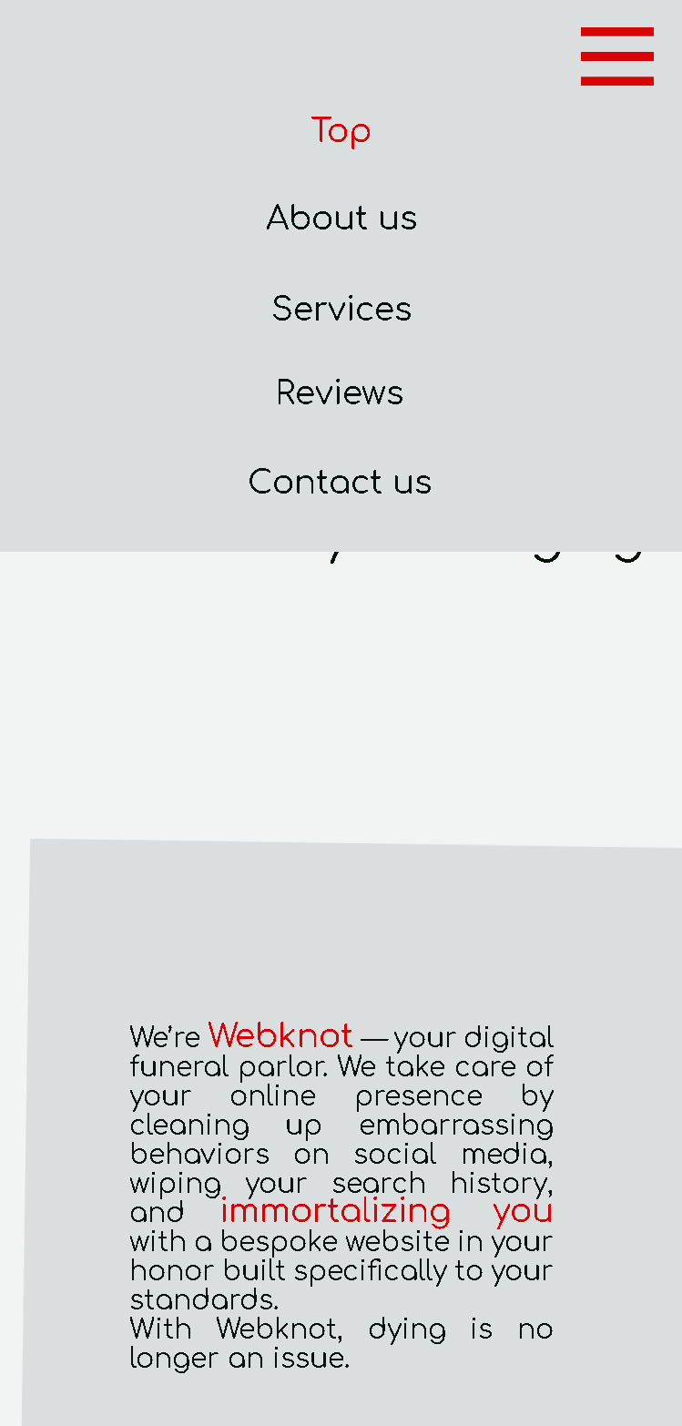
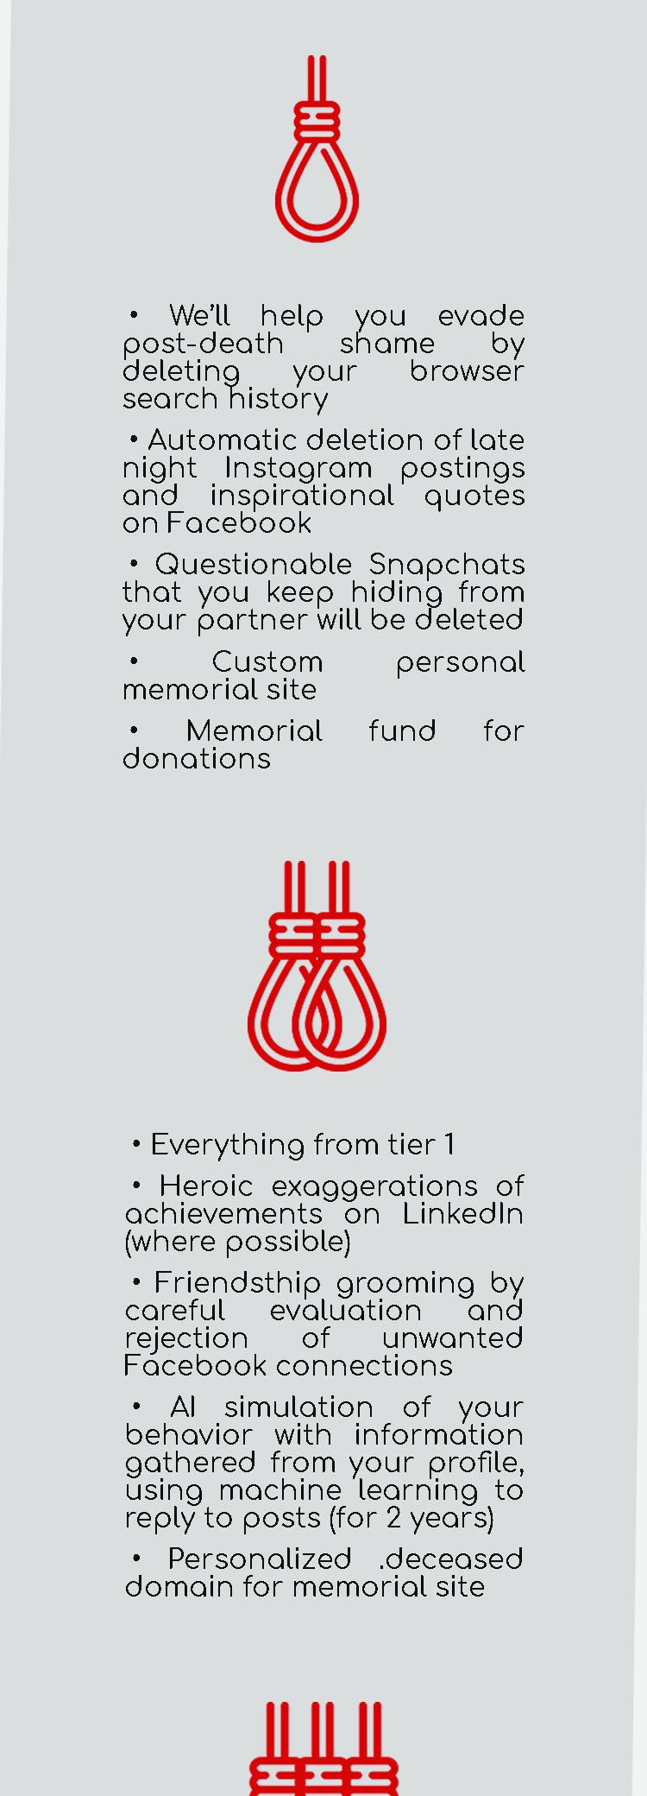
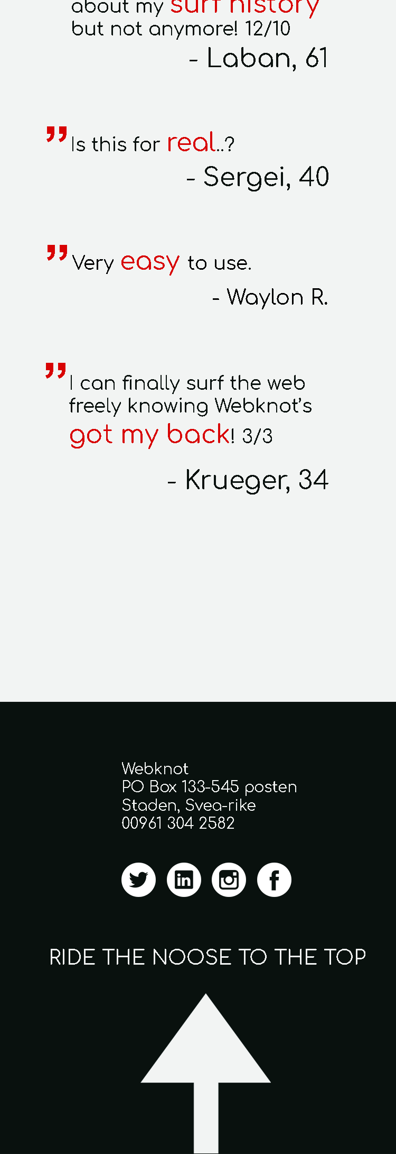
Mobile

Slide 7
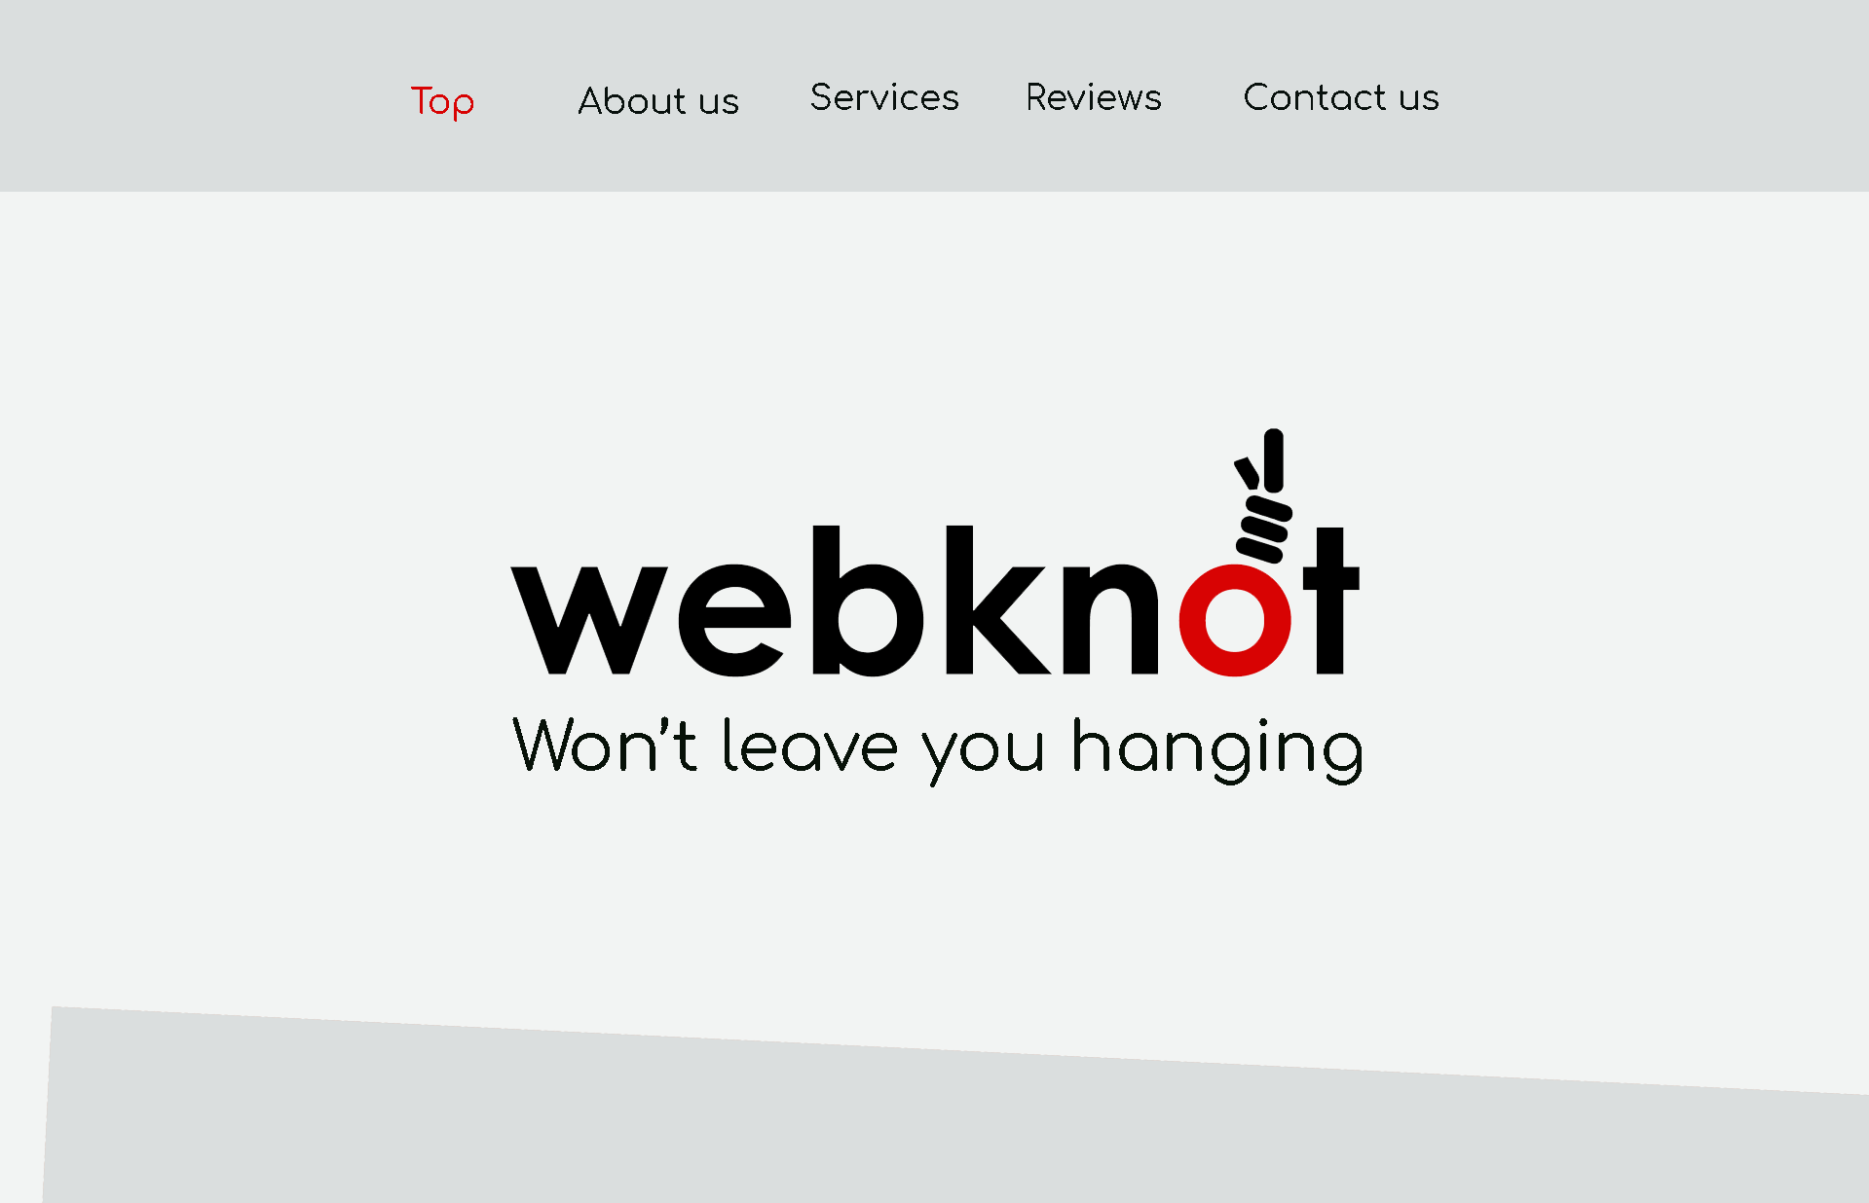
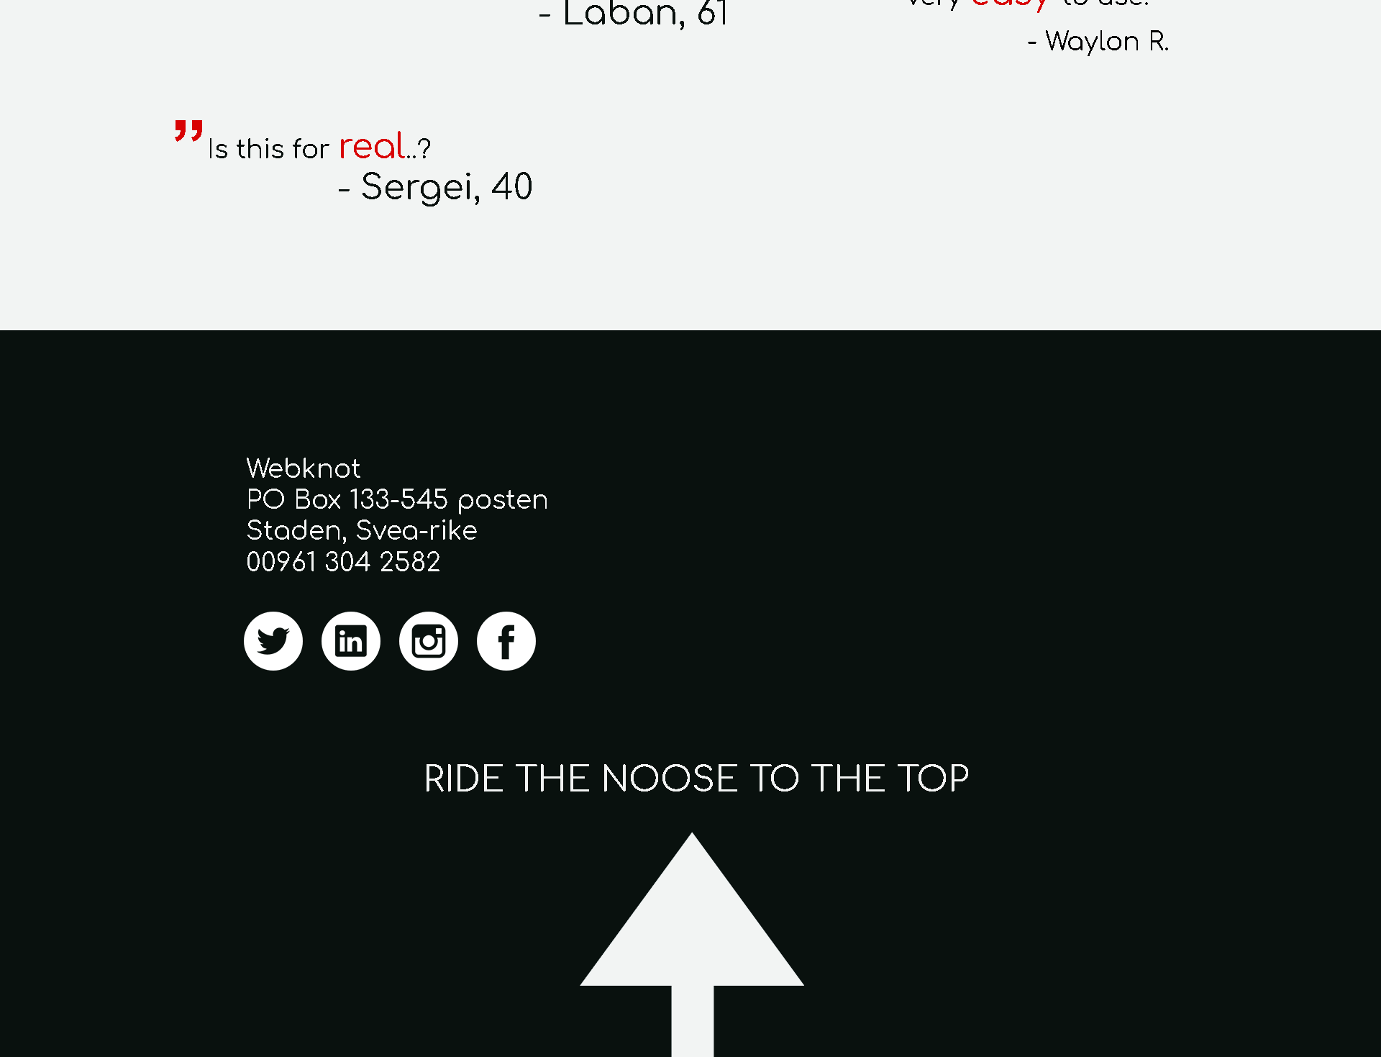
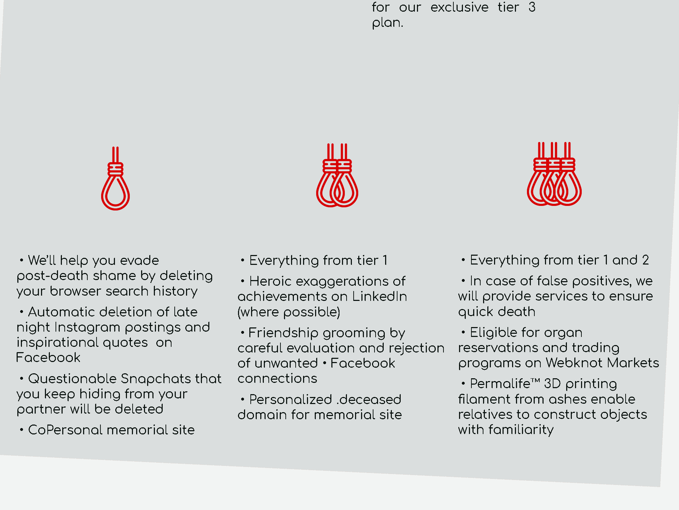
Desktop

Slide 8
Utmaningar
Svårt med versionshantering
Hålla sig till ett arbetssätt
Problem med bakgrund
Kommunikation
GitHub

