Slide 1

Leo | Gabriel | Maia | Henrik

Slide 2
Webknot - your digital funeral parlor.
We take care of your online presence by cleaning up embarrassing behaviors on social media, wiping your search history, and immortalizing you with a bespoke website in your honor built specifically to your standards.
With Webknot, dying is no longer an issue.

Slide 3
Arbetssätt
Kanban
BEM
Progressive
Enchancement
Mobile first
Trello
Slack
GitHub
Scout

Slide 4
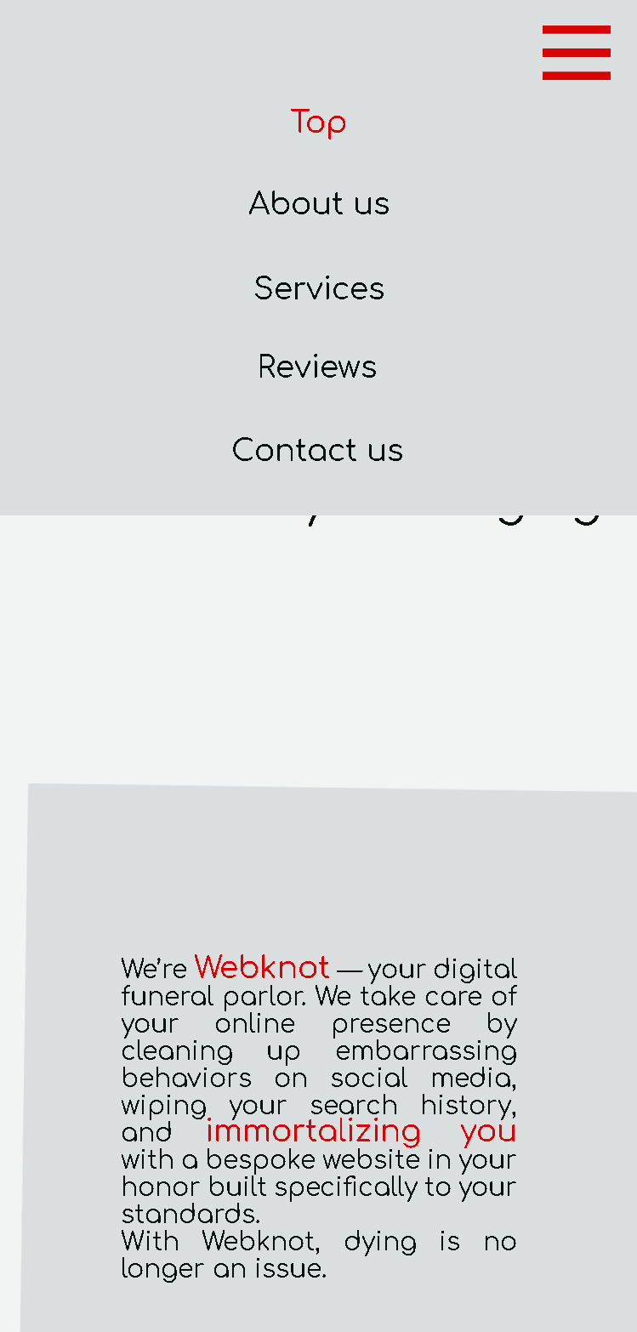
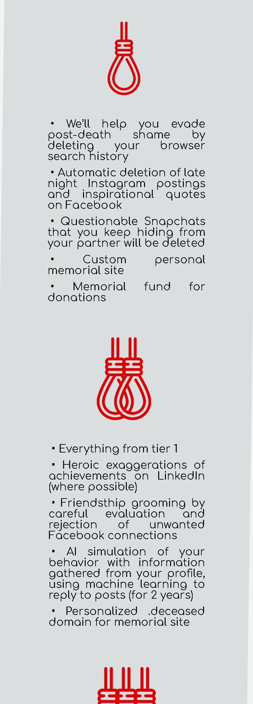
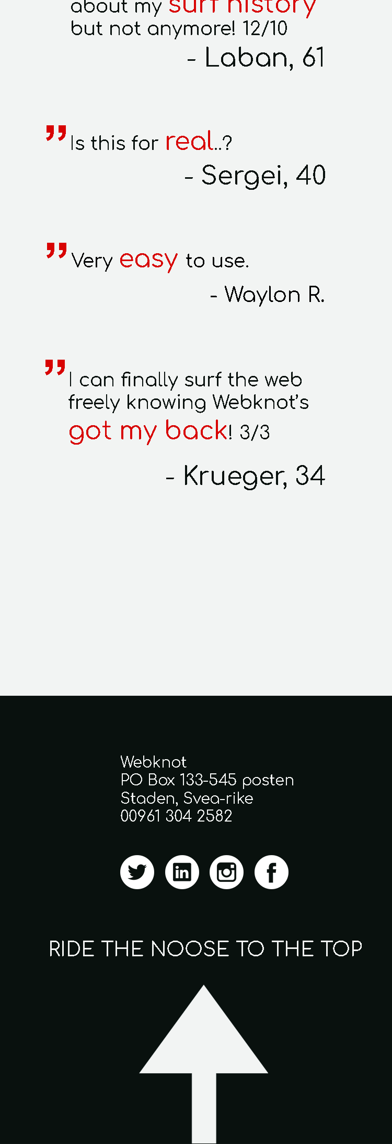
Mobile

Slide 5
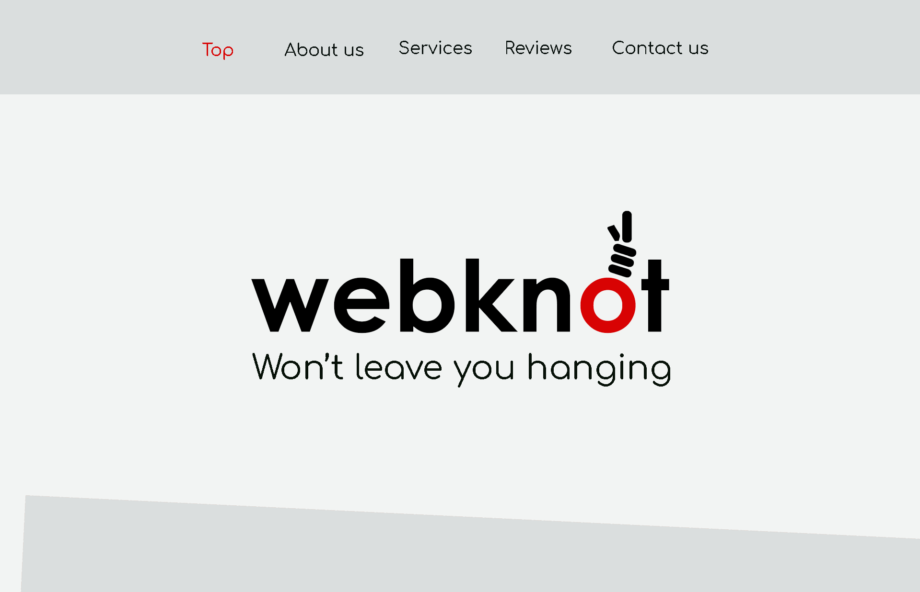
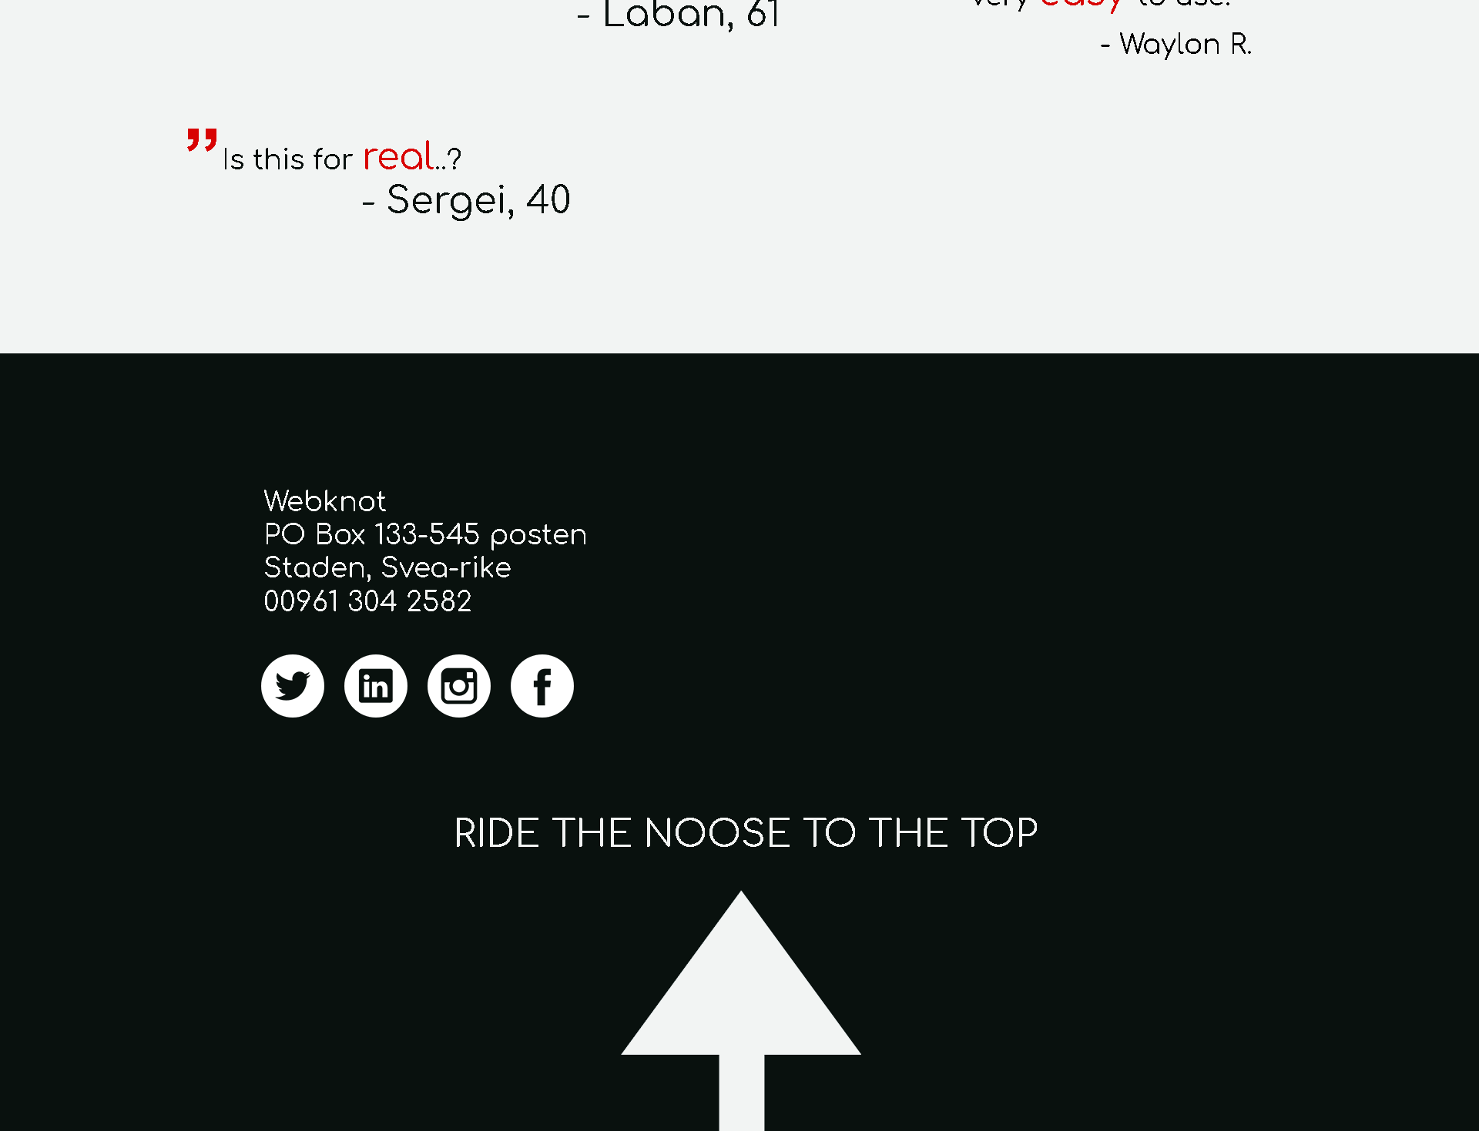
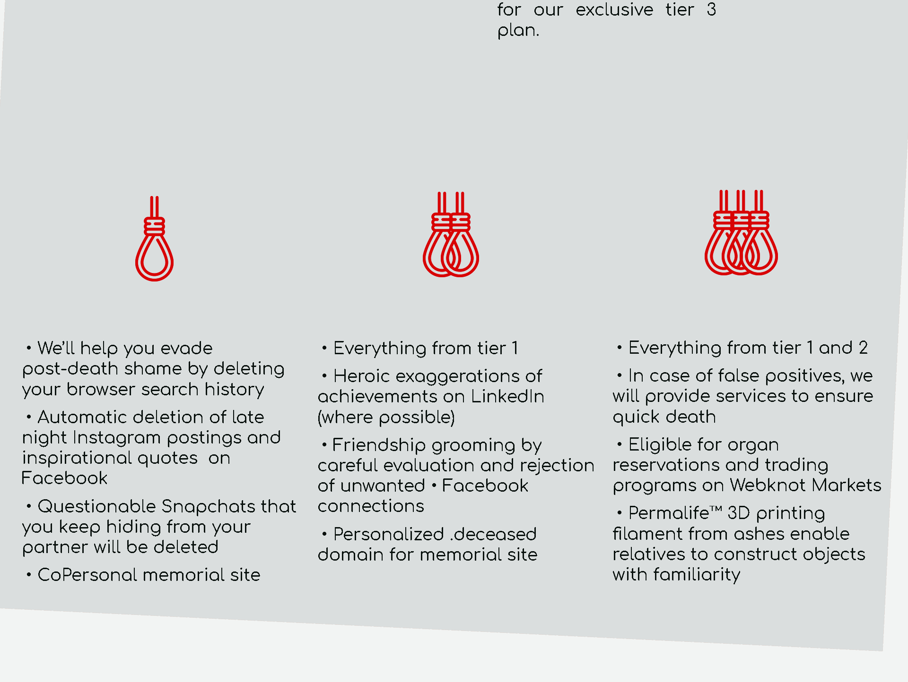
Desktop

Slide 6
Utmaningar
Svårt med versionshantering
Hålla sig till ett arbetssätt
Internet Explorer….
Olika måttenheter
Bakgrunden var svår att lösa
Kommunikation

