Slide 1
Process for group work
Aims and steps:
To learn how to gather data on work practices
To learn how to analyze these data
To learn how to envision a new way of working based on your analysis
To learn how to get feedback from users on your vision
To learn how to design the general properties of the UI to this new system

Slide 2
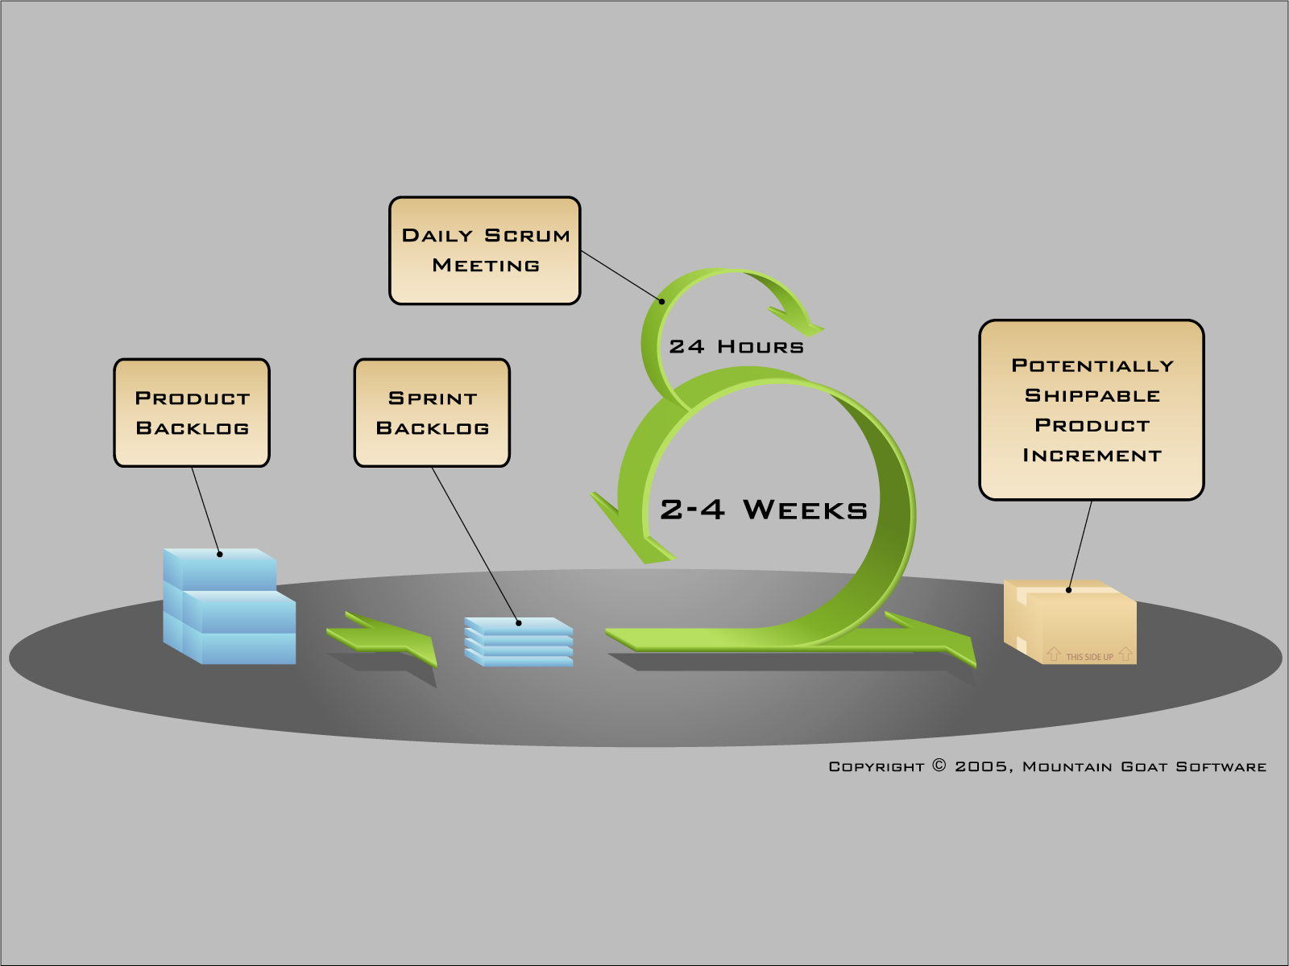
Introduce a “Phase 0” to:
Define all user categories
Find each user groups’ characteristics that are important for usability
Describe the work for each user group
To do this, use Contextual Inquiry
Use Contextual Design to create a vision of the entire human-computer interface already in phase 0

Slide 3
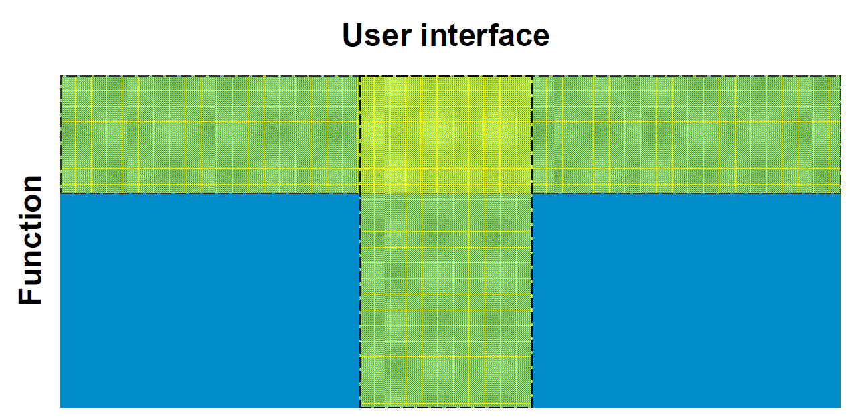
Wide and shallow vs narrow and deep prototypes

Slide 4
Understand
Create
Work
Artifact
New options!
Evaluate and discuss

Slide 5
A system with a high degree of usability
Gives the specified users the functionality they need to efficiently reach their goals
Has a high-quality human-computer interface
Allows the specified users to access the functionality with effectiveness, efficiency and satisfaction in a specified context of use

Slide 6

Model of work
Model of system
Visual design
Basic functionality
Interface concepts
Conceptual mapping
Behavior
Human-computer interface

Slide 7
A high-quality human-computer interface:
Is Guessable
Is Explorable
Supports memory
Is easy to physically handle

Slide 8
The simplified graph
Max performance
User efficiency
Initial performance <= Guessable
Learning time
time

Slide 9
Guessable:
What a users sees should lead new users to guess correctly:
what can and cannot be done
how it can be done
how difficult or easy it is to do it
in as high a degree as possible

Slide 10
To accomplish ”guessability”:
Affordances (N.B. not Gibsonian!) and Constraints
Foundation: Easily perceivable properties that acts as memory cues or show physical constraints
Affordances activate:
Memories of what you can do
And/or
Insight into what is physically possible or easy
Constraints activate:
Memories of what you CANNOT do
And/or
Insight into what is physically impossible or difficult

Slide 11
The simplified graph
Max performance
User efficiency
Initial performance <= Guessable
Learning time
time

Slide 12
A high-quality human-computer interface:
Is Guessable
Is Explorable
Supports memory
Is easy to physically handle

Slide 13
The simplified graph
Max performance
User efficiency
Initial performance <= Guessable
Learning time <= explorable
time

Slide 14
Explorable:
What you can’t guess from visual information you must be able to learn by exploration
Always easy and complete ”undo”
Always differentiated and immediate feedback on all actions

Slide 15
Explorable:
What you can’t guess from visual information you must be able to learn by exploration
Always easy and complete ”undo”
Always differentiated and immediate feedback on all actions

Slide 16
A high-quality human-computer interface:
Is Guessable
Is Explorable
Supports memory
Is easy to physically handle

Slide 17
The simplified graph
Max performance
User efficiency
Initial performance <= Guessable
Learning time <= explorable + support for memory
time

Slide 18
Supports memory:
All usage-relevant properties should have a consistent mapping to visual features
All visual features should be easy to perceive
Visual features should be chosen such that they either:
correctly map to previously existing memory structures,
or
are unique
Large scale visual structure should be easily discriminable
Actions and objects should have a minimalistic (logical) structure
Concepts should be mutually exclusive
Consistent

Slide 19
All usage-relevant properties should have a consistent mapping to visual features
Usage-relevant properties
Examples:
Can be saved, is /isn’t saved, possible to edit, read-only, machine-generated, user-generated, …

Slide 20
Supports memory:
All usage-relevant properties should have a consistent mapping to visual features
All visual features should be easy to perceive
Visual features should be chosen such that they either:
correctly map to previously existing memory structures,
or
are unique
Large scale visual structure should be easily discriminable
Actions and objects should have a minimalistic (logical) structure
Concepts should be mutually exclusive
Consistent

Slide 21
A high-quality human-computer interface:
Is Guessable
Is Explorable
Supports memory
Is easy to physically handle

Slide 22
Is Easy to physically handle
Minimize actions needed while keeping the structure of actions consistent
Each action should be tuned using Fitt’s law

Slide 23
The simplified graph
Is easy to physically handle
Max performance
User efficiency
Initial performance <= Guessable
Learning time <= explorable + support for memory
time

Slide 24
Analyzed case
Taking a shower/bath

Slide 25

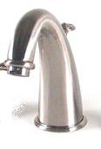
Basic functionality
55 degree water under constant pressure
12 degree water under constant pressure
Scolding hot Ice cold

Slide 26
Model of work
Model of system
Visual design
Basic functionality
Interface concepts
Conceptual mapping
Behavior
Human-computer interface

Slide 27
Goal and mental model
Water: {Off; On}
Temperature: = [cold⬄ warm]
Flow: = [low⬄ high]
Select: {Tub;Shower}
Goal: (Cold morning) Temp= + 40°C Flow=75%
(Hot summer night) Temp=+25 °C Flow= 40%

Slide 28
Comparison between basic functionaltiy and user goals
Water: {Off; On}
Hot water flow (hwf): {0; low⬄ high}
Temperature: = [cold ⬄ warm]
Cold water flow(cwf): {0; low⬄ high}
Flow: = [low ⬄ high]

Slide 29
Problem with the basic functionality from a usage perspective
Sutiable temperature cannot be accomplished
I.e., Effectiveness is, for logical reasons, 0!
Several solutions possible:
Install a heater to the cold water…
Install a cooler to the warm water…

Slide 30
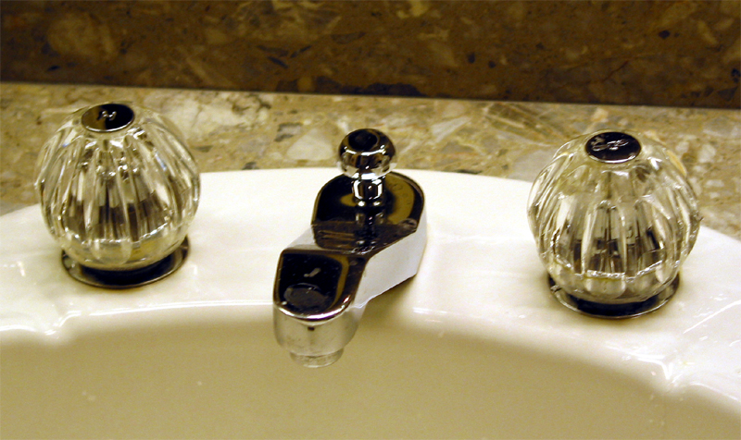
Mix hot and warm water in a controlled manner

Slide 31

The improved version vs mental model
Water: {Off; On}
Temperature: = [cold ⬄ warm]
Flow: = [low ⬄ high]
Controls:
Hot water flow (hwf): {0; low⬄ high}
Cold water flow(cwf): {0; low⬄ high}
Resulting mix: Temperature = (12*cwf + 55*hwf)/(cwf+hwf) Flow = cwf + hwf

Slide 32
Comparison with the improved version
Translation
Water: {Off; On}
Temperature: = [cold ⬄ warm]
Flow: = [low ⬄ high]
Controls:
Hot water flow (hwf): {0; low⬄ high}
Cold water flow(cwf): {0; low⬄ high}
Resulting mix: Temperature = (12*cwf + 55*hwf)/(cwf+hwf) Flow = cwf + hwf

Slide 33

Comparison with the criteria:
Minimalistic mental model: No!
Guessability:
Affordance: Good for grip and turn. Bad for direction of turn,
Constraints: so so, Push for instance,
Handle:so so

